Slide 1
A presentation on
Motif Discovery Using Genetic Algorithm
Presented By:
Al Muttakin
ID: 2013-2-60-005
Department of Computer Science and Engineering
East West University
Supervised By:
Dr. Mohammad Rezwanul Huq
Assistant Professor
Department of Computer Science and Engineering
East West University
Course Code: CSE 497
Course Title: Thesis/Project
Semester: Spring 2017

Slide 2
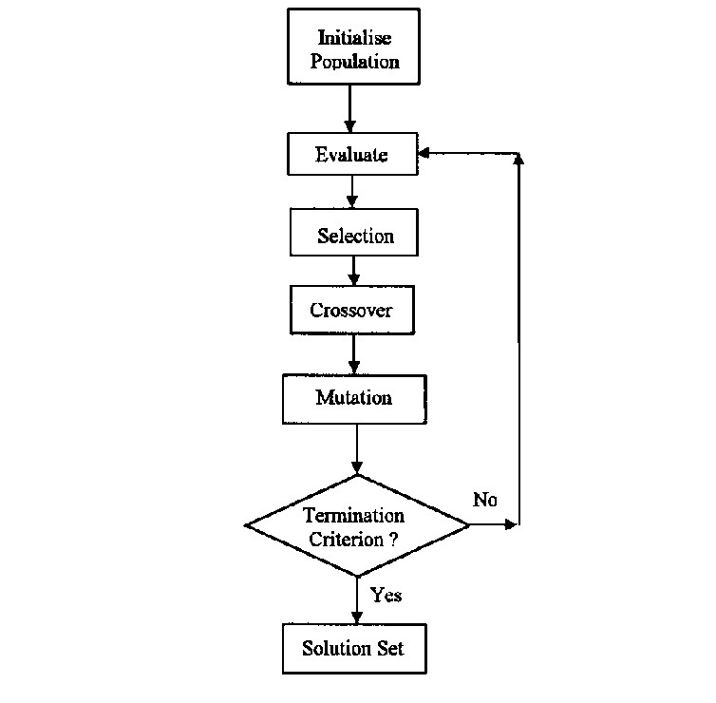
Overview
Genetic Algorithm
A metaheuristic based on Natural Selection
Bioinspired
Provide high quality solution
2

Slide 3
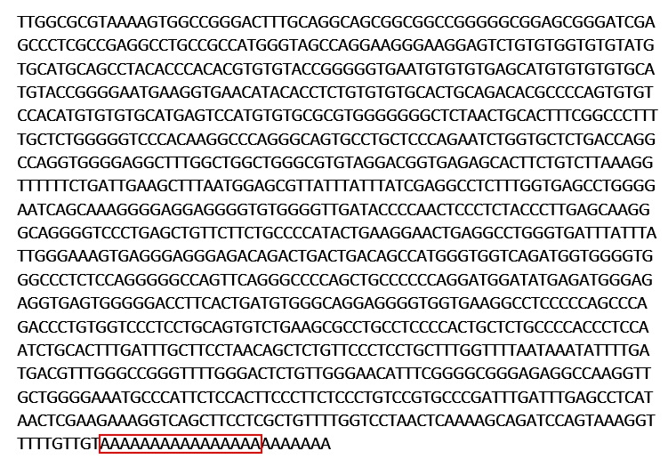
Overview (Cont...)
Promoter sequence
Reflect frequent base and amino acid
Represent Conserved Functional Domain
Motif
5-20 bp long
Carry biological significance.
3

Slide 4
Related Work
Gibbs sampler for motif finding by Lawrence in 1993
Motif Elicitation by Expectation Maximization (MEME) by Bailey and Elkan in1995
Finding Motif by Genetic Algorithm (FMGA) by Falcon F.M Liu in 2004
4

Slide 5
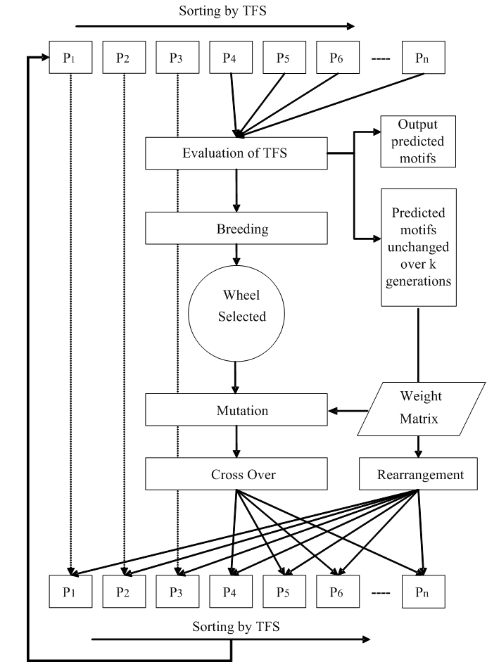
Related Work (Cont.…)
Architecture of FMGA
5

Slide 6
Motif Discovery using Genetic Algorithm
(MDGA)

Slide 7
Evaluation Criteria
Occurrence Frequency
Fitness Score
Total Fitness Score
7

Slide 8
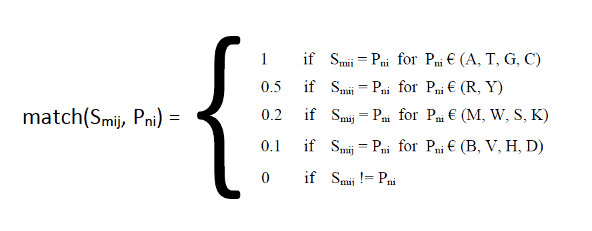
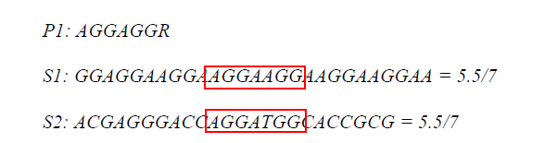
Evaluation Criteria (Cont.…)
Fitness Score
8

Slide 9
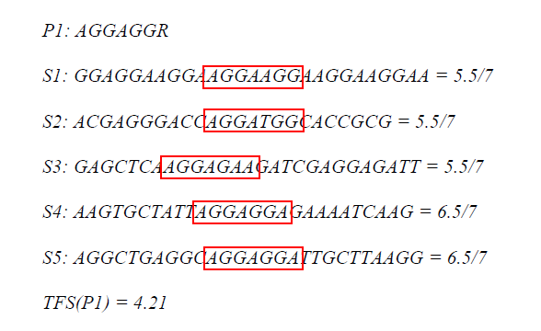
Evaluation Criteria (Cont.…)
Total Fitness Score
9

Slide 10
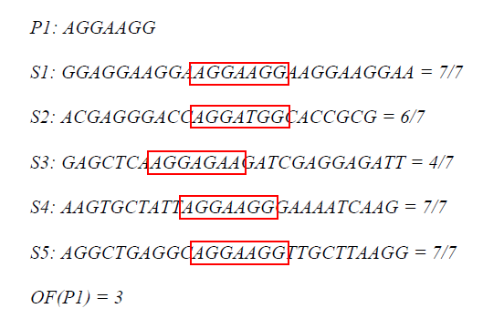
Evaluation Criteria (Cont.…)
Occurrence Frequency
10

Slide 11
Operations

Slide 12
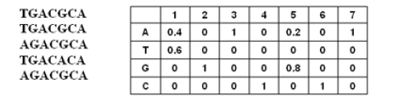
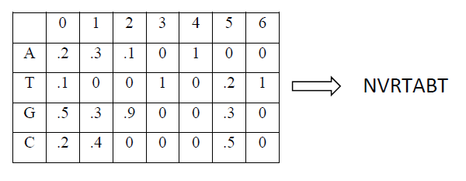
Operations (Cont.…)
Preprocessing
12

Slide 13
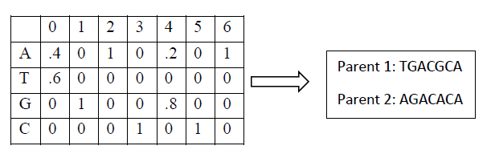
Operations (Cont.…)
Mutation
13

Slide 14
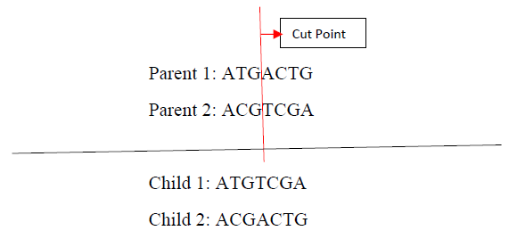
Operations (Cont.…)
Crossover
14

Slide 15
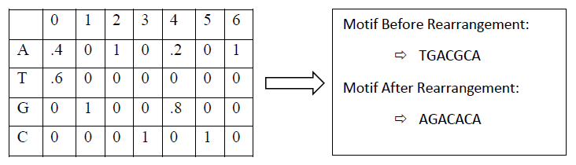
Operations (Cont.…)
Rearrangement
15

Slide 16
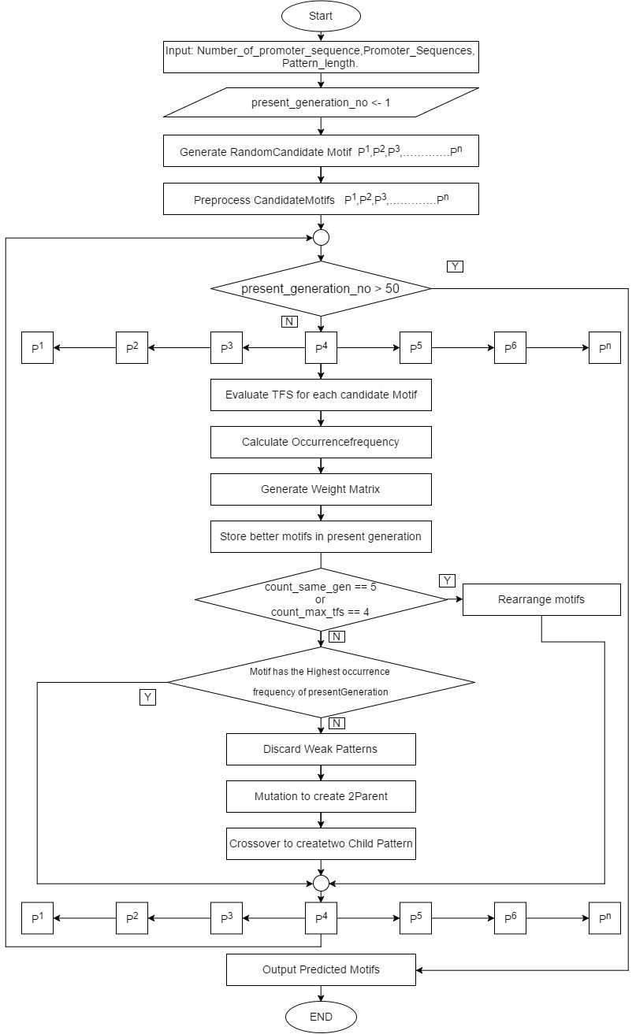
Architecture of Proposed Algorithm
16

Slide 17
Result Analysis and Comparison

Slide 18
Result analysis and comparison (Cont.…)
Comparison between Predicted motifs of MDGA and FMGA (Group 1)
18

Slide 19
Result analysis and comparison (Cont.…)
Comparison between Predicted motifs of MDGA and FMGA (Group 2)
19

Slide 20
Result analysis and comparison (Cont.…)
Comparison between Predicted motifs of MDGA and FMGA (Group 3)
20

Slide 21
Remarks & Future Improvements

Slide 22
Remarks
Effect of Preprocessing
Change in scoring based on purine and pyridine base
Change in Rearrangement
Change in Crossover
Introduction of a Discursion Function
22

Slide 23
Future Improvements
Implement MDGA in a distributer parallel system on any Big Data platform
Implement other types of crossover to improve result.
Expand MDGA to operate on Double strand DNA and RNA.
Expand MDGA to identify domains and proteins.
23

Slide 24

24

