Slide 1
LEED CERTIFICATION
Presented By
Touhidul Islam Samira Akter
ID: 2013-3-80-025 ID:2013-2-60-006
Mofazzal Hossain Al Muttakin
ID: 2013-3-80-022 ID: 2013-2-60-005

Slide 2
1. WHAT IS LEED
History and evolution
2. LEED RATING SYSTEM
Credit Categories
3. LEED ACCREDITATION
LEED AP Exam
4. WHY SHOULD WE CARE
Scope and Challenges for Bangladesh
LEED CREDENTIALS

Slide 3
WHAT IS LEED
LEADERSHIP in
ENERGY and
ENVIRONMENTAL
DESIGN
Developed by US green building council in 1994.

Slide 4
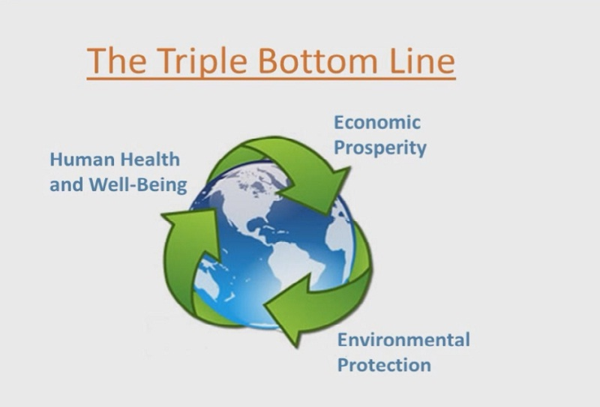
WHAT IS LEED

Slide 5
HISTORY AND EVOLUTION
INTRODUCED in 1994
LEED New Construction v1.0
LEED New Construction v2.0
LEED New Construction v2.2
(in 2005)
LEED v3 ( 2009)
LEED v4 (2013)

Slide 6
HISTORY AND EVOLUTION
From A Standard For New Construction To A Comprehensive System Of Interrelated Standards
200 volunteers
20 Committee
7000 project in 30 countries
1.5 billion square feet (140 km²) of development area

Slide 7
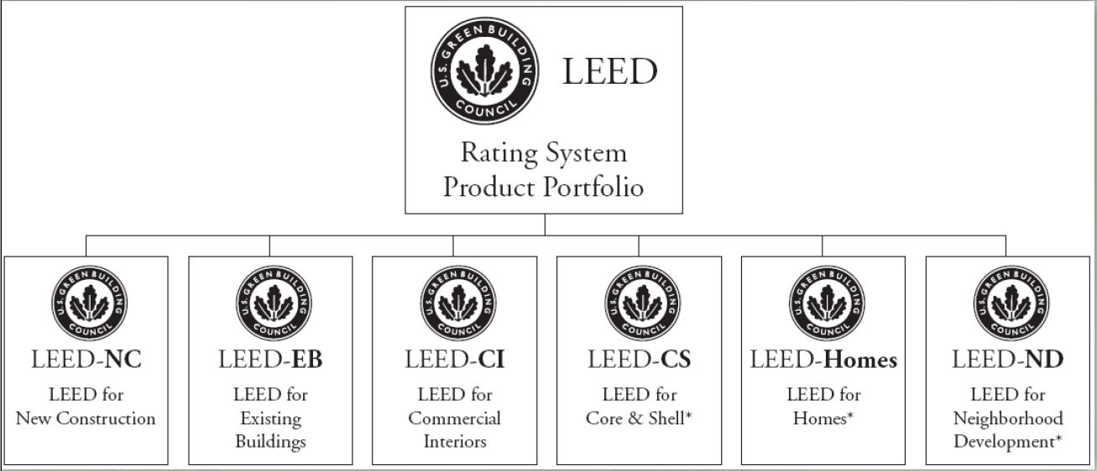
LEED RATING SYSTEM

Slide 8
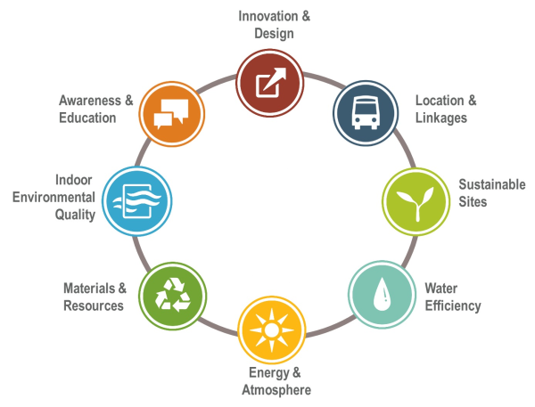

LEED CREDIT CATEGORIES

Slide 9
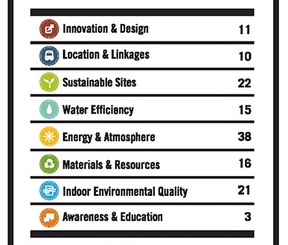
LEED CREDIT CATEGORIES

Slide 10
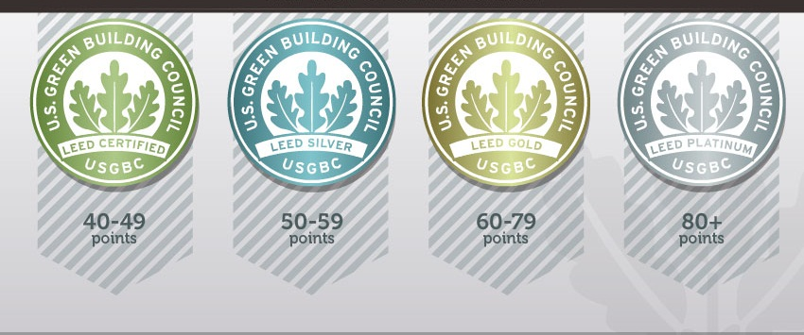
LEED POINT SYSTEM

Slide 11
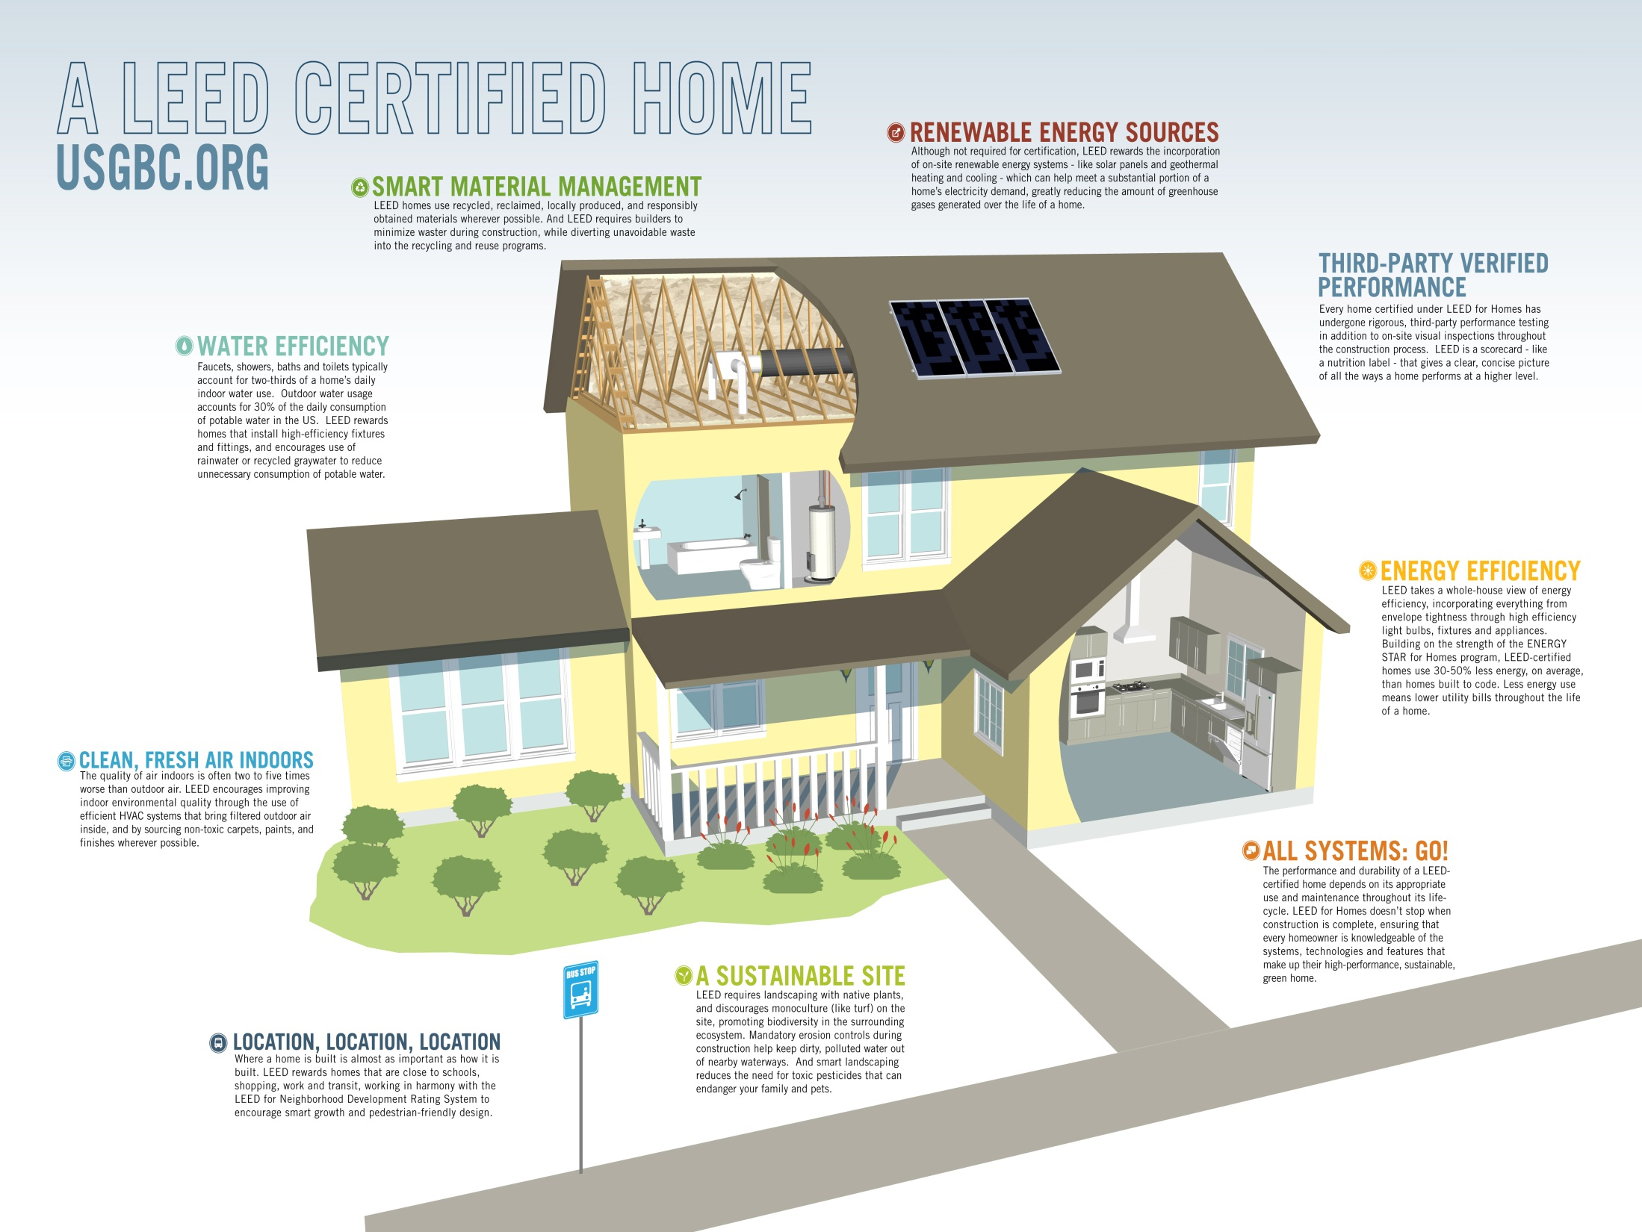

Slide 12
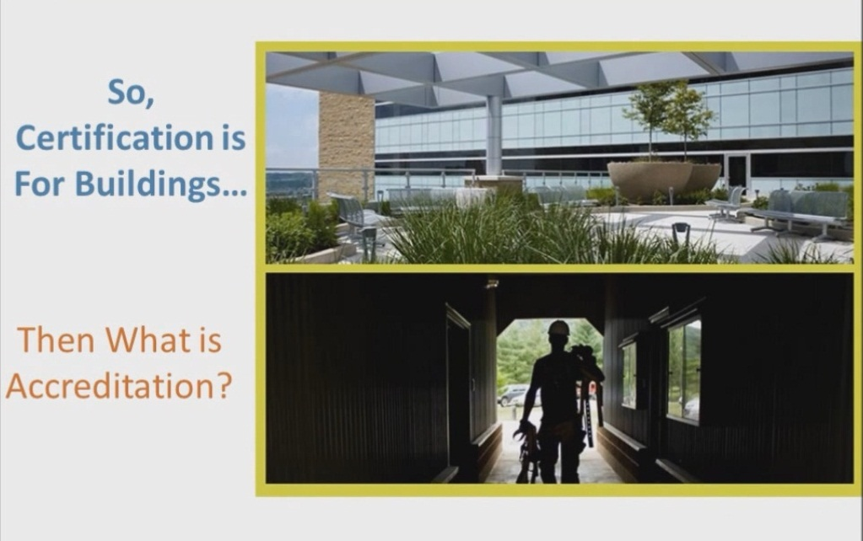

Slide 13
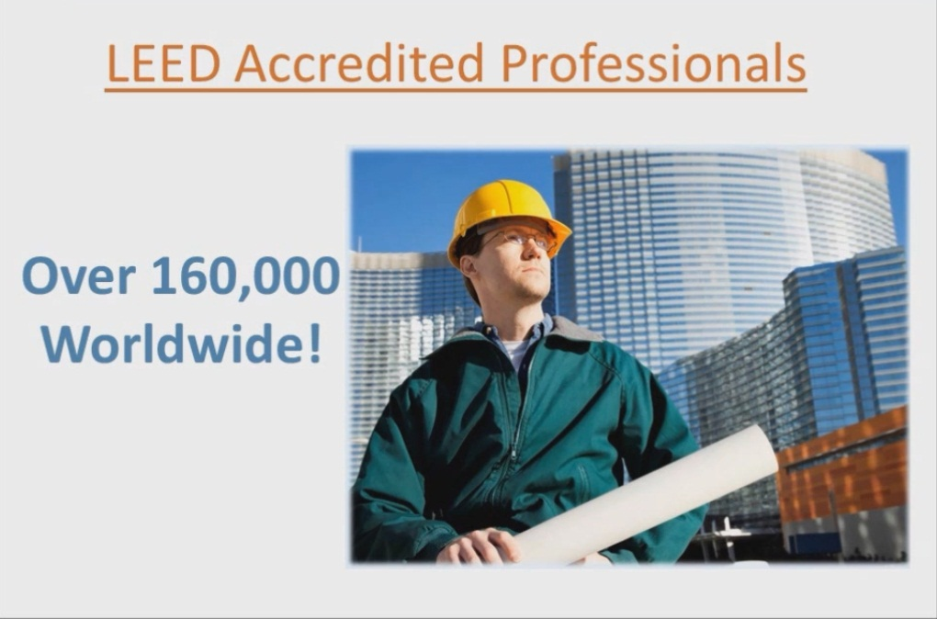
LEED ACCREDIATION
The process that individuals go through to show their knowledge about LEED

Slide 14
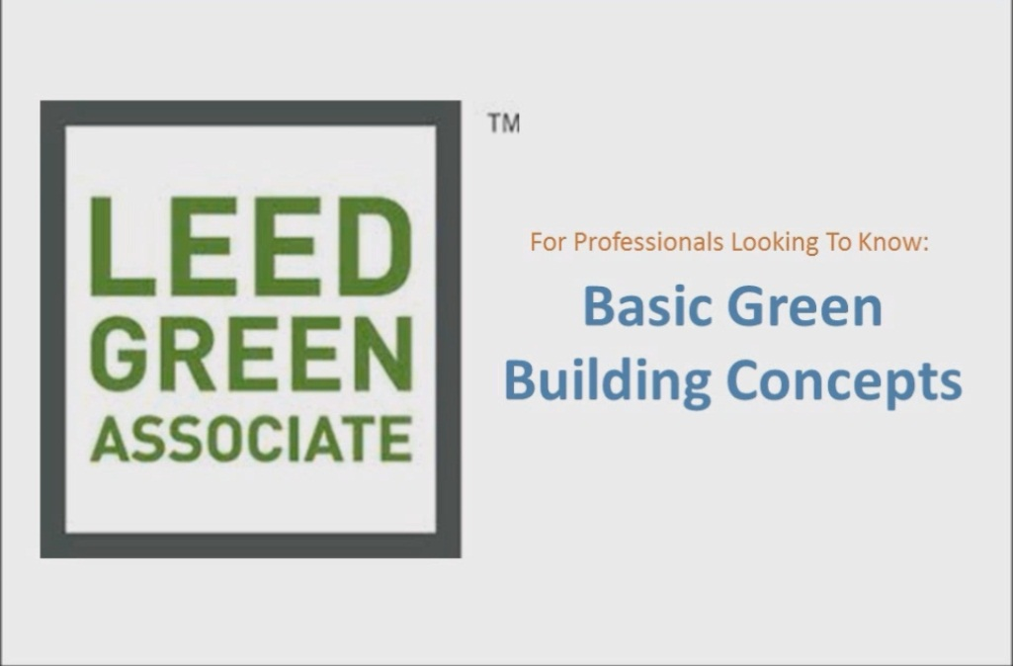
LEED CREDENTIALS

Slide 15
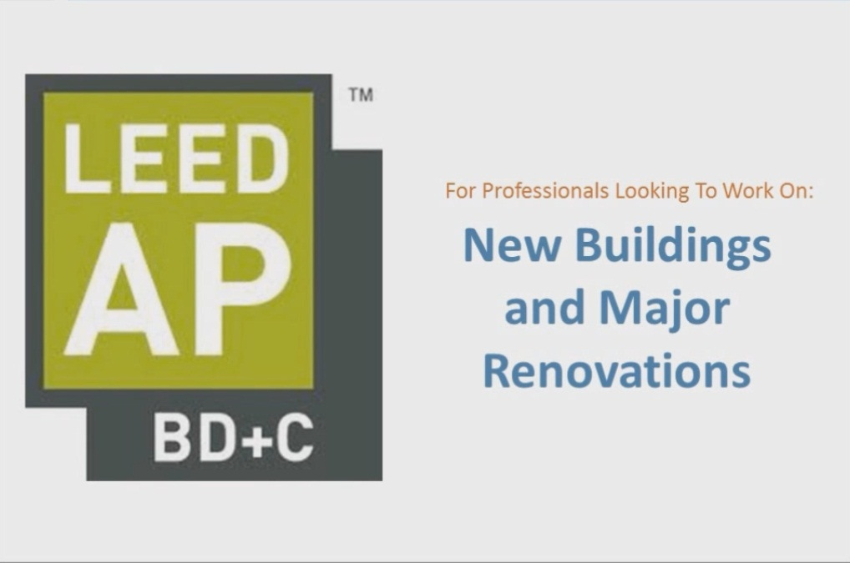
LEED CREDENTIALS

Slide 16
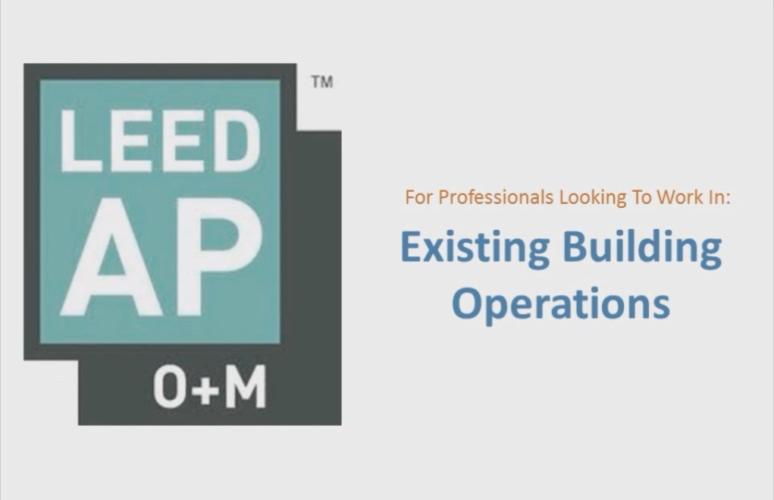
LEED CREDENTIALS

Slide 17
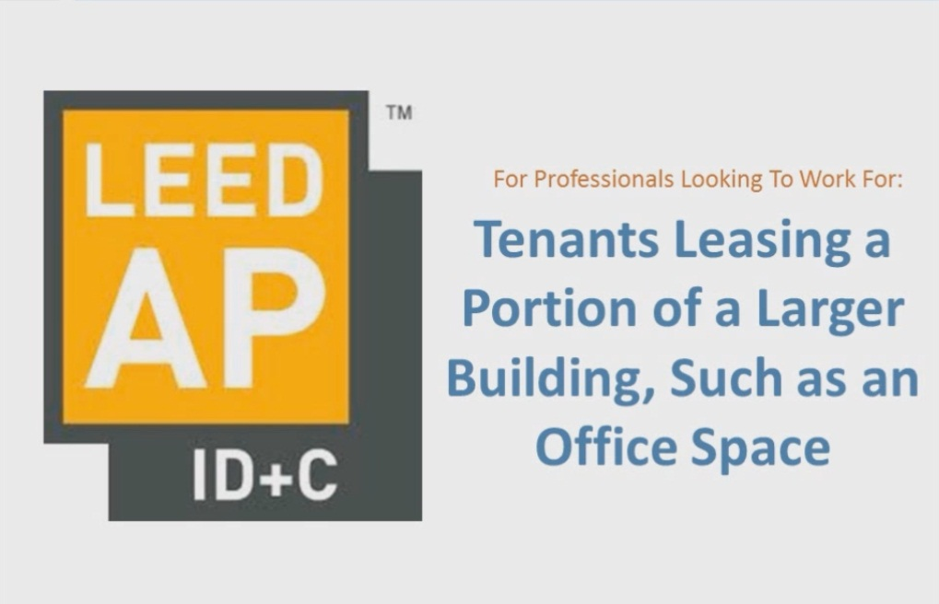
LEED CREDENTIALS

Slide 18

LEED CREDENTIALS

Slide 19
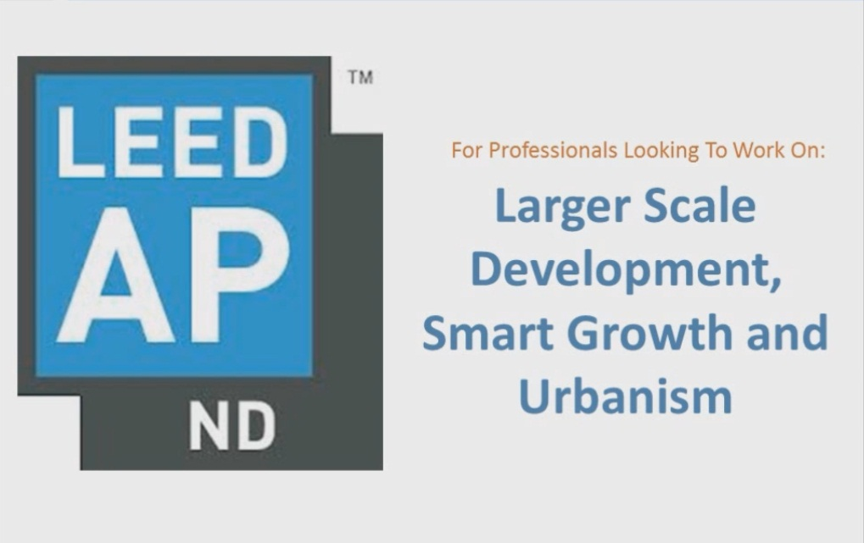
LEED CREDENTIALS

Slide 20
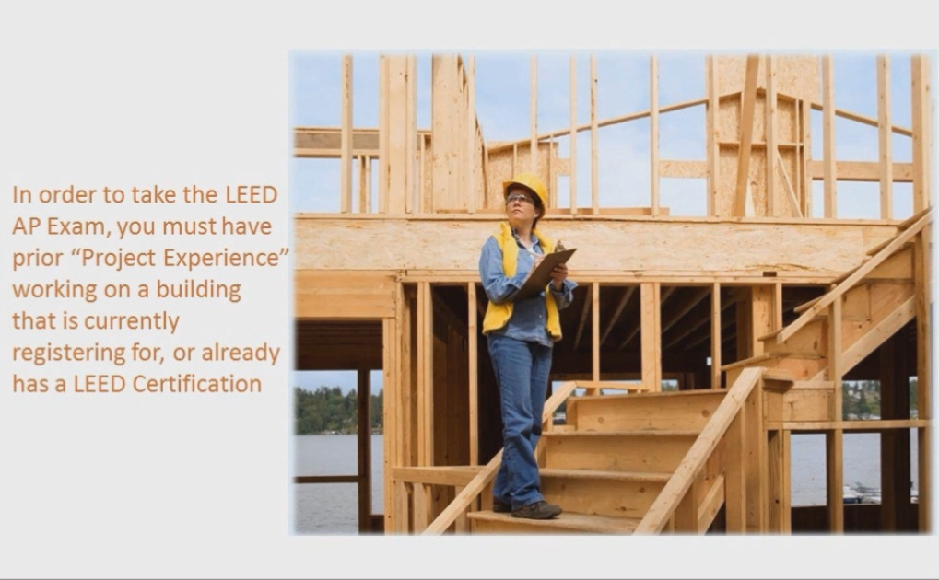
LEED AP EXAM

Slide 21
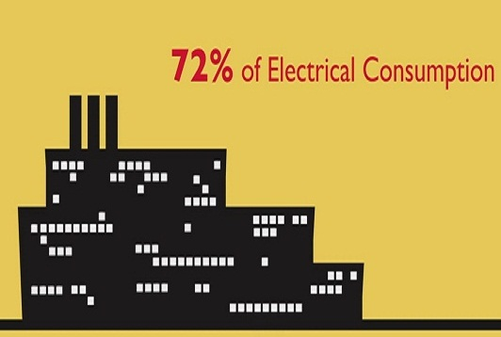
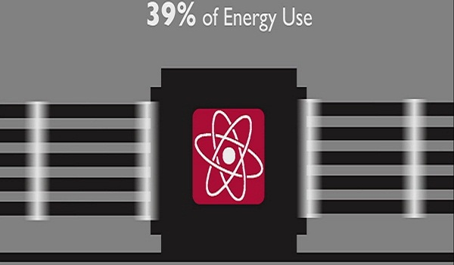
WHY SHOULD WE CARE
Traditional Buildings

Slide 22
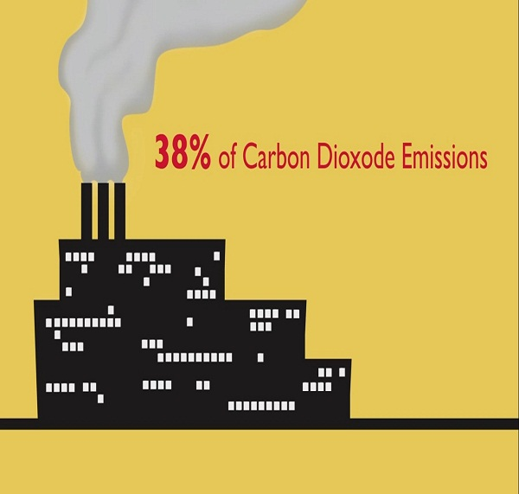
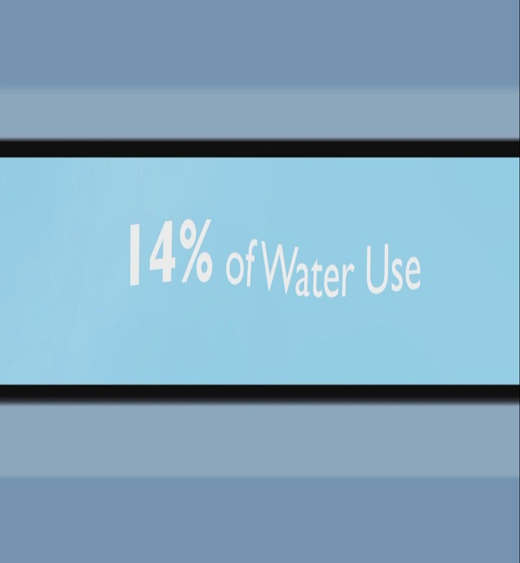
WHY SHOULD WE CARE
Traditional Buildings

Slide 23
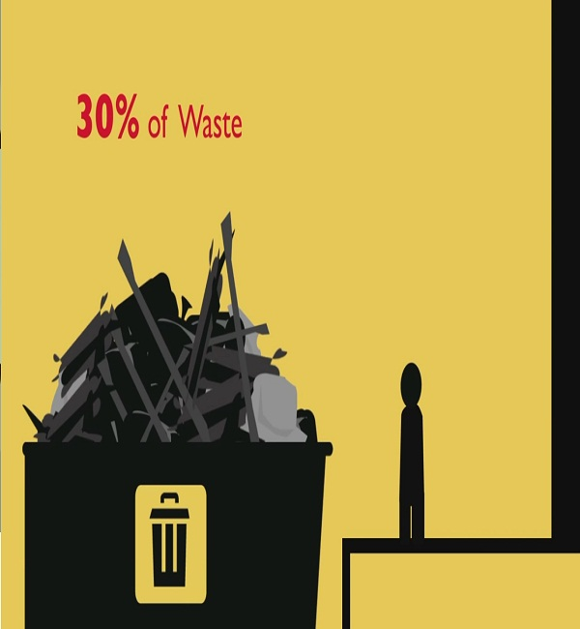
WHY SHOULD WE CARE
Traditional Buildings

Slide 24
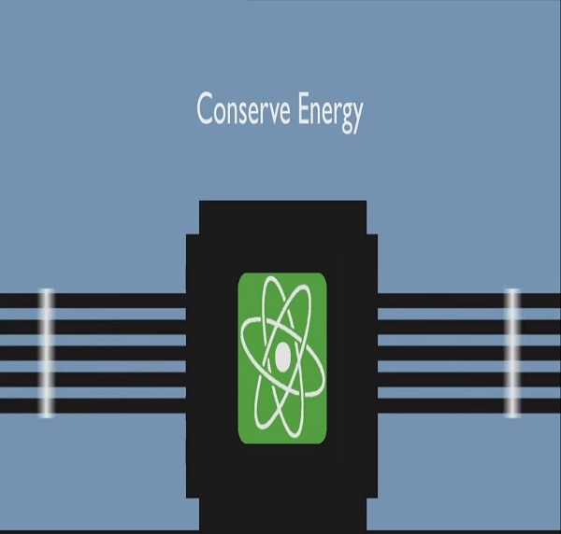
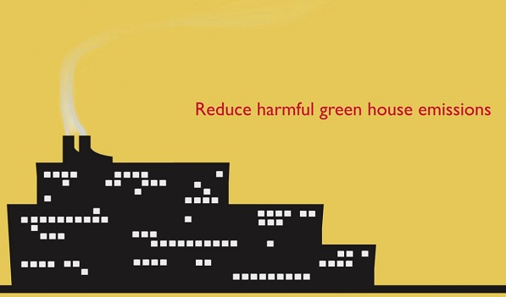
WHY SHOULD WE CARE
LEED Certified Buildings

Slide 25
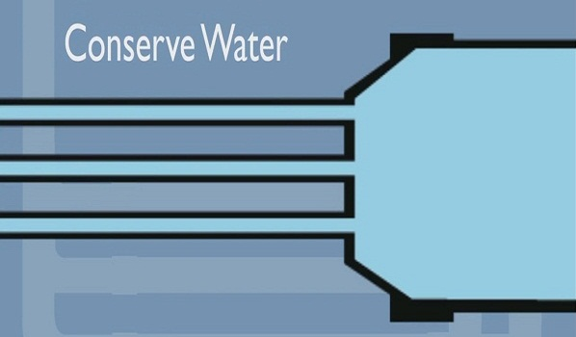
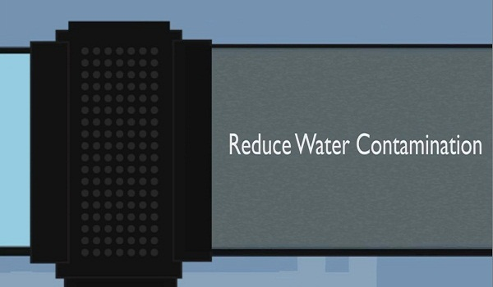
WHY SHOULD WE CARE
LEED Certified Buildings

Slide 26
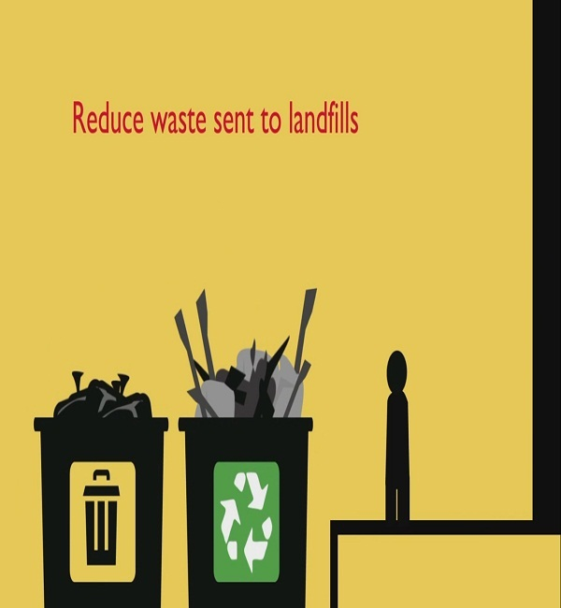
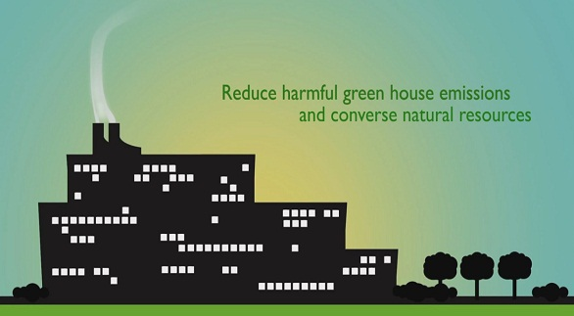
WHY SHOULD WE CARE
LEED Certified Buildings

Slide 27
PROSPECTS of BANGLADESH
Scopes
Problems:
Climate change
Population Density
Pollution
Low production of electricity
Shortage of pure water
Resource Scarcity
LEED can Solve:
Reduce harmful impact on environment.
Make best use of space
Reduce pollution
Save electricity
Conserve pure water
Use resource efficiently

Slide 28
PROSPECTS of BANGLADESH
Challenges
Corruption
Political Instability
High rate of poverty
Lake of education among general people
Lack of modern technologies
Poor implementation of laws

Slide 29
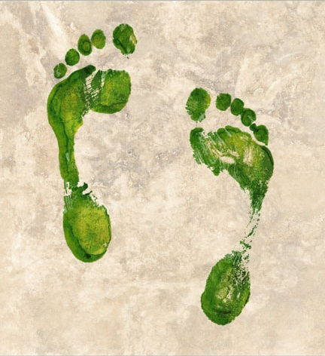
A STEP of HOPE
Cityscape Tower 1st Commercial Green Building in Bangladesh

Slide 30
Cityscape Tower
A Short Video

Slide 31


