Slide 1
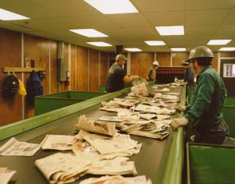
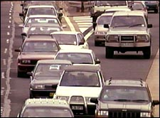
CSE 326: Sorting
Henry Kautz
Autumn Quarter 2002

Slide 2
Material to be Covered
Sorting by comparision:
  Bubble Sort
  Selection Sort
  Merge Sort
  QuickSort
Efficient list-based implementations
Formal analysis
Theoretical limitations on sorting by comparison
Sorting without comparing elements
Sorting and the memory hierarchy

Slide 3
Bubble Sort Idea
Move smallest element in range 1,…,n to position 1 by a series of swaps
Move smallest element in range 2,…,n to position 2 by a series of swaps
Move smallest element in range 3,…,n to position 3 by a series of swaps
  etc.

Slide 4
Selection Sort Idea
Rearranged version of Bubble Sort:
Are first 2 elements sorted? If not, swap.
Are the first 3 elements sorted? If not, move the 3rd element to the left by series of swaps.
Are the first 4 elements sorted? If not, move the 4th element to the left by series of swaps.
  etc.

Slide 5
Selection Sort
procedure SelectionSort (Array[1..N])
For (i=2 to N) {
j = i;
while ( j > 0 && Array[j] < Array[j-1] ){
swap( Array[j], Array[j-1] )
j --; }
}

Slide 6
Why Selection (or Bubble) Sort is Slow
Inversion: a pair (i,j) such that i<j but
Array[i] > Array[j]
Array of size N can have θ(N²) inversions
Selection/Bubble Sort only swaps adjacent elements
  Only removes 1 inversion at a time!
Worst case running time is θ(N²)

Slide 7
Merge Sort
MergeSort (Table [1..n])
Split Table in half
Recursively sort each half
Merge two halves together
Merge (T1[1..n],T2[1..n])
i1=1, i2=1
While i1<n, i2<n
If T1[i1] < T2[i2]
Next is T1[i1]
i1++
Else
Next is T2[i2]
i2++
End If
End While
Merging Cars by key
[Aggressiveness of driver].
Most aggressive goes first.
Photo from http://www.nrma.com.au/inside-nrma/m-h-m/road-rage.html

Slide 8
Merge Sort Running Time
Any difference best / worse case?
T(1) = b
T(n) = 2T(n/2) + cn for n>1
T(n) = 2T(n/2)+cn
T(n) = 4T(n/4) +cn +cn substitute
T(n) = 8T(n/8)+cn+cn+cn substitute
T(n) = 2^{k}T(n/2^{k})+kcn inductive leap
T(n) = nT(1) + cn log n where k = log n select value for k
T(n) = θ(n log n) simplify
Notes:
This is the same sort of analysis as last slide.
Here’s a function defined in terms of itself.
WORK THROUGH
Answer: O(n log n)
Generally, then, the strategy is to keep expanding these things out until you see a pattern. Then, write the general form. Finally, sub in for the series bounds to make T(?) come out to a known value and solve all the series.
Tip: Look for powers/multiples of the numbers that appear in the original equation.

Slide 9

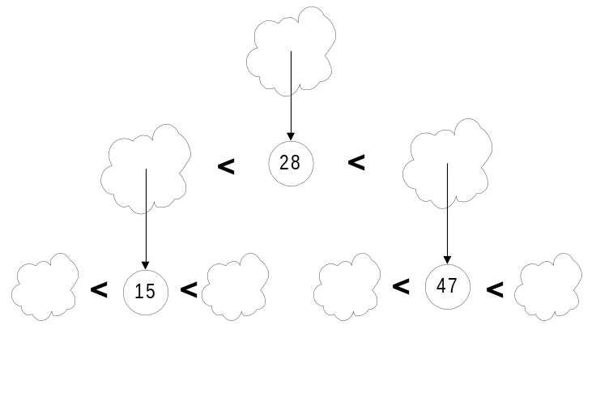
QuickSort
Picture from PhotoDisc.com
Pick a “pivot”.
Divide list into two lists:
  One less-than-or-equal-to pivot value
  One greater than pivot
Sort each sub-problem recursively
Answer is the concatenation of the two solutions

Slide 10
QuickSort: Array-Based Version
Pick pivot:
7 | 2 | 8 | 3 | 5 | 9 | 6
Partition
with cursors
7 | 2 | 8 | 3 | 5 | 9 | 6
<
>
2 goes to
less-than
7 | 2 | 8 | 3 | 5 | 9 | 6
<
>

Slide 11
QuickSort Partition (cont’d)
6, 8 swap
less/greater-than
7 | 2 | 6 | 3 | 5 | 9 | 8
<
>
3,5 less-than
9 greater-than
7 | 2 | 6 | 3 | 5 | 9 | 8
Partition done.
7 | 2 | 6 | 3 | 5 | 9 | 8

Slide 12
QuickSort Partition (cont’d)
Put pivot
into final
position.
5
2
6
3
7
9
8
Recursively
sort each side.
2
3
5
6
7
8
9

Slide 13
QuickSort Complexity
QuickSort is fast in practice, but has θ(N²) worst-case complexity
Tomorrow we will see why
But before then…

Slide 14
List-Based Implementation
All these algorithms can be implemented using linked lists rather than arrays while retaining the same asymptotic complexity
Exercise:
  Break into 6 groups (6 or 7 people each)
  Select a leader
  25 minutes to sketch out an efficient implementation
    Summarize on transparencies
    Report back at 3:00 pm.

Slide 15
Notes
“Almost Java” pseudo-code is fine
Don’t worry about iterators, “hiding”, etc – just directly work on ListNodes
The “head” field can point directly to the first node in the list, or to a dummy node, as you prefer

Slide 16
List Class Declarations
class LinkedList {
class ListNode {
Object element;
ListNode next; }
ListNode head;
void Sort(){ . . . }
}

Slide 17
My Implementations
Probably no better (or worse) than yours…
Assumes no header nodes for lists
Careless about creating garbage, but asymptotically doesn’t hurt
For selection sort, did the bubble-sort variation, but moving largest element to end rather than smallest to beginning each time. Swapped elements rather than nodes themselves.

Slide 18
My QuickSort
void QuickSort(){ // sort self
if (is_empty()) return;
Object val = Pop(); // choose pivot
b = new List();
c = new List();
Split(val, b, c); // split self into 2 lists
b.QuickSort();
c.QuickSort();
c.Push(val); // insert pivot
b.Append(c); // concatenate solutions
head = b.head; // set self to solution
}

Slide 19
Split, Append
void Split( Object val, List b, c ){
if (is_empty()) return;
Object obj = Pop();
if (obj <= val)
b.Push(val);
else c.Push(val);
Split( val, b, c );
}
void Append( List c ){
if (head==null) head = c.head;
else Last().next = c.head;
}

Slide 20
Last, Push, Pop
ListNode Last(){
ListNode n = head;
if (n==null) return null;
while (n.next!=null) n=n.next;
return n; }
void Push(Object val){
ListNode h = new ListNode(val);
h.next = head;
head = h; }
Object Pop(){
if (head==null) error();
Object val = head.element;
head = head.next;
return val; }

Slide 21
My Merge Sort
void MergeSort(){ // sort self
if (is_empty()) return;
b = new List();
c = new List();
SplitHalf(b, c); // split self into 2 lists
b.MergeSort();
c.MergeSort();
head = Merge(b.head,c.head);
// set self to merged solutions
}

Slide 22
SplitHalf, Merge
void SplitHalf(List b, c){
if (is_empty()) return;
b.Push(Pop());
SplitHalf(c, b); // alternate b,c
}
ListNode Merge( ListNode b, c ){
if (b==null) return c;
if (c==null) return b;
if (b.element<=c.element){
// Using Push would reverse lists –
// this technique keeps lists in order
b.next = Merge(b.next, c);
return b; }
else {
c.next = Merge(b, c.next);
return c; }
}

Slide 23
My Bubble Sort
void BubbleSort(){
int n = Length(); // length of this list
for (i=2; i<=n; i++){
ListNode cur = head;
ListNode prev = null;
for (j=1; j<i; j++){
if (cur.element>cur.next.element){
// swap values – alternative would be
// to change links instead
Object tmp = cur.element;
cur.element = cur.next.element;
cur.next.element = tmp;
}
prev = cur;
cur = cur.next;
}
}
}

Slide 24
Let’s go to the Races!

Slide 25
Analyzing QuickSort
Picking pivot: constant time
Partitioning: linear time
Recursion: time for sorting left partition (say of size i) + time for right (size N-i-1) + time to combine solutions
  T(1) = b
  T(N) = T(i) + T(N-i-1) + cN
  where i is the number of elements smaller than the pivot

Slide 26


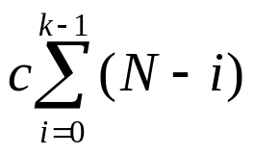
QuickSort
Worst case
Pivot is always smallest element, so i=0:
T(N) = T(i) + T(N-i-1) + cN
T(N) = T(N-1) + cN
= T(N-2) + c(N-1) + cN
= T(N-k) +
= O(N²)

Slide 27
Dealing with Slow QuickSorts
Randomly choose pivot
  Good theoretically and practically, but call to random number generator can be expensive
Pick pivot cleverly
  “Median-of-3” rule takes Median(first, middle, last element elements). Also works well.

Slide 28

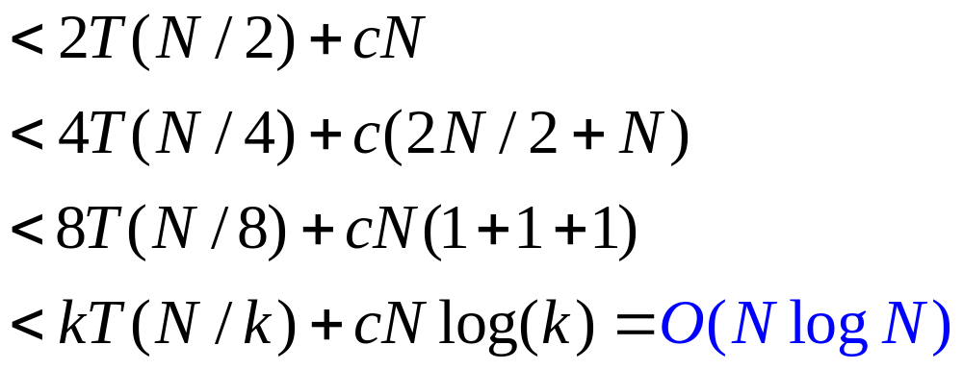
QuickSort
Best Case
Pivot is always middle element.
T(N) = T(i) + T(N-i-1) + cN
T(N) = 2T(N/2 - 1) + cN
What is k?

Slide 29
QuickSort
Average Case
Suppose pivot is picked at random from values in the list
All the following cases are equally likely:
  Pivot is smallest value in list
  Pivot is 2nd smallest value in list
  Pivot is 3rd smallest value in list
  …
  Pivot is largest value in list
Same is true if pivot is e.g. always first element, but the input itself is perfectly random

Slide 30
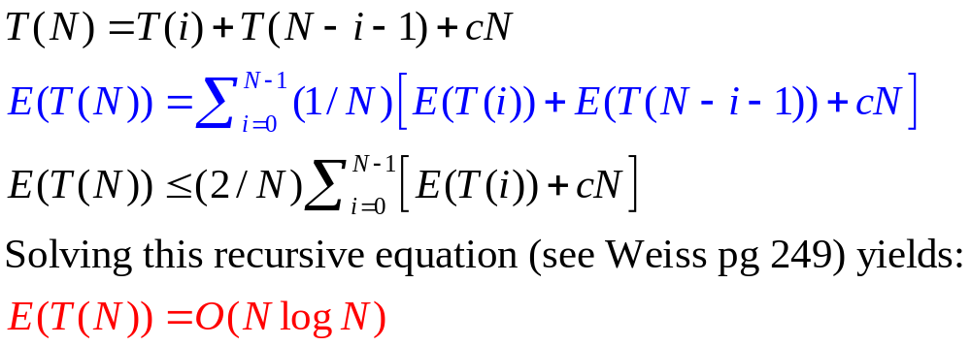
QuickSort Avg Case, cont.
Expected running time = sum of
(time when partition size i)×(probability partition is size i)
In either random case, all size partitions are equally likely – probability is just 1/N

Slide 31
Could We Do Better?
For any possible correct Sorting by Comparison algorithm, what is lowest worst case time?
  Imagine how the comparisons that would be performed by the best possible sorting algorithm form a decision tree…
  Worst-case running time cannot be less than the depth of this tree!

Slide 32
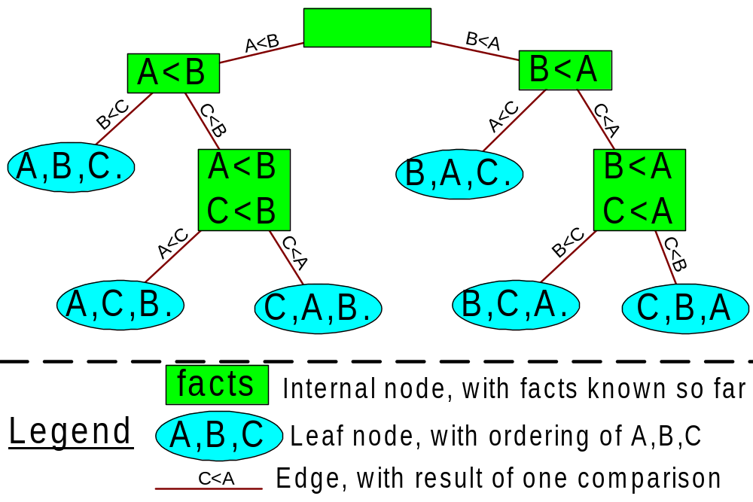
Decision tree to sort list A,B,C

Slide 33
Max depth of the decision tree
How many permutations are there of N numbers?
How many leaves does the tree have?
What’s the shallowest tree with a given number of leaves?
What is therefore the worst running time (number of comparisons) by the best possible sorting algorithm?
Notes:
N!
N!
log (N!)

Slide 34
Max depth of the decision tree
How many permutations are there of N numbers?
N!
How many leaves does the tree have?
N!
What’s the shallowest tree with a given number of leaves?
log(N!)
What is therefore the worst running time (number of comparisons) by the best possible sorting algorithm?
log(N!)
Notes:
N!
N!
log (N!)

Slide 35
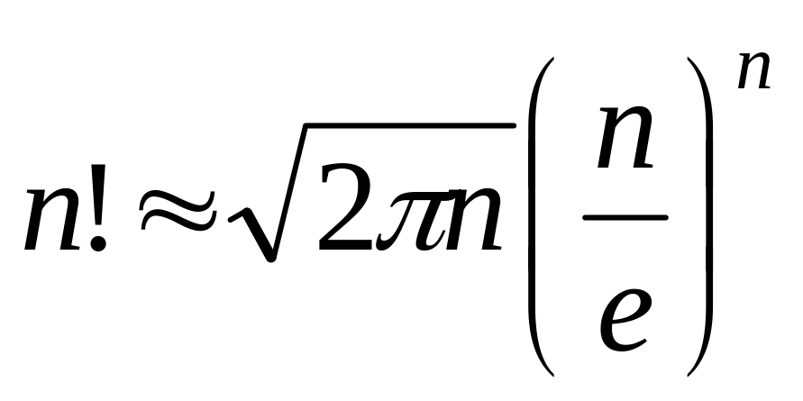
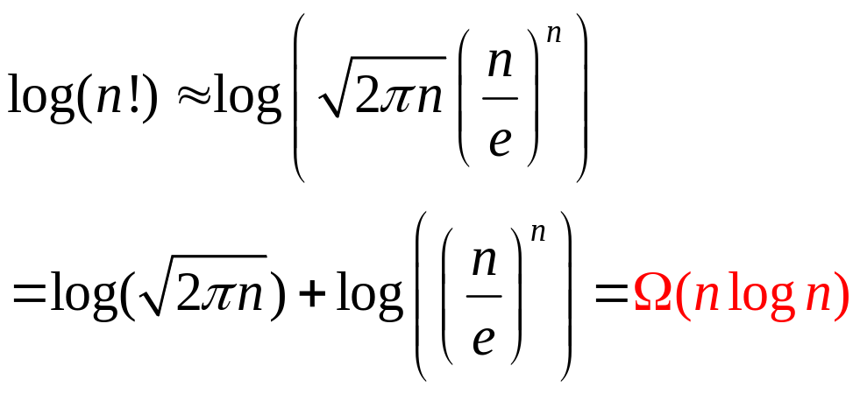
Stirling’s approximation

Slide 36
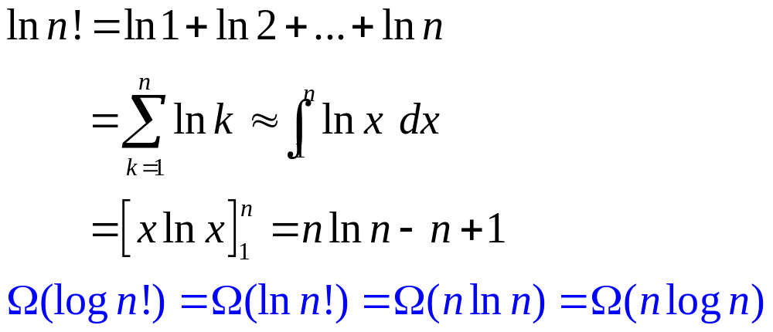
Stirling’s Approximation Redux

Slide 37
Why is QuickSort Faster than
Merge Sort?
Quicksort typically performs more comparisons than Mergesort, because partitions are not always perfectly balanced
  Mergesort – n log n comparisons
  Quicksort – 1.38 n log n comparisons on average
Quicksort performs many fewer copies, because on average half of the elements are on the correct side of the partition – while Mergesort copies every element when merging
  Mergesort – 2n log n copies (using “temp array”)
  n log n copies (using “alternating array”)
  Quicksort – n/2 log n copies on average

Slide 38

Sorting HUGE Data Sets
US Telephone Directory:
  300,000,000 records
    64-bytes per record
      Name: 32 characters
      Address: 54 characters
      Telephone number: 10 characters
  About 2 gigabytes of data
  Sort this on a machine with 128 MB RAM…
Other examples?

Slide 39
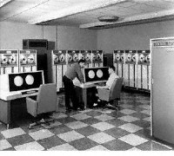
Merge Sort Good for Something!
Basis for most external sorting routines
Can sort any number of records using a tiny amount of main memory
  in extreme case, only need to keep 2 records in memory at any one time!

Slide 40
External MergeSort
Split input into two “tapes” (or areas of disk)
Merge tapes so that each group of 2 records is sorted
Split again
Merge tapes so that each group of 4 records is sorted
Repeat until data entirely sorted
log N passes

Slide 41
Better External MergeSort
Suppose main memory can hold M records.
Initially read in groups of M records and sort them (e.g. with QuickSort).
Number of passes reduced to log(N/M)

Slide 42
Sorting by Comparison: Summary
Sorting algorithms that only compare adjacent elements are θ(N²) worst case – but may be θ(N) best case
MergeSort - θ(N log N) both best and worst case
QuickSort θ(N²) worst case but θ(N log N) best and average case
Any comparison-based sorting algorithm is
Ω(N log N) worst case
External sorting: MergeSort with θ(log N/M) passes
but not quite the end of the story…

Slide 43
BucketSort
If all keys are 1…K
Have array of K buckets (linked lists)
Put keys into correct bucket of array
  linear time!
BucketSort is a stable sorting algorithm:
  Items in input with the same key end up in the same order as when they began
Impractical for large K…

Slide 44
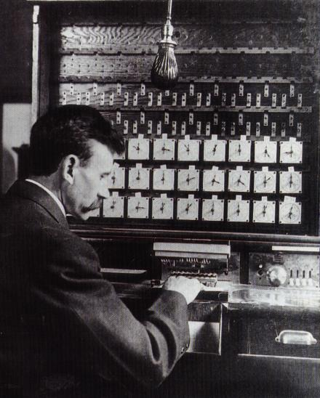
RadixSort
Radix = “The base of a number system” (Webster’s dictionary)
  alternate terminology: radix is number of bits needed to represent 0 to base-1; can say “base 8” or “radix 3”
Used in 1890 U.S. census by Hollerith
Idea: BucketSort on each digit, bottom up.

Slide 45
The Magic of RadixSort
Input list:
126, 328, 636, 341, 416, 131, 328
BucketSort on lower digit:
341, 131, 126, 636, 416, 328, 328
BucketSort result on next-higher digit:
416, 126, 328, 328, 131, 636, 341
BucketSort that result on highest digit:
126, 131, 328, 328, 341, 416, 636

Slide 46
Inductive Proof that RadixSort Works
Keys: K-digit numbers, base B
  (that wasn’t hard!)
Claim: after i^{th} BucketSort, least significant i digits are sorted.
  Base case: i=0. 0 digits are sorted.
  Inductive step: Assume for i, prove for i+1.
    Consider two numbers: X, Y. Say X_{i} is i^{th} digit of X:
    X_{i+1} < Y_{i+1} then i+1th BucketSort will put them in order
    X_{i+1} > Y_{i+1} , same thing
    X_{i+1} = Y_{i+1} , order depends on last i digits. Induction hypothesis says already sorted for these digits because BucketSort is stable

Slide 47
Running time of Radixsort
N items, K digit keys in base B
How many passes?
How much work per pass?
Total time?

Slide 48
Running time of Radixsort
N items, K digit keys in base B
How many passes? K
How much work per pass? N + B
  just in case B>N, need to account for time to empty out buckets between passes
Total time? O( K(N+B) )

Slide 49
Evaluating Sorting Algorithms
What factors other than asymptotic complexity could affect performance?
Suppose two algorithms perform exactly the same number of instructions. Could one be better than the other?

Slide 50
Example Memory Hierarchy Statistics
Name | Extra CPU cycles used to access | Size
L1 (on chip) cache | 0 | 32 KB
L2 cache | 8 | 512 KB
RAM | 35 | 256 MB
Hard Drive | 500,000 | 8 GB

Slide 51
The Memory Hierarchy Exploits Locality of Reference
Idea: small amount of fast memory
Keep frequently used data in the fast memory
LRU replacement policy
  Keep recently used data in cache
  To free space, remove Least Recently Used data
Often significant practical reduction in runtime by minimizing cache misses

Slide 52
Cache Details (simplified)
Main Memory
Cache
Cache line
size (4 adjacent
memory cells)

Slide 53
Iterative MergeSort
Cache Size
cache misses
cache hits

Slide 54
Iterative MergeSort – cont’d
Cache Size
no temporal locality!

Slide 55
“Tiled” MergeSort – better
Cache Size

Slide 56
“Tiled” MergeSort – cont’d
Cache Size

Slide 57
Additional Cache Optimizations
“TBL Padding” – optimizes virtual memory
  insert a few unused cells into array so that sub-problems fit into separate pages of memory
  Translation Lookaside Buffer
Multi-MergeSort – merge all “tiles” simultaneously, in a big (n/tilesize) multi-way merge
Lots of tradeoffs – L1, L2, TBL cache, number of instructions

Slide 58
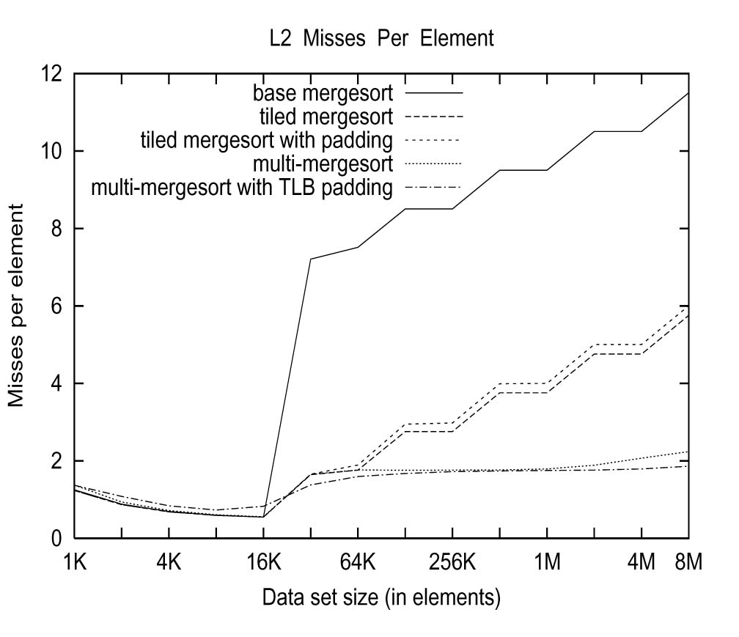

Slide 59
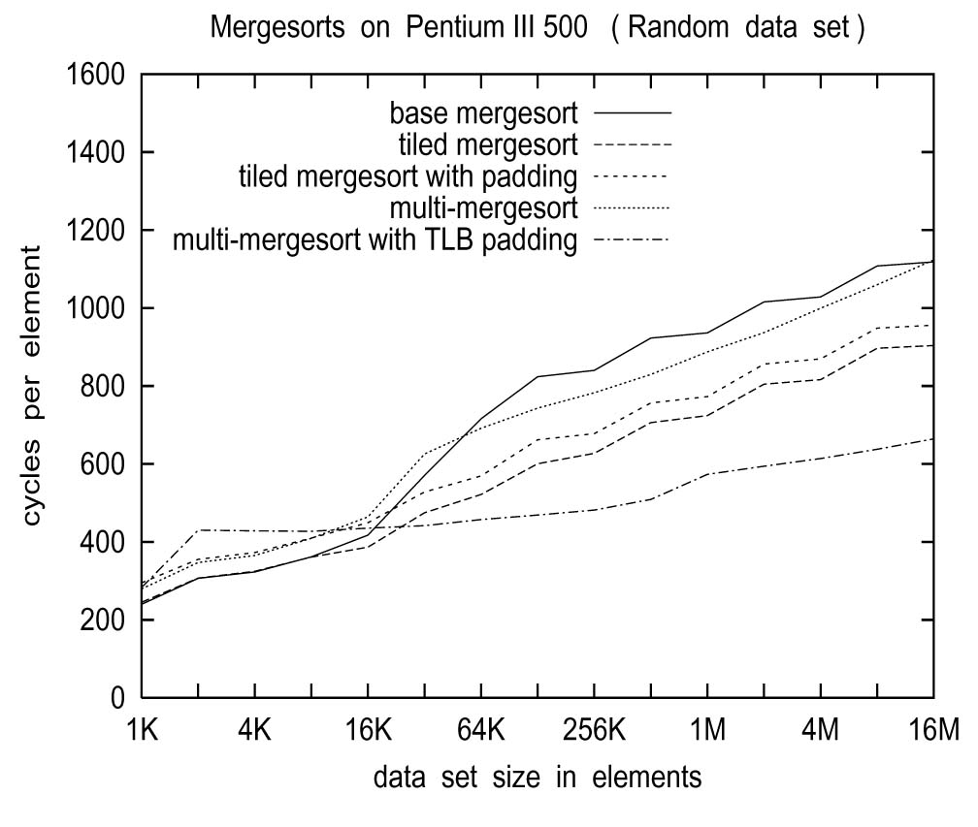

Slide 60
Other Sorting Algorithms
Quicksort - Similar cache optimizations can be performed – still slightly better than the best-tuned Mergesort
Radix Sort – ordinary implementation makes bad use of cache: on each BucketSort
  Sweep through input list – cache misses along the way (bad!)
  Append to output list – indexed by pseudo-random digit (ouch!)
With a lot of work, is competitive with Quicksort

Slide 61
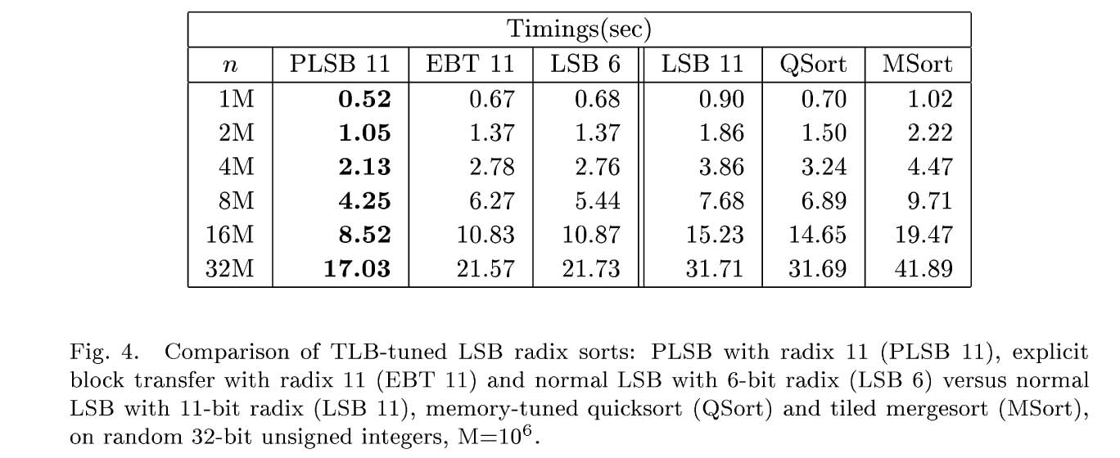

Slide 62
Conclusions
Speed of cache, RAM, and external memory has a huge impact on sorting (and other algorithms as well)
Algorithms with same asymptotic complexity may be best for different kinds of memory
Tuning algorithm to improve cache performance can offer large improvements

