Slide 1
Visionary analyst

Slide 2
agenda
Project Title: Superstore Sales Analysis Team Name: Visionary Analyst Team Members: Mohammed , Moaz ,Omnia , Sarah Elsayed and Sarah Mostafa Tools Used: Excel, SQL, Python, Tableau

Slide 3
Project overview
Explore and analyze Superstore dataset
Use multiple tools to show different perspectives
Deliver insights that can help business decisions

Slide 4

Tools & Roles
Tool | Team Members | Purpose
Excel | Moaz Abdulsalam | Data cleaning & prep
SQL | Sarah Mostafa & Mohammed Hazem | Structured queries
Python | Omnia Ashraf & Sara Elsayed | Visualizations
Tableau | Sarah Mostafa & Sara ElSayed | Dashboard & insights

Slide 5
Excel By Moaz
Key Tasks Performed:
Data Cleaning:
Removed duplicate entries to ensure accurate analysis.
Deleted irrelevant or blank rows that added no value.
Fixed inconsistencies in column names and formats (e.g., dates, currency).
Standardization:
Unified text formats (e.g., product categories, regions).
Applied data validation to prevent user entry errors.
Functional Enhancements:
Used formulas like:
IF for conditional logic (e.g., flagging high/low sales).
VLOOKUP to merge and relate different fields.
Conditional formatting to highlight anomalies like negative profits.
Mini Analysis:
Performed quick summaries using PivotTables to explore:
Top-selling categories.
Yearly revenue trends.
Exported clean dataset for further use in SQL, Power BI, Python, and Tableau.
📎 Outcomes:
Structured, ready-to-analyze dataset.
Provided a foundation for advanced tools.

Slide 6
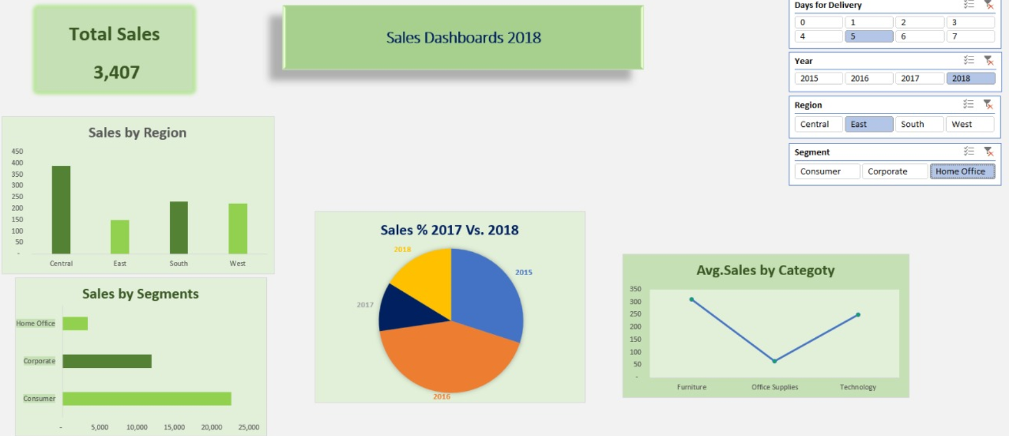
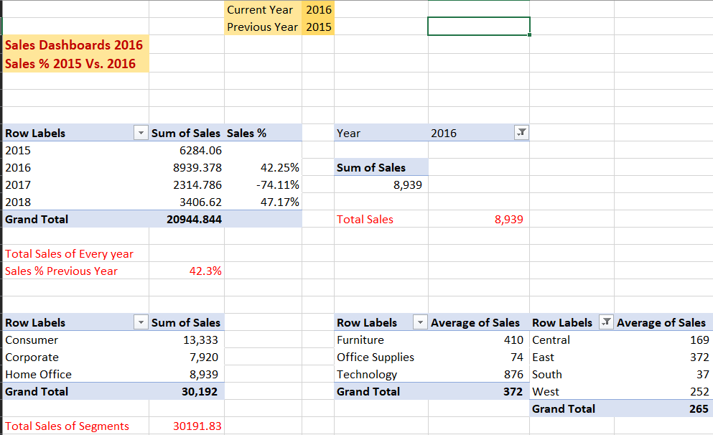
Insights from excel

Slide 7
python
What We Did:
Loaded & Explored Data Used pandas to read the cleaned Excel dataset and understand its structure.
Data Cleaning & Preparation
Handled missing/null values.
Renamed columns for better readability.
Filtered unnecessary records.
Exploratory Data Analysis (EDA)
Checked sales and profit trends across different categories and regions.
Analyzed shipping times, order quantities, and customer behavior.
Identified key KPIs like average order value and most profitable segments.
Visualizations Used matplotlib and seaborn to create charts that show:
Sales trends over time
Category-wise comparison of sales vs. profit
Heatmaps for correlation insights
📎 Outcomes:
Uncovered hidden patterns in the data.
Supported the dashboard team with deeper insights.
Validated key business conclusions from other tools.
Omnia Ashraf
&
Sara Elsayed

Slide 8
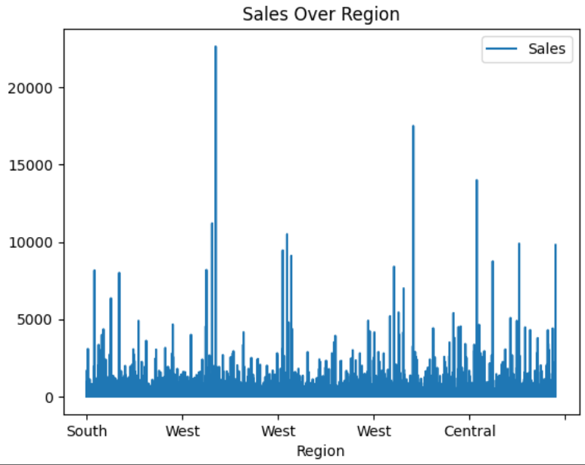
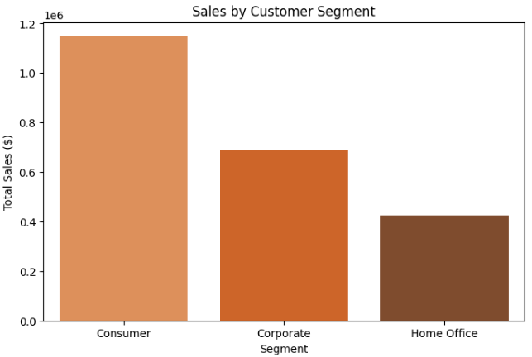
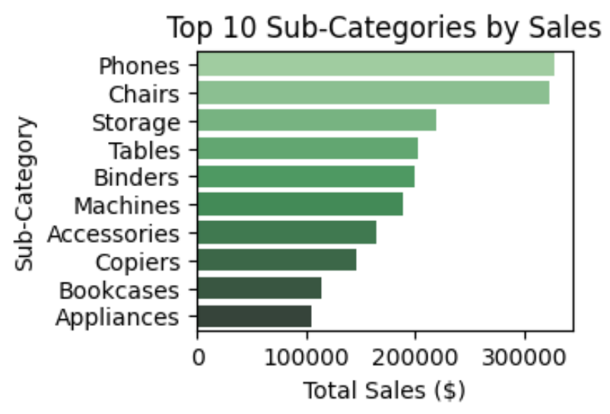
Insights from Python

Slide 9
SQL
Cleaned the Raw Data
Removed duplicates and irrelevant entries.
Handled null values directly inside the database.
Transformed the Data
Renamed columns for clarity.
Created new calculated fields like profit margins.
Changed data types to optimize accuracy and performance.
Structured Analysis
Applied GROUP BY, HAVING, and ORDER BY clauses for summarization.
Filtered insights by segments, products, and locations.
Outcomes:
Created a query-ready dataset for deeper analysis.
Delivered aggregated reports to support the Power BI and Tableau teams.
Helped in answering key business questions like:
What’s the most profitable region?
Which product categories have the highest returns?
Sarah Mostafa & Muhammed Hazem

Slide 10
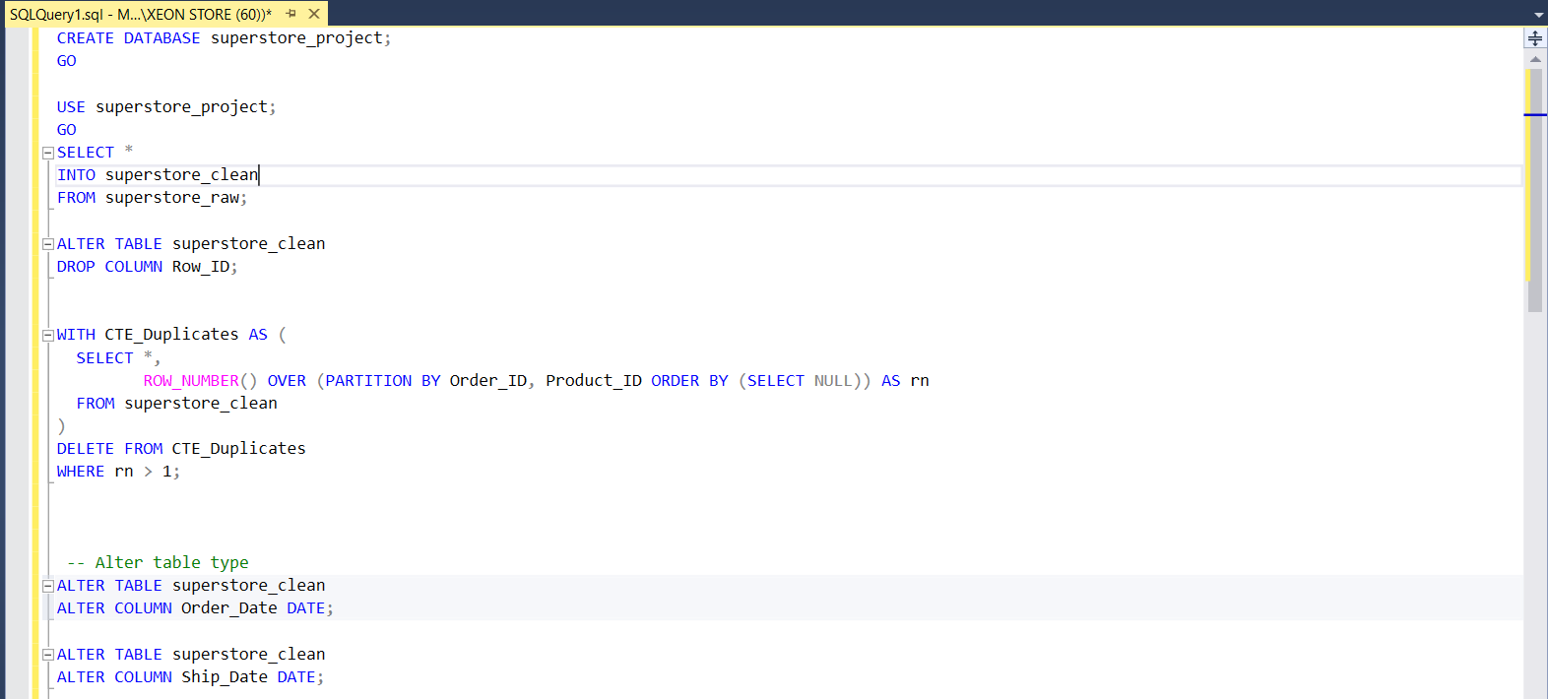
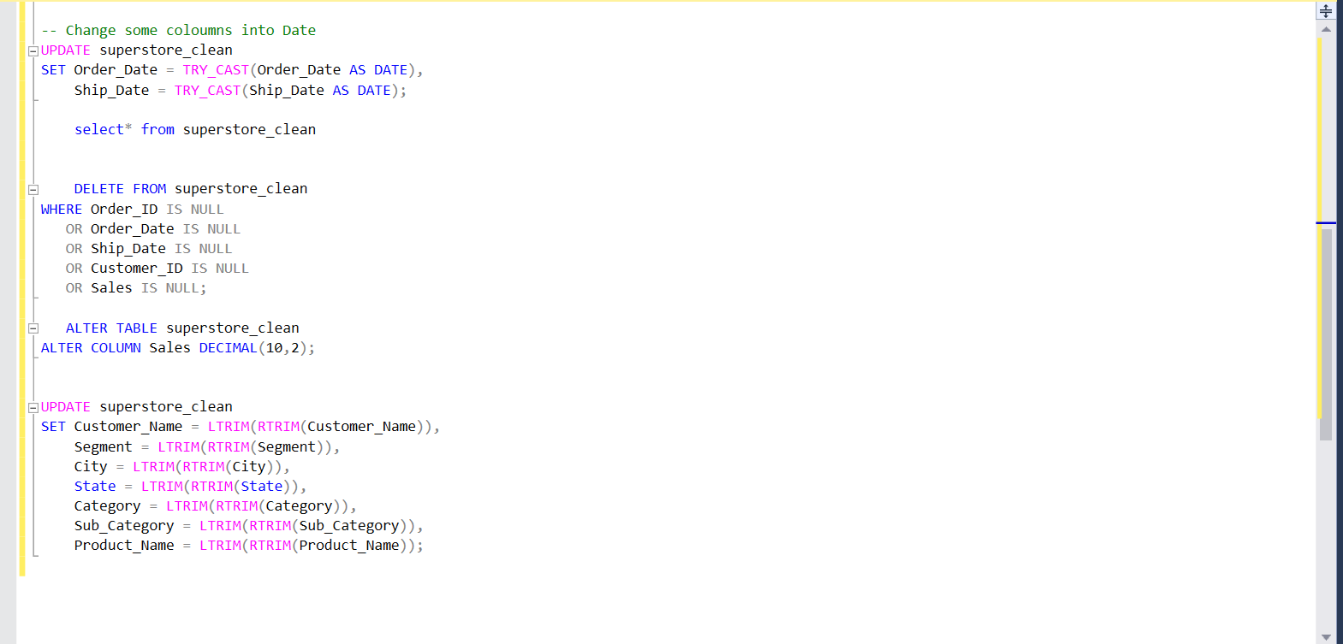
Some work from SQL

Slide 11
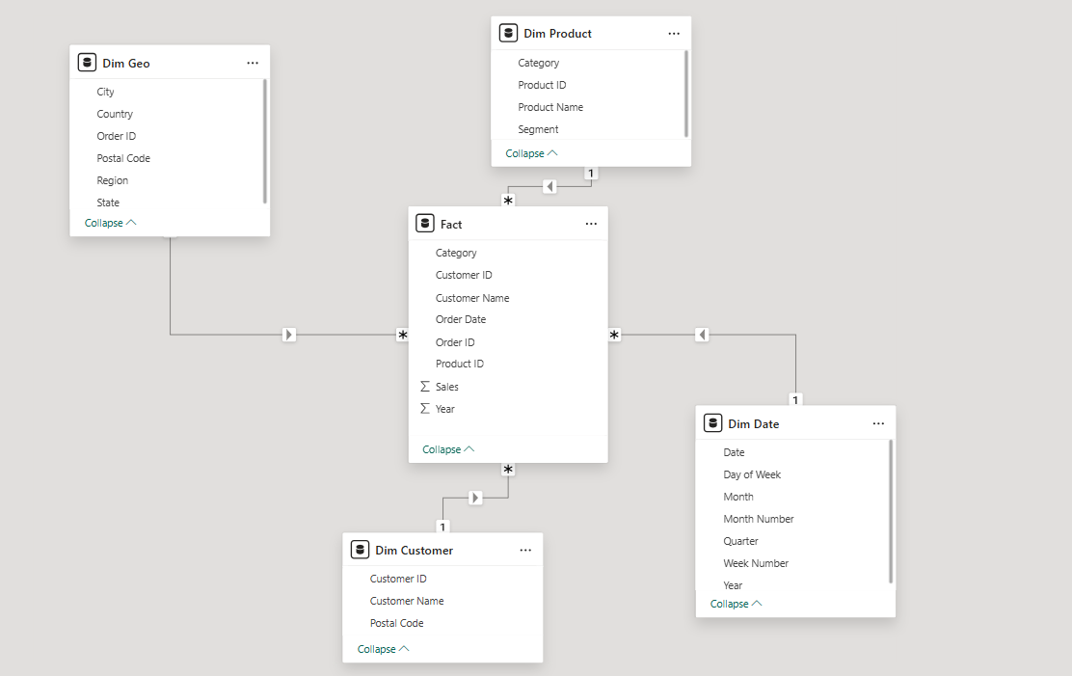
Data modeling

Slide 12
Our feedback
Strengths Identified
Strong Performance in California & West Region California alone accounts for nearly 20% of total sales, and the West region leads overall. This suggests high market maturity and loyal customer base.
Technology is a Clear Market Driver With $827K+ in sales, the Technology category outperforms Furniture and Office Supplies — indicating a tech-savvy customer base and high product relevance.
Positive Year-over-Year Growth Sales rose steadily from 2016 to 2018, particularly a strong jump from $600K to $722K. This upward trend is a good indicator of healthy business dynamics.
Areas for Improvement
Underperforming States (New Mexico, Montana, etc.) Sales below $6K indicate either a lack of awareness, poor distribution, or insufficient demand. These need localized strategies, not a broad national push.
Southern Region Lagging Behind The South is the only region under $400K. Further breakdown is needed, but this might involve longer delivery times, weaker infrastructure, or lower purchasing power.
Furniture Category Saturation or Decline Although second in total, Furniture sales growth may be stagnating. Consider whether product design, shipping cost, or showroom experience is limiting growth.

Slide 13
KPI’s
Category | Insight / KPI | Strategic Recommendation
Top Sales State | California — $446,395 | Continue investing — new product launches, loyalty programs, upselling high-margin items.
Low Sales States | New Mexico — $4,752, Montana — $5,513 | Investigate reasons (low demand/logistics/marketing), apply regional campaigns or discounts.
Top Region | West — $710,994 | Focus expansion, pilot new strategies in strong markets.
Low Performing Region | South — $389,166 | Deep-dive into state-wise performance, improve delivery, marketing, or inventory.
Top Category | Technology — $827,455 | Push bundles, subscription models, increase tech accessories promotion.
Total Sales | $2,260,160 | Set realistic growth targets based on this baseline.
Sales by Year Trend | 2015: 479,856 → 2018: 722,052 | Continue leveraging growth momentum, especially from 2017 to 2018.
Mid-tier Opportunity | Illinois — $79,323, Colorado — $31,145 | Expand presence — potential for growth with moderate investment.
Customer Segmentation | Segments: Consumer, Corporate, Home Office | Personalize offers and communication by segment.
Delivery Metric | Days for Delivery | Reduce delivery time to increase satisfaction and repeat purchase rate.

Slide 14
Promised state and which should we focus on
Which State is Most Promising?
California ($446K in sales):
Top-performing state by far.
Already has a strong base, so it's ideal for:
New product launches.
Loyalty programs to increase repeat purchases.
Premium services like same-day delivery.
Colorado and Illinois (~$31K–$79K):
These states are mid-tier and show room to grow.
Consider testing regional ads and local partnerships here.
Emerging Opportunity: Washington ($185K):
High sales but still behind California — shows growth potential.
Invest in local supply chain and expand tech offerings.
West Region – Top Performer ($710K):
Contains California, Washington, Oregon.
Has a proven customer base.
Best for launching new tech products and premium offerings.
South Region – Underperformer ($389K):
Lowest sales.
Needs investigation: is it a demand issue or operational inefficiency?
East and Central:
East ($669K) is strong — could be pushed to surpass the West with the right strategy.
Central ($492K) is moderate — could benefit from more localized marketing.

Slide 15
Suggestions for Improvements
1. Maximize High-Sales Areas
California ($446,395): Launch new products, premium services, and loyalty programs here.
West Region ($710,994): Continue investment; great for testing new offerings.
2. Boost Underperforming Regions ⚡
South Region ($389,166): Identify low-conversion states (e.g., New Mexico, Montana) and address causes:
Low demand?
Poor delivery logistics?
Lack of marketing?
3. Double Down on Technology Category 📦
Highest revenue-generating category: $827,455.
Push bundled deals, tech accessories, and subscription models.
4. Optimize Delivery Times 🚚
Analyze "Days for Delivery" metric per state to improve customer experience and reduce cart abandonment.
5. Use Segmentation 🧠
Run targeted promotions for different customer segments (e.g., Corporate vs Consumer).
Use RFM (Recency-Frequency-Monetary) model to find high-value customers.

Slide 16
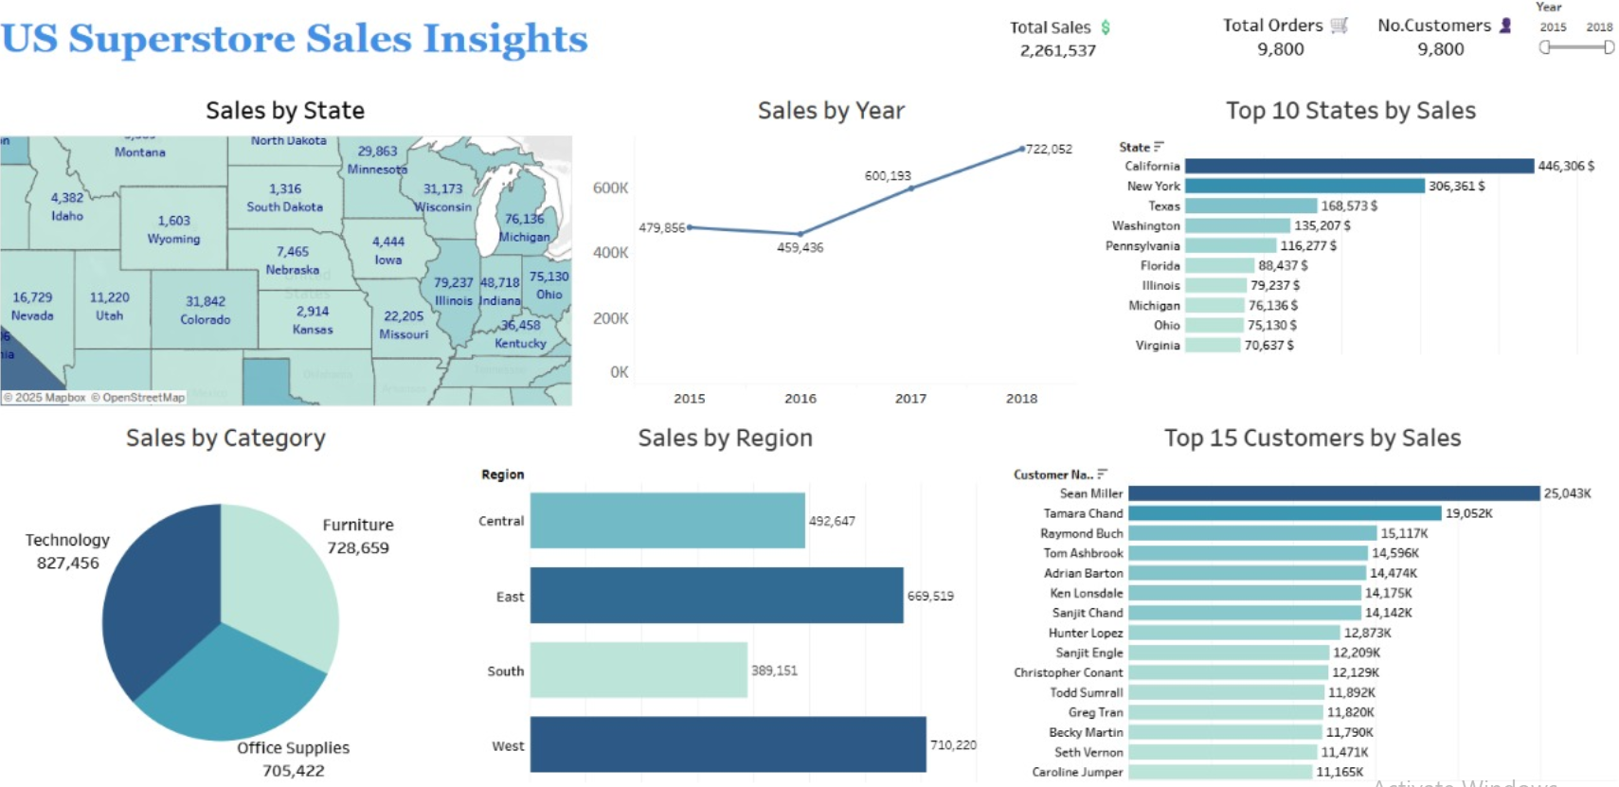
Our Dashboard by (Sara Mostafa & Sara Elsayed)

Slide 17
Final summary
The US Superstore is performing strongly in tech-focused markets like California and the West region, driven primarily by high sales in the Technology category and a consistent year-over-year sales increase. This creates a clear path for profitable growth through a geographic and product-based focus.
To maximize overall profitability, the company should leverage its strengths in high-performing areas while taking strategic actions in weaker markets. Specifically, this means prioritizing growth and innovation in the West, expanding mid-tier states like Illinois and Colorado, and diagnosing underperformance in the South and low-yield states such as New Mexico and Montana.
At the same time, the company must improve operational efficiencies, including reducing delivery times and applying customer segmentation to personalize offers and marketing strategies. By combining these approaches, the US Superstore can increase customer retention, improve performance, and maintain a competitive edge across regions.

Slide 18
Work References
..\DEPI\projecto\final_Superstore_Sales_Project.xlsx
..\DEPI\projecto\final.sql
https://colab.research.google.com/drive/1WVghUjvfUJkaTtW8yUAHNoQrpq9WhHa2?usp=sharing
://public.tableau.com/app/profile/moaz.abdulsalam/viz/ProjectUSSales_17464356546190/Dashboard1

Slide 19
Thank you

