Slide 1
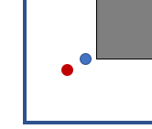
18mm
10mm
Blue dot: Nozzle of Original Print Head
Red dot: Nozzle of Direct Drive Extruder

Slide 2
Direct Drive Extruder
w/ 3D Touch
Original Print Head
27mm
35mm
30mm
Blue dot: Nozzle
Red dot: Probing position of leveling sensor

