Slide 1

Database Viewer
By Checkmate Group

Slide 2
Who are we?
Zakariya Oulhadj (Team Leader)
Bogdan Adascalului (Team Leader)
Taylor Head (Scrum Master)
Notes:
Zakariya Oulhadj (Team Leader 1)
Responsible for managing the group
Bogdan (Team Leader 2)
The second team leader that….
Taylor Head (Scrum Master)
The scrum master which …..

Slide 3
Our Project
Database Viewer
Easy to use platform
Latest technologies
v0.0.1
v0.0.3
Sprint 2
Sprint 4
Sprint 1
Sprint 3
v0.0.2
v0.0.4
Notes:
Latest technologies
Node.js, Express.js, Docker, Bootstrap, Pug
Easy to use platform through a website interface
4 Month-long project
600+ total commits
40 Merges

Slide 4








Development Stack
Notes:
Quick mention of the different tool used.

Slide 5
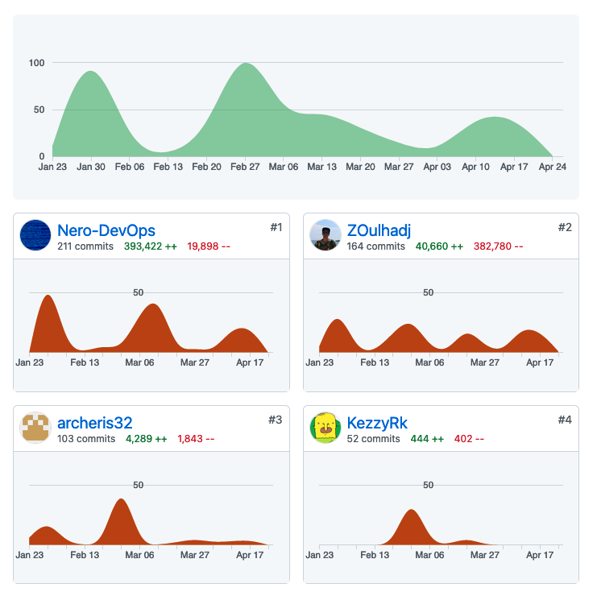
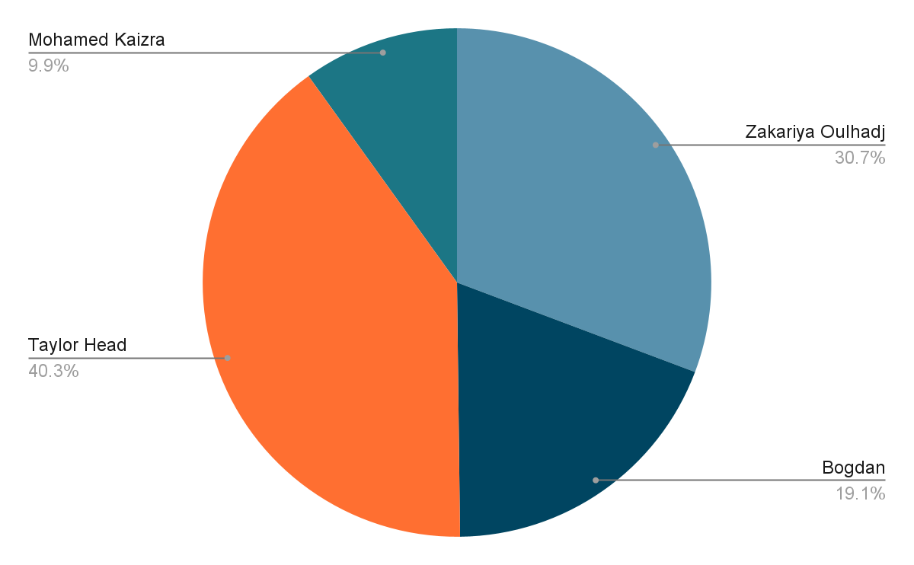
Group Statistics

Slide 6
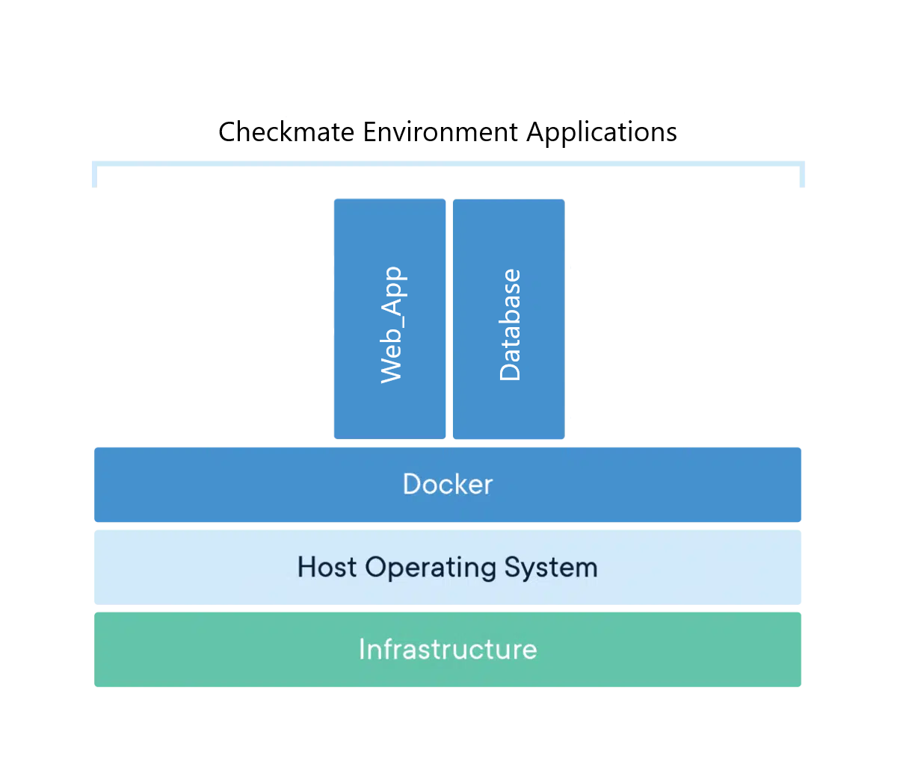
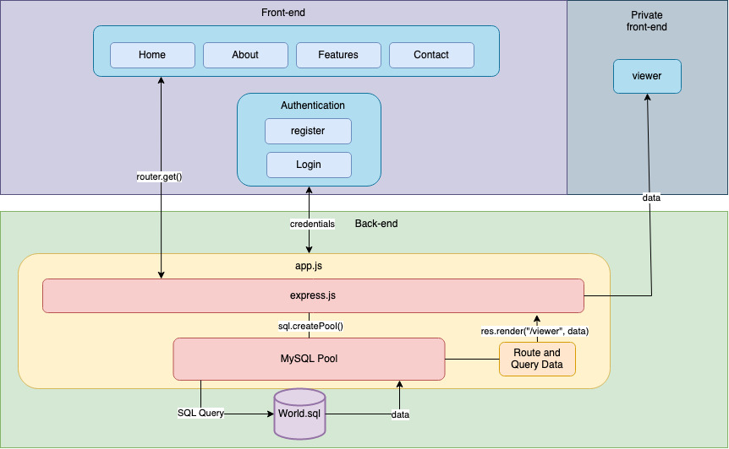
Internal Systems
Notes:
The internal systems have been built within the Docker Engine which would be called a container which can easily deploy and host the environment.
Internal systems build with Docker
Easily deployable
Separate containers to reduce the risk of conflicts

Slide 7
Project Tour
Notes:
We can present our website

Slide 8
Any Questions?

