Slide 1
Checkmate Presentation (Sprint 3)
@ZOulhadj
@Nero-DevOps
@archeris32
@KezzyRk

Slide 2

Our pledge
We vow to act socially responsible and in an honourable manner. All our procedures and activities must abide by all relevant international, national and local laws and contractual terms.

Slide 3
About the project
This group of talented programmers are tasked with creating an application
for the smooth and efficient operation of a business.
We will work on the project as a Scrum team and therefore need to
adopt both design methods (user stories, use cases) and project management
methods (Agile, Kanban). We will also need to become familiar with the tools
of a typical software development team (Visual Studio, Git, Docker) and
some of the difficult human and technical issues around collaborating on and
continuous improvement of online applications. Fundamentally, we aim to develop
a CRUD application. A CRUD application is effectively a front-end to a database,
providing a method to create, read, update, and delete data from a web site
to a database on a server.

Slide 4
TABLE OF CONTENTS
01
02
03
Updated user stories
Implementation of Travis CI
GitHub repository
04
05
06
Integration tests
Unit testing
Prototype

Slide 5
01
Updated user stories

Slide 6
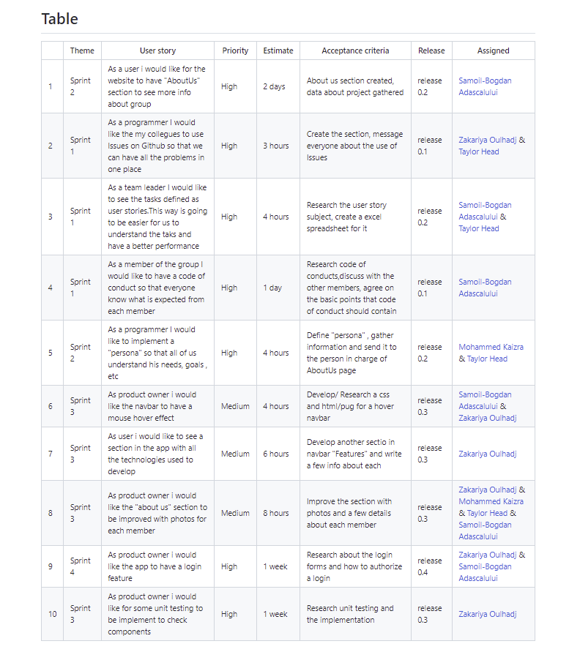
Updated user stories
In software development and product management, a user story is an informal, natural language description of features of a software system. They are written from the perspective of an end user or user of a system, and may be recorded on index cards, Post-it notes, or digitally in project management software. Depending on the project, user stories may be written by different stakeholders like client, user, manager, or development team.
We continued to develop / update user stories from multiple perspective points and allocate it to different team members with different priorities.

Slide 7
02
Implementation of Travis CI

Slide 8
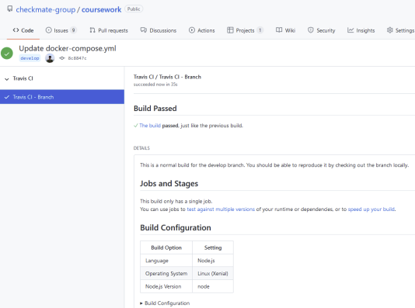
Travis CI
Travis CI is a hosted, distributed continuous integration service used to build and test software projects hosted at GitHub

Slide 9
03
GitHub repository

Slide 10
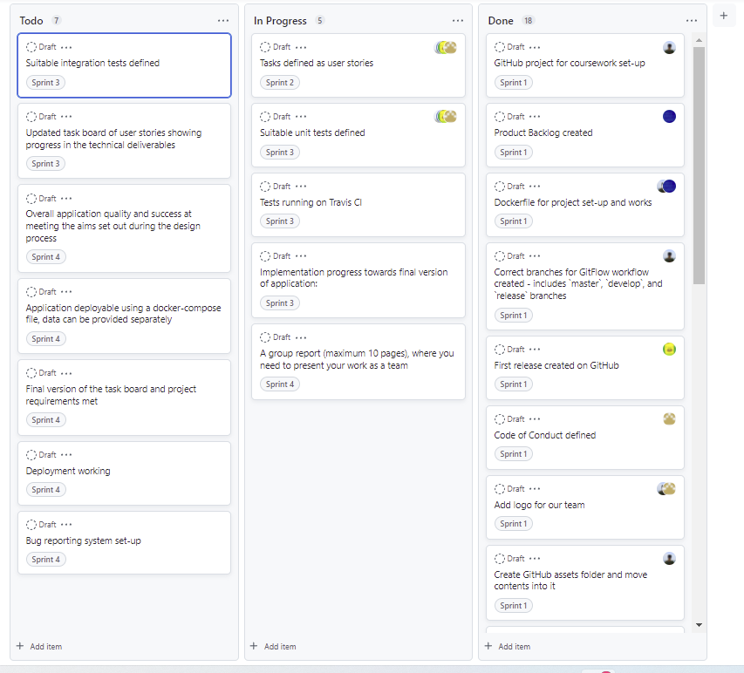
GitHub repository
Kanban is a popular framework used to implement agile and DevOps software development. It requires real-time communication of capacity and full transparency of work. Work items are represented visually on a kanban board, allowing team members to see the state of every piece of work at any time.

Slide 11
04
Full use cases defined

Slide 12
05
Meeting Minutes

Slide 13
06
Use Case Diagram

