Slide 1
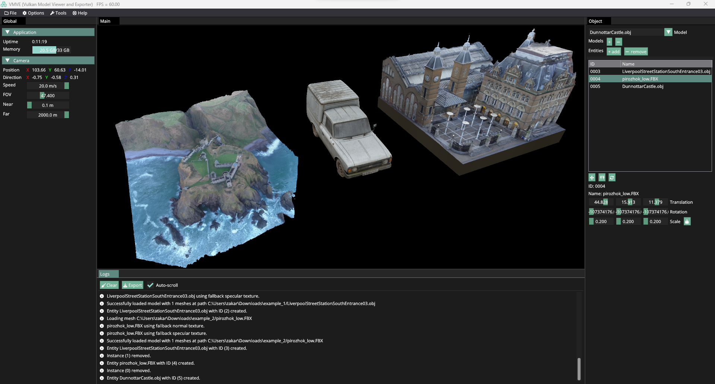
VMVE Presentation
Milestone 6 Screencast
By Zakariya Oulhadj
Notes:
Hello, my name is Zakariya Oulhadj a final year student at The University of Roehampton. I present my final year project, VMVE, A standalone application developed
in the domain of computer graphics that provides an easy-to-use, efficient
platform for 3D graphics rendering and asset encryption. It serves as an
important learning tool and as a stepping stone that aims to bridge to gap between
new users and industry-leading rendering engines.
Throughout the presentation I will be showcasing the application at its current state, the features it provides and the overall progress of the project.

Slide 2
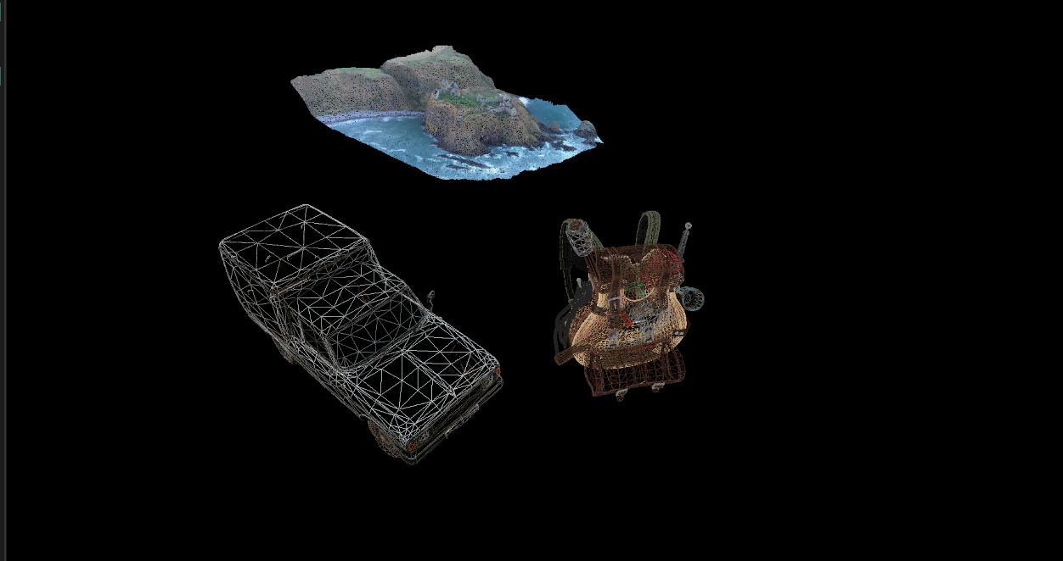
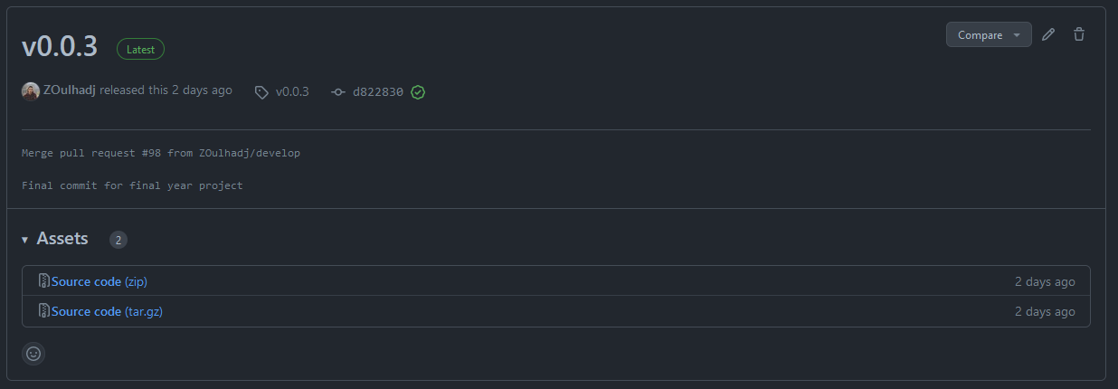
Overview
Vulkan API
Deferred Pipeline
Texture Mipmaps
Debugging Tools
v0.0.3 released
364 Commits

Slide 3
Demonstration
Notes:
I will now go ahead and present the application.
Load Model
Add Entities
Manipulate entities
Debug Views
Explain helper tooltips

Slide 4
End
Notes:
In conclusion, the goal of the VMVE to be used by students and trainees to learn about computer graphics and take advantage of the latest technologies without needing to know the complex implementation details. This project required considerable levels of understanding of low level software architecture, including the Vulkan rendering API. Currently the application showcases a basic running prototype that lays the foundations for future work going forward.
Thank for watching.

