Slide 1
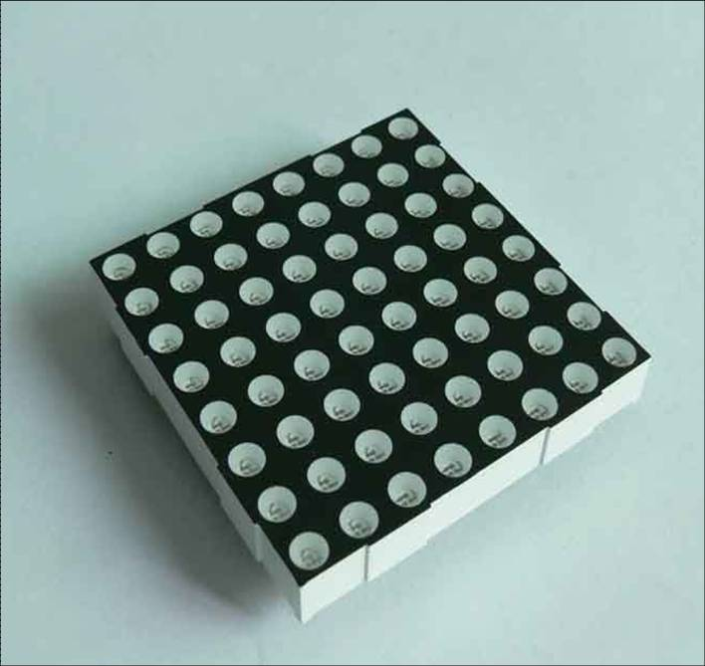
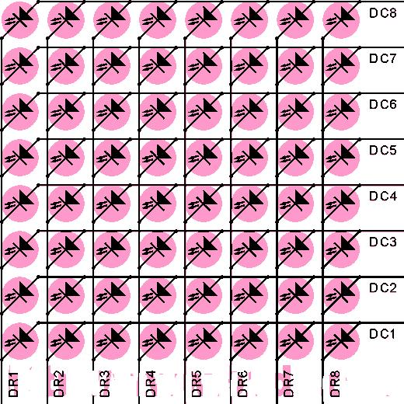
点阵的应用
点阵实物图
点阵内部原理图

Slide 2
0-9的点阵数值：
unsigned char code tab[]={
0x00,0x7E,0xFF,0xC3,0xC3,0xFF,0x7E,0x00, //0
0x00,0x00,0x43,0xFF,0xFF,0x03,0x00,0x00, //1
0x00,0x63,0xC7,0xCF,0xDB,0xF3,0x63,0x00, //2
0x00,0x42,0xDB,0xDB,0xDB,0xFF,0x66,0x00, //3
0x00,0x3E,0x46,0xFF,0xFF,0x06,0x06,0x00, //4
0x00,0xF6,0xF7,0xD3,0xD3,0xDF,0xDE,0x00, //5
0x00,0x7E,0xFF,0xDB,0xDB,0xDF,0x4E,0x00, //6
0x00,0xC0,0xC0,0xC7,0xFF,0xF8,0xC0,0x00, //7
0x00,0xFF,0xFF,0xDB,0xDB,0xFF,0xFF,0x00, //8
0x00,0x72,0xFB,0xDB,0xDB,0xFF,0x7E,0x00, //9
};（高电平有效）

