Slide 1

DAN : Deep Attention Neural Network for News Recommendation
Qiannan Zhu, Xiaofei Zhou, Zengliang Song,Jianlong Tan, Guo Li
¹Institute of Information Engineering, Chinese Academy of Sciences
²University of Chinese Academy of Sciences
AAAI'19 (Oral) 1.27 - 2.1, 2019, Hawaii, USA
Notes:
Good afternoon, everyone. I’m Qiannan Zhu from Institute of Information engineering, university of Chinese Academy of Sciences. I will give a presentation of our recent work named “learning knowledge graph embeddings via generalized hyperplanes”, which is a method for embedding knowledge graphs.

Slide 2
Introduction
Observation
Recommendation System
Problem & Motivation
ignore the news profile
ignore the influence of sequential information of a user’s clicked news
Proposal: DAN
A deep attention neural network DAN that consists of three components including PCNN, ANN, ARNN
Results
3.91% on F1 and 2.64% on AUC improvemnet on evaluation metrices
Notes:
At first, let me make a brief introduction of what we have done in this work. We know that knowledge graphs play important roles in numerous AI applications. Factually they are far from completeness. for completing knowledge graphs, Recently an approach named knowledge graph embedding has highly attracted attention, which embeds the entities and relations of a knowledge graph into a low-dimensional space. But we note that previous embedding-based models have limitations in preserving inherent properties of complex relations in knowledge graphs. Therefore we propose to use generalized hyperplanes to address the issues, and have improvement from 2 percent to 9 percent on evaluation.

Slide 3
Contents
Backgrounds
Proposal
Experiments
Conclusion
Notes:
This slide gives an outline about what I will present next.
First is the backgrounds of knowledge graph embedding. Then I will explain the architecture of our method. And next are the evaluations on our method. Finally, there is a conclusion.

Slide 4
Backgrounds
Recommendation System
Task
Given a list of reading news history, recommend a candidate news for users.
Notes:
So, what are knowledge graphs? As this Figure shown, a typical knowledge graph is a multi-relational directed graph, where nodes represent entities and edges represent relations. That is a basic triplet fact (h,r,t) represents that the relation r links the head entity h and tail entity t, for example, (Obama, place_of_birth, Hawai)

Slide 5
Backgrounds
Recommendation System
Collaborative Filtering (CF) based Methods
predicts a personalized rankingover a set of items for each individual user with the similarities among the users and items
Content based Methods
consider the actual content or attributes of the items for making recommendations
Notes:
So, what are knowledge graphs? As this Figure shown, a typical knowledge graph is a multi-relational directed graph, where nodes represent entities and edges represent relations. That is a basic triplet fact (h,r,t) represents that the relation r links the head entity h and tail entity t, for example, (Obama, place_of_birth, Hawai)

Slide 6
Backgrounds
Recommendation System
Hybrid Methods
recommend items through a hybrid recommender system that usually combines several different recommender algorithms
Deep Learning Based Models
modeling complex user-item (i.e., news) interactions, and capturing the dynamic properties of news and users
Notes:
Although there are huge amounts of structured data, a knowledge graph is factually far from completeness. Knowledge graph completion aims to predict new relational facts under supervision of the existing facts. There are two tasks for completing knowledge graphs including link prediction and triplet classification, which respectively predict the candidate entities and relations. Recently an approach named knowledge graph embedding has successfully applied for knowledge graph completion. Knowledge graph embedding first embeds entities and relations of a given KB into continuous vector spaces, and then for each triplet, a score function is defined to measure its plausibility in that spaces. Then it learns entity and relation embeddings by minimizing a loss function.

Slide 7
Backgrounds
Related Works
Methodologies
Autoencoders (Sheng,Kawale,and Fu. 2015)
CDAE (Wu et al. 2016)
DMF (Xue et al. 2017)
DSSM (Huang et al. 2013)
SCENE (Li et al. 2011)
DeepWide (Cheng et al. 2016),
DeepFM (Guo et al. 2017),
DeepJoNN (Zhang, Liu, and Gulla 2018)
DKN(HongweiWang2018)
Notes:
Most of the current embedding-based models are focused on defining various effective scoring functions, for example RESCAL, SE,NTN, TransE, TransH. Other works mainly focused on loss function such as the upper-limit scoring loss function. Here our work is focused on devising score function.

Slide 8
Backgrounds
Issues
Issues of existing models
have the cold start problem when being exposed to the sparsity of
user-item interactions
have difficulties in reflecting a user's interests in real time
ignore the news profile
can not consider the influence of sequential information of a user's clicked news
Notes:
There are two issues of existing score function, one is that the score function has the limitations in preserving mapping properties of complex relation facts for knowledge graphs. The other is that the score function has lower generality for capturing correlations between entities an relations.

Slide 9
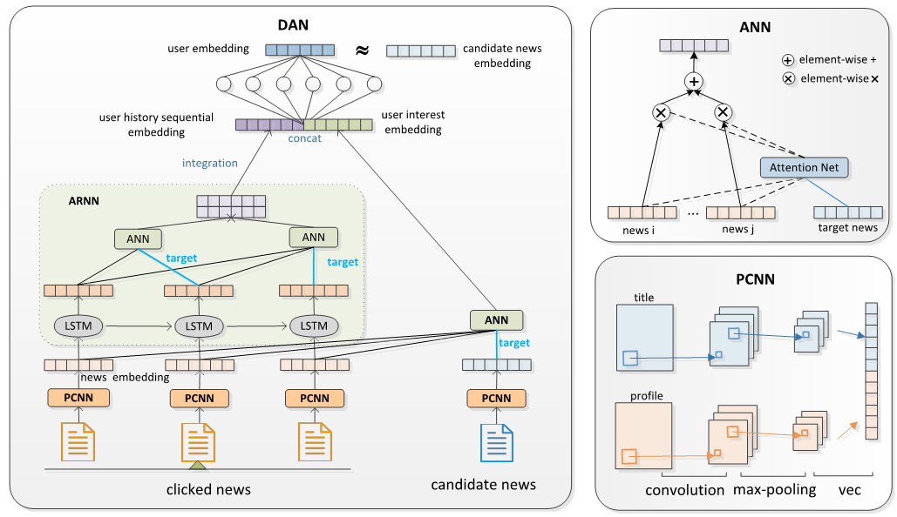
Proposal
DAN
DAN uses three components for capturing the dynamic of news and user's interest, and recommend news to users.
Notes:
For addressing aforementioned issues, we propose a new embedding-based method named TransGH. As this figure shown, compared with TransH, instead of the only one normal vector, TransGH uses a set of basis vectors to determine a generalized hyperplane.

Slide 10
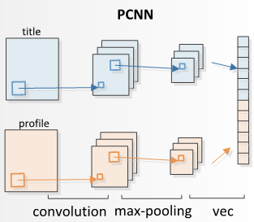
Proposal
PCNN Component
input: profile embedding C and title embedding T
convolution layer
pooling layer
output: news feature representation
Figure 3
Notes:
The basic idea oof TransGH is shown in this Figure. It can be summed up in two steps: the first step is projection, whose aim is to project entity embeddings on the generalized hyperplane. Specifically, with the normal of the vector w equals to 1, we can easily to get the projections of the head and tail embedding on the generalized hyperplane as equation 1. Then the second step is translation, which is to connect the projected entities with the relation-specific translation vector. Therefore the score function is defined as equation 2.

Slide 11
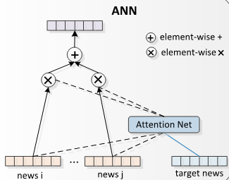
Proposal
ANN Component
input: profile embedding C and title embedding T
convolution layer
pooling layer
output: news feature representation
Notes:
For learning the embeddings of entities and relations, we consider following four constraints. The constraints three assures the translation vector r is on the generalized hyperplane and constraint four guarantees each two basis vectors are orthogonal.

Slide 12
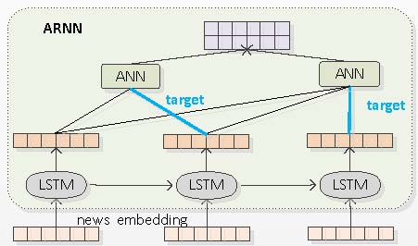
Proposal
ARNN Component
input: profile embedding C and title embedding T
convolution layer
pooling layer
output: news feature representation
Notes:
Afterwards with the soft constraints, we directly optimize following margin-based ranking loss function to encourage the discrimination between positive triplets and negative triplets. The loss function favors the lower scores for positive triplets than that for nagative triplets. We adopt SGD to minimize the loss function. Notice that in training stage, the negative triplets are corrupted by two strategies. the first is named unif that the negative triplets are generated by replacing the head or tail entity of correct triplets with equal probability. the second is named bern that using different probabilities replaces the head or tail entity

Slide 13
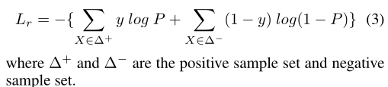
Proposal
Training
Notes:
Afterwards with the soft constraints, we directly optimize following margin-based ranking loss function to encourage the discrimination between positive triplets and negative triplets. The loss function favors the lower scores for positive triplets than that for nagative triplets. We adopt SGD to minimize the loss function. Notice that in training stage, the negative triplets are corrupted by two strategies. the first is named unif that the negative triplets are generated by replacing the head or tail entity of correct triplets with equal probability. the second is named bern that using different probabilities replaces the head or tail entity

Slide 14
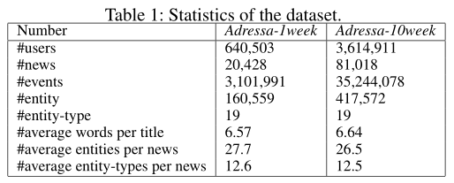
Experiments
Data sets
Adressa is an event-based news dataset that includes anonumized users with their clicked news articles
Adressa-1week: from 1 January to 7 January 2017
Adreesa-10week: from 1 January to 31 March 2017
Notes:
Next is the experiments. In the experiments, we use two datasets including FreeBase and WordNet. In WordNet, each entity represents a synset containing several words, and relation indicates the lexical relations between synsets. WN18 and WN11 are two data sets from WornNet. WN18 contains eightteen relations and WN11 contains eleven relations. Freebase is a large and rising knowledge graph of general facts. FB15k and FB13 are also two subgraph of FreeBase. The statistic of these data sets are listed in Table one.
which is published with the collaboration of Norwegian University of Science and Technology and Adressavisen as a part of RecTech project on recommendation technolopy.

Slide 15
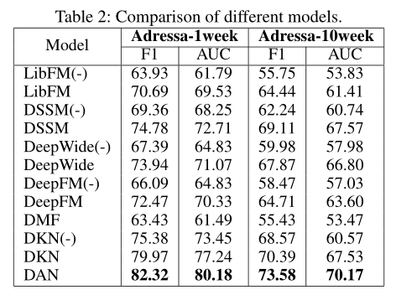
Experiments
Result and analysis
(-) represents that removing the profile embedding from input matrix
Notes:
Our model DAN consistently outperforms all baselines on both datasets, which is at least 3.19% on F1, 2.64% on AUC higher than other models. We attribute the superiority of our model to its three advantages: (1)Our model uses PCNN to process title and profile of news and can better extract the specific local patterns in news. (2) Our model uses ARNN to better capture the sequential correlation of user’s clicked history reading. (3) Our model uses ANN to treat users' click history discriminatively, which better captures users' diverse reading interests
using profile embedding can increase the performance of models.
deep learning based models have higher performance since deep models can well capture the non-linear relations and dependencies.
all models achieve better performance than CF-based DMF because CF-based models cannot work well in recommending news due to the time-sensitive attribution of news.

Slide 16
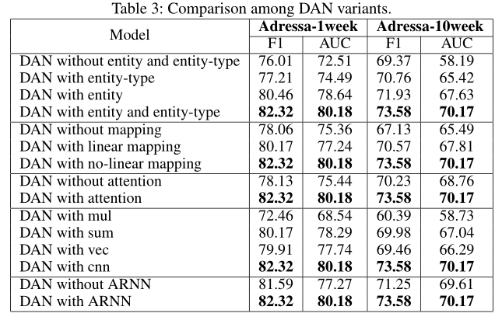
Experiments
Discussion on different DAN variants
Notes:
This table illustrates the results of our model and previous works on WN18 and FB15k. The results in the red square is our model TransGH, which shows that our model consistently and significantly outperforms previous models on both metrices. Compared with TransH, our model has respectively remarkable improvements on metrics of Mean(raw), mean(filt), hitten(raw) and hitten(filt), which are 172, 124, 6.2% and 8.3% on WN18, 25, 23, 8.4%, 15.7% on FB15k. We believe that the improved performance of our model is due to its use of the set of basis vectors.

Slide 17
Summary
Conclusion
DAN considers the user’s history sequential information and user’s current interest together to determine whether the user clicks on the candidate news.
DAN devises three components including news representation extractor PCNN, sequential information extractor ARNN and user interest extractor ANN.
DAV significantly and consistently has considerable improvement over baselines, and achieves state-of-the-art performance
Notes:
PCNN learns the news representation through two parallelCNNs by fusing the title-level and profile-level information of news. Based on such news representations, ARNN captures the user’s history sequential information through an attention-based RNN, which enforces the attention mecha-
nism on each state of RNN. Meanwhile ANN also utilizes
the same attention mechanism in ARNN to learn the user’s
current interest with respect to candidate news

Slide 18
Thanks
THANKS
Q&A
Notes:
That’s all, thank you. Are there any questions or suggestions?

