Slide 1
Using large language models for
extracting the data from the mobile device screen content.
Bachelor Thesis by:
Szymon Kozłowski, Gustaw Blachowski, Kamil Dybek, Natalia Junkiert
Collaboration with company Murmuras

Slide 2
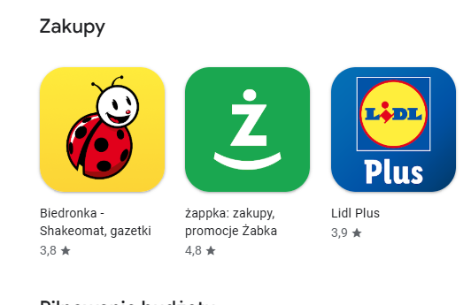
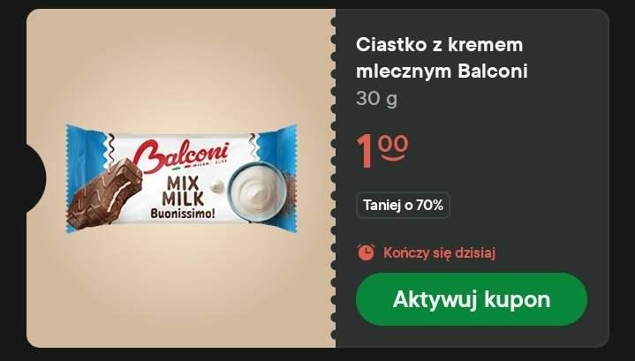
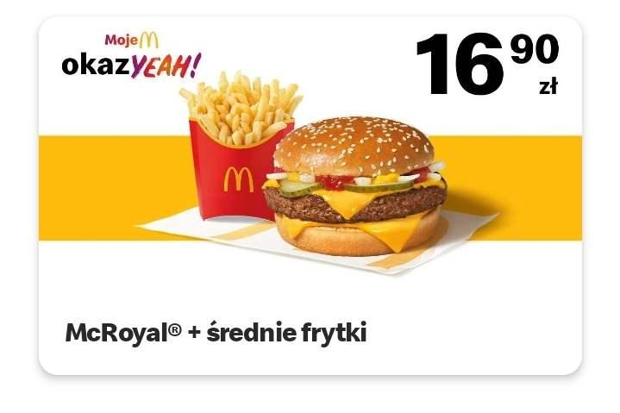
The problem
The case we worked on:
mobile discount coupons
Q: Why not conventional scrapping on phone layout? A: many apps, layout changing often This generalizes to other problems - like scraping social media posts, adverts, etc
Notes:
Q: where data will be stored A: it will be sent to the external server, (server is outside of the scope of our project)

Slide 3
Project assumptions
Our solution should be, in theory, deployable on mobile device
We focus on maximizing recall
Our solution should be easily generalizable to other domains

Slide 4
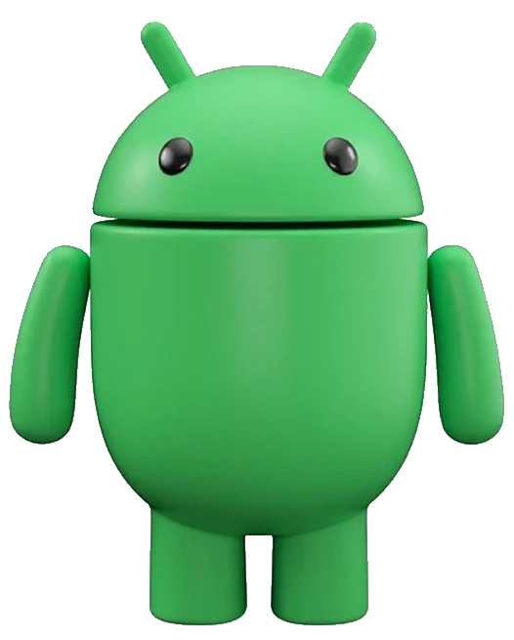
Additional challenge - privacy
Users are being paid to use our app
Still, we have to protect their privacy
For that to happen, we perform the inference locally, on the end device
This means limited resources
Notes:
As we get all the screen content it can possibly contain confidential/personal info

Slide 5
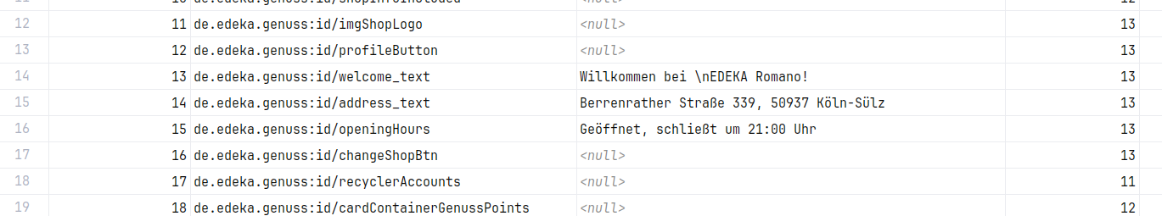
Mobile phone screen dump - the data we work with
Notes:
-obtained via Android Accessibility API
Q: what is the last col?
A: view depth in the XML tree

Slide 6

Dataset details
Data from 5 shops: Lidl, Rewe, Rossman, DM, Penny
Split into two CSV files: phone screen dump, and target coupons
Initially over 2 140 000 rows of screen dumps, and 69500 rows of target data
After cleanup: 11 000 rows in HF Datasets

Slide 7
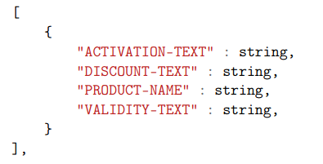
What we want to get?
Discount coupons in a form of JSON list
More General:
Concise summary of the screen contents
Notes:
Q: why not price as numeric value? A: coupons might have nontrivial discounts, like get one free if you have spent at least $xyz on some product group

Slide 8
Let’s use LLMs!
Notes:
Q: how llms guarantee that no private data is considered as coupon and sent to the server? A: It does not xd (idk what to say here)

Slide 9
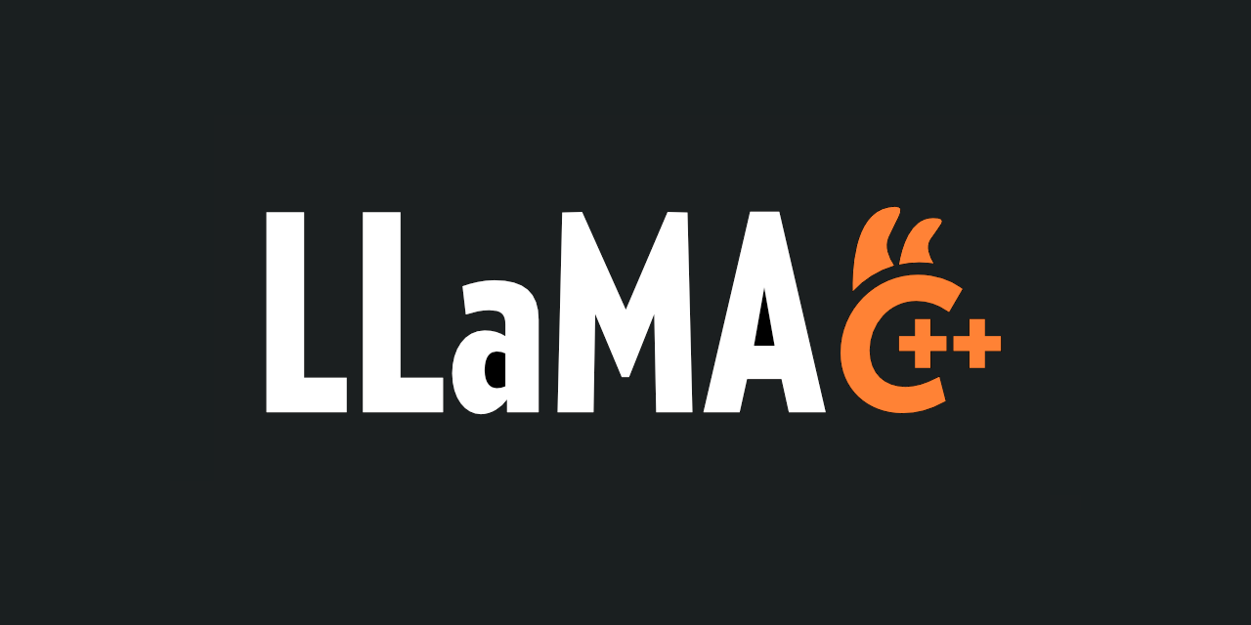


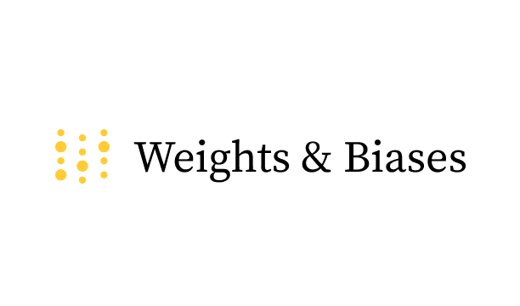


Tech Stack

Slide 10
What did Murmuras provide us with
Datasets
Credits for ChatGPT
Credits for Modal
Weekly knowledge exchange

Slide 11
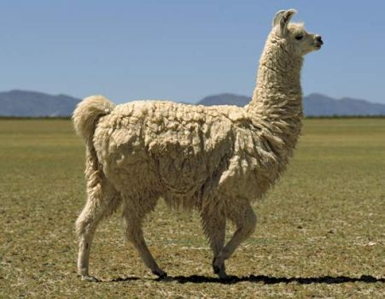
Approach 1: simply prompt it - Llama
We need relatively smart model Further optimizations: Q4 and Q8 quantizations, Llama.cpp
Llama-3.2
appr. 1 billion params
Fine tuning - Unsloth, Modal, LoRA Our dataset - around 10k samples Single fine tuning ~30min on H100
Notes:
wpomnieć tu coś o tym że wyzwaniem jest wgl odpalenie takiego modelu na telefonie

Slide 12
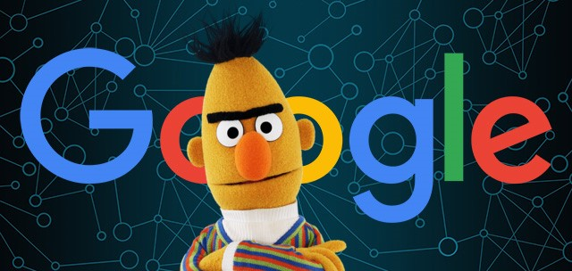
Approach 2: utilize NER
Named Entity Recognition
Powered By BERT - around 150mln params
Two phases:
Select coupon contents
select coupon attributes inside contents
More lightweight

Slide 13
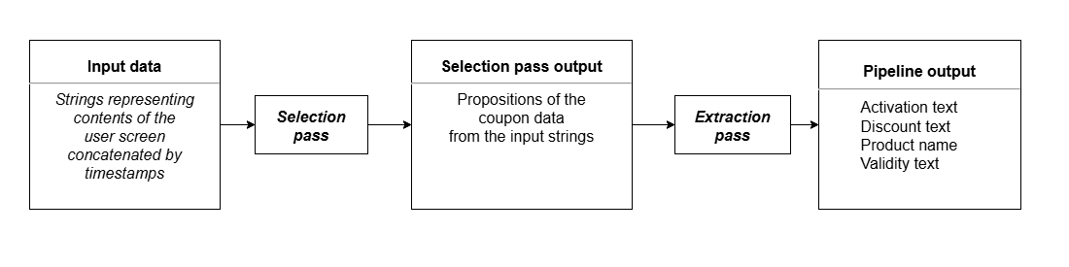
Architecture
Notes:
nie zagłębiać się

Slide 14
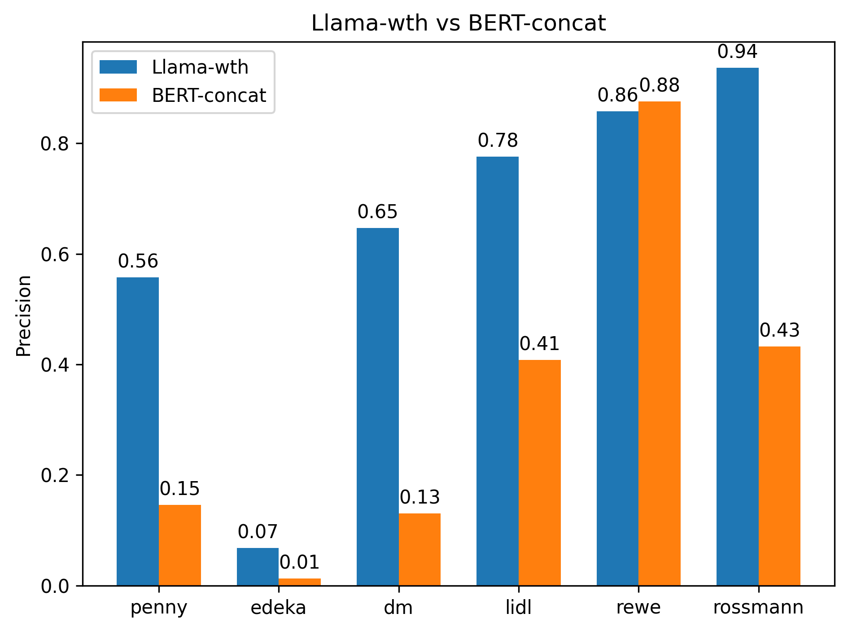
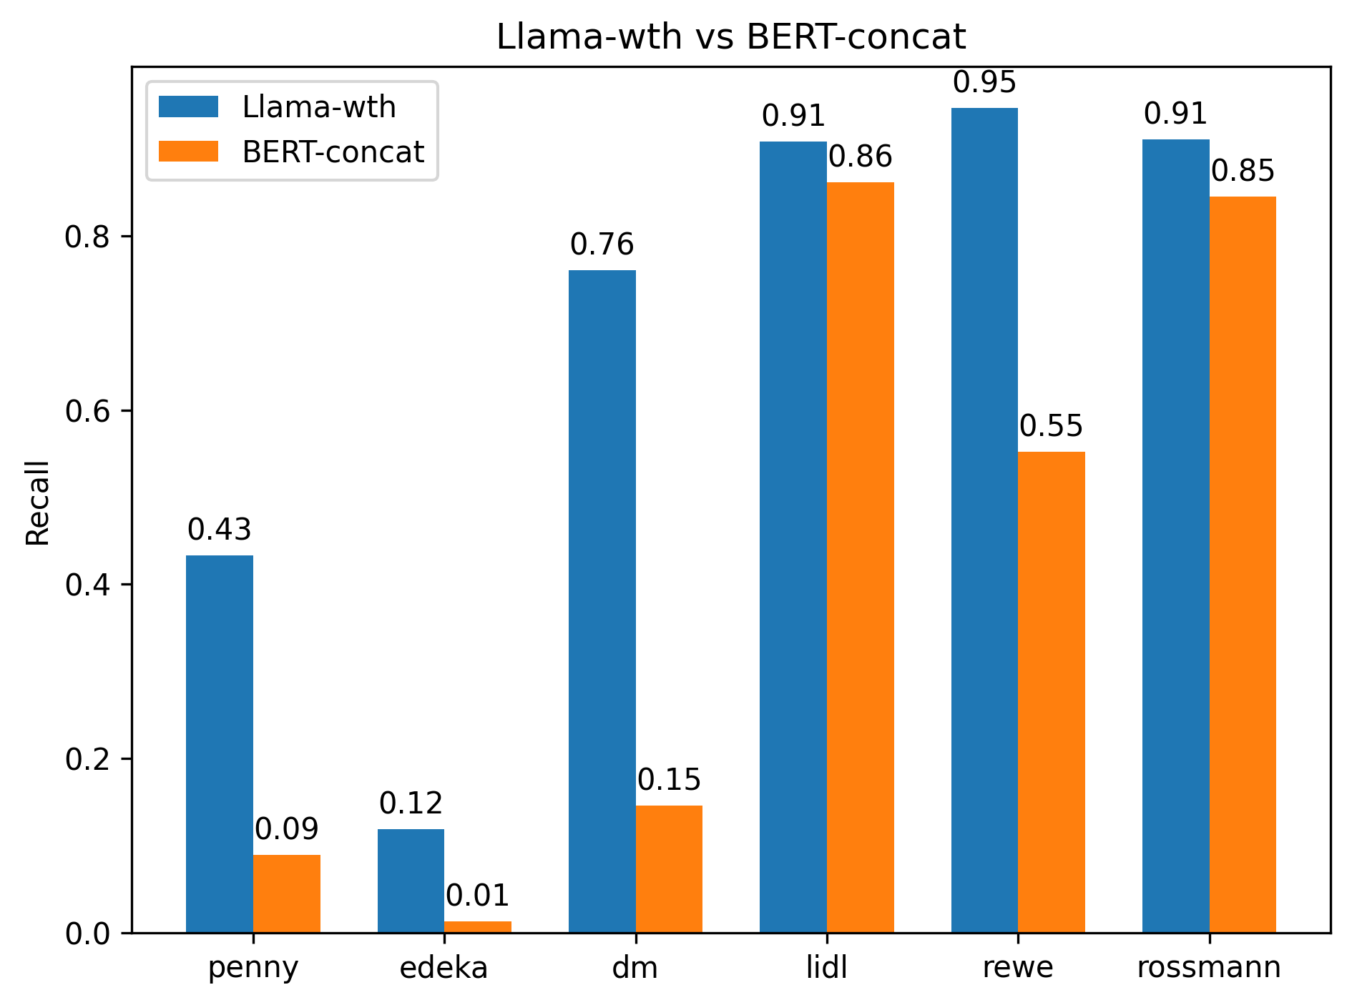
Results
Custom benchmark Different apps present different difficulties for models
LLama - more accurate, but can hallucinate data
BERT - predictable execution times, faster.

Slide 15
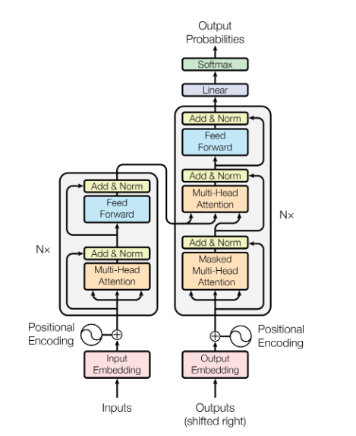
Thank you for your attention
That’s all we needed
Special thanks for Company’s representatives:
Konrad Błaszkiewicz & Maciej Skórski

