Slide 1
Using large language models for
extracting the data from the mobile device screen content.
Bachelor Thesis by:
Szymon Kozłowski, Gustaw Blachowski, Kamil Dybek, Natalia Junkiert
Collaboration with company Murmuras

Slide 2
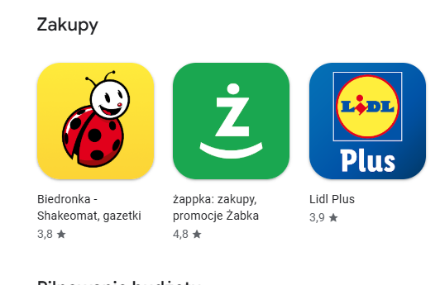
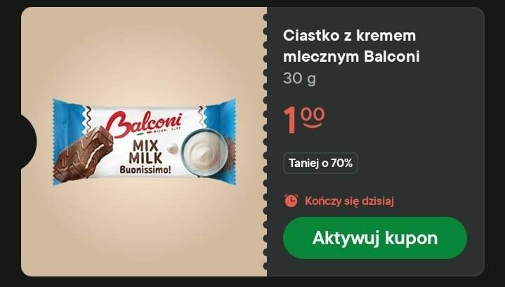
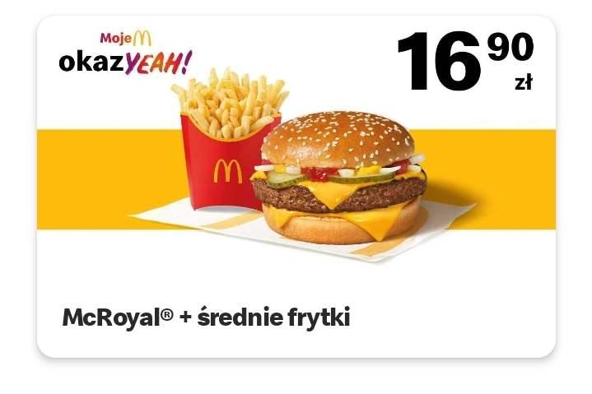
The problem
The case we worked on:
mobile discount coupons
Q: Why not conventional scrapping on phone layout? A: many apps, layout changing often This generalizes to other problems - like scraping social media posts, adverts, etc

Slide 3
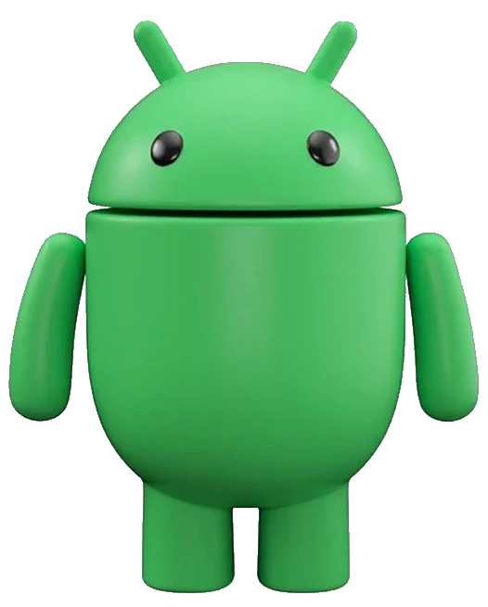
Additional challenge - privacy
We have to process layouts locally
This means limited resources

Slide 4
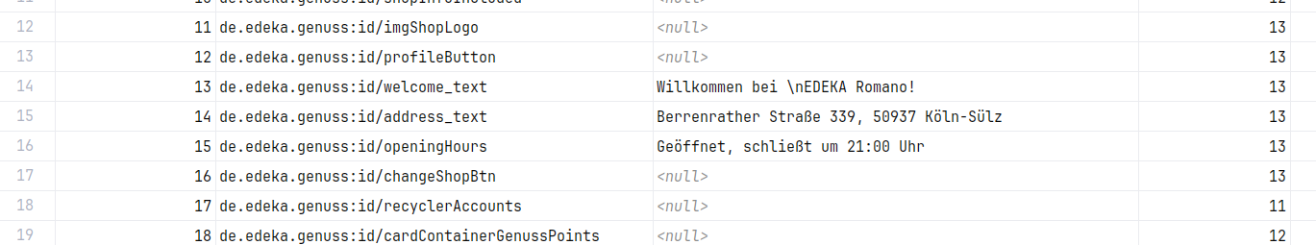
Mobile phone screen dump - the data we work with

Slide 5
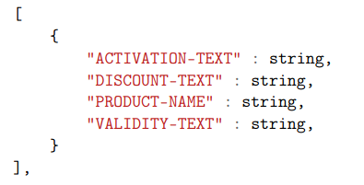
What we want to get?
Discount coupons in a form of JSON list
More General:
Concise summary of the screen contents

Slide 6
Let’s use LLMs!

Slide 7
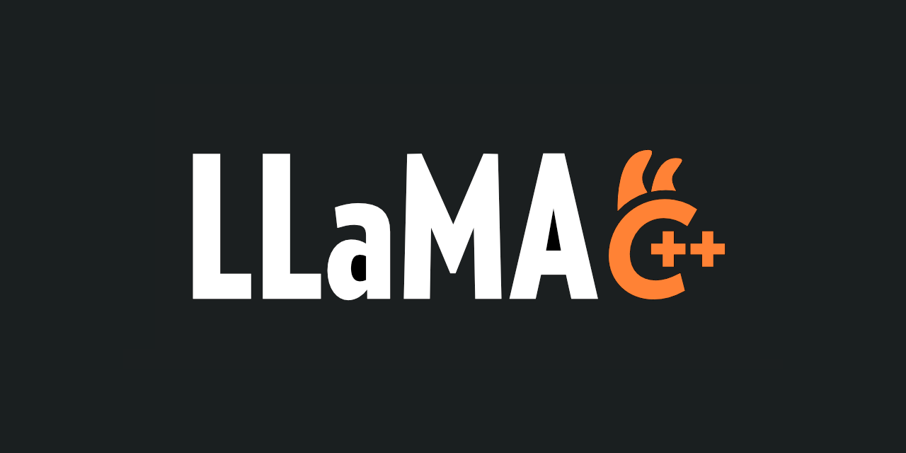

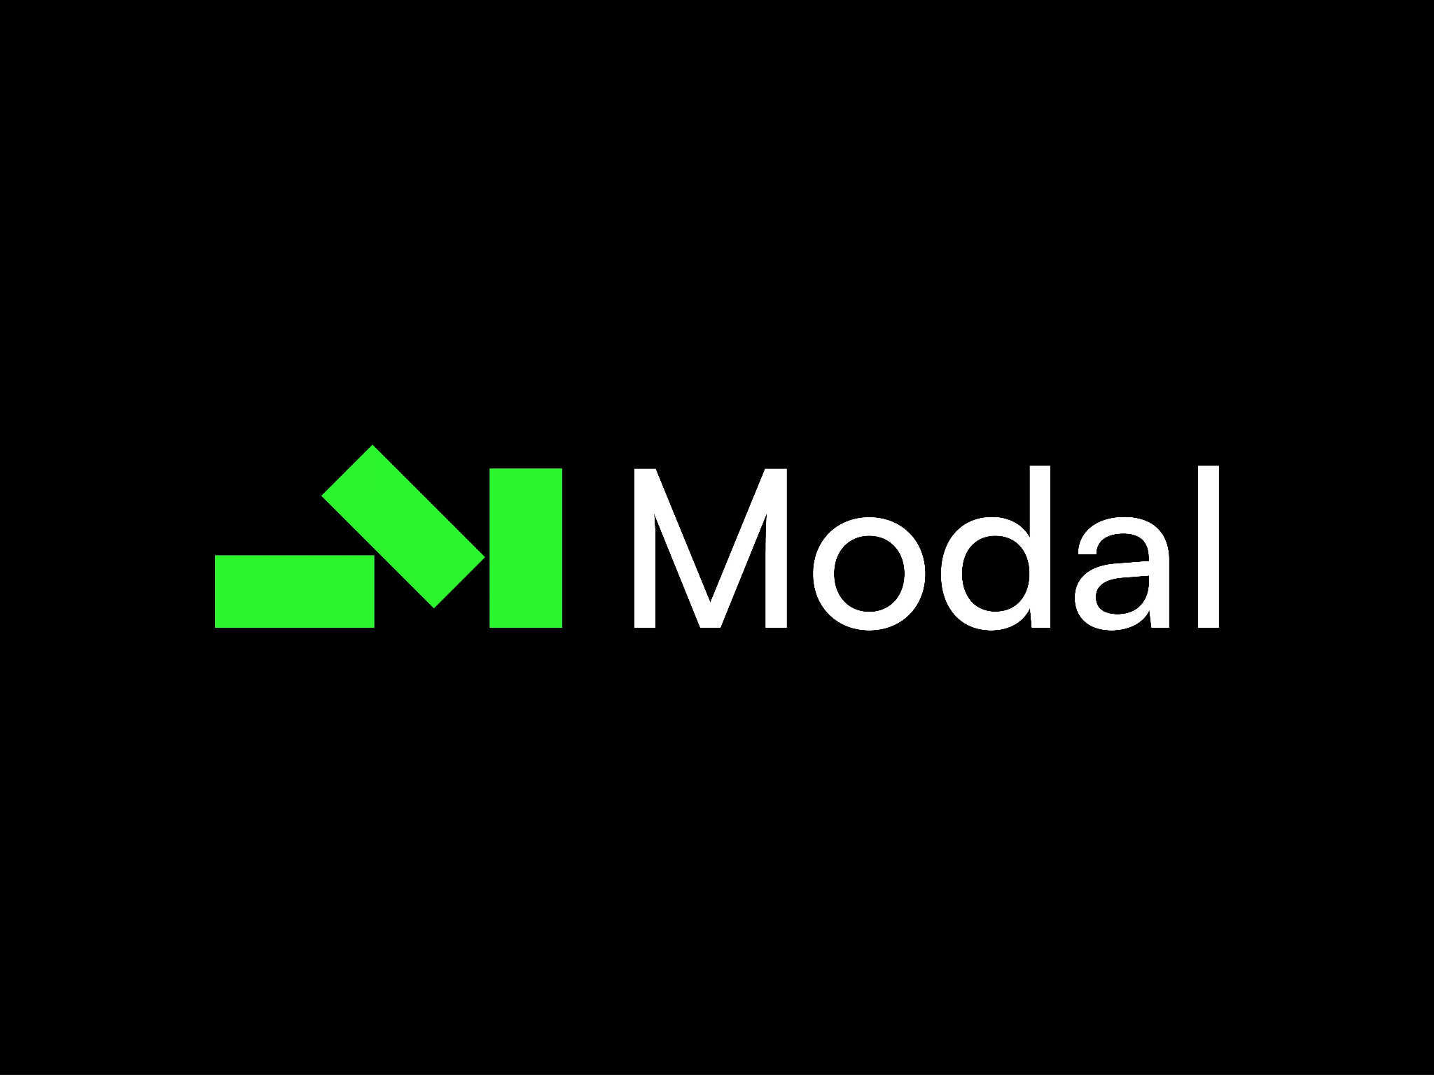
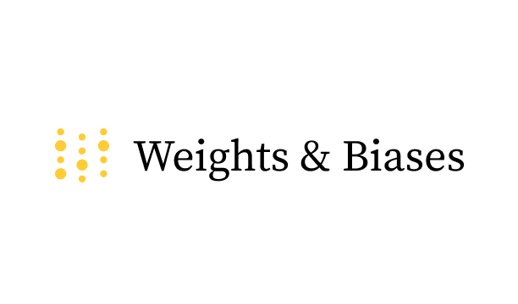


Tech Stack

Slide 8
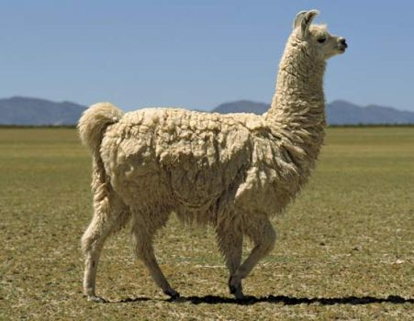
Approach 1: simply prompt it - Llama
We need relatively smart model Further optimizations: Q5 quantizations, Llama.cpp
Llama-3.2
appr. 1 billion params
Fine tuning - Unsloth, Modal, LoRA Our dataset - around 10k samples Single fine tuning ~30min on H100

Slide 9
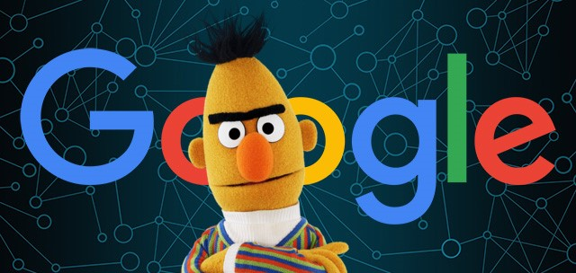
Approach 2: utilize NER
Named Entity Recognition
Powered By BERT - around 150mln params
Two phases:
Select coupon contents
select coupon attributes inside contents
More lightweight

Slide 10
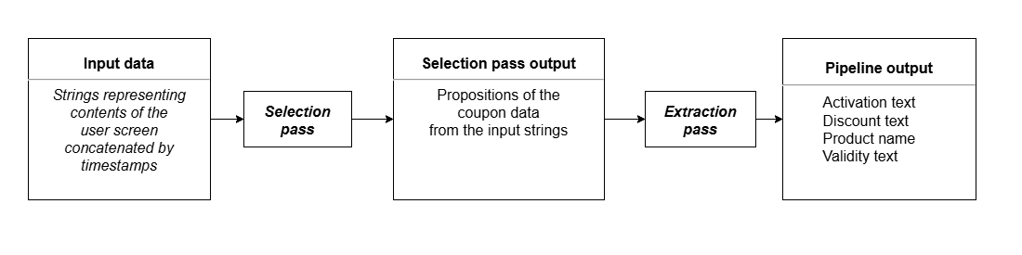
Architecture

Slide 11
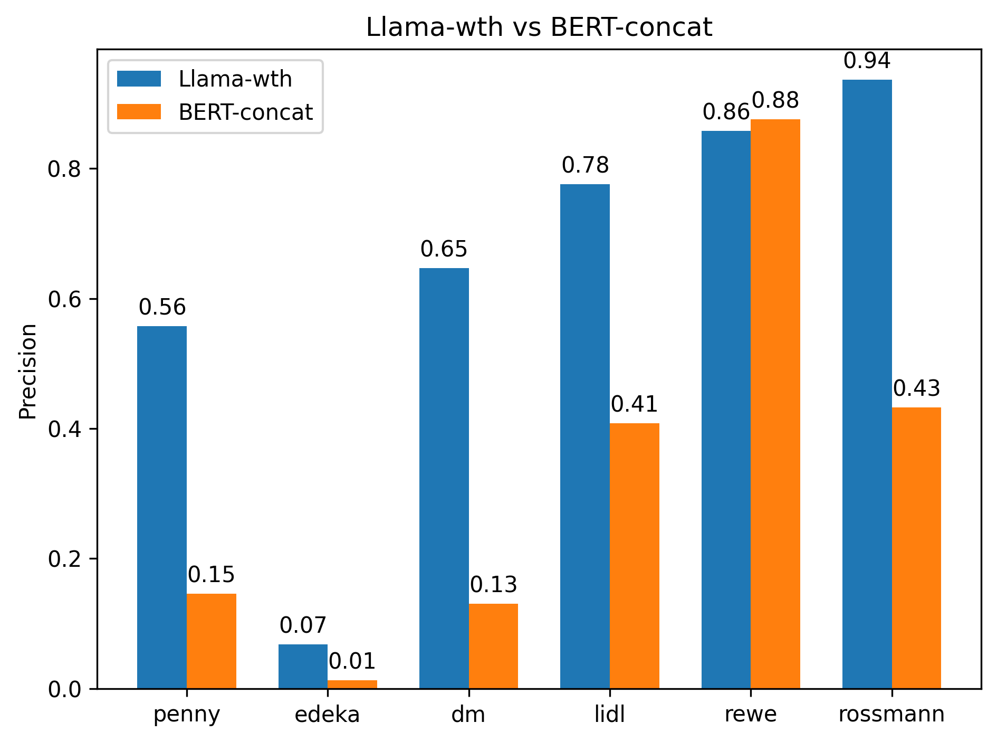
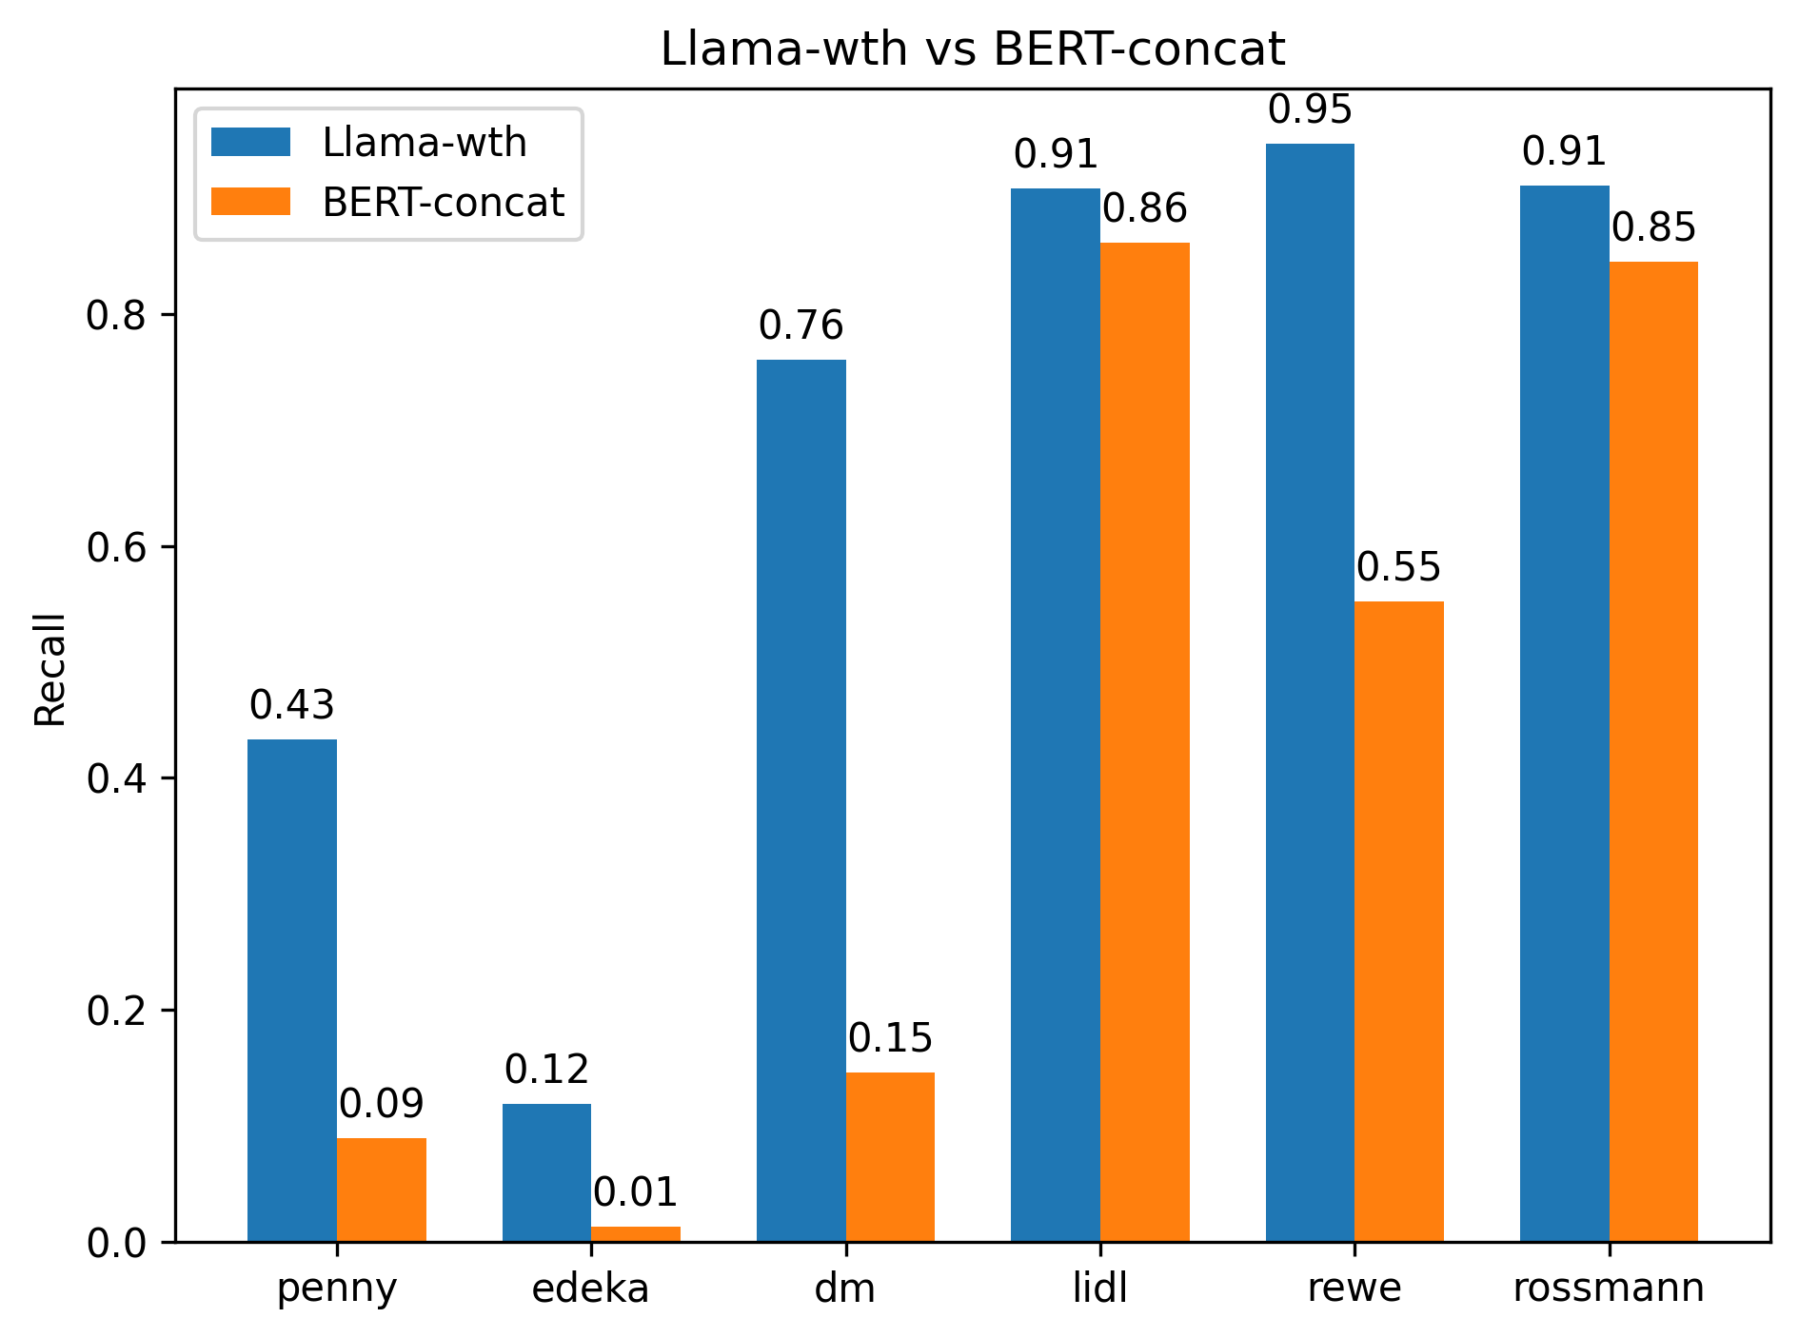
Results
Custom benchmark Different apps present different difficulties for models
LLama - more accurate, but can hallucinate data
BERT - predictable execution times, faster.

Slide 12
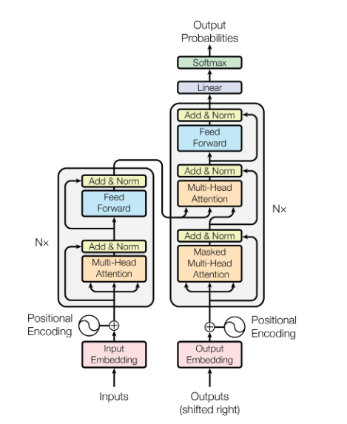
Thank you for your attention
That’s all we needed
Special thanks for Company’s representatives:
Konrad Blaszkiewicz & Maciej Skórski

