Slide 1
Using large language models for
extracting the data from the mobile device screen content.
Bachelor Thesis by:
Szymon Kozłowski, Gustaw Blachowski, Kamil Dybek, Natalia Junkiert
Collaboration with company Murmuras

Slide 2
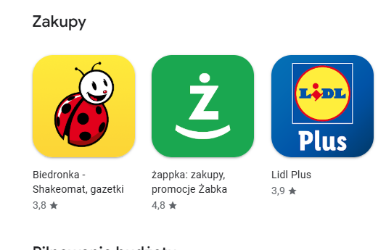
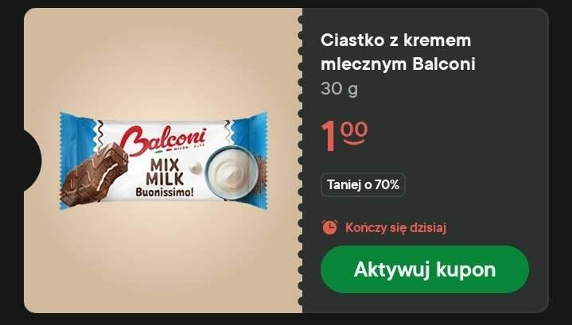
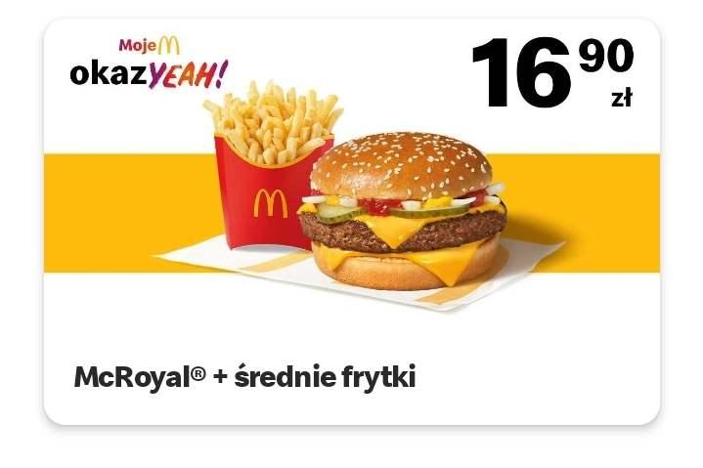
The problem
The case we worked on:
mobile discount coupons
Q: Why not conventional scrapping on phone layout? A: many apps, layout changing often This generalizes to other problems - like scraping social media posts, adverts, etc
Notes:
Q: where data will be stored A: it will be sent to the external server, (server is outside of the scope of our project)

Slide 3
Additional challenge - privacy
We have to process layouts locally
This means limited resources
Notes:
As we get all the screen content it can possibly contain confidential/personal info

Slide 4
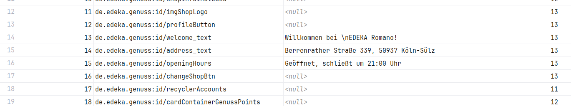
Mobile phone screen dump - the data we work with
Notes:
-obtained via Android Accessibility API
Q: what is the last col?
A: view depth in the XML tree

Slide 5
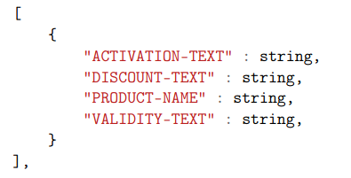
What we want to get?
Discount coupons in a form of JSON list
More General:
Concise summary of the screen contents
Notes:
Q: why not price as numeric value? A: coupons might have nontrivial discounts, like get one free if you have spent at least $xyz on some product group

Slide 6
Let’s use LLMs!
Notes:
Q: how llms guarantee that no private data is considered as coupon and sent to the server? A: It does not xd (idk what to say here)

Slide 7
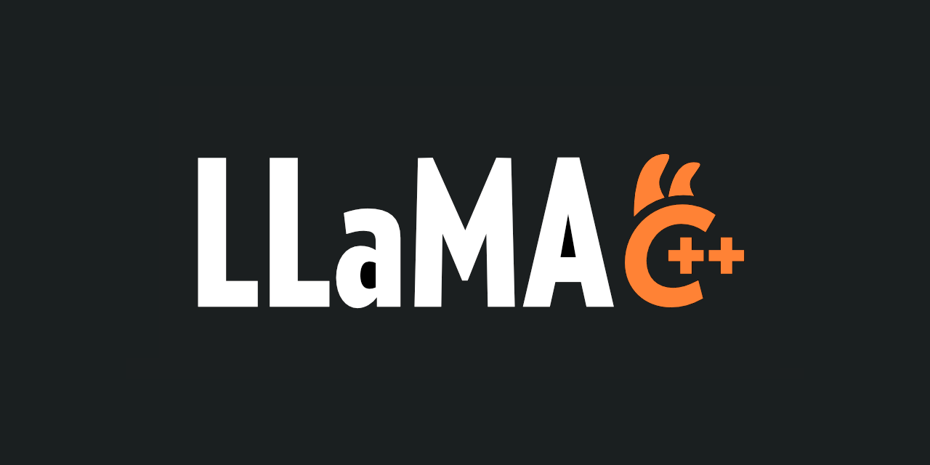


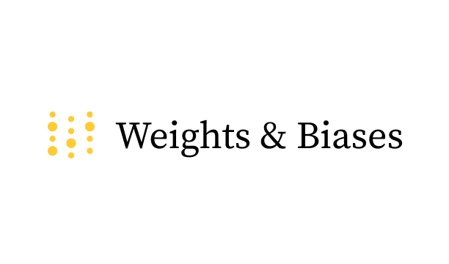


Tech Stack

Slide 8
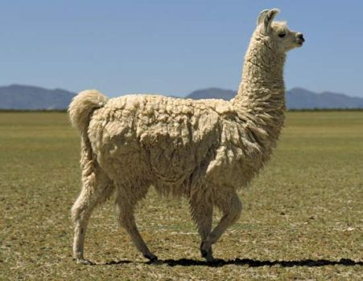
Approach 1: simply prompt it - Llama
We need relatively smart model Further optimizations: Q5 quantizations, Llama.cpp
Llama-3.2
appr. 1 billion params - still too much
Fine tuning - Unsloth, Modal, LoRA Our dataset - around 10k samples Single fine tuning ~30min on H100
Notes:
wpomnieć tu coś o tym że wyzwaniem jest wgl odpalenie takiego modelu na telefonie

Slide 9

Approach 2: utilize NER
Named Entity Recognition
Powered By BERT - around 150mln params
Two phases:
Select coupon contents
select coupon attributes inside contents
More lightweight

Slide 10
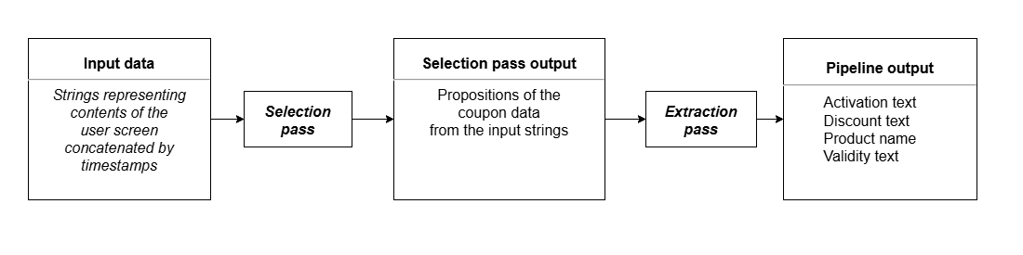
Architecture
Notes:
nie zagłębiać się

Slide 11
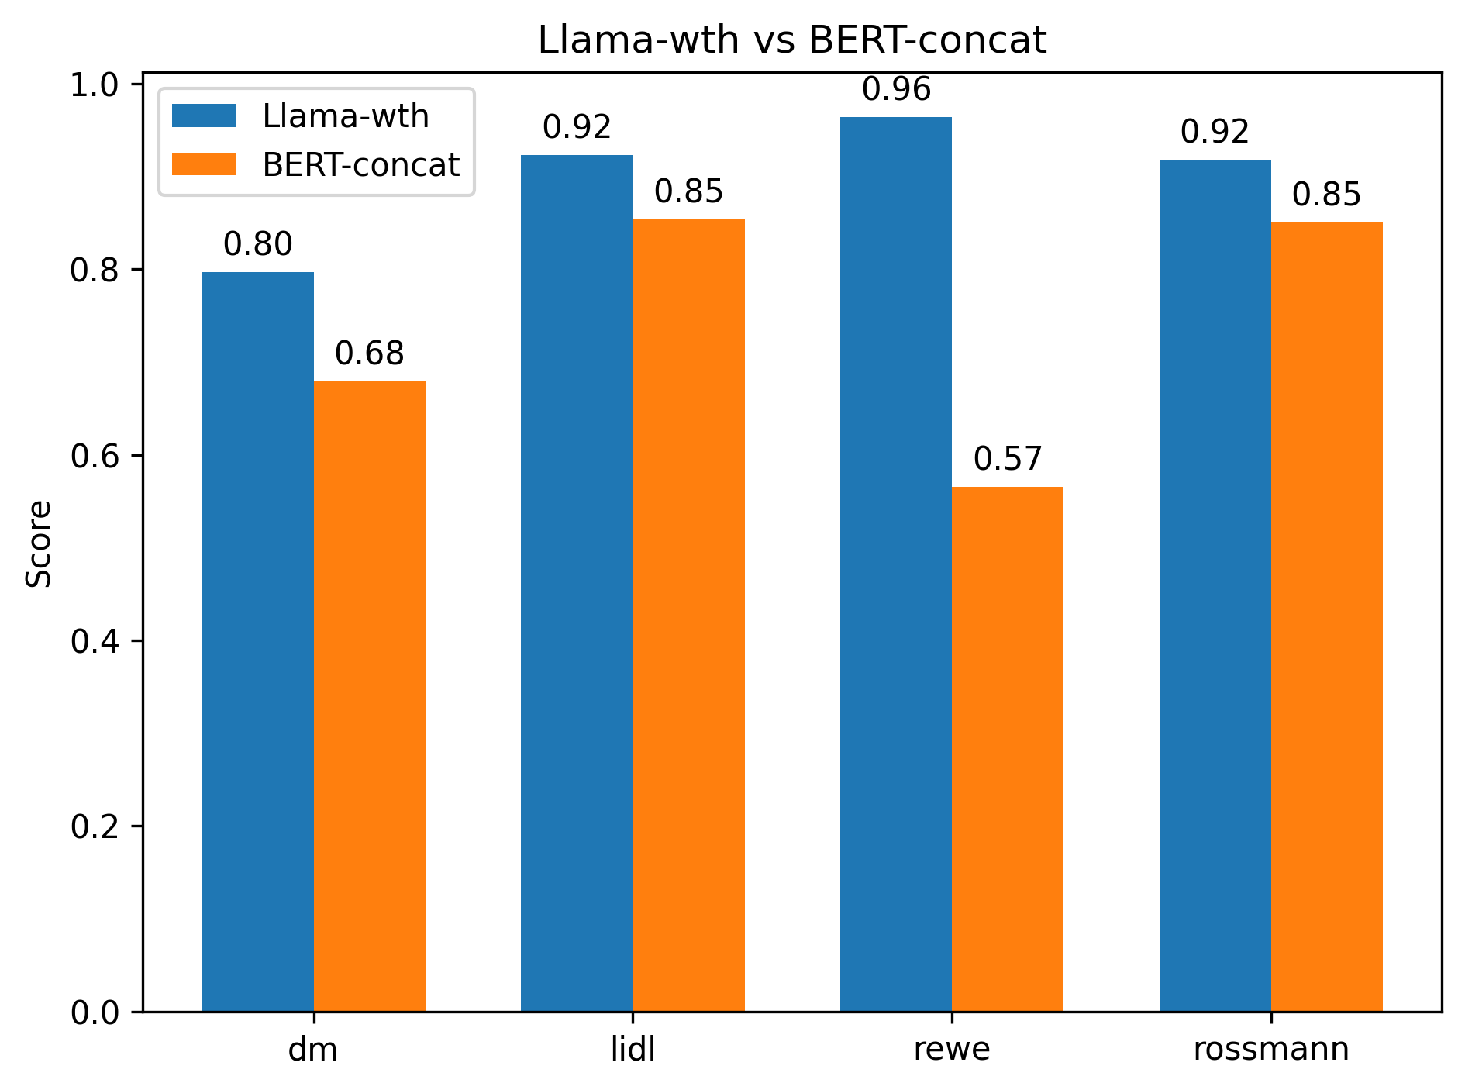
Results
Custom benchmark Different apps present different difficulties for models
LLama - more accurate, but can hallucinate data
BERT - predictable execution times, faster.
Jak Kamil zrobi skrypty do wykresów to bym tutaj dał jakiś, można by wtedy powiedzieć zdanie o nim

Slide 12
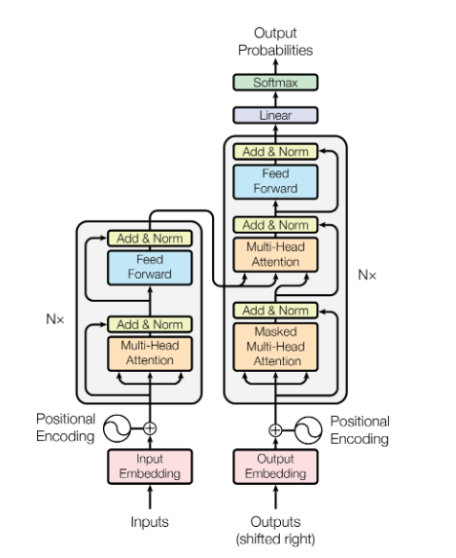
Thank you for your attention
That’s all we needed
Special thanks for Company’s representatives:
Konrad Blaszkiewicz & Maciej Skórski

