Slide 1
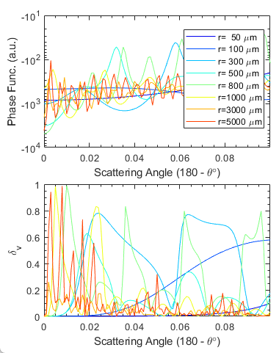
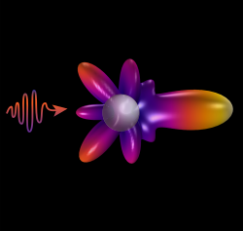
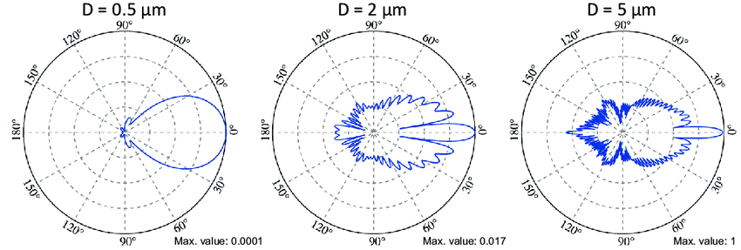
Polarimetry by single water droplet
Scattering by spheric particle (Mie Scattering)
Zoom-in at near-backscatter angles
Very complex structure at near-backscatter angles
Strong depol. component with high sensitivity to particle size and scattering angles
incident wavelength = 473 nm

Slide 2
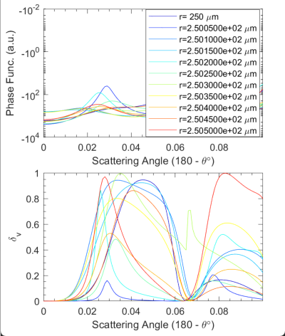
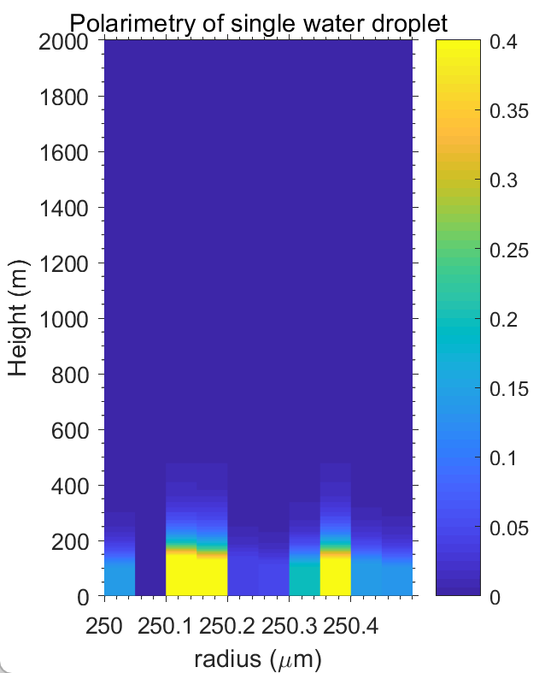
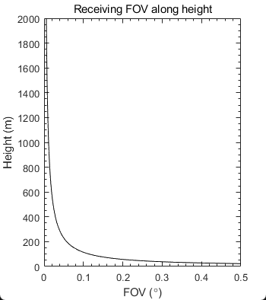
Polarimetry by single water droplet
Lidar receiving geometry with height
assume rain droplet with the same size
r=250 um
depolarization ratio
@ 355 nm
droplet
FOV
δ_{v}
telescope
D=200 mm
δ_{v} enhancement at lower height
peak value of δ_{v} fluctuates with particle size
peak value height not sensitive to particle size
Mind the constrain of field of view of the telescope

Slide 3
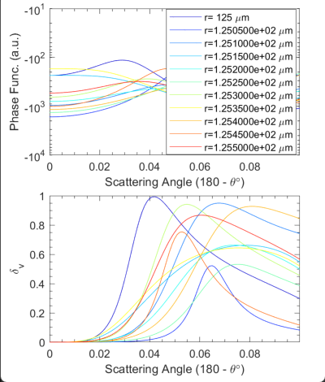
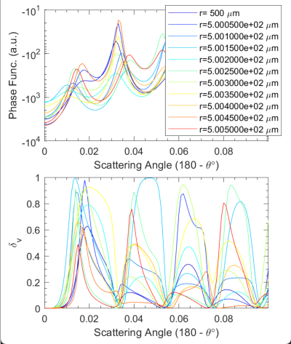
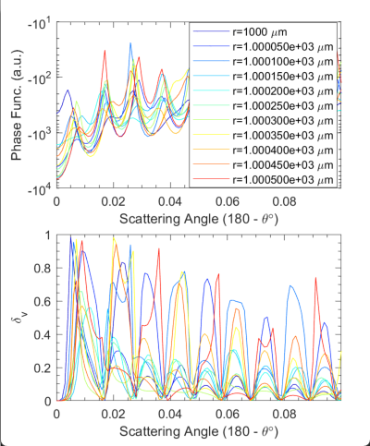
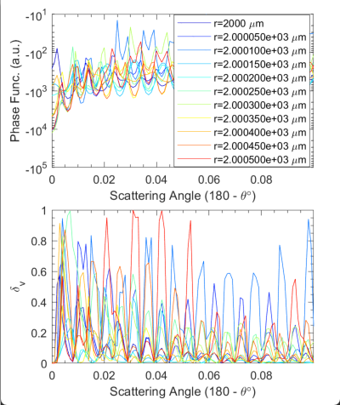
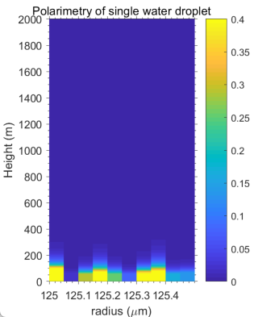
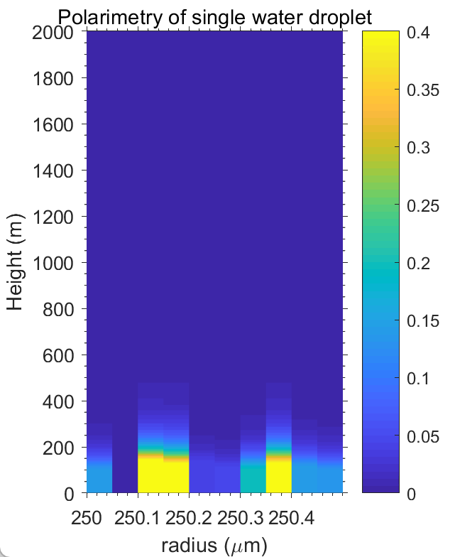
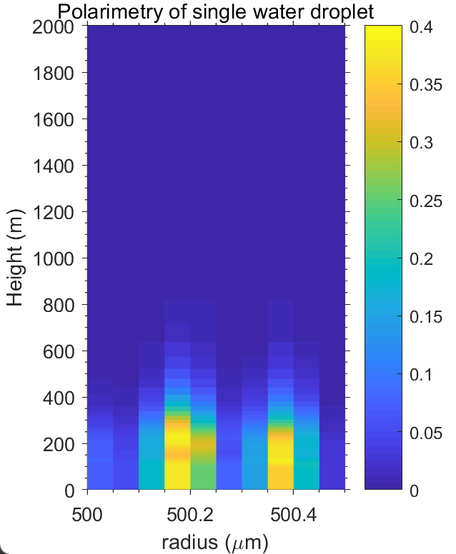
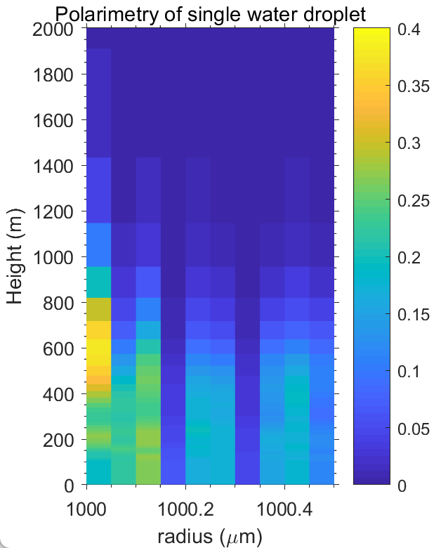
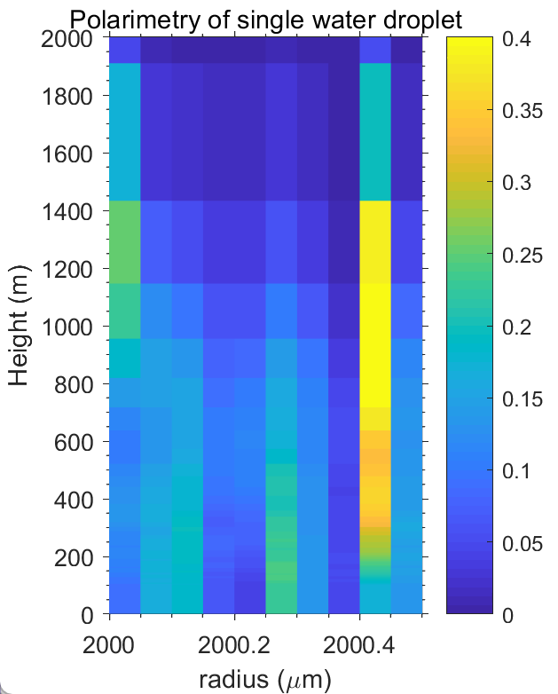
r=125 um
r=250 um
r=500 um
r=1000 um
r=2000 um

Slide 4
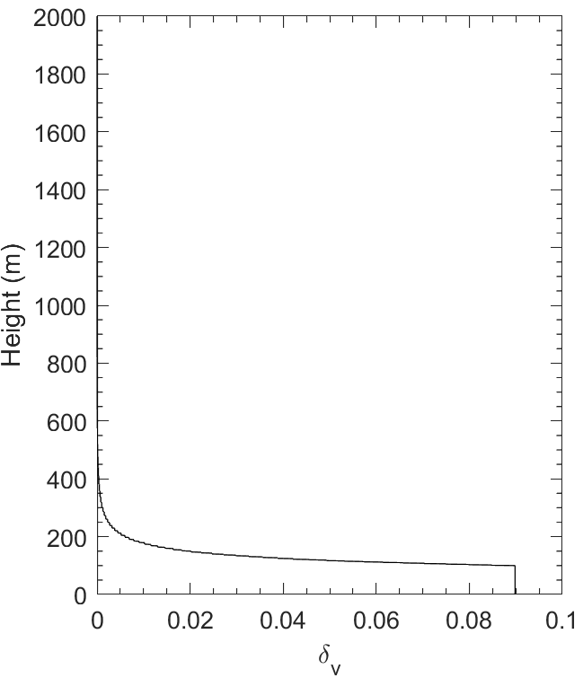
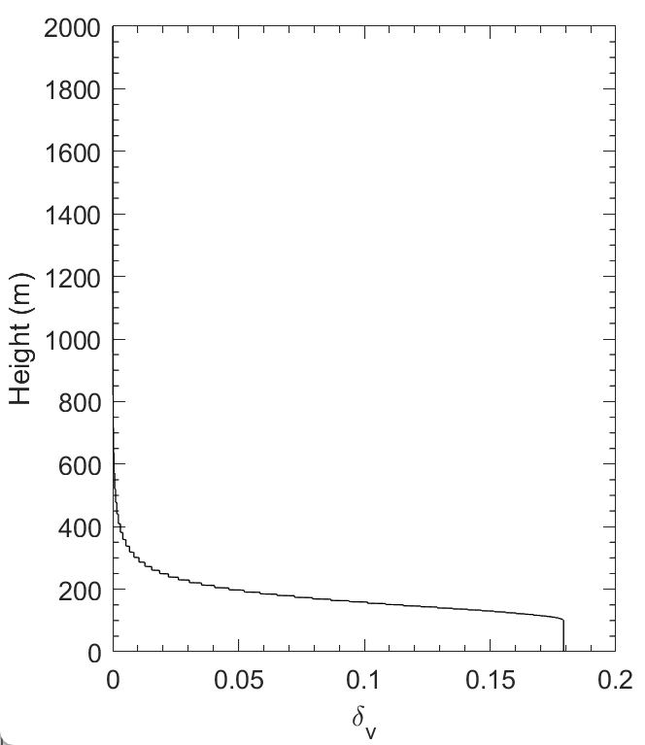
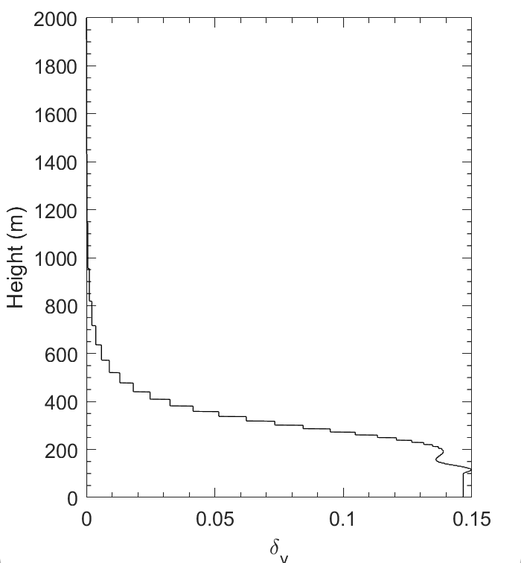
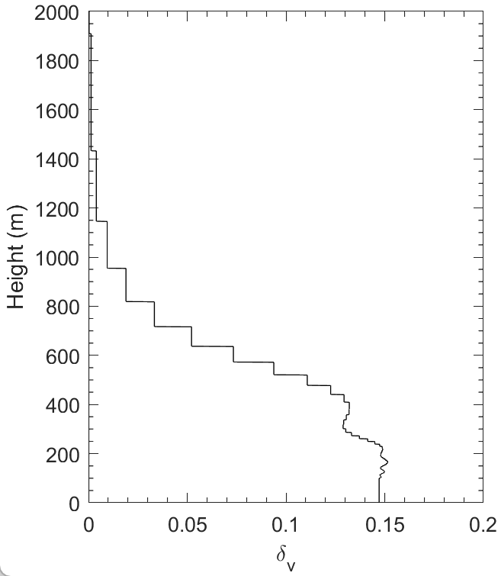
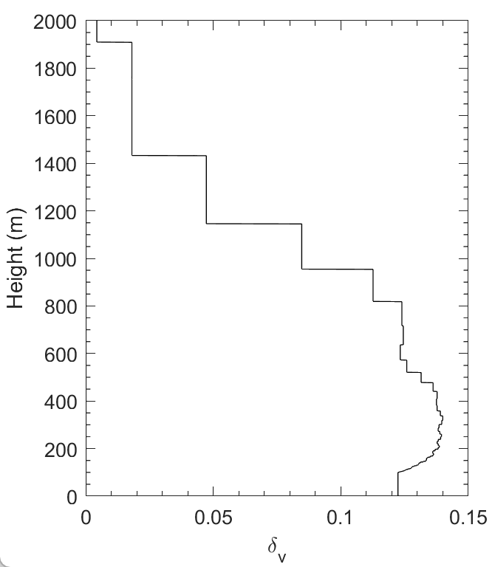
r=125 um
r=250 um
r=500 um
r=1000 um
r=2000 um

Slide 5
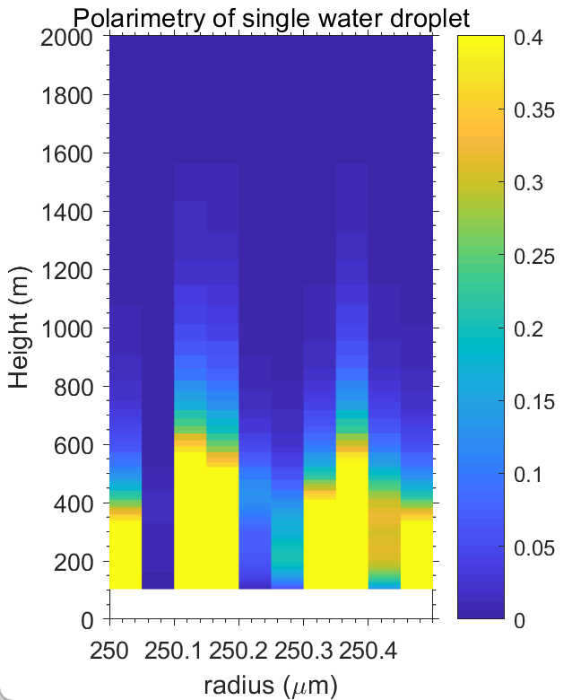
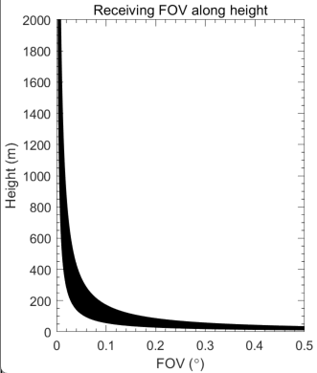
Polarimetry by single water droplet
r=250 um
Lidar receiving geometry with height
axial
biaxial
droplet
depolarization ratio
@ 355 nm
biaxial
FOV
δ_{v}
telescope
D=200 mm
δ_{v} enhancement at lower height
peak value of δ_{v} fluctuates with particle size
peak value height not sensitive to particle size
Assume distance = 200 mm
Mind the constrain of field of view of the telescope

Slide 6
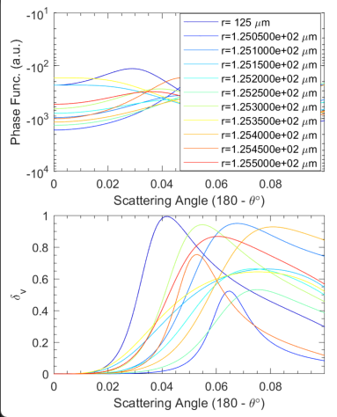
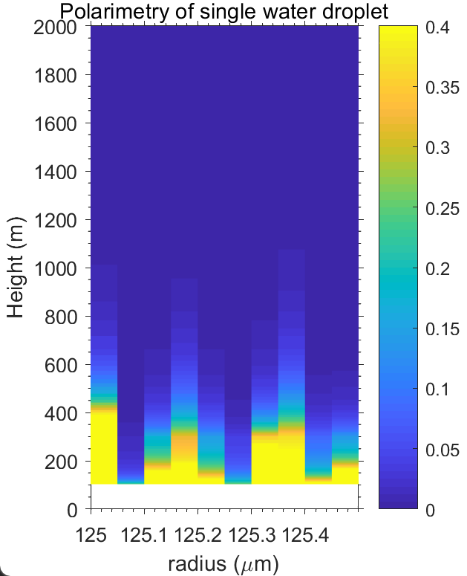
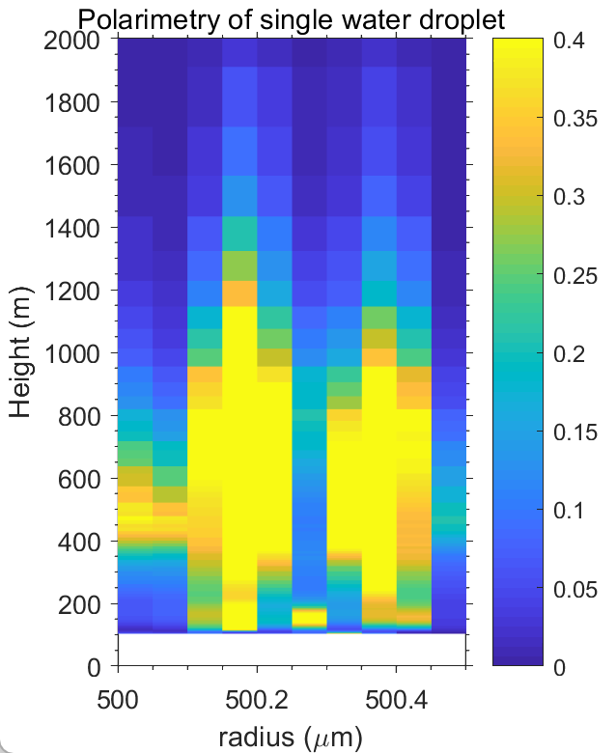
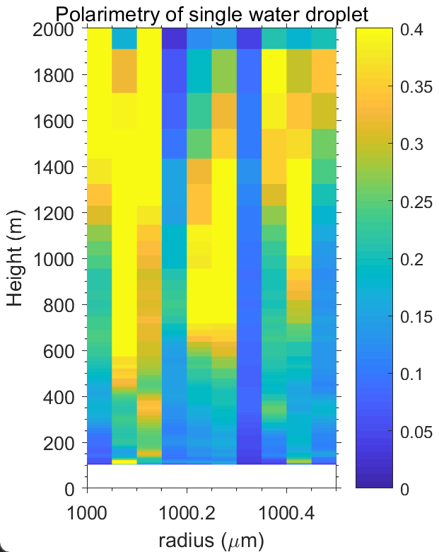
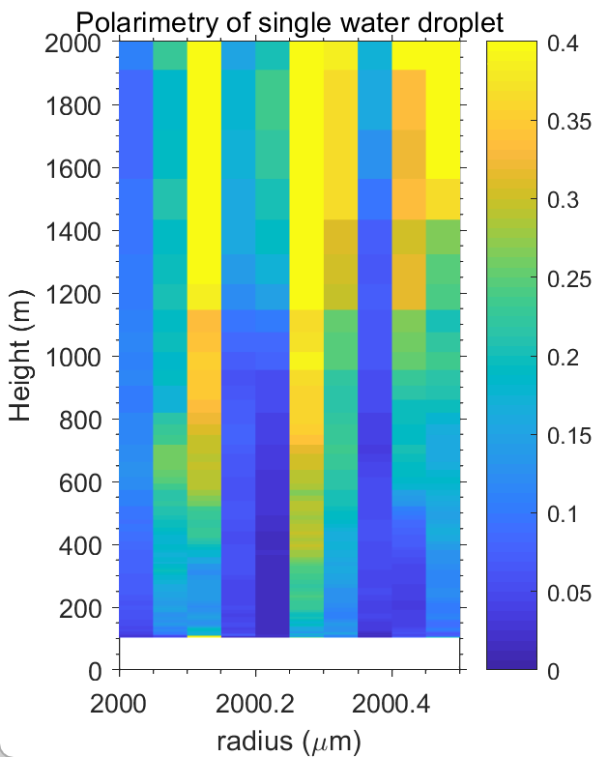
r=125 um
r=250 um
r=500 um
r=1000 um
r=2000 um

Slide 7
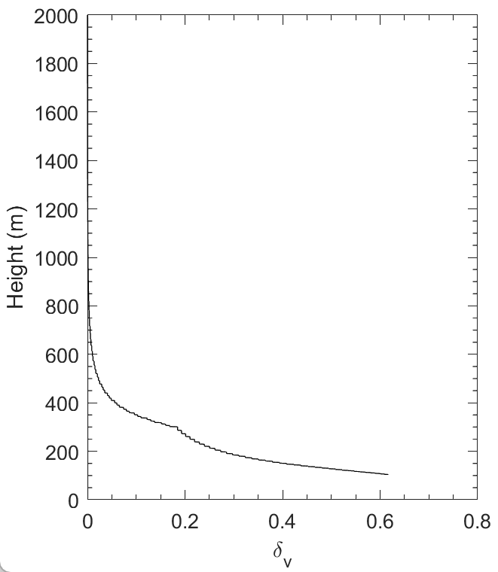
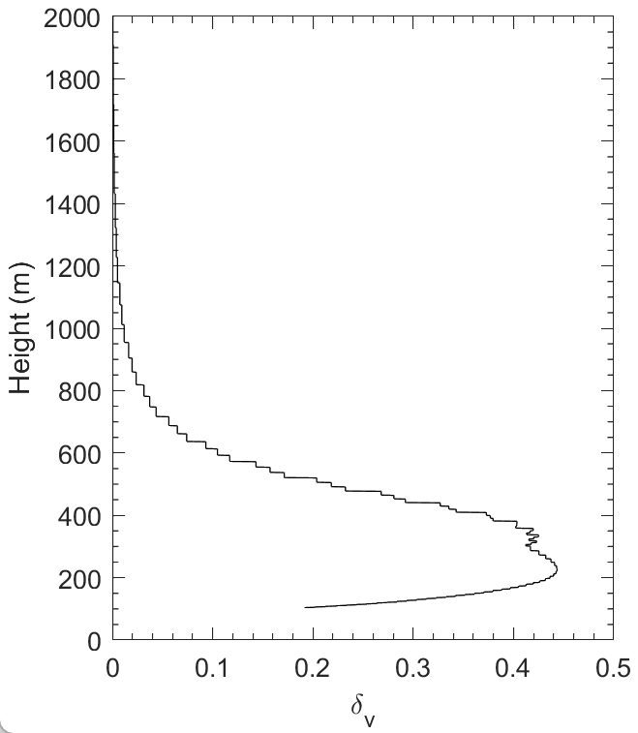
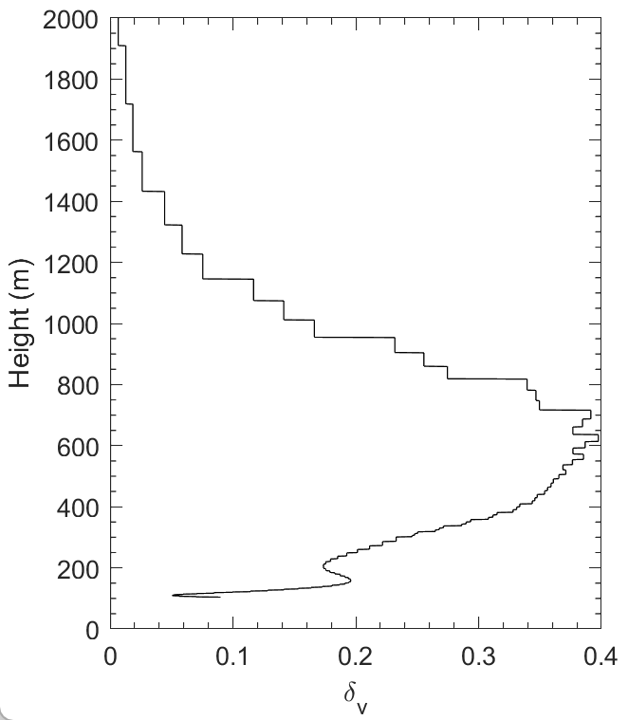
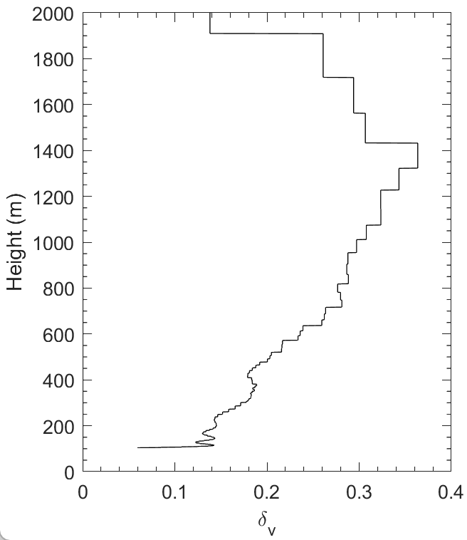
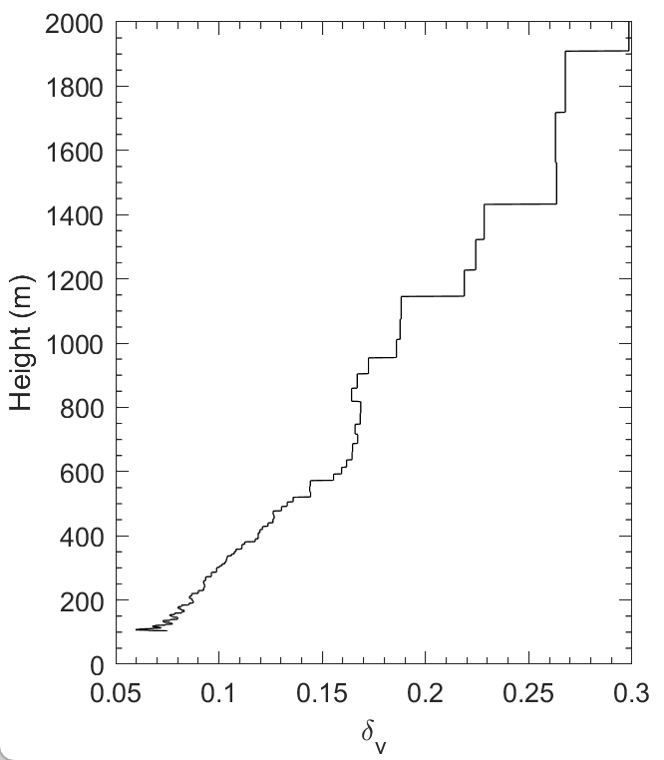
r=125 um
r=250 um
r=500 um
r=1000 um
r=2000 um

Slide 8
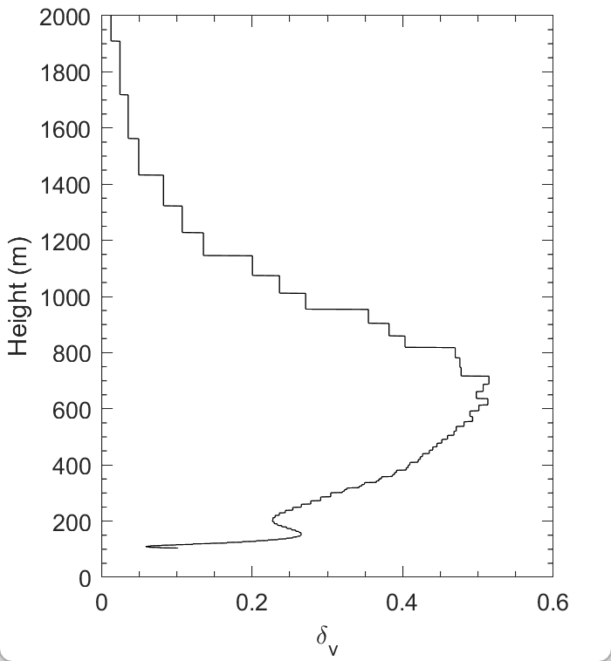
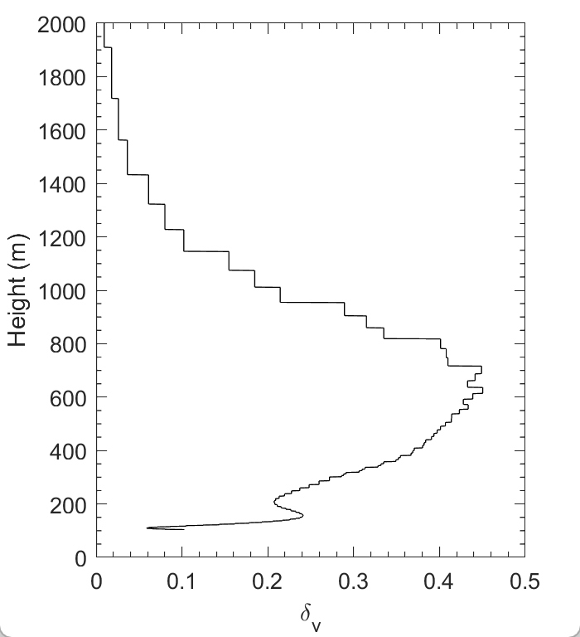
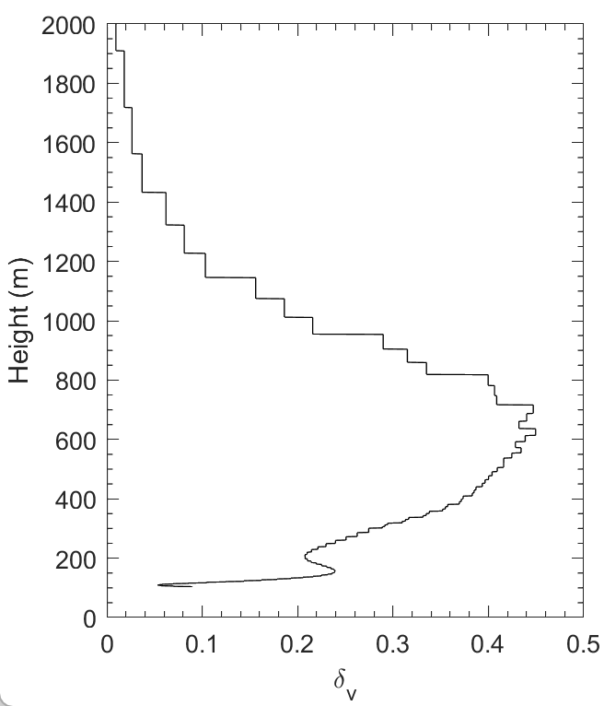
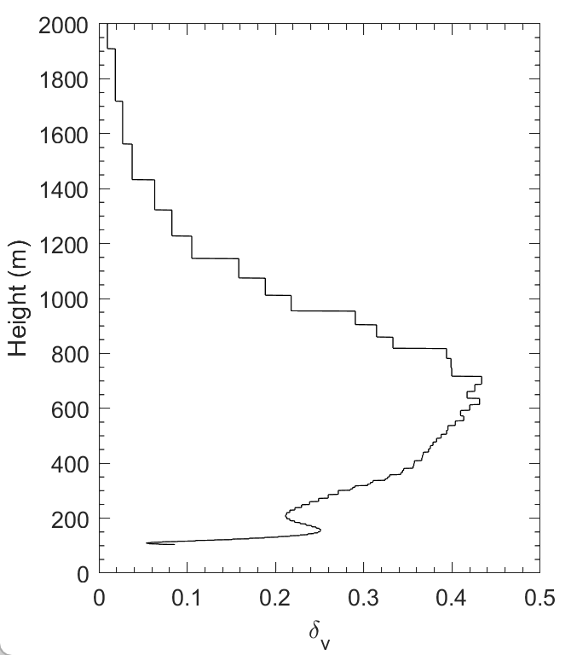
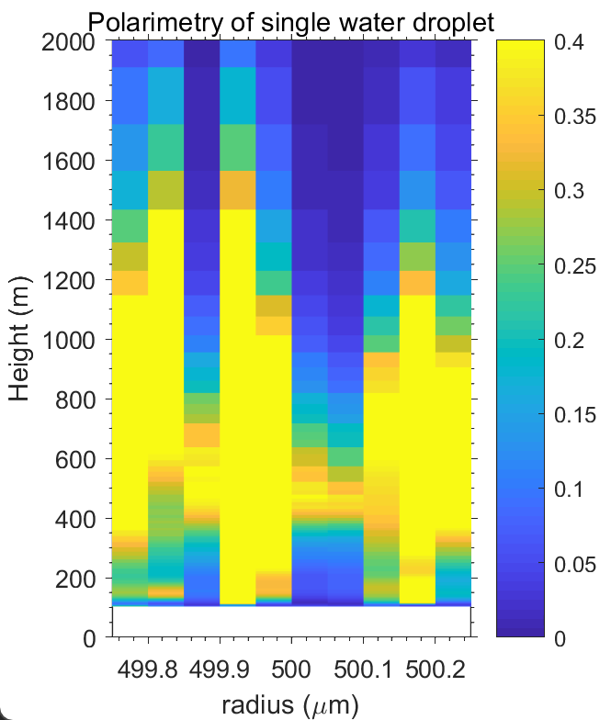
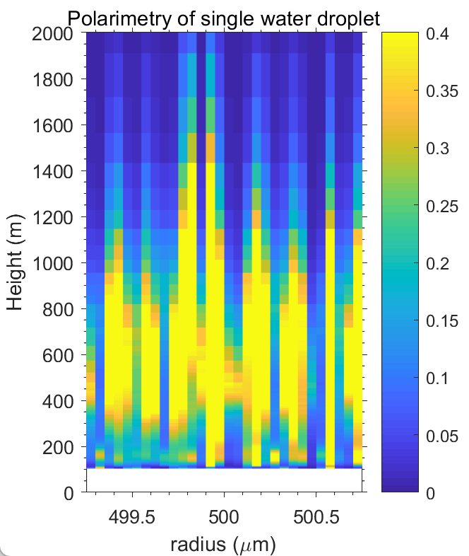
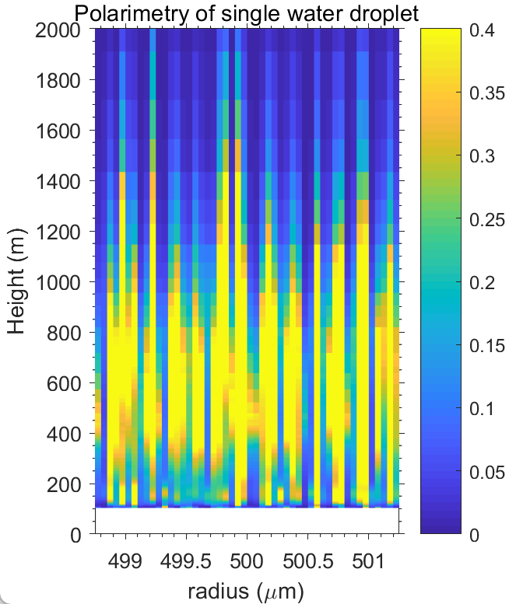
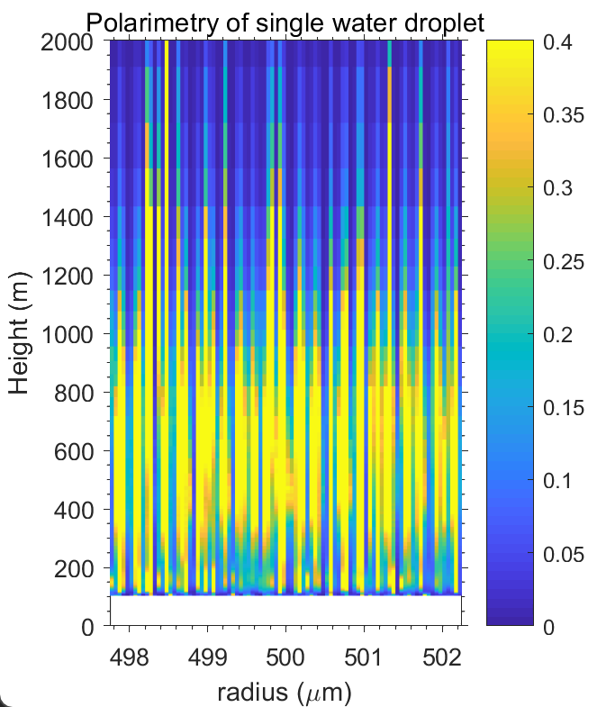
Polarimetry by water droplets with similar size distribution
999.5-1000.5 um
998.5-1001.5 um
997.5-1002.5 um
995.5-1004.5 um

Slide 9
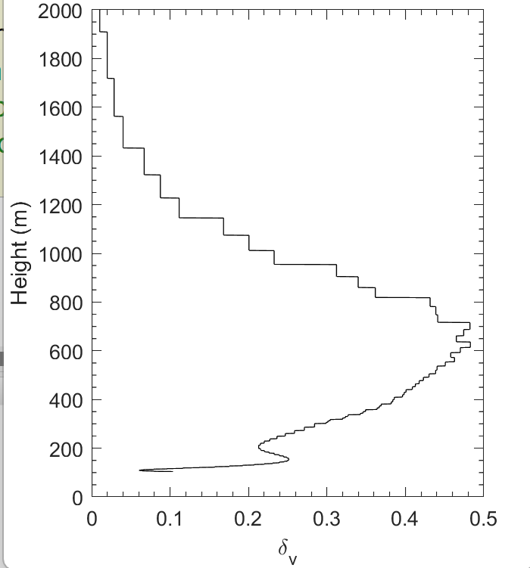
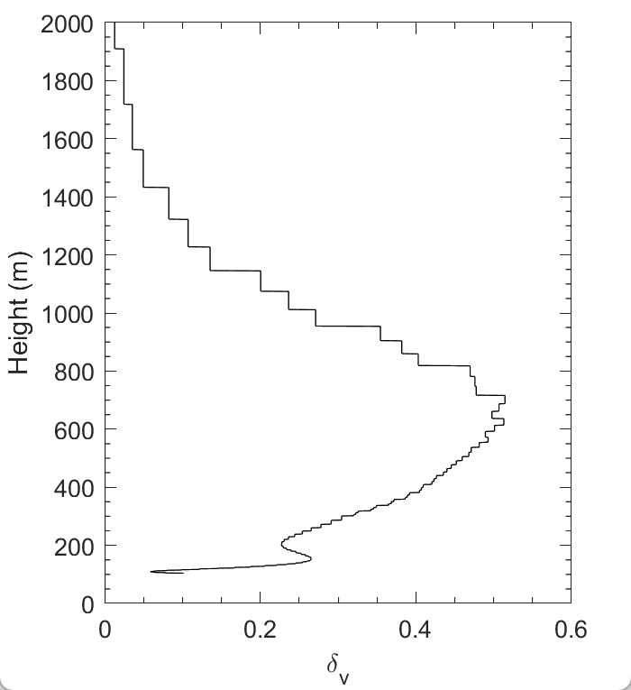

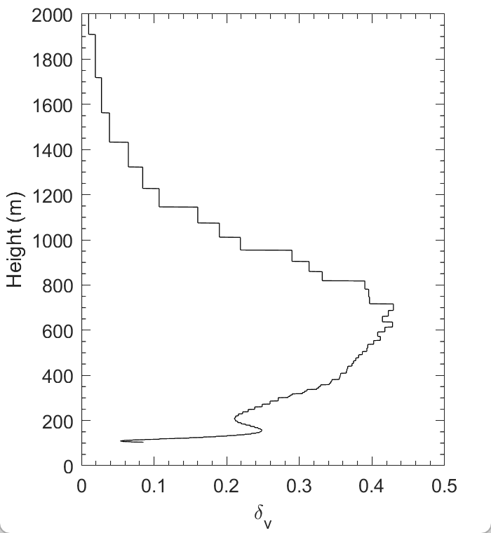
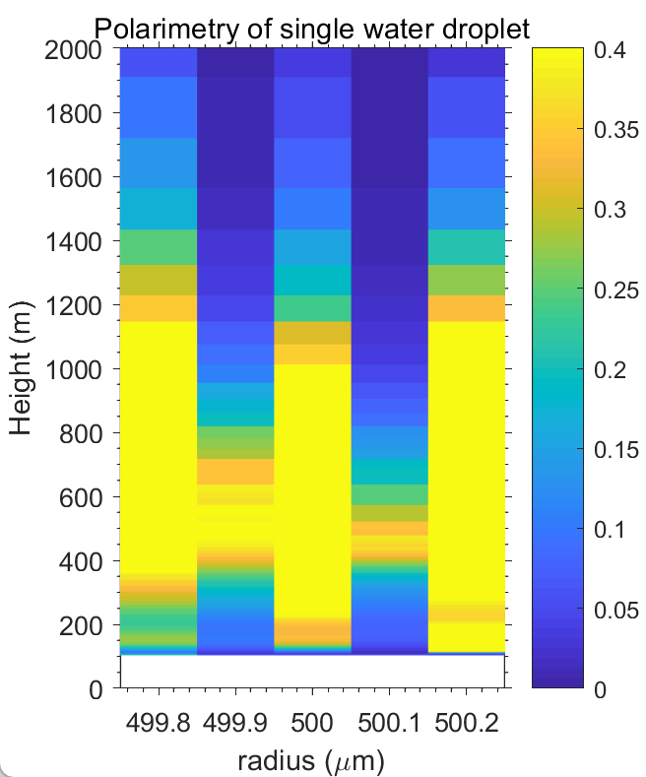
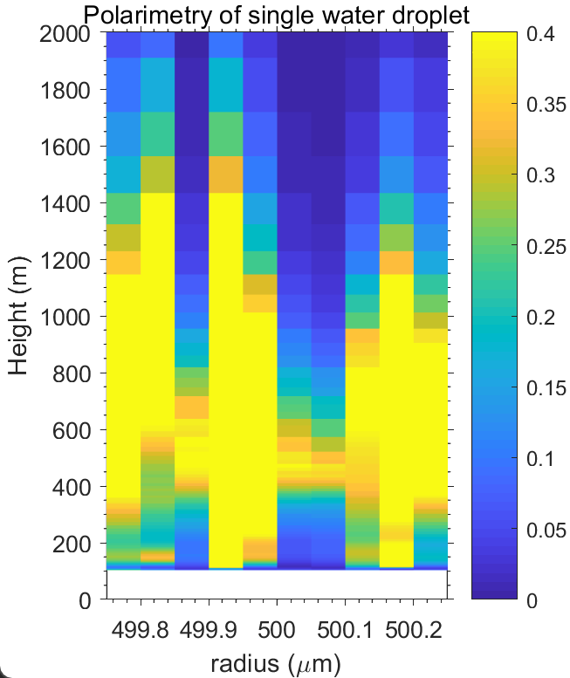
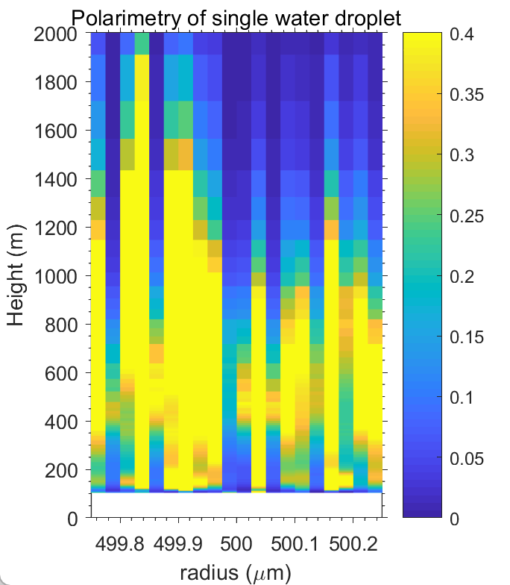
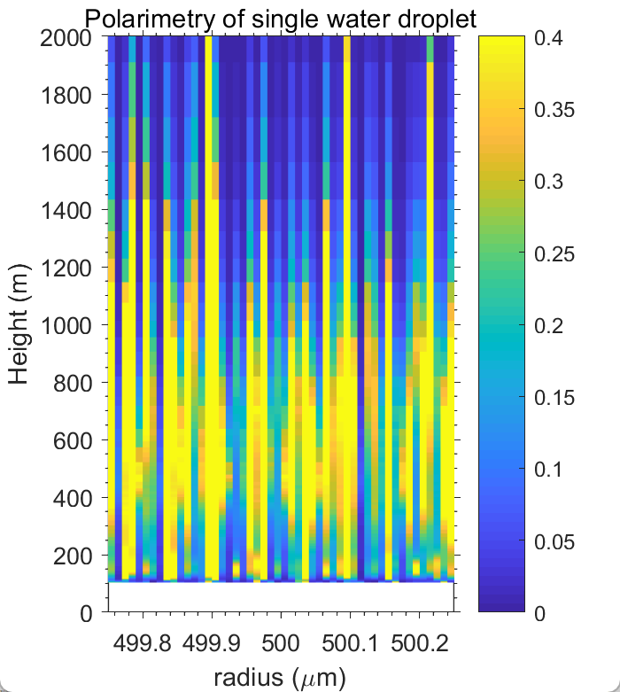
Polarimetry by water droplets with similar size distribution
999.5:0.2:1000.5 um
999.5:0.1:1000.5 um
999.5:0.05:1000.5 um
999.5:0.02:1000.5 um

Slide 10
Polarimetry by water droplets with similar size distribution
355 um
250:0.1:251 um
500:0.1:501 um
1000:0.1:1001 um
2000:0.1:2001 um

Slide 11
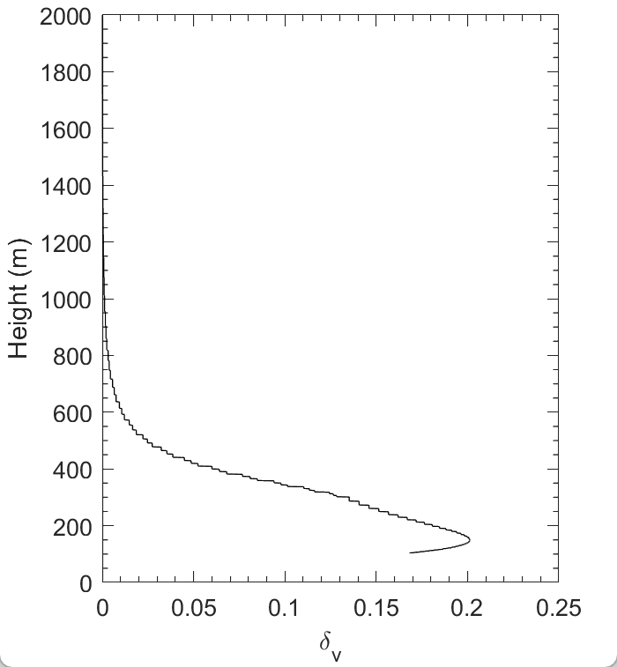
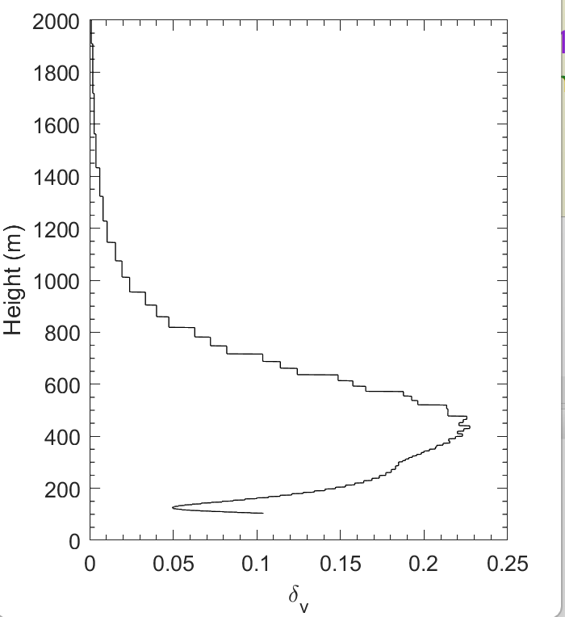
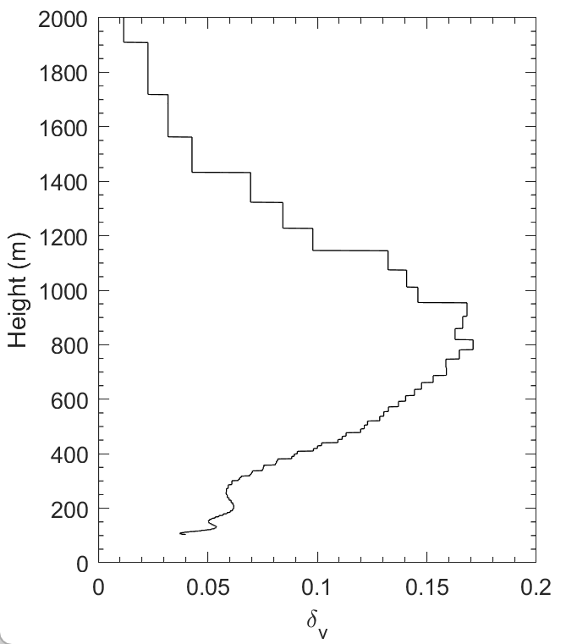





Polarimetry by water droplets with similar size distribution
532 um
250:0.1:251 um
500:0.1:501 um
1000:0.1:1001 um
2000:0.1:2001 um

Slide 12



Wavelength Dependent Polarimetry
355 nm
200 mm telescope
200 mm distance
Height
532 nm
300 mm telescope
250 mm distance
Height

Slide 13


Scattering by water droplets at VIS band
Backscatter Efficiency
Extinction Efficiency
Lolli, S.; Welton, E.J.; Campbell, J.R. Evaluating Light Rain Drop Size Estimates from Multiwavelength Micropulse Lidar Network Profiling. Journal of Atmospheric and Oceanic Technology 2013, 30, 2798-2807, doi:https://doi.org/10.1175/JTECH-D-13-00062.1.

Slide 14




Polarimetry by polydisperse water droplets
simulation
observation at Wuhan 2020-06-02
biaxial
axial
二阶和三阶矩

Slide 15


Polarimetry by polydisperse water droplets
observation at Wuhan 2020-06-02
17:00-17:05

Slide 16

Polarimetry by polydisperse water droplets
observation at Wuhan 2020-06-02
scattering by drizzles along height
depolarization along height

Slide 17



Backup
整体MRR反演结果跟Disdrometer一致
MRR小粒径雨滴偏多
MRR大粒径偏少

Slide 18


Mie Scattering Code Validation

Slide 19
Mie Scattering Code Validation

Slide 20





Validation of Mie Scattering Code
(O’Connor. et al, 2005)

Slide 21




Impacts of small droplets
With measured small droplets
With more small droplets
小雨滴影响较小，小雨滴在低空的退偏信号峰值主要在300米以下，对500-700退偏峰值贡献小

