Slide 1
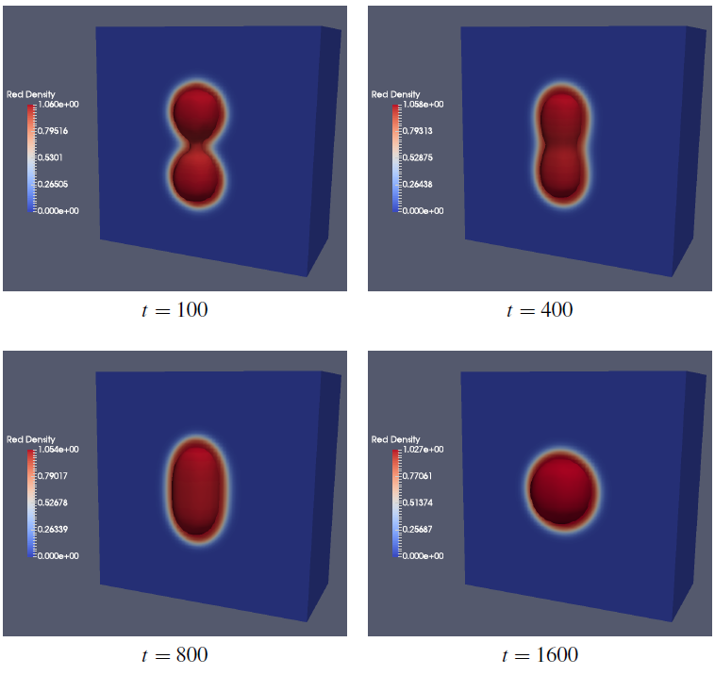
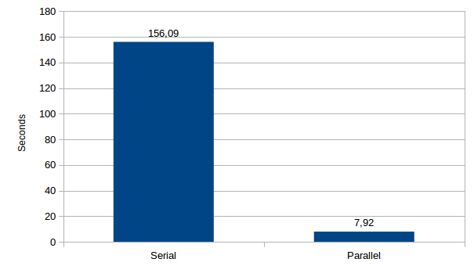
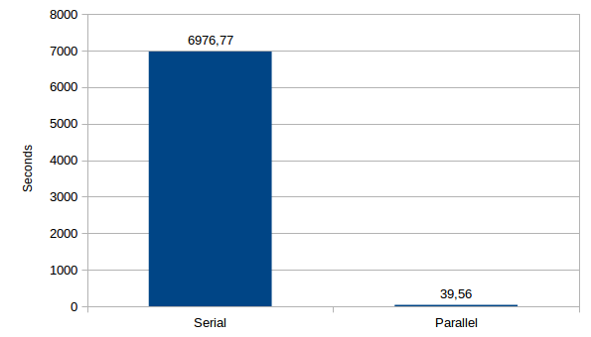
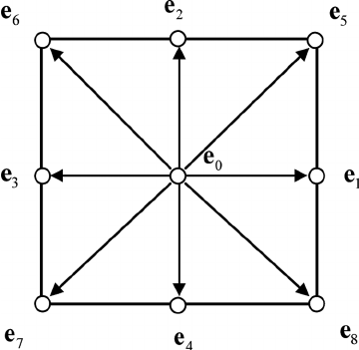
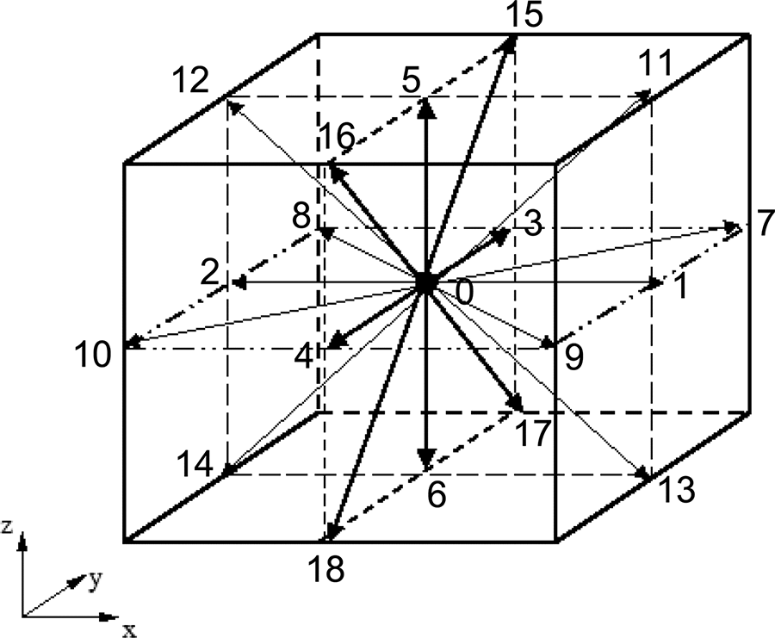
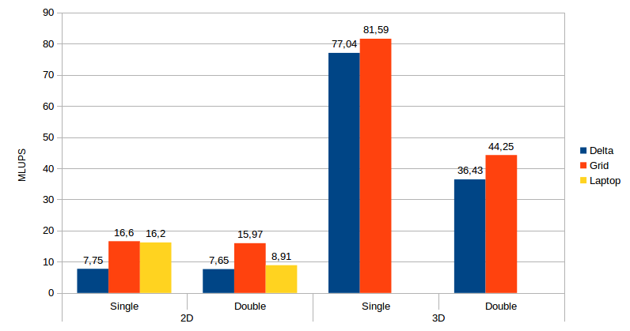
Centre for Computational Engineering Sciences
MULTIPHASE IMPLEMENTATION ON A PARALLEL 2D/3D LATTICE BOLTZMANN SOLVER USING GPGPUS
Aim & Objectives
Results
The Lattice Boltzmann method is a CFD, mesoscopic approach capable of simulating fluid flows. Multiphase flows present themselves as one of the main focus of the LBM’s research areas. With them, it is possible to represent the flow of materials in different states.
These simulations tend to be very complex and time consuming, and so, implementations of these models tend to use parallel computing to provide a better performance. This solver will be based on CUDA, which is a novel platform developed by NVIDIA targeting GPUs.
This project aims to implement Multiphase capabilities into the existing in-house LBM solver, both in 2D and 3D.
3D validation of the coalescence case using 128 sized mesh
Research
2D Run-time comparison between
serial and parallel code in Delta
3D Run-time comparison between
serial and parallel code in Delta
D2Q9
D3Q19
The Multiphase implementation was based on the Color Gradient model. This model was adapted into LBM solver following the respective speed model for each direction.
Each fluid must be taken into account and independent distribution functions are needed.
To include the new capabilities in the solver, 2 operators were added into the collision step: the perturbation and recoloring step. All other sub-steps were updated to take both fluids into account.
Performance comparison between 2D and 3D model
Conclusions
The Multiphase implementation using the Color Gradient model was successfully validated both in 2D and 3D.
The 2D and 3D version had an increase of 20 and 176 times in performance when compared with the serial version.
The final parallel performance was increased in 18% when compared with the initial version
Author: José Paulo Santos Oliveira
Supervisor: Dr. Irene Moulitsas
Jose.s.oliveira@cranfield.ac.uk

