Slide 1
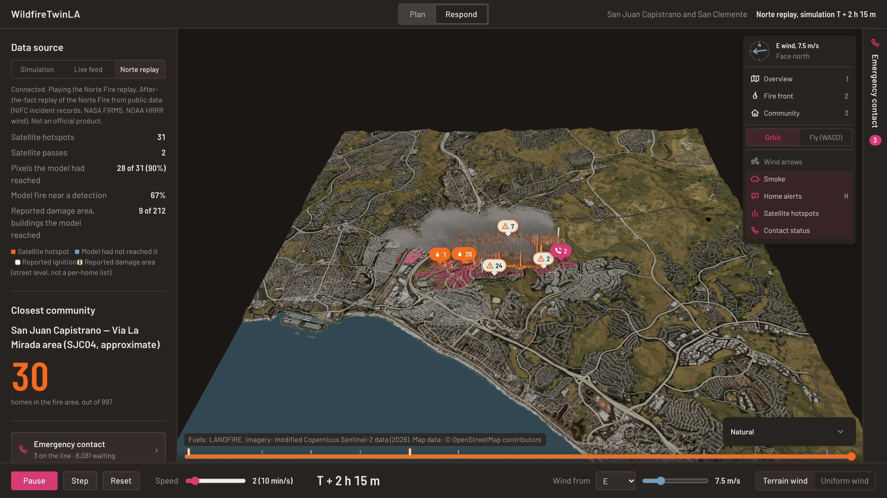
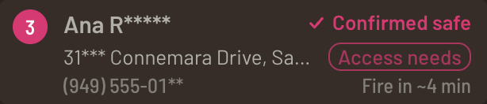
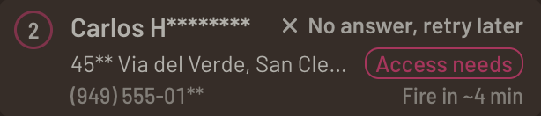
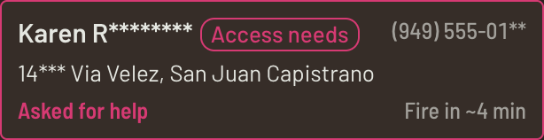
A warning sent isn’t a person reached.
WildfireTwinLA — from fire information to prioritized outreach.
▪ Confirm that someone received the message.
▪ Let them ask for repetition or help.
▪ Keep unanswered contacts visible.
ACKNOWLEDGED
NO ANSWER
NEEDS A PERSON
Demo contacts and call outcomes are fictional.
1
SIMULATED CONTACT
Outcomes from the demo dispatcher; fictional residents
Notes:
[20 s] During a wildfire, sending a warning is only the beginning. A conversation can confirm that someone received it, or that they need a person. With limited staff, the practical question is whom to contact first. These three cards are simulated outcomes from our demo dispatcher; every resident and phone number is fictional.
Evidence: CAL FIRE's Norte incident page lists a Public Information Hotline, which shows voice still matters. We make no claim that calls beat texts or save lives.

Slide 2
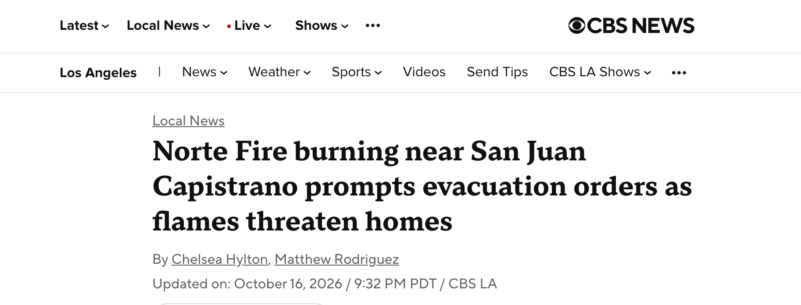
Real fires. A local decision.
Public fire observations, geographic context and experimental spread scenarios.
Regional context — CAL FIRE
Norte
San Clemente, Orange County · lead: OCFA
570 acres · 25% contained
Bryson
Malibu area, Los Angeles County
146 acres · 61% contained
Peak
Azusa area, Los Angeles County
43 acres · 41% contained
CAL FIRE pages (local agencies lead), updated Oct 17; retrieved 7:10–7:19 PM PDT. Bryson and Peak are not shown in our app.
REPLAY
Norte Fire, Orange County — after-the-fact replay of Oct 16, 2026 at T + 2 h 15 m (≈1:48 p.m. PDT), from NIFC incident records, NASA FIRMS VIIRS and NOAA HRRR wind. Not live.
Experimental, unofficial model outputs. Demo contacts and call outcomes are fictional. Follow official evacuation instructions.
2
Notes:
[30 s] Wildfires are burning in Southern California this week: Bryson near Malibu, Peak near Azusa, and Norte in Orange County, our case study. What you see is an after-the-fact replay of Norte on October 16, built from public data: the reported ignition, NASA VIIRS satellite passes and archived NOAA HRRR wind. It is a replay, not a live feed. Bryson and Peak are regional context from CAL FIRE pages; our app only displays Norte.
Source times: CAL FIRE pages retrieved Oct 17, 2026, 7:10–7:19 PM PDT. Norte is led by the Orange County Fire Authority.

Slide 3
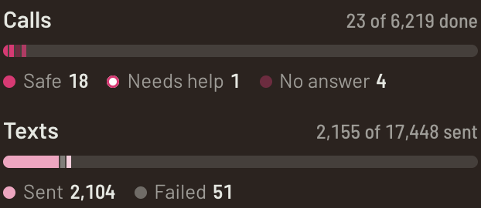
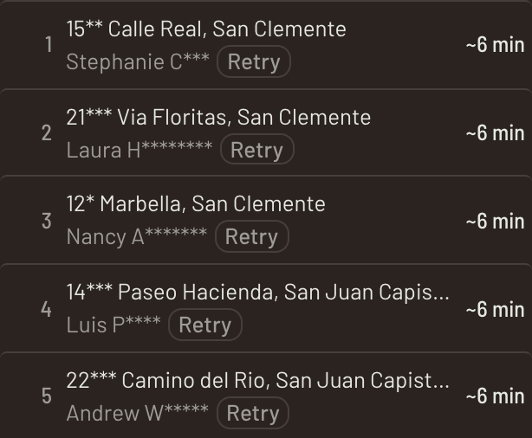
Limited staff. Many households. Who comes first?
▪ User: the overnight call-line supervisor.
▪ Decision: prioritize outbound follow-up.
▪ Delivery: simulated today; Retell integration planned.
Live counts from the simulated dispatcher
Households near the fire
Retell voice call
Approved update; outcome returned to the queue
ILLUSTRATIVE
PLANNED
Calls are simulated today
Ordered by estimated fire arrival
Ranking reflects estimated fire arrival, not conversational urgency or rescue priority. Demo contacts are fictional.
3
Notes:
[25 s] Our seat is the overnight supervisor of a call line: too many households, too few people. We tackle one part of that problem: ordering outbound outreach. Today every call and text is simulated. A Retell voice agent is the planned delivery path, returning call outcomes to the same queue. We rank by estimated fire arrival, not by who sounds most urgent on the phone.

Slide 4
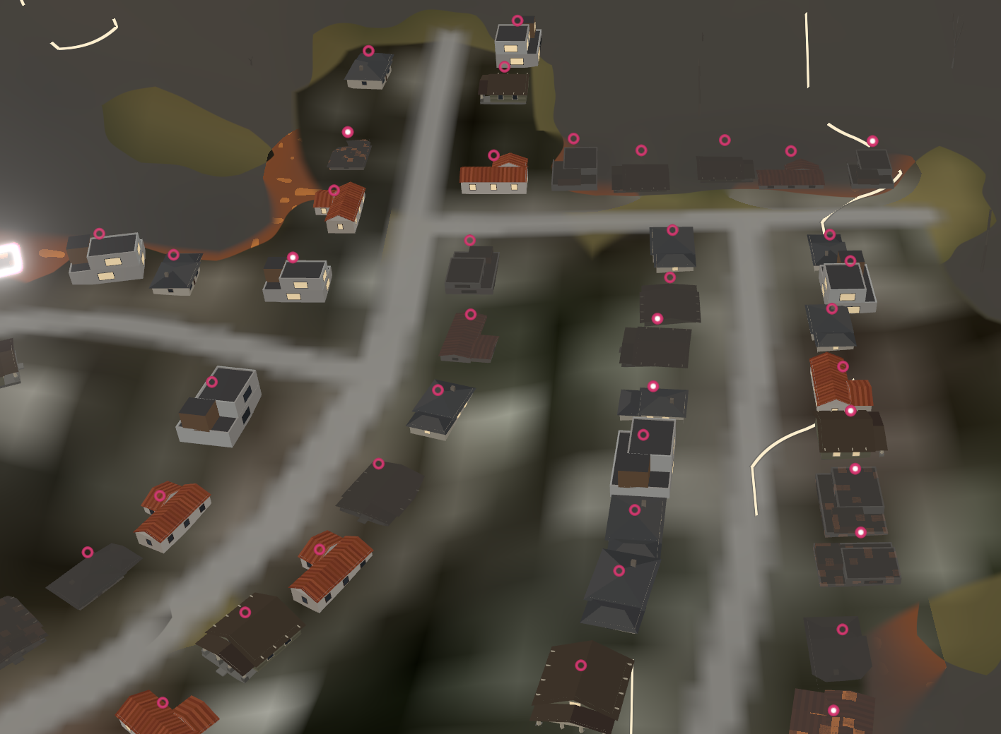
Nearby homes become a clear outreach queue.
Home location
Distance + wind (or model ETA)
Estimated arrival
Sorted queue
Call status
Top of the queue
earliest expected fire arrival
“Retry”
no answer on the first call
Farther away is not the same as safe.
Each home’s status sits above its roof (ring = queued).
Rank · masked address · resident · flags · arrival
Ranked by estimated fire arrival at each home (nearest simulated burning cell; simulation seeded from reported ignitions and VIIRS hotspots). Access-needs flag moves a home up 5 min. Not a complete danger assessment.
Experimental, unofficial model outputs. Demo contacts and call outcomes are fictional. Follow official evacuation instructions.
4
Notes:
[40 s, live demo] Our rule is simple and inspectable: the sooner the fire is expected at a home, the sooner we call. The estimate uses distance to the nearest simulated burning cell plus the wind, or the model's own arrival time when it has one. Residents flagged with access needs move up five minutes. Six lines run in parallel; each card shows the call and then its outcome. On the map, every home's status sits above its roof.
Demo: start the Norte replay; open the contact panel; hover queue row 1 to highlight the house; click to fly there; compare with a row further down that has a later arrival time; watch a line card turn into Confirmed safe or No answer.
Numbers are from the fictional 555-01 range. Being farther away never means someone is safe.

Slide 5
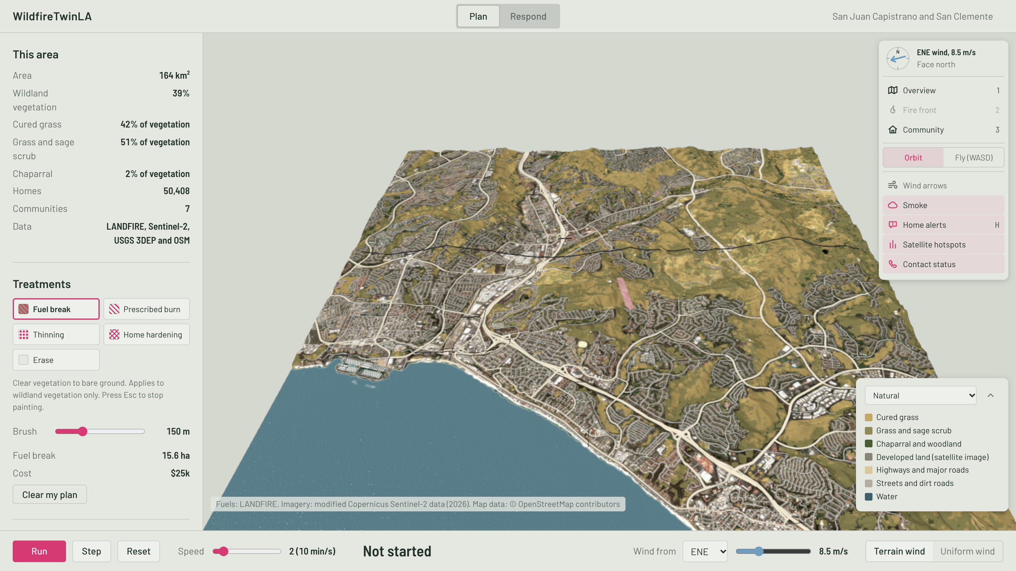
Before the emergency: where should we prepare?
▪ Intended user: community planner or Fire Safe Council.
▪ Explore preventive treatment locations.
▪ Compare scenarios before allocating resources.
MODELLED
Plan mode: a fuel break drawn downwind of the Norte ignition point
Prevention planning, not a guarantee. Prospective users are not confirmed partners.
5
Notes:
[20 s] The same map has an everyday use. A community planner or Fire Safe Council can explore where preventive treatments might help, before any fire starts. That keeps the tool useful between emergencies, so it is already in place when one comes.

Slide 6
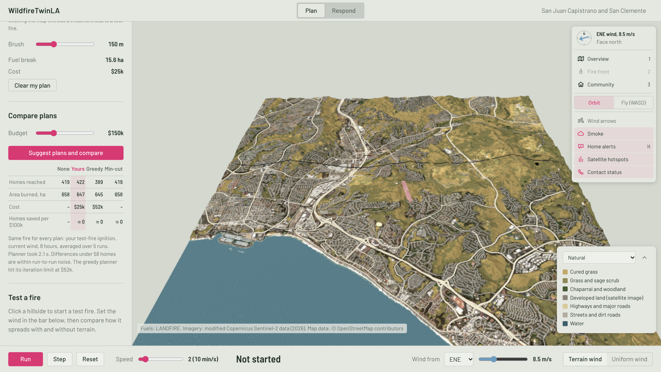
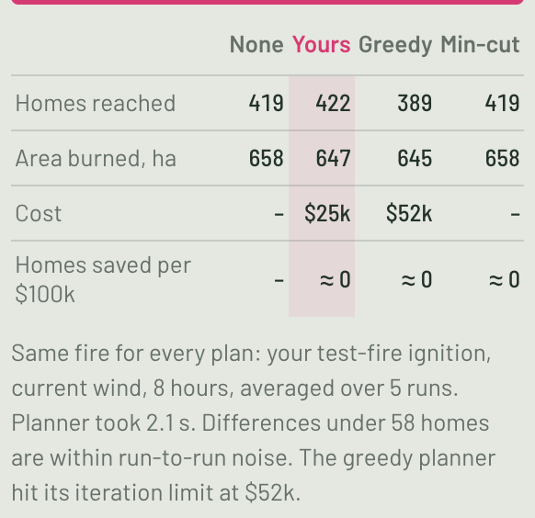
Test a treatment. Compare the simulated outcome.
Fuel break · Prescribed burn · Thinning · Home hardening
Our $25k fuel break: 422 buildings reached vs 419 untreated — inside the ±58 run-to-run noise, so the app shows “≈ 0”, not “homes saved”.
MODELLED
Test fire at the Norte ignition · ENE 8.5 m/s · 8 h · 5 runs · “homes” = mapped buildings
Experimental, unofficial model outputs. Demo contacts and call outcomes are fictional. Follow official evacuation instructions.
6
Notes:
[40 s, pre-run result] We drew a fuel break downwind of the Norte ignition and compared it with no treatment and two algorithm plans: same ignition, wind and 8-hour horizon, five simulation runs each. Our $25k break reached 422 buildings against 419 untreated; the greedy plan reached 389 for $52k. All of these differences are inside the run-to-run noise of about 58 buildings, so the table shows approximately zero instead of claiming homes saved. That is the point: planners see the uncertainty, not a promise. Fuel breaks can be crossed by embers, and prescribed burns are for authorized professionals.
This comparison was run before the pitch (GPU, about half a minute); do not launch it live.

Slide 7
What powers today’s prototype?
Input | Function | Source / status
Terrain, fuels, buildings | Geographic context and home locations | USGS 3DEP, LANDFIRE FBFM40, OpenStreetMap (50,408 buildings), Sentinel-2 imagery (Oct 14, 2026) — committed real data
Satellite fire observations | Reported hotspot locations and times | NASA FIRMS VIIRS — replay of 4 passes on Oct 16; live FIRMS/GOES pollers built, not configured
Wind | Replay conditions and simulation input | Archived NOAA HRRR (5×5 points, hourly); WindNinja terrain-wind library
Resident contacts | Demonstrate the outreach workflow | Synthetic, one per building; fictional (949) 555-01xx numbers; never dialled
Observed data, model outputs and fictional contacts are labelled separately.
Community areas are approximate, not official evacuation zones. Replay evacuation orders: OCFA, as reported by CBS Los Angeles and KTLA (times approximate). Sentinel-2 is periodic imagery, not real-time monitoring.
7
Notes:
[25 s] Today's prototype combines committed real geographic data, public fire observations and archived wind. Satellite detections in the demo come from the replay; live pollers exist in the backend but are not configured. The map knows buildings, not people: every resident contact here is synthetic, and the numbers can never ring a real phone. Community areas are approximations, not official evacuation zones.

Slide 8
What would an operational deployment need?
▪ Verified, authorized contact records.
▪ Agency-approved zones and message sources.
▪ Additional observations and independent validation.
Residents
Opt-in enrollment, language, consent
Agency partners
Approved zones, messages, contact data
Field observations
Validation of fire position and model
WildfireTwinLA
PROPOSED
Twist 1 — Federal funding pathway
Primary: USDA Forest Service Community Wildfire Defense Grant (CWDG). It funds Community Wildfire Protection Plans (up to $250k) and their projects; we would join an eligible community or Fire Safe Council application as the planning-and-outreach tool.
Alternative: NSF SBIR/STTR (America’s Seed Fund), reauthorized through Sept 30, 2031; project pitches accepted anytime.
fs.usda.gov CWDG (next round not yet posted); sba.gov, Apr 13, 2026; seedfund.nsf.gov. Retrieved Oct 17, 2026.
Twist 2 — Going global (e.g., China)
Carries over: NASA FIRMS fire detections, Sentinel-2 imagery, Copernicus GLO-30 elevation; ECMWF or GFS weather replaces US-only HRRR.
Needs local work: fuel maps (LANDFIRE is US-only), building footprints (OSM is sparse in many regions), agency zones, contact consent, local telephony rules.
Retell voice agents support Mandarin (zh-CN).
NASA FIRMS; Copernicus; LANDFIRE; NOAA NCO; Herfort et al., Nature Comms 2023; docs.retellai.com. Retrieved Oct 17, 2026.
No agency relationship or funding award is implied. Building footprints do not establish a resident’s phone number or permission to call.
8
Notes:
[25 s] A real deployment needs verified contact records through opt-in enrollment or an approved agency partnership, agency-approved zones and messages, and independent validation. We are not assuming government phone records are available.
Twist 1, funding: our primary pathway is the USDA Forest Service Community Wildfire Defense Grant, which funds community wildfire protection plans; we would join an eligible community application. The alternative is NSF SBIR, reauthorized through 2031.
Twist 2, going global: fire detections, imagery, elevation and global weather models carry over anywhere. Fuel maps, building footprints, zones, consent and telephony rules need local work. Retell supports Mandarin voice agents. Expanding is more than changing a bounding box.

Slide 9
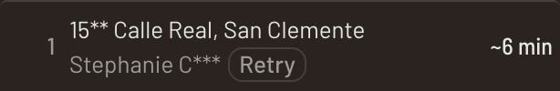
No answer does not mean safe.
Call attempted
No answer → retry once after 3 min
SIMULATED CONTACT
Line card and queue row in the demo: the retry stays visible to the operator.
Still no answer → text moved up the queue
SIMULATED CONTACT
Text delivered ≠ acknowledged
Reply captured? Yes → record · No → unresolved
PLANNED
Stale fire data → show age
PLANNED
Missing observations → simulation remains an estimate
Phone/SMS outage → delivery unavailable
Experimental, unofficial model outputs. Demo contacts and call outcomes are fictional. Follow official evacuation instructions.
9
Notes:
[40 s] An unanswered call is retried once after three minutes. If it still fails, that household's text moves up the queue. Both steps run in our simulation today. But a delivered text is not an acknowledgement; capturing replies is planned. Unresolved contacts stay visible to the operator. If data goes stale or phone networks fail, we show that uncertainty instead of promising contact.
Terminology: these are ordinary SMS follow-ups, not AMBER Alerts or Wireless Emergency Alerts. Evacuation orders stay with authorized officials, and a help flag is not a promise of rescue.

Slide 10
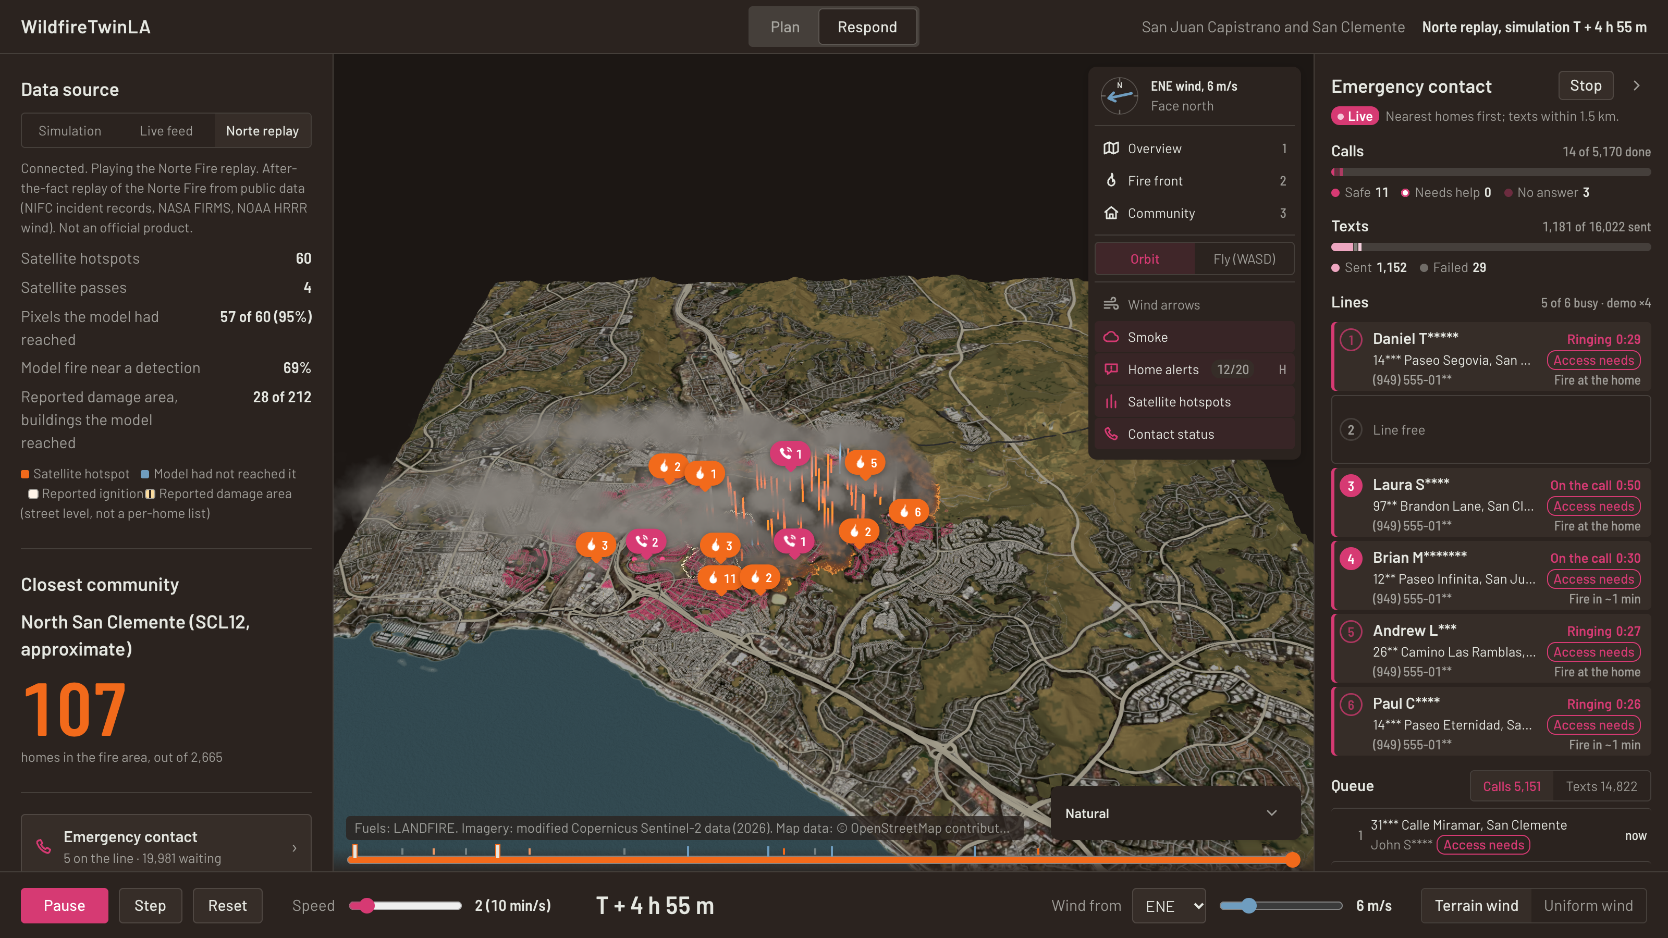

One workflow from preparation to outreach.
The map feeds an inspectable next action.
Tool category | What our design connects
Incident maps | Geographic context → household outreach queue
Notification systems | Recipient ordering → visible unresolved contacts
Prevention models | Treatment exploration → the same incident-area workflow
Prepare before the fire. Prioritize outreach during it.
Code repository
github.com/ZQC8848/WildfireTwinLA
Next: a consenting-volunteer pilot and verified call/SMS integration.
Team: Qinchuan · Tia · Lucia — The Dual-Use Hackathon, Resilience Comms lens
Category comparison, not a claim about named products. Fictional demo contacts; unofficial model outputs. Follow official evacuation instructions.
10
Notes:
[35 s] Our contribution is the connection: plan prevention before a fire, then use the same geographic context to organize outreach during one. The operator can see why a household is high in the queue and which contacts remain unresolved.
Working today: real Norte data, the public-data replay, the GPU fire simulator and 64-run forecast, treatment comparison, and the simulated contact pipeline with the map and queue. Simulated or planned: real Retell calls, SMS delivery, reply capture, and a configured live feed. Next step: a small pilot with consenting volunteers.
Responsible use: the tool could be misused to contact people without consent or to overstate model predictions. We limit that with fictional demo data, masked contact details, consent-gated real calls, and labels that separate observations, model outputs and official orders.

