Slide 1

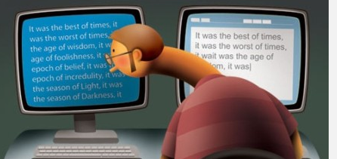
Academic Writing Course
Avoiding

Slide 2

Contents
1
Definition of Plagiarism
2
Types of Plagiarism
3
Avoidance of Plagiarism--Citing
4
Different Citation Styles
5
Different Citation methods
6
Strategies for Avoiding Plagiarism

Slide 3

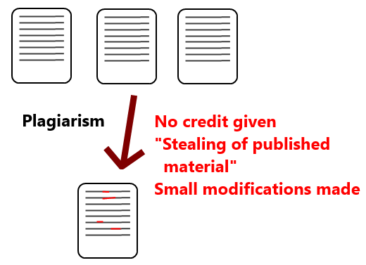
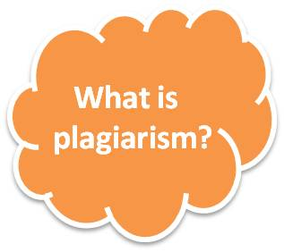
What is plagiarism?
the copying or paraphrasing of other people’s work or ideas into your own work without full acknowledgement
http://www.ox.ac.uk/students/academic/goodpractice/about/
the act of representing as one's own original work the creative works of another, without appropriate acknowledgment of the author or source
https://academichonesty.unimelb.edu.au/plagiarism.html
the "wrongful appropriation" and "stealing and publication" of another author's "language, thoughts, ideas, or expressions" and the representation of them as one's own original work.
https://en.wikipedia.org/wiki/Plagiarism

Slide 4


Why people plagiarize?
Less time
Procrastination
Ambition of achieving higher grades
Lack of knowledge
Lack of patience
No trust in one's own ability
Sheer lethargy
Ignorance of the consequences of plagiarism
Notes:
http://www.buzzle.com/articles/different-types-of-plagiarism.html

Slide 5

Types of Plagiarism?
Deliberate Plagiarism
Purchasing a pre-written paper (either by mail or electronically). Letting someone else write part or all of a paper for you. Paying someone else to write part or all of a paper for you. Submitting as your own someone else’s unpublished work (including a computer program or algorithm), either with or without permission. Submitting as your own, work done jointly by a group in which you may have participated. Submitting work done by you, but for another class or another purpose without documenting that it was previously used. Creating phony citations.
Accidental Plagiarism
Failure to cite a source that is not common knowledge. Failure to "quote" or block quote author’s exact words, even if documented. Failure to put a paraphrase in your own words, even if documented. Failure to put a summary in your own words, even if documented. Failure to be loyal to a source.

Slide 6


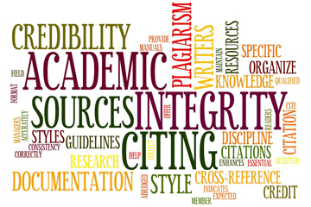
How to avoid plagiarism?
acknowledge
attribute
cite
reference
give credit to
acknowledgement
attribution
citation
your sources of information

Slide 7
Why to cite?
To give credit to another author for his/her ideas
To show that you have researched your topic, that you understand the concepts and know who has written about them
To allow your reader to find and examine your sources

Slide 8





Styles of citation?
the social and behavioural sciences
the humanities, especially language and literature
Institute of Electrical and Electronics Engineers
Business, History, and the Fine Arts
Notes:
http://academic.evergreen.edu/curricular/stilllooking/reference/Citation%20Guides/introduction.htm

Slide 9

P33
How to cite? 1
Internal/In-text/parenthetical citation
1. Information prominent
Shrinking markets are also evident in other areas. The wool industry is experiencing difficulties related to falling demand worldwide since the development of high-quality synthetic fibres (Smith, 2000).
2. Author prominent
Shrinking markets are also evident in other areas. As Smith (2000) argued that the wool industry was experiencing difficulties related to falling demand worldwide since the development of high-quality synthetic fibres. However, Jones et al. (2004) found that industry difficulties were more related to quality of supply than to demand issues. It is clear that considerable disagreement exists about the underlying sources of these problems.
3. Weak author prominent
Several authors have reported that the wool industry is experiencing difficulties related to falling demand since the development of highquality synthetic fibres (Nguyen, 2005; Smith, 2000; Wilson, 2003).

Slide 10
Practice 1
Read and decide which citation method is used. And then change the citation method
1. Close (1983) developed a simplified theory using an analogy between heat and mass transfer and the equivalent heat transfer only case.
A simplified theory has been developed using an analogy between heat and mass transfer and the equivalent heat transfer only case (Close, 1983).
author-prominent
2. For viscoelastic fluids, the behaviour of the time-dependent stresses in the transient shear flows is also very important (Boger et al., 1974).
Boger et al (1974) claim that for viscoelastic fluids, the behaviour of the time-dependent stresses in the transient shear flows is also very important.
information prominent
3. It has been suggested by several authors that automated testing should be more readily accepted (Balcer, 1989; Stahl, 1989; Carver and Tai, 1991).
It has been suggested that automated testing should be more readily accepted (Balcer, 1989; Stahl, 1989; Carver and Tai, 1991).
weak author-prominent

Slide 11
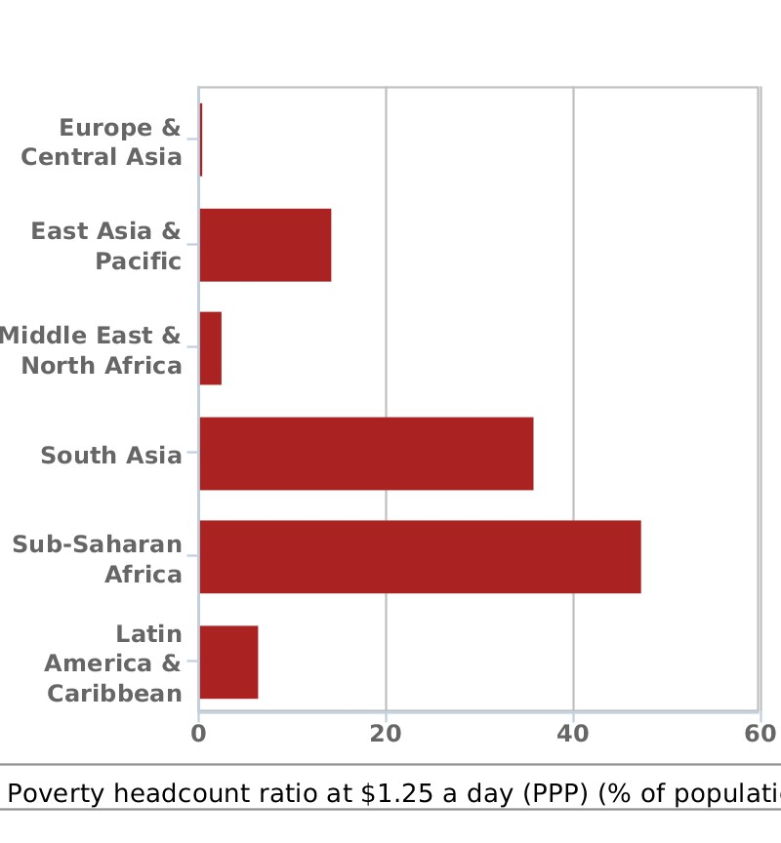
P34
Practice 2
The following is a chart describing people living on less than 1.25 dollars. Look at the chart and practice citing these figures by using three different types of citation.
Figure: Poverty headcount ratio at $1.25 a day (% of population)
Created By Swati Revankar from World Bank, 2012

Slide 12
Key for Reference
Information prominent citation
Among the six areas regarding the poverty headcount ratio at $1.25 a day, sub-Saharan Africa constituted the biggest ratio up to almost 50% of the population. (World Bank, 2012)
Author prominent citation
The World Bank (2012) stated that South Asia ranked the second in the chart regarding poverty ratio at $1.25 a day among six areas in the world.
As a report from the World Bank (2012) indicated, the top two areas of poverty headcount ratio at $1.25 a day were sub-Saharan Africa and South Asia, with a population of almost 50 percent and 37 percent respectively.
Weak author prominent citation
As a report from an authority indicated, the top two areas of poverty headcount ratio at $1.25 a day were sub-Saharan Africa and South Asia, with a population of almost 50 percent and 37 percent respectively. (World Bank, 2012)

Slide 13
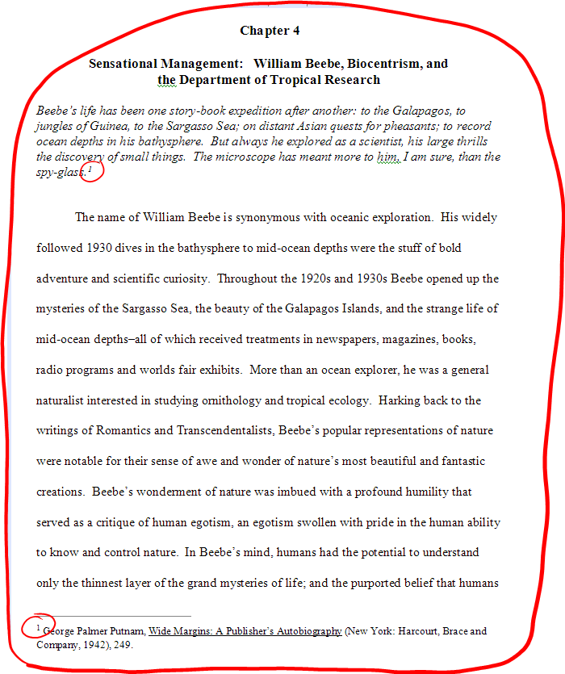
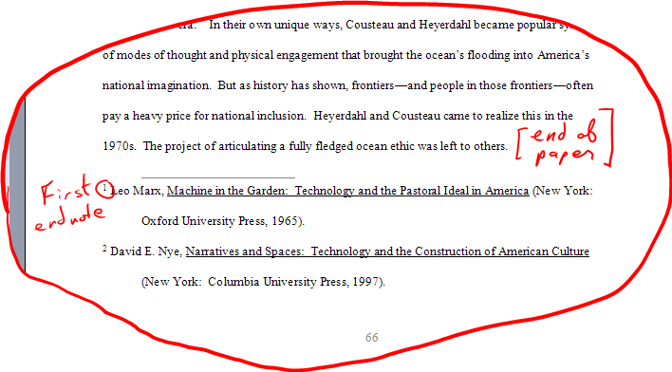
How to cite? 2
Footnote/endnote
http://www.philteach.net/OnFootnotes.html

Slide 14



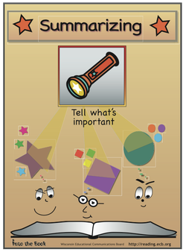

Strategies for avoiding plagiarism?
put quotation marks around the words and identify the source.
put the information into your own words and identify the source.
take the key ideas and paraphrase them and identify the source
Notes:
http://integrity.mit.edu/academic-writing/incorporating-words-and-ideas-others

Slide 15

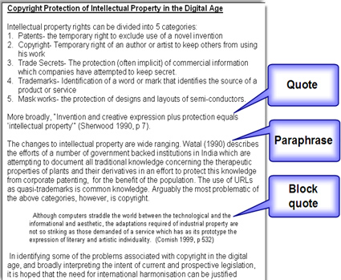
Quoting
To repeat in speech or writing (the words of (another person, esp. a powerful or important person)), usu. with acknowledgement of the source
--Longman Dictionary

Slide 16
When and how to quote?
When language is particularly vivid or expressive.
When exact wording is needed for technical accuracy.
When the words of an important authority lend weight to an argument.
Name the source in an introductory phrase.
Use quotation marks or indent long quotations.
Cite the source appropriately.
Notes:
http://integrity.mit.edu/academic-writing/avoiding-plagiarism-quoting

Slide 17
Read, Compare and Decide
Original
Because of their unique perspective, Americans fear globalization less than anyone else, and as a consequence they think about it less than anyone else. When Americans do think about globalization, they think of the global economy as an enlarged version of the American economy.
(Source: Thurow, L. (1993). Fortune Favors the Bold (p. 6). New York: Harper Collins.)
Economist Lester Thurow (1993) has asserted that the American reaction to globalization is different from that of the rest of the world in that "Americans fear globalization less than anyone else, and as a consequence . . . think about it less than anyone else" (p. 6).
The American view of globalization is unlike that of the rest of the world. Because of their unique perspective, Americans fear globalization less than anyone else, and therefore think about it less than anyone else (Thurow, 1993).
Notes:
The left one is accurate because:
The writer has introduced the quotation with his/her own words.
The writer has also named the source in an introduction phrase.
The writer has indicated where exact words of the source begin and end by using quotation marks.
The right one is plagiarism because:
The writer has identified the source but has not put quotation marks around the words.
Lack of quotation marks allows the reader to think the words are the writer's, not Thurow's

Slide 18
What is paraphrasing?
To express the meaning of a word, phrase, or passage in other words, usu. with the object of fuller and clearer exposition so as to bring out the sense
--The Oxford English Dictionary
Notes:
Is a condensed version of another author's work, or putting the author's words into your own words
is one way to use a text in your own writing without directly quoting source material
using your own words to express someone else's ideas whilst still preserving the main ideas of the original source

Slide 19
Guidelines for Paraphrasing
Lexical transformation
Syntactic transformation
Use synonyms
Change word forms
Make necessary structural adjustments
Change between the affirmative and the negative
Change the voice from active to passive and vice versa
Change clauses to phrases and vice versa
Include reference to the original source
Notes:
http://integrity.mit.edu/academic-writing/avoiding-plagiarism-paraphrasing

Slide 20
Read, Compare and Decide
Acceptable or unacceptable?
Original
We do not yet understand all the ways in which brain chemicals are related to emotions and thoughts, but the salient point is that our state of mind has an immediate and direct effect on our state of body.
(Source: Siegel, B. (1986).
Love, Medicine and Miracles (p. 69). New York: Harper and Row.)
Siegel (1986) writes that although the relationship between brain chemistry and thoughts and feelings is not fully understood, we do know that our psychological state affects our physical state.
Siegel (1986) writes that we still do not know all the ways in which brain chemistry is related to emotions and thoughts, but the important point is that our mental state has an immediate and direct effect on our physical state.
According to Siegel (1986), our mind affects our body quickly and directly, although we do not yet understand every aspect of how brain chemicals relate to emotions and thoughts.
Notes:
The left one is acceptable because:
Used synonyms
Changed sentence structure
Changed voice
Cited source
The middle one is unacceptable because:
The writer has kept the same exact sentence structure
The writer had only substituted synonyms in certain places; in others the wording is exactly the same as that of the original.
Even though the writer mentions the original source in the introductory phrase, the result is plagiarism.
The right one is also unacceptable because:
Although the writer has changed the structure of the sentence, key phrases have been taken directly from the original.
Even though the writer mentions the original source in the introductory phrase, the result is plagiarism.

Slide 21
Tips for paraphrasing
Do:
use your own words, synonyms or synonym phrases.
change the order of the information, change the grammar and sentence structure.
keep the meaning, as well as the emphasis on and relationships between main and supporting points the same.
reference the original text when paraphrasing written material.
Don't:
repeat the information word for word, or change a word here and there, leaving most of the text and the sentence order the same - this is plagiarism.

Slide 22
Paraphrasing the following sentences
1. It is worth looking at one or two aspects of the way a mother behaves towards her baby.
It is useful to observe several features of how a mother acts when she is with her small child.
2. Similarly, the muscles will not grow in length unless they are attached to tendons and bones so that as the bones lengthen, they are stretched.
Likewise, if muscles are not attached to tendons and bones so that as the bones lengthen, they are stretched, they will not grow in length.
3. We can relate a study of this kind to texts in other media too.
A study of this kind can be related to texts in other media too.
4. Among all the feelings of mankind, love is probably the noblest.
There is probably no other feeling that is nobler than love.
5. The bomb exploded and caused many casualties.
The bomb explosion led to a great number of injuries and deaths.

Slide 23
5. The position of women in the society has changed greatly in the past 20 years.
Women’s social status has undergone dramatic changes in the last two decades.
6. It has long been known that Cairo is the most populous city on earth, but no one knew exactly how populous it was until last month.
Although Cairo has been the world’s most heavily-populated city for many years, the precise population was not known until four weeks ago.
7. Widespread tobacco consumption has led to grave consequences, yet the tobacco companies are still claiming that they make a valuable contribution to the world economy.
Extensive cigarette smoking has caused serious problems. But the tobacco companies insist that they contribute greatly to the global economy.

Slide 24
P91
Practice Paraphrasing
Read the following text carefully and try to rewrite an acceptable paraphrase.
Starting in the 15th century, the reality and the idea of the family were to change: a slow and profound revolution, scarcely distinguished by either contemporary observers or later historians, and difficult to recognize. And yet the essential event is quite obvious: the extension of school education. We have seen how in the middle ages children’s education was ensured by apprenticeship in adults, and that after the age of seven, children lived in families other than their own. Henceforth, on the contrary, education became increasingly a matter for the school. The school ceased to be confined to clerics and became the normal instrument of social initiation, of progress from childhood to manhood. ( Source: Aries, P. 1962. Contemporary Childhood: A Social History of Family Life )

Slide 25
Key for reference
Starting in the 15th century, the reality and the idea of the family were to change: a slow and profound revolution, scarcely distinguished by either contemporary observers or later historians, and difficult to recognize. And yet the essential event is quite obvious: the extension of school education. We have seen how in the middle ages children’s education was ensured by apprenticeship in adults, and that after the age of seven, children lived in families other than their own. Henceforth, on the contrary, education became increasingly a matter for the school. The school ceased to be confined to clerics and became the normal instrument of social initiation, of progress from childhood to manhood. ( Source: Aries, P. 1962. Contemporary Childhood: A Social History of Family Life )
Aries (1962) claims that beginning in the 1400s the way we viewed the family and the actual reality of the family changed. However, the change was so slow and subtle that people at that time did not see it. But the event itself, the growing importance of school, was quite striking. Prior to that time children were educated from the age of seven by being placed out or apprenticed to other families. Once schools were no longer limited to religious study, they replaced apprenticeship as society’s means of educating the young and initiating them into society.

Slide 26
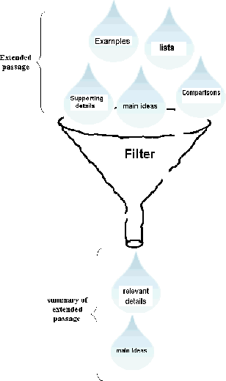
Summarizing
Is to put in your own words a shortened version of written or spoken material, stating the main points and leaving out anything that is not essential
Involves analyzing information, distinguishing important elements from unimportant elements and transforming large chunks of information into a few short cohesive sentences
Is more than retelling

Slide 27
How to Summarize
Start by reading a short text and highlight the main points as you read
Reread the text and make notes of the main points, leaving out examples, evidence, etc.
Restate or repeat the ideas of the source in different words and phrases
Do not add your own ideas, opinions or judgment of the arguments.
Make it shorter than the source

Slide 28
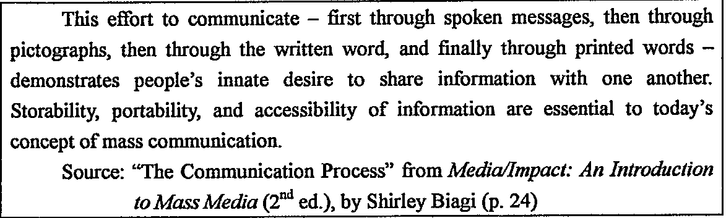
Example
P88
In Media Impact, Shirley Biagi explains that people have always had an inherent need to communicate. The ability to store, carry and have access to information is necessary in modern mass communication.

Slide 29
Summarizing tips
Do:
use your own words.
only note the most important points, using key words and phrases.
read the original text multiple times, ensuring you don't miss any critical points.
ensure a summary is much shorter than the original source.
include the original source in the references for a written document.
read widely and try to develop a summary or the article/book in your head as you read.
Don't:
include unnecessary details, examples or supporting information.
include your own opinions or thoughts.
repeat phrases word for word - this is plagiarism.
Notes:
http://hubpages.com/hub/Learn-to-summarize-and-paraphrase

Slide 30
Paraphrase vs. Summary
Original Passage:
Language is the main means of communication between peoples. But so many different language have developed that language has often been a barrier rather than aid to understanding among peoples. For many years, people have dreamed of setting up an international, universal language which all people could speak and understand. The arguments in favor of a universal language are simple and obvious. If all peoples spoke the same tongue, cultural and economic ties might be much closer, and good will might increase between countries.
Humans communicate through language. However, because there are so many languages in the world, language is an obstacle rather than aid to communication. For a long time, people have wished for an international language that speakers all over the world could understand. A universal language would certainly build cultural and economic bonds. It would also create better feelings among countries.
People communicate mainly through language; however, having so many different languages creates communication barriers. Some think that one universal language would bring countries together culturally and economically and also increase good feelings among them.

Slide 31
Read, Compare and Decide
The original passage:
Students frequently overuse direct quotation in taking notes, and as a result they overuse quotations in the final [research] paper. Probably only about 10% of your final manuscript should appear as directly quoted matter. Therefore, you should strive to limit the amount of exact transcribing of source materials while taking notes. [source: Lester, James D. Writing Research Papers. 2nd ed. (1976): 46-47.]
Students should take just a few notes in direct quotation from sources to help minimize the amount of quoted material in a research paper (Lester 46-47).
In research papers students often quote excessively, failing to keep quoted material down to a desirable level. Since the problem usually originates during note taking, it is essential to minimize the material recorded verbatim (Lester 46-47).
Students often use too many direct quotations when they take notes, resulting in too many of them in the final research paper. In fact, probably only about 10% of the final copy should consist of directly quoted material. So it is important to limit the amount of source material copied while taking notes.
Notes:
The first one is a summary; the second one is an acceptable paraphrase; the third one is a plagiarized version

Slide 32
Practice Summarizing 1
John fell into the river and, before help could reach him, he sank.
John was drowned in the river.
Change phrases into words
She brought home several Chinese and English novels, a few copies of Time and Newsweek, and some textbooks. She intended to read all of them during the winter vacation.
She brought home a lot of books and magazines to read during the vacation.
Use general words instead of specific words
Beautiful mountains like Mount Tai, Lushan Mountain, and Yellow mountain, were visited by only a few people in the past. Today, better wages, holidays with pay, new hotels on those mountains, and better train and bus services, have brought them within reach of many who never thought of visiting them ten years ago.
Beautiful mountains like Mount Tai, once visited by only a few people, are today accessible to many, thanks to better wages, paid holidays, new hotels and better communications.
Change clauses or sentences into phrases

Slide 33
Practice Summarizing 2
Kate looked at Paul disapprovingly:”You use much too much salt on your food, Paul—it’s not at all good for you!” Paul put down his knife and frowned:” Why on earth not! If you didn’t have salt on your food it would taste awful… like eating cardboard or sand…just imagine bread without salt in it, or potatoes or pasta cooked without salt!” Kate was patient. She didn’t want to quarrel with Paul. She wanted to persuade him. She said firmly:”’But too much salt is bad for you. It causes high blood pressure and later on, heart-attacks. It also disguises the tastes of food, the real tastes, which are much more subtle than salt, and which we have lost the sensitivity to appreciate any more.”
Kate suggested to Paul that he should eat less salt. She thought that eating too much salt would do harm to Paul’s health and that it could reduce the real tastes of food. But Paul disagreed. He said that food without salt would be tasteless.
Put the main points of a dialogue in indirect speech

Slide 34
P89
Practice Summarizing 3
Read the following text and write a summary
I come from Taiwan, but I have lived in Canada for several years now. I am surprised at how Canadian society respects the rights of women, both at work and home. Personally I believe women in Canada are better off than women in Taiwan. However, some of my female friends in Canada miss the good old days when women were treated in a different way. You see, in the past, gentlemen followed different rules of behavior. They would open the doors for ladies, pull out chairs for ladies to sit down, stand up when a lady left the table, and offer to pay the bill at restaurants. Now, however, most Canadian believe that men and women should be considered equal. For example, women now generally have to pay for their own meals.

Slide 35
Key for Reference
This text describes the experience of a Taiwanese who has lived in Canada for several years. He considers Canadian women better off than Taiwanese. However, he notes that some Canadian women feel nostalgic about the days when they received special courtesies. For example, formerly men opened doors for women or paid for their meals. At this time, most Canadians endeavor to treat men and women equally. Women today therefore are expected to cover the cost of their own meals.

Slide 36
Academic Writing Course
Thank You !

