Slide 1

Academic Writing Course

Slide 2
Contents
1
Data Types and Collection Methods
2
General Format of Research Paper
3
Definition of Literature Review
4
Steps in Reviewing Literature
5
Organization of Literature Review
6
Elements in Introduction Section

Slide 3


Types of data?
Way of collecting
Primary Data
--field research
Secondary Data
--desk research
Types of Data
Continuous Data 连续
(variable)
Discrete Data 间断/离散
Quantitative Data 定量
Interval Data 定距
Nature of data
Ratio Data 定比
Nominal Data 定类
Attribute Data
Qualitative Data 定性
Ordinal Data 定序
‘Open’ Data

Slide 4

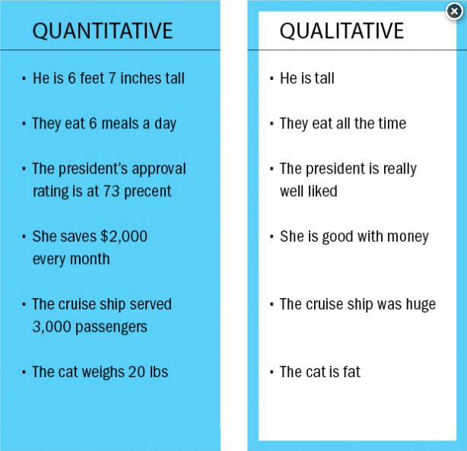
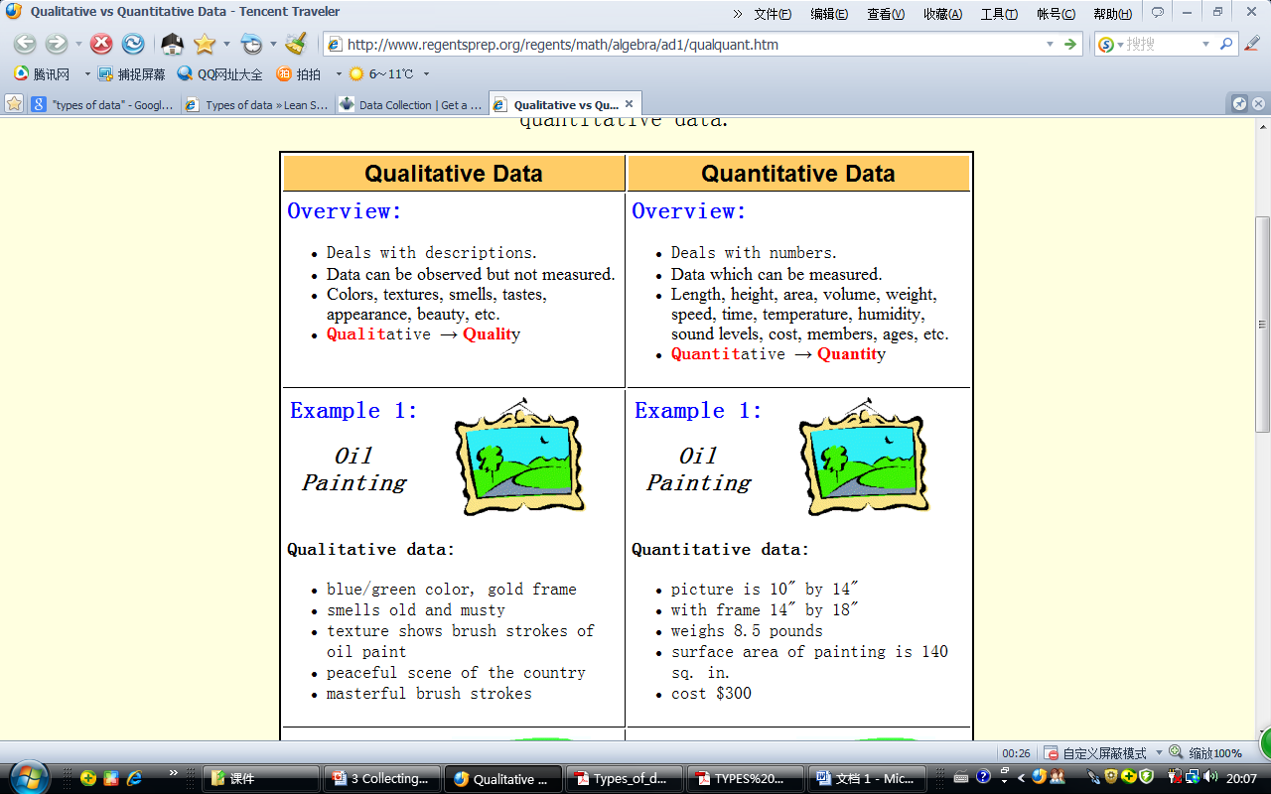
Qualitative data vs. quantitative data?

Slide 5
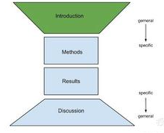
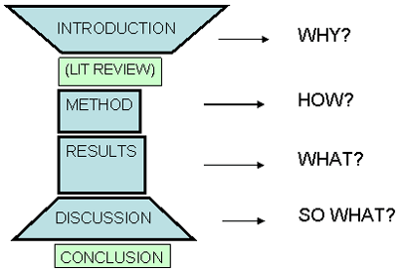
General Format of Research Paper
IMRaD format
Introduction
Why research needed
Methodology
How research completed and results analyzed
Results And
What was found (data)
Discussion
Interpretation of results and application to clinical practice

Slide 6

What is a literature?
imaginative works like novels or poetry?
any published material that provides information in the field being discussed, perhaps within a specific time period.

Slide 7

What is a literature review?
surveys scholarly articles, books and other sources (e.g. dissertations, conference proceedings) relevant to a particular issue, area of research, or theory.
provides a description, summary, and critical evaluation of each work.
offers an overview of significant literature published on a topic.
The focus of a literature review is to summarize and synthesize the arguments and ideas of others without adding new contributions.

Slide 8

Steps to conduct a literature review
Step 1
Step 2
Step 3
Step 4
Step 5
Defining the purpose
Searching for the literature
Reading and analyzing the literature
Organizing the contents
Writing the review
Journal papers
Books
Theses and dissertations
Conference proceedings
Government publications
Technical reports
Internet resources

Slide 9

Organization of Literature Review
Chronological
  By publication date
  By trend
Thematic
  A structure which considers different themes
Methodological
  Focuses on the methods of the researcher, e.g., qualitative versus quantitative approaches

Slide 10

P26
What are included in Introduction?
Elements |  | Functions
Para. 1 S1-2
Para. 1 S3-5
Para. 2-3
Para. 4
Para. 5
General Statements
to provide the reader with a setting for the problem to be investigated
Specific Statements
to describe the aspects of the problem already studied by other researchers
(Literature Review)
to find the gap and indicate the need for more investigation of the problem
Thesis Statement
to present the purposes/objectives of the current study
Optional Statements
to give a value or justification for carrying out the study, limitation of the study, etc.

Slide 11
List different opinions on poverty and environmental degradation
Bruntland Commission Report, etc. on the one side | Leach and Mearns on the other side
Poverty is a major cause of environmental problems and amelioration of poverty is a necessary and central condition of any effective programs addressing the environment.
Environmental degradation, rapid population growth and stagnant production are closely linked with the fast spread of acute poverty in many countries of Asia.
Poor families who have to meet short term needs mine the natural capital by excessive cutting of trees for firewood and failure to replace soil nutrients.
These studies point to demographic, cultural, and institutional factors as important variables in the poverty-environmental degradation nexus.
An intricate web of factors plus the existence of feedback loops from environmental degradation to poverty makes the process of identifying causality links, if any, between environmental degradation and poverty a difficult exercise.

Slide 12
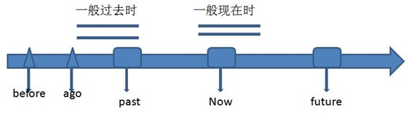
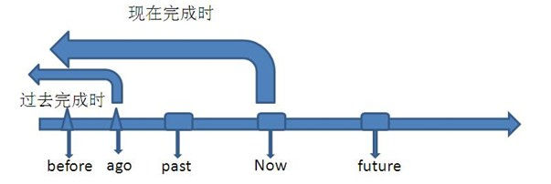
Tenses in citation?

Slide 13
some of the questions a literature review should answer
What do we already know in the immediate area concerned? What are the characteristics of the key concepts or the main factors or variables? What are the relationships between these key concepts, factors or variables? What are the existing theories? Where are the inconsistencies or other shortcomings in our knowledge and understanding? What views need to be (further) tested? What evidence is lacking, inconclusive, contradictory or too limited? Why study (further) the research problem? What contribution can the present study be expected to make? What research designs or methods seem unsatisfactory?

Slide 14
Read, Think and Answer P35
Literature Review
Until recently many researchers have shown interest in the field of coastal erosion and the resulting beach profiles. They have carried out numerous laboratory experiments and field observations to illuminate the darkness of this field. Their findings and suggestions are reviewed here.
JACHOWSKI (1964) developed a model investigation conducted on the interlocking precast concrete block seawall. After a result of a survey of damages caused by the severe storm along the coast of USA, a new and especially shaped concrete block was developed for use in shore protection. This block was designed to be used in a revetment type seawall that would be both durable and economical as well as reduce wave run-up and overtopping, and scour at its base or toe. It was proved that effective shore protection could be designed utilising these units.
HOM-MA and HORIKAWA (1964) studied wave forces acting on the seawall which was located inside the surf zone. On the basis of the experimental results conducted to measure wave forces against a vertical wall, the authors proposed an empirical formula of wave pressure distribution on a seawall. The computed results obtained by using the above formula were compared well with the field data of wave pressure on a vertical wall.
SELEZOV and ZHELEZNYAK (1965) conducted experiments on scour of sea bottom in front of harbour seawalls, basing on the theoretical investigation of solitary wave interaction with a vertical wall using a Boussinesque type equation. It showed that the numerical results were in reasonable agreement with laboratory experimental data.

Slide 15
4. Is it a good literature review? Why?
We don't believe that it is a good literature review. It only gives a summary of previous research; it does not use the literature to explain more about the writer's own research problem. Also, it is not critical: after we read it we still do not know which theories or findings are important, which are inconclusive and what the shortcomings are.
The main problem with this literature review is that it does not show how previous research relates to the writer's own research problem, or the relationship between different research already carried out. Given the organisation the writer has used, this literature review could not be effective because there is little scope for showing relationships, drawing comparisons or making evaluations.

Slide 16
1. Which of the questions does this literature review answer?
This literature offers a summary of previous research, so it does answer the first question. It simply tells the reader what was discovered in previous research.
2. Which of them doesn't it answer?
This literature review doesn't answer any of the questions from 2 to 10. It doesn't evaluate the research it summarises, nor does it show the relationships between the different theories, views and approaches it describes.
3. Which method has the writer used to organise the literature review?
The writer has organised this literature review around the researchers and has presented it chronologically (arranging the work by when it was published). Notice that by organising it around the researchers (the summaries are listed after the names of the people who did the research) and not around the research (around key concepts) the writer emphasises the people and not their work.

Slide 17
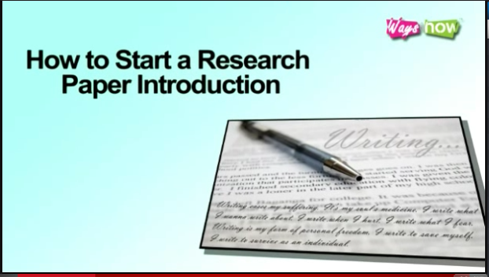
Tips for Writing an Introduction

Slide 18
Academic Writing Course
Thank You !

