Slide 1

Academic Writing Course

Slide 2
Contents
1
Presentation of Data
2
Graphic Description
3
Comparison and Contrast
4
Elements in Results Section
5
Outline of Results Section

Slide 3



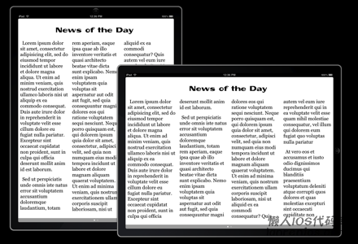
How to present data?
Notes:
http://www.mcwdn.org/Graphs/TabGraphMain.html

Slide 4


How to present data?
Favorite Student After School Activity
Activity | Number
Visit W/Friends | 175
Talk on Phone | 168
Play Sports | 120
Earn Money | 120
Use Computers | 65
present a set of facts and figures arranged in columns and rows
show exact numerical values and present quantitative data

Slide 5
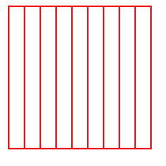
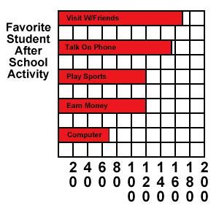
How to present data?
show results that are one time, that aren't continuous
clearly show the relationship of different parts of the sample to each other
Activity | Number
Visit W/Friends | 175
Talk on Phone | 168
Play Sports | 120
Earn Money | 120
Use Computers | 65

Slide 6

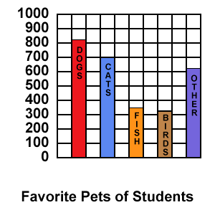
How to present data?
used more for one time or single events rather than continuous events
not clearly show the parts in relation to the whole
DOGS | CATS | FISH | BIRDS | OTHER
820 | 700 | 350 | 320 | 615

Slide 7

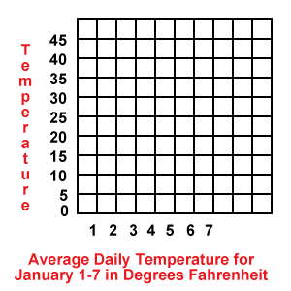
How to present data?
display data or information that changes continuously over time
show a pattern or trend which usually takes place over a period of time
Date | Temperature
1 | 10
2 | 25
3 | 30
4 | 42
5 | 23
6 | 25
7 | 40

Slide 8


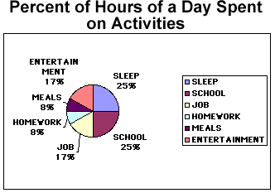
How to present data?
a legend that tells which color stands for which category
PIE CHART
ACTIVITY | HOURS | PERCENT OF DAY
Sleep | 6 | 25%
School | 6 | 25%
Job | 4 | 17%
Entertainment | 4 | 17%
Meals | 2 | 8%
Homework | 2 | 8%
used to show percentages
show the sizes of various parts in relation to each other and the whole sample

Slide 9
Tips on labelling and using tables and graphs
Table 1，Table 2, Table 3, …
表
table
条形图 bar graph/chart
图表
柱状图 column graph/chart
线形图 line graph
图
figure
饼图 pie chart
Figure 1, Figure 2, Figure 3, …
(topographical) map 地(形)图
diagram
示意图
flow chart
流程图
Number tables and figures sequentially.

Slide 10
Tips on labelling and using tables and graphs
Label tables and figures clearly.
Place tables and figures as close to the relevant text as possible.
Make specific reference to each figure and table. Do not assume that the reader will make the necessary connection between the text and the figure or table.
Refer to each figure or table in the text by its figure or table number.
Remember to guide the reader in interpreting the information in the table or figure. What does the table show? What specific point are you making?
Label tables above the table and figures below the figure.
Number all tables and figures, even if you use only one of each.
A table or figure from an outside source should be labelled like any other outside information and its source should be provided.

Slide 11
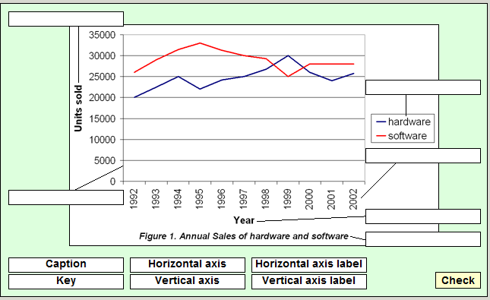
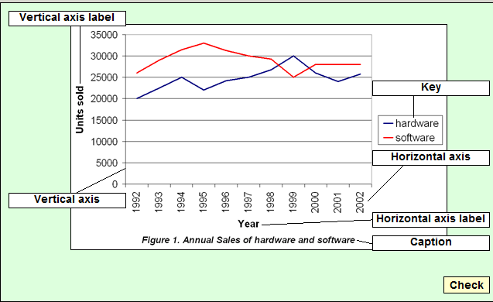
How to describe a graph?
Activity 1: Understanding how to present a graph
Look at the example graph below and name the different parts of the graph

Slide 12
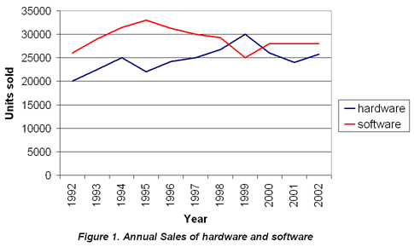
Activity 2: Understanding information in a graph
Study the line graph and then read the statements. Decide if they are true or false
1. The graph shows annual sales of hardware and software over a period of ten years.
2. The graph only shows where sales have increased.
3. The horizontal axis on the graph shows the number of units sold.
T
F
F
T
4. The vertical axis shows the number of units sold and is measured in numbers which go up by 5000 at each level.
5. It would be fair to say that sales figures have gone up and down over the period described.
T

Slide 13
Activity 3: Describing a graph
Read the following text, which describes the graph on the right. Select the words that are needed to complete the text.
shows
The graph ________ the sales figures for two products from 1992 to 2002. The __________ axis represents years and the ________ axis represents units sold. The graph _________ both the _________ and the ________ in sales for both products, as sales __________ during the ten-year period.
horizontal
vertical
presents
increase
decline
fluctuated
horizontal vertical shows presents increase decline fluctuated

Slide 14
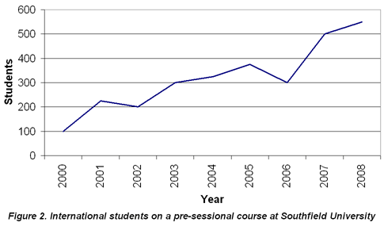
Activity 4: Writing about a graph
Study the graph below. Write a brief paragraph describing the data shown in the graph.
The graph shows the number of international students on a pre-sessional course, at Southfield University, from 2000 to 2008. The horizontal axis presents the years and the vertical axis shows student numbers.
The graph indicates that numbers of international students on the course each year have fluctuated. There was a decline in student numbers from 2001-2002, and 2005-2006, but generally, student numbers have increased over the period.

Slide 15
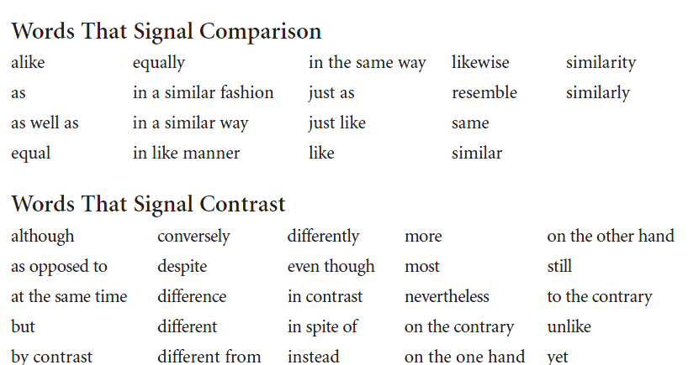
Compare or Contrast?

Slide 16

P54
Elements in the First Paragraph?
Sentences | Elements
Sentence 1
Sentence 2
Sentence 3
Sentence 4
Research problem
Material
Review of Methodology section
Procedure
Statistical treatment

Slide 17
P54-55
Elements in Result Section?
paragraphs | Elements
Paragraph 1
Paragraph 2
Paragraph 3
Table
Review of methodology section
Description of Table 1
Comparison and Contrast of Data in Table 1
Presentation of Research Data

Slide 18
Paragraphs | Verbs locating the results
In the 2nd paragraph
In the 3rd paragraph
discovered
found
records
demonstrated
displayed
showed
Sentences | Function
Last sentence in the 2nd paragraph
Last sentence in the 3rd paragraph
Comparison with previous literature or hypothesis
summary of the major research results

Slide 19
P58
Graphic description
2.1.1 The following table lists results of a questionnaire concerning students’ interest and performance in class.
Question 1: You are very interested in the English writing course.
□Strongly agree □agree □I don’t know □ disagree □strongly disagree
Question 2: You are active in group discussion in the classroom.
□Strongly agree □agree □I don’t know □ disagree □strongly disagree
Table 1 Data concerning the students’ interest and participation
Item | strongly agree |  | agree |  | I don’t know |  | disagree |  | strongly disagree
 | N | P | N | P | N | P | N | P | N | P
1 | 35 | 50% | 25 | 35.7% | 2 | 2.9% | 5 | 7.1% | 3 | 4.3%
2 | 28 | 40% | 28 | 40% | 3 | 4.3% | 7 | 10% | 4 | 5.7%
Note: N=number; P=percentage

Slide 20
Now you are required to report the results based on the data above. The following sentence patterns may be used in your report:
Of all the participants, 70 completed and returned the questionnaire.
The majority of respondents felt that …
Over a half of those surveyed indicated that …
A small number of respondents …
A majority of participants indicated …
In response to Question 1, most of those surveyed indicated that …
The overall response to this questionnaire was very positive.
It is apparent from the table above that …

Slide 21
Key for reference
The questionnaire survey was related to students’ interest and performance in English class. 82 participants were involved. Of all the subjects, 70 completed and returned the questionnaire form. Question 1 was about the interest in English writing course. A half of the participants surveyed indicated that they were very interested in it. 37.5% agreed that they had interest in the course. Only a small number of respondents felt that they did not have any interest in it. In response to Question 2 concerning the performance in class, most of the respondents (80%) indicated that they were active in group discussion in class. Only 5.7% of those surveyed indicated that they were not active at all in such a classroom activity. It is apparent from the table that the majority of the students liked the English writing course and were willing to participate in group discussion. The overall response to this question was very positive.

Slide 22
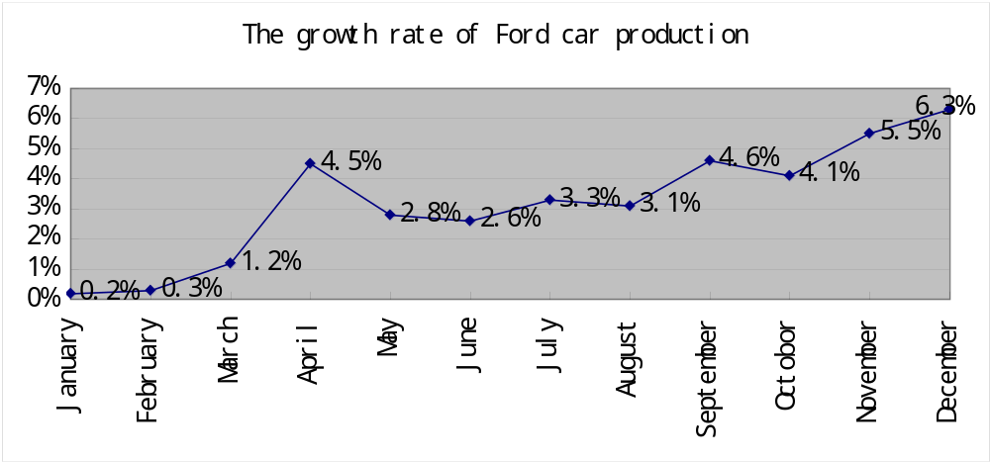
P59
2.1.2 The following line graph shows an upward trend in growth rate of Ford car production during the period from January to December 2011.

Slide 23
Look at the line graph carefully first and then do the following exercises.
A. Mark the following places in the graph.
a) The bottom of the line;____________________
b) The peak of the line;______________________
c) The fluctuating part.______________________
in January
in December
from May to October

Slide 24
B. Describe the growth rate of Ford car production in the following months respectively. Try to use the phrases or sentence patterns of graphic description you learned in this section.
In January:
b) From March to April:
c) From May to September:
d) From October to December:
C. What does the overall line graph reveal in the growth rate of Ford car production during the period from January to December 2011? _______________________________________________.
____________________________________________________
The growth rate of car production was at the bottom of the whole year.
The growth rate was about 1.2% in March. Then, it rose sharply to nearly 4.5% in April.
There was a fluctuation in the growth rate of car production between 2.6% and 4.6%.
It declined to 4.1% in October, but then increased rapidly and reached the peak at 6.2% in December.
The overall graph shows an upward trend in the growth rate
The graph reveals two important rising periods during the whole year.

Slide 25
P61
Comparison and contrast
Age | Subjects
 | Math | Science | Geography | Languages | PE
7 | 63 | 70 | 63 | 62 | 71
10 | 65 | 72 | 68 | 60 | 74
13 | 69 | 74 | 70 | 60 | 75
15 | 67 | 73 | 64 | 58 | 78
Boys
Age | Subjects
 | Math | Science | Geography | Languages | PE
7 | 64 | 69 | 62 | 62 | 65
10 | 65 | 73 | 64 | 67 | 64
13 | 64 | 70 | 62 | 65 | 62
15 | 68 | 72 | 64 | 75 | 60
Girls

Slide 26
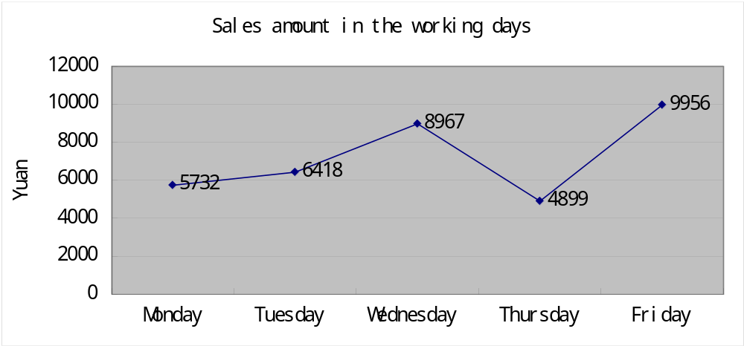
P64
Describing a line graph
3.2.1 The line graph below shows the sales amount of an online shop from Monday to Friday. Match the descriptive statements with the graph. Which are the correct statements describing the graph?
A. The sales amount increased sharply from Monday to Tuesday.
B. The sales amount reached a peak on Friday.
C. There was a fluctuation in the sales amount.
D. The sales amount dropped drastically from Wednesday to Thursday.

Slide 27
Key for reference
The line graph below shows the sales amount of an online shop from Monday to Friday. As the graph indicates, the sales amount of the online shop increased slowly from Monday to Tuesday (5732 yuan and 6418 yuan respectively). From the graph we can see that there was a fluctuation in the sales amount. From Wednesday to Thursday, the sales amount dropped drastically from 8967 yuan to 4899 yuan. Actually, on Thursday it was in the bottom of the whole week. But the online shop sold well on Friday and the sales amount reached 9956 yuan, a peak of the whole week. The line graph reveals the change of the sales amount of an online shop from Monday to Friday.

Slide 28
P65
Describing a table
Table Y: Teaching Language(s) Used by English Teachers in Class
Choices | Frequency | Percent
Almost English | 6 | 30%
Mainly English | 13 | 65%
Mainly Chinese | 1 | 5%
Almost Chinese | 0 | 0%
Total | 20 | 100%
1. What does the table show us?
It shows the teaching language(s) used by English teachers in class.
2. How many teaching languages are mentioned in the table?
Two.
3. What language is used most frequently by English teachers in class?
English.
4. Do English teachers in class often use Chinese?
No.

Slide 29
Table Y: Teaching Language(s) Used by English Teachers in Class
Choices | Frequency | Percent
Almost English | 6 | 30%
Mainly English | 13 | 65%
Mainly Chinese | 1 | 5%
Almost Chinese | 0 | 0%
Total | 20 | 100%
5. In summary, what impression do you have on the teaching language(s) used by English teachers in class?
English teachers attempt to put their students in an entire English atmosphere, which is good for students’ English learning.

Slide 30
Table Y: Teaching Language(s) Used by English Teachers in Class
Choices | Frequency | Percent
Almost English | 6 | 30%
Mainly English | 13 | 65%
Mainly Chinese | 1 | 5%
Almost Chinese | 0 | 0%
Total | 20 | 100%
Table 1 shows the teaching language(s) used by English teachers in class. As Table 1 shows, among the teachers interviewed, 65% of them mainly use English as their teaching language. It indicates that generally speaking, teachers in English classes speak more English than Chinese. They attempt to put their students in an entirely English atmosphere, which is undoubtedly an asset for students’ English learning.

Slide 31
Academic Writing Course
Thank You !

