Slide 1
Automatic Accessibility Evaluation and Analytics
of NHS General Practices' Websites ﻿
Third Year Project
Ruoqing Zheng
Supervisor: Dr. Markel Vigo

Slide 2
Content
Motivation
Aims
Project Design
Demonstration
Results and Evaluation

Slide 3
Web Accessibility
User group:
People with disabilities
Order people
Rural areas
Low accessibility:
Users get excluded
Web accessibility evaluation:
Detect inaccessibility
Monitor accessibility level
Fix and improve
Crucial

Slide 4
Accessibility Evaluation
Web Content Accessibility Guidelines (WCAG) 2.0
Testable success criteria
Organized under 4 principles:
Perceivable
Operable
Understandable
Robust
At 3 levels: A, AA, AAA

Slide 5
Aims
Web accessibility evaluation of NHS GP websites:
Build crawlers to collect GP information
Embed evaluation tool AChecker
Analyze evaluation results
Visualize findings on a dashboard
Update the results quarterly

Slide 6
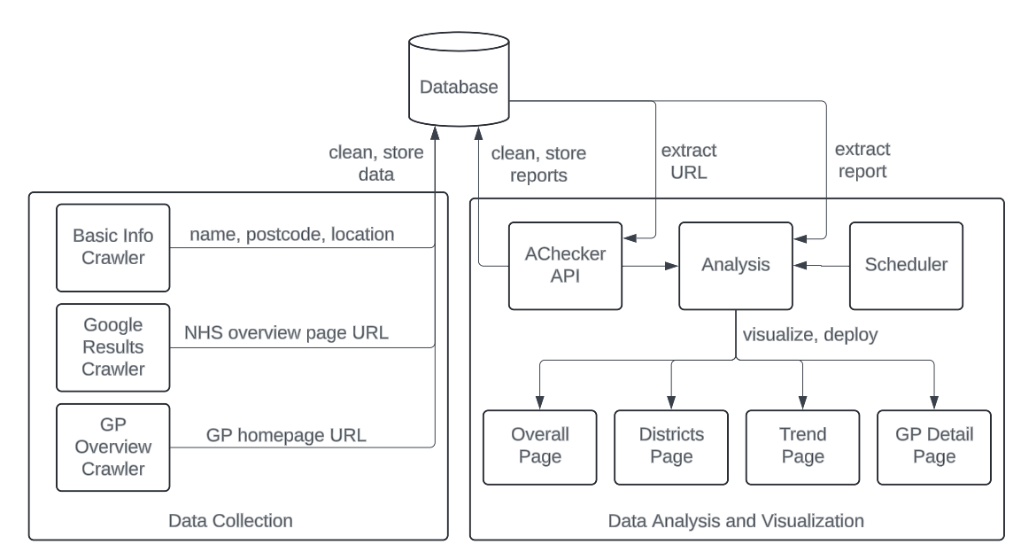
Design: overview
Crawling project
Analysis project

Slide 7
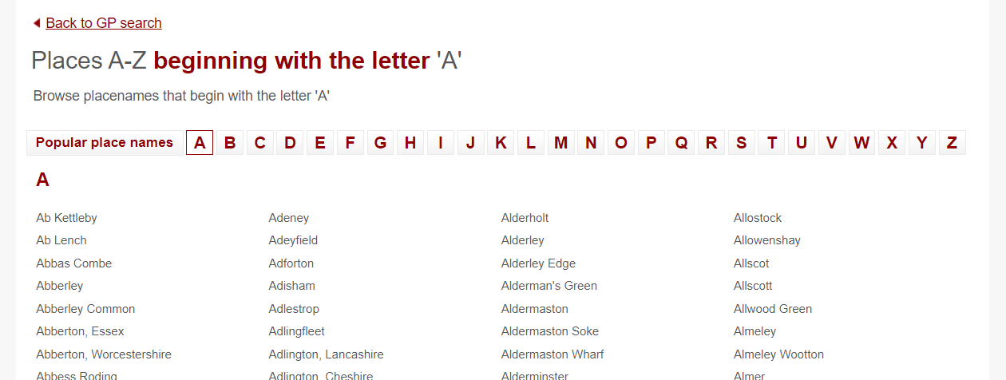
Data Collection
Source: NHS list of GP locations [1]

Slide 8
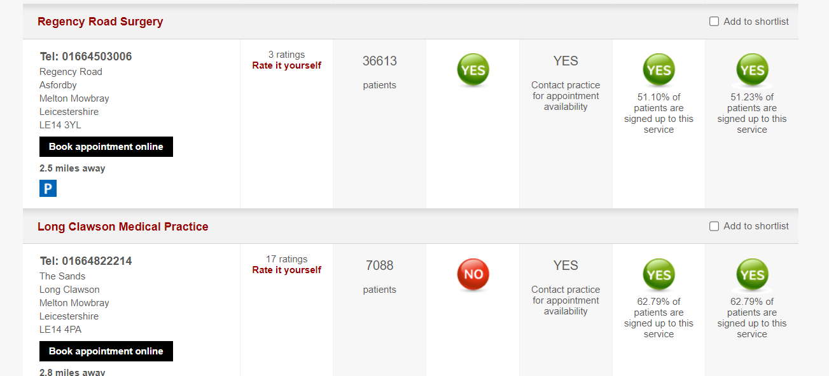
Data Collection
Source: NHS List of GPs in a region [2]

Slide 9
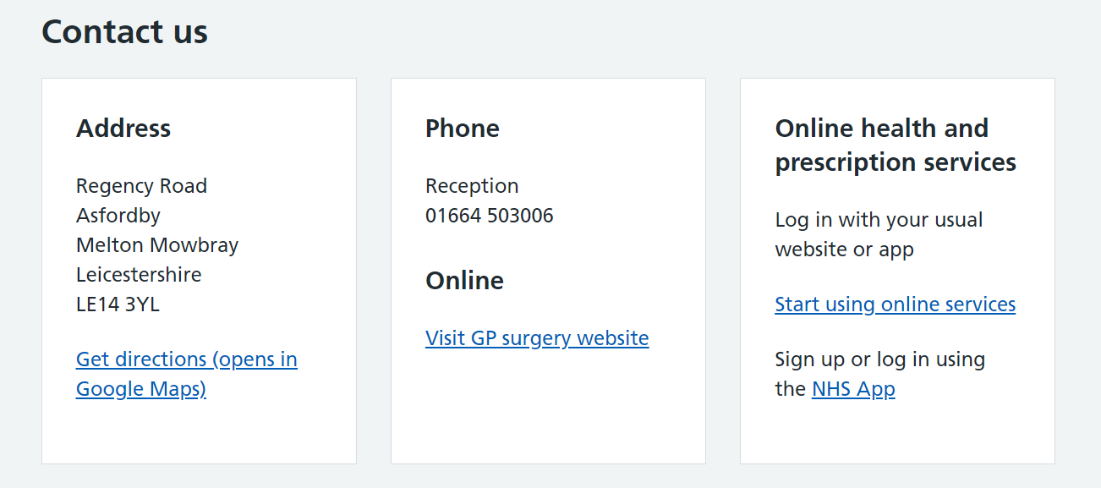
Data Collection
Source: NHS overview page for a GP [3]

Slide 10
Data Collection
Problem…
Page not found error

Slide 11
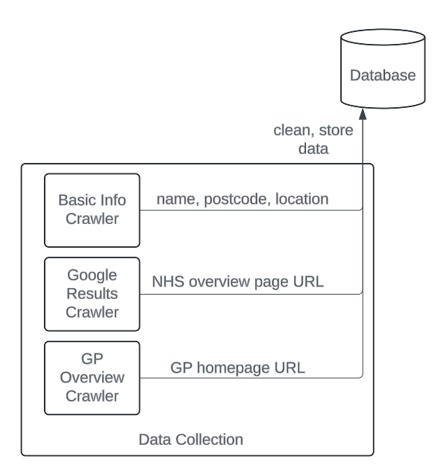
Data Collection
Google search:“[GP postcode] [GP name] nhs gp overview”

Slide 12
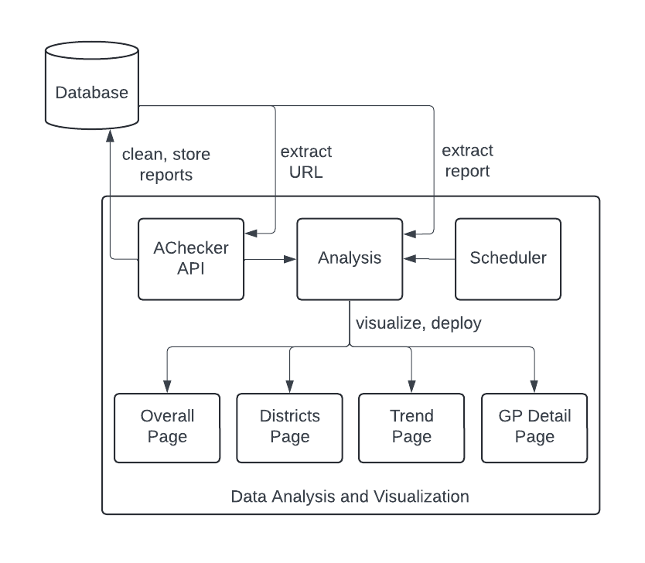
Analysis and Visualization
Backend
AChecker evaluation tool
Known problems (errors), likely and potential problems
Analysis
Scheduler

Slide 13
Analysis and Visualization
Frontend
Bootstrap and Echarts
Deployment
PythonAnywhere

Slide 14
Demonstration
Now let's check the website…

Slide 15
Evaluation
Automated tests
Single functionality
General behavior
Usability evaluation
Tasks and questions: 90% accuracy
System Usability Scale (SUS): over 90% satisfaction
Strongly
Disagree
Strongly
Agree

Slide 16
Achievements
Build three crawlers to collect GP information
Names, postcodes, locations, URLs
Integrate AChecker API to evaluate web accessibility of 6,593 GPs
Analyze evaluation results based on WCAG 2.0
Build a user-friendly dashboard to visualize evaluation results
General, regional, individual GP analysis
Embed a scheduler to update and store the results quarterly

Slide 17
Improvements
More data
Number of registered patients
Website ratings
Evaluate additional widgets
More evaluation tools
Manual check

Slide 18
Thank you

Slide 19
References
[1] National Health Service. Places a-z. https://www.nhs.uk/service-search/ other-services/GP/Location/Places/A/4, 2024.
[2] National Health Service. Results for GP in Ab Kettleby. https://www.nhs.uk/service-search/other-services/GP/Ab-Kettleby/Results/4/-0.931/52.799/4/1?distance=25, 2024.
[3] National Health Service. Regency Road Surgery Overview. https://www.nhs.uk/services/gp-surgery/regency-road-surgery/X35645?gsdServiceId=4, 2024.

