Slide 1
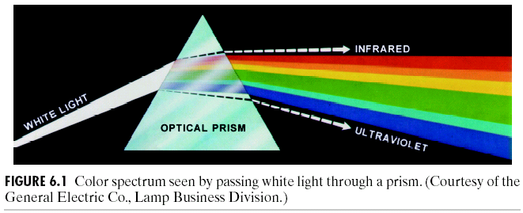
Chapter 6
Color Image Processing
Isaac Newton, 1666

Slide 2
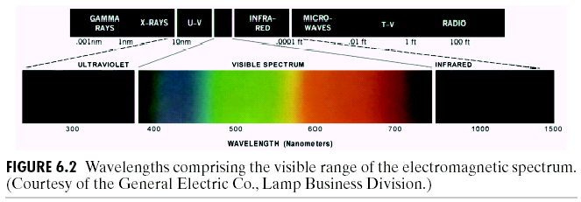
Chapter 6
Color Image Processing
Electromagnetic Spectrum

Slide 3
Chapter 6
Color Image Processing: Some terminology
The only attribute of achromatic (void of color) light is its intensity (grey level)
Chromatic light is described using the following basic quantities:
-Radiance is the total amount of energy flowing from the light source, measure in Watts
-Luminance is the amount of energy perceived by an observer, measured in lumens
-Brightness is subjective

Slide 4
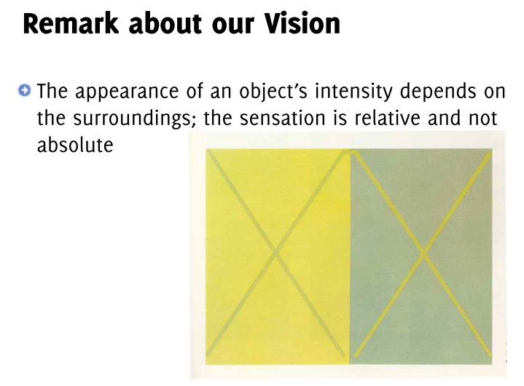

Slide 5
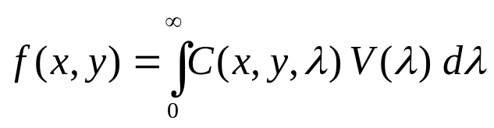
Chapter 6
Color Image Processing:
Color Image Representation
Color images can be represented by an intensity function C(x,y,λ) which depends on the wavelength λ of the reflected light. (so, for fixed λ, C(x,y,λ) represents a monochrome image).
As in the monochrome case, 0 < C(x,y,λ) < C_{max}
The brightness response of a human observer to an image will therefore be
where V(λ) is the response factor of the human eye at frequency λ.
V(λ) is called the relative luminous efficiency function of the visual system.
For the human eye, V(λ) is a bell-shaped function, see plot next slide.

Slide 6
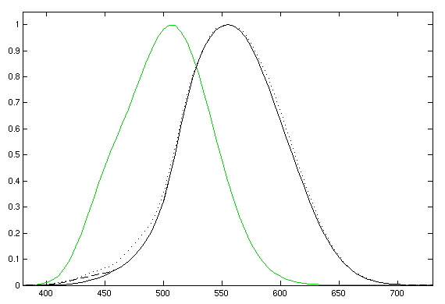
Relative Luminous Efficiency Function
Photopic (black) and scotopic (green) luminosity functions

Slide 7
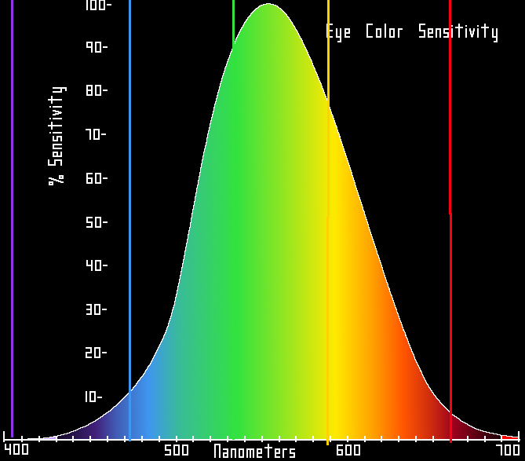
Relative brightness sensitivity of the human visual system as a function of wavelength

Slide 8
Human Eye..
The human eye senses this spectrum using a combination of rod and cone cells for vision.
Rod cells are better for low-light vision, but can only sense the intensity of light, whereas while cone cells can also discern color, they function best in bright light.
There are 6-7 million cones (sensors) in the human eye
Three types of cone cells exist in your eye, with each being more sensitive to either short (S), medium (M), or long (L) wavelength light.
These principal sensing categories correspond roughly to red, green and blue: (65% of cones are sensitive to red, 33% to green and 2% to blue)

Slide 9
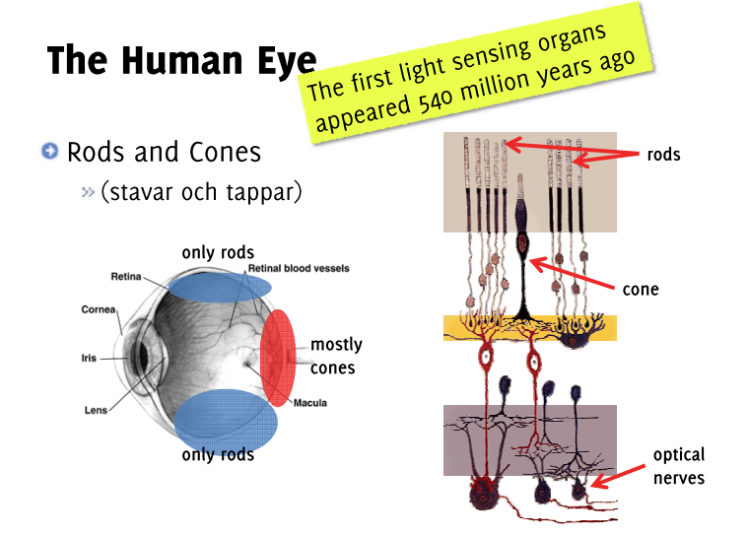


Slide 10
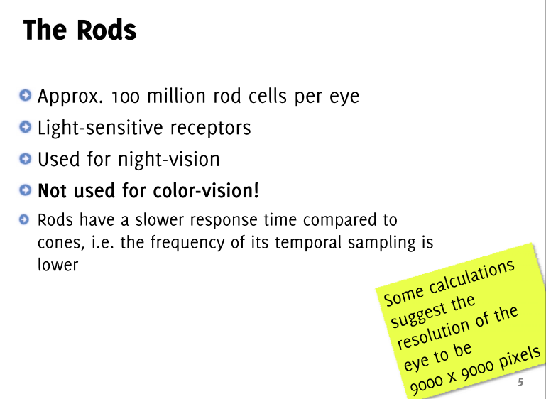

Slide 11
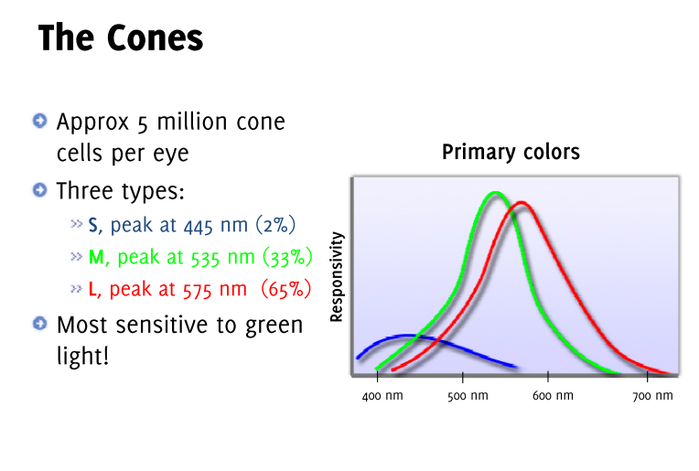

Slide 12
Chapter 6
Color Image Processing: Human Eye
The set of signals possible to sense at all three cone cells describes the range of colors we can see with our eyes. The diagram in the next slide illustrates the relative sensitivity of each type of cell for the entire visible spectrum. These curves are often also referred to as the "tristimulus functions.“

Slide 13
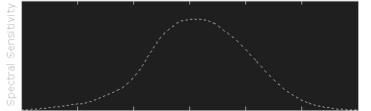
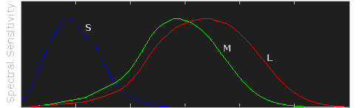
Tristimulus functions
Raw data courtesy of the Colour and Vision Research Laboratories (CVRL), UCL.

Slide 14
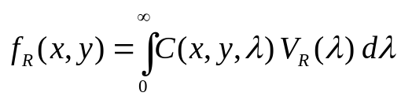
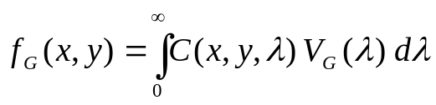
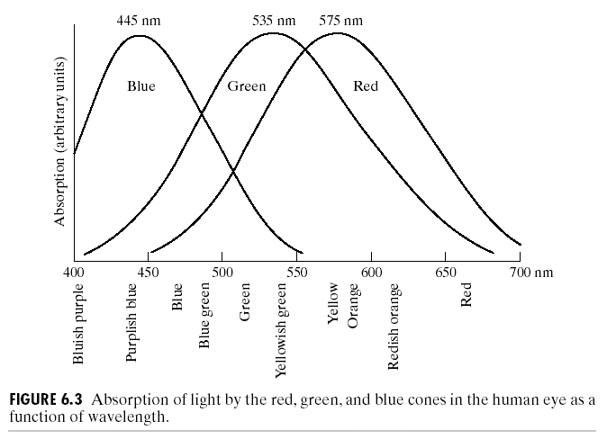

Chapter 6
Color Image Processing:
Color Image Representation
We have three brightness response functions:

Slide 15
Chapter 6
Color Image Processing
Due to these absorption characteristics, colors are seen as variable combinations of so called “primary colors” red, green and blue.
In 1931, CIE (International Commission on Illumitation) designated the following:
Blue = 435.8nm
Green = 546.1nm
Red = 700nm
The shown detailed experimental curves became available 1965.
Remember that there is no single color called red, green or blue
in the color spectrum!
Also, these fixed RGB components cannot generate ALL
spectrum colors!

Slide 16
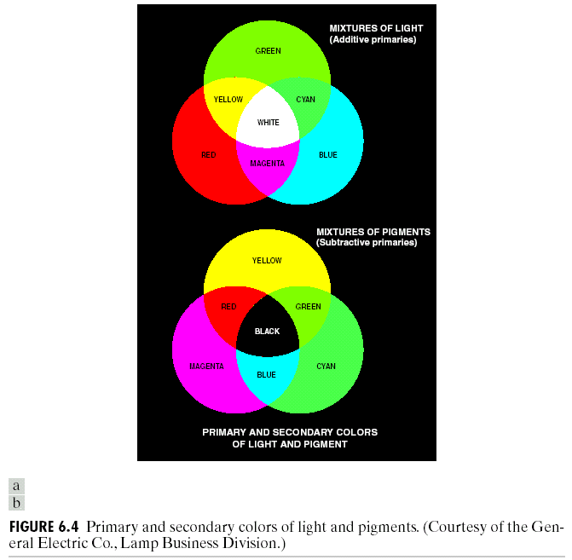
Chapter 6
Color Image Processing
Primary colors can be added
in pairs to procude secondary
colors of light: e.g. magenta,
cyan and yellow.
Mixing the three primaries
produces white color.
A primary color of pigments or
colorants is defined as one that
subtracts or absorbs a primary
color of light and reflects the
other two.
Primary colors of pigments
are magenta, cyan and yellow
and their secondary colors are
red, green and blue

Slide 17
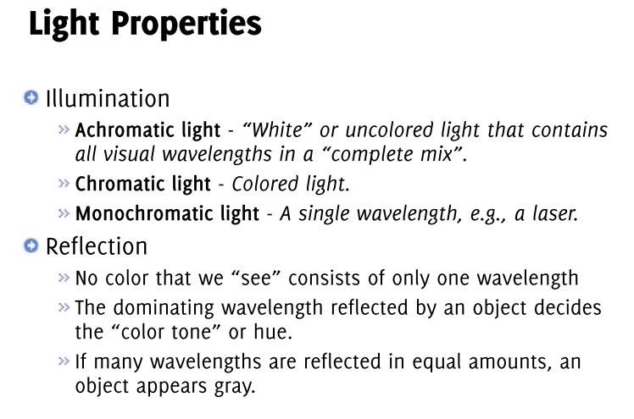

Slide 18
Chapter 6
Color Image Processing: Color Image Representation
Colors are distinguished from another by brightness, hue, and saturation.
Brightness embodies the achromatic notion of intensity.
Hue is associated with the dominant wavelength in the mixture and represents the perceived dominant color.
Saturation refers to the relative purity or the amount of white light mixed with a hue.
Together hue and saturation are called chromaticity.

Slide 19
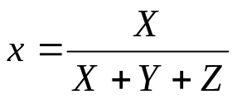
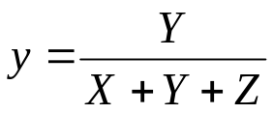

Chapter 6
Color Image Processing: Color Image Representation
Tristimulus Values (X,Y,Z)
Are the amounts of red, green and blue needed to form any particular color.
A color is specified by its trichromatic coefficients defined as:
Note that x+y+z = 1! (i,e. only two of the trichromatic coefficients
are independent.)
Experimental curves and tables are used to find the tristimulus values
needed to generate a given color.

Slide 20
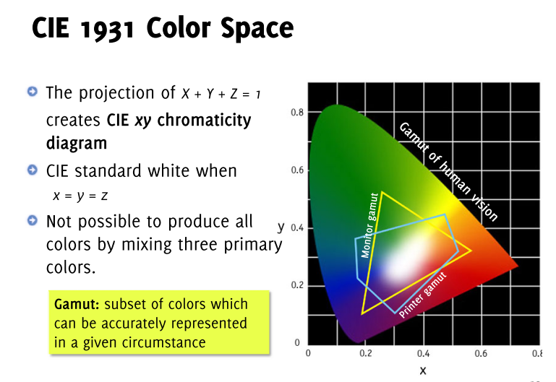

Slide 21
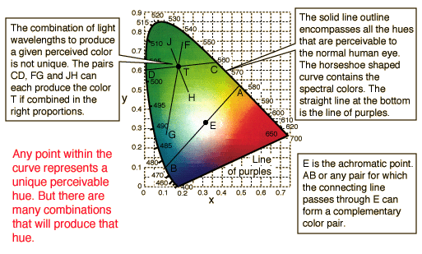
Chapter 6
Color Image Processing

Slide 22
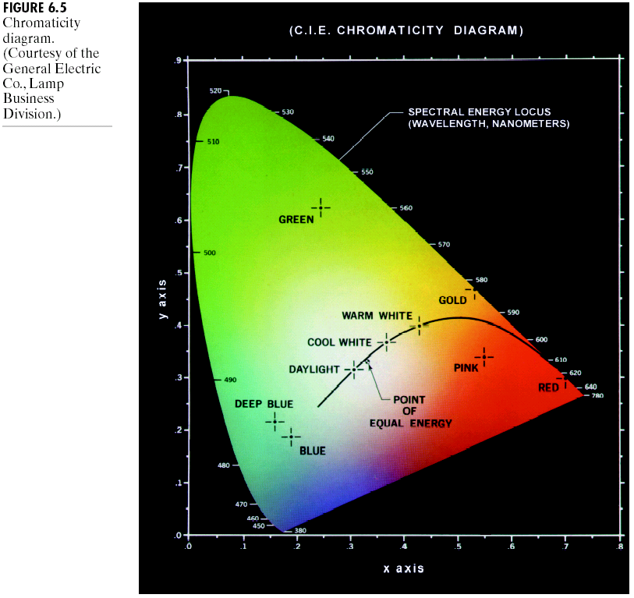
Chapter 6
Color Image Processing
Example: the point shown as GREEN
is made of 62% green, 25% red
and 13% blue.

Slide 23
Chapter 6
Color Image Processing
Pure colors are mapped on the boundary of the
chromaticity diagram, fully saturated colors
Colors inside the diagram are combinations of
these colors
Reference white is the point of equal energy, with
zero saturation value
The diagram is useful for color mixing, e.g.
a straight line joining any two points defines all
colors generated by adding those colors,
in particular, if one of these points is reference
white and the other is some color on the
boundary, then the colors on the line in-
between represent all the shades of that
particular spectrum color

Slide 24
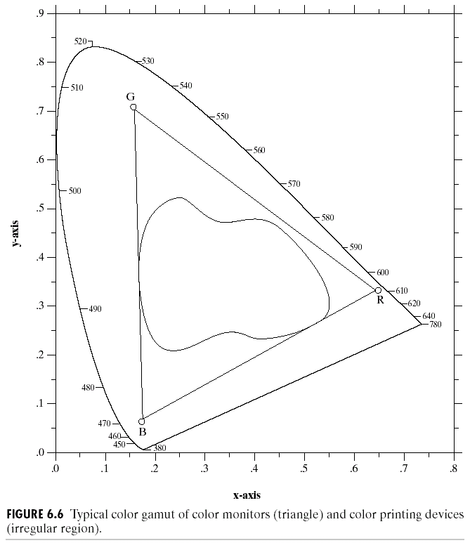
Chapter 6
Color Image Processing
color gamut of a high
quality color printer,
irregular shape is due
to additive and
subtractive color
combinations
Typical color
gamut of an
RGB display
Remember that due to the shape of the chromaticity diagram, no fixed
three colors can reproduce all colors inside the diagram!

Slide 25
Chapter 6
Color Image Processing: Color Models
Color models or color spaces refer to a color coordinate system in which each point represents one color.
Different models are defined (standardized) for different purposes, e.g.
Hardware oriented models:
- RGB for color monitors (CRT and LCD) and video cameras,
- CMYK (cyan, magenta, yellow and black) for color printers
Color manipulation models:
- HSI (hue, saturation and brightness) is closest to the human visual system
- Lab is most uniform color space
- YCbCr (or YUV) is often used in video where chroma is down-sampled (recall that the human visual system is much more sensitive to luminance than to color)
- XYZ is known as the raw format
- others
Two important aspects to retain about color models:
conversion between color models can be either linear or nonlinear,
some models can be more useful as they can decouple color and gray-scale components of a color image, e.g. HSI, YUV.

Slide 26
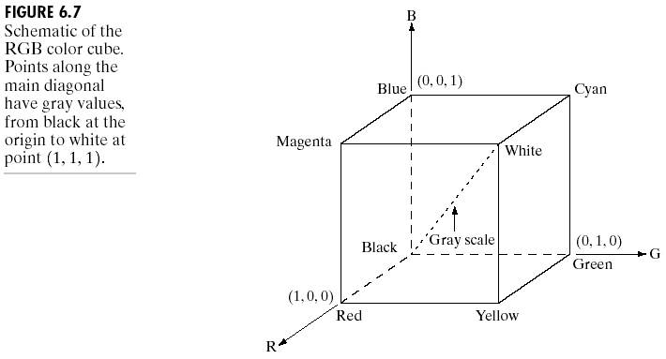
Chapter 6
Color Image Processing: RGB Color Model
The eight vertices of the cube are occupied by
red, green and blue (primary colors)
magenta, cyan and yellow (secondary colors)
and finally black and white.
(RGB values have been normalized in the range [0,1])

Slide 27
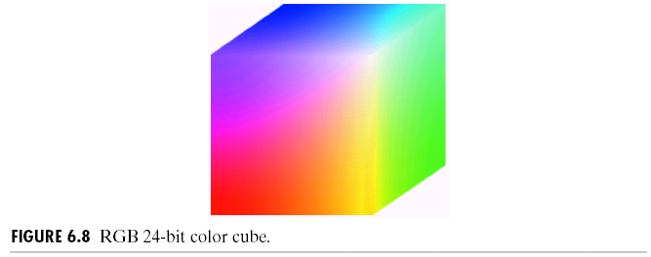
Chapter 6
Color Image Processing
Pixel depth refers to the number of bits used to represent each pixel in the RGB space
If each pixel component (red, green and blue) is represented by 8 bits, the pixel is said
to have a depth of 24 bits.
A full-color image refers to a 24-bit RGB color image. The number of possible colors
in a full-color image is:
(2⁸)³ = 16,777,216 colors (or 16 million colors)

Slide 28
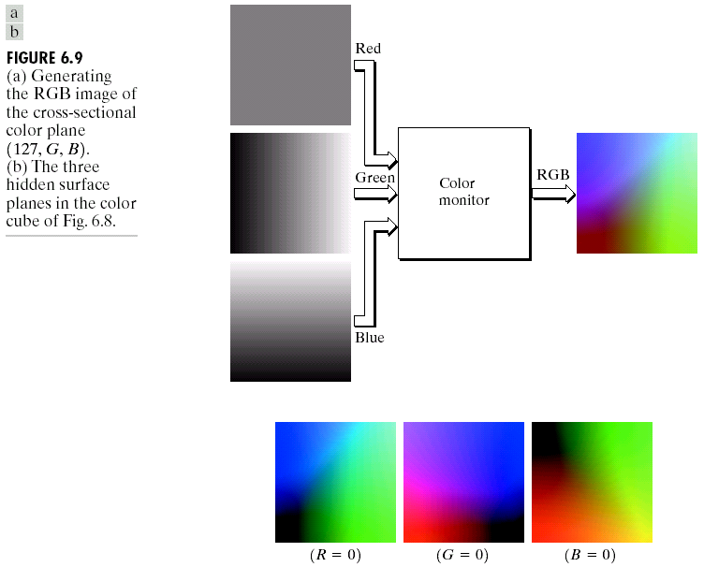
Chapter 6
Color Image Processing
An example showing
how to generate the RGB
image for the cross-
sectional color plane
(127,G,B)
Note that each plane is
represented as a gray-
scale image.
Note: color image acquisition is
the reverse process, i.e. three
filters are used, each is sensitive
to each of the three primary colors

Slide 29
Chapter 6
Color Image Processing
RGB color cube
The hidden surfaces of the cube

Slide 30
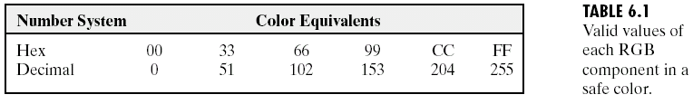
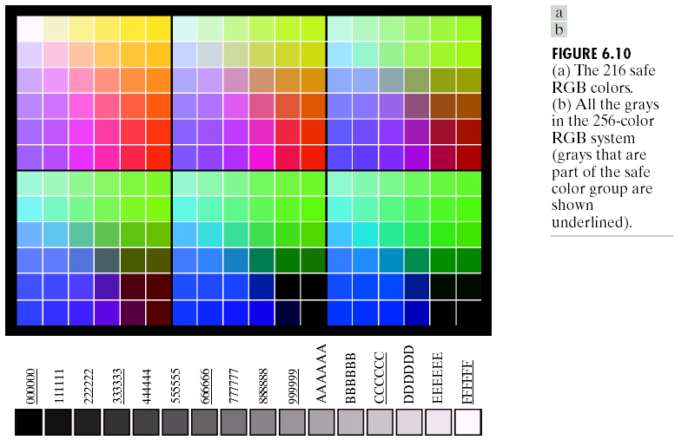
Chapter 6
Color Image Processing
A subset of these colors is called all-systems-safe colors. In Internet
applications they’re called safe Web colors or safe browser colors.
These are colors which are reproduced faithfully independent of the
display capability.
These are 216 colors made with combinations of component values 0,51,102,153,204 and 255
all the grays in the
256-color system

Slide 31
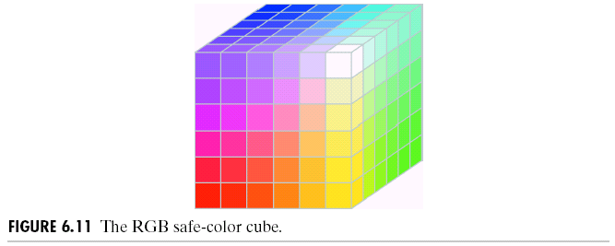
Chapter 6
Color Image Processing
Unlike the color cube which is solid, the safe-color cube
above has valid colors only on the surface planes (36 colors
per plane for a total of 216 colors).

Slide 32
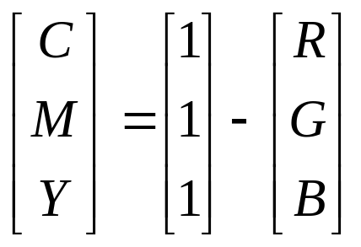
Chapter 6
Color Image Processing: Color Models
CMY and CMYK Color Models
Most devices that deposit color pigments on paper, e.g. printers and copiers, use CMY inputs or perform RGB to CMY conversion internally:
Recall that all color values have been normalised in the range [0,1].
Remarks:
1. Note that, e.g. a surface coated with cyan does not contain red, that is
C = 1 – R.
2. Equal amounts of the pigment primaries should produce black.
In printing this appears as muddy-looking black; therefore, a fourth color,
black is added, leading to CMYK color model (four-color printing).

Slide 33
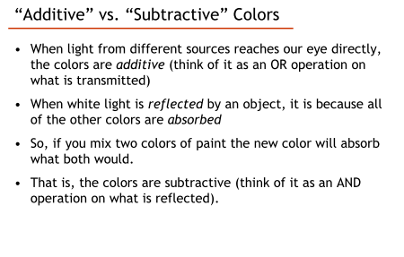

Slide 34
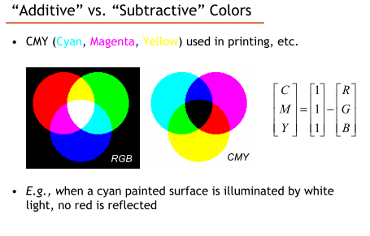

Slide 35
RGB Image Formation in Cameras
Most video cameras use RGB space
Expensive variants use 3 CCDs (charge-coupled devices), each with a filter for the respective wavelength of light
More common variants have a single CCD with different filters

Slide 36
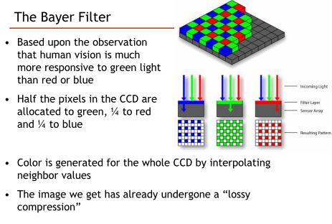

Slide 37
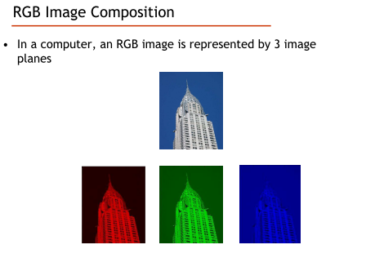

Slide 38
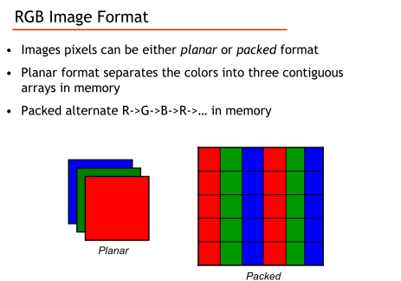

Slide 39
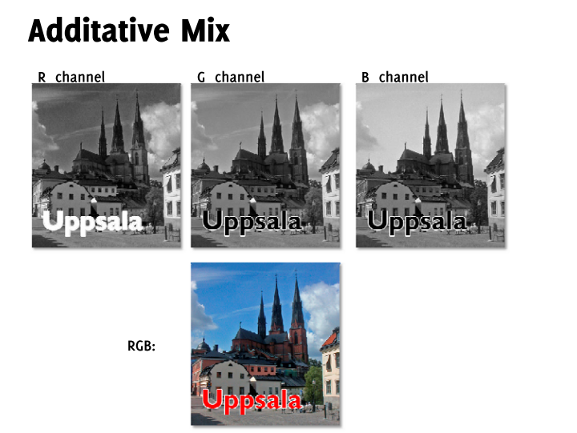

Slide 40
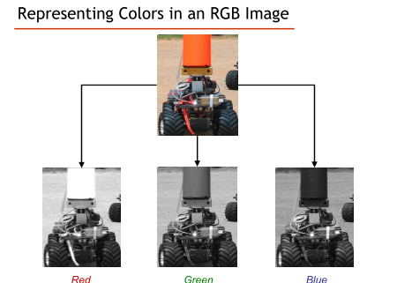

Slide 41
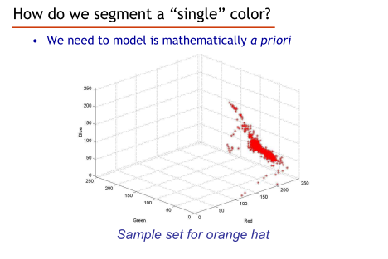

Slide 42
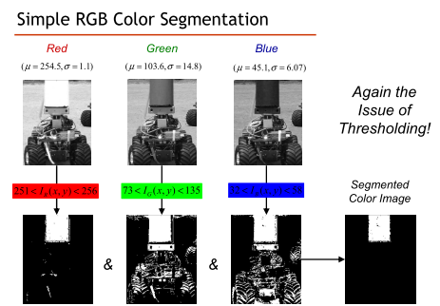

Slide 43
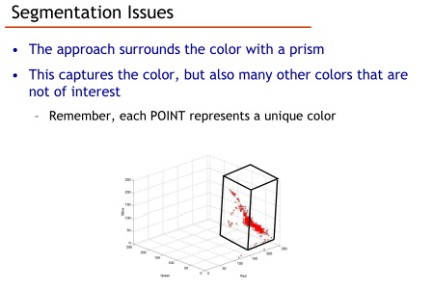

Slide 44
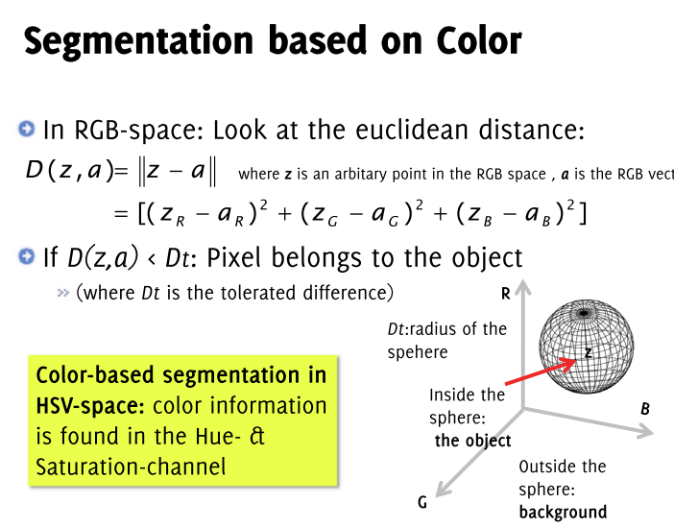

Slide 45
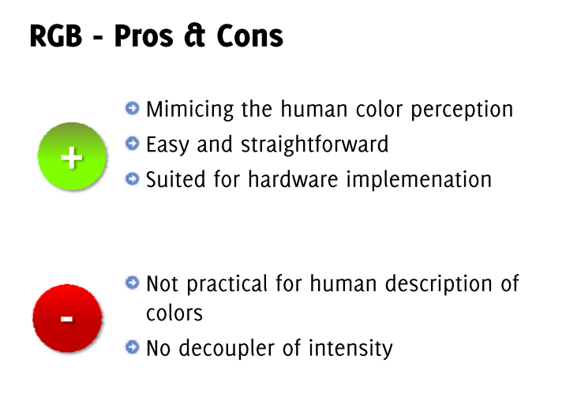

Slide 46
Chapter 6
Color Image Processing: Color Models
HSI Color Model
Although RGB and CMY color models are very well suited for hardware and RGB reflects well the sensitivity of the human eye to these primary colors, both are not suited for describing color in a way that is easily interpreted by humans.
When humans see a color object, they tend to describe it by its hue, saturation and brightness, i.e. HSI model is used
In addition, HSI decouples brightness from the chroma components.

Slide 47
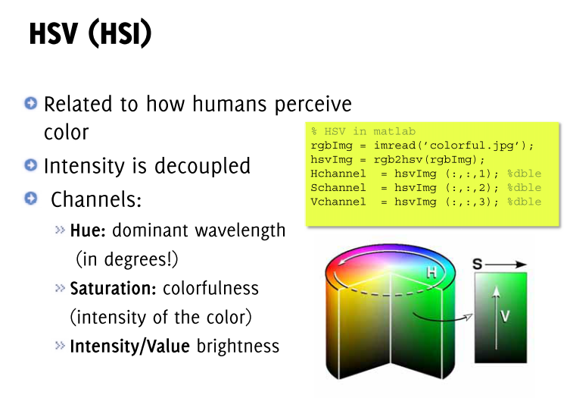

Slide 48
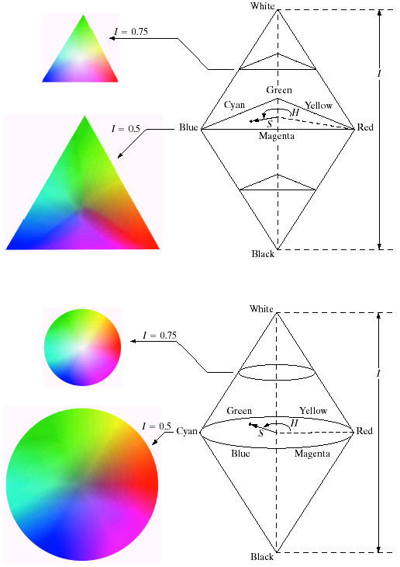
Chapter 6
Color Image Processing:
HSV Color Image Representation
Three Perceptual Measures
1. Intensity or Value or Brightness: varies along the vertical axis and measures the extent to which an area appears to exhibit light. It is proportional to the electromagnetic energy radiated by the source.
2. Hue: denoted by H and varies along the circumference. It measures the extent to which an area matches colors red, orange, yellow, blue or purple (or a mixture of any two). In other words, hue is a parameter which distinguishes the color of the source, i.e., is the color red, yellow, blue, etc.
3. Saturation: the quantity which distinguishes a pure spectral light from a pastel shade of the same hue. It is simply a measure of white light added to the pure spectral color. In other words, saturation is the colorfulness of an area judged in proportion to the brightness of the object itself. Saturation varies along the radial axis.

Slide 49
Chapter 6
Color Image Processing:
HSV Color Image Representation

Slide 50
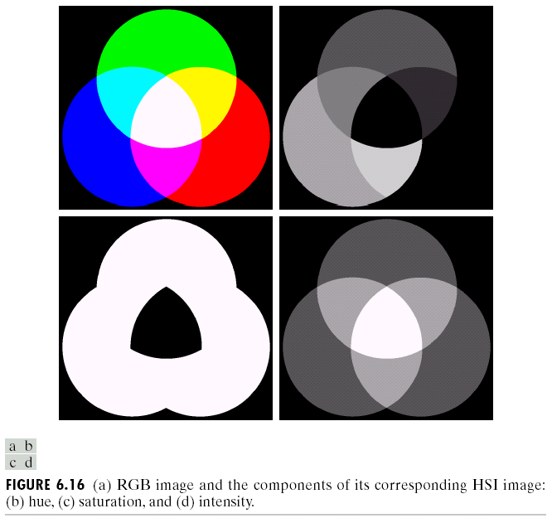
Chapter 6
Color Image Processing: Manipulating HSI Component Images
RGB image composed
of primary and secondary
colors
Hue component
Notice how red is
mapped to black
since its hue is 0
Saturation
component
Intensity
component
Idea: can change any of these color components independently by
changing the gray levels of that component.

Slide 51
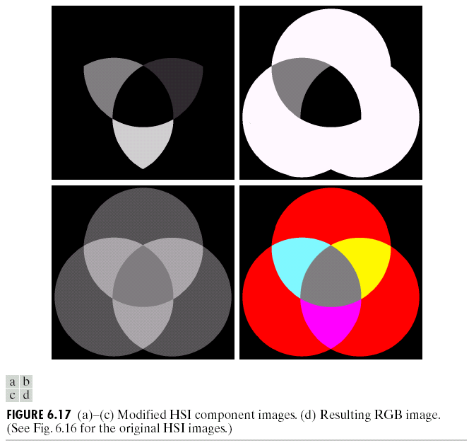
Chapter 6
Color Image Processing
Example of modifying HSI components
Modified hue where blue
and green are set to 0
Modified saturation where
saturation of the cyan region
is halved
Finally, this is the modified
HSI image converted back
to RGB.
Note how the outer circles
became red, cyan saturation
is reduced and white central
region became gray.
Modified intensity where
intensity of the central
white region is halved
HSI color model allows independent control over the hue,
saturation and intensity values.

Slide 52
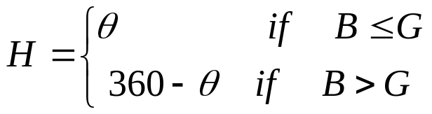
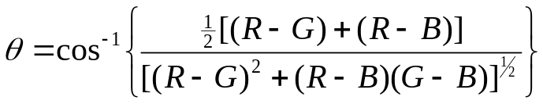
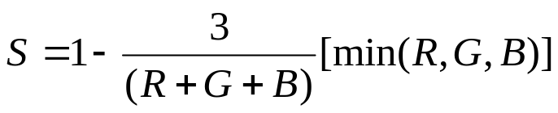
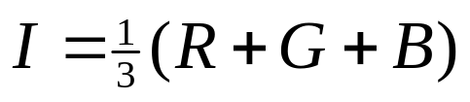
Chapter 6
Color Image Processing: Color Models
HSI-RGB Color Model Conversions
From RGB to HSI:
the hue is:
with
the saturation:
and the intensity is:
It’s assumed that RGB values are normalised and Ө is measured wrt red axis.
Conversion from HSI to RGB depends on which sector H is located.

Slide 53

Chapter 6
Color Image Processing
HSI color model with
different intensity levels
and different cross section
shapes.

Slide 54
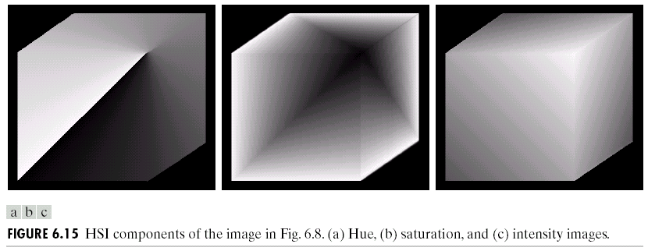
Chapter 6
Color Image Processing
The HSI components of the RGB 24-bit color cube image are shown below.

Slide 55


