Slide 1
Algorithm Analysis 101
Data Structures and Algorithms
Nanjing University, Fall 2019
郑朝栋

Slide 2
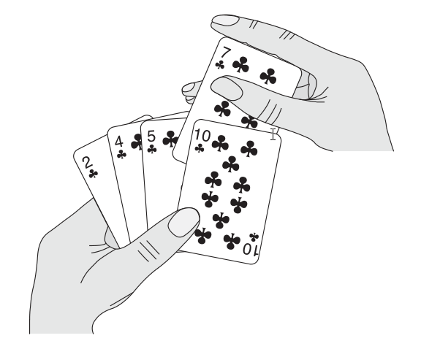
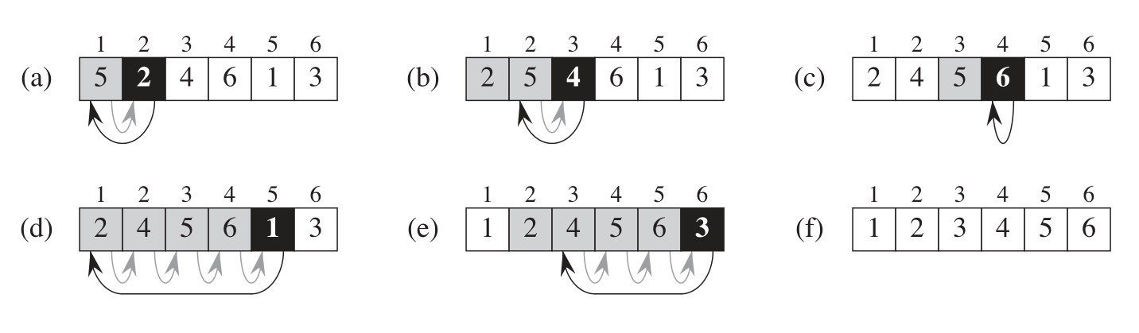
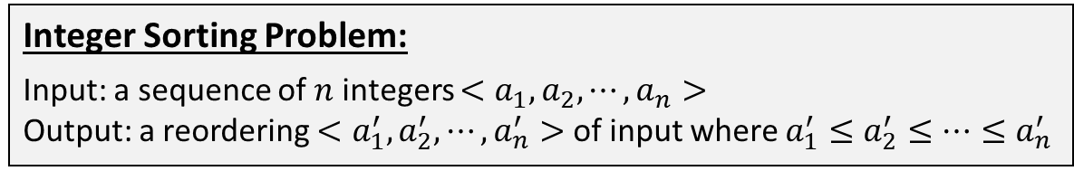
Insertion Sort
Integer Sorting Problem:
Input: a sequence of $n$ integers $<a_{1},a_{2},⋯,a_{n}>$
Output: a reordering $<a_{1}^{′},a_{2}^{′},⋯,a_{n}^{′}>$ of input where $a_{1}^{′}≤a_{2}^{′}≤⋯≤a_{n}^{′}$
Algorithm design strategy 0: wisdom from daily life.
Insertion-Sort (A)
for j = 2 to A.length
key = A[j]
i = j – 1
while (i>0 and A[i]>key)
A[i+1] = A[i]
i = i – 1
A[i+1] = key
Assume we have $j−1$ sorted cards, then put the $j$^{th} card into its correct position.
Notes:
See live demo at https://visualgo.net/en/sorting

Slide 3
Correctness of Insertion Sort
Insertion-Sort (A)
for j = 2 to A.length
key = A[j]
i = j – 1
while (i>0 and A[i]>key)
A[i+1] = A[i]
i = i – 1
A[i+1] = key
An algorithm is correct if for every input instance of the considered problem, the algorithm halts with the correct output.
The algorithm terminates within finite steps on every instance. (WHY?!)
The algorithm outputs correct result on every instance. (WHY?!)

Slide 4
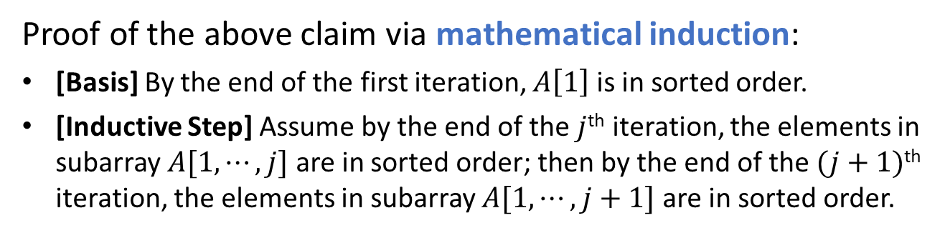
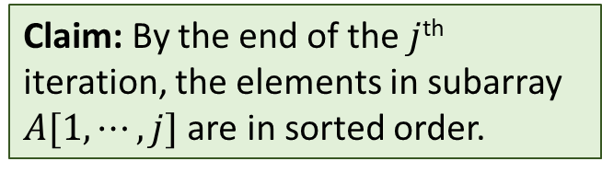
Correctness of Insertion Sort
The algorithm outputs correct result on every instance.
Insertion-Sort (A)
for j = 1 to n
key = A[j]
i = j – 1
while (i>0 and A[i]>key)
A[i+1] = A[i]
i = i – 1
A[i+1] = key
Claim: By the end of the $j$^{th} iteration, the elements in subarray $A[1,⋯,j]$ are in sorted order.
Often called a “loop invariant”,
which gives helpful properties when loop exits.
Proof of the above claim via mathematical induction:
[Basis] By the end of the first iteration, $A\left[1\right]$ is in sorted order.
[Inductive Step] Assume by the end of the $j$^{th} iteration, the elements in subarray $A[1,⋯,j]$ are in sorted order; then by the end of the $(j+1)$^{th} iteration, the elements in subarray $A[1,⋯,j+1]$ are in sorted order.

Slide 5
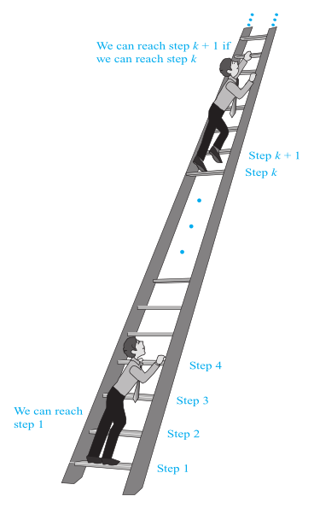
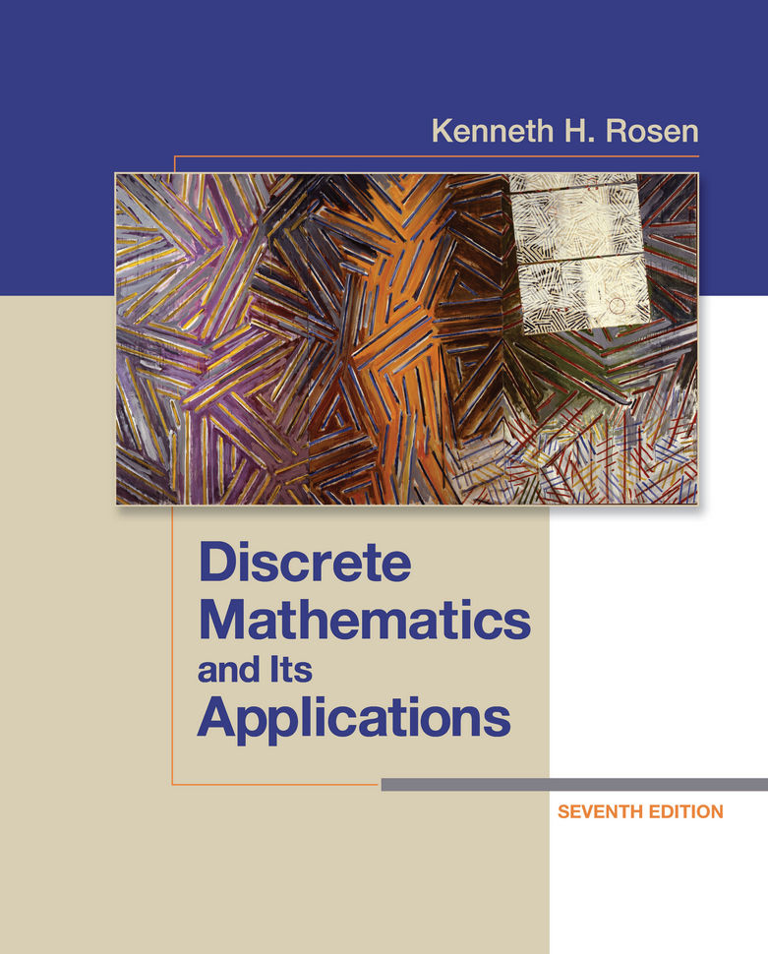
Proving the correctness of algorithms
Some methods and strategies: proof by cases, proof by contraposition, proof by contradiction, etc.
When loops and/or recursions are involved: often (if not always) use mathematical induction.
Review your discrete math book if you feel
unfamiliar with above terms…
[Rosen] Ch.1 (1.7, 1.8) and Ch.5 (5.1, 5.2)

Slide 6
Efficiency of Insertion Sort
Insertion-Sort (A)
for j = 2 to A.length
key = A[j]
i = j – 1
while (i>0 and A[i]>key)
A[i+1] = A[i]
i = i – 1
A[i+1] = key
Time complexity: how much time is needed before halting.
Space complexity: how much memory (usually excluding input) is required for successful execution.
Other complexity measures…
Observation: larger inputs often demands more time.
Cost of an algorithm should be a function of input size.
Observation: same (high-level) algorithm on same input can have different running times on different machines.
Cost of an algorithm should be measured on a specific model of computation.

Slide 7
Running time in the RAM model
Random-Access-Machine (RAM):
relatively simple, yet generic and representative.
One processor which executes instructions one by one.
Memory cells supporting random access, each of limited size.
RAM model supports common instructions.
  Arithmetic, logic, data movement, control, …
RAM model supports common data types.
  Integers, floating point numbers, …
RAM model does not support complex instructions or data types (directly).
  Vector operations, graphs, …
Given an algorithm and an input, running time in the RAM model:
Number of instructions executed before the algorithm halts.

Slide 8

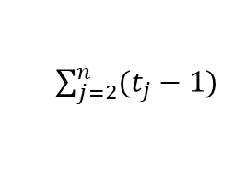
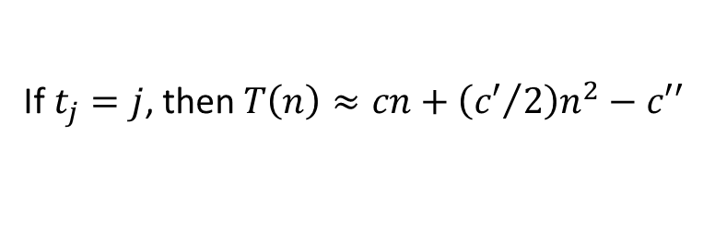





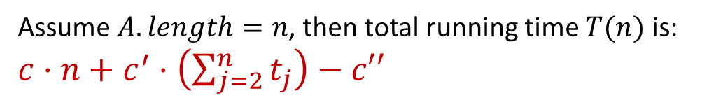


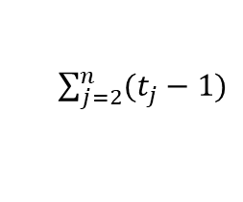





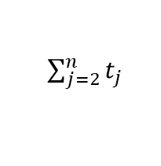

Time complexity of Insertion Sort
Insertion-Sort (A)
for j = 2 to A.length
key = A[j]
i = j – 1
while (i>0 and A[i]>key)
A[i+1] = A[i]
i = i – 1
A[i+1] = key
cost
times
$$c_{1}$$
$$n$$
$$c_{2}$$
$$n−1$$
$$c_{3}$$
$$n−1$$
$$c_{4}$$
$\sum_{j=2}^{n}{t_{j}}$
$$c_{5}$$
$\sum_{j=2}^{n}{(t_{j}−1)}$
$$c_{6}$$
$\sum_{j=2}^{n}{(t_{j}−1)}$
$$c_{7}$$
$$n−1$$
Assume $A.length=n$, then total running time $T(n)$ is:
$c⋅n+c^{′}⋅\left(\sum_{j=2}^{n}{t_{j}}\right)−c′′$
If $t_{j}=1$, then $T\left(n\right)≈cn+c^{′}n−c′′$
Best case: $A$ is sorted
If $t_{j}=j$, then $T\left(n\right)≈cn+\left({c′}/2\right)n^{2}−c′′$
Worst case: $A$ is reverse sorted
Average case???

Slide 9

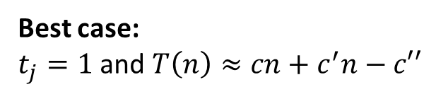
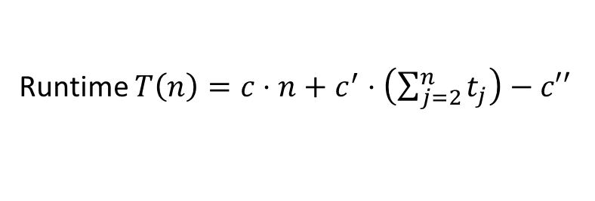

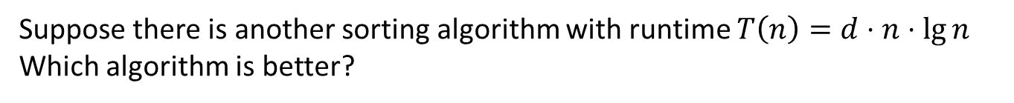

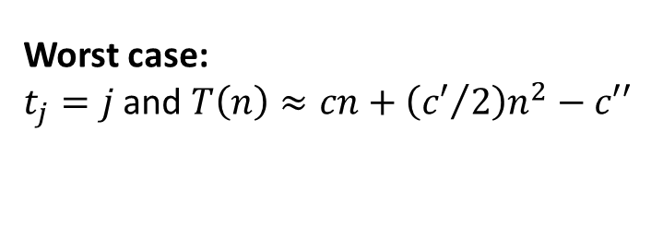

Asymptotic Time Complexity
$$T\left(n\right)=O\left(n^{2}\right)$$
Insertion-Sort (A)
for j = 2 to A.length
key = A[j]
i = j – 1
while (i>0 and A[i]>key)
A[i+1] = A[i]
i = i – 1
A[i+1] = key
Runtime $T\left(n\right)=c⋅n+c^{′}⋅\left(\sum_{j=2}^{n}{t_{j}}\right)−c′′$
Best case:
$t_{j}=1$ and $T\left(n\right)≈cn+c^{′}n−c′′$
$$T\left(n\right)=Θ(n)$$
Worst case:
$t_{j}=j$ and $T\left(n\right)≈cn+\left({c′}/2\right)n^{2}−c′′$
$$T\left(n\right)=Θ\left(n^{2}\right)$$
Suppose there is another sorting algorithm with runtime $T\left(n\right)=d⋅n⋅\lg{n}$
Which algorithm is better?
$$T\left(n\right)=Θ(n\lg{n})$$
Constant coefficients are not that important (when $n$ is large).
Lower-order terms are not that important (when $n$ is large).

Slide 10
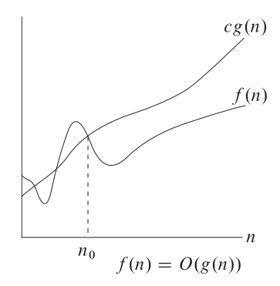
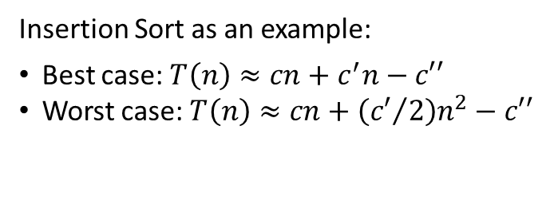
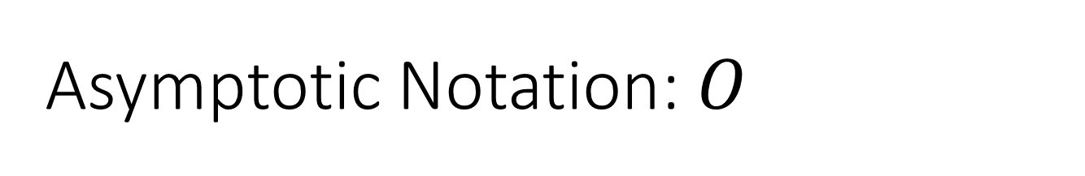



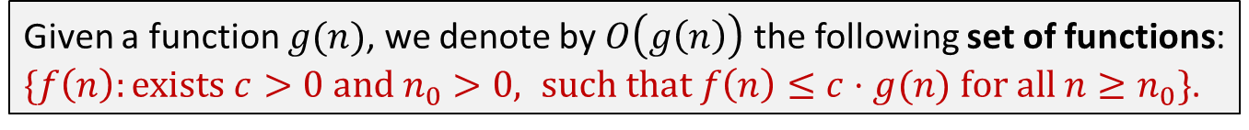

Asymptotic Notation: $O$
Use asymptotic notations to describe asymptotic efficiency of algorithms.
(Ignore constant coefficients and lower-order terms.)
Given a function $g(n)$, we denote by $O\left(g\left(n\right)\right)$ the following set of functions:
$\{f\left(n\right):exists c>0 and n_{0}>0, such that f\left(n\right)≤c⋅g(n) for all n≥n_{0}\}$.
$f\left(n\right)=O(g(n))$: $f(n)$ is asymptotically smaller than $g(n)$.
$f\left(n\right)∈O(g(n))$: $f(n)$ is asymptotically at most $g(n)$.
$O$-notation gives an asymptotic upper bound.
Insertion Sort as an example:
Best case: $T\left(n\right)≈cn+c^{′}n−c′′$
Worst case: $T\left(n\right)≈cn+\left({c′}/2\right)n^{2}−c′′$
$$T\left(n\right)=O(n)$$
$$T\left(n\right)=O\left(n^{2}\right)$$
Q: Is $n^{3}=O\left(n^{2}\right)$? How to prove your answer?

Slide 11
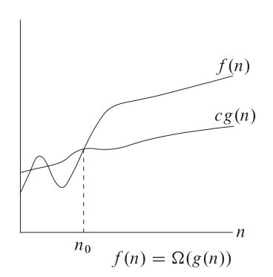
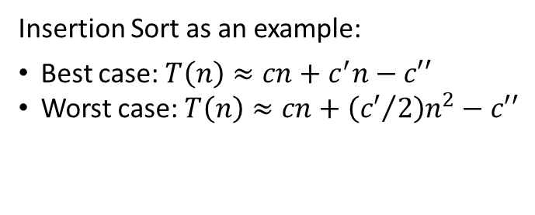
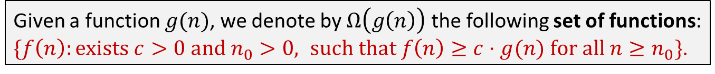
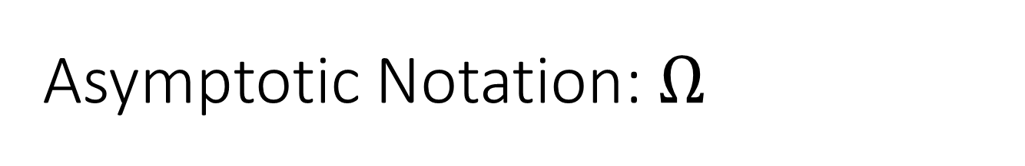



Asymptotic Notation: $Ω$
Given a function $g(n)$, we denote by $Ω\left(g\left(n\right)\right)$ the following set of functions:
$\{f\left(n\right):exists c>0 and n_{0}>0, such that f\left(n\right)≥c⋅g(n) for all n≥n_{0}\}$.
$f\left(n\right)=Ω(g(n))$: $f(n)$ is asymptotically larger than $g(n)$.
$f\left(n\right)∈Ω(g(n))$: $f(n)$ is asymptotically at least $g(n)$.
$Ω$-notation gives an asymptotic lower bound.
Insertion Sort as an example:
Best case: $T\left(n\right)≈cn+c^{′}n−c′′$
Worst case: $T\left(n\right)≈cn+\left({c′}/2\right)n^{2}−c′′$
correct but not helpful
$$T\left(n\right)=Ω(n)$$
$$T\left(n\right)=Ω\left(n^{2}\right)$$
Q: The time complexity of Insertion Sort is $Ω(n^{2})$?

Slide 12
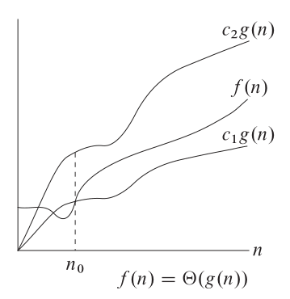
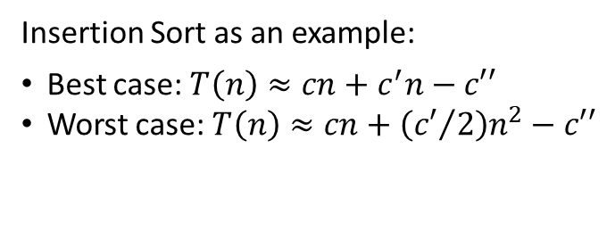
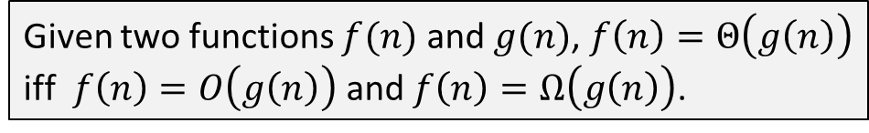
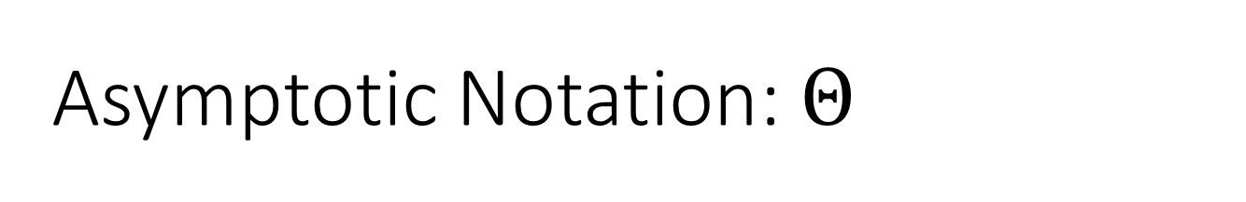

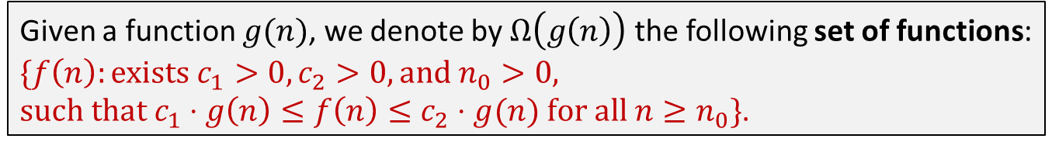
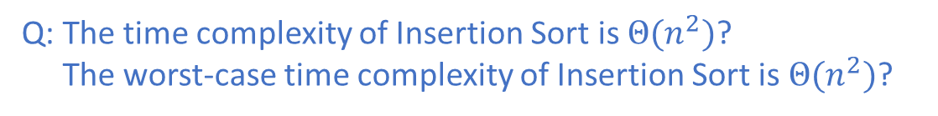
Asymptotic Notation: $Θ$
Given a function $g(n)$, we denote by $Ω\left(g\left(n\right)\right)$ the following set of functions:
$\{f\left(n\right):exists c_{1}>0, c_{2}>0, and n_{0}>0,$
$such that c_{1}⋅g\left(n\right)≤f\left(n\right)≤c_{2}⋅g(n) for all n≥n_{0}\}$.
$f\left(n\right)=Θ(g(n))$: $f(n)$ is asymptotically equal to $g(n)$.
$Θ$-notation gives an asymptotic tight bound.
Given two functions $f(n)$ and $g(n)$, $f\left(n\right)=Θ\left(g\left(n\right)\right)$ iff $f\left(n\right)=O\left(g\left(n\right)\right)$ and $f\left(n\right)=Ω\left(g\left(n\right)\right)$.
Insertion Sort as an example:
Best case: $T\left(n\right)≈cn+c^{′}n−c′′$
Worst case: $T\left(n\right)≈cn+\left({c′}/2\right)n^{2}−c′′$
Q: The time complexity of Insertion Sort is $Θ(n^{2})$?
Q: The worst-case time complexity of Insertion Sort is $Θ(n^{2})$?

Slide 13

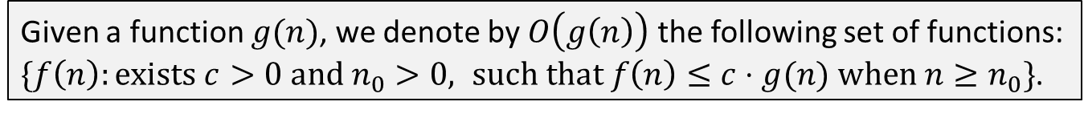
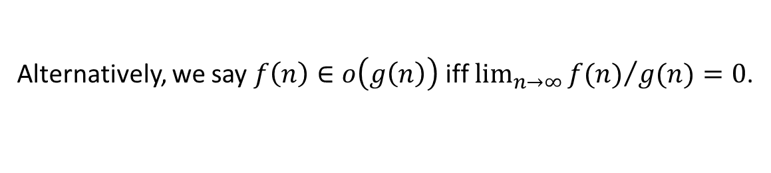
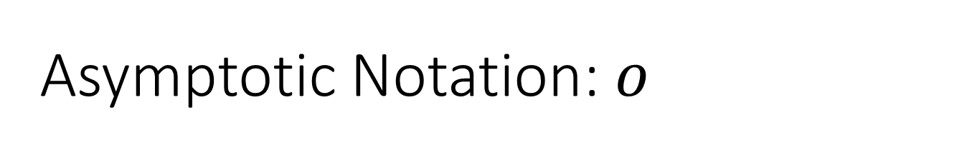
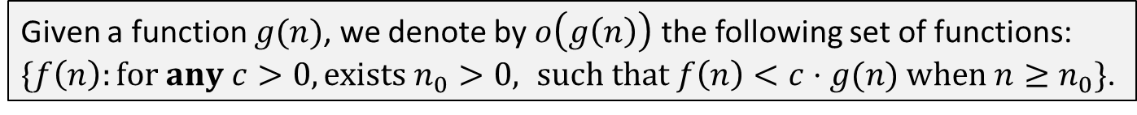
Asymptotic Notation: $o$
Given a function $g(n)$, we denote by $O\left(g\left(n\right)\right)$ the following set of functions:
$\{f\left(n\right):exists c>0 and n_{0}>0, such that f\left(n\right)≤c⋅g(n) when n≥n_{0}\}$.
$f\left(n\right)∈O(g(n))$: $f(n)$ is asymptotically at most $g(n)$, or “$f\left(n\right)≤g(n)$” asymptotically.
How to define: $f(n)$ is asymptotically (strictly) smaller than $g(n)$?
Given a function $g(n)$, we denote by $o\left(g\left(n\right)\right)$ the following set of functions:
$\{f\left(n\right):for any c>0, exists n_{0}>0, such that f\left(n\right)<c⋅g(n) when n≥n_{0}\}$.
Alternatively, we say $f\left(n\right)∈o\left(g\left(n\right)\right)$ iff $\lim_{n→∞}{{f(n)}/{g(n)}}=0$.
Q: Is $n^{2}∈o\left(n^{2}\right)$ true? Is $n\lg{n}∈o\left(n^{2}\right)$ true?

Slide 14
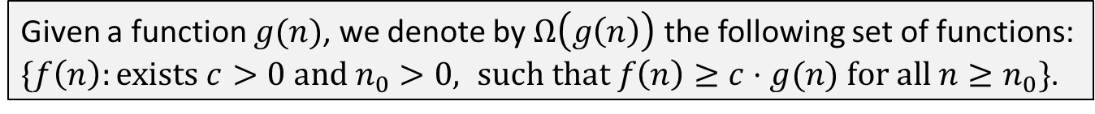
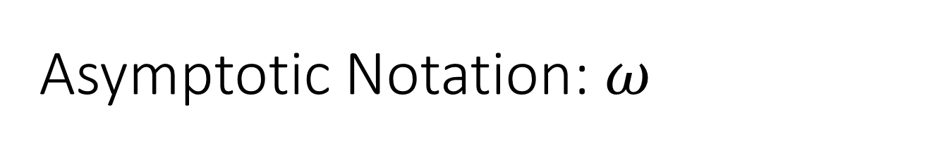
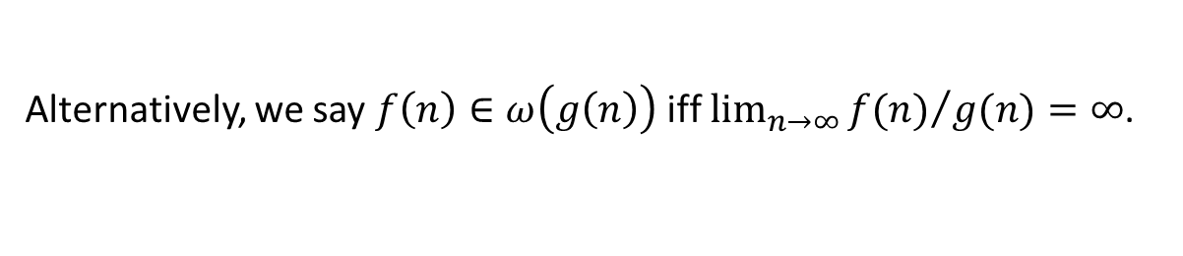

Asymptotic Notation: $ω$
Given a function $g(n)$, we denote by $Ω\left(g\left(n\right)\right)$ the following set of functions:
$\{f\left(n\right):exists c>0 and n_{0}>0, such that f\left(n\right)≥c⋅g(n) for all n≥n_{0}\}$.
$f\left(n\right)∈Ω(g(n))$: $f(n)$ is asymptotically at least $g(n)$, or “$f\left(n\right)≥g(n)$” asymptotically.
How to define: $f(n)$ is asymptotically (strictly) larger than $g(n)$?
Given a function $g(n)$, we denote by $ω\left(g\left(n\right)\right)$ the following set of functions:
$\{f\left(n\right):for any c>0, exists n_{0}>0, such that f\left(n\right)>c⋅g(n) when n≥n_{0}\}$.
Alternatively, we say $f\left(n\right)∈ω\left(g\left(n\right)\right)$ iff $\lim_{n→∞}{{f(n)}/{g(n)}}=∞$.
Q: Now that we have $O, Ω, Θ$ and $o,ω$, do we have small $θ$?

Slide 15
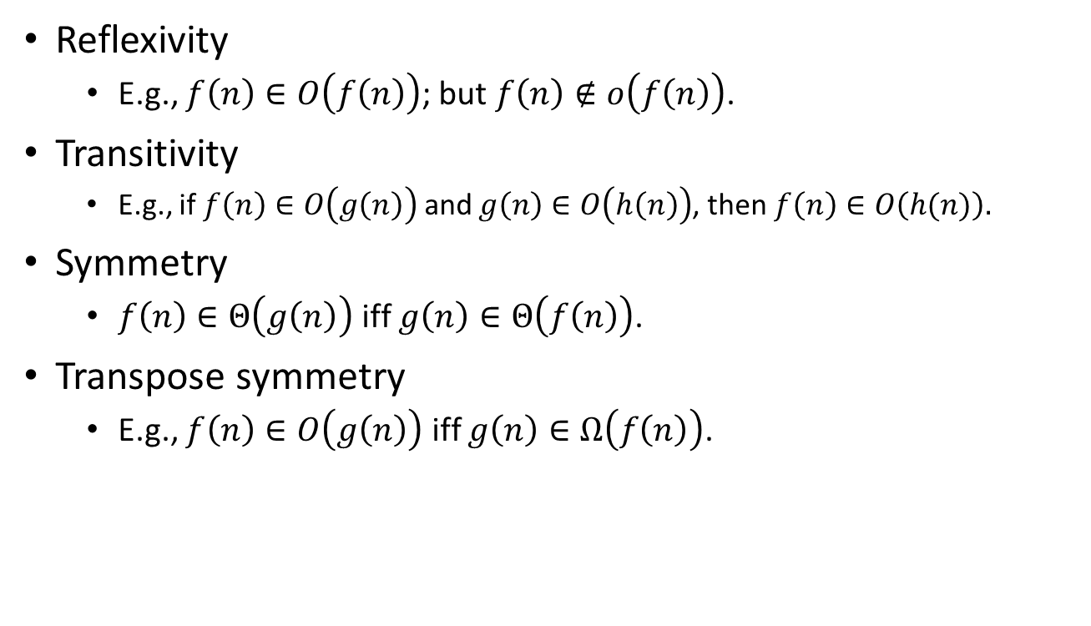
Some properties of asymptotic notations
Reflexivity
  E.g., $f\left(n\right)∈O\left(f\left(n\right)\right)$; but $f\left(n\right)∉o\left(f\left(n\right)\right)$.
Transitivity
  E.g., if $f\left(n\right)∈O\left(g\left(n\right)\right)$ and $g\left(n\right)∈O\left(h\left(n\right)\right)$, then $f\left(n\right)∈O\left(h(n)\right).$
Symmetry
  $f\left(n\right)∈Θ\left(g\left(n\right)\right)$ iff $g\left(n\right)∈Θ\left(f\left(n\right)\right)$.
Transpose symmetry
  E.g., $f\left(n\right)∈O\left(g\left(n\right)\right)$ iff $g\left(n\right)∈Ω\left(f\left(n\right)\right)$.

Slide 16
Comparing some common functions
$Θ(1)$, constant
Θ(1), constant
$Θ(\lg{n})$, logarithm
Θ(lg⁡𝑛), logarithm
$Θ(n)$, linear
Θ(𝑛), linear
$Θ\left(n^{c}\right)$, polynomial
Θ(𝑛^𝑐 ), polynomial
$Θ\left(2^{n}\right)$, exponential
Θ(2^𝑛 ), exponential
Handy tools:
L'Hôpital's rule for comparison of two functions.
Stirling’s approximation to deal with factorials.

Slide 17
Reading
[CLRS] Ch.2 (2.1, 2.2), Ch.3
[Rosen] Ch.1 (1.7, 1.8) and Ch.5 (5.1, 5.2)

