Slide 1
Divide and Conquer
Data Structures and Algorithms
Nanjing University, Fall 2019
郑朝栋

Slide 2
The Divide-and-Conquer Approach
Divide the given problem into a number of subproblems that are smaller instances of the same problem.
Conquer the subproblems by solving them recursively.
  Or, use brute-force if a subproblem is small enough.
Combine the solutions for the subproblems to obtain the solution for the original problem.

Slide 3
If your prefer some pseudocode…
Solve(I):
if (I is small enough)
solution = DirectSolve(I)
else
<I₁,I₂,…,I_{k}> = DivideProblem(I)
for (j=1 to k)
solution_{j} = Solve(I_{j})
solution = Combine(solution₁,…,solution_{k})
return solution
Or, use brute-force if
(sub)problem is simple.
Divide the problem into
smaller subproblems.
Recursively solve subproblems.
Combine solutions of subproblems
to get solution for original problem.

Slide 4
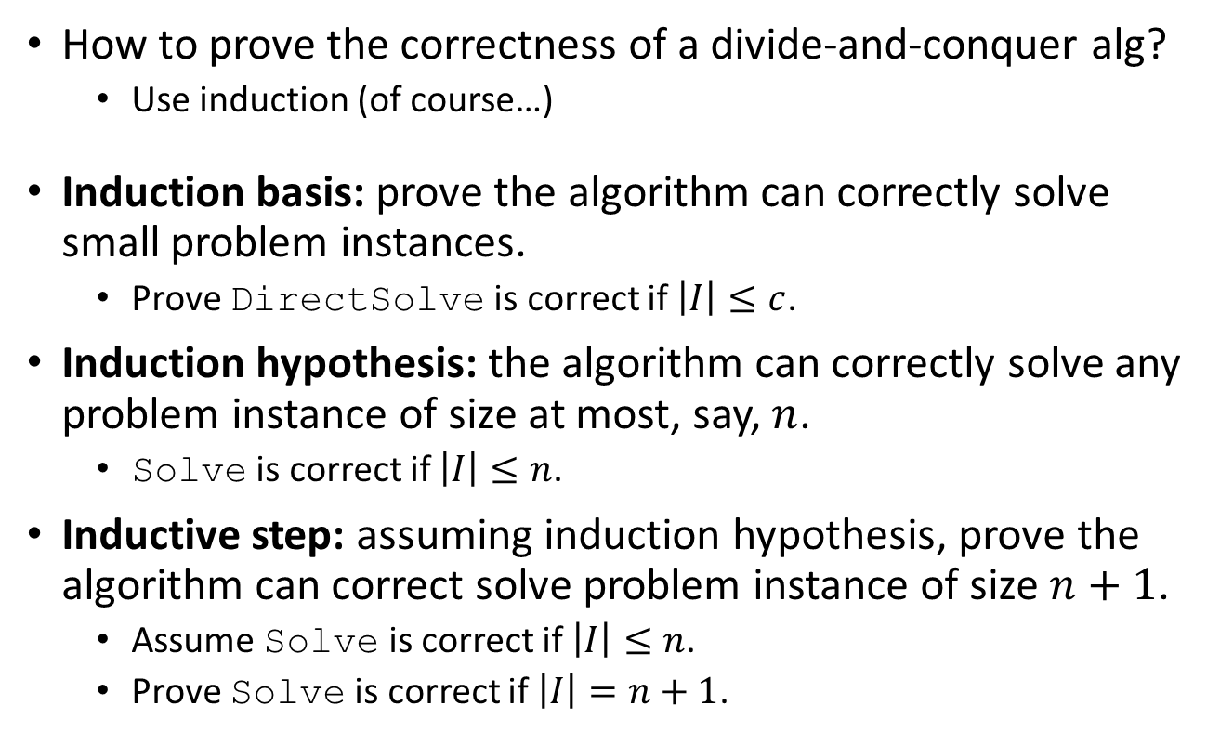
Correctness of Divide-and-Conquer
Solve(I):
if (I is small enough)
solution = DirectSolve(I)
else
<I₁,I₂,…,I_{k}> = DivideProblem(I)
for (j=1 to k)
solution_{j} = Solve(I_{j})
solution = Combine(solution₁,…,solution_{k})
return solution
How to prove the correctness of a divide-and-conquer alg?
  Use induction (of course…)
Induction basis: prove the algorithm can correctly solve small problem instances.
  Prove DirectSolve is correct if $\left|I\right|≤c$.
Induction hypothesis: the algorithm can correctly solve any problem instance of size at most, say, $n$.
  Solve is correct if $\left|I\right|≤n$.
Inductive step: assuming induction hypothesis, prove the algorithm can correct solve problem instance of size $n+1$.
  Assume Solve is correct if $\left|I\right|≤n$.
  Prove Solve is correct if $\left|I\right|=n+1$.

Slide 5
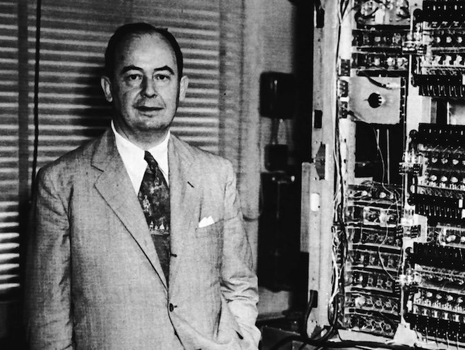
MergeSort
An efficient divide-and-conquer algorithm for sorting.
Invented by John von Neumann in the 1940s.
John von Neumann
Dec 1903 – Feb 1957
Hungarian-American,
mathematician, physicist,
computer scientist, and polymath.

Slide 6
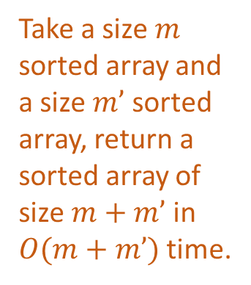
MergeSort
Solve(I):
if (I is small enough)
solution = DirectSolve(I)
else
<I₁,I₂,…,I_{k}> = DivideProblem(I)
for (j=1 to k)
solution_{j} = Solve(I_{j})
solution = Combine(solution₁,…,solution_{k})
return solution
Divide-and-Conquer Template
Take a size $m$ sorted array and a size $m’$ sorted array, return a sorted array of size $m+m’$ in $O(m+m’)$ time.
MergeSort(A[1…n]):
if (n==1)
sol[1…n] = A[1…n]
else
solLeft[1…(n/2)] = MergeSort(A[1…(n/2)])
solRright[1…(n/2)] = MergeSort(A[(n/2+1)…n])
sol[1…n] = Merge(solLeft[1…(n/2)],solRight[1…(n/2)])
return sol[1…n]
The MergeSort Algorithm

Slide 7
Sample execution of MergeSort
MergeSort(A[1…n]):
if (n==1)
sol[1…n] = A[1…n]
else
solLeft[1…(n/2)] = MergeSort(A[1…(n/2)])
solRright[1…(n/2)] = MergeSort(A[(n/2+1)…n])
sol[1…n] = Merge(solLeft[1…(n/2)],solRight[1…(n/2)])
return sol[1…n]
1
2
4
5
4
5
2
1
4
5
2
1
1
2
4
5
2
1

Slide 8

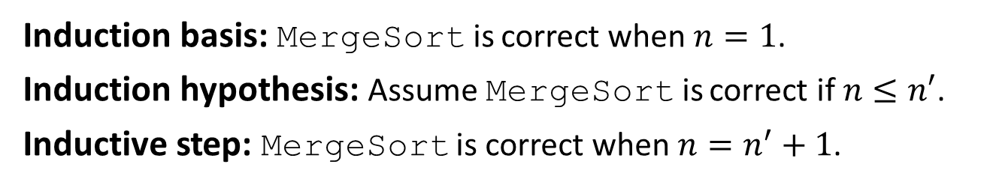
Correctness of MergeSort
Take a size $m$ sorted array and a size $m’$ sorted array, return a sorted array of size $m+m’$ in $O(m+m’)$ time.
MergeSort(A[1…n]):
if (n==1)
sol[1…n] = A[1…n]
else
solLeft[1…(n/2)] = MergeSort(A[1…(n/2)])
solRright[1…(n/2)] = MergeSort(A[(n/2+1)…n])
sol[1…n] = Merge(solLeft[1…(n/2)],solRight[1…(n/2)])
return sol[1…n]
Induction basis: MergeSort is correct when $n=1$.
Induction hypothesis: Assume MergeSort is correct if $n≤n′$.
Inductive step: MergeSort is correct when $n=n^{′}+1$.

Slide 9
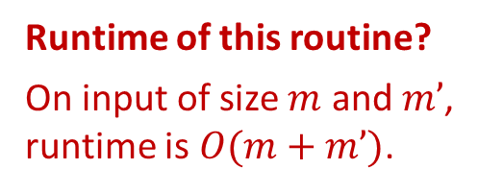
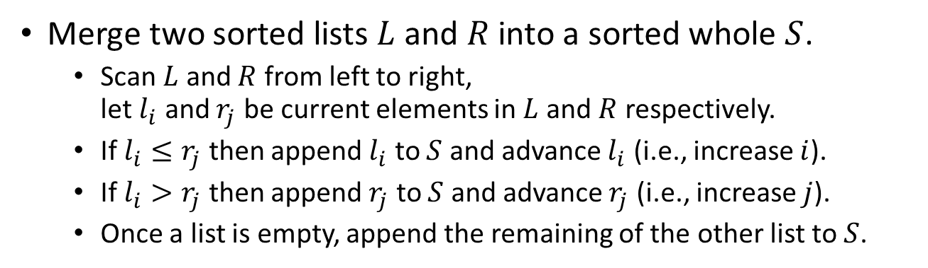
The Merge Subroutine
Merge two sorted lists $L$ and $R$ into a sorted whole $S$.
  Scan $L$ and $R$ from left to right,
  let $l_{i}$ and $r_{j}$ be current elements in $L$ and $R$ respectively.
  If $l_{i}≤r_{j}$ then append $l_{i}$ to $S$ and advance $l_{i}$ (i.e., increase $i$).
  If $l_{i}>r_{j}$ then append $r_{j}$ to $S$ and advance $r_{j}$ (i.e., increase $j$).
  Once a list is empty, append the remaining of the other list to $S$.
Correctness of this routine?
Find proper loop invariant,
and apply induction…
2
4
6
7
1
5
8
9
Runtime of this routine?
On input of size $m$ and $m’$,
runtime is $O(m+m’)$.
1
2
4
5
6
7
8
9

Slide 10
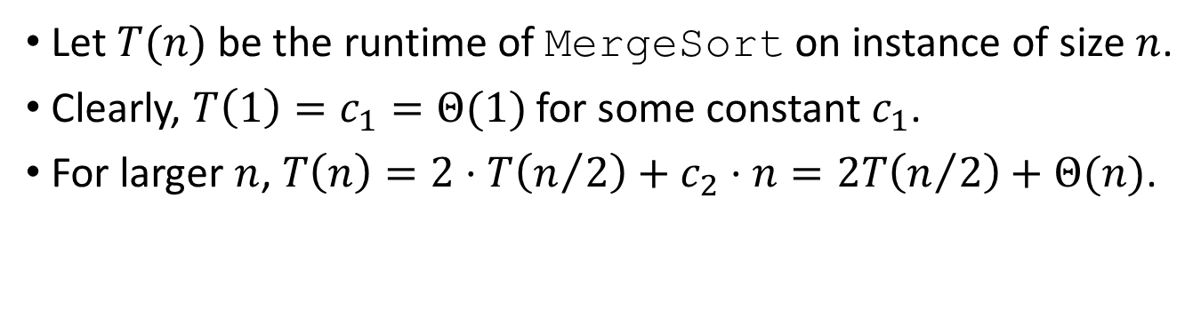
Time complexity of MergeSort
MergeSort(A[1…n]):
if (n==1)
sol[1…n] = A[1…n]
else
solLeft[1…(n/2)] = MergeSort(A[1…(n/2)])
solRright[1…(n/2)] = MergeSort(A[(n/2+1)…n])
sol[1…n] = Merge(solLeft[1…(n/2)],solRight[1…(n/2)])
return sol[1…n]
Let $T(n)$ be the runtime of MergeSort on instance of size $n$.
Clearly, $T\left(1\right)=c_{1}=Θ(1)$ for some constant $c_{1}$.
For larger $n$, $T\left(n\right)=2⋅T\left(n/2\right)+c_{2}⋅n=2T\left(n/2\right)+Θ(n)$.

Slide 11
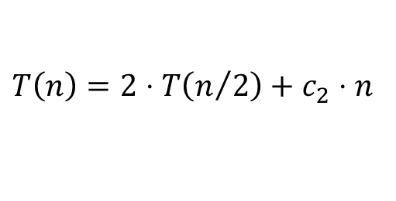



Time complexity of MergeSort
A recurrence equation:
$$T(n)$$
$$T\left(1\right)=c_{1}$$
$$T\left(n\right)=2⋅T\left(n/2\right)+c_{2}⋅n$$

Slide 12
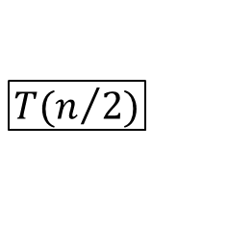
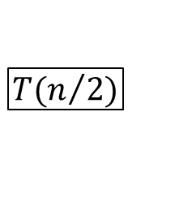

Time complexity of MergeSort
A recurrence equation:
$$c_{2}n$$
$$T\left(1\right)=c_{1}$$
$$T\left(n\right)=2⋅T\left(n/2\right)+c_{2}⋅n$$
$$T(n/2)$$
$$T(n/2)$$

Slide 13
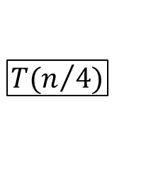
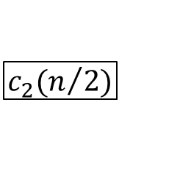
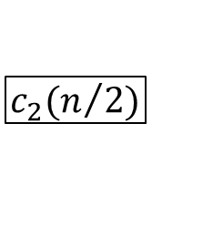
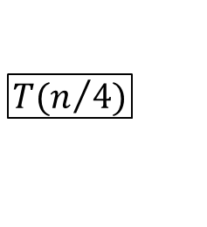
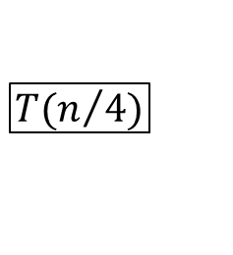
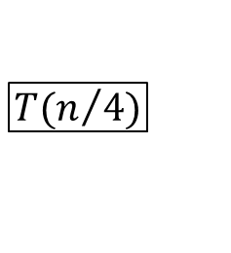
Time complexity of MergeSort
A recurrence equation:
$$c_{2}n$$
$$T\left(1\right)=c_{1}$$
$$T\left(n\right)=2⋅T\left(n/2\right)+c_{2}⋅n$$
$$c_{2}(n/2)$$
$$c_{2}(n/2)$$
$$T(n/4)$$
$$T(n/4)$$
$$T(n/4)$$
$$T(n/4)$$

Slide 14
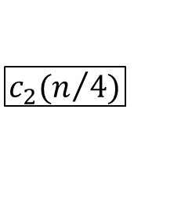







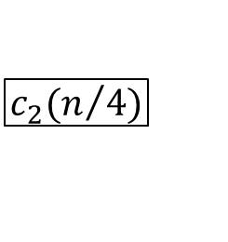
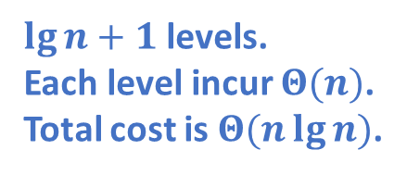


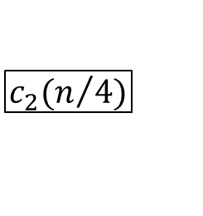

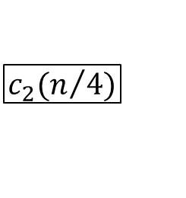


Time complexity of MergeSort
A recurrence equation:
$$c_{2}n$$
$$T\left(1\right)=c_{1}$$
$$T\left(n\right)=2⋅T\left(n/2\right)+c_{2}⋅n$$
$$c_{2}(n/2)$$
$$c_{2}(n/2)$$
$\lg{n}+1$ levels.
Each level incur $Θ(n)$.
Total cost is $Θ(n\lg{n})$.
$$c_{2}(n/4)$$
$$c_{2}(n/4)$$
$$c_{2}(n/4)$$
$$c_{2}(n/4)$$
……
…
$$c_{1}$$
$$c_{1}$$
$$c_{1}$$
$$c_{1}$$
$$c_{1}$$
$$c_{1}$$
$$c_{1}$$
$$c_{1}$$
$$c_{1}$$
$$c_{1}$$
$$c_{1}$$
$$c_{1}$$
Recursion tree.

Slide 15
Iterative MergeSort
MergeSort(A[1…n]):
if (n==1)
sol[1…n] = A[1…n]
else
solLeft[1…(n/2)] = MergeSort(A[1…(n/2)])
solRright[1…(n/2)] = MergeSort(A[(n/2+1)…n])
sol[1…n] = Merge(solLeft[1…(n/2)],solRight[1…(n/2)])
return sol[1…n]
Any recursive algorithm can be converted into an iterative one,
we just simulate the call stack!

Slide 16
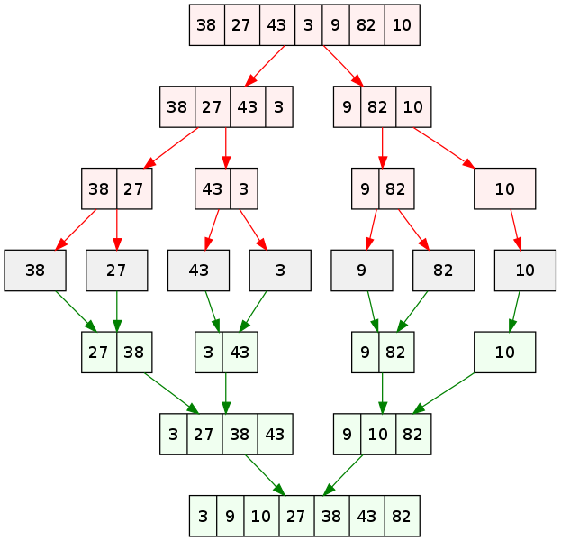
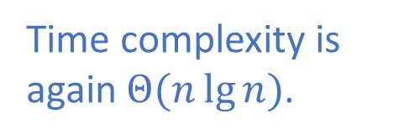
Iterative MergeSort
MergeSort(A[1…n]):
if (n==1)
sol[1…n] = A[1…n]
else
solLeft[1…(n/2)] = MergeSort(A[1…(n/2)])
solRright[1…(n/2)] = MergeSort(A[(n/2+1)…n])
sol[1…n] = Merge(solLeft[1…(n/2)],solRight[1…(n/2)])
return sol[1…n]
MergeSortIter(A[1…n]):
Deque Q
for (i=1 to n)
Q.AddLast(A[i])
while (Q.Size()>1)
L=Q.RemoveFirst(),R=Q.RemoveFirst()
Q.AddLast(Merge(L,R))
return Q.RemoveFirst()
Do “merge” operation
layer by layer!
Time complexity is again $Θ(n\lg{n})$.

Slide 17
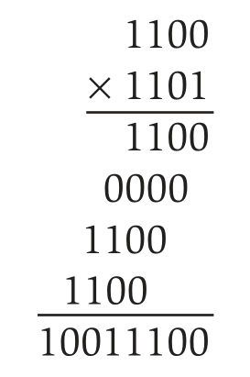
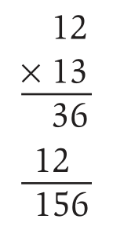
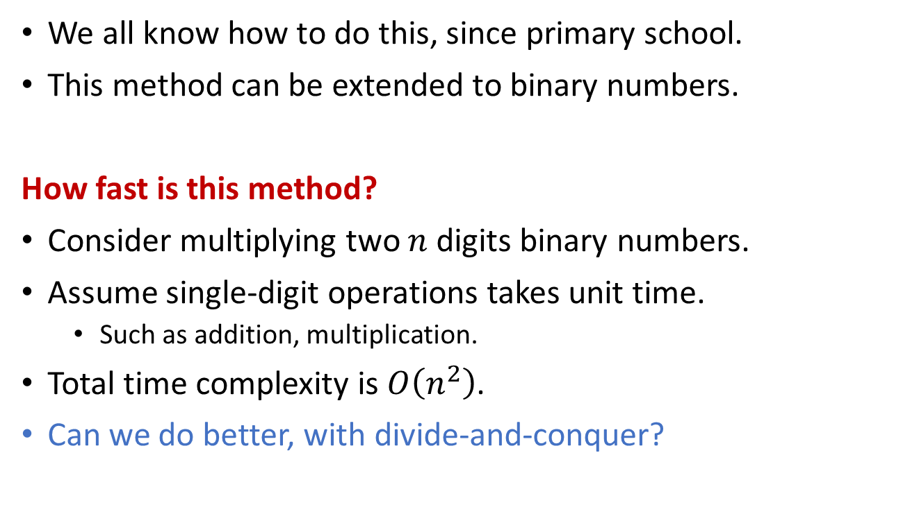
Integer Multiplication
We all know how to do this, since primary school.
This method can be extended to binary numbers.
How fast is this method?
Consider multiplying two $n$ digits binary numbers.
Assume single-digit operations takes unit time.
  Such as addition, multiplication.
Total time complexity is $O\left(n^{2}\right)$.
Can we do better, with divide-and-conquer?

Slide 18
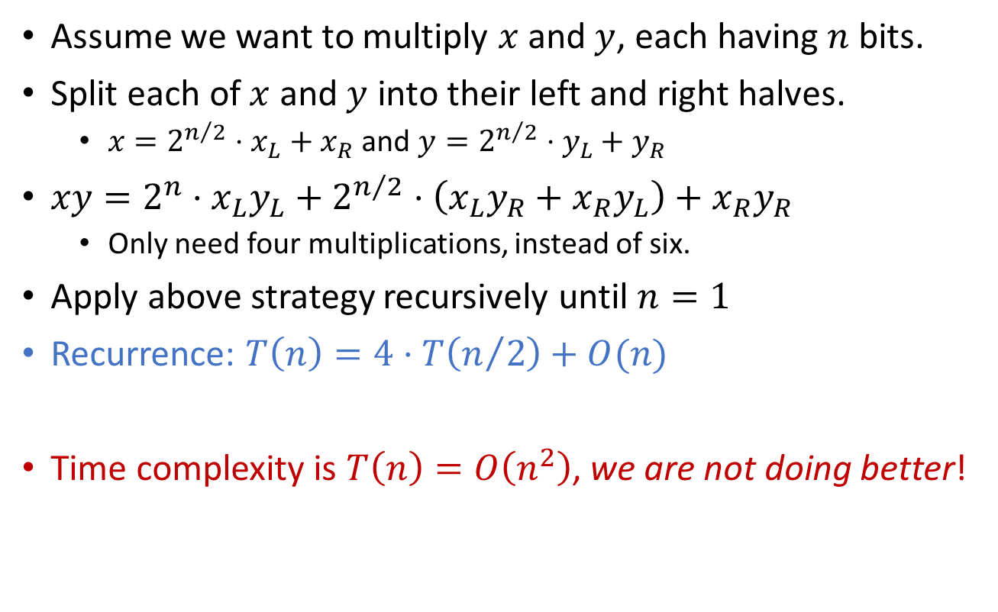
Integer Multiplication
Assume we want to multiply $x$ and $y$, each having $n$ bits.
Split each of $x$ and $y$ into their left and right halves.
  $x=2^{n/2}⋅x_{L}+x_{R}$ and $y=2^{n/2}⋅y_{L}+y_{R}$
$xy=2^{n}⋅x_{L}y_{L}+2^{n/2}⋅\left(x_{L}y_{R}+x_{R}y_{L}\right)+x_{R}y_{R}$
  Only need four multiplications, instead of six.
Apply above strategy recursively until $n=1$
Recurrence: $T\left(n\right)=4⋅T\left(n/2\right)+O(n)$
Time complexity is $T\left(n\right)=O\left(n^{2}\right)$, we are not doing better!

Slide 19
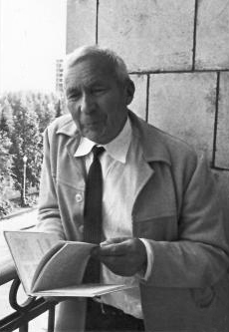

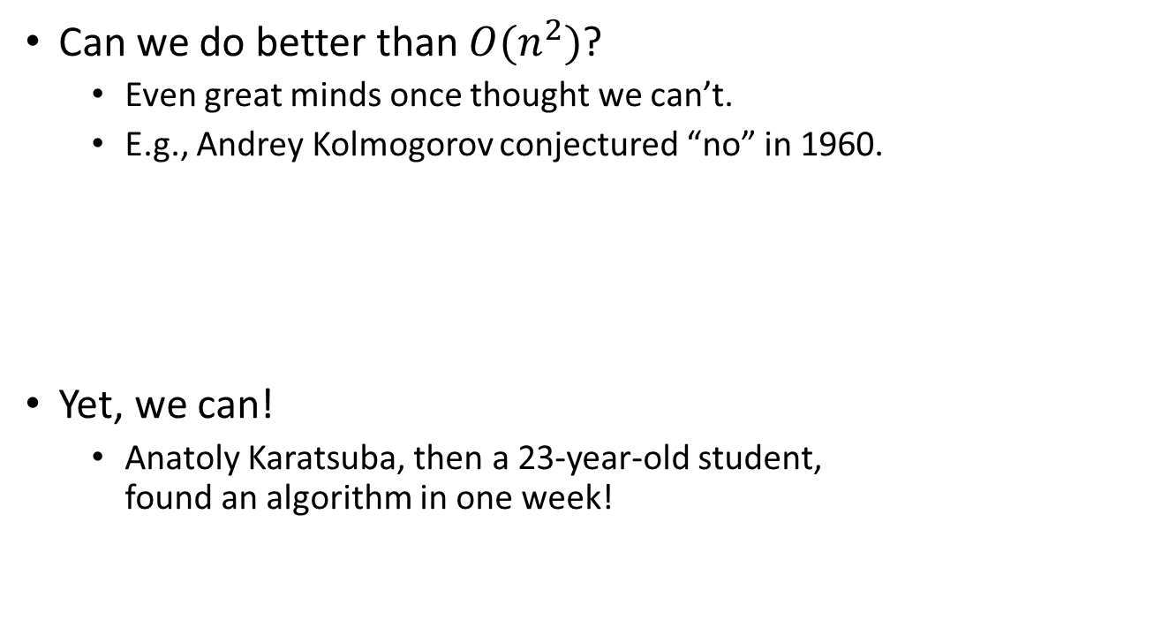
Integer Multiplication
Can we do better than $O(n^{2})$?
  Even great minds once thought we can’t.
  E.g., Andrey Kolmogorov conjectured “no” in 1960.
Yet, we can!
  Anatoly Karatsuba, then a 23-year-old student,
  found an algorithm in one week!

Slide 20

Karatsuba’s algorithm for
Integer Multiplication
Assume we want to multiply $x$ and $y$, each having $n$ bits.
Split each of $x$ and $y$ into their left and right halves.
  $x=2^{n/2}⋅x_{L}+x_{R}$ and $y=2^{n/2}⋅y_{L}+y_{R}$
$xy=2^{n}⋅x_{L}y_{L}+2^{n/2}⋅\left(x_{L}y_{R}+x_{R}y_{L}\right)+x_{R}y_{R}$
$x_{L}y_{R}+x_{R}y_{L}=\left(x_{L}+x_{R}\right)\left(y_{L}+y_{R}\right)−x_{L}y_{L}−x_{R}y_{R}$
We only need three multiplications, instead of four!
$T\left(n\right)=3⋅T\left(n/2\right)+O(n)$
$T\left(n\right)=O\left(n^{\lg{3}}\right)=O\left(n^{1.59}\right)$
FastMulti(x, y):
if (x and y are both of 1 bit)
return x*y
xl, xr = most, least significant |x|/2 bits of x
yl, yr = most, least significant |y|/2 bits of y
z1 = FastMulti(xl,yl)
z2 = FastMulti(xr,yr)
z3 = FastMulti(xl+xr,yl+yr)
return z1*(2^n)+(z3-z1-z2)*(2^(n/2))+z2

Slide 21
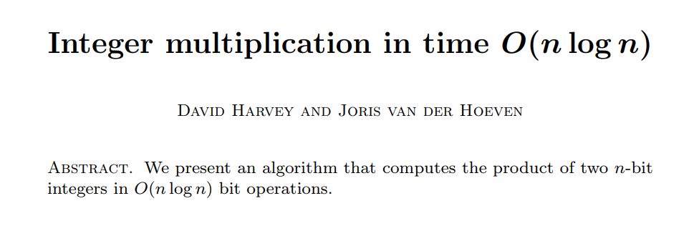

Integer Multiplication
The story didn’t end here…
  Andrei Toom and Stephen Cook generalizes Karatsuba’s idea:
  $O\left(n^{1+1/{(\lg{k})}}\right)$ for any $k$, and the constant in $O(⋅)$ depends on $k$.
  Arnold Schönhage and Volker Strassen uses FFT:
  $O(n⋅\log{n}⋅\log{\log{n}})$
  Finally, in March 2019, David Harvey and Joris van der Hoeven:
  $O(n⋅\log{n})$
Can we do better?

Slide 22
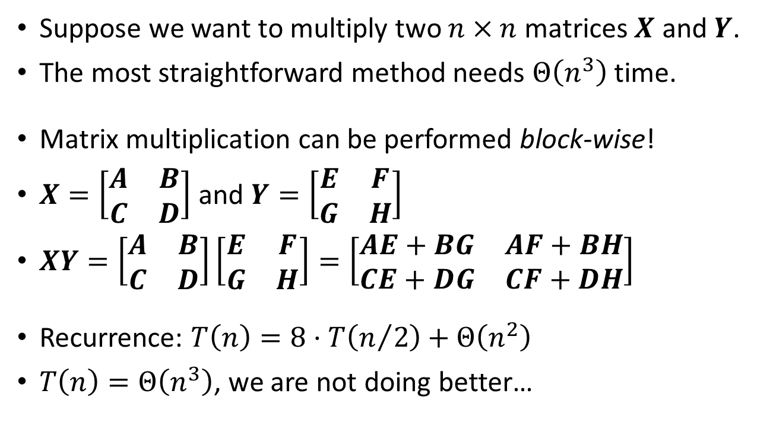
Matrix Multiplication
Suppose we want to multiply two $n×n$ matrices $X$ and $Y$.
The most straightforward method needs $Θ\left(n^{3}\right)$ time.
Matrix multiplication can be performed block-wise!
$X=\left[\begin{matrix}A & B \\ C & D\end{matrix}\right]$ and $Y=\left[\begin{matrix}E & F \\ G & H\end{matrix}\right]$
$XY=\left[\begin{matrix}A & B \\ C & D\end{matrix}\right]\left[\begin{matrix}E & F \\ G & H\end{matrix}\right]=\left[\begin{matrix}AE+BG & AF+BH \\ CE+DG & CF+DH\end{matrix}\right]$
Recurrence: $T\left(n\right)=8⋅T\left(n/2\right)+Θ\left(n^{2}\right)$
$T\left(n\right)=Θ\left(n^{3}\right)$, we are not doing better…

Slide 23
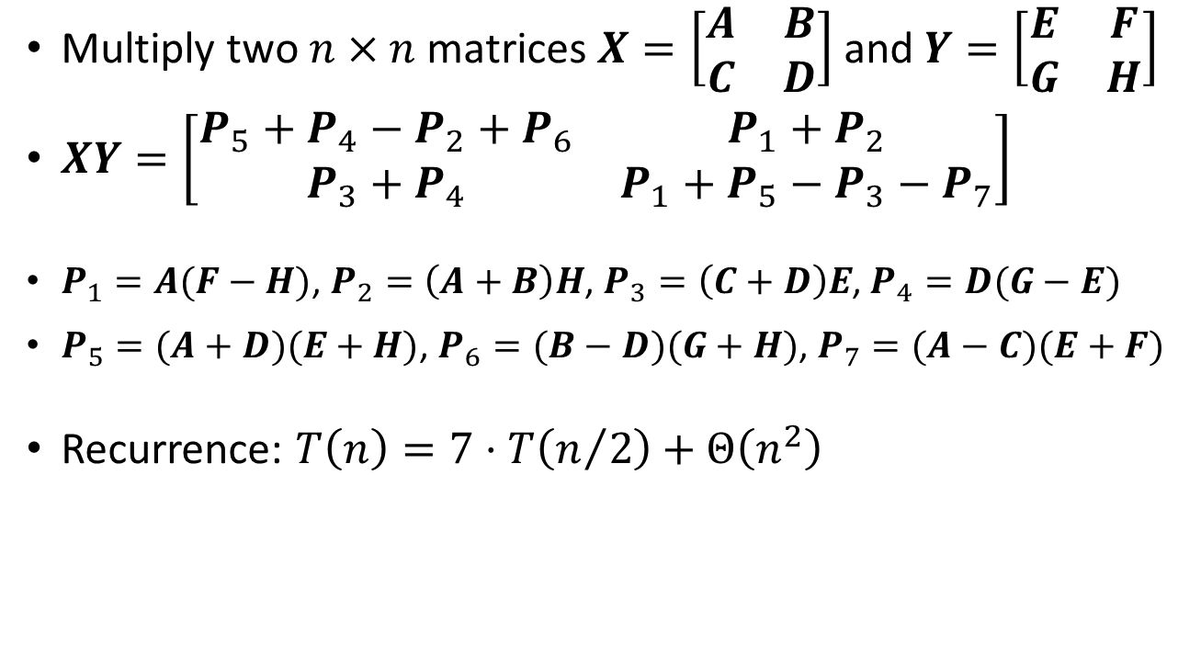
Strassen’s algorithm for
Matrix Multiplication
Multiply two $n×n$ matrices $X=\left[\begin{matrix}A & B \\ C & D\end{matrix}\right]$ and $Y=\left[\begin{matrix}E & F \\ G & H\end{matrix}\right]$
$XY=\left[\begin{matrix}P_{5}+P_{4}−P_{2}+P_{6} & P_{1}+P_{2} \\ P_{3}+P_{4} & P_{1}+P_{5}−P_{3}−P_{7}\end{matrix}\right]$
$P_{1}=A(F−H)$, $P_{2}=\left(A+B\right)H$, $P_{3}=\left(C+D\right)E$, $P_{4}=D(G−E)$
$P_{5}=(A+D)(E+H)$, $P_{6}=(B−D)(G+H)$, $P_{7}=(A−C)(E+F)$
Recurrence: $T\left(n\right)=7⋅T\left(n/2\right)+Θ\left(n^{2}\right)$

Slide 24
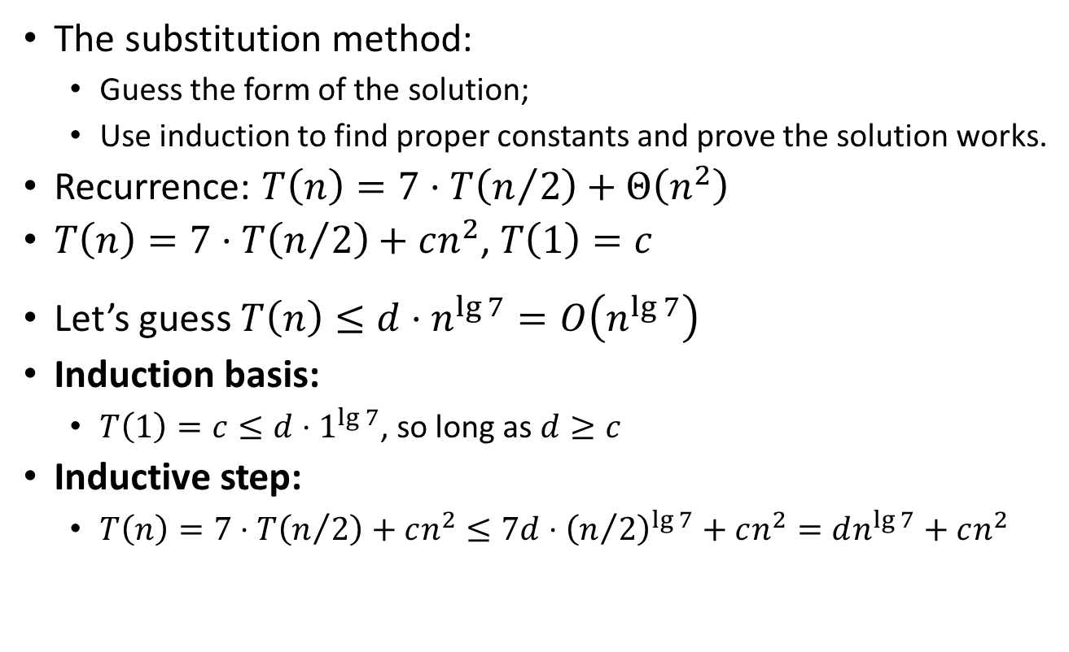
Time complexity of Strassen’s algorithm
Substitution method (or, guess and verify)
The substitution method:
  Guess the form of the solution;
  Use induction to find proper constants and prove the solution works.
Recurrence: $T\left(n\right)=7⋅T\left(n/2\right)+Θ\left(n^{2}\right)$
$T\left(n\right)=7⋅T\left(n/2\right)+cn^{2}$, $T\left(1\right)=c$
Let’s guess $T\left(n\right)≤d⋅n^{\lg{7}}=O\left(n^{\lg{7}}\right)$
Induction basis:
  $T\left(1\right)=c≤d⋅1^{\lg{7}}$, so long as $d≥c$
Inductive step:
  $T\left(n\right)=7⋅T\left(n/2\right)+cn^{2}≤7d⋅{\left(n/2\right)}^{\lg{7}}+cn^{2}=dn^{\lg{7}}+cn^{2}$
???

Slide 25
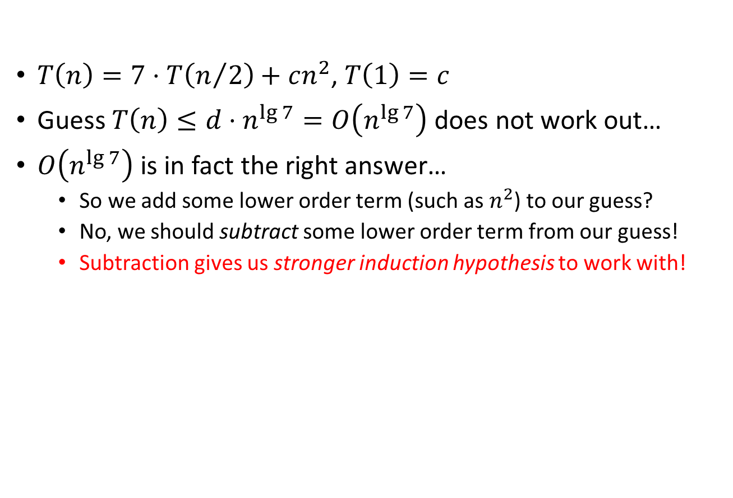
Time complexity of Strassen’s algorithm
Substitution method (or, guess and verify)
$T\left(n\right)=7⋅T\left(n/2\right)+cn^{2}$, $T\left(1\right)=c$
Guess $T\left(n\right)≤d⋅n^{\lg{7}}=O\left(n^{\lg{7}}\right)$ does not work out…
$O\left(n^{\lg{7}}\right)$ is in fact the right answer…
  So we add some lower order term (such as $n^{2}$) to our guess?
  No, we should subtract some lower order term from our guess!
  Subtraction gives us stronger induction hypothesis to work with!

Slide 26
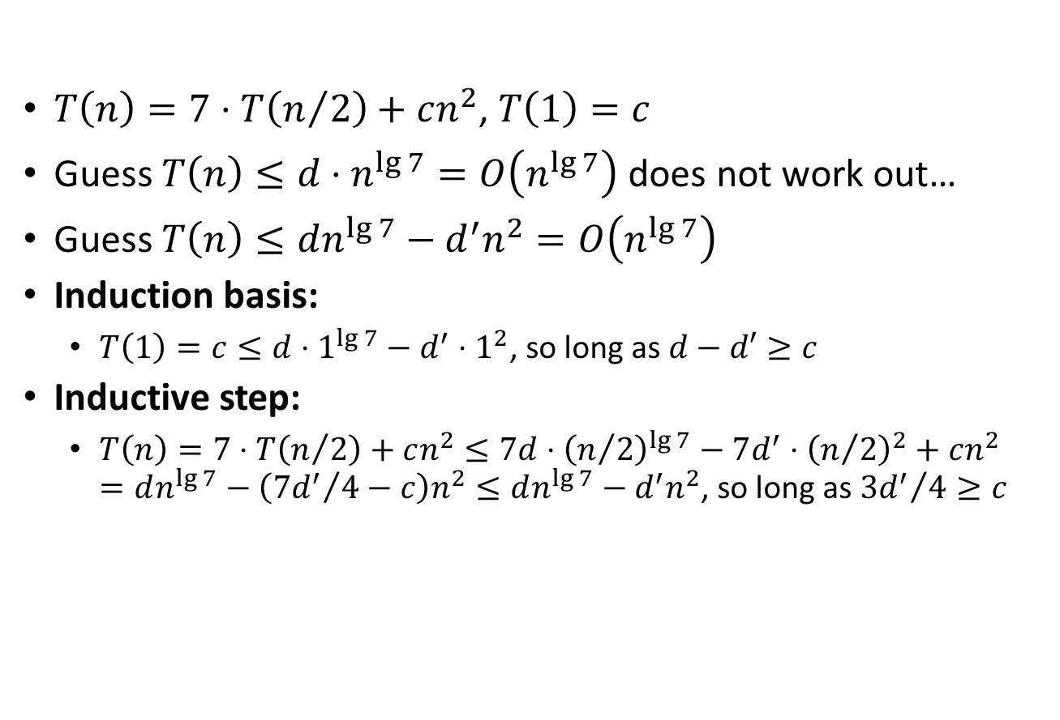
Time complexity of Strassen’s algorithm
Substitution method (or, guess and verify)
$T\left(n\right)=7⋅T\left(n/2\right)+cn^{2}$, $T\left(1\right)=c$
Guess $T\left(n\right)≤d⋅n^{\lg{7}}=O\left(n^{\lg{7}}\right)$ does not work out…
Guess $T\left(n\right)≤dn^{\lg{7}}−d^{′}n^{2}=O\left(n^{\lg{7}}\right)$
Induction basis:
  $T\left(1\right)=c≤d⋅1^{\lg{7}}−d^{′}⋅1^{2}$, so long as $d−d′≥c$
Inductive step:
  $T\left(n\right)=7⋅T\left(n/2\right)+cn^{2}≤7d⋅{\left(n/2\right)}^{\lg{7}}−7d^{′}⋅{\left(n/2\right)}^{2}+cn^{2}$
  $=dn^{\lg{7}}−\left({7d^{′}}/4−c\right)n^{2}≤dn^{\lg{7}}−d^{′}n^{2}$, so long as ${3d^{′}}/4≥c$

Slide 27
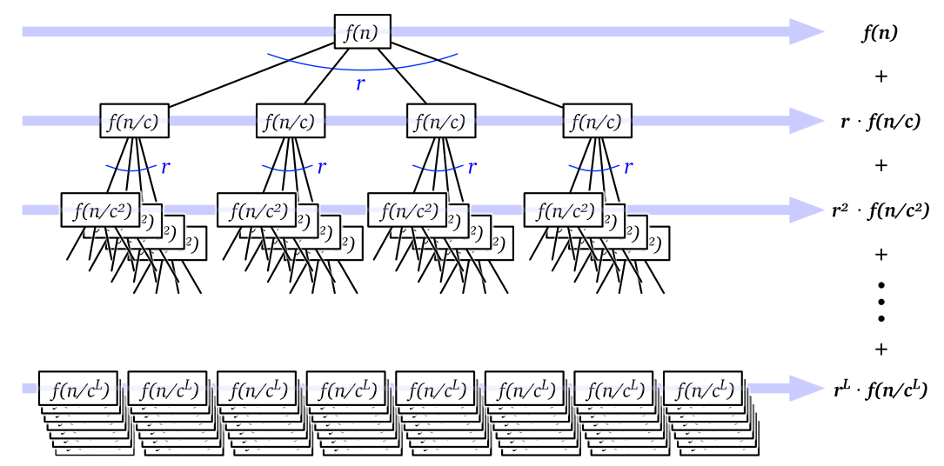
Solving recurrence
The recurrence-tree method
A great tool for solving divide-and-conquer recurrences.
  Simple, pictorial, yet general.
A recursion tree is a rooted tree with one node for each recursive subproblem.
The value of each node is time spent on that subproblem
excluding recursive calls.
The sum of all values is the
runtime of the algorithm.

Slide 28

Solving recurrence
The recurrence-tree method
Typical divide-and-conquer approach:
  Divide a size $n$ problem into $r$ subproblems each of size $n/c$,
  the cost for “divide” and “combine” is $f(n)$.
  Solve problem directly if $n≤n_{0}$ for some small constant $n_{0}$.
$T\left(n\right)=r⋅T\left(n/c\right)+f(n)$, $T\left(n_{0}\right)=c_{0}$
$T\left(n\right)=r⋅T\left(n/c\right)+f(n)$, $T\left(1\right)=f(1)$

Slide 29
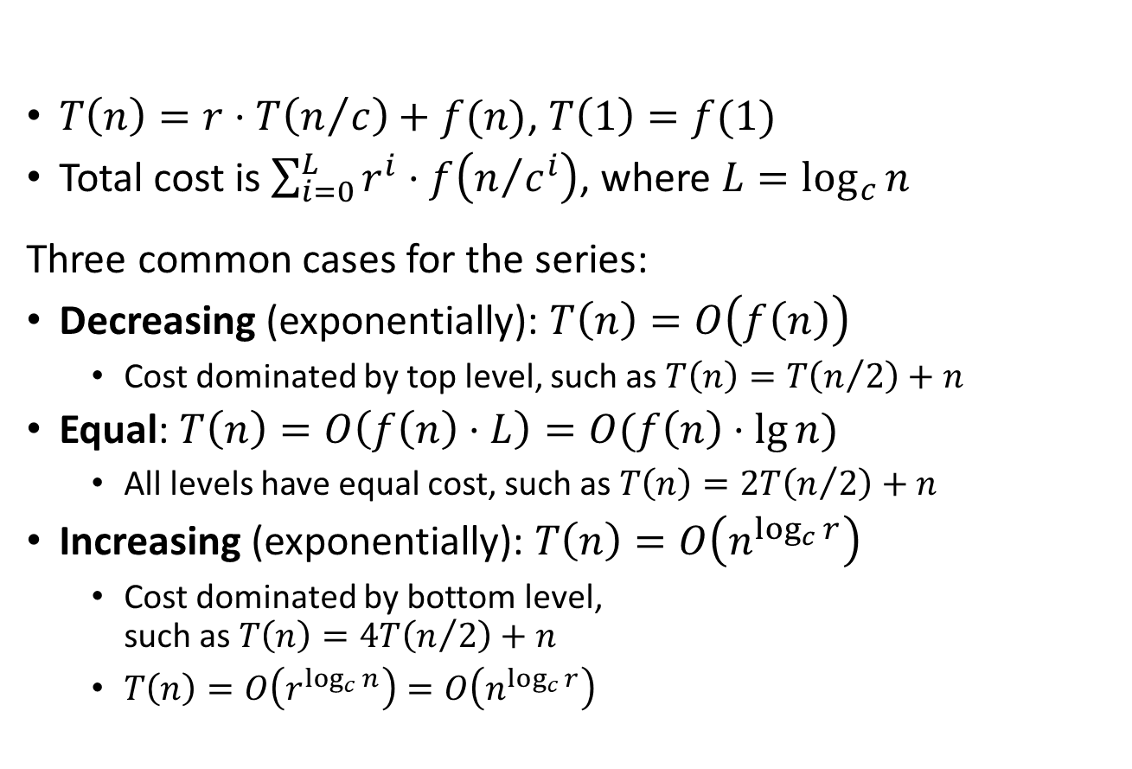
Solving recurrence
The recurrence-tree method
$T\left(n\right)=r⋅T\left(n/c\right)+f(n)$, $T\left(1\right)=f(1)$
Total cost is $\sum_{i=0}^{L}{r^{i}⋅f\left(n/{c^{i}}\right)}$, where $L=\log_{c}{n}$
Three common cases for the series:
Decreasing (exponentially): $T\left(n\right)=O\left(f\left(n\right)\right)$
  Cost dominated by top level, such as $T\left(n\right)=T\left(n/2\right)+n$
Equal: $T\left(n\right)=O\left(f\left(n\right)⋅L\right)=O(f\left(n\right)⋅\lg{n})$
  All levels have equal cost, such as $T\left(n\right)=2T\left(n/2\right)+n$
Increasing (exponentially): $T\left(n\right)=O\left(n^{\log_{c}{r}}\right)$
  Cost dominated by bottom level,
  such as $T\left(n\right)=4T\left(n/2\right)+n$
  $T\left(n\right)=O\left(r^{\log_{c}{n}}\right)=O\left(n^{\log_{c}{r}}\right)$

Slide 30
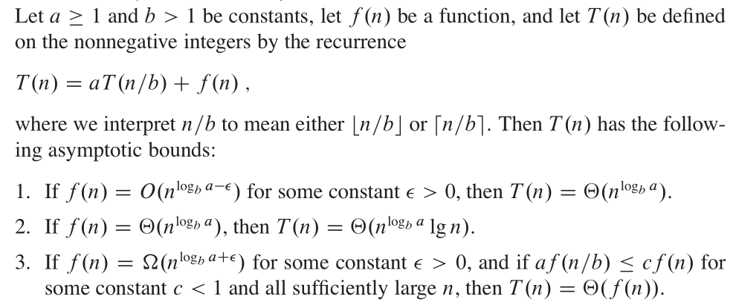
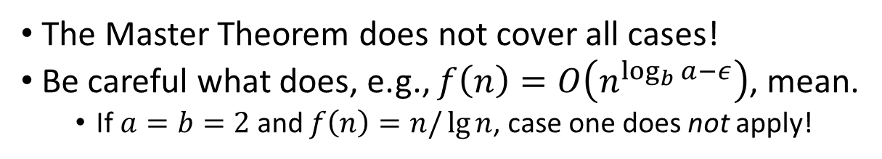
The recurrence-tree method
Master Theorem
The Master Theorem does not cover all cases!
Be careful what does, e.g., $f\left(n\right)=O\left(n^{\log_{b}{a}−ε}\right)$, mean.
  If $a=b=2$ and $f\left(n\right)=n/\lg{n}$, case one does not apply!

Slide 31
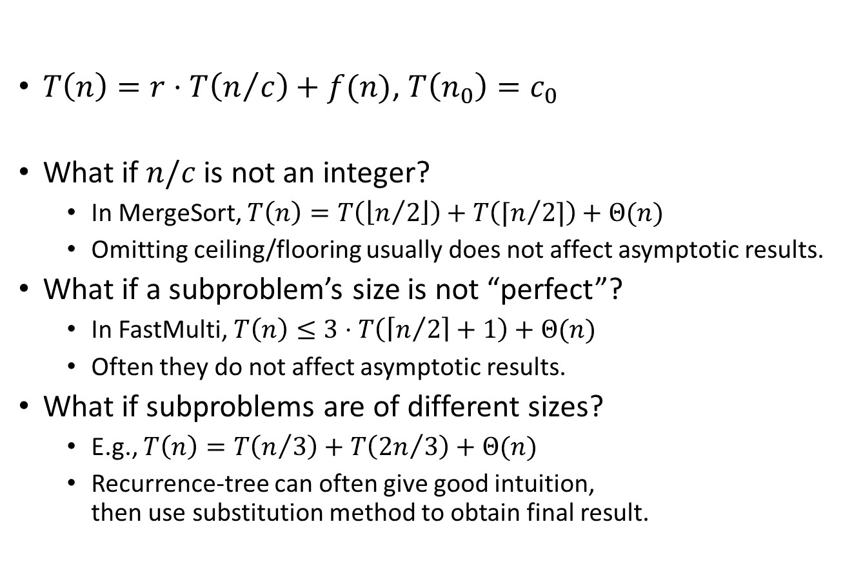
Solving recurrence
The recurrence-tree method
$T\left(n\right)=r⋅T\left(n/c\right)+f(n)$, $T\left(n_{0}\right)=c_{0}$
What if $n/c$ is not an integer?
  In MergeSort, $T\left(n\right)=T\left(\left\lfloor n/2\right\rfloor \right)+T\left(⌈n/2⌉\right)+Θ(n)$
  Omitting ceiling/flooring usually does not affect asymptotic results.
What if a subproblem’s size is not “perfect”?
  In FastMulti, $T\left(n\right)≤3⋅T\left(\left\lceil n/2\right\rceil +1\right)+Θ(n)$
  Often they do not affect asymptotic results.
What if subproblems are of different sizes?
  E.g., $T\left(n\right)=T\left(n/3\right)+T\left({2n}/3\right)+Θ(n)$
  Recurrence-tree can often give good intuition,
  then use substitution method to obtain final result.

Slide 32
The divide-and-conquer approach
Summary
Divide, Conquer (recursive or direct), and Combine.
Same problem can be divided in different ways, leading to different algorithms with different performances!
  MergeSort uses half-and-half split, how about 1-and-(n-1) split?
  Another splitting method leads to QuickSort. (We’ll learn it later…)
Correctness of divide-and-conquer algorithms:
  Use mathematical induction (of course…)
Time complexity of divide-and-conquer algorithms:
  Recursion-tree method (master theorem), substitution method
We’ll see more in this course!

Slide 33
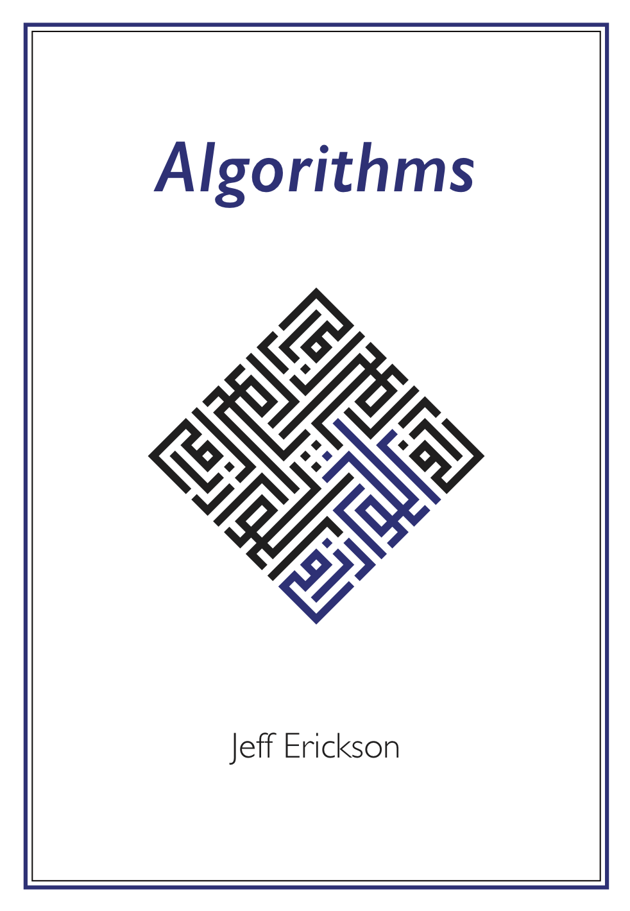
Reading
[CLRS] Ch.2 (2.3), Ch.4
[Erickson v1] Ch.1 (excluding 1.5 and 1.8)

