Slide 1
Search Trees
Data Structures and Algorithms
Nanjing University, Fall 2019
郑朝栋

Slide 2
The Set Abstract Data Type (ADT)
The Set ADT is used to represent a set of elements with (usually distinct) key values.
  Each element has a key field and a data field.
Operations the Set ADT should support:
  Search(S,k): Find an element in S with key value k.
  Insert(S,x): Add x to S. (What if element with same key exists?)
  Remove(S,x): Remove element x from S, assuming x is in S.
  Remove(S,k): Remove element with key value k from S.
If elements are from an ordered universe (OSet):
  Min(S) and Max(S): Find minimum/maximum element in S.
  Successor(S,x) or Successor(S,k):
  Find smallest element in S that is larger than x.key (or key k).
  Predecessor(S,x) or Predecessor(S,k):
  Find largest element in S that is smaller than x.key (or key k).
010025
Alice
female
021437
Bob
male
114582
Emma
female

Slide 3

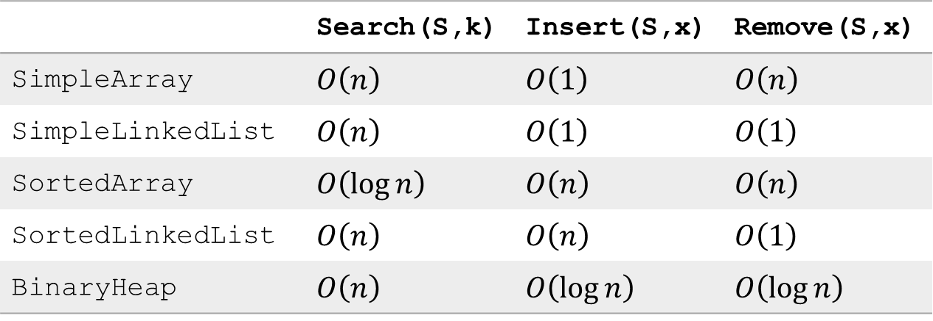
Efficient implementation of OSet
 | Search(S,k) | Insert(S,x) | Remove(S,x)
SimpleArray | $O\left(n\right)$ | $O\left(1\right)$ | $O\left(n\right)$
SimpleLinkedList | $O\left(n\right)$ | $O\left(1\right)$ | $O\left(1\right)$
SortedArray | $O\left(\log{n}\right)$ | $O\left(n\right)$ | $O\left(n\right)$
SortedLinkedList | $O\left(n\right)$ | $O\left(n\right)$ | $O\left(1\right)$
BinaryHeap | $O\left(n\right)$ | $O\left(\log{n}\right)$ | $O\left(\log{n}\right)$
Data structure implementing all these operations efficiently?
Efficient means within $O\left(\log{n}\right)$ time.

Slide 4




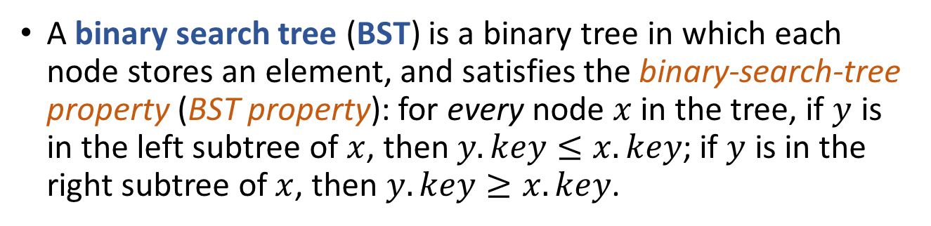


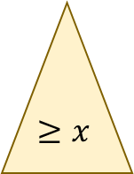

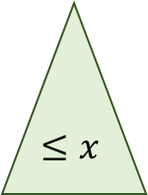

Binary Search Tree (BST)
A binary search tree (BST) is a binary tree in which each node stores an element, and satisfies the binary-search-tree property (BST property): for every node $x$ in the tree, if $y$ is in the left subtree of $x$, then $y.key≤x.key$; if $y$ is in the right subtree of $x$, then $y.key≥x.key$.
$$41$$
$$x$$
$$20$$
$$65$$
$$≤x$$
$$≥x$$
$$13$$
$$32$$
$$50$$
$$91$$

Slide 5



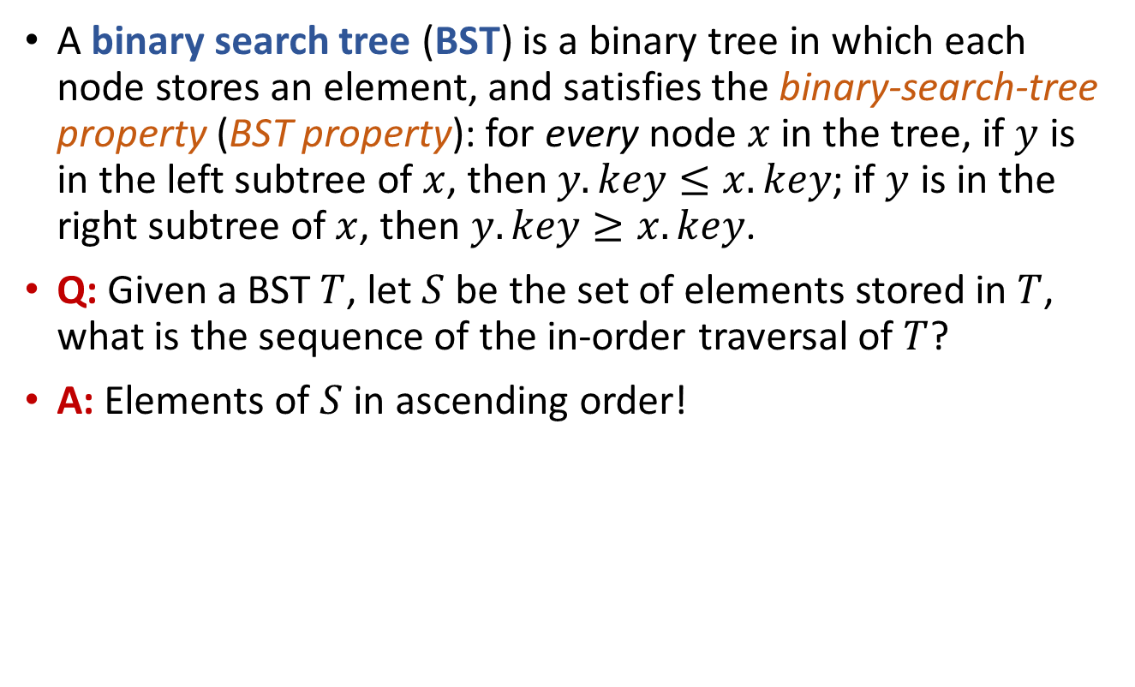




Binary Search Tree (BST)
A binary search tree (BST) is a binary tree in which each node stores an element, and satisfies the binary-search-tree property (BST property): for every node $x$ in the tree, if $y$ is in the left subtree of $x$, then $y.key≤x.key$; if $y$ is in the right subtree of $x$, then $y.key≥x.key$.
Q: Given a BST $T$, let $S$ be the set of elements stored in $T$, what is the sequence of the in-order traversal of $T$?
A: Elements of $S$ in ascending order!
$$41$$
$$20$$
$$65$$
In-order traversal:
13, 20, 32, 41, 50, 65, 91
$$13$$
$$32$$
$$50$$
$$91$$

Slide 6











Search in BST
BSTSearch(x,k):
if (x==NULL or x.key==k)
return x
else if (x.key>k)
return BSTSearch(x.left,k)
else
return BSTSearch(x.right,k)
Given a BST root $x$ and key $k$, find an element with key $k$?
  If $x.key=k$ then return $x$ and we are done!
  If $x.key>k$ then recurse into the BST rooted at $x.left$.
  If $x.key<k$ then recurse into the BST rooted at $x.right$.
This is tail recursion, and we can have an iterative version!
BSTSearchIter(x,k):
while (x!=NULL and x.key!=k)
if (x.key>k)
x = x.left
else
x = x.right
return x
Example One:
Search for element with key 50.
$$41$$
Example Two:
Search for element with key 35.
$$x$$
$$20$$
$$65$$
$$≤x$$
$$≥x$$
$$13$$
$$32$$
$$50$$
$$91$$

Slide 7





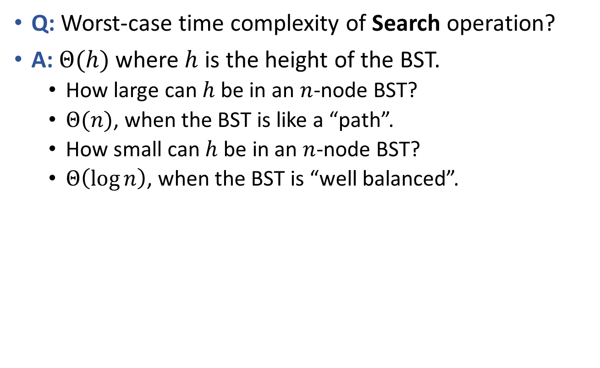






Complexity of Search in BST
Q: Worst-case time complexity of Search operation?
A: $Θ(h)$ where $h$ is the height of the BST.
  How large can $h$ be in an $n$-node BST?
  $Θ(n)$, when the BST is like a “path”.
  How small can $h$ be in an $n$-node BST?
  $Θ\left(\log{n}\right)$, when the BST is “well balanced”.
$$41$$
$$13$$
$$20$$
Height of the BST affects the efficiency of Search
$$20$$
$$65$$
$$32$$
$$13$$
$$32$$
$$50$$
$$91$$
$$91$$

Slide 8

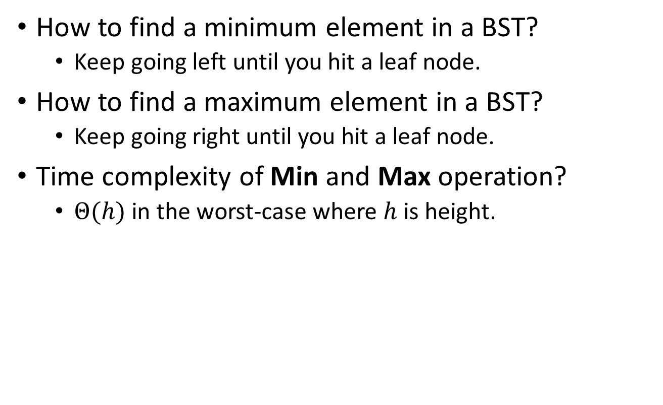


Min and Max in BST
How to find a minimum element in a BST?
  Keep going left until you hit a leaf node.
How to find a maximum element in a BST?
  Keep going right until you hit a leaf node.
Time complexity of Min and Max operation?
  $Θ(h)$ in the worst-case where $h$ is height.
$$41$$
$$20$$
$$65$$
$$13$$
$$32$$
$$50$$
$$91$$

Slide 9



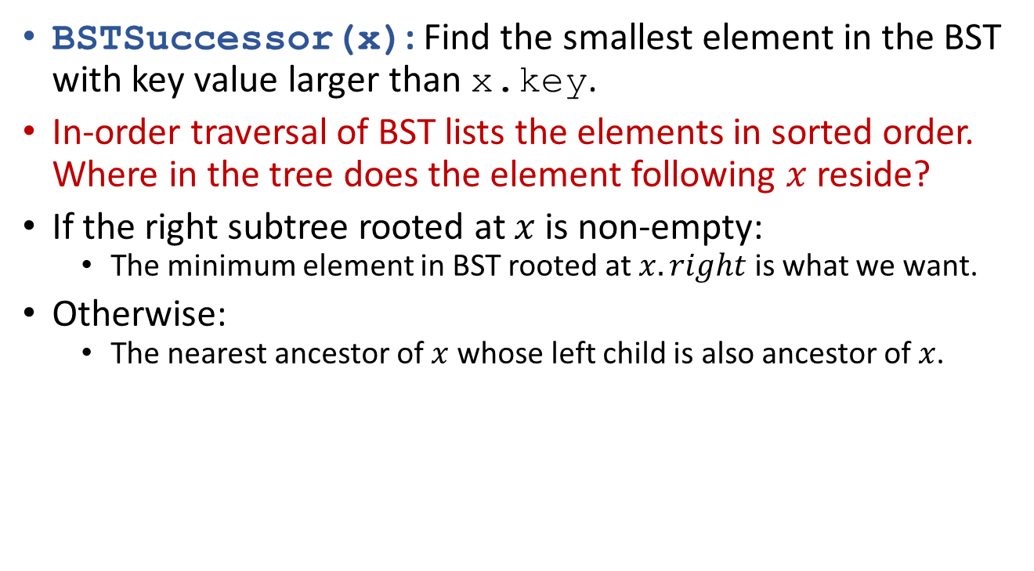



Successor in BST
BSTSuccessor(x): Find the smallest element in the BST with key value larger than x.key.
In-order traversal of BST lists the elements in sorted order. Where in the tree does the element following $x$ reside?
If the right subtree rooted at $x$ is non-empty:
  The minimum element in BST rooted at $x.right$ is what we want.
Otherwise:
  The nearest ancestor of $x$ whose left child is also ancestor of $x$.
$$w$$
BSTSuccessor(x):
if (x.right!=NULL)
return BSTMin(x.right)
y = x.parent
while (y!=NULL and y.right==x)
x = y
y = y.parent
return y
$$z$$
$$x$$
$$y$$
$$x$$
$$y$$

Slide 10
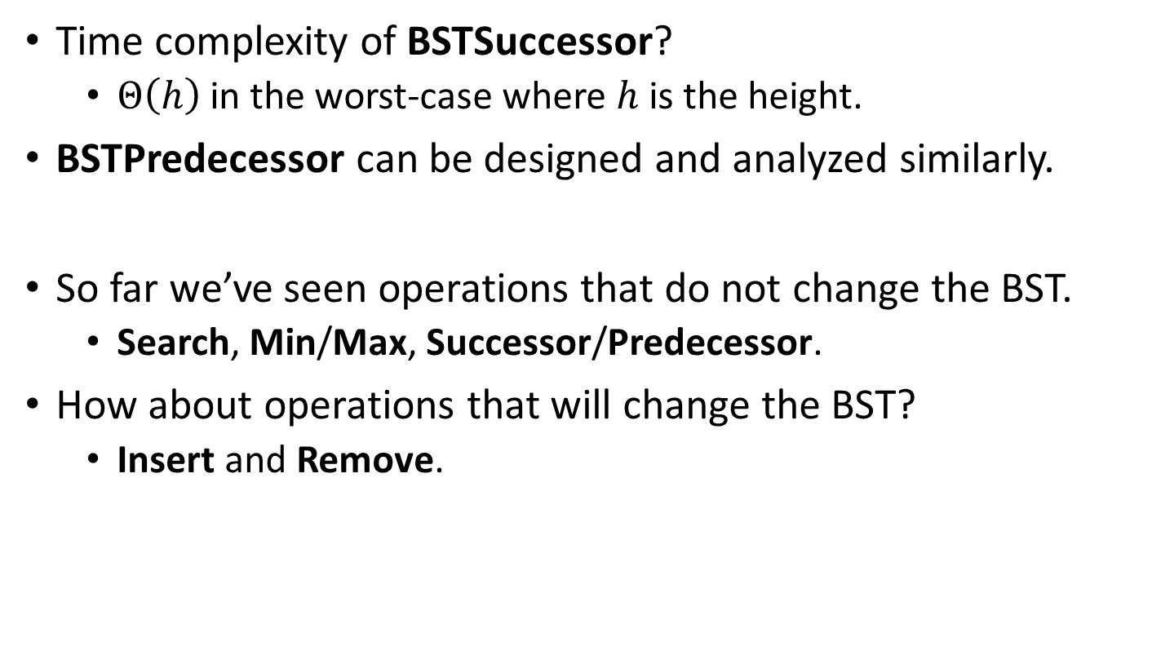
Successor in BST
Time complexity of BSTSuccessor?
  $Θ\left(h\right)$ in the worst-case where $h$ is the height.
BSTPredecessor can be designed and analyzed similarly.
So far we’ve seen operations that do not change the BST.
  Search, Min/Max, Successor/Predecessor.
How about operations that will change the BST?
  Insert and Remove.
BSTSuccessor(x):
if (x.right!=NULL)
return BSTMin(x.right)
y = x.parent
while (y!=NULL and y.right==x)
x = y
y = y.parent
return y

Slide 11



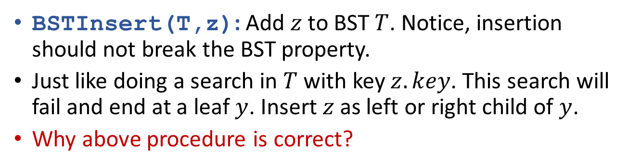





Insert in BST
BSTInsert(T,z): Add $z$ to BST $T$. Notice, insertion should not break the BST property.
Just like doing a search in $T$ with key $z.key$. This search will fail and end at a leaf $y$. Insert $z$ as left or right child of $y$.
Why above procedure is correct?
$$41$$
Example:
Insert element with key 36.
$$20$$
$$65$$
$$13$$
$$32$$
$$50$$
$$91$$
$$36$$

Slide 12

Insert in BST
BSTInsert(T,z): Add $z$ to BST $T$. Notice, insertion should not break the BST property.
Just like doing a search in $T$ with key $z.key$. This search will fail and end at a leaf $y$. Insert $z$ as left or right child of $y$.
Q: Time complexity of the Insert operation?
A: $Θ\left(h\right)$ in the worst-case where $h$ is the height of $T$.

Slide 13
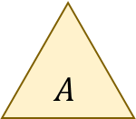


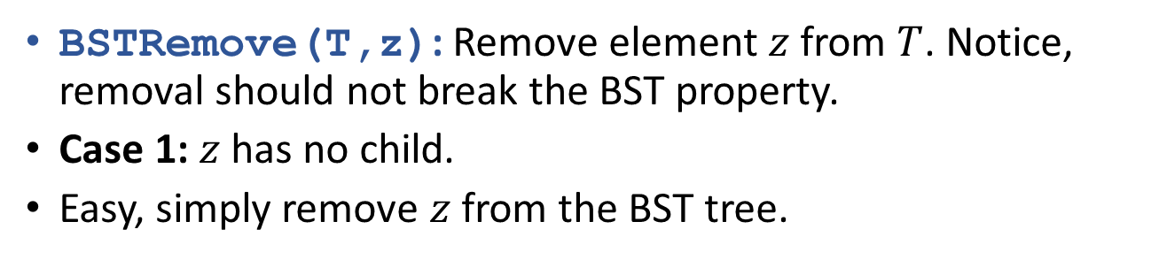




Remove in BST
BSTRemove(T,z): Remove element $z$ from $T$. Notice, removal should not break the BST property.
Case 1: $z$ has no child.
Easy, simply remove $z$ from the BST tree.
$$q$$
$$q$$
$$z$$
$$A$$
$$A$$
$$⋯,z,q,A,⋯$$
$$⋯,q,A,⋯$$

Slide 14
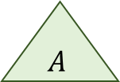
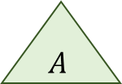


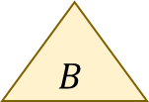
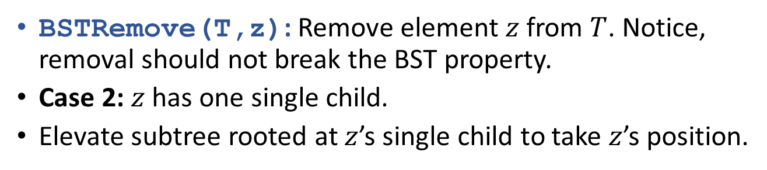
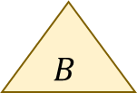
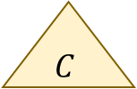
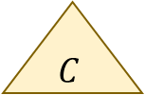





Remove in BST
BSTRemove(T,z): Remove element $z$ from $T$. Notice, removal should not break the BST property.
Case 2: $z$ has one single child.
Elevate subtree rooted at $z$’s single child to take $z$’s position.
$$q$$
$$q$$
$$z$$
$$C$$
$$r$$
$$C$$
$$r$$
$$A$$
$$B$$
$$A$$
$$B$$
$$⋯,A,r,B,q,C,⋯$$
$$⋯,z,A,r,B,q,C,⋯$$

Slide 15

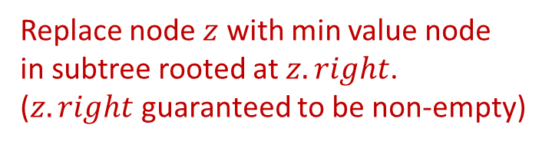



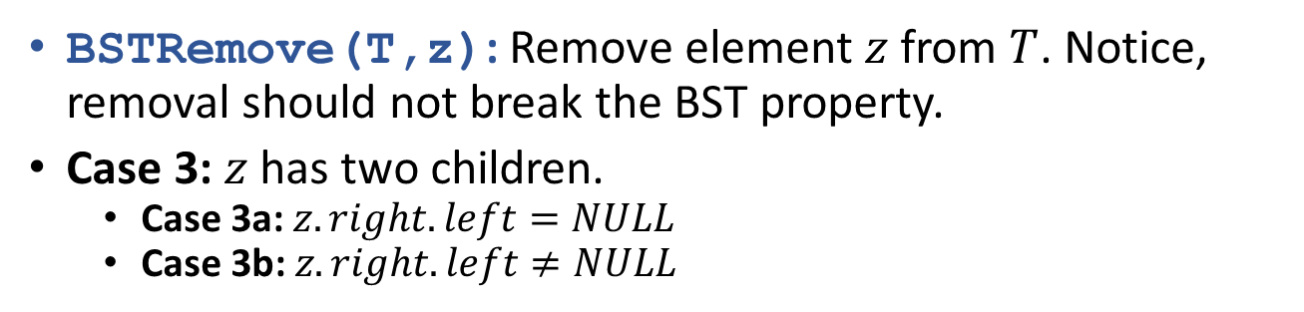


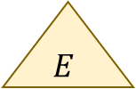
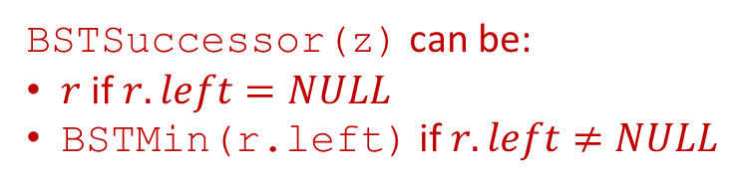




Remove in BST
BSTRemove(T,z): Remove element $z$ from $T$. Notice, removal should not break the BST property.
Case 3: $z$ has two children.
  Case 3a: $z.right.left=NULL$
  Case 3b: $z.right.left≠NULL$
Replace node $z$ with min value node
in subtree rooted at $z.right$.
($z.right$ guaranteed to be non-empty)
$$q$$
$$z$$
$$E$$
Replace node $z$ with BSTSuccessor(z)
$$l$$
$$r$$
BSTSuccessor(z) can be:
$r$ if $r.left=NULL$
BSTMin(r.left) if $r.left≠NULL$
$$A$$
$$B$$
$$C$$
$$D$$
$$⋯,A,l,B,z,C,r,D,q,E,⋯$$

Slide 16



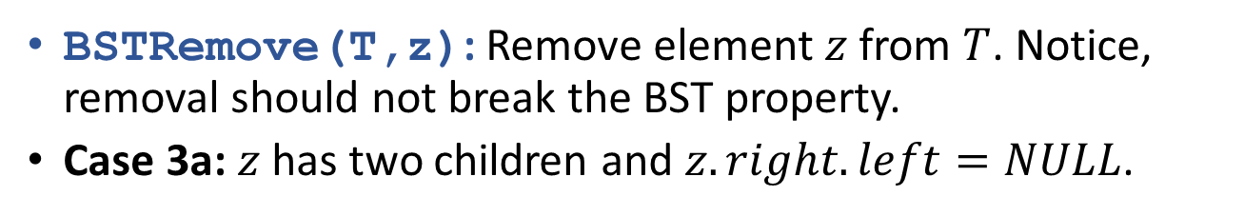














Remove in BST
BSTRemove(T,z): Remove element $z$ from $T$. Notice, removal should not break the BST property.
Case 3a: $z$ has two children and $z.right.left=NULL$.
$$q$$
$$q$$
$$z$$
$$E$$
$$r$$
$$E$$
$$l$$
$$r$$
$$l$$
$$D$$
$$A$$
$$B$$
$$D$$
$$A$$
$$B$$
$$⋯,A,l,B,z,r,D,q,E,⋯$$
$$⋯,A,l,B,r,D,q,E,⋯$$

Slide 17




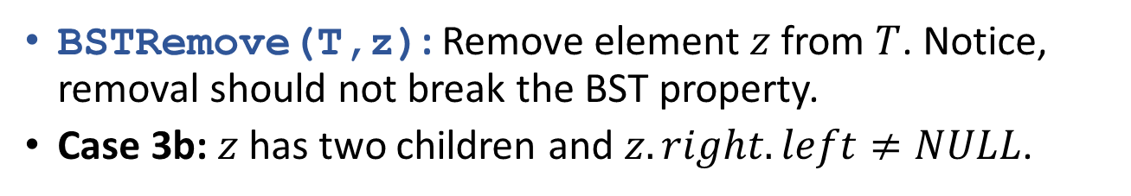

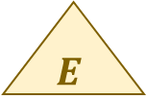

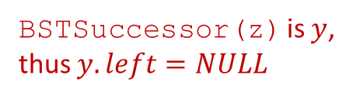


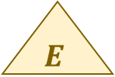















Remove in BST
BSTRemove(T,z): Remove element $z$ from $T$. Notice, removal should not break the BST property.
Case 3b: $z$ has two children and $z.right.left≠NULL$.
$$q$$
$$q$$
$$z$$
$$E$$
$$y$$
$$E$$
$$l$$
$$r$$
$$l$$
$$r$$
$$A$$
$$B$$
$$D$$
$$A$$
$$B$$
$$D$$
$$y$$
$$x$$
$$C′$$
$$C′$$
BSTSuccessor(z) is $y$,
thus $y.left=NULL$
$$x$$
$$C$$
$$C$$
$$⋯,A,l,B,z,y,C^{′},C\backslash C′,r,D,q,E,⋯$$
$$⋯,A,l,B,y,C^{′},C\backslash C′,r,D,q,E,⋯$$

Slide 18
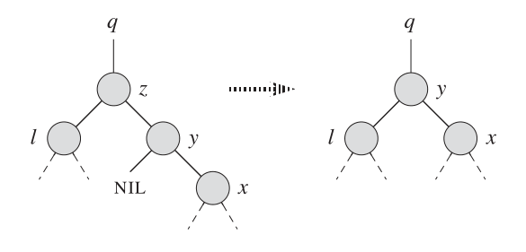
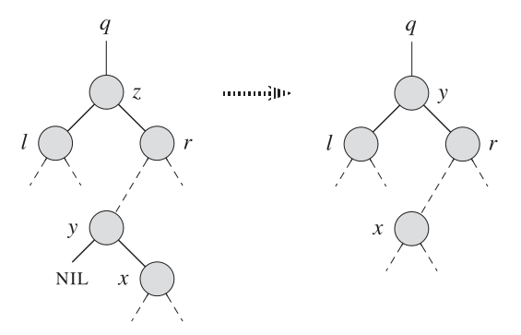


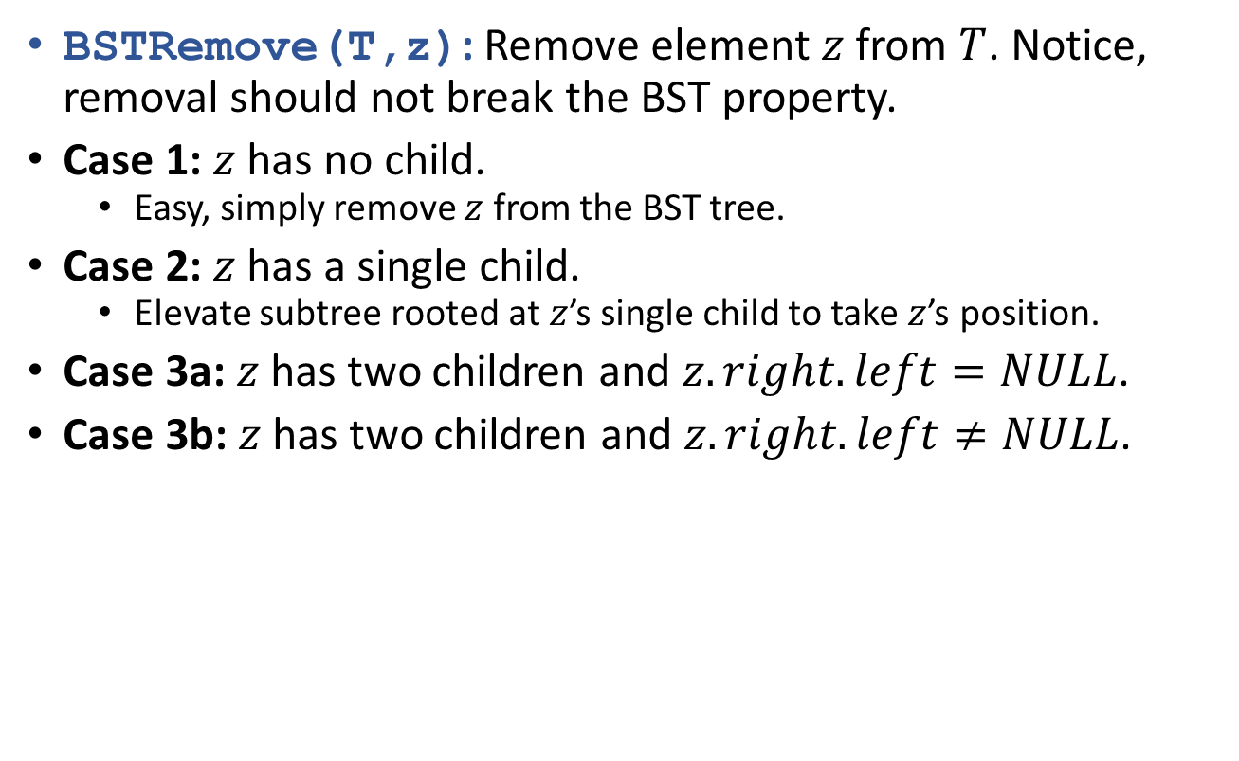


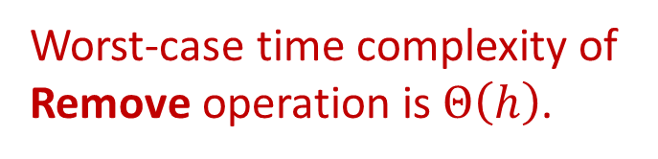
Remove in BST
Worst-case time complexity of Remove operation is $Θ\left(h\right)$.
BSTRemove(T,z): Remove element $z$ from $T$. Notice, removal should not break the BST property.
Case 1: $z$ has no child.
  Easy, simply remove $z$ from the BST tree.
Case 2: $z$ has a single child.
  Elevate subtree rooted at $z$’s single child to take $z$’s position.
Case 3a: $z$ has two children and $z.right.left=NULL$.
Case 3b: $z$ has two children and $z.right.left≠NULL$.
$$Θ\left(1\right)$$
$$Θ\left(1\right)$$
$$Θ\left(1\right)$$
$$Θ\left(h\right)$$
Case 3a
Case 3b

Slide 19
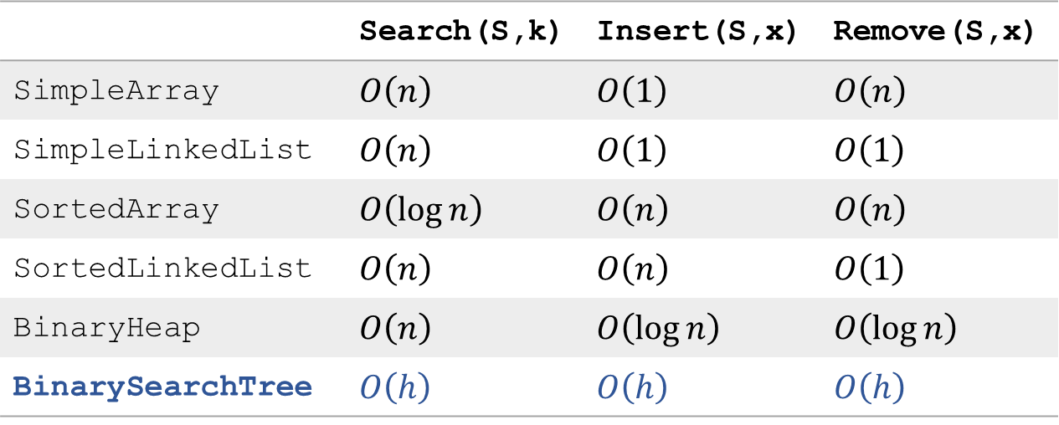
Efficient implementation of OSet
 | Search(S,k) | Insert(S,x) | Remove(S,x)
SimpleArray | $O\left(n\right)$ | $O\left(1\right)$ | $O\left(n\right)$
SimpleLinkedList | $O\left(n\right)$ | $O\left(1\right)$ | $O\left(1\right)$
SortedArray | $O\left(\log{n}\right)$ | $O\left(n\right)$ | $O\left(n\right)$
SortedLinkedList | $O\left(n\right)$ | $O\left(n\right)$ | $O\left(1\right)$
BinaryHeap | $O\left(n\right)$ | $O\left(\log{n}\right)$ | $O\left(\log{n}\right)$
BinarySearchTree | $O\left(h\right)$ | $O\left(h\right)$ | $O\left(h\right)$
BST also supports other operations of OSet, in $O\left(h\right)$ time.
But height of a $n$-node BST varies between $Θ\left(\log{n}\right)$ and $Θ\left(n\right)$.

Slide 20
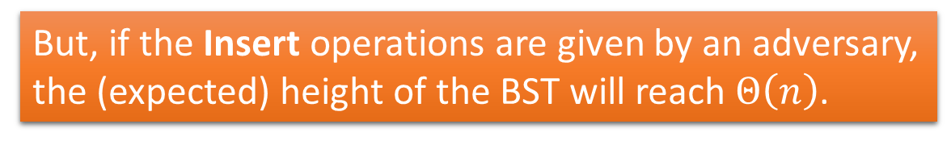
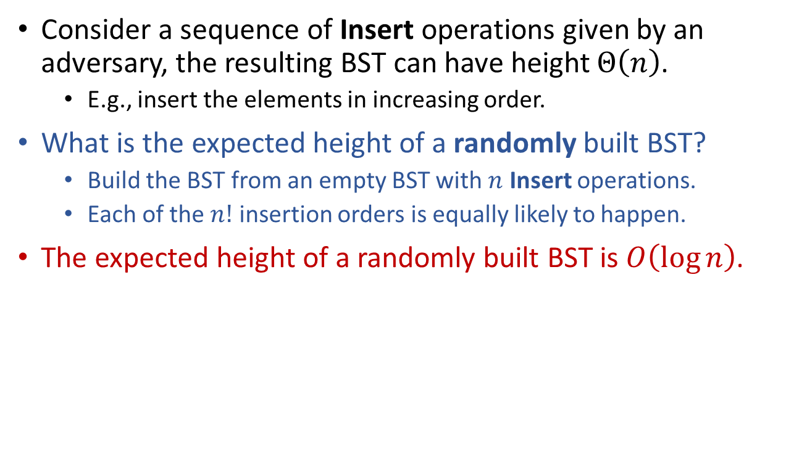
Height of BST
Consider a sequence of Insert operations given by an adversary, the resulting BST can have height $Θ\left(n\right)$.
  E.g., insert the elements in increasing order.
What is the expected height of a randomly built BST?
  Build the BST from an empty BST with $n$ Insert operations.
  Each of the $n!$ insertion orders is equally likely to happen.
The expected height of a randomly built BST is $O\left(\log{n}\right)$.
But, if the Insert operations are given by an adversary,
the (expected) height of the BST will reach $Θ\left(n\right)$.

Slide 21
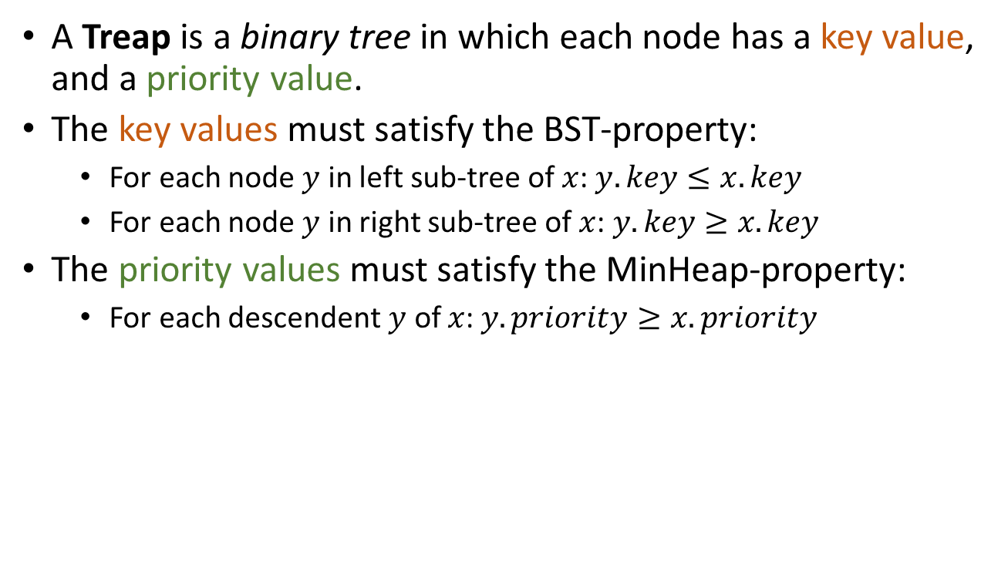
A randomized BST structure
Treap (Binary-Search-Tree + Heap)
A Treap is a binary tree in which each node has a key value, and a priority value.
The key values must satisfy the BST-property:
  For each node $y$ in left sub-tree of $x$: $y.key≤x.key$
  For each node $y$ in right sub-tree of $x$: $y.key≥x.key$
The priority values must satisfy the MinHeap-property:
  For each descendent $y$ of $x$: $y.priority≥x.priority$
A Treap is not necessarily a complete binary tree.
(Thus it is not a BinaryHeap.)
0.11
42
0.20
30
0.31
54
0.25
11
0.48
36
0.51
76

Slide 22
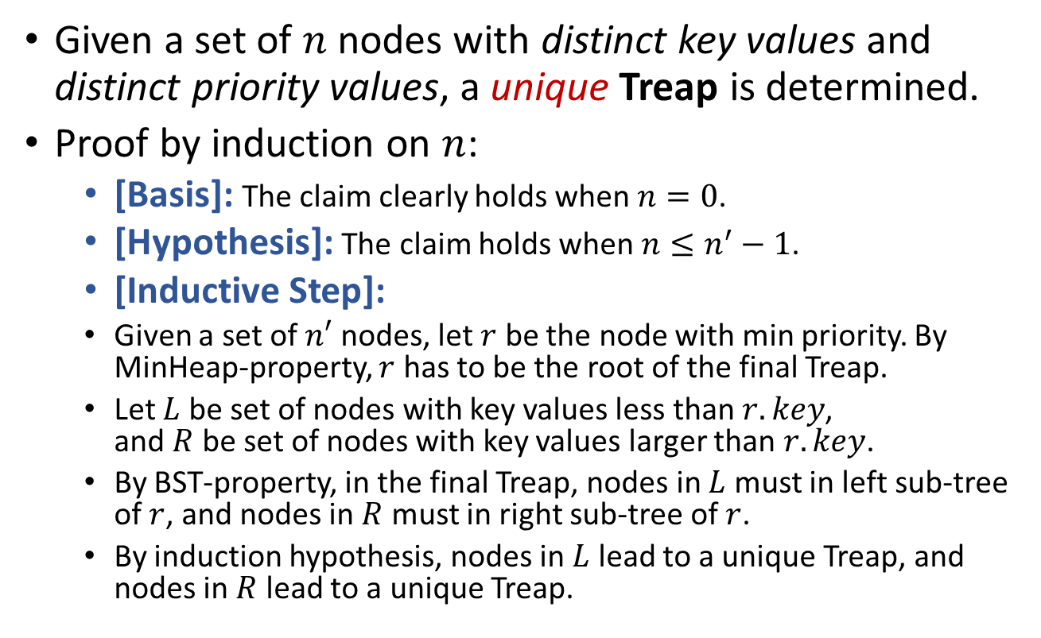
A randomized BST structure
Treap
Given a set of $n$ nodes with distinct key values and distinct priority values, a unique Treap is determined.
Proof by induction on $n$:
  [Basis]: The claim clearly holds when $n=0$.
  [Hypothesis]: The claim holds when $n≤n^{′}−1$.
  [Inductive Step]:
  Given a set of $n′$ nodes, let $r$ be the node with min priority. By MinHeap-property, $r$ has to be the root of the final Treap.
  Let $L$ be set of nodes with key values less than $r.key$,
  and $R$ be set of nodes with key values larger than $r.key$.
  By BST-property, in the final Treap, nodes in $L$ must in left sub-tree of $r$, and nodes in $R$ must in right sub-tree of $r$.
  By induction hypothesis, nodes in $L$ lead to a unique Treap, and nodes in $R$ lead to a unique Treap.

Slide 23
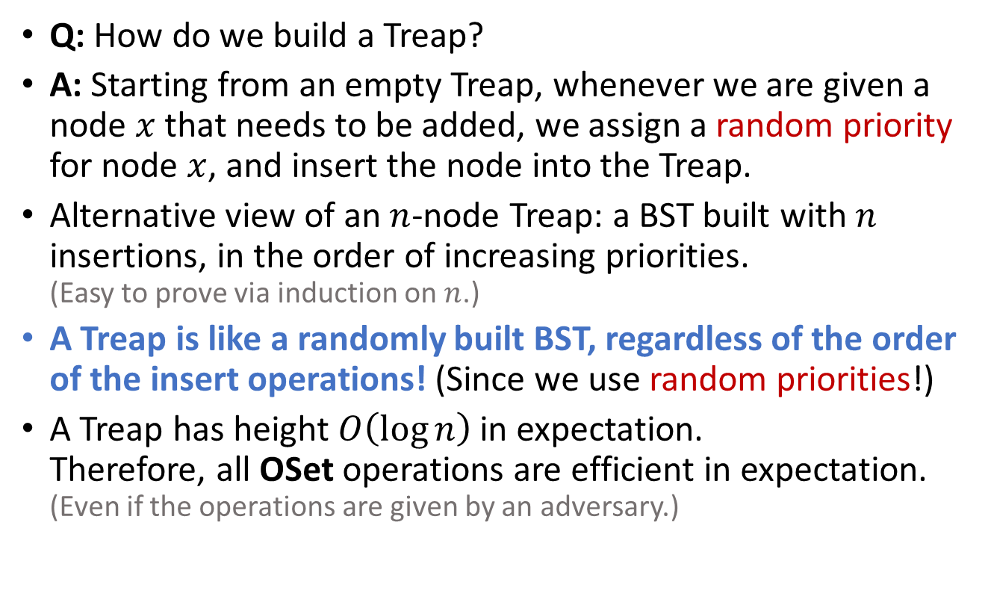
Treap
Q: How do we build a Treap?
A: Starting from an empty Treap, whenever we are given a node $x$ that needs to be added, we assign a random priority for node $x$, and insert the node into the Treap.
Alternative view of an $n$-node Treap: a BST built with $n$ insertions, in the order of increasing priorities.
(Easy to prove via induction on $n$.)
A Treap is like a randomly built BST, regardless of the order of the insert operations! (Since we use random priorities!)
A Treap has height $O\left(\log{n}\right)$ in expectation.
Therefore, all OSet operations are efficient in expectation.
(Even if the operations are given by an adversary.)

Slide 24
Insert in Treap
Step 1: Assign a random priority to the node to be added.
Step 2: Insert the node following BST-property.
Step 3: Fix MinHeap-property (without violating BST-property).
Example:
Insert element with key 33.
0.11
42
0.18
33
0.20
30
0.31
54
0.25
11
0.48
36
0.51
76
0.18
33

Slide 25




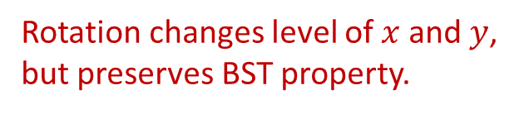






Insert in Treap
Step 1: Assign a random priority to the node to be added.
Step 2: Insert the node following BST-property.
Step 3: Fix MinHeap-property (without violating BST-property).
right-rotate
0.11
42
$$y$$
$$x$$
left-rotate
0.20
30
0.31
54
$$x$$
$$C$$
$$A$$
$$y$$
0.25
11
0.48
36
0.51
76
$$A$$
$$B$$
$$B$$
$$C$$
Rotation changes level of $x$ and $y$,
but preserves BST property.
0.18
33

Slide 26
Insert in Treap
Step 1: Assign a random priority to the node to be added.
Step 2: Insert the node following BST-property.
Step 3: Fix MinHeap-property (without violating BST-property).
right-rotate
0.11
42
$$y$$
$$x$$
left-rotate
0.20
30
0.31
54
$$x$$
$$C$$
$$A$$
$$y$$
0.25
11
0.18
33
0.51
76
$$A$$
$$B$$
$$B$$
$$C$$
Rotation changes level of $x$ and $y$,
but preserves BST property.
0.48
36

Slide 27
Insert in Treap
Step 1: Assign a random priority to the node to be added.
Step 2: Insert the node following BST-property.
Step 3: Fix MinHeap-property (without violating BST-property).
right-rotate
0.11
42
$$y$$
$$x$$
left-rotate
0.18
33
0.31
54
$$x$$
$$C$$
$$A$$
$$y$$
0.20
30
0.48
36
0.51
76
$$A$$
$$B$$
$$B$$
$$C$$
Rotation changes level of $x$ and $y$,
but preserves BST property.
0.25
11

Slide 28










Insert in Treap
Step 1: Assign a random priority to the node to be added.
Step 2: Insert the node following BST-property.
Step 3: Fix MinHeap-property (without violating BST-property).
  Use rotations to push-up violating nodes until MinHeap-property restored.
right-rotate
$$y$$
$$x$$
left-rotate
$$x$$
$$C$$
$$A$$
$$y$$
$$A$$
$$B$$
$$B$$
$$C$$

Slide 29
Remove in Treap
Q: Given a pointer to a node, how to remove it?
A: Just invert the process of insertion!
Step 1: Use rotations to push-down the node till it is a leaf.
Step 2: Remove the leaf.
Example:
Remove element
with key 33.
0.11
42
0.11
42
0.18
33
0.31
54
0.20
30
0.31
54
0.20
30
0.48
36
0.51
76
0.25
11
0.48
36
0.51
76
0.25
11
0.18
33

Slide 30
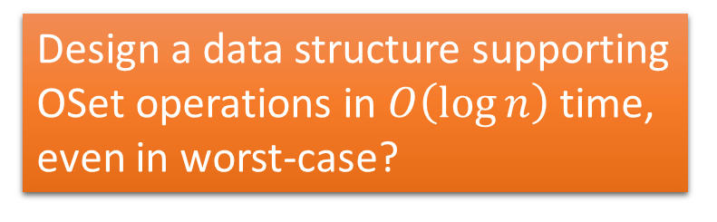

Treap
A probabilistic data structure.
Like a randomly built BST. (Expected height is $O\left(\log{n}\right)$, even for adversarial operation sequence.)
Support OSet operations in $O\left(\log{n}\right)$ time, in expectation.
Design a data structure supporting OSet operations in $O\left(\log{n}\right)$ time, even in worst-case?
0.11
42
0.20
30
0.31
54
0.25
11
0.48
36
0.51
76

Slide 31
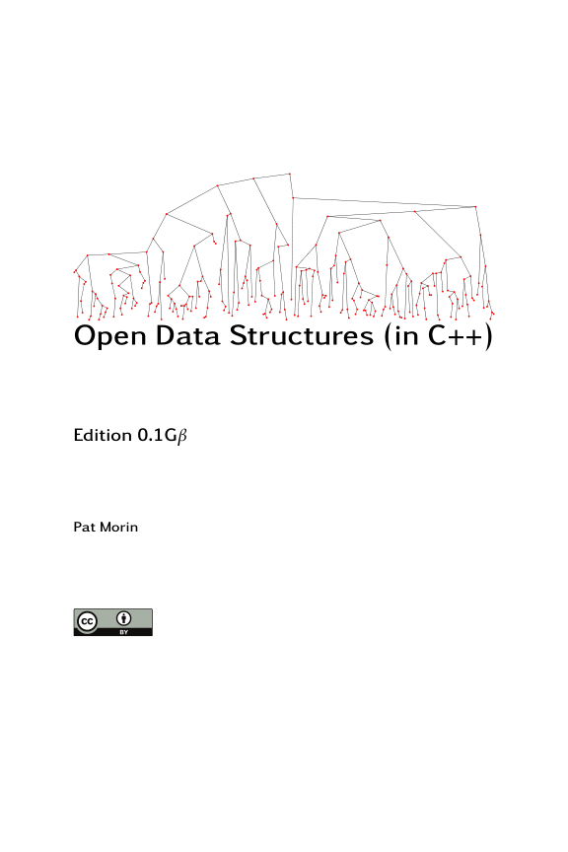
Reading
[CLRS] Ch.12
[Morin] Ch.7 (7.2)

