Slide 1
Hashing
Data Structures and Algorithms
Nanjing University, Fall 2019
郑朝栋

Slide 2












Quick Review
Hash Tables
  Store $n$ keys from a huge universe $U$ into a table of size $m≈n$
  Use a hash function $h:U→\left[m\right]$ to decide where to put each key
Collisions are inevitable!
[Collision Resolution] Method 1: Chaining.
[Collision Resolution] Method 2: Open addressing.
$$U$$
3
0
$$h\left(x\right)=0$$
1
$$h\left(u\right)=2$$
2
3
3
$$x$$
$$u$$
$$h\left(y\right)=5$$
4
$$y$$
5
$$w$$
3
6
$$h\left(z\right)=8$$
$$h\left(w\right)=8$$
7
$$z$$
8

Slide 3
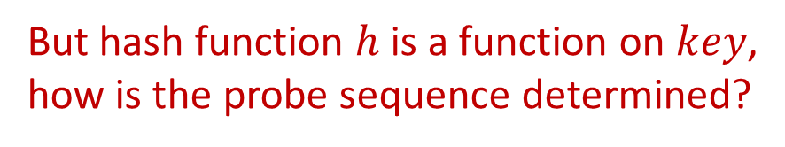


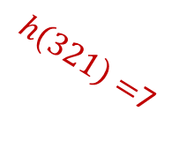
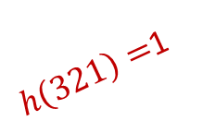

Coping with collisions in hashing
Open Addressing
Basic idea:
  No linked lists!
  All items store in table,
  one item per bucket!
Load factor $α=\frac{n}{m}≤1$
On collision?
  Probe a sequence of
  buckets until an empty
  one is found!
3
0
245
1
$h\left(321\right)=$1
2
$$key=321$$
$h\left(321\right)=$4
366
3
$h\left(321\right)=$7
321
4
111
5
3
6
571
7
533
8
But hash function $h$ is a function on $key$,
how is the probe sequence determined?
Notes:
Open addressing: 开放寻址

Slide 4

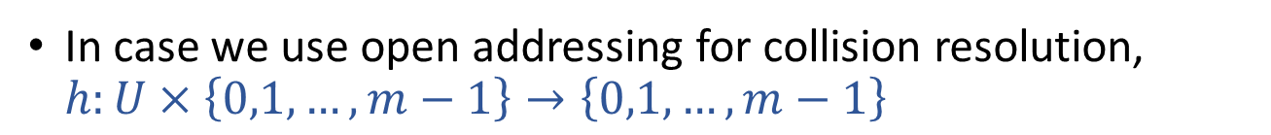
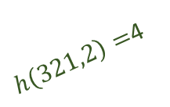

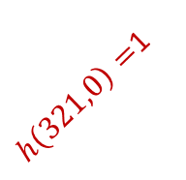
Open addressing
Hash Function Re-defined
In case we use open addressing for collision resolution,
$h:U×\left\{0,1,…,m−1\right\}→\left\{0,1,…,m−1\right\}$
key
probe number
table index
HashInsert(T,k):
i=0
repeat
j=h(k,i)
if (T[j]==NIL)
T[j]=k
return j
else i=i+1
until (i==m)
return “overflow”
HashSearch(T,k):
i=0
repeat
j=h(k,i)
if (T[j]==k)
return j
i=i+1
until (i==m or T[j]==NIL)
return NIL
3
0
245
1
$h\left(321,0\right)=$1
2
366
3
$h\left(321,2\right)=$4
321
4
111
5
$$key=321$$
3
6
$h\left(321,1\right)=$7
571
7
533
8

Slide 5

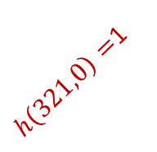




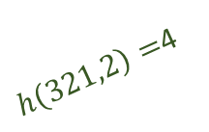
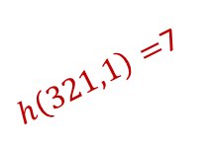

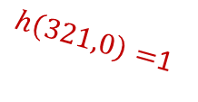
Open addressing
The Remove Operation
HashInsert(T,k):
i=0
repeat
j=h(k,i)
if (T[j]==NIL)
T[j]=k
return j
else i=i+1
until (i==m)
return “overflow”
HashSearch(T,k):
i=0
repeat
j=h(k,i)
if (T[j]==k)
return j
i=i+1
until (i==m or T[j]==NIL)
return NIL
HashRemove(T,k):
pos=HashSearch(T,k)
if (pos!=NIL)
T[pos]=NIL
return pos
No change!
WRONG!!!
HashRemove(T,k):
pos=HashSearch(T,k)
if (pos!=NIL)
T[pos]=DEL
return pos
T[j]==NIL or T[j]==DEL
3
0
$h\left(245,0\right)=$1
Remove $245$
245
1
DEL
$h\left(321,0\right)=$1
2
$h\left(321,0\right)=$1
366
3
$h\left(321,2\right)=$4
Search $321$
$h\left(321,2\right)=$4
321
4
111
5
$h\left(321,1\right)=$7
Insert $321$
3
6
$h\left(321,1\right)=$7
571
7
533
8

Slide 6
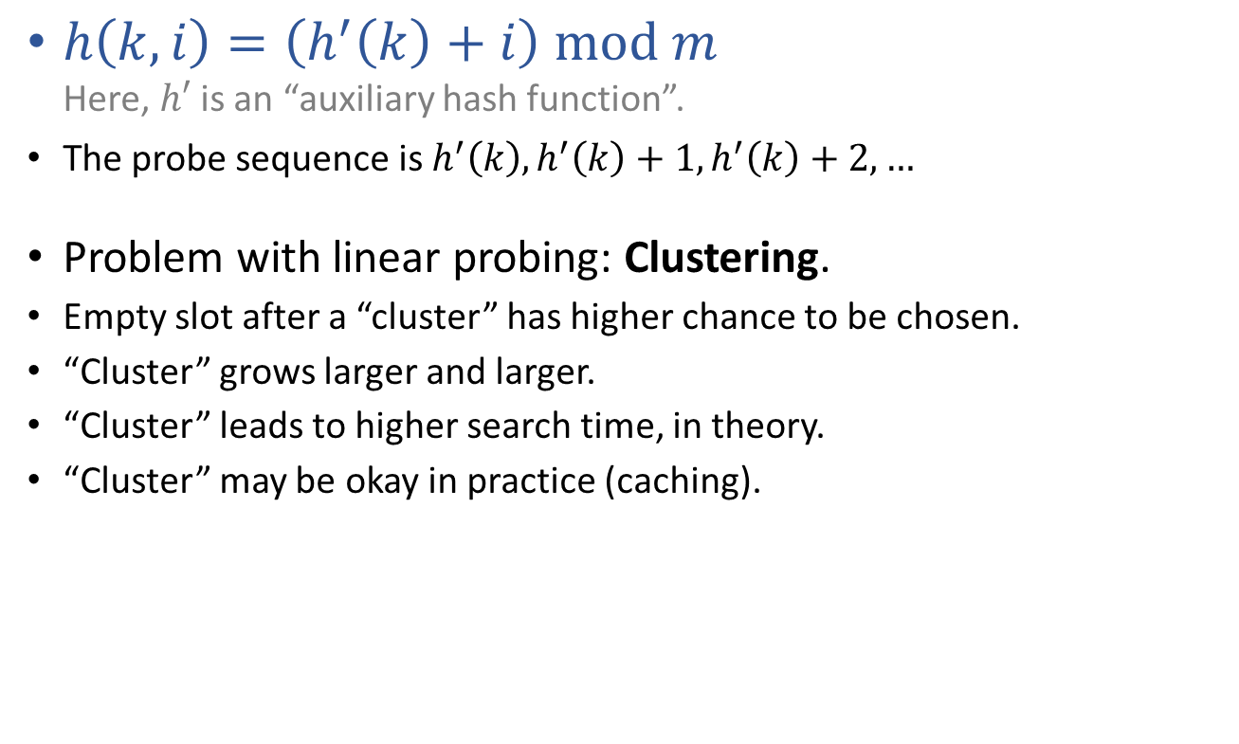
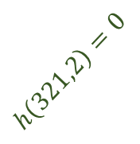

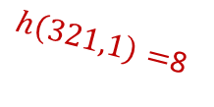

Commonly used probing sequences
Linear Probing
$h\left(k,i\right)=\left(h^{′}\left(k\right)+i\right) mod m$
Here, $h′$ is an “auxiliary hash function”.
The probe sequence is $h^{′}\left(k\right),h^{′}\left(k\right)+1,h^{′}\left(k\right)+2,…$
Problem with linear probing: Clustering.
Empty slot after a “cluster” has higher chance to be chosen.
“Cluster” grows larger and larger.
“Cluster” leads to higher search time, in theory.
“Cluster” may be okay in practice (caching).
321
0
1
2
$$h\left(321,2\right)=0$$
366
3
689
4
111
5
Insert $321$
$h\left(321,0\right)=$7
3
6
571
7
$h\left(321,1\right)=$8
533
8
Notes:
Linear probing: 线性探查

Slide 7

Commonly used probing sequences
Quadratic Probing
$h\left(k,i\right)=\left(h^{′}\left(k\right)+c_{1}i+c_{2}i^{2}\right) mod m$
Here, $h′$ is an “auxiliary hash function”.
Problem with quadratic probing: (Secondary) Clustering.
Keys having same $h′$ values result in same probe sequences.
Notes:
Quadratic probing: 二次探查

Slide 8
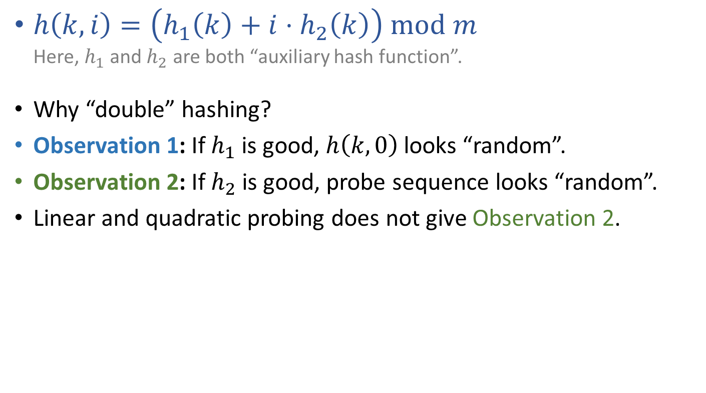
Commonly used probing sequences
Double Hashing
$h\left(k,i\right)=\left(h_{1}\left(k\right)+i⋅h_{2}\left(k\right)\right) mod m$
Here, $h_{1}$ and $h_{2}$ are both “auxiliary hash function”.
Why “double” hashing?
Observation 1: If $h_{1}$ is good, $h\left(k,0\right)$ looks “random”.
Observation 2: If $h_{2}$ is good, probe sequence looks “random”.
Linear and quadratic probing does not give Observation 2.
Notes:
Double hashing: 双重哈希（散列）

Slide 9
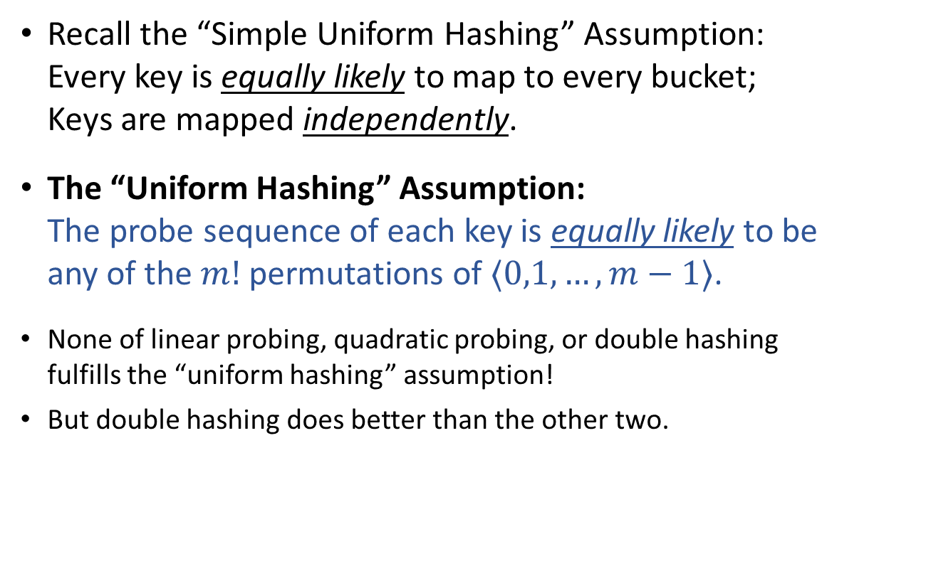
Performance of open-address hashing
The “Uniform Hashing” Assumption
Recall the “Simple Uniform Hashing” Assumption:
Every key is equally likely to map to every bucket;
Keys are mapped independently.
The “Uniform Hashing” Assumption:
The probe sequence of each key is equally likely to be
any of the $m!$ permutations of $⟨0,1,…,m−1⟩$.
None of linear probing, quadratic probing, or double hashing
fulfills the “uniform hashing” assumption!
But double hashing does better than the other two.

Slide 10
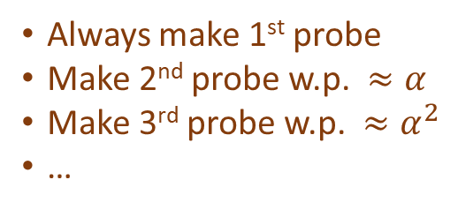
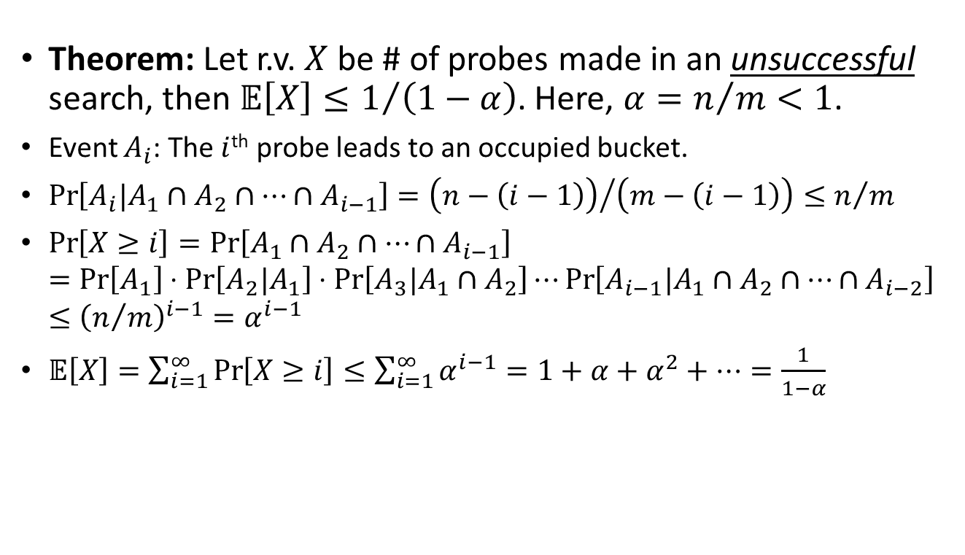
Assuming “uniform hashing”
Performance of open-address hashing
Theorem: Let r.v. $X$ be # of probes made in an unsuccessful search, then $𝔼\left[X\right]≤1/{\left(1−α\right)}$. Here, $α=n/m<1$.
Event $A_{i}$: The $i$^{th} probe leads to an occupied bucket.
$\operatorname{Pr}\left[A_{i}|A_{1}∩A_{2}∩…∩A_{i−1}\right]={\left(n−\left(i−1\right)\right)}/{\left(m−\left(i−1\right)\right)}≤n/m$
$\operatorname{Pr}\left[X≥i\right]=\operatorname{Pr}\left[A_{1}∩A_{2}∩…∩A_{i−1}\right]$
$=\operatorname{Pr}\left[A_{1}\right]⋅\operatorname{Pr}\left[A_{2}|A_{1}\right]⋅\operatorname{Pr}\left[A_{3}|A_{1}∩A_{2}\right]⋯\operatorname{Pr}\left[A_{i−1}|A_{1}∩A_{2}∩…∩A_{i−2}\right]$
$≤{\left(n/m\right)}^{i−1}=α^{i−1}$
$𝔼\left[X\right]=\sum_{i=1}^{∞}{\operatorname{Pr}\left[X≥i\right]}≤\sum_{i=1}^{∞}{α^{i−1}}=1+α+α^{2}+…=\frac{1}{1−α}$
Always make 1st probe
Make 2nd probe w.p. $≈α$
Make 3rd probe w.p. $≈α^{2}$
…

Slide 11
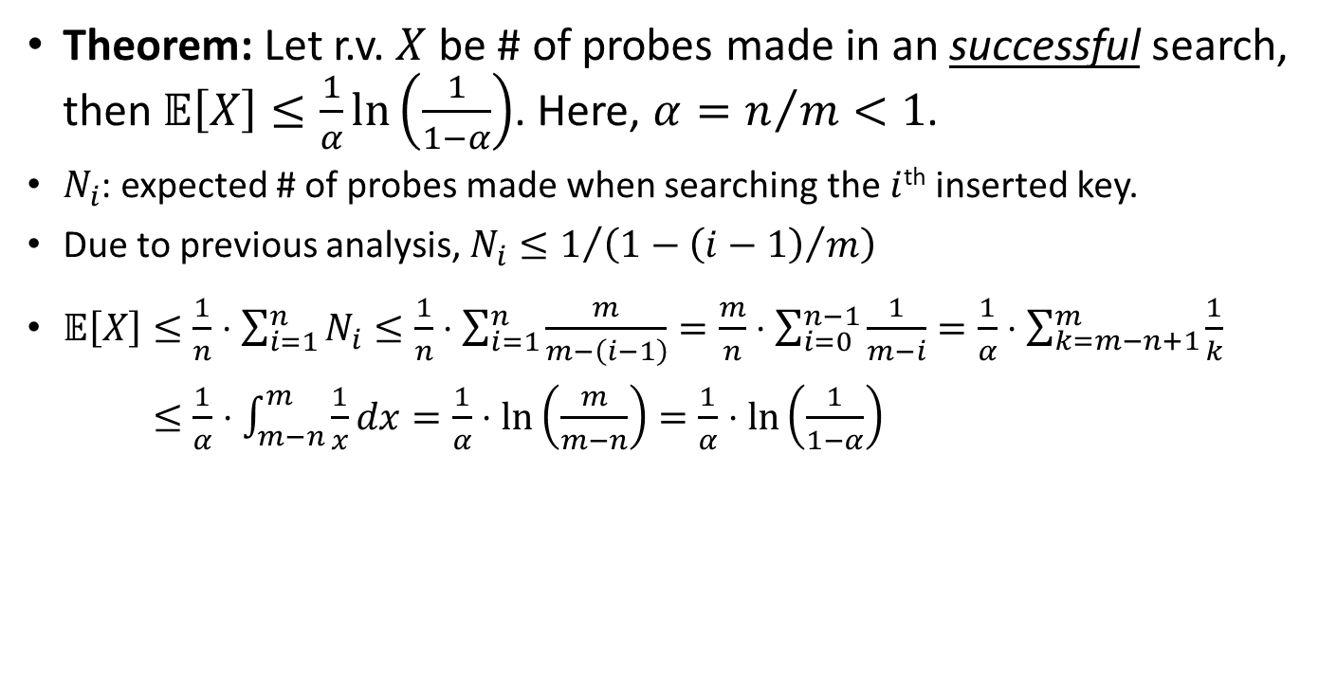
Assuming “uniform hashing”
Performance of open-address hashing
Theorem: Let r.v. $X$ be # of probes made in an successful search, then $𝔼\left[X\right]≤\frac{1}{α}\ln\left(\frac{1}{1−α}\right)$. Here, $α=n/m<1$.
$N_{i}$: expected # of probes made when searching the $i$^{th} inserted key.
Due to previous analysis, $N_{i}≤1/{\left(1−{\left(i−1\right)}/m\right)}$
$𝔼\left[X\right]≤\frac{1}{n}⋅\sum_{i=1}^{n}{N_{i}}≤\frac{1}{n}⋅\sum_{i=1}^{n}{\frac{m}{m−\left(i−1\right)}}=\frac{m}{n}⋅\sum_{i=0}^{n−1}{\frac{1}{m−i}}=\frac{1}{α}⋅\sum_{k=m−n+1}^{m}{\frac{1}{k}}$
$𝔼\left[X\right]≤\frac{1}{α}⋅\int_{m−n}^{m}{\frac{1}{x}dx}=\frac{1}{α}⋅\ln\left(\frac{m}{m−n}\right)=\frac{1}{α}⋅\ln\left(\frac{1}{1−α}\right)$

Slide 12
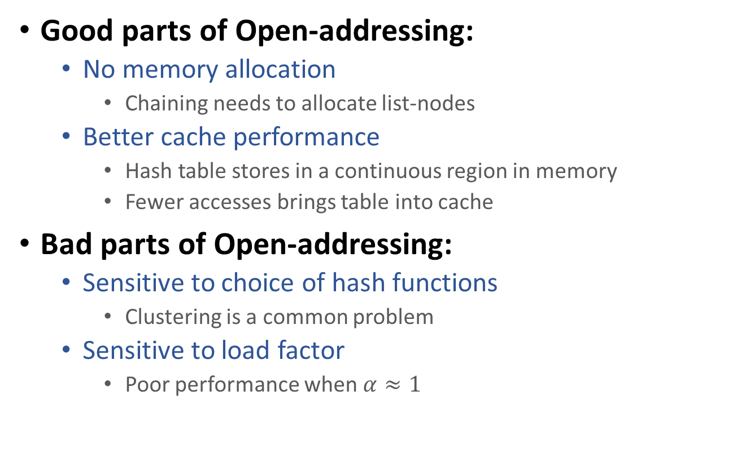
Collision resolution in hashing
Chaining vs Open-addressing
Good parts of Open-addressing:
  No memory allocation
    Chaining needs to allocate list-nodes
  Better cache performance
    Hash table stores in a continuous region in memory
    Fewer accesses brings table into cache
Bad parts of Open-addressing:
  Sensitive to choice of hash functions
    Clustering is a common problem
  Sensitive to load factor
    Poor performance when $α≈1$

Slide 13
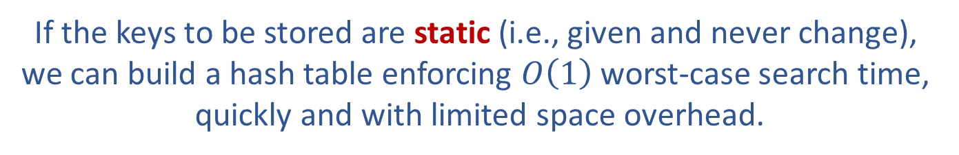
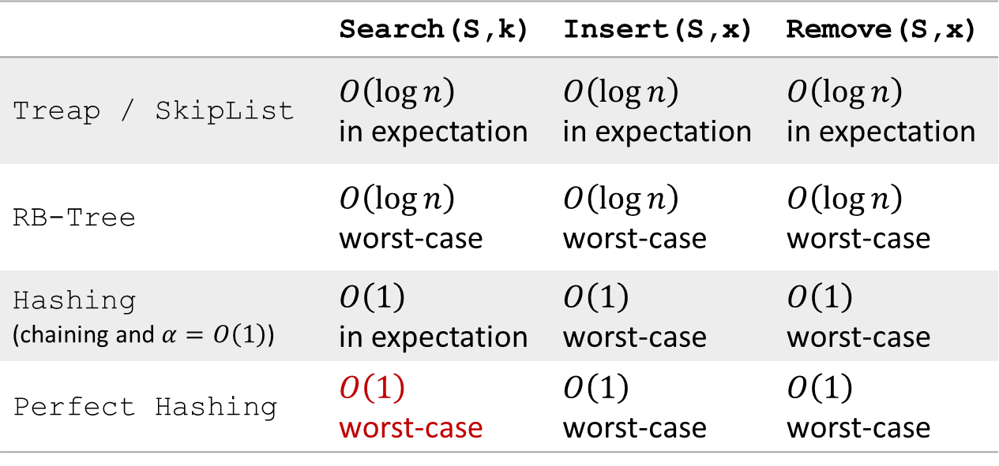
Efficient implementation of OSet
 | Search(S,k) | Insert(S,x) | Remove(S,x)
Treap / SkipList | $O\left(\log{n}\right)$ in expectation | $O\left(\log{n}\right)$ in expectation | $O\left(\log{n}\right)$ in expectation
RB-Tree | $O\left(\log{n}\right)$ worst-case | $O\left(\log{n}\right)$ worst-case | $O\left(\log{n}\right)$ worst-case
Hashing (chaining and $α=O\left(1\right)$) | $O\left(1\right)$ in expectation | $O\left(1\right)$ worst-case | $O\left(1\right)$ worst-case
Perfect Hashing | $O\left(1\right)$ worst-case | $O\left(1\right)$ worst-case | $O\left(1\right)$ worst-case
If the keys to be stored are static (i.e., given and never change),
we can build a hash table enforcing $O\left(1\right)$ worst-case search time,
quickly and with limited space overhead.

Slide 14
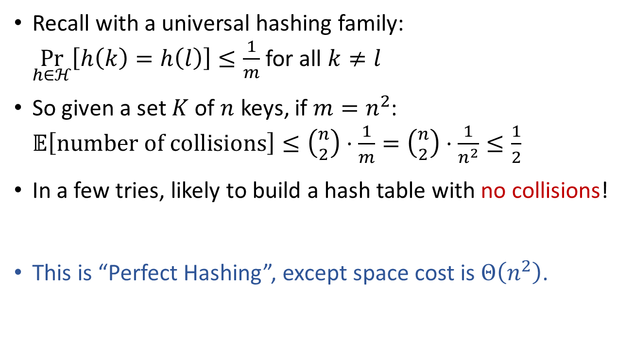

HashTable of size $Θ\left(n^{2}\right)$
Recall with a universal hashing family:
$\underset{h∈ℋ}{Pr}\left[h\left(k\right)=h\left(l\right)\right]≤\frac{1}{m}$ for all $k≠l$
So given a set $K$ of $n$ keys, if $m=n^{2}$:
$𝔼\left[number of collisions\right]≤\left({n \atop 2}\right)⋅\frac{1}{m}=\left({n \atop 2}\right)⋅\frac{1}{n^{2}}≤\frac{1}{2}$
In a few tries, likely to build a hash table with no collisions!
This is “Perfect Hashing”, except space cost is $Θ\left(n^{2}\right)$.

Slide 15



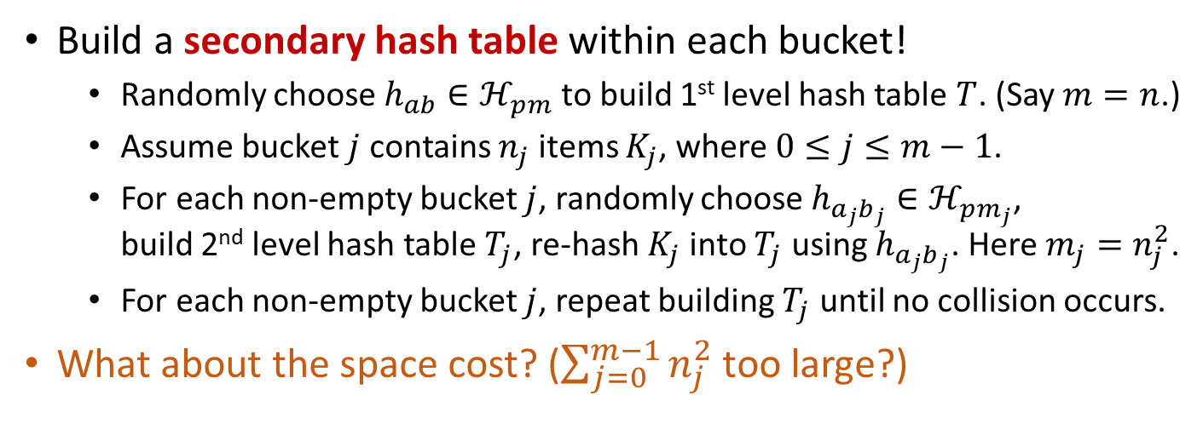



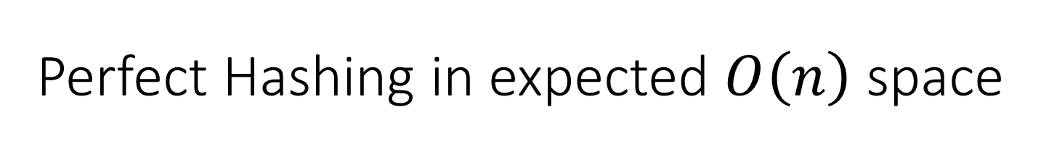









Perfect Hashing in expected $O\left(n\right)$ space
Build a secondary hash table within each bucket!
  Randomly choose $h_{ab}∈ℋ_{pm}$ to build 1st level hash table $T$. (Say $m=n$.)
  Assume bucket $j$ contains $n_{j}$ items $K_{j}$, where $0≤j≤m−1$.
  For each non-empty bucket $j$, randomly choose $h_{a_{j}b_{j}}∈ℋ_{pm_{j}}$,
  build 2nd level hash table $T_{j}$, re-hash $K_{j}$ into $T_{j}$ using $h_{a_{j}b_{j}}$. Here $m_{j}=n_{j}^{2}$.
  For each non-empty bucket $j$, repeat building $T_{j}$ until no collision occurs.
What about the space cost? ($\sum_{j=0}^{m−1}{n_{j}^{2}}$ too large?)
This is not hard…
0
0
1
$$k_{6}$$
$$k_{5}$$
$$k_{4}$$
1
$$\left(a_{1},b_{1},m_{1}\right)$$
$$k_{5}$$
$$k_{4}$$
$$k_{6}$$
2
2
3
3
$$k_{1}$$
3
$$\left(a_{3},b_{3},m_{3}\right)$$
$$k_{1}$$
4
3
4
5
$$k_{3}$$
$$k_{2}$$
5
$$\left(a_{5},b_{5},m_{5}\right)$$
$$k_{3}$$
$$k_{2}$$

Slide 16
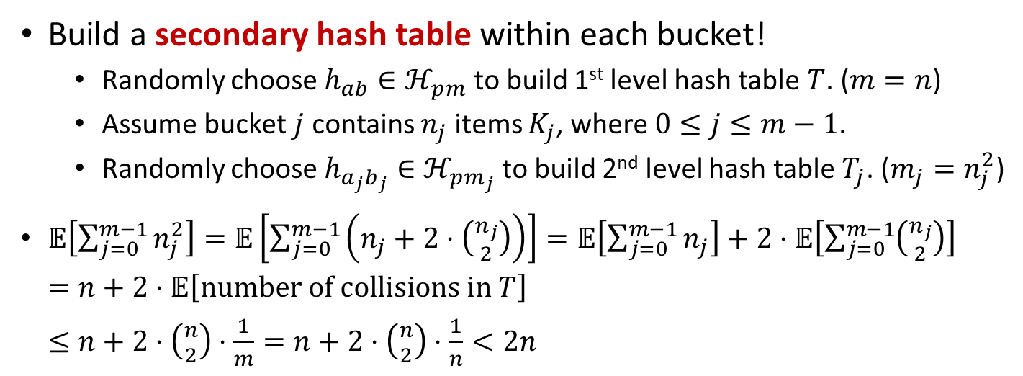
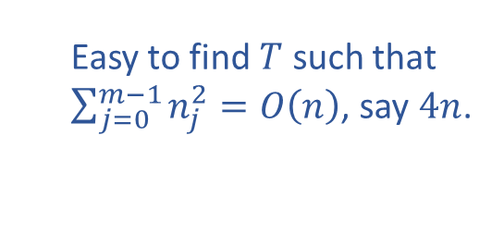
Perfect Hashing in expected $O\left(n\right)$ space
Build a secondary hash table within each bucket!
  Randomly choose $h_{ab}∈ℋ_{pm}$ to build 1st level hash table $T$. ($m=n$)
  Assume bucket $j$ contains $n_{j}$ items $K_{j}$, where $0≤j≤m−1$.
  Randomly choose $h_{a_{j}b_{j}}∈ℋ_{pm_{j}}$ to build 2nd level hash table $T_{j}$. ($m_{j}=n_{j}^{2}$)
$𝔼\left[\sum_{j=0}^{m−1}{n_{j}^{2}}\right]=𝔼\left[\sum_{j=0}^{m−1}{\left(n_{j}+2⋅\left({n_{j} \atop 2}\right)\right)}\right]=𝔼\left[\sum_{j=0}^{m−1}{n_{j}}\right]+2⋅𝔼\left[\sum_{j=0}^{m−1}{\left({n_{j} \atop 2}\right)}\right]$
$=n+2⋅𝔼\left[number of collisions in T\right]$
$≤n+2⋅\left({n \atop 2}\right)⋅\frac{1}{m}=n+2⋅\left({n \atop 2}\right)⋅\frac{1}{n}<2n$
Easy to find $T$ such that
$\sum_{j=0}^{m−1}{n_{j}^{2}}=O\left(n\right)$, say $4n$.
0
0
1
$$k_{6}$$
$$k_{5}$$
$$k_{4}$$
1
$$\left(a_{1},b_{1},m_{1}\right)$$
$$k_{5}$$
$$k_{4}$$
$$k_{6}$$
2
2
3
3
$$k_{1}$$
3
$$\left(a_{3},b_{3},m_{3}\right)$$
$$k_{1}$$
4
3
4
5
$$k_{3}$$
$$k_{2}$$
5
$$\left(a_{5},b_{5},m_{5}\right)$$
$$k_{3}$$
$$k_{2}$$

Slide 17
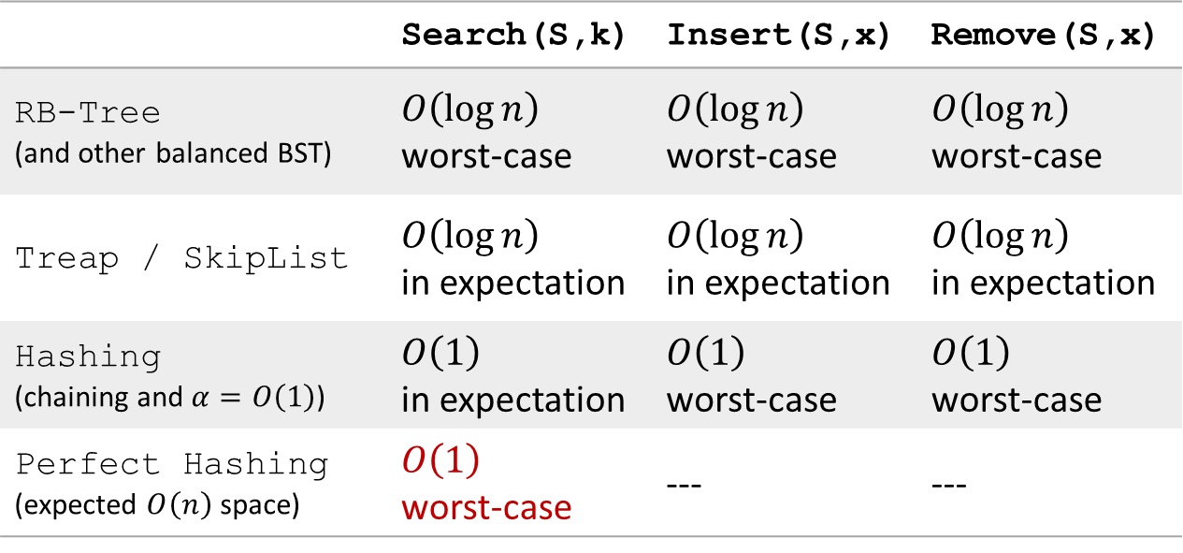
Efficient implementation of OSet
 | Search(S,k) | Insert(S,x) | Remove(S,x)
RB-Tree (and other balanced BST) | $O\left(\log{n}\right)$ worst-case | $O\left(\log{n}\right)$ worst-case | $O\left(\log{n}\right)$ worst-case
Treap / SkipList | $O\left(\log{n}\right)$ in expectation | $O\left(\log{n}\right)$ in expectation | $O\left(\log{n}\right)$ in expectation
Hashing (chaining and $α=O\left(1\right)$) | $O\left(1\right)$ in expectation | $O\left(1\right)$ worst-case | $O\left(1\right)$ worst-case
Perfect Hashing (expected $O\left(n\right)$ space) | $O\left(1\right)$ worst-case | --- | ---
Hashing can also be used for unordered Set ADT

Slide 18
Reading
[CLRS] Ch.11 (11.4-11.5)

