Slide 1
Amortized Analysis
Data Structures and Algorithms
Nanjing University, Fall 2019
郑朝栋

Slide 2

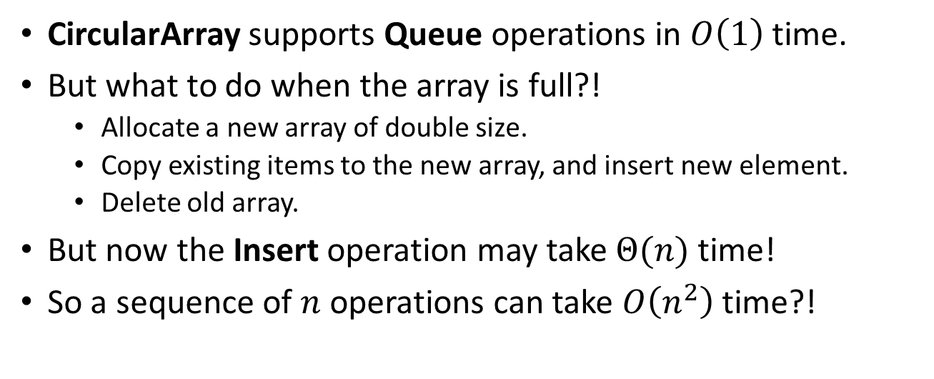


Implement Queue with CircularArray
CircularArray supports Queue operations in $O\left(1\right)$ time.
But what to do when the array is full?!
  Allocate a new array of double size.
  Copy existing items to the new array, and insert new element.
  Delete old array.
But now the Insert operation may take $Θ(n)$ time!
So a sequence of $n$ operations can take $O\left(n^{2}\right)$ time?!
$$Θ(1)$$
$$Θ(n)$$
$$Θ(1)$$
Correct but not tight!!
Insert(x)
tail
head
head
tail
head
tail
c
f
a
e
q
c
d
a
f
f
a
a
e
e
q
q
c
c
d
d
a
a
c
c
x
c
f
a
e
q
c
c
c
x
f
a
e
q
c
d
a

Slide 3

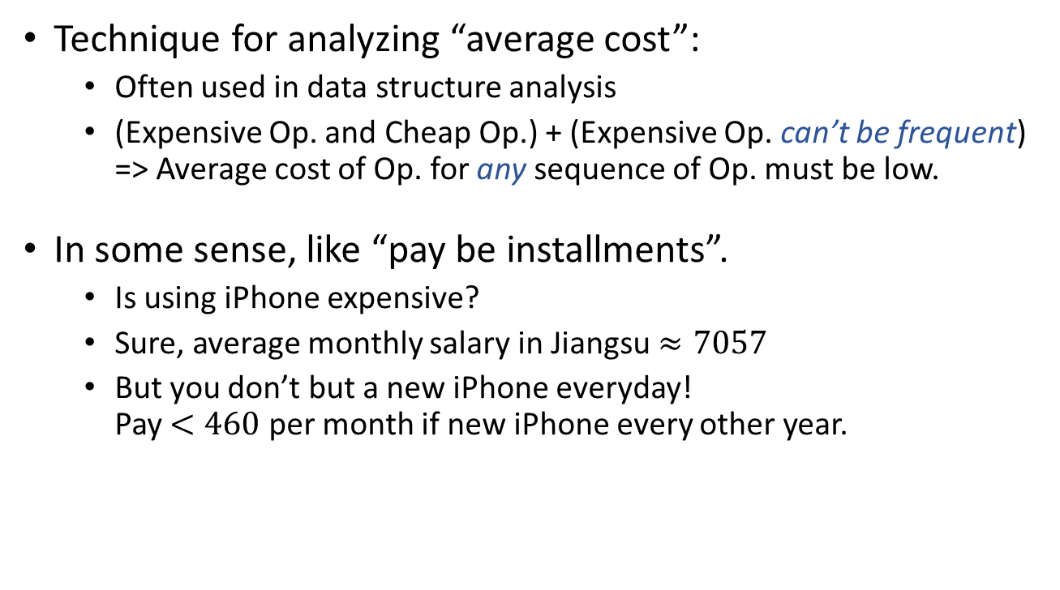
Amortized Analysis
Technique for analyzing “average cost”:
  Often used in data structure analysis
  (Expensive Op. and Cheap Op.) + (Expensive Op. can’t be frequent)
  => Average cost of Op. for any sequence of Op. must be low.
In some sense, like “pay be installments”.
  Is using iPhone expensive?
  Sure, average monthly salary in Jiangsu $≈7057$
  But you don’t but a new iPhone everyday!
  Pay $<460$ per month if new iPhone every other year.
RMB 10899
256GB
Salary data from: http://www.jiangsu.gov.cn/art/2019/5/22/art_34151_8343241.html

Slide 4
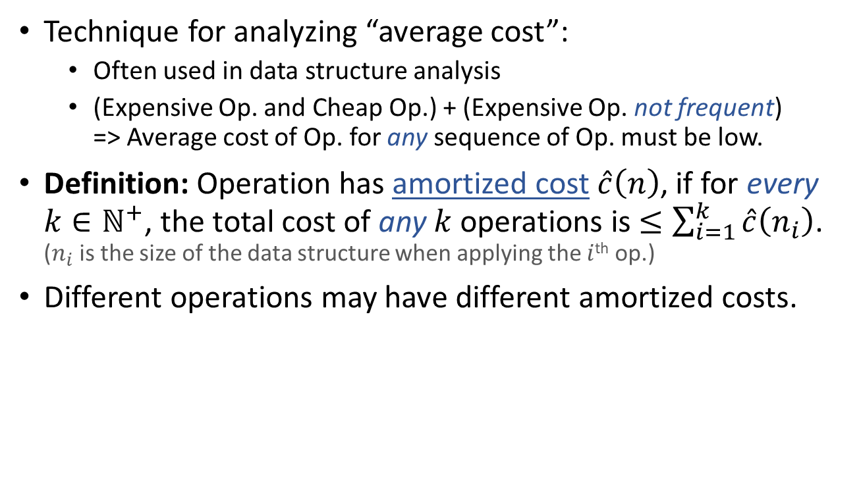
Amortized Analysis
Technique for analyzing “average cost”:
  Often used in data structure analysis
  (Expensive Op. and Cheap Op.) + (Expensive Op. not frequent)
  => Average cost of Op. for any sequence of Op. must be low.
Definition: Operation has amortized cost $\hat{c}\left(n\right)$, if for every $k∈ℕ^{+}$, the total cost of any $k$ operations is $≤\sum_{i=1}^{k}{\hat{c}\left(n_{i}\right)}$.
($n_{i}$ is the size of the data structure when applying the $i$^{th} op.)
Different operations may have different amortized costs.

Slide 5
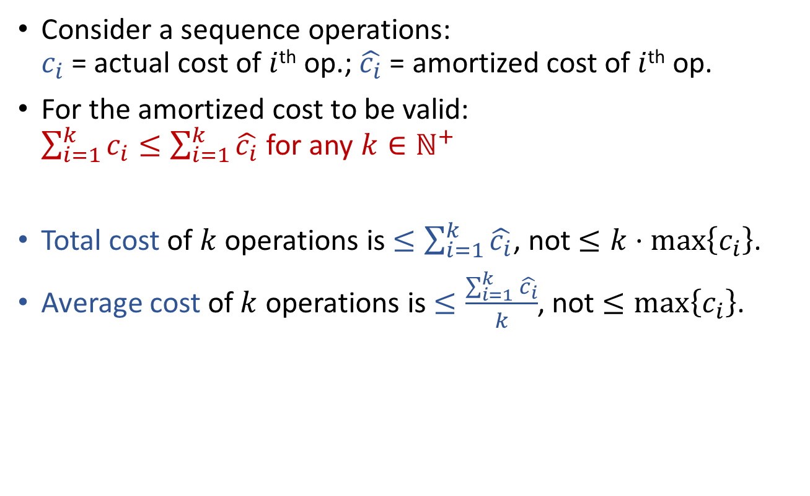
Amortized Analysis
Consider a sequence operations:
$c_{i}$ = actual cost of $i$^{th} op.; $\hat{c_{i}}$ = amortized cost of $i$^{th} op.
For the amortized cost to be valid:
$\sum_{i=1}^{k}{c_{i}}≤\sum_{i=1}^{k}{\hat{c_{i}}}$ for any $k∈ℕ^{+}$
Total cost of $k$ operations is $≤\sum_{i=1}^{k}{\hat{c_{i}}}$, not $≤k⋅\max\left\{c_{i}\right\}$.
Average cost of $k$ operations is $≤\frac{\sum_{i=1}^{k}{\hat{c_{i}}}}{k}$, not $≤\max\left\{c_{i}\right\}$.

Slide 6
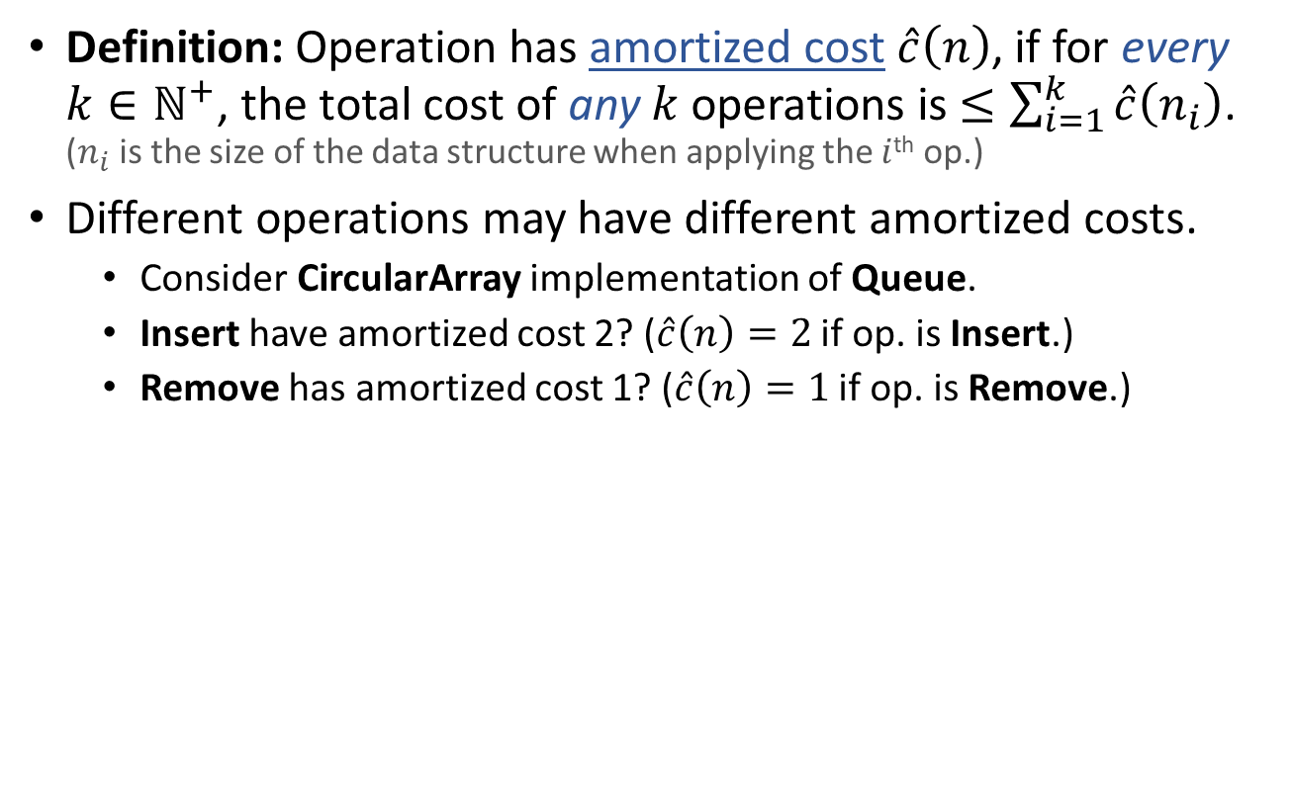
Amortized Analysis
Definition: Operation has amortized cost $\hat{c}\left(n\right)$, if for every $k∈ℕ^{+}$, the total cost of any $k$ operations is $≤\sum_{i=1}^{k}{\hat{c}\left(n_{i}\right)}$.
($n_{i}$ is the size of the data structure when applying the $i$^{th} op.)
Different operations may have different amortized costs.
  Consider CircularArray implementation of Queue.
  Insert have amortized cost 2? ($\hat{c}\left(n\right)=2$ if op. is Insert.)
  Remove has amortized cost 1? ($\hat{c}\left(n\right)=1$ if op. is Remove.)
Ignore cost of array
alloc and free for now.
Actual total cost
Amortized total cost
Insert(c)
1
2
Insert(c)
1+(1+1)=3
2+2=4
Insert(c)
3+(2+1)=6
4+2=6
Insert(c)
6+1=7
6+2=8
Insert(c)
7+(4+1)=12
>
8+2=10
c
c
c
c
c
c
c
c

Slide 7
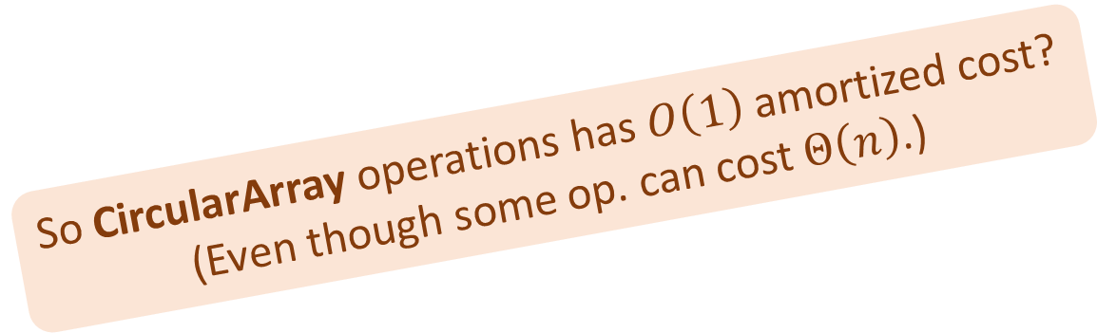

Amortized Analysis
Definition: Operation has amortized cost $\hat{c}\left(n\right)$, if for every $k∈ℕ^{+}$, the total cost of any $k$ operations is $≤\sum_{i=1}^{k}{\hat{c}\left(n_{i}\right)}$.
($n_{i}$ is the size of the data structure when applying the $i$^{th} op.)
Different operations may have different amortized costs.
  Consider CircularArray implementation of Queue.
  Insert have amortized cost 3? ($\hat{c}\left(n\right)=3$ if op. is Insert.)
  Remove has amortized cost 1? ($\hat{c}\left(n\right)=1$ if op. is Remove.)
So CircularArray operations has $O\left(1\right)$ amortized cost?
(Even though some op. can cost $Θ\left(n\right)$.)
Ignore cost of array
alloc and free for now.
Actual total cost
Amortized total cost
Insert(c)
1
3
Insert(c)
1+(1+1)=3
3+3=6
Insert(c)
3+(2+1)=6
6+3=9
Insert(c)
6+1=7
9+3=12
Insert(c)
7+(4+1)=12
12+3=15
c
c
c
c
c
c
c
c
Remove()
12+1=13
15+1=16

Slide 8
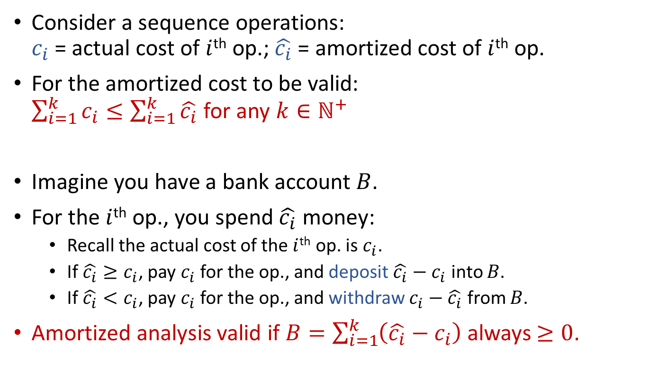
Amortized Analysis
The Accounting Method
Consider a sequence operations:
$c_{i}$ = actual cost of $i$^{th} op.; $\hat{c_{i}}$ = amortized cost of $i$^{th} op.
For the amortized cost to be valid:
$\sum_{i=1}^{k}{c_{i}}≤\sum_{i=1}^{k}{\hat{c_{i}}}$ for any $k∈ℕ^{+}$
Imagine you have a bank account $B$.
For the $i$^{th} op., you spend $\hat{c_{i}}$ money:
  Recall the actual cost of the $i$^{th} op. is $c_{i}$.
  If $\hat{c_{i}}≥c_{i}$, pay $c_{i}$ for the op., and deposit $\hat{c_{i}}−c_{i}$ into $B$.
  If $\hat{c_{i}}<c_{i}$, pay $c_{i}$ for the op., and withdraw $c_{i}−\hat{c_{i}}$ from $B$.
Amortized analysis valid if $B=\sum_{i=1}^{k}{\left(\hat{c_{i}}−c_{i}\right)}$ always $≥0$.

Slide 9
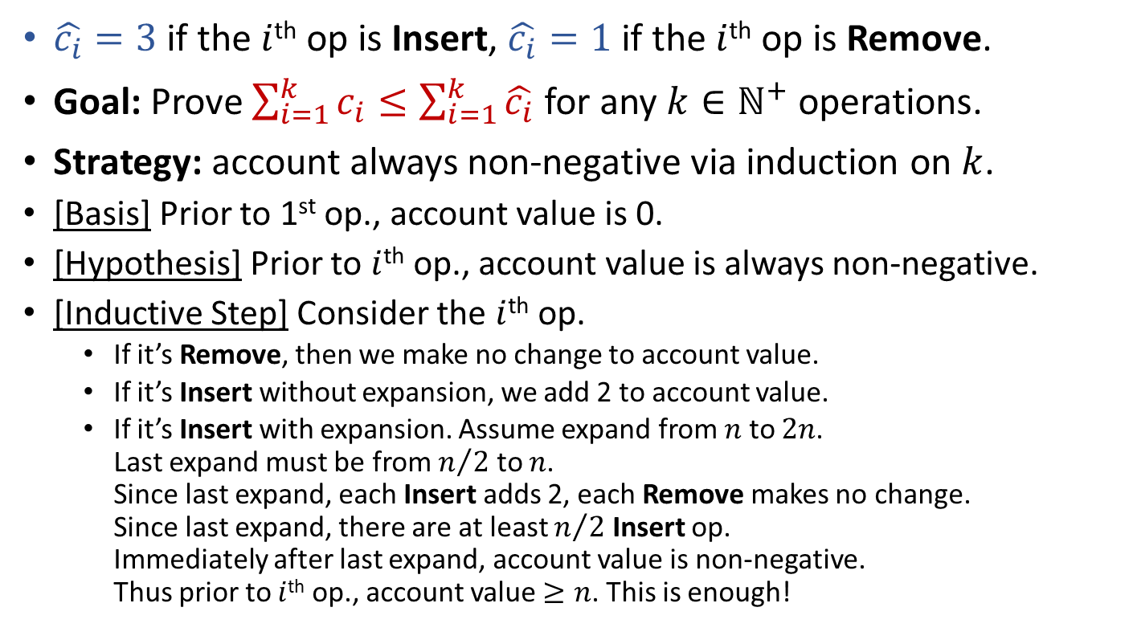
The Accounting Method
Example: CircularArray based Queue
$\hat{c_{i}}=3$ if the $i$^{th} op is Insert, $\hat{c_{i}}=1$ if the $i$^{th} op is Remove.
Goal: Prove $\sum_{i=1}^{k}{c_{i}}≤\sum_{i=1}^{k}{\hat{c_{i}}}$ for any $k∈ℕ^{+}$ operations.
Strategy: account always non-negative via induction on $k$.
[Basis] Prior to 1st op., account value is 0.
[Hypothesis] Prior to $i$^{th} op., account value is always non-negative.
[Inductive Step] Consider the $i$^{th} op.
  If it’s Remove, then we make no change to account value.
  If it’s Insert without expansion, we add 2 to account value.
  If it’s Insert with expansion. Assume expand from $n$ to $2n$.
  Last expand must be from $n/2$ to $n$.
  Since last expand, each Insert adds 2, each Remove makes no change.
  Since last expand, there are at least $n/2$ Insert op.
  Immediately after last expand, account value is non-negative.
  Thus prior to $i$^{th} op., account value $≥n$. This is enough!

Slide 10

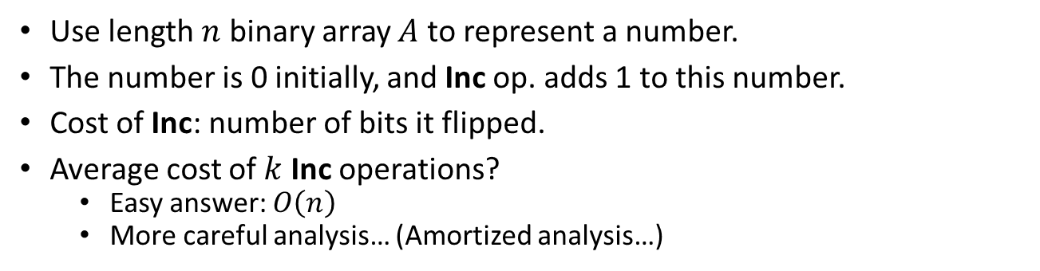

The Accounting Method
Example: Binary Counter
Use length $n$ binary array $A$ to represent a number.
The number is 0 initially, and Inc op. adds 1 to this number.
Cost of Inc: number of bits it flipped.
Average cost of $k$ Inc operations?
  Easy answer: $O\left(n\right)$
  More careful analysis… (Amortized analysis…)
$$A\left[n−1\right]$$
$$A\left[0\right]$$
Inc(A):
i=0
while (i<n and A[i]==1)
A[i]=0
i=i+1
if (i<n)
A[i]=1
0
1
0
0
1
1
Inc()
0
1
0
1
0
0

Slide 11
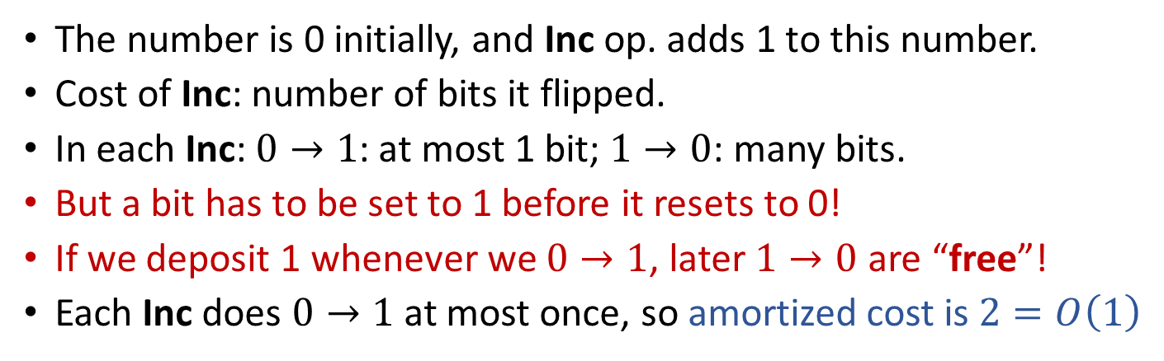
The Accounting Method
Example: Binary Counter
The number is 0 initially, and Inc op. adds 1 to this number.
Cost of Inc: number of bits it flipped.
In each Inc: $0→1$: at most 1 bit; $1→0$: many bits.
But a bit has to be set to 1 before it resets to 0!
If we deposit 1 whenever we $0→1$, later $1→0$ are “free”!
Each Inc does $0→1$ at most once, so amortized cost is $2=O\left(1\right)$
0
1
0
0
1
1
Inc(A):
i=0
while (i<n and A[i]==1)
A[i]=0
i=i+1
if (i<n)
A[i]=1
Inc()
0
1
0
1
0
0

Slide 12









Actual
Total Cost
Amortized
Total Cost
0
0
0
0
0
0
$$1$$
$$×2$$
0
0
0
0
0
1
$$1+2=3$$
$$×4$$
0
0
0
0
1
0
$$3+1=4$$
$$×6$$
0
0
0
0
1
1
$$4+3=7$$
$$×8$$
0
0
0
1
0
0

Slide 13
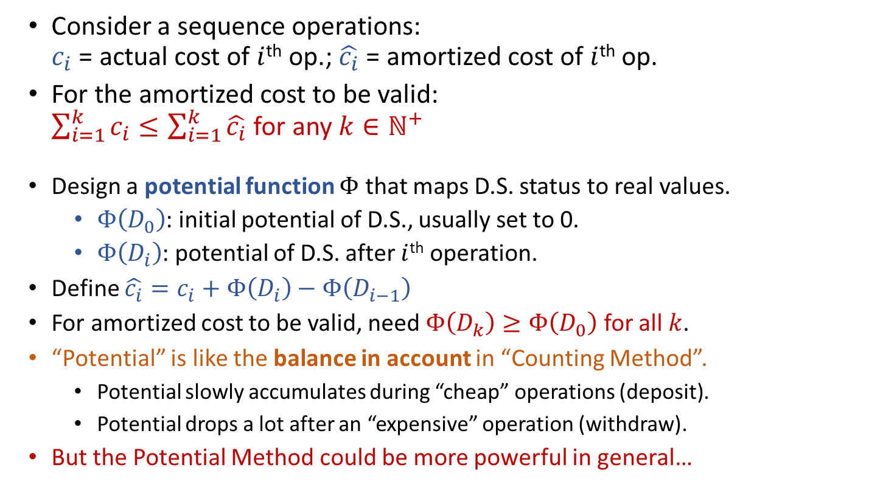
Amortized Analysis
The Potential Method
Consider a sequence operations:
$c_{i}$ = actual cost of $i$^{th} op.; $\hat{c_{i}}$ = amortized cost of $i$^{th} op.
For the amortized cost to be valid:
$\sum_{i=1}^{k}{c_{i}}≤\sum_{i=1}^{k}{\hat{c_{i}}}$ for any $k∈ℕ^{+}$
Design a potential function $Φ$ that maps D.S. status to real values.
  $Φ\left(D_{0}\right)$: initial potential of D.S., usually set to 0.
  $Φ\left(D_{i}\right)$: potential of D.S. after $i$^{th} operation.
Define $\hat{c_{i}}=c_{i}+Φ\left(D_{i}\right)−Φ\left(D_{i−1}\right)$
For amortized cost to be valid, need $Φ\left(D_{k}\right)≥Φ\left(D_{0}\right)$ for all $k$.
“Potential” is like the balance in account in “Counting Method”.
  Potential slowly accumulates during “cheap” operations (deposit).
  Potential drops a lot after an “expensive” operation (withdraw).
But the Potential Method could be more powerful in general…

Slide 14
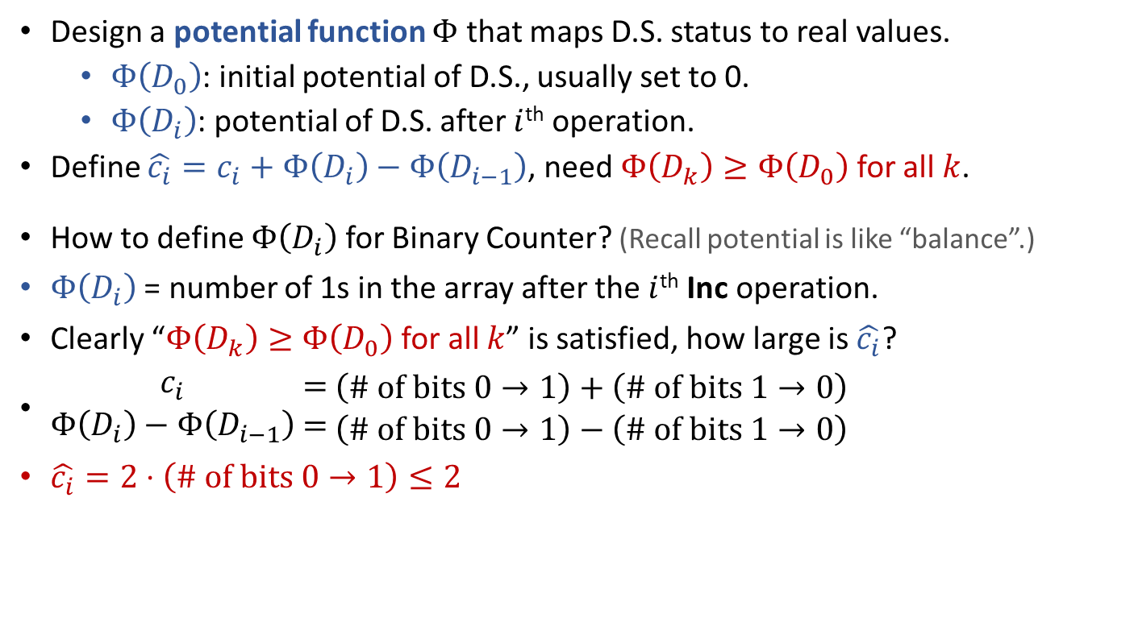
The Potential Method
Example: Binary Counter
Design a potential function $Φ$ that maps D.S. status to real values.
  $Φ\left(D_{0}\right)$: initial potential of D.S., usually set to 0.
  $Φ\left(D_{i}\right)$: potential of D.S. after $i$^{th} operation.
Define $\hat{c_{i}}=c_{i}+Φ\left(D_{i}\right)−Φ\left(D_{i−1}\right)$, need $Φ\left(D_{k}\right)≥Φ\left(D_{0}\right)$ for all $k$.
How to define $Φ\left(D_{i}\right)$ for Binary Counter? (Recall potential is like “balance”.)
$Φ\left(D_{i}\right)$ = number of 1s in the array after the $i$^{th} Inc operation.
Clearly “$Φ\left(D_{k}\right)≥Φ\left(D_{0}\right)$ for all $k$” is satisfied, how large is $\hat{c_{i}}$?
$\begin{matrix}c_{i} \\ Φ\left(D_{i}\right)−Φ\left(D_{i−1}\right)\end{matrix}\begin{matrix} = \\ =\end{matrix}\begin{matrix}\left(\text{\# }\text{of} \text{bits} 0→1\right)+\left(\text{\#} \text{of} \text{bits} 1→0\right) \\ \left(\text{\# }\text{of} \text{bits} 0→1\right)−\left(\text{\#} \text{of} \text{bits} 1→0\right)\end{matrix}$
$\hat{c_{i}}=2⋅\left(\text{\# }\text{of} \text{bits} 0→1\right)≤2$
0
1
0
0
1
1
Inc()
0
1
0
1
0
0

Slide 15
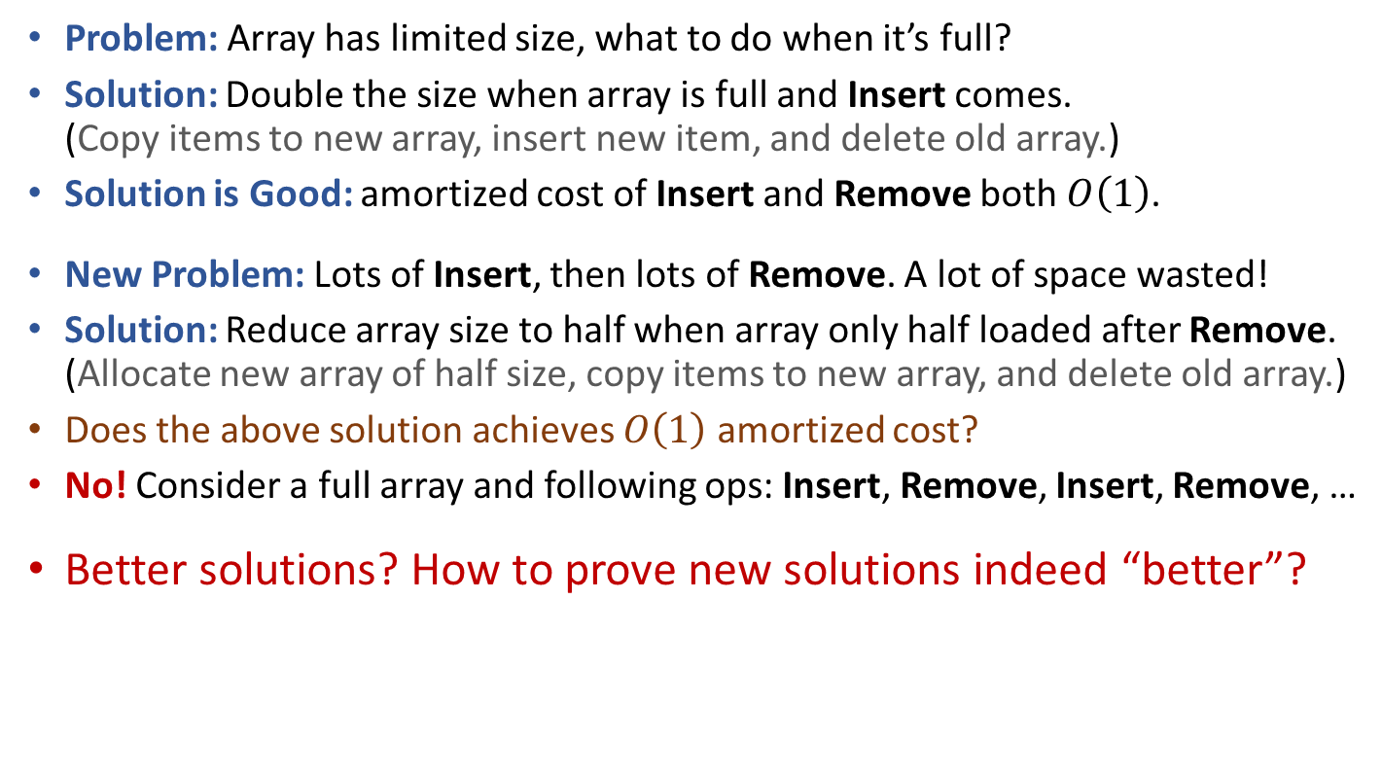
Back to CircularArray based Queue
Problem: Array has limited size, what to do when it’s full?
Solution: Double the size when array is full and Insert comes.
(Copy items to new array, insert new item, and delete old array.)
Solution is Good: amortized cost of Insert and Remove both $O\left(1\right)$.
New Problem: Lots of Insert, then lots of Remove. A lot of space wasted!
Solution: Reduce array size to half when array only half loaded after Remove.
(Allocate new array of half size, copy items to new array, and delete old array.)
Does the above solution achieves $O\left(1\right)$ amortized cost?
No! Consider a full array and following ops: Insert, Remove, Insert, Remove, …
Better solutions? How to prove new solutions indeed “better”?

Slide 16
Reading
[CLRS] Ch.17 (including 17.4)

