Slide 1
(Some) Applications of DFS
Data Structures and Algorithms
Nanjing University, Fall 2019
郑朝栋

Slide 2
Directed Acyclic Graphs (DAG)
A graph without cycles is called acyclic.
A directed graph without cycles is a directed acyclic graph (DAG).
DAGs are good for modeling relations such as:
causalities, hierarchies, and temporal dependencies.
Cyclic
Acyclic
Cyclic
DAG
A
B
A
B
A
B
A
B
D
C
D
C
D
C
D
C

Slide 3
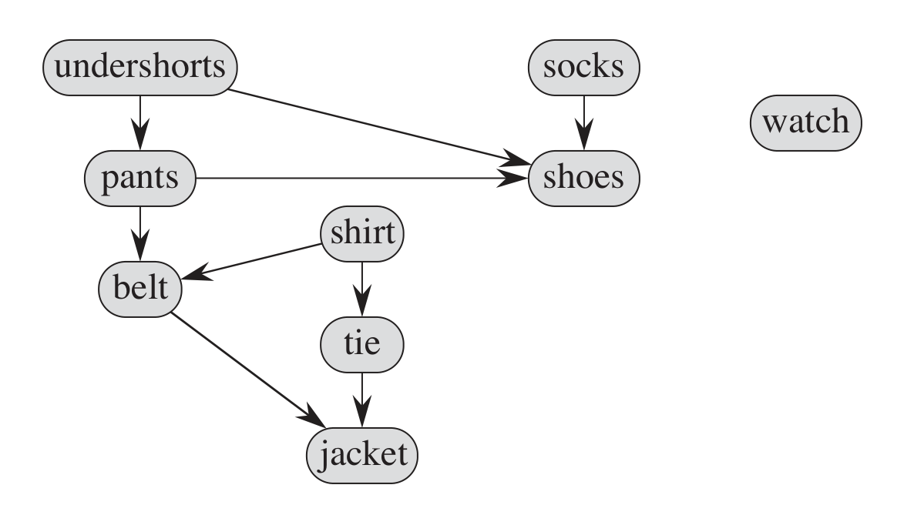
Application of DAG
DAGs are good for modeling relations such as:
causalities, hierarchies, and temporal dependencies.
Example:
  Consider how you get dressed in the morning.
  Must don certain garments before others (e.g., socks before shoes).
  Other items may be put on in any order (e.g., socks and pants).
  This process can be modeled by a DAG!
What is a valid order to perform all the task?

Slide 4
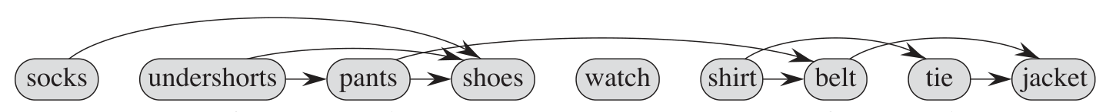
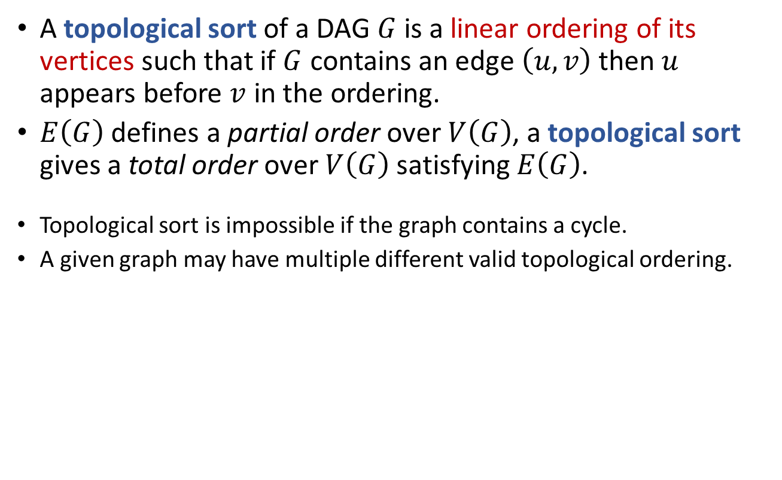
Topological Sort
A topological sort of a DAG $G$ is a linear ordering of its vertices such that if $G$ contains an edge $\left(u,v\right)$ then $u$ appears before $v$ in the ordering.
$E\left(G\right)$ defines a partial order over $V\left(G\right)$, a topological sort gives a total order over $V\left(G\right)$ satisfying $E\left(G\right)$.
Topological sort is impossible if the graph contains a cycle.
A given graph may have multiple different valid topological ordering.
How to generate a topological ordering?
A topological ordering arranges the vertices along a horizontal line so that all edges go “from left to right”.

Slide 5

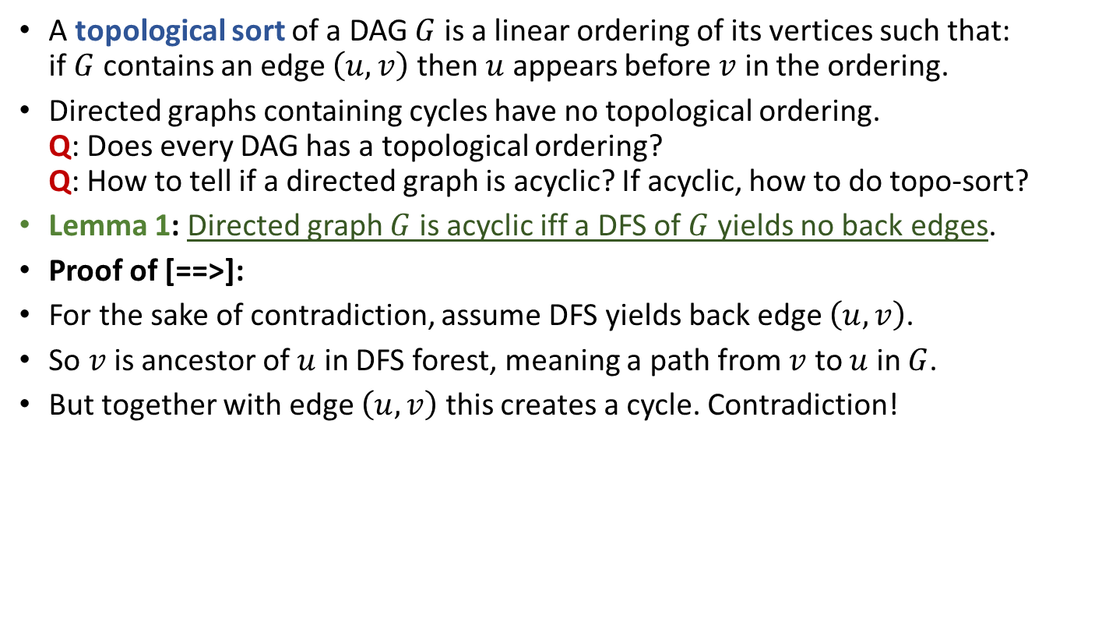



Topological Sort
A topological sort of a DAG $G$ is a linear ordering of its vertices such that:
if $G$ contains an edge $\left(u,v\right)$ then $u$ appears before $v$ in the ordering.
Directed graphs containing cycles have no topological ordering.
Q: Does every DAG has a topological ordering?
Q: How to tell if a directed graph is acyclic? If acyclic, how to do topo-sort?
Lemma 1: Directed graph $G$ is acyclic iff a DFS of $G$ yields no back edges.
Proof of [==>]:
For the sake of contradiction, assume DFS yields back edge $\left(u,v\right)$.
So $v$ is ancestor of $u$ in DFS forest, meaning a path from $v$ to $u$ in $G$.
But together with edge $\left(u,v\right)$ this creates a cycle. Contradiction!
$$v$$
$$v_{1}$$
$$v_{2}$$
……
$$u$$

Slide 6

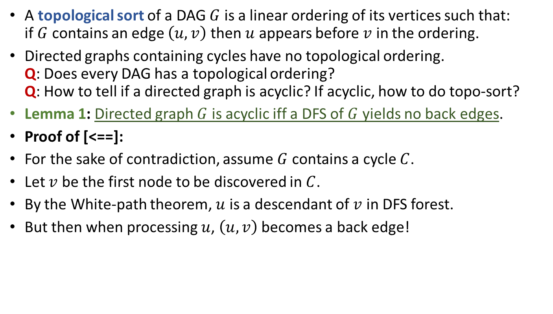


Topological Sort
A topological sort of a DAG $G$ is a linear ordering of its vertices such that:
if $G$ contains an edge $\left(u,v\right)$ then $u$ appears before $v$ in the ordering.
Directed graphs containing cycles have no topological ordering.
Q: Does every DAG has a topological ordering?
Q: How to tell if a directed graph is acyclic? If acyclic, how to do topo-sort?
Lemma 1: Directed graph $G$ is acyclic iff a DFS of $G$ yields no back edges.
Proof of [<==]:
For the sake of contradiction, assume $G$ contains a cycle $C$.
Let $v$ be the first node to be discovered in $C$.
By the White-path theorem, $u$ is a descendant of $v$ in DFS forest.
But then when processing $u$, $\left(u,v\right)$ becomes a back edge!
$$v$$
$$u$$
$$v_{1}$$
……

Slide 7
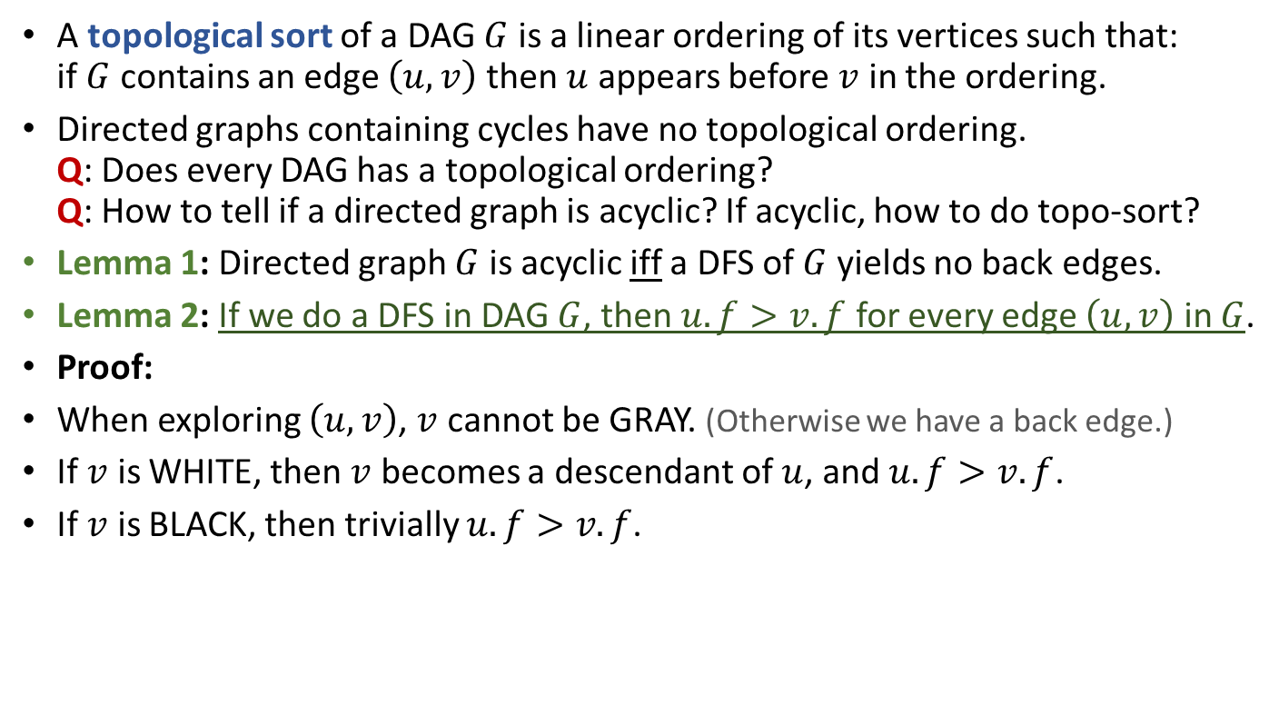
Topological Sort
A topological sort of a DAG $G$ is a linear ordering of its vertices such that:
if $G$ contains an edge $\left(u,v\right)$ then $u$ appears before $v$ in the ordering.
Directed graphs containing cycles have no topological ordering.
Q: Does every DAG has a topological ordering?
Q: How to tell if a directed graph is acyclic? If acyclic, how to do topo-sort?
Lemma 1: Directed graph $G$ is acyclic iff a DFS of $G$ yields no back edges.
Lemma 2: If we do a DFS in DAG $G$, then $u.f>v.f$ for every edge $\left(u,v\right)$ in $G$.
Proof:
When exploring $\left(u,v\right)$, $v$ cannot be GRAY. (Otherwise we have a back edge.)
If $v$ is WHITE, then $v$ becomes a descendant of $u$, and $u.f>v.f$.
If $v$ is BLACK, then trivially $u.f>v.f$.

Slide 8

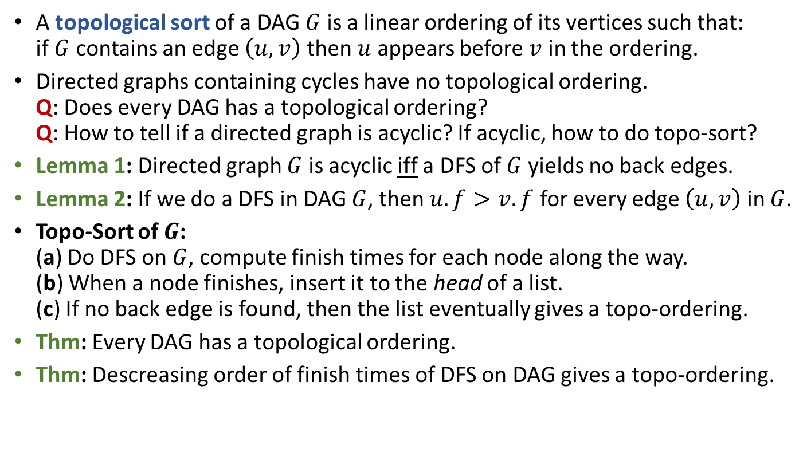
Topological Sort
A topological sort of a DAG $G$ is a linear ordering of its vertices such that:
if $G$ contains an edge $\left(u,v\right)$ then $u$ appears before $v$ in the ordering.
Directed graphs containing cycles have no topological ordering.
Q: Does every DAG has a topological ordering?
Q: How to tell if a directed graph is acyclic? If acyclic, how to do topo-sort?
Lemma 1: Directed graph $G$ is acyclic iff a DFS of $G$ yields no back edges.
Lemma 2: If we do a DFS in DAG $G$, then $u.f>v.f$ for every edge $\left(u,v\right)$ in $G$.
Topo-Sort of $G$:
(a) Do DFS on $G$, compute finish times for each node along the way.
(b) When a node finishes, insert it to the head of a list.
(c) If no back edge is found, then the list eventually gives a topo-ordering.
Thm: Every DAG has a topological ordering.
Thm: Descreasing order of finish times of DFS on DAG gives a topo-ordering.
Time complexity is $O\left(n+m\right)$.

Slide 9
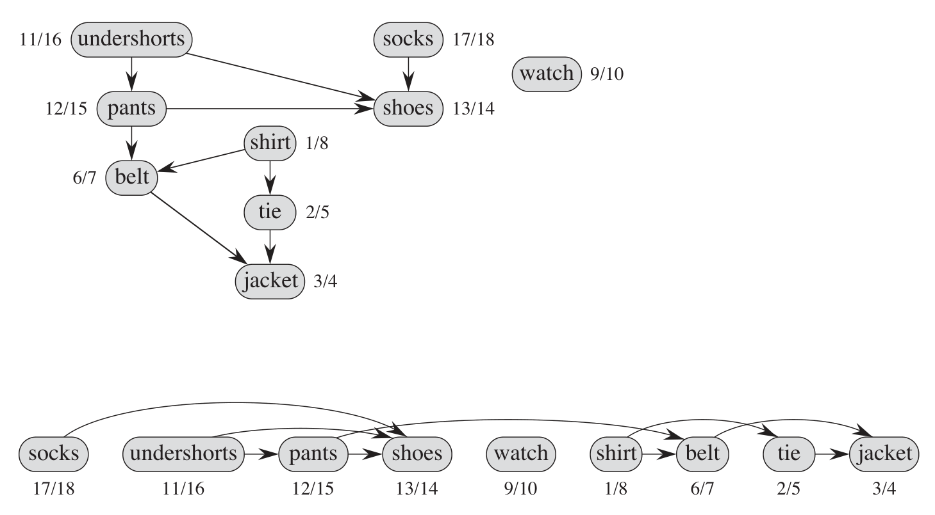
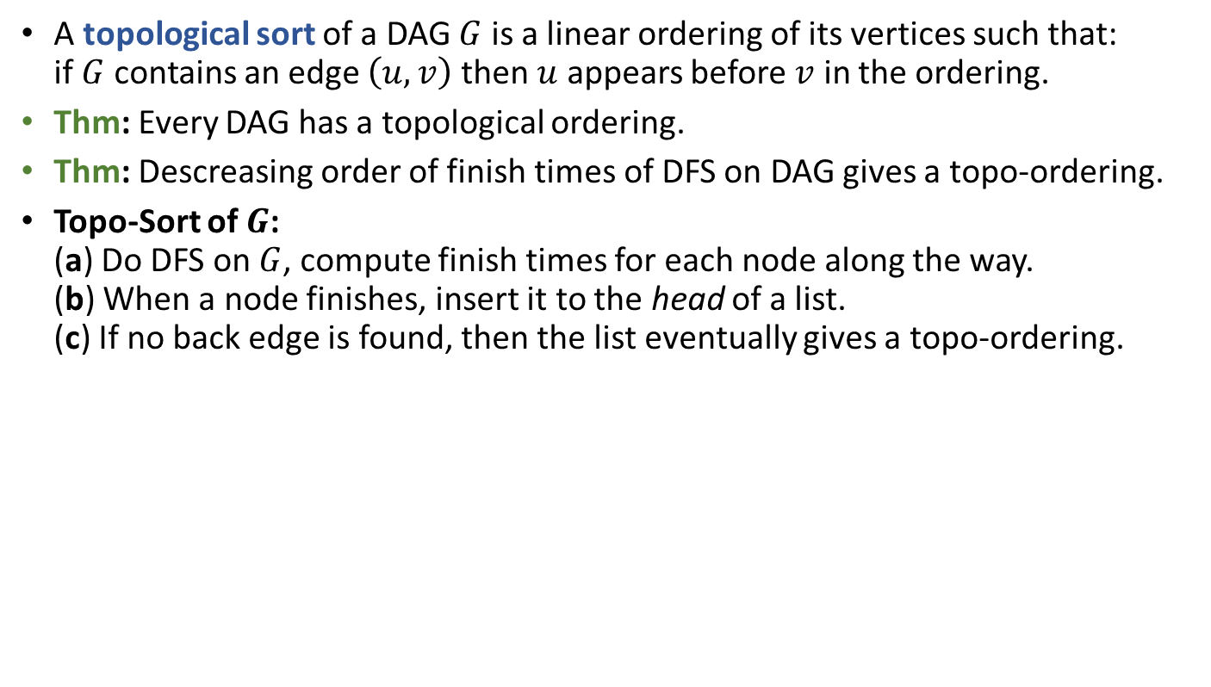
Topological Sort
A topological sort of a DAG $G$ is a linear ordering of its vertices such that:
if $G$ contains an edge $\left(u,v\right)$ then $u$ appears before $v$ in the ordering.
Thm: Every DAG has a topological ordering.
Thm: Descreasing order of finish times of DFS on DAG gives a topo-ordering.
Topo-Sort of $G$:
(a) Do DFS on $G$, compute finish times for each node along the way.
(b) When a node finishes, insert it to the head of a list.
(c) If no back edge is found, then the list eventually gives a topo-ordering.

Slide 10
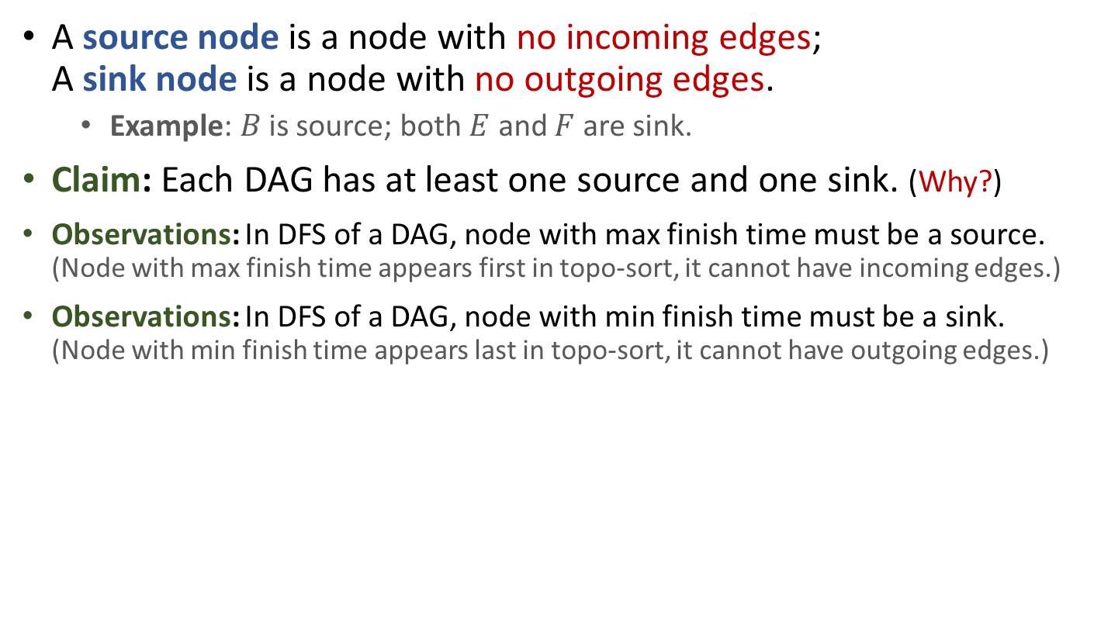
Source and Sink in DAG
A source node is a node with no incoming edges;
A sink node is a node with no outgoing edges.
  Example: $B$ is source; both $E$ and $F$ are sink.
Claim: Each DAG has at least one source and one sink. (Why?)
Observations: In DFS of a DAG, node with max finish time must be a source.
(Node with max finish time appears first in topo-sort, it cannot have incoming edges.)
Observations: In DFS of a DAG, node with min finish time must be a sink.
(Node with min finish time appears last in topo-sort, it cannot have outgoing edges.)
A
C
E
B
D
F

Slide 11
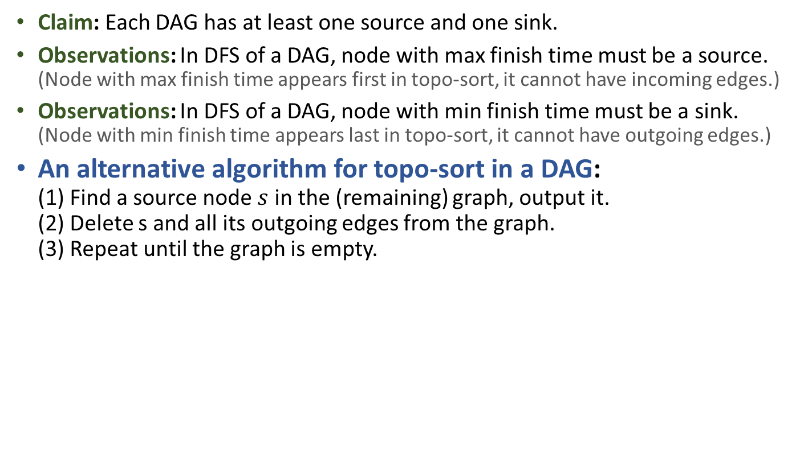
Alt Algorithm for Topo-Sort
Claim: Each DAG has at least one source and one sink.
Observations: In DFS of a DAG, node with max finish time must be a source.
(Node with max finish time appears first in topo-sort, it cannot have incoming edges.)
Observations: In DFS of a DAG, node with min finish time must be a sink.
(Node with min finish time appears last in topo-sort, it cannot have outgoing edges.)
An alternative algorithm for topo-sort in a DAG:
(1) Find a source node $s$ in the (remaining) graph, output it.
(2) Delete s and all its outgoing edges from the graph.
(3) Repeat until the graph is empty.
Formal proof of correctness? How efficient can you implement it?
A
C
E
B
A
D
C
E
F
B
D
F

Slide 12
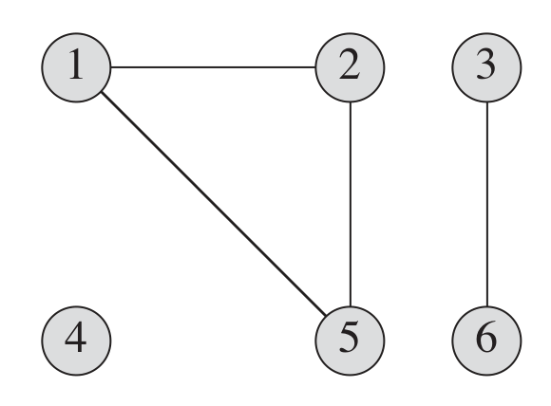
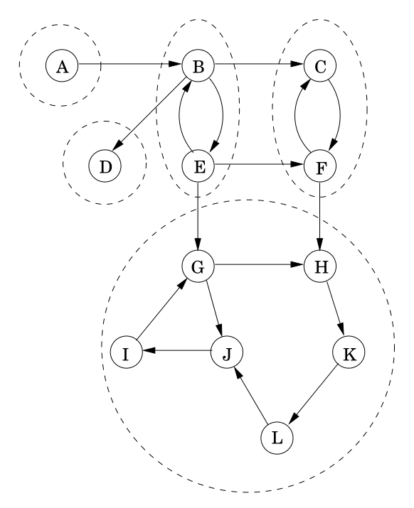
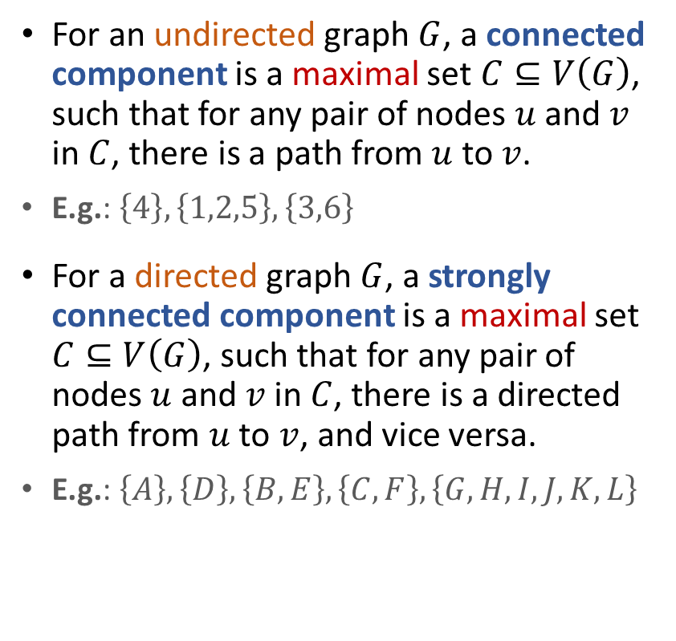
(Strongly) Connected Components
For an undirected graph $G$, a connected component is a maximal set $C⊆V\left(G\right)$, such that for any pair of nodes $u$ and $v$ in $C$, there is a path from $u$ to $v$.
E.g.: $\left\{4\right\},\left\{1,2,5\right\},\left\{3,6\right\}$
For a directed graph $G$, a strongly connected component is a maximal set $C⊆V\left(G\right)$, such that for any pair of nodes $u$ and $v$ in $C$, there is a directed path from $u$ to $v$, and vice versa.
E.g.: $\left\{A\right\},\left\{D\right\},\left\{B,E\right\},\left\{C,F\right\},\left\{G,H,I,J,K,L\right\}$

Slide 13
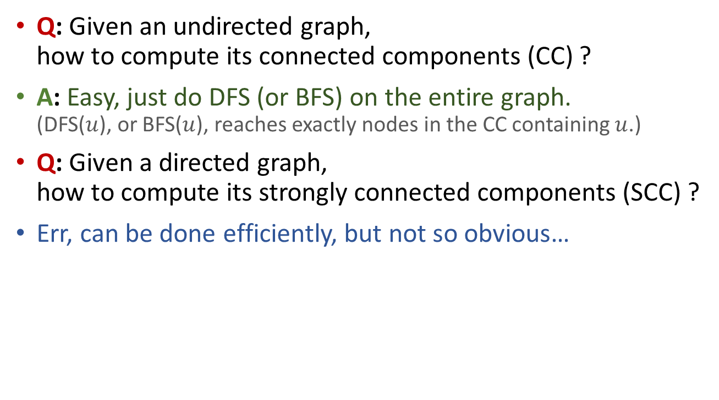
Computing CC and SCC
Q: Given an undirected graph,
how to compute its connected components (CC) ?
A: Easy, just do DFS (or BFS) on the entire graph.
(DFS($u$), or BFS($u$), reaches exactly nodes in the CC containing $u$.)
Q: Given a directed graph,
how to compute its strongly connected components (SCC) ?
Err, can be done efficiently, but not so obvious…

Slide 14
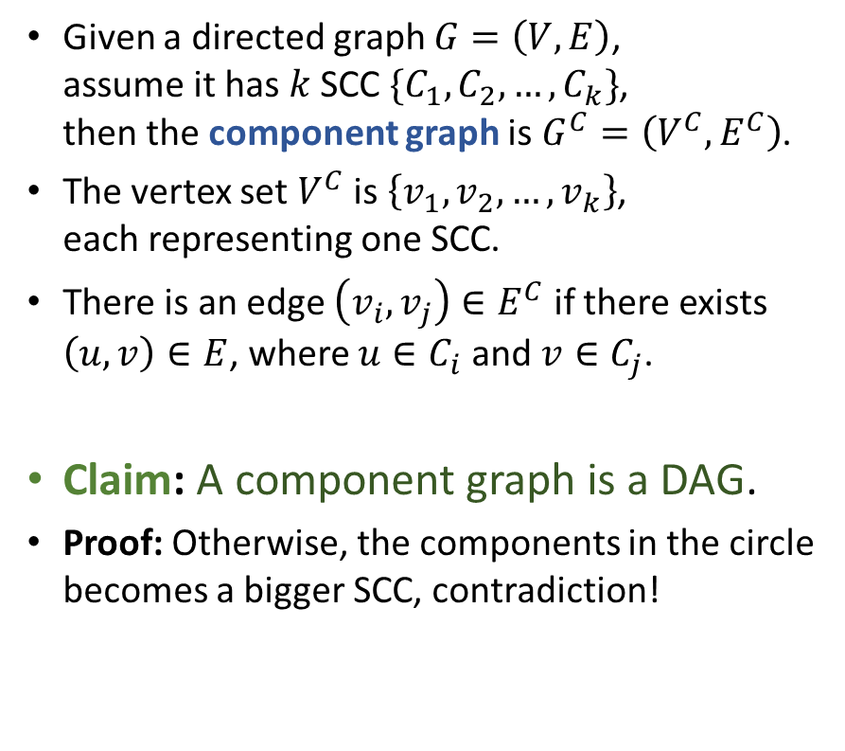
Component Graph
Given a directed graph $G=\left(V,E\right)$,
assume it has $k$ SCC $\{C_{1},C_{2},…,C_{k}\}$,
then the component graph is $G^{C}=\left(V^{C},E^{C}\right)$.
The vertex set $V^{C}$ is $\left\{v_{1},v_{2},…,v_{k}\right\}$,
each representing one SCC.
There is an edge $\left(v_{i},v_{j}\right)∈E^{C}$ if there exists $\left(u,v\right)∈E$, where $u∈C_{i}$ and $v∈C_{j}$.
Claim: A component graph is a DAG.
Proof: Otherwise, the components in the circle becomes a bigger SCC, contradiction!
A
B,E
C,F
G,H,I
J,K,L
D

Slide 15
Computing SCC
A component graph is a DAG.
Each DAG has at least one source and one sink.
If we start from a node in a sink SCC, then we explore exactly nodes in that SCC and stop!
(Due to the white-path theorem.)
A good start, but two problems exist:
(1) How to identify a node that is in a sink SCC?
(2) What to do when the first SCC is done?
A
B,E
C,F
G,H,I
J,K,L
D

Slide 16
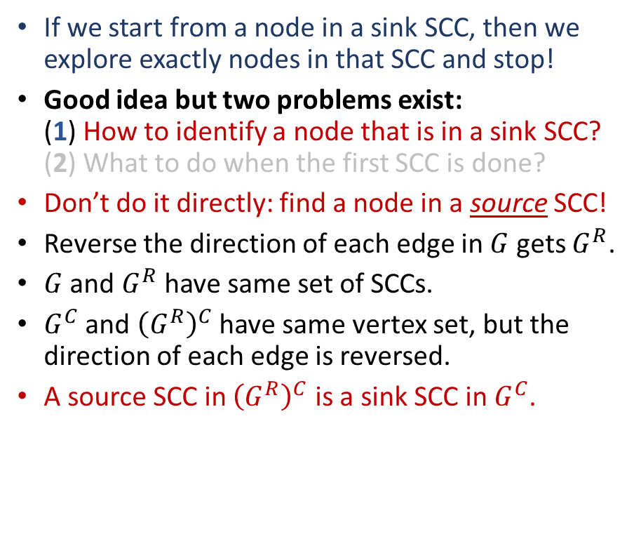



Computing SCC
If we start from a node in a sink SCC, then we explore exactly nodes in that SCC and stop!
Good idea but two problems exist:
(1) How to identify a node that is in a sink SCC?
(2) What to do when the first SCC is done?
Don’t do it directly: find a node in a source SCC!
Reverse the direction of each edge in $G$ gets $G^{R}$.
$G$ and $G^{R}$ have same set of SCCs.
$G^{C}$ and ${\left(G^{R}\right)}^{C}$ have same vertex set, but the direction of each edge is reversed.
A source SCC in ${\left(G^{R}\right)}^{C}$ is a sink SCC in $G^{C}$.
$$G$$
A
B,E
C,F
A
B,E
C,F
G,H,I
J,K,L
G,H,I
J,K,L
D
$${\left(G^{R}\right)}^{C}$$
D
$$G^{C}$$

Slide 17
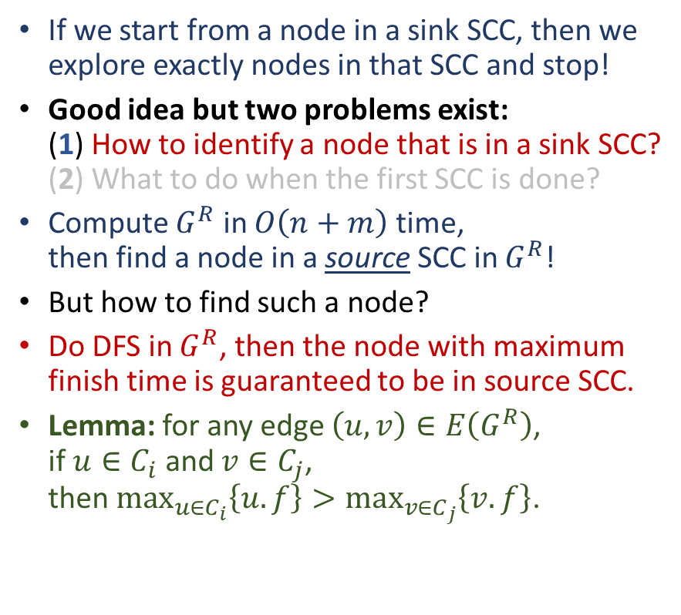



Computing SCC
If we start from a node in a sink SCC, then we explore exactly nodes in that SCC and stop!
Good idea but two problems exist:
(1) How to identify a node that is in a sink SCC?
(2) What to do when the first SCC is done?
Compute $G^{R}$ in $O\left(n+m\right)$ time,
then find a node in a source SCC in $G^{R}$!
But how to find such a node?
Do DFS in $G^{R}$, then the node with maximum finish time is guaranteed to be in source SCC.
Lemma: for any edge $\left(u,v\right)∈E\left(G^{R}\right)$,
if $u∈C_{i}$ and $v∈C_{j}$,
then $\max_{u∈C_{i}}\left\{u.f\right\}>\max_{v∈C_{j}}\left\{v.f\right\}$.
$$G$$
A
B,E
C,F
G,H,I
J,K,L
D
$$G^{C}$$
A
B,E
C,F
G,H,I
J,K,L
D
$${\left(G^{R}\right)}^{C}$$

Slide 18
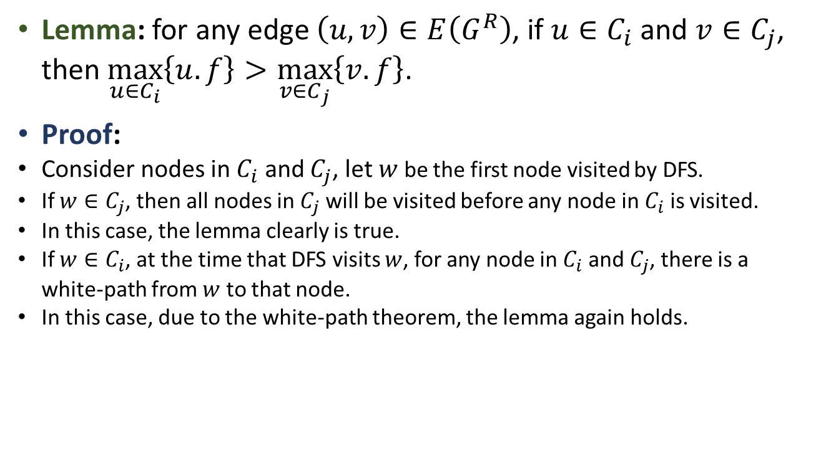
Computing SCC
Lemma: for any edge $\left(u,v\right)∈E\left(G^{R}\right)$, if $u∈C_{i}$ and $v∈C_{j}$,
then $\max_{u∈C_{i}}\left\{u.f\right\}>\max_{v∈C_{j}}\left\{v.f\right\}$.
Proof:
Consider nodes in $C_{i}$ and $C_{j}$, let $w$ be the first node visited by DFS.
If $w∈C_{j}$, then all nodes in $C_{j}$ will be visited before any node in $C_{i}$ is visited.
In this case, the lemma clearly is true.
If $w∈C_{i}$, at the time that DFS visits $w$, for any node in $C_{i}$ and $C_{j}$, there is a white-path from $w$ to that node.
In this case, due to the white-path theorem, the lemma again holds.

Slide 19
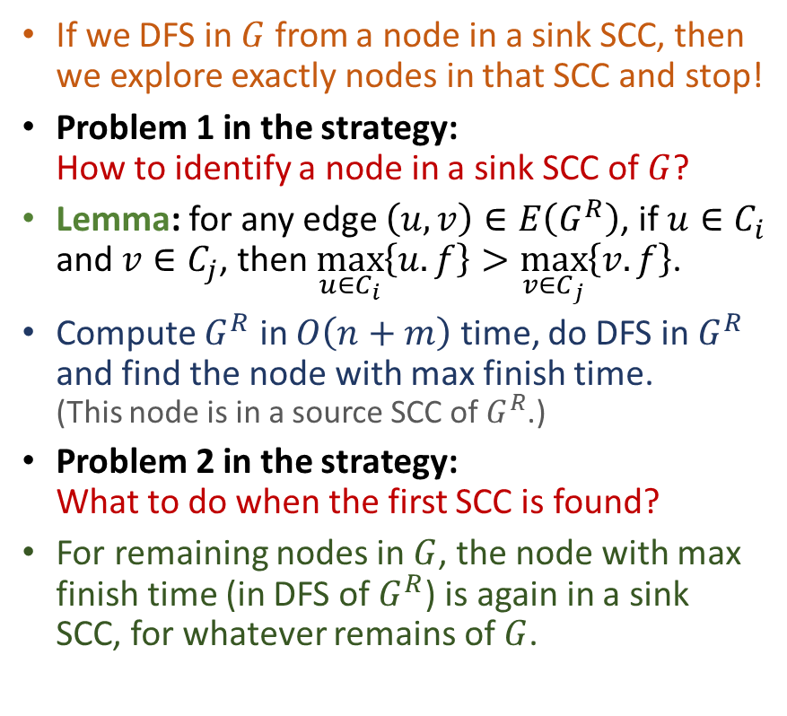
Computing SCC
If we DFS in $G$ from a node in a sink SCC, then we explore exactly nodes in that SCC and stop!
Problem 1 in the strategy:
How to identify a node in a sink SCC of $G$?
Lemma: for any edge $\left(u,v\right)∈E\left(G^{R}\right)$, if $u∈C_{i}$ and $v∈C_{j}$, then $\max_{u∈C_{i}}\left\{u.f\right\}>\max_{v∈C_{j}}\left\{v.f\right\}$.
Compute $G^{R}$ in $O\left(n+m\right)$ time, do DFS in $G^{R}$ and find the node with max finish time.
(This node is in a source SCC of $G^{R}$.)
Problem 2 in the strategy:
What to do when the first SCC is found?
For remaining nodes in $G$, the node with max
finish time (in DFS of $G^{R}$) is again in a sink
SCC, for whatever remains of $G$.
$$G$$
A
B,E
C,F
G,H,I
J,K,L
D
$$G^{C}$$
A
B,E
C,F
G,H,I
J,K,L
D
$${\left(G^{R}\right)}^{C}$$

Slide 20
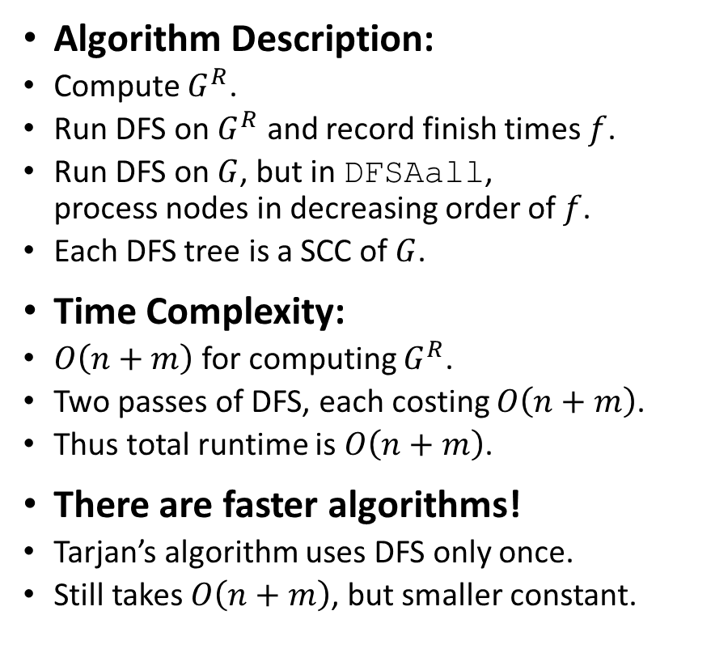
Computing SCC
Algorithm Description:
Compute $G^{R}$.
Run DFS on $G^{R}$ and record finish times $f$.
Run DFS on $G$, but in DFSAall,
process nodes in decreasing order of $f$.
Each DFS tree is a SCC of $G$.
Time Complexity:
$O\left(n+m\right)$ for computing $G^{R}$.
Two passes of DFS, each costing $O\left(n+m\right)$.
Thus total runtime is $O\left(n+m\right)$.
There are faster algorithms!
Tarjan’s algorithm uses DFS only once.
Still takes $O\left(n+m\right)$, but smaller constant.
$$G$$
A
B,E
C,F
G,H,I
J,K,L
D
$$G^{C}$$
A
B,E
C,F
G,H,I
J,K,L
D
$${\left(G^{R}\right)}^{C}$$

Slide 21
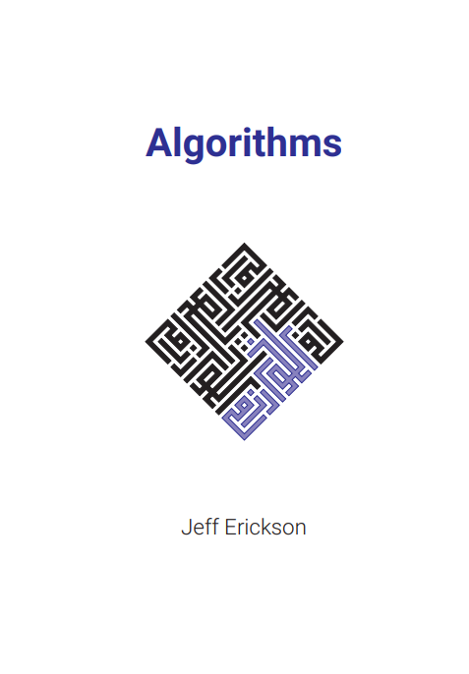
Reading
[CLRS] Ch.22 (22.4-22.5)
If you want to know more about Tarjan’s SCC algorithm:
[Erickson v1] Ch.6 (6.6)

