Slide 1
Midterm Exam Statistics
Highest: 84; Average: 42; (Median: 40); Lowest: <20
75 Percentile: 54; 25 Percentile: 31
Your “real” score is usually 5-10 points higher.
(But that’s still not enough…)

Slide 2
All-Pairs Shortest Path
Data Structures and Algorithms
Nanjing University, Fall 2019
郑朝栋

Slide 3
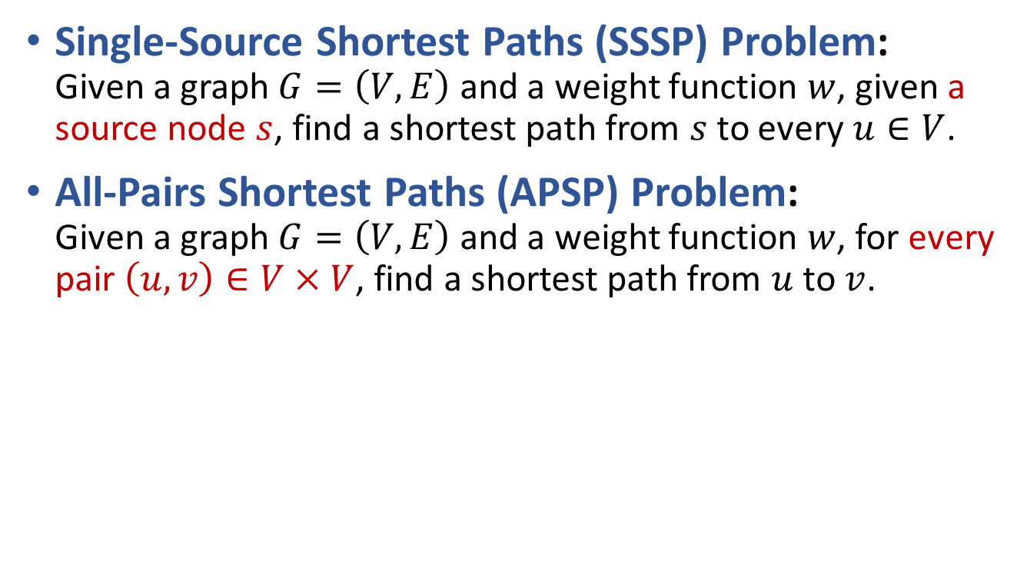
SSSP and APSP
Single-Source Shortest Paths (SSSP) Problem:
Given a graph $G=\left(V,E\right)$ and a weight function $w$, given a source node $s$, find a shortest path from $s$ to every $u∈V$.
All-Pairs Shortest Paths (APSP) Problem:
Given a graph $G=\left(V,E\right)$ and a weight function $w$, for every pair $\left(u,v\right)∈V×V$, find a shortest path from $u$ to $v$.

Slide 4
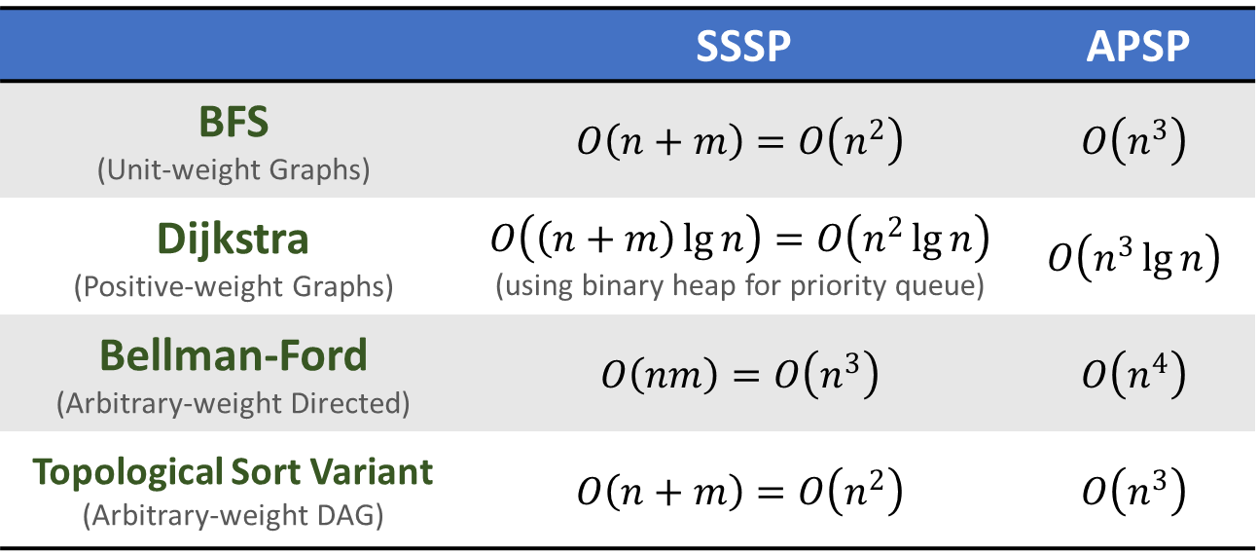

APSP from multiple SSSP
Straightforward solution for APSP:
For each $v∈V$, execute SSSP algorithm once!
 | SSSP | APSP
BFS (Unit-weight Graphs) | $$O\left(n+m\right)=O\left(n^{2}\right)$$ | $$O\left(n^{3}\right)$$
Dijkstra (Positive-weight Graphs) | $$O\left(\left(n+m\right)\lg{n}\right)=O\left(n^{2}\lg{n}\right)$$ (using binary heap for priority queue) | $$O\left(n^{3}\lg{n}\right)$$
Bellman-Ford (Arbitrary-weight Directed) | $$O\left(nm\right)=O\left(n^{3}\right)$$ | $$O\left(n^{4}\right)$$
Topological Sort Variant (Arbitrary-weight DAG) | $$O\left(n+m\right)=O\left(n^{2}\right)$$ | $$O\left(n^{3}\right)$$

Slide 5
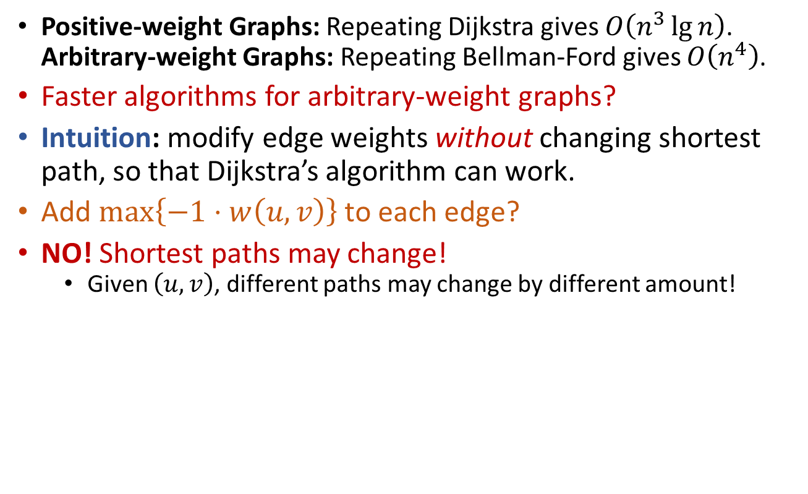
APSP from multiple SSSP
Positive-weight Graphs: Repeating Dijkstra gives $O\left(n^{3}\lg{n}\right)$.
Arbitrary-weight Graphs: Repeating Bellman-Ford gives $O\left(n^{4}\right)$.
Faster algorithms for arbitrary-weight graphs?
Intuition: modify edge weights without changing shortest path, so that Dijkstra’s algorithm can work.
Add $\max\left\{−1⋅w\left(u,v\right)\right\}$ to each edge?
NO! Shortest paths may change!
  Given $\left(u,v\right)$, different paths may change by different amount!
3
C
3
6
C
6
S
T
S
T
4
4
7
7
A
-3
B
A
0
B

Slide 6
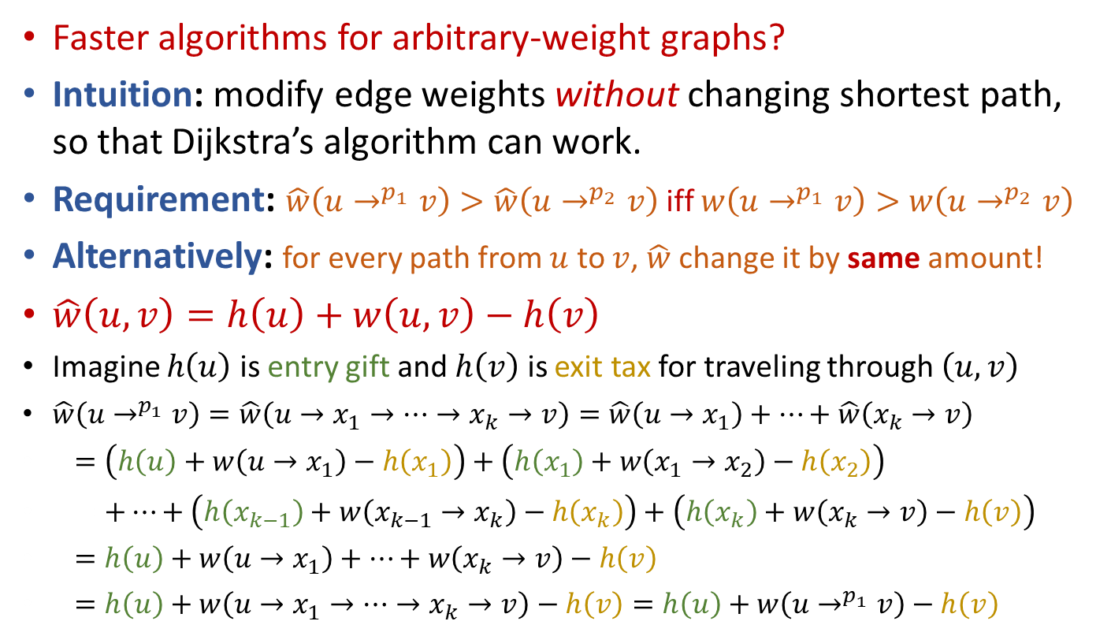
APSP from multiple SSSP
Faster algorithms for arbitrary-weight graphs?
Intuition: modify edge weights without changing shortest path, so that Dijkstra’s algorithm can work.
Requirement: $\hat{w}\left(u→^{p_{1}}v\right)>\hat{w}\left(u→^{p_{2}}v\right)$ iff $w\left(u→^{p_{1}}v\right)>w\left(u→^{p_{2}}v\right)$
Alternatively: for every path from $u$ to $v$, $\hat{w}$ change it by same amount!
$\hat{w}\left(u,v\right)=h\left(u\right)+w\left(u,v\right)−h\left(v\right)$
Imagine $h\left(u\right)$ is entry gift and $h\left(v\right)$ is exit tax for traveling through $\left(u,v\right)$
$\hat{w}\left(u→^{p_{1}}v\right)=\hat{w}\left(u→x_{1}→⋯→x_{k}→v\right)=\hat{w}\left(u→x_{1}\right)+⋯+\hat{w}\left(x_{k}→v\right)$
$==\left(h\left(u\right)+w\left(u→x_{1}\right)−h\left(x_{1}\right)\right)+\left(h\left(x_{1}\right)+w\left(x_{1}→x_{2}\right)−h\left(x_{2}\right)\right)$
$==+⋯+\left(h\left(x_{k−1}\right)+w\left(x_{k−1}→x_{k}\right)−h\left(x_{k}\right)\right)+\left(h\left(x_{k}\right)+w\left(x_{k}→v\right)−h\left(v\right)\right)$
$==h\left(u\right)+w\left(u→x_{1}\right)+⋯+w\left(x_{k}→v\right)−h\left(v\right)$
$==h\left(u\right)+w\left(u→x_{1}→⋯→x_{k}→v\right)−h\left(v\right)=h\left(u\right)+w\left(u→^{p_{1}}v\right)−h\left(v\right)$

Slide 7
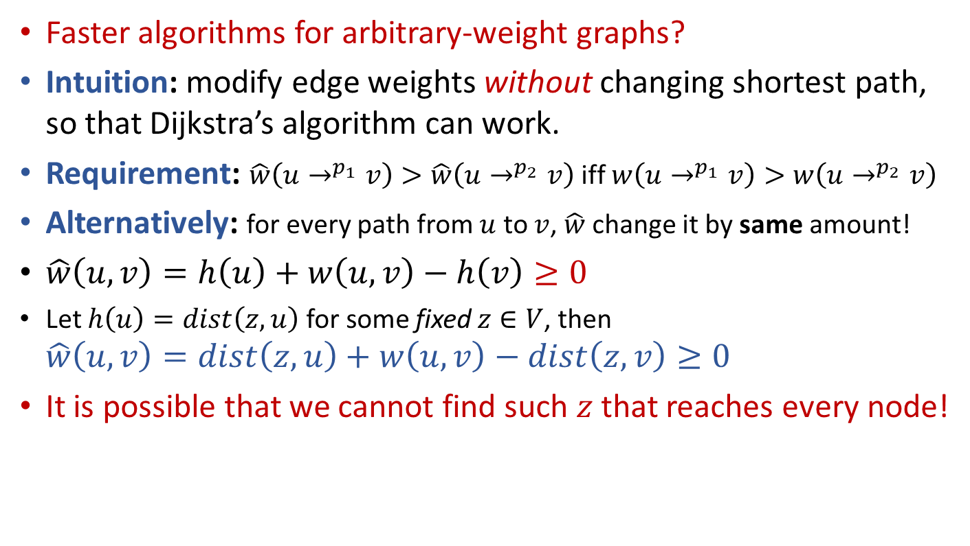
APSP from multiple SSSP
Faster algorithms for arbitrary-weight graphs?
Intuition: modify edge weights without changing shortest path, so that Dijkstra’s algorithm can work.
Requirement: $\hat{w}\left(u→^{p_{1}}v\right)>\hat{w}\left(u→^{p_{2}}v\right)$ iff $w\left(u→^{p_{1}}v\right)>w\left(u→^{p_{2}}v\right)$
Alternatively: for every path from $u$ to $v$, $\hat{w}$ change it by same amount!
$\hat{w}\left(u,v\right)=h\left(u\right)+w\left(u,v\right)−h\left(v\right)≥0$
Let $h\left(u\right)=dist\left(z,u\right)$ for some fixed $z∈V$, then
$\hat{w}\left(u,v\right)=dist\left(z,u\right)+w\left(u,v\right)−dist\left(z,v\right)≥0$
It is possible that we cannot find such $z$ that reaches every node!

Slide 8
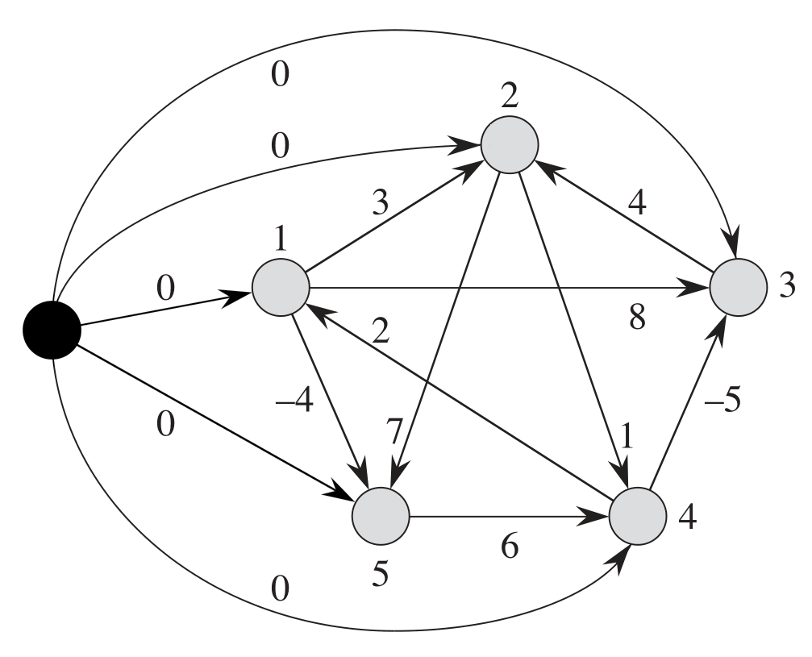
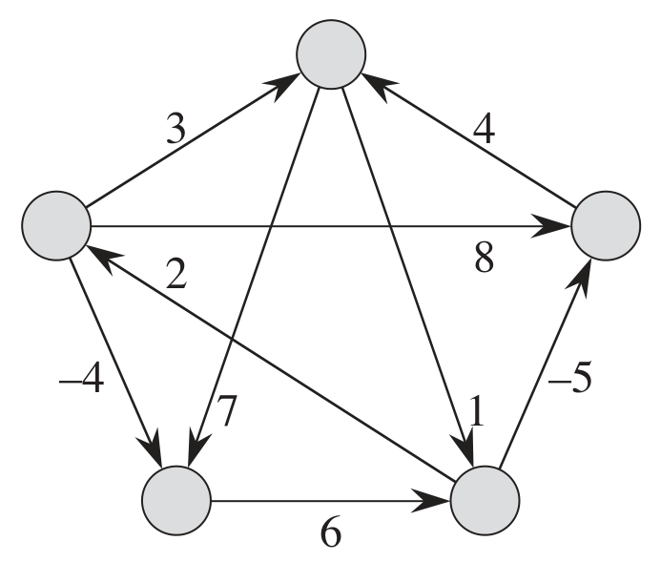
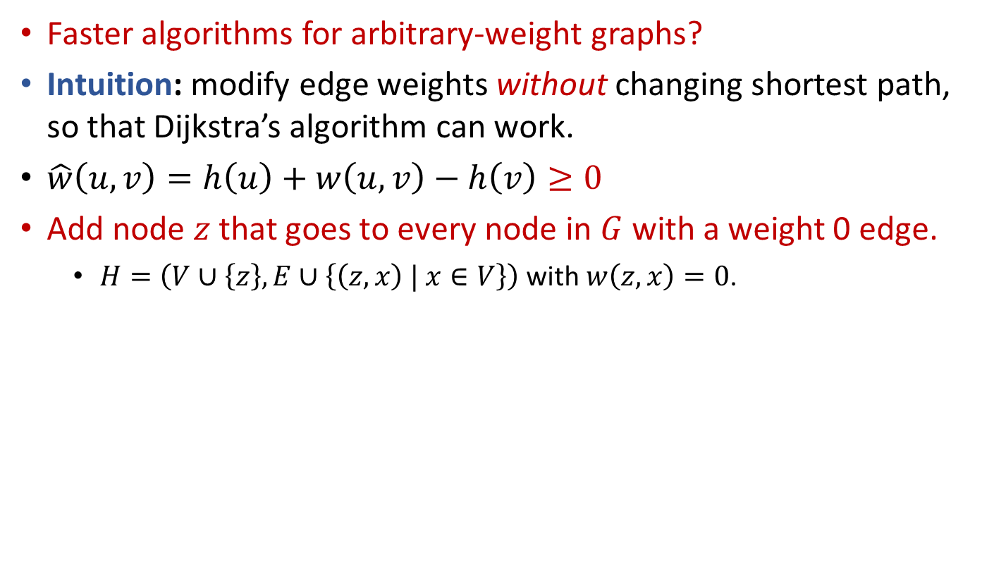
APSP from multiple SSSP
Faster algorithms for arbitrary-weight graphs?
Intuition: modify edge weights without changing shortest path, so that Dijkstra’s algorithm can work.
$\hat{w}\left(u,v\right)=h\left(u\right)+w\left(u,v\right)−h\left(v\right)≥0$
Add node $z$ that goes to every node in $G$ with a weight 0 edge.
  $H=\left(V∪\left\{z\right\},E∪\left\{\left(z,x\right) | x∈V\right\}\right)$ with $w\left(z,x\right)=0$.

Slide 9
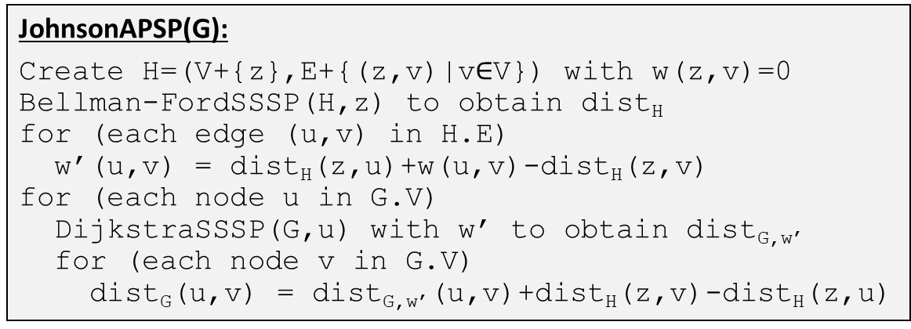

APSP from multiple SSSP
Faster algorithms for arbitrary-weight graphs?
Strategy: modify edge weights without changing shortest path,
so that Dijkstra’s algorithm can work.
Add node $z$ that goes to every node in $G$ with a weight 0 edge.
Reweight edges: $\hat{w}\left(u,v\right)=dist\left(z,u\right)+w\left(u,v\right)−dist\left(z,v\right)≥0$
  For node pairs in $G$, addition of $z$ does not create new shortest path.
  For node pairs in $G$, a path is shortest under $w$ iff this path is shortest under $\hat{w}$.
JohnsonAPSP(G):
Create H=(V+{z},E+{(z,v)|v$∈$V}) with w(z,v)=0
Bellman-FordSSSP(H,z) to obtain dist_{H}
for (each edge (u,v) in H.E)
w’(u,v) = dist_{H}(z,u)+w(u,v)-dist_{H}(z,v)
for (each node u in G.V)
DijkstraSSSP(G,u) with w’ to obtain dist_{G,w’}
for (each node v in G.V)
dist_{G}(u,v) = dist_{G,w’}(u,v)+dist_{H}(z,v)-dist_{H}(z,u)

Slide 10
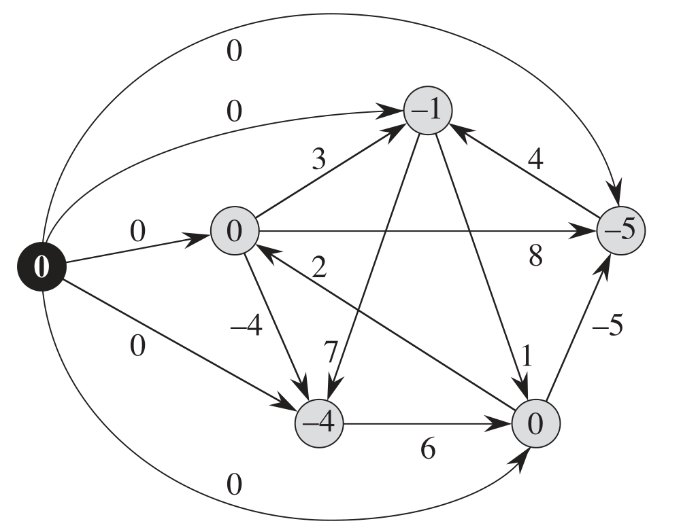
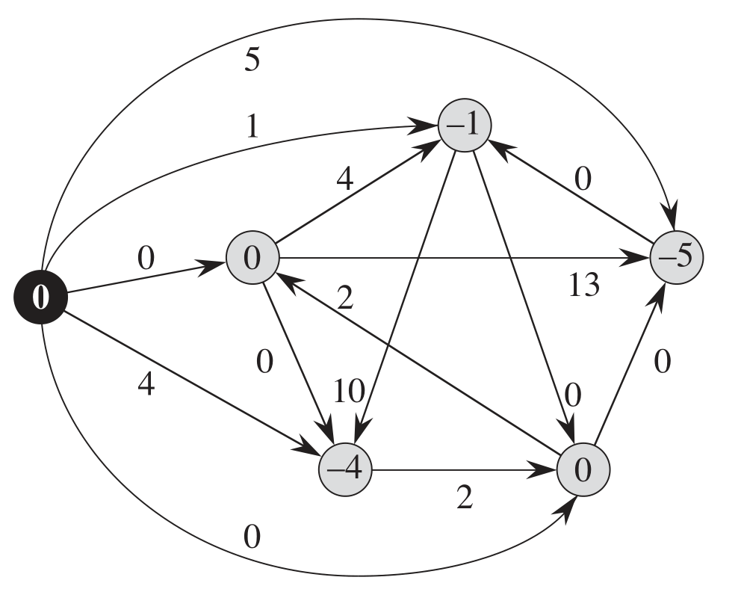
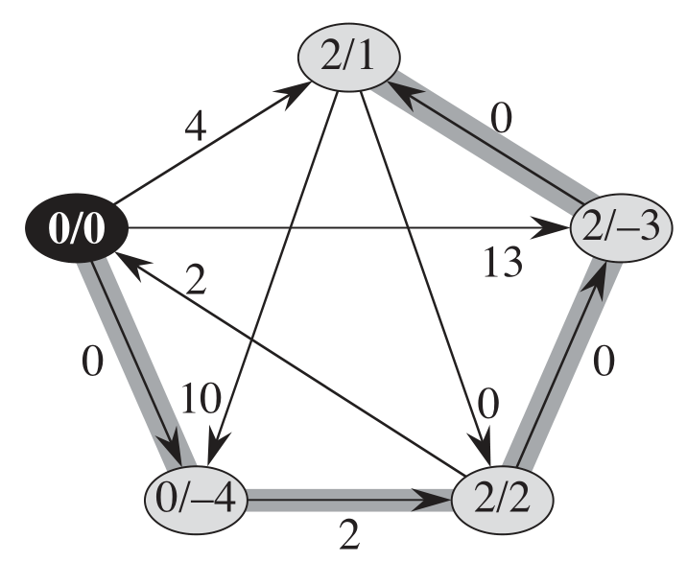
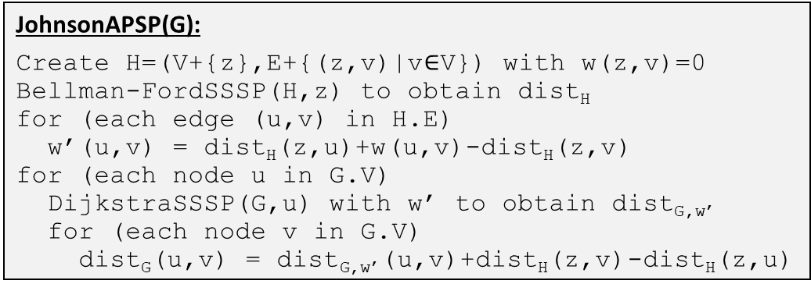
APSP from multiple SSSP
Faster algorithms for arbitrary-weight graphs?
Strategy: reweight edges without changing shortest path,
so that Dijkstra’s algorithm can work.
JohnsonAPSP(G):
Create H=(V+{z},E+{(z,v)|v$∈$V}) with w(z,v)=0
Bellman-FordSSSP(H,z) to obtain dist_{H}
for (each edge (u,v) in H.E)
w’(u,v) = dist_{H}(z,u)+w(u,v)-dist_{H}(z,v)
for (each node u in G.V)
DijkstraSSSP(G,u) with w’ to obtain dist_{G,w’}
for (each node v in G.V)
dist_{G}(u,v) = dist_{G,w’}(u,v)+dist_{H}(z,v)-dist_{H}(z,u)

Slide 11


APSP from multiple SSSP
Johnson’s algorithm
Positive-weight Graphs: Repeating Dijkstra gives $O\left(n^{3}\lg{n}\right)$.
Arbitrary-weight Graphs: Repeating Bellman-Ford gives $O\left(n^{4}\right)$.
Faster algorithms for arbitrary-weight graphs?
Johnson’s Alg.: reweight edges without changing shortest path,
so that Dijkstra’s algorithm can work.
Johnson’s algorithm combines Dijkstra and Bellman-Ford,
resulting a runtime of $O\left(n^{3}\lg{n}\right)$, for arbitrary weight graphs.
JohnsonAPSP(G):
Create H=(V+{z},E+{(z,v)|v$∈$V}) with w(z,v)=0
Bellman-FordSSSP(H,z) to obtain dist_{H}
for (each edge (u,v) in H.E)
w’(u,v) = dist_{H}(z,u)+w(u,v)-dist_{H}(z,v)
for (each node u in G.V)
DijkstraSSSP(G,u) with w’ to obtain dist_{G,w’}
for (each node v in G.V)
dist_{G}(u,v) = dist_{G,w’}(u,v)+dist_{H}(z,v)-dist_{H}(z,u)

Slide 12
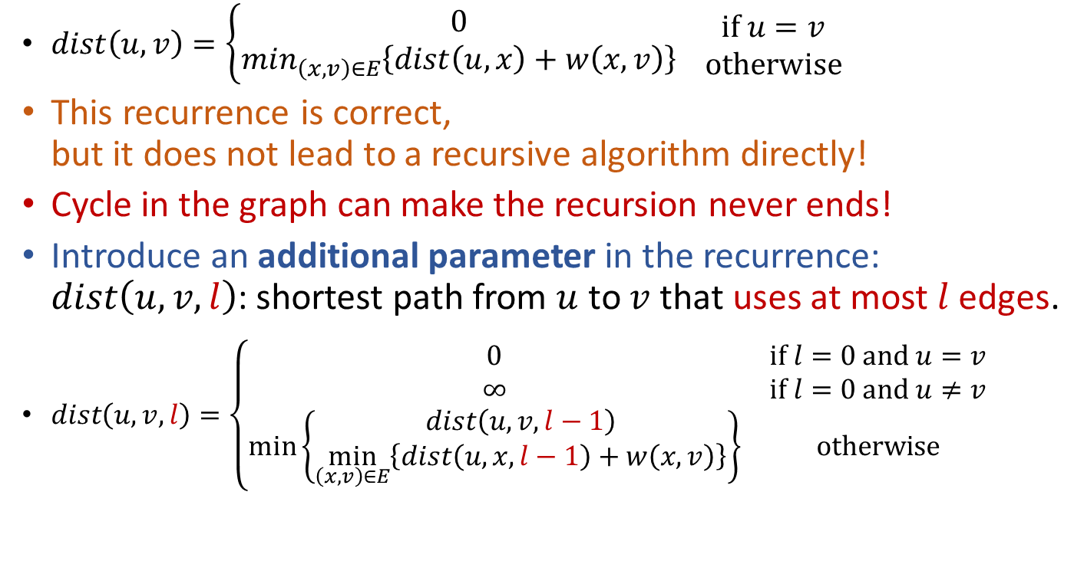
APSP via Recursion
$dist\left(u,v\right)=\left\{\begin{matrix}0 \\ min_{\left(x,v\right)∈E}\left\{dist\left(u,x\right)+w\left(x,v\right)\right\}\end{matrix} \begin{matrix}if u=v \\ otherwise\end{matrix}\right.$
This recurrence is correct,
but it does not lead to a recursive algorithm directly!
Cycle in the graph can make the recursion never ends!
Introduce an additional parameter in the recurrence:
$dist\left(u,v,l\right)$: shortest path from $u$ to $v$ that uses at most $l$ edges.
$dist\left(u,v,l\right)=\left\{\begin{matrix}0 & if l=0 and u=v \\ ∞ & if l=0 and u≠v \\ \min\left\{\begin{matrix}dist\left(u,v,l−1\right) \\ \min_{\left(x,v\right)∈E}\left\{dist\left(u,x,l−1\right)+w\left(x,v\right)\right\}\end{matrix}\right\} & otherwise\end{matrix}\right.$
B
C
A
U
V

Slide 13
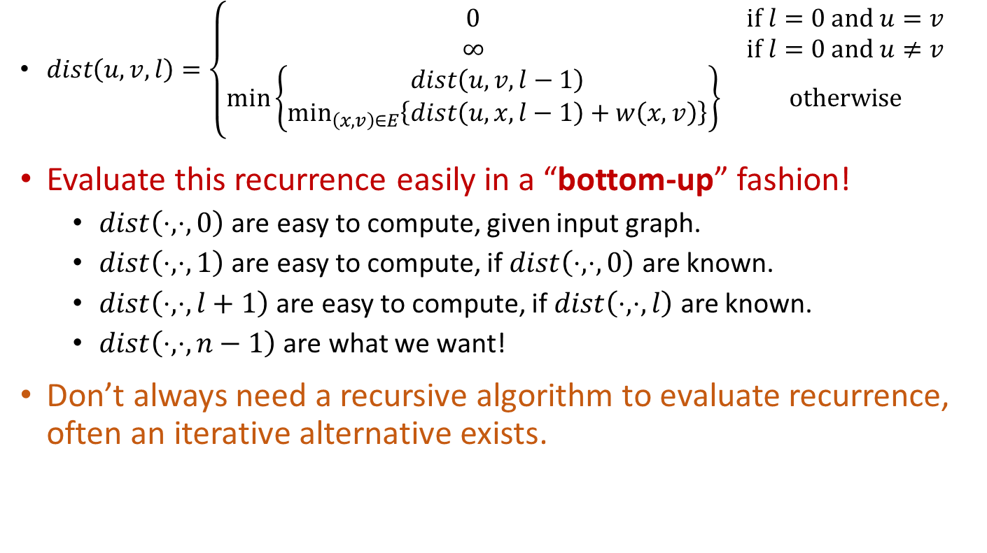
APSP via Recursion
$dist\left(u,v,l\right)=\left\{\begin{matrix}0 & if l=0 and u=v \\ ∞ & if l=0 and u≠v \\ \min\left\{\begin{matrix}dist\left(u,v,l−1\right) \\ \min_{\left(x,v\right)∈E}\left\{dist\left(u,x,l−1\right)+w\left(x,v\right)\right\}\end{matrix}\right\} & otherwise\end{matrix}\right.$
Evaluate this recurrence easily in a “bottom-up” fashion!
  $dist\left(⋅,⋅,0\right)$ are easy to compute, given input graph.
  $dist\left(⋅,⋅,1\right)$ are easy to compute, if $dist\left(⋅,⋅,0\right)$ are known.
  $dist\left(⋅,⋅,l+1\right)$ are easy to compute, if $dist\left(⋅,⋅,l\right)$ are known.
  $dist\left(⋅,⋅,n−1\right)$ are what we want!
Don’t always need a recursive algorithm to evaluate recurrence,
often an iterative alternative exists.

Slide 14
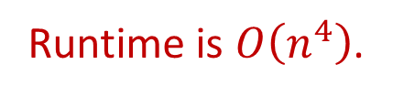

APSP via Recursion
$dist\left(u,v,l\right)=\left\{\begin{matrix}0 & if l=0 and u=v \\ ∞ & if l=0 and u≠v \\ \min\left\{\begin{matrix}dist\left(u,v,l−1\right) \\ \min_{\left(x,v\right)∈E}\left\{dist\left(u,x,l−1\right)+w\left(x,v\right)\right\}\end{matrix}\right\} & otherwise\end{matrix}\right.$
Evaluate this recurrence easily in a “bottom-up” fashion!
RecursiveAPSP(G):
for (every pair (u,v) in V*V)
if (u=v) then dist[u,v,0]=0
else dist[u,v,0]=INF
for (l=1 to n-1)
for (each node u)
for (each node v)
dist[u,v,l] = dist[u,v,l-1]
for (each edge (x,v) going to v)
if (dist[u,v,l] > dist[u,x,l-1] + w(x,v))
dist[u,v,l] = dist[u,x,l-1]+w(x,v)
Runtime is $O\left(n^{4}\right)$.
Can this approach do better?

Slide 15
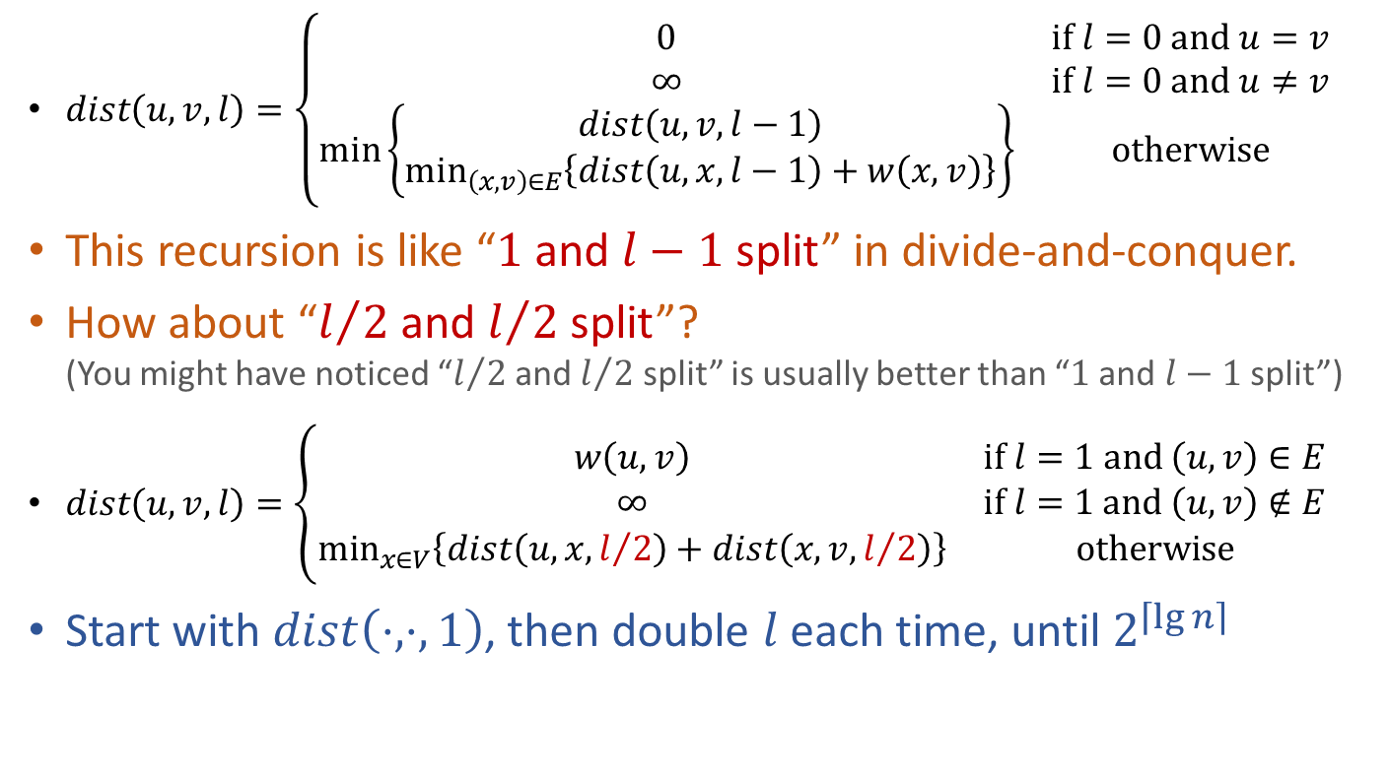
APSP via Recursion
$dist\left(u,v,l\right)=\left\{\begin{matrix}0 & if l=0 and u=v \\ ∞ & if l=0 and u≠v \\ \min\left\{\begin{matrix}dist\left(u,v,l−1\right) \\ \min_{\left(x,v\right)∈E}\left\{dist\left(u,x,l−1\right)+w\left(x,v\right)\right\}\end{matrix}\right\} & otherwise\end{matrix}\right.$
This recursion is like “$1$ and $l−1$ split” in divide-and-conquer.
How about “$l/2$ and $l/2$ split”?
(You might have noticed “$l/2$ and $l/2$ split” is usually better than “$1$ and $l−1$ split”)
$dist\left(u,v,l\right)=\left\{\begin{matrix}w\left(u,v\right) & if l=1 and \left(u,v\right)∈E \\ ∞ & if l=1 and \left(u,v\right)∉E \\ \min_{x∈V}\left\{dist\left(u,x,l/2\right)+dist\left(x,v,l/2\right)\right\} & otherwise\end{matrix}\right.$
Start with $dist\left(⋅,⋅,1\right)$, then double $l$ each time, until $2^{\left\lceil \lg{n}\right\rceil }$

Slide 16
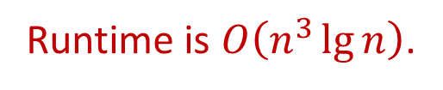

APSP via Recursion
$dist\left(u,v,l\right)=\left\{\begin{matrix}w\left(u,v\right) & if l=1 and \left(u,v\right)∈E \\ ∞ & if l=1 and \left(u,v\right)∉E \\ \min_{x∈V}\left\{dist\left(u,x,l/2\right)+dist\left(x,v,l/2\right)\right\} & otherwise\end{matrix}\right.$
Start with $dist\left(⋅,⋅,1\right)$, then double $l$ each time, until $2^{\left\lceil \lg{n}\right\rceil }$
FasterRecursiveAPSP(G):
for (every pair (u,v) in V*V)
if ((u,v) in E) then dist[u,v,1]=w(u,v)
else dist[u,v,1]=INF
for (i=1 to Ceil(lg(n)))
for (each node u)
for (each node v)
dist[u,v,i] = INF
for (each node x)
if (dist[u,v,i] > dist[u,x,i-1] + dist[x,v,i-1])
dist[u,v,i] = dist[u,x,i-1] + dist[x,v,i-1]
Runtime is $O\left(n^{3}\lg{n}\right)$.
Can this approach do better?

Slide 17



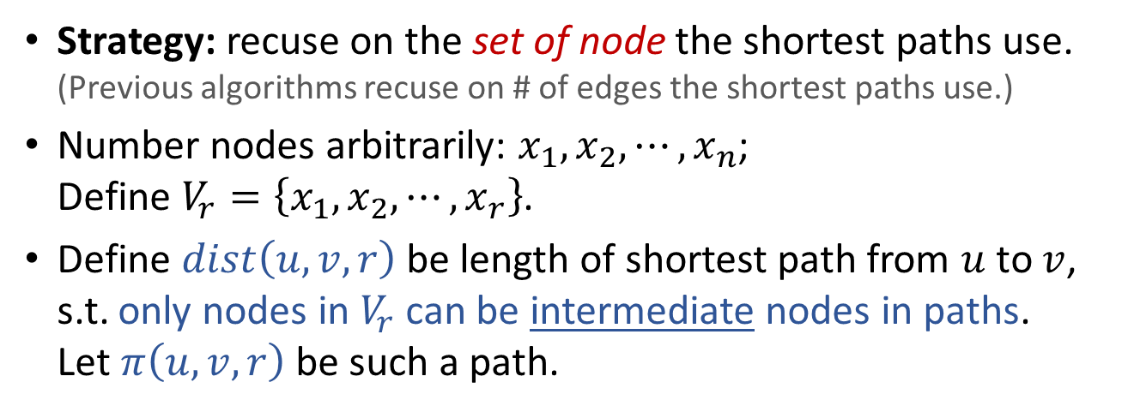




APSP via Recursion
Strategy: recuse on the set of node the shortest paths use.
(Previous algorithms recuse on # of edges the shortest paths use.)
Number nodes arbitrarily: $x_{1},x_{2},⋯,x_{n}$;
Define $V_{r}=\left\{x_{1},x_{2},⋯,x_{r}\right\}$.
Define $dist\left(u,v,r\right)$ be length of shortest path from $u$ to $v$,
s.t. only nodes in $V_{r}$ can be intermediate nodes in paths.
Let $π\left(u,v,r\right)$ be such a path.
$$x_{5}$$
$$dist\left(u,v\right)=w\left(u→x_{5}→x_{6}→v\right)$$
$$x_{6}$$
u
v
$$x_{2}$$
$$x_{1}$$
$$x_{3}$$
$$V_{4}=\left\{x_{1},x_{2},x_{3},x_{4}\right\}$$
$$x_{4}$$
$$dist\left(u,v,4\right)=w\left(u→x_{1}→x_{2}→x_{3}→v\right)$$

Slide 18




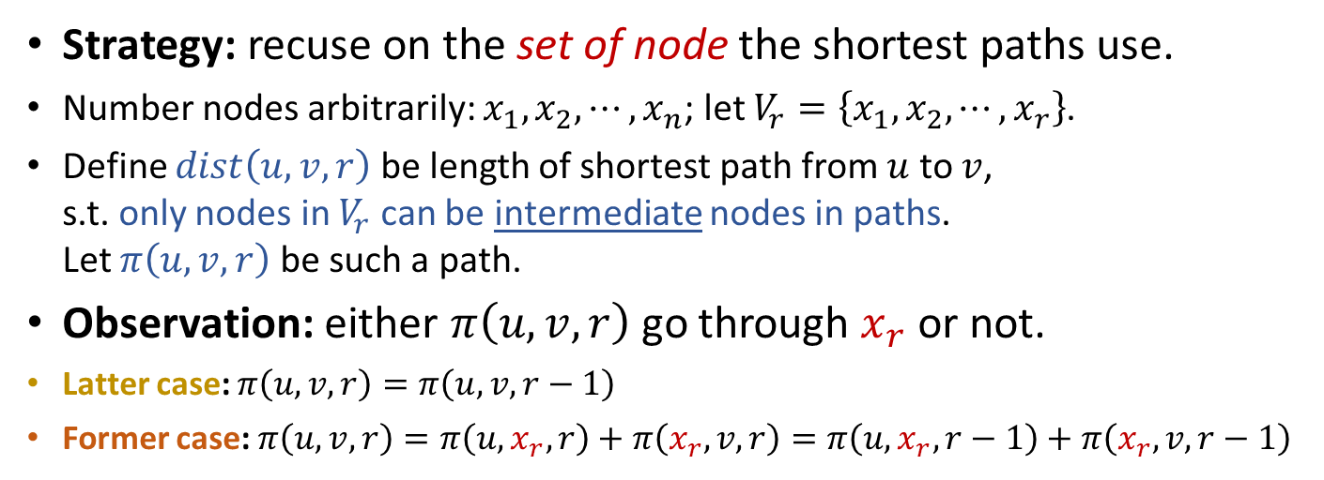






APSP via Recursion
Strategy: recuse on the set of node the shortest paths use.
Number nodes arbitrarily: $x_{1},x_{2},⋯,x_{n}$; let $V_{r}=\left\{x_{1},x_{2},⋯,x_{r}\right\}$.
Define $dist\left(u,v,r\right)$ be length of shortest path from $u$ to $v$,
s.t. only nodes in $V_{r}$ can be intermediate nodes in paths.
Let $π\left(u,v,r\right)$ be such a path.
Observation: either $π\left(u,v,r\right)$ go through $x_{r}$ or not.
Latter case: $π\left(u,v,r\right)=π\left(u,v,r−1\right)$
Former case: $π\left(u,v,r\right)=π\left(u,x_{r},r\right)+π\left(x_{r},v,r\right)=π\left(u,x_{r},r−1\right)+π\left(x_{r},v,r−1\right)$
$$π\left(u,v,r\right)=π\left(u,v,r−1\right)$$
$$x_{5}$$
$$x_{6}$$
v
u
$$x_{2}$$
$$π\left(u,x_{r},r−1\right)$$
$$x_{1}$$
$$x_{3}$$
$$x_{r}$$
$$x_{4}$$
$$π\left(x_{r},v,r−1\right)$$

Slide 19
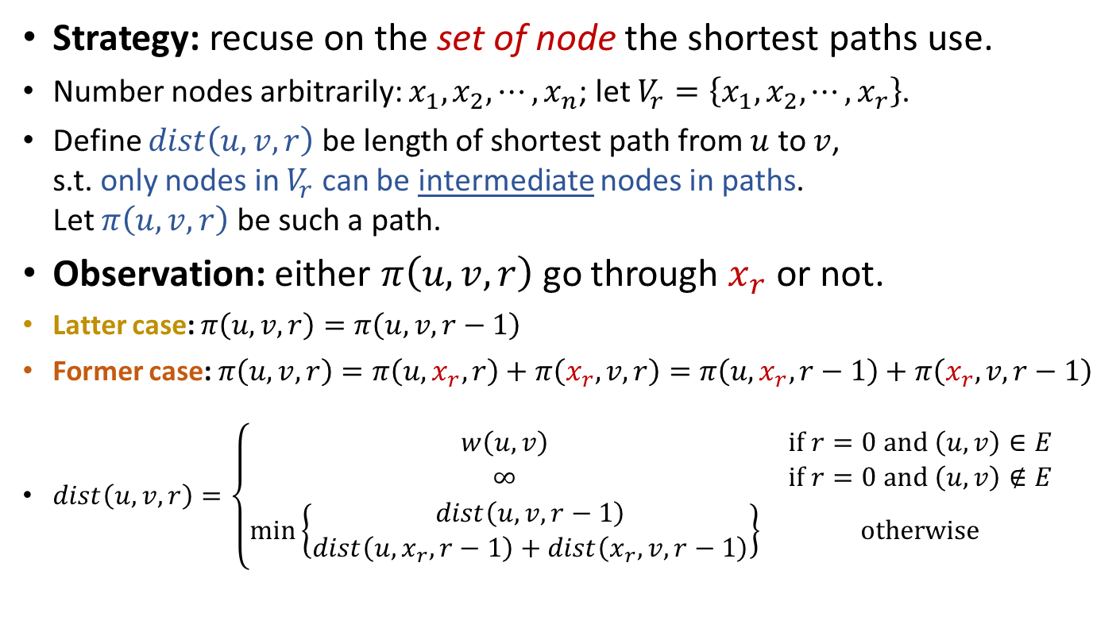
APSP via Recursion
Strategy: recuse on the set of node the shortest paths use.
Number nodes arbitrarily: $x_{1},x_{2},⋯,x_{n}$; let $V_{r}=\left\{x_{1},x_{2},⋯,x_{r}\right\}$.
Define $dist\left(u,v,r\right)$ be length of shortest path from $u$ to $v$,
s.t. only nodes in $V_{r}$ can be intermediate nodes in paths.
Let $π\left(u,v,r\right)$ be such a path.
Observation: either $π\left(u,v,r\right)$ go through $x_{r}$ or not.
Latter case: $π\left(u,v,r\right)=π\left(u,v,r−1\right)$
Former case: $π\left(u,v,r\right)=π\left(u,x_{r},r\right)+π\left(x_{r},v,r\right)=π\left(u,x_{r},r−1\right)+π\left(x_{r},v,r−1\right)$
$dist\left(u,v,r\right)=\left\{\begin{matrix}w\left(u,v\right) & if r=0 and \left(u,v\right)∈E \\ ∞ & if r=0 and \left(u,v\right)∉E \\ \min\left\{\begin{matrix}dist\left(u,v,r−1\right) \\ dist\left(u,x_{r},r−1\right)+dist\left(x_{r},v,r−1\right)\end{matrix}\right\} & otherwise\end{matrix}\right.$
No longer needs to enumerate multiple potential choices!

Slide 20
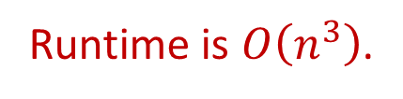

APSP via Recursion
The Floyd-Warshall Algorithm
Strategy: recuse on the set of node the shortest paths use.
Define $dist\left(u,v,r\right)$ be length of shortest path from $u$ to $v$,
s.t. only nodes in $V_{r}=\left\{x_{1},x_{2},⋯,x_{r}\right\}$ can be intermediate nodes in paths.
$dist\left(u,v,r\right)=\left\{\begin{matrix}w\left(u,v\right) & if r=0 and \left(u,v\right)∈E \\ ∞ & if r=0 and \left(u,v\right)∉E \\ \min\left\{\begin{matrix}dist\left(u,v,r−1\right) \\ dist\left(u,x_{r},r−1\right)+dist\left(x_{r},v,r−1\right)\end{matrix}\right\} & otherwise\end{matrix}\right.$
Runtime is $O\left(n^{3}\right)$.
FloydWarshallAPSP(G):
for (every pair (u,v) in V*V)
if ((u,v) in E) then dist[u,v,0]=w(u,v)
else dist[u,v,0]=INF
for (r=1 to n)
for (each node u)
for (each node v)
dist[u,v,r] = dist[u,v,r-1]
if (dist[u,v,r] > dist[u,x_{r},r-1] + dist[x_{r},v,r-1])
dist[u,v,r] = dist[u,x_{r},r-1] + dist[x_{r},v,r-1]

Slide 21


Application of APSP
Compute Transitive Closure
FloydWarshallAPSP(G):
for (every pair (u,v) in V*V)
if ((u,v) in E) then dist[u,v,0]=w(u,v)
else dist[u,v,0]=INF
for (r=1 to n)
for (each node u)
for (each node v)
dist[u,v,r] = dist[u,v,r-1]
if (dist[u,v,r] > dist[u,x_{r},r-1] + dist[x_{r},v,r-1])
dist[u,v,r] = dist[u,x_{r},r-1] + dist[x_{r},v,r-1]
What if we don’t care exact distance, but only reachability?
Given $G=\left(V,E\right)$, compute transitive closure $G^{′}=\left(V,E^{′}\right)$,
where $\left(u,v\right)∈E^{′}$ if exists path from $u$ to $v$ in $G$.
Simple, any APSP algorithm will do! (Check whether $dist\left(u,v\right)=∞$)
But we can save a lot of space if a bit cleverer.
FloydWarshallTransitiveClosure(G):
for (every pair (u,v) in V*V)
if ((u,v) in E) then t[u,v,0] = TRUE
else t[u,v,0] = FALSE
for (r=1 to n)
for (each node u)
for (each node v)
t[u,v,r] = t[u,v,r-1]
if (t[u,x_{r},r-1] AND t[x_{r},v,r-1])
t[u,v,r] = TRUE
$$t_{u, v}^{\left(r\right)}=t_{u, v}^{\left(r−1\right)}∨\left(t_{u, x_{r}}^{\left(r−1\right)}∧t_{x_{r}, v}^{\left(r−1\right)}\right)$$

Slide 22
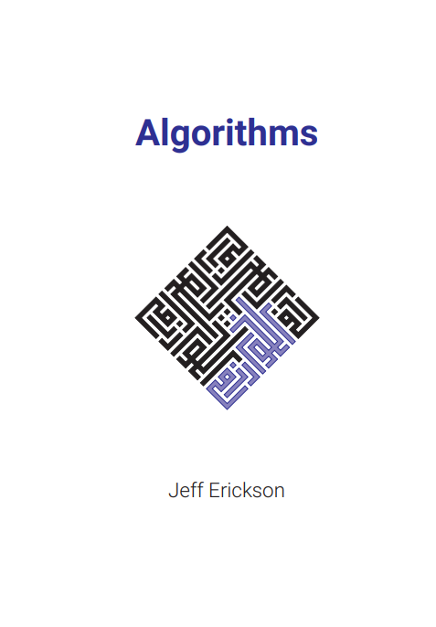
Reading
[CLRS] Ch.25
[Erickson v1] Ch.9

