Slide 1
CartPole by Genetic Alg.
Zachary Richardson
Group: “Me, Myself, and Zack”

Slide 2
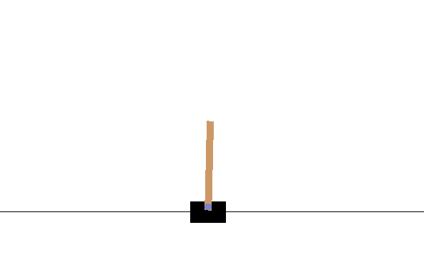
Environment
Pole is attached by an un-actuated joint to a cart, which moves along a frictionless track
Controlled by applying a force of +1 or -1 to the cart
Pendulum starts upright, and the goal is to prevent it from falling over
Reward of +1 is provided for every timestep that the pole remains upright
Episode ends when the pole is more than 15 degrees from vertical, or the cart moves more than 2.4 units from the center

Slide 3
Libraries
OpenAI Gym
NumPy
Matplotlib
Python Std Lib
  Random
  Math
  Bisect

Slide 4
Solution(s)
Genetic Algorithm
  Generate random population
    Each child has a set number of actions
  Test each node in population
    Record fitness value
  Generate new population from previous
  Repeat for each generation
Neural Network
  Used for choosing next actions
  Based upon other solutions

Slide 5
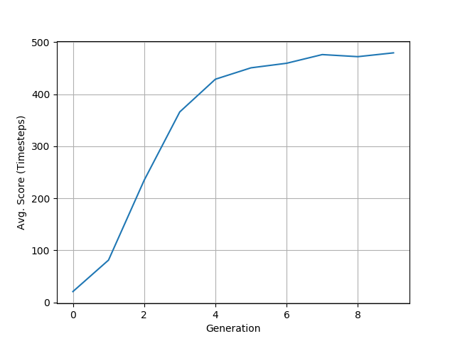
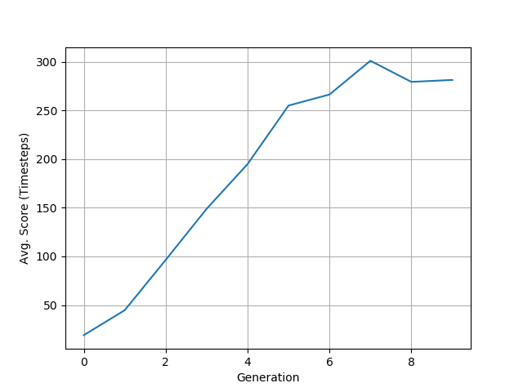
Demonstration 1
GENERATIONS = 10
MAX_STEPS = 500
POPULATION_COUNT = 200
MUTATION_RATE = 0.01

Slide 6
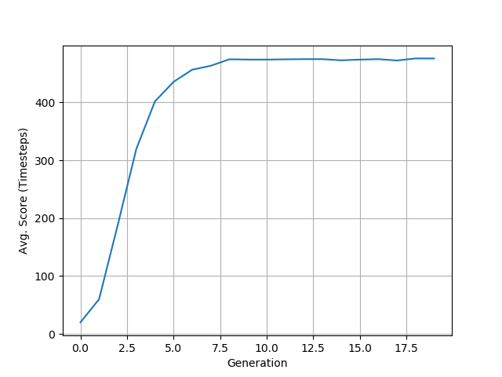
Demonstration 2
GENERATIONS = 100
MAX_STEPS = 500
POPULATION_COUNT = 2000
MUTATION_RATE = 0.01

Slide 7
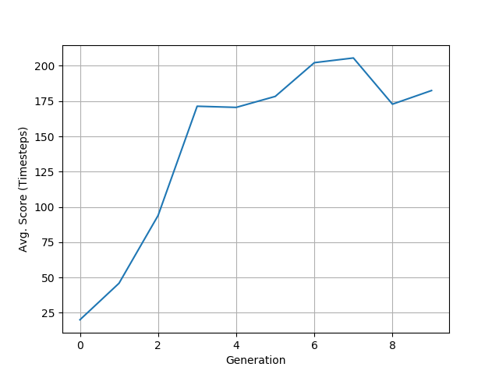
Demonstration 3
GENERATIONS = 10
MAX_STEPS = 500
POPULATION_COUNT = 200
MUTATION_RATE = 0.20

Slide 8
Future Goals / Changes
Better understanding of Neural Networks
Make use of Keras, PyTorch, etc.

Slide 9
Works Cited
A Quick Introduction to Neural Networks
  https://ujjwalkarn.me/2016/08/09/quick-intro-neural-networks/
Evolve a Neural Network with a Genetic Algorithm by Matt Harvey
  https://blog.coast.ai/lets-evolve-a-neural-network-with-a-genetic-algorithm-code-included-8809bece164
Genetic Algorithms + Neural Networks by Suryansh S.
  https://towardsdatascience.com/gas-and-nns-6a41f1e8146d

