Slide 1
CartPole-v1 by Genetic Alg.
Zachary Richardson
Group: “Me, Myself, and Zack”

Slide 2
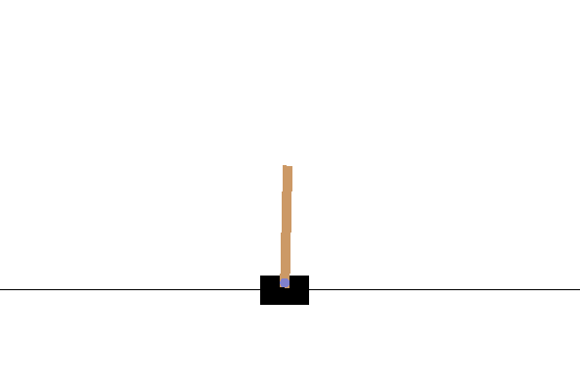
Environment
Pole is attached by an un-actuated joint to a cart, which moves along a frictionless track
Controlled by applying a force of +1 or -1 to the cart
Pendulum starts upright, and the goal is to prevent it from falling over
Reward of +1 is provided for every timestep that the pole remains upright
Episode ends when the pole is more than 15 degrees from vertical, or the cart moves more than 2.4 units from the center

Slide 3
Libraries
OpenAI Gym
NumPy
Python Std Lib
Random
Math
Bisect

Slide 4
Solution(s)
Genetic Algorithm
Generate random population
Each child has a set number of actions
Test each node in population
Record fitness value
Generate new population from previous
Repeat for each generation

Slide 5
Solution(s)
Neural Network
Lots of research

Slide 6
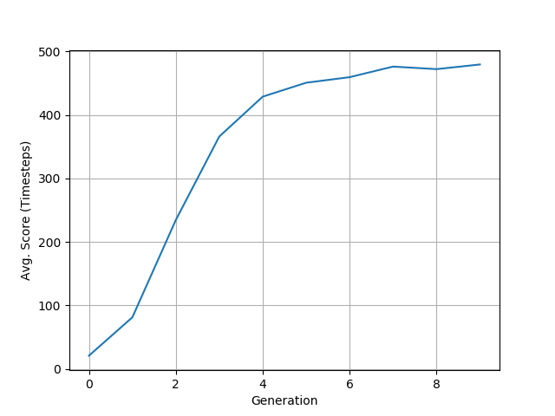
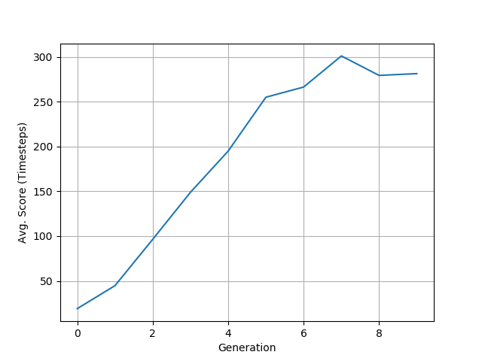
Demonstration 1
GENERATIONS = 10
MAX_STEPS = 500
POPULATION_COUNT = 200
MUTATION_RATE = 0.01

Slide 7
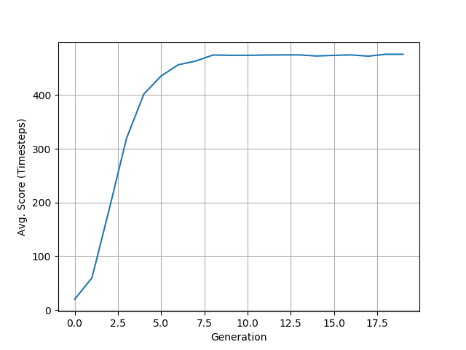
Demonstration 2
GENERATIONS = 100
MAX_STEPS = 500
POPULATION_COUNT = 2000
MUTATION_RATE = 0.01

Slide 8
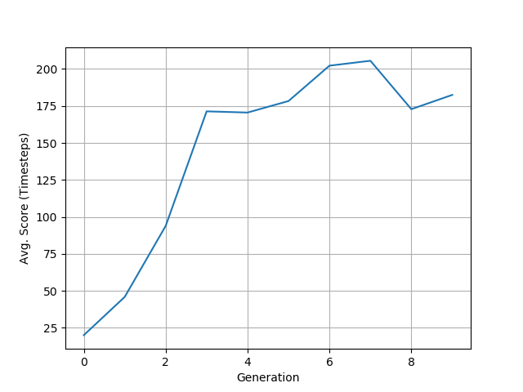
Demonstration 3
GENERATIONS = 10
MAX_STEPS = 500
POPULATION_COUNT = 200
MUTATION_RATE = 0.20

Slide 9
Future Goals / Changes
Better understanding of Neural Networks
Make use of Keras, PyTorch, etc.

Slide 10
Works Cited
A Quick Introduction to Neural Networks
https://ujjwalkarn.me/2016/08/09/quick-intro-neural-networks/
Evolve a Neural Network with a Genetic Algorithm by Matt Harvey
https://blog.coast.ai/lets-evolve-a-neural-network-with-a-genetic-algorithm-code-included-8809bece164
Genetic Algorithms + Neural Networks by Suryansh S.
https://towardsdatascience.com/gas-and-nns-6a41f1e8146d

