Slide 1

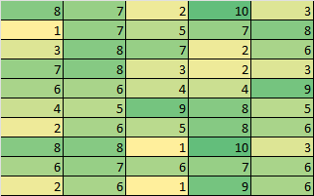


1
Documents
2
Chunks of Text
3
Document Embedding
6
Compare to find the best match
Enhance output with Language Model
Query Text
5
4
Query Embedding

