Slide 1


AIA Claim Analysis
Hill Nguyen Duy, Prakash Chandra, Jianshu Weng

Slide 2
Questions we want to answer
What is the right granularity of studying the claim data?
What are the key factors driving the claim to increase?
Is there any seasonality/trend in the increasing pattern?

Slide 3
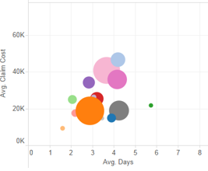



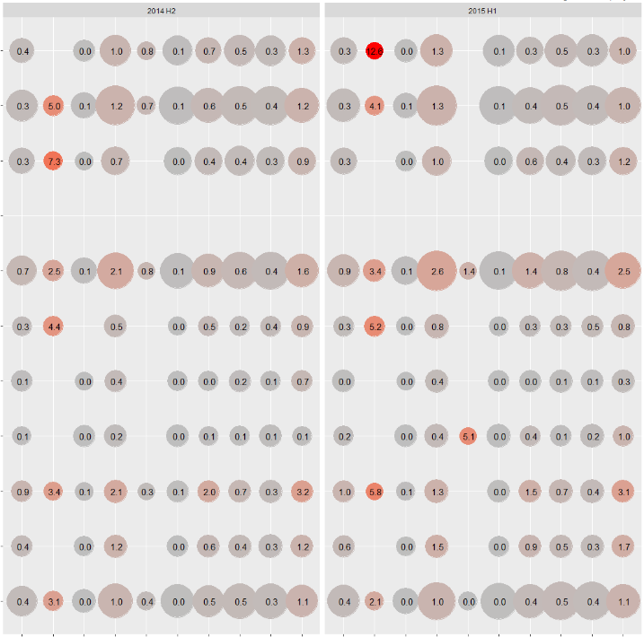
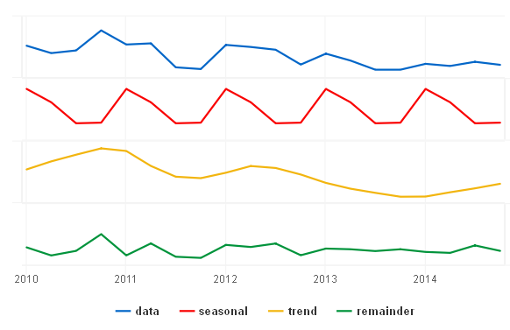
Analysis Flow
Data loading
Filtering &
Pre-processing
General trend analysis
with
data visualization
We are here!!
Identify key drivers & conduct further analysis to understand seasonality and trend, short-term forecasting, etc

Slide 4
Filtering & Pre-processing
Select only “IP”.
Select only records with completed information, as suggested by Zhaoyu.
Harmonize names of same hospitals, e.g. Beijing Xiehe Hospital and Beijing Union Xiehe Hospital, Hong Kong Union Hospital and Union Hospital, Matilda & War Memorial Hospital and Matilda International Hospital, Hong Kong Adventist Hospital.
Adjust the treatment cost by medical service inflation in Hong Kong
Assumption: all treatments are affected by the same inflation, as majority of the claims happed in Hong Kong.
Add the number of hospitalized days and normalize the claim amount by the hospitalized days for variable-cost items like “Room & Board”, etc.

Slide 5
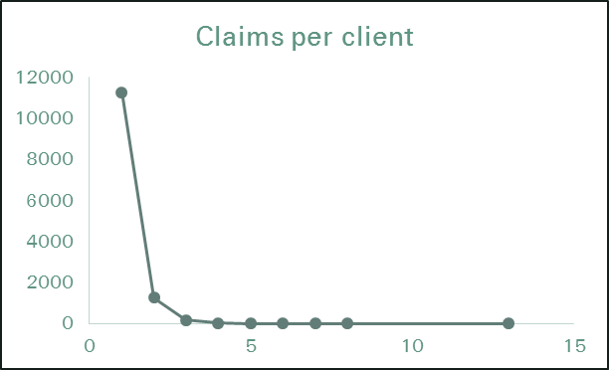
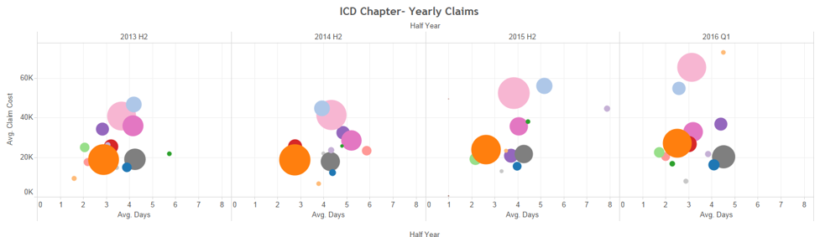
General Observation (I)
~90% of the clients raise 1 claim over their existence in the database
The ICD Chapters driving the majority increase in costs are Circulatory, Neoplasms and Digestive, Musculoskeletal & Connective Tissue, and Respiratory
The average days spent by a person in the hospital is decreasing vs increasing cost of claim
Note:
There is a high variance in the costs over time for some ICD Chapters as the severity of diseases grouped under one chapter may vary. Similarly, Diagnosis_Name is too fine.

Slide 6
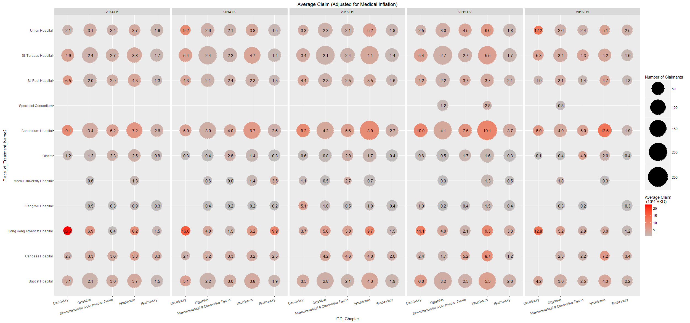
Trend of Average Claim Amount – ICD Chapter vs Hospital
Main observations
Hong Kong Adventist Hospital is really expensive. The # of claims is small. However, # of Neoplasms claims jumped a lot from 60 (2015 H1) to 101 (2015 H2)
Sanatorium Hospital is relatively expensive. Worryingly, its share of claimants seem to be increasing fast (2014 H1 -> 2015 H2)
St. Teressa and Baptist Hospitals cost increases slowly over time. However, due to their shares of claimants, they did contribute substantial to the cost rise.

Slide 7
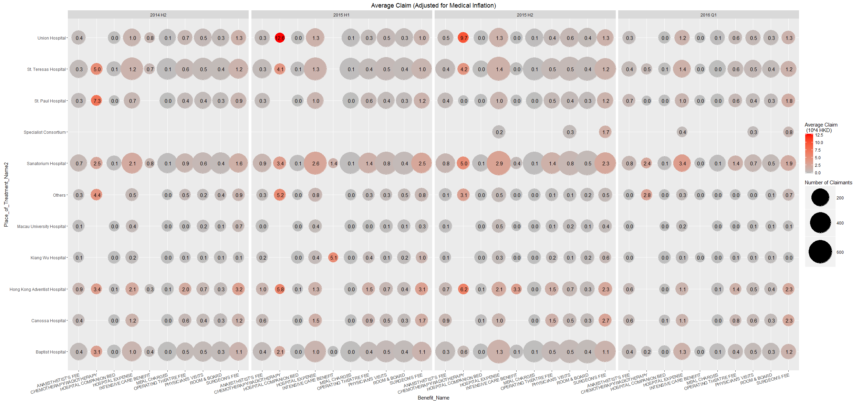
Trend of Average Claim Amount – Benefit name vs Hospital
Main observations
# of Chemotherapy /Radiotherapy claim is small but expensive
The five most important hospitals: Union, St. Teressa’s, Sanatorium, HK Adventist, and Baptist

Slide 8
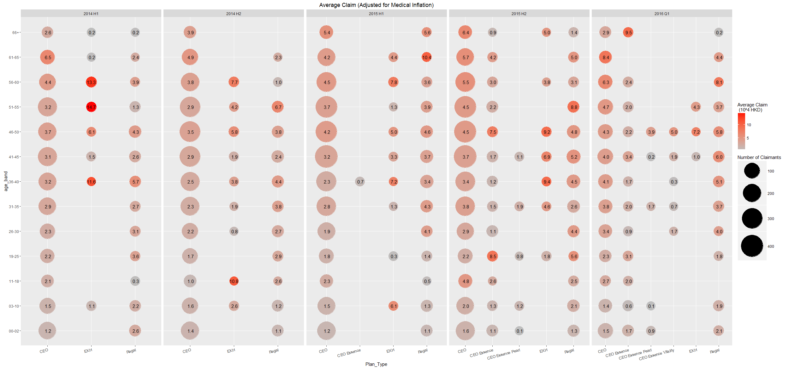
Trend of Average Claim Amount – Plan Types vs Age Bands
Main observations
CEO policy holders on average claim more and more across all ages (10%). Their share is big, so it hurts.
Regal holders claims substantially more (20%).
The most worrying sign:
the share of claimant with CEO Essence is swelling. 2016 Q1 number is already = 2015 H2. And they claimed quite much.
A big share of CEO Essence claimants only have in-force duration of 1 year.

Slide 9
What is next
Identify key drivers
Conduct further analysis to understand seasonality and trend, short-term forecasting, etc

