Slide 1
SPBlock: A Useless Information Blocker for PTT Gossiping

Slide 2
Outline
1
Introduction
2
Dataset
3
Method
4
Result

Slide 3
PART ONE
Introduction

Slide 4
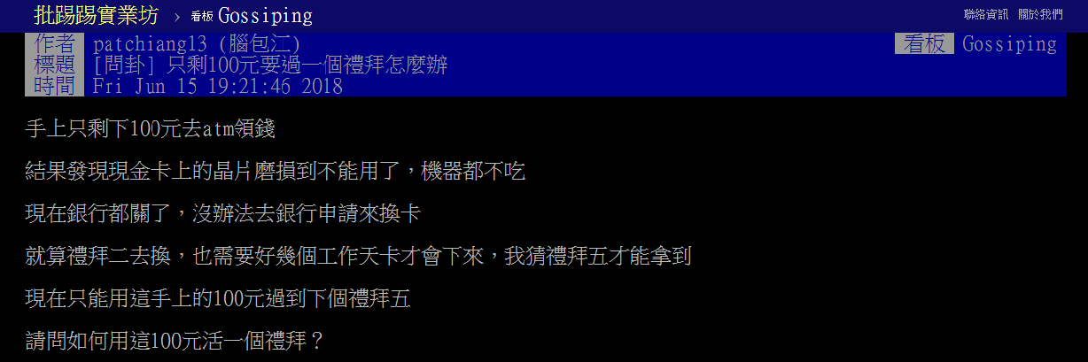

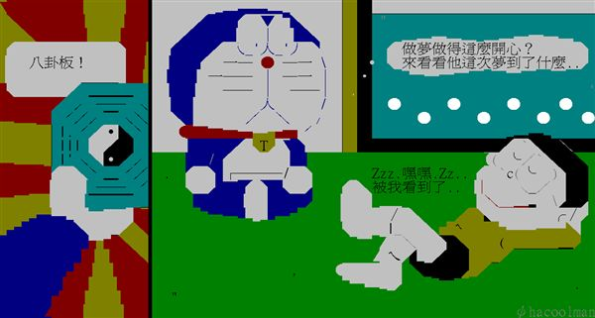
PART ONE Introduction
The culture in PTT Gossiping
Sometimes, the comments below a article are totally useless (or even the article itself is useless).

Slide 5
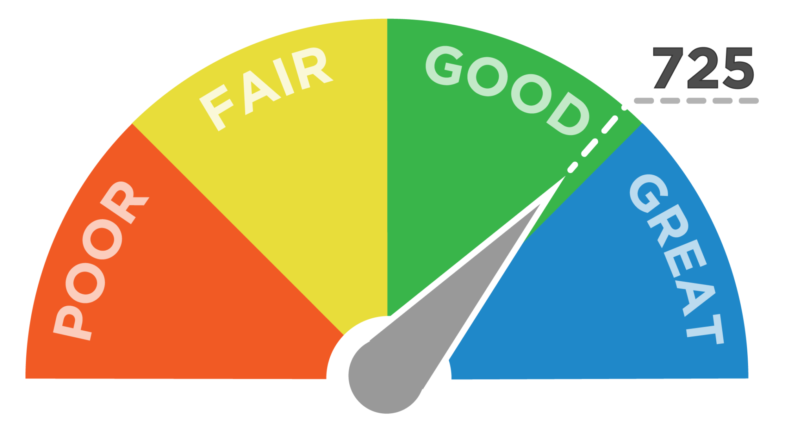

PART ONE Introduction
Credit Score
Classify the articles
Can you trust this user?
Is this article a shitposting?
SPBlock
Filter useless comments
Is this comment useful?

Slide 6
PART TWO
Dataset

Slide 7

PART TWO Dataset
Dataset
180,000 articles from PTT Gossiping
9,800,000 comments
Wikipedia

Slide 8
PART THREE
Methods

Slide 9
PART THREE Methods
Crawl
01
Label
02
Train
03
Test
04
Crawl
Label
Train
Test
Crawl the articles from 2018.1 to 2018.3 in PTT Gossiping
Manually label the comment data
Use the training data to train a LSTM model
Use the testing data to evaluate the model

Slide 10
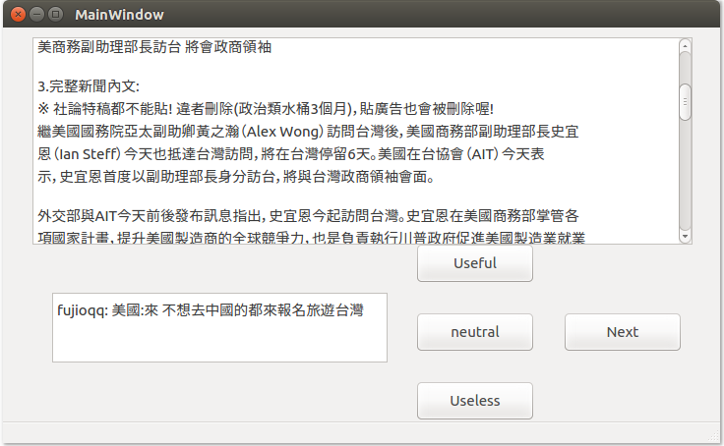
PART THREE Methods
User
Training data
Familiar with Ptt
80%
User
Testing data
Unfamiliar with Ptt
20%
User
GUI
Data

Slide 11
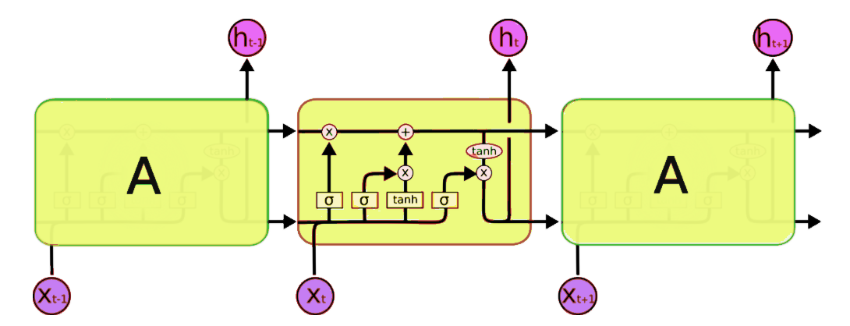
PART THREE Methods
Two kinds of input layers
One hot encoding
Word2vec

Slide 12
PART THREE Methods
Our best accuracy
83%
However…
We choose the word2vec model which has lower accuracy as final input, because…

Slide 13
PART FOUR
Result

Slide 14
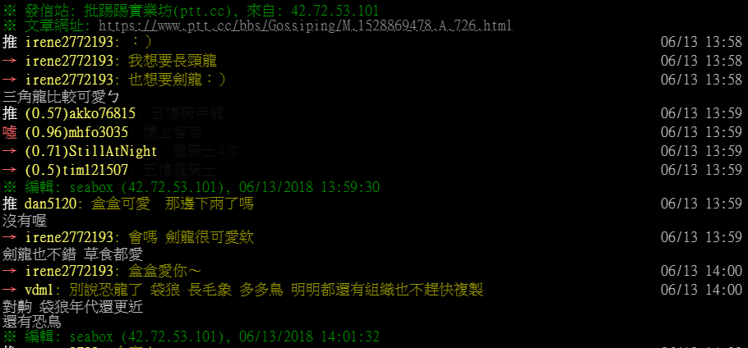
PART FOUR Result
Change the color of the useless comments
Credit Score

Slide 15
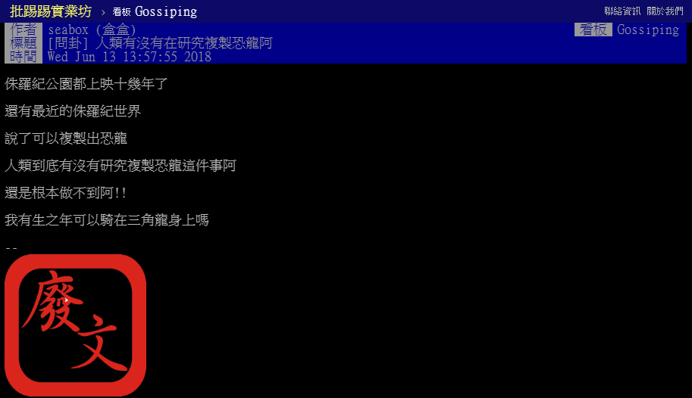
PART FOUR Result
Shitposting mark(廢文印)

Slide 16
THANK YOU

