Slide 1


WEEK 1
SPRINT 3
PL6
QUA

Slide 2


about us.

Slide 3
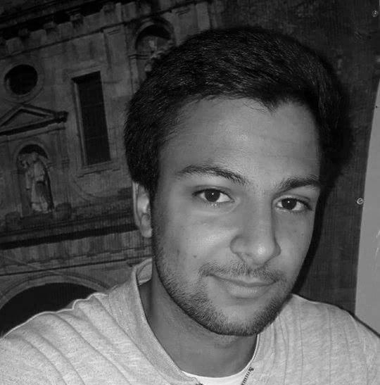
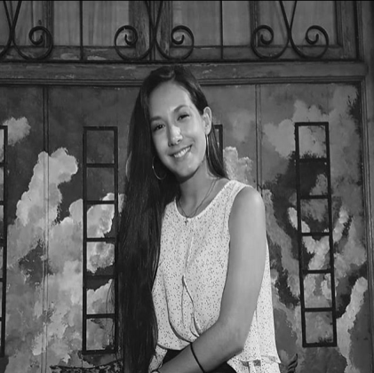

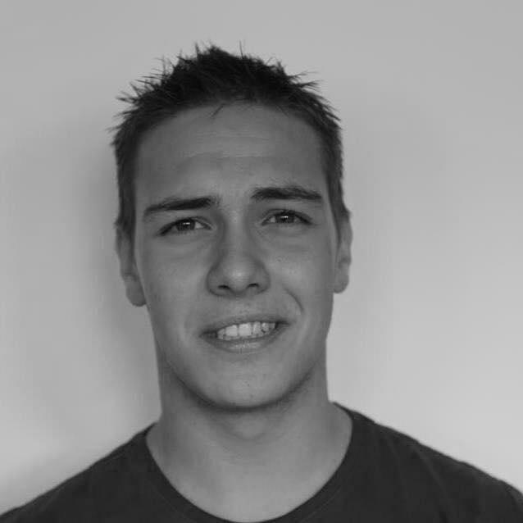
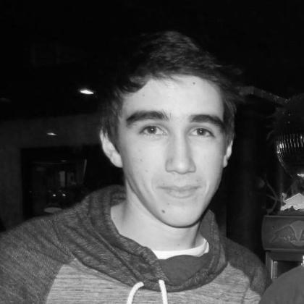
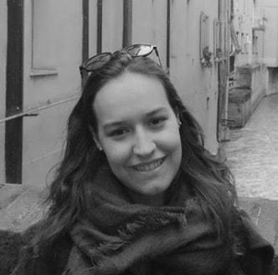
QUA
Hugo Marques
Viviana Abreu
Maria Alves
Luís Gonçalves
Rui Reis
Ana Almeida

Slide 4
Sprint #3 goals.
• Update the QUA section of the quality manual according to experience and the feedback.
• Manage your team quality processes and monitor their metrics, as usual.

Slide 5
tasks.
 | TASK #1 | TASK #2 | TASK #3 | TASK #4 | TASK #5
TASK | Task delegation and group leadership | Status data gathering from the other units | Weekly presentation | Organization of the tasks and presentation | Update of the QUA section of the QM
OWNER | Hugo Marques | Viviana Abreu Hugo Marques | Hugo Marques | Ana Almeida | Full Group
GOAL EFFORT | 30 MINUTES | 2 HOURS | 30 MINUTES | 2 HOURS | 2 HOUR
EFFECTIVE EFFORT | 30 MINUTES | 2HOURS | 30 MINUTES | 2 HOURS | 2 HOUR
STATUS | COMPLETED | IN PROGRESS | COMPLETED | COMPLETED | IN PROGRESS

Slide 6
planned tasks.
 | TASK #1 | TASK #2 | TASK #3 | TASK #4 | TASK #5
TASK | Task delegation and group leadership | Status data gathering from the other units | Weekly presentation | Update of the QUA section of the QM | Organization of the tasks and presentation
OWNER | Hugo Marques | Viviana Abreu Hugo Marques | Hugo Marques | Full Group | Ana Almeida
GOAL EFFORT | 1 HOURS | 2 HOURS | 30 MINUTES | 4 HOURS (each) | 2 HOURS
STATUS | IN PROGRESS | IN PROGRESS | IN PROGRESS | IN PROGRESS | IN PROGRESS

Slide 7
Metrics.
Number of hours spent: 5
Information documents gathered and analysed: 3

Slide 8
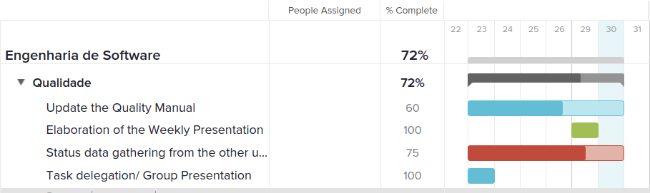
Esforço semanal (Gantt).
Full Group
Ana Almeida
Viviana A. / Hugo M.
Hugo Monteiro

