Slide 1
Object Oriented Programming Lecture 2

Slide 2
What is a Variable?
Variables are places where information can be stored while a program is running.
Their values can be changed at any point over the course of a program

Slide 3
Creating Variables
To create a variable, declare its name and the type of information that it will store.
The type is listed first, followed by the name.
Example: a variable that stores an integer representing the highest score on an exam could be declared as follows:
int highScore ; type name
Now you have the variable (highScore), you will want to assign a value to it.
Example: the highest score in the class exam is 98.
highScore = 98;

Slide 4
Naming Variables
The name that you choose for a variable is called an identifier. In Java, an identifier can be of any length, but must start with:
a letter (a – z),
a dollar sign ($),
or, an underscore ( _ ).
In addition, there are certain keywords reserved (e.g., "class") in the Java language which can never be used as identifiers.
Notes:
we'll learn what operators are later

Slide 5
Naming (Continued)
Java is a case-sensitive language – the capitalization of letters in identifiers matters. A rose is not a Rose is not a ROSE
It is good practice to select variable names that give a good indication of the sort of data they hold
For example, if you want to record the size of a video, videSize is a good choice for a name whereas qqq would be a bad choice

Slide 6
Naming (Continued)
When naming a variable, the following convention is commonly used:
The first letter of a variable name is lowercase
Each successive word in the variable name begins with a capital letter
All other letters are lowercase
Here are some examples: pageCount loadFile anyString threeWordVariable

Slide 7
Statements
A statement is a command that causes something to happen.
All statements in Java are separated by semicolons ;
Example:
System.out.println(“Hello, World”);
You have already used statements to create a variable and assign it a value.

Slide 8
Variables and Statements
One way is to declare a variable and then assign a value to it with two statements:
int e; // declaring a variable e = 5; // assigning a value to a variable
Another way is to write a single initialization statement:
int e = 5; // declaring AND assigning

Slide 9
Primitive Data Types
There are eight built-in (primitive) data types in the Java language
4 integer types (byte, short, int, long)
2 floating point types (float, double)
Boolean (boolean)
Character (char)

Slide 10
Integer Data Types
Data Type | Value Range
byte | -128 to +127
short | -32768 to +32767
int | -2147483648 to +2147483647
long | -9223372036854775808 to +9223372036854775807
There are four data types that can be used to store integers.
The one you choose to use depends on the size of the number that we want to store.
In this course, we will always use int when dealing with integers.

Slide 11
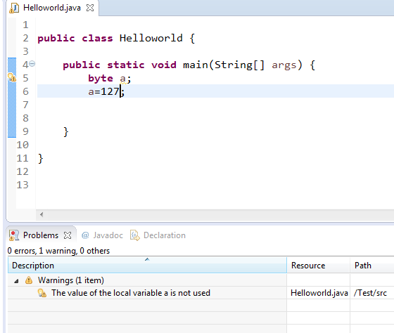
Example

Slide 12
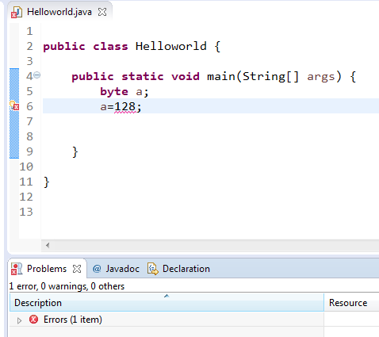
Example

Slide 13
Floating Point Data Types
There are two data types that can be used to store decimal values (real numbers).
The one you choose to use depends on the size of the number that we want to store.
float a= 2.3f;
Double

Slide 14
Integer Division Example
int i = 63;
int j = 35;
System.out.println(i / j);
Output: 1
double x = 63;
double y = 35;
System.out.println(x / y);
Ouput: 1.8
The result of integer division is just the integer part of the quotient!

Slide 15
Boolean Data Type
Boolean is a data type that can be used in situations where there are two options, either true or false.
Example:
boolean Hungry = true;
boolean fileOpen = false;

Slide 16
Character Data Types
Character is a data type that can be used to store a single characters such as a letter, number, punctuation mark, or other symbol.
Example:
char firstLetterOfName = 'e' ;
char myQuestion = '?' ;
Note that you need to use singular quotation marks when assigning char data types.

Slide 17
Introduction to Strings
Strings consist of a series of characters inside double quotation marks.
Examples statements assign String variables:
String Author = “abc";
String password = “123";

Slide 18
Reserved Words
abstract | assert | boolean | break | byte
case | catch | char | class | const
continue | default | do | double | else
extends | final | finally | float | for
goto | if | implements | import | instanceof
int | interface | long | native | new
package | private | protected | public | return
short | static | strictfp | super | switch
synchronized | this | throw | throws | transient
try | void | violate | while

Slide 19
QUIZ
Which of the following are valid variable names?
int $amount
String $amount
int salary
String _salary

