Slide 1
Collections

Slide 2
Collections
Built-in support for collections
  Similar to STL in C++
Collection type
  Sequence/Set
  Example ArrayList
Map type
  Hashtable/dictionary
  Example HashMap
Collections store references to objects
Use inheritance and interfaces
Read
  http://java.sun.com/docs/books/tutorial/collections

Slide 3
Collection Design
All classes provides almost same methods
  get(), size(), isEmpty()…
  Easy learning curve for using Collections
Implemented as reference to Object
  Similar to using a void * in C
  Require a cast back (down casting) to the actual type
  Example
    String element = (String)arraylist.get(i)
Remember, Java checks all casts at run-time

Slide 4
Collection Messages
Basic messages
  constructor()
    Creates a collection with no elements
  int size()
    Number of elements in the collection
  boolean add()
    Add a new reference/element at the end of the collection
    Returns true is the collection is modified.
  iterator()
    Returns an Iterator Object

Slide 5
Additional Collection Messages
Utilities
  Additional useful methods
  boolean isEmpty()
  boolean contains(Object o)
    Iterative search, uses equals()
  boolean remove(Object o)
    Iterative remove(), uses equals()
  Boolean addAll(Collection c)

Slide 6
ArrayList

Slide 7
ArrayList
Replaces the “Vector”
Can grow over time
Methods
  add(Object)
    Can add all kinds of objects
    implicit upcasting
  int size()
  Object get(int index)
    Index is from 0 to size() -1
    Must cast to appropriate type when used.
  remove(index)
    Removes object reference at the specified index
  iterator()
    We’ll see an example!

Slide 8
Example TestArrayList. java
/* ArrayList in this example, is used to store Student objects.
We are using the same Student class which we build in our
previous lectures */
import java.util.*;
public class TestArrayList {
public static void main (String args[ ]){
//Create ArrayList object
ArrayList al = new ArrayList();
Student s1 = new Student(“ali”, 1);
Student s2 = new Student(“saad”, 2);
Student s3 = new Student(“raza”, 3);
al.add( s1 );
al.add( s2 );
al.add( s3 );
//continue..

Slide 9
Example TestArrayList. java
//checking whether arraylist contains student objects or not
boolean b = al.isEmpty();
if (b == true){
System.out.println("arraylist is empty");
}
else {
int size = al.size();
System.out.println("arraylist size: "+ size);
}
// continue..

Slide 10
Example TestArrayList. java
//using loop to iterate
for (int i=0; i< al.size(); i++) {
Student s = (Student) al.get(i);
s.print();
}
} //end of main
}

Slide 11
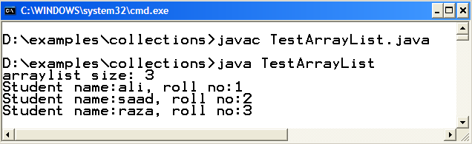
Compile & Execute

Slide 12
HashMap

Slide 13
HashMap
Stores key & value in pair form
Cannot contain duplicate keys
Implements the Map interface
Keys and Values are stored as Objects
  put(Key, Value)
    implicit upcasting
  Object get(Key)
    Must cast to appropriate type when used.
  int size()

Slide 14
Example TestHashMap. java
/* HashMap is used to store Student objects as value and
rollnos as keys.
We are using the same Student class which we build in our
previous lectures */
import java.util.*;
public class TestHashMap {
public static void main (String args[]){
HashMap h = new HashMap();
Student s1 = new Student(“ali”, 1);
Student s2 = new Student(“saad”, 2);
Student s3 = new Student(“raza”, 6);
h.put("one", s1 );
h.put("two", s2 );
h.put("six", s6 );
//continue..

Slide 15
Example TestHashMap. java
boolean b = h.isEmpty();
if (b == true){
System.out.println("hashmap is empty");
}
else {
int size = h.size();
System.out.println("hashmap size:"+ size);
}
Student s = (Student) h.get("two");
s.print();
} //end of main
}

Slide 16
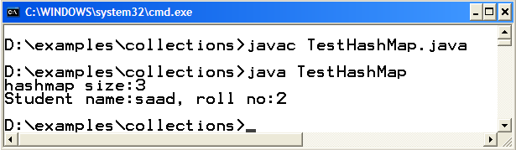
Compile & Execute

Slide 17
Example code for using equals(), toString() etc.

Slide 18
Putting All Together

Slide 19
We have learned So far
How to Perform IO
Selection and Control Structures
OOP
Collections
So, lets do a small problem

Slide 20
Problem
Address Book
Wants to store name, address, phone no of a Person
Features
  Add
  Delete
  Search (on name)
  Exit (from application)
The above listed features must be available to user in the form of JOptionPane based MENU.

Slide 21
Approach for Solving Problem
Step 1
  Make a Person class with name, address, phone no attributed
Step 2
  Make a AddressBook class
  Use ArrayList to store Person’s Obejcts
  Write methods add, delete and Search
    Use JOptionPane methods for IO
Step 3
  Make a Test class (Driver Program)
  Build Menu using switch selection structure
  Call appropriate methods of AddressBook

Slide 22
Lets Start Coding!

