Slide 1
Packages

Slide 2
Packages
Packages are groups of classes.
Often you put an application in its own package.
Also ‘libraries’ of useful classes.
Packages allow us to use other people’s code.
Saves name clashes with other people.

Slide 3
Packages
package test;
import java.util.*;
public class Input {
public static void main(String[] args) {
Scanner s =new Scanner(System.in);
int a= s.nextInt();
System.out.print(a);
}
}

Slide 4
Packages
package test;
public class Input {
public static void main(String[] args) {
java.util.Scanner s =new java.util.Scanner(System.in);
int a= s.nextInt();
System.out.print(a);
}
}

Slide 5
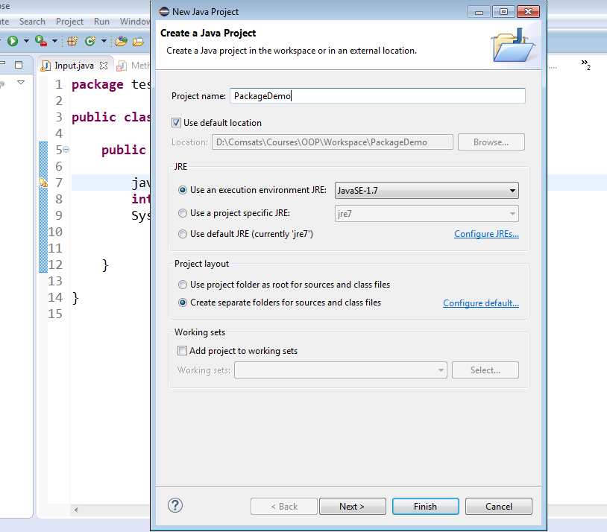
Packages

Slide 6
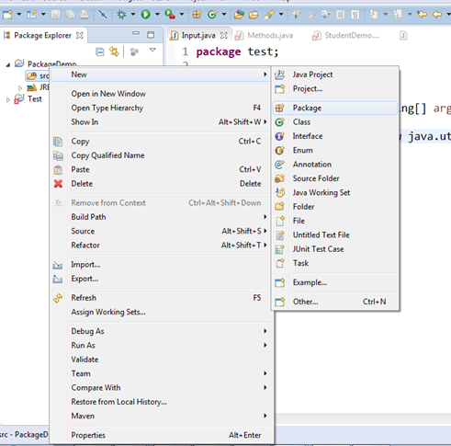
Packages

Slide 7
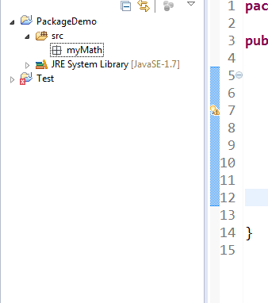
Packages

Slide 8
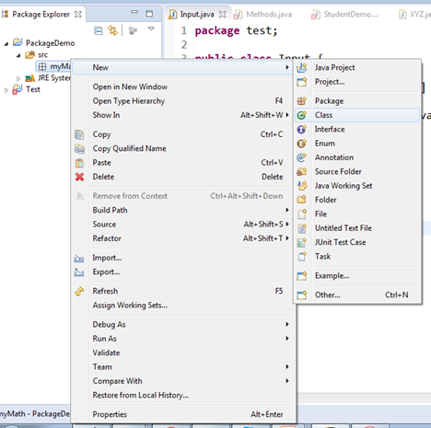
Packages

Slide 9
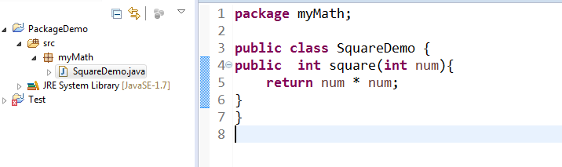
Packages

Slide 10
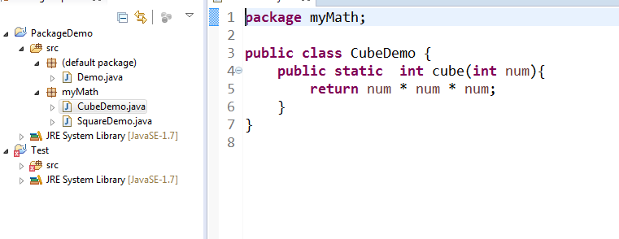
Packages

Slide 11
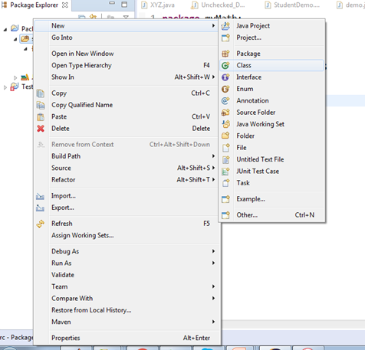
Packages

Slide 12
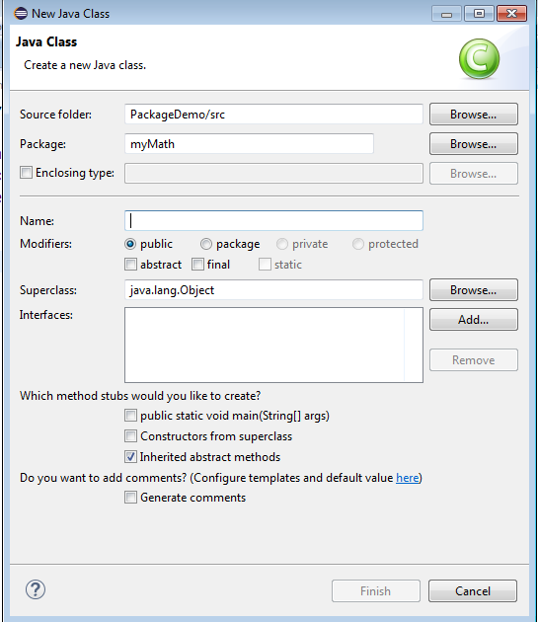
Packages

Slide 13
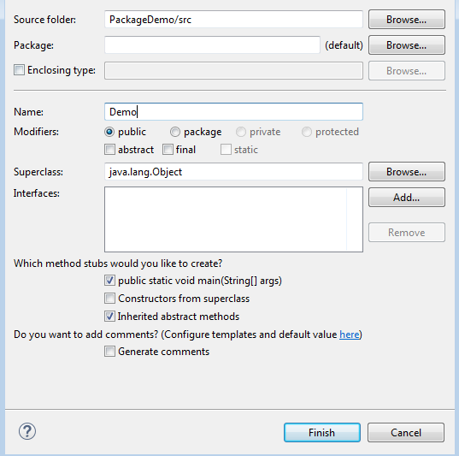
Packages

Slide 14
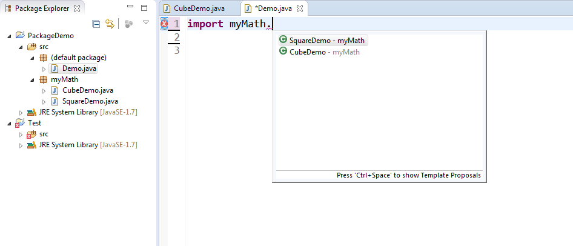
Packages

Slide 15
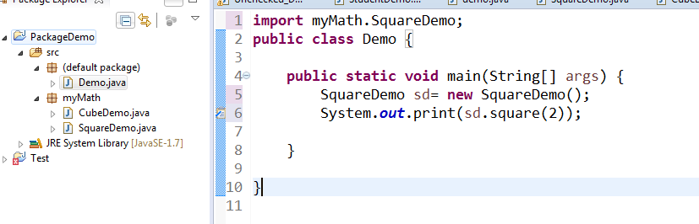
Packages

Slide 16
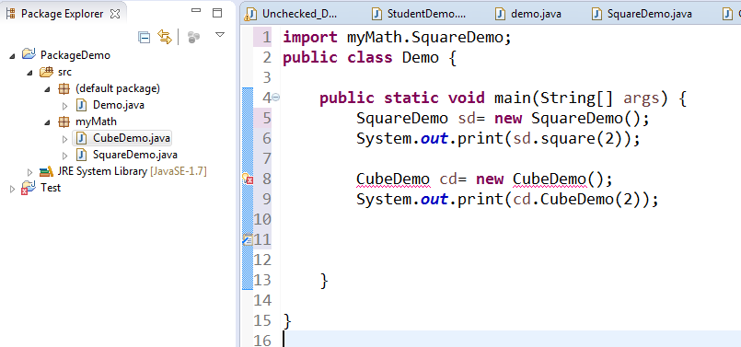
Packages

Slide 17
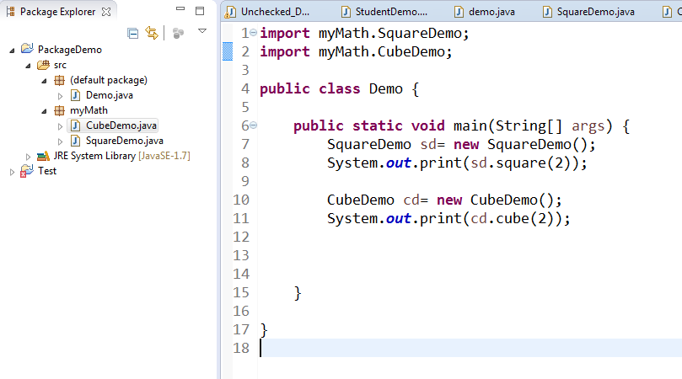
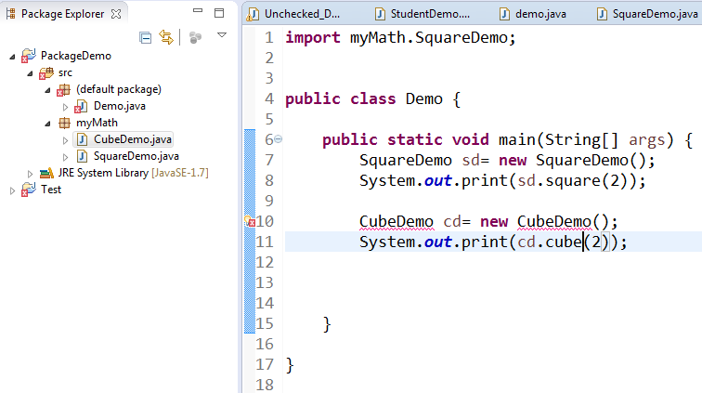
Packages

Slide 18
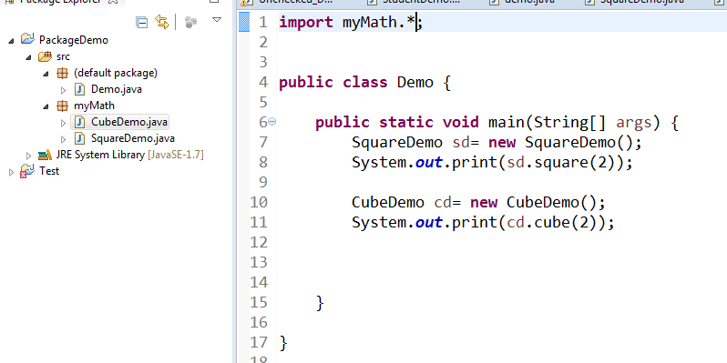
Packages

Slide 19
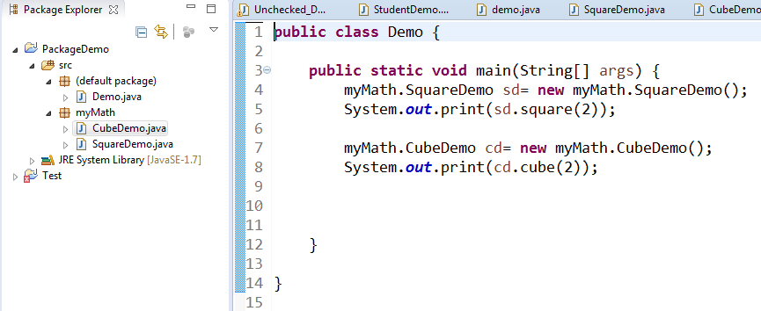
Packages

Slide 20
Quiz

Slide 21
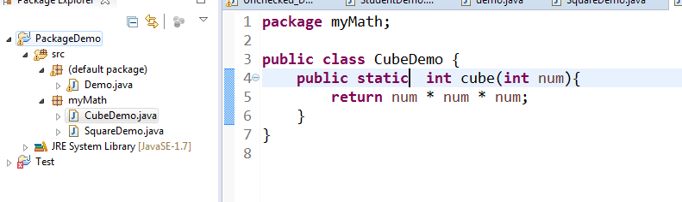
Packages

Slide 22
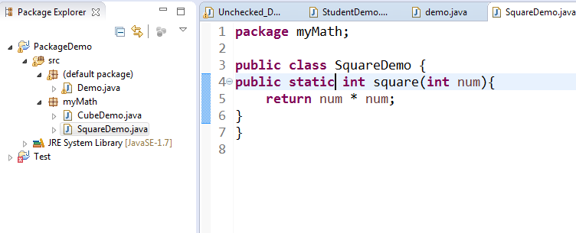
Packages

Slide 23
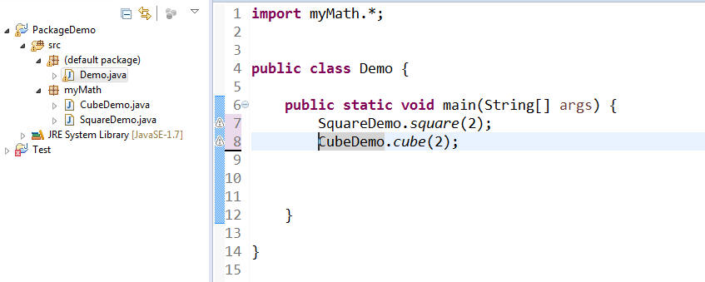
Packages

Slide 24

Packages and inheritance

Slide 25
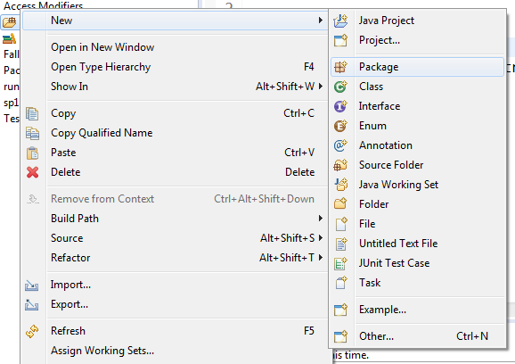
Packages

Slide 26

Packages

Slide 27
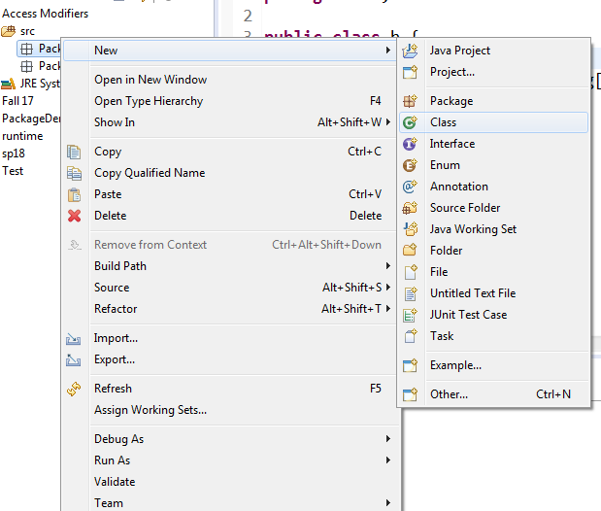
Packages

Slide 28
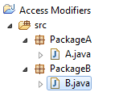
Packages

Slide 29
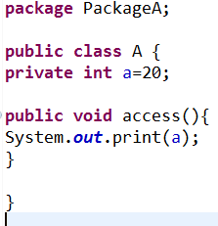
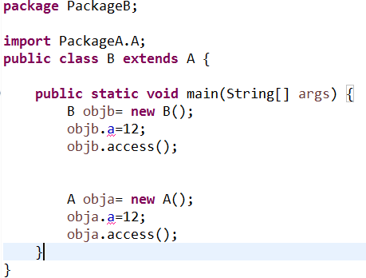
Private With Extends

Slide 30
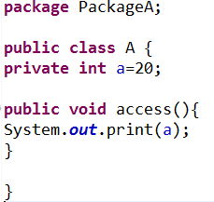
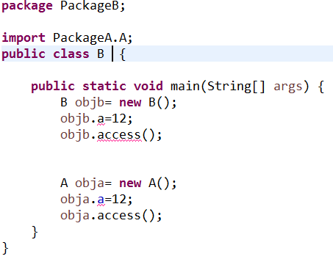
Private Without Extends

Slide 31
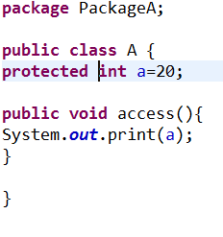
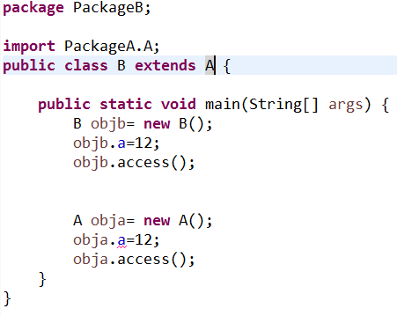
Protected With Extends

Slide 32
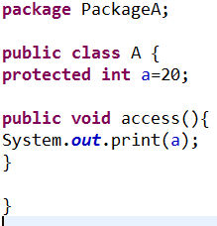
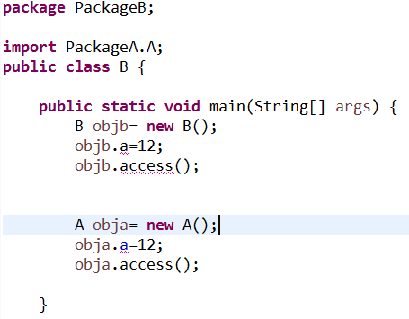
Protected Without Extends

Slide 33
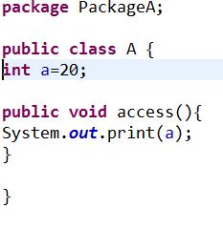
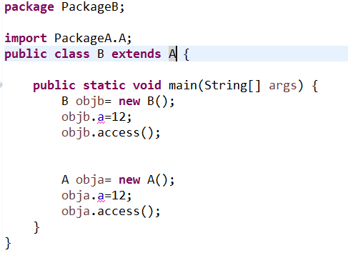
Default with extends

Slide 34
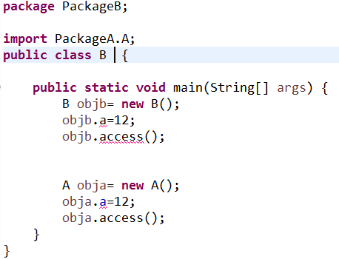
Default without Extends

