Slide 1


















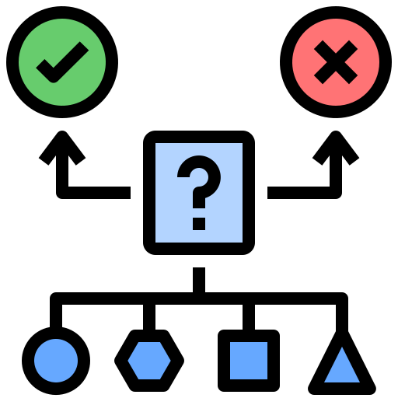





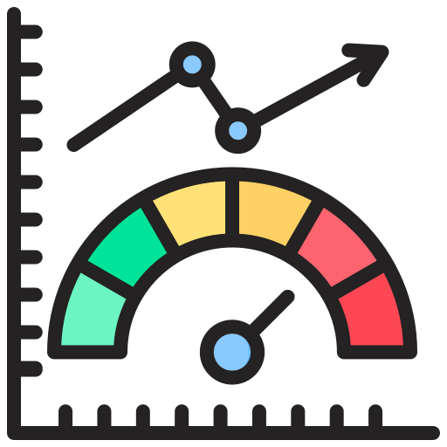


1. RAG Evidence Sources
2. Evidence Unit Construction
3. Evidence Graph Construction
4. RAG Knowledge Views &
Benchmark Evaluation
Omics Data
Entity Normalization
Evidence
LINKED_TO
Entities
Knowledge Views
Gene / Disease / Drug
/ Pathway / Phenotype
Evidence
OBSERVED_IN
Cohort
Document Corpus
(flattened passages)
Evidence Sources
Semantic KG
(entity-relation triples)
mutation
copy
number
SUPPORTS / REFINES / CONTRADICTS / …
Evidence Graph
(structure, logic, context)
Evidence
Evidence
expression
clinical
result
Observed Evidence Modeling
DERIVED_FROM
DERIVED_FROM
RAG Pipeline
Omics
Observation
Literature Observation
Observation
Claim
Bundle
BM25
Top-K
context
LLM
PDCD1-HCC bundle
Benchmark Evaluation
Literature Data
Source
Cohort
Study Context
Statistics
Entities
DERIVED_FROM
PDCD1-related immune exhaustion
, DOI:10.3390/v16050707 (PubMed)
PDCD1 downregulated in HCC, delta=-2.6507, n=371 (TCGA)
External Grounded Cancer Benchmark
Gold Sources: ClViC / ClinVar / IntOGen / Open Targets / SIGOR / BioASQ
mechanism
claim
study
context
Evidence Unit Assembly
LINKED_TO
Automatic QA Construction: normalization / label mapping / balancing
Gene: PDCD1, HGNC:8760
SUPPORTS / REFINES
LINKED_TO
cohort statistical aggregation
Cancer: HCC, DOID:684
Audit & Review: quality audit / expert validation
DERIVED_FROM
HBV-HCC immune exhaustion, (PubMed)
DERIVED_FROM
phenotype
/ outcome
provenance
Observation
Bundle
LINKED_TO
LINKED_TO
Metrics & Analysis
Claim
OBSERVED_IN
PDCD1 expression signal (TCGA)
OBSERVED_IN
HBV-associated HCC, T cell dysfunction, n=6931
high tumor purity Q4 vs low Q1, n=371, 93 vs 92 groups
Accuracy
Macro-F1
Evidence Coverage
Bundle Retrieval
Evidence Sufficiency
Ablation Analysis
Robustness Analysis
Task Analysis
claim semantic aggregation
Subgraph Example

