Slide 1
Use of the Hough Transformation to Detect Lines and Curves in Pictures
赵炜宁

Slide 2
1.Background
Contents
2. fundamental

Slide 3

PART 01
1
Background

Slide 4
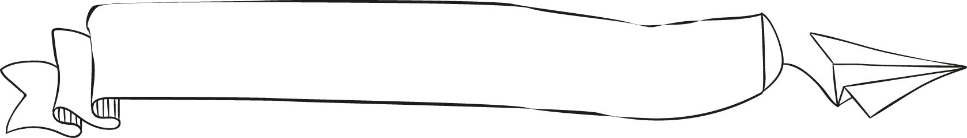
Background
The Hough transform was patented as U.S. Patent 3,069,654 in 1962 and assigned to the U.S. Atomic Energy Commission with the name "Method and Means for Recognizing Complex Patterns". This patent uses a slope-intercept parametrization for straight lines, which awkwardly leads to an unbounded transform space since the slope can go to infinity.
- wikipedia

Slide 5
PART 02
2
Fundamentals

Slide 6

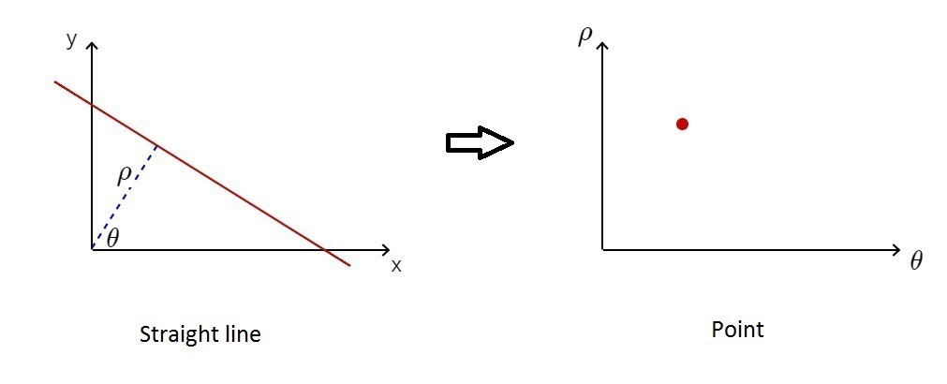
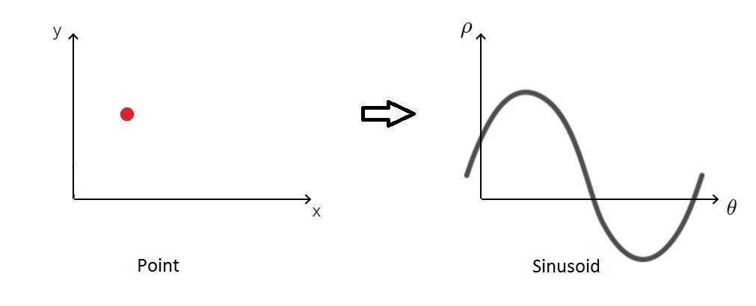
Polar coordinate system
Hough space
We can easily draw a line in Polar coordinate system which is composed of a set of points but it's hard for computer to determine which set in an image is corresponding to a line. We should find an easier and clearer standard.
For a given line, we can determine specific ρ and θ. Then, the equation is satisfied for each x, y point belonging to this line. So, we can draw the point in Hough space.
In a similar way, we can transform a point in Polar coordinate system to a sinusoid in Hough space.
Polar coordinate system
Hough space

Slide 7
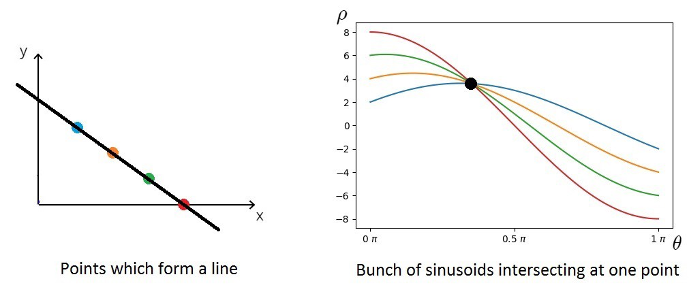
If we draw points which form a line in the image space(Polar coordinate system), we will obtain a bunch of sinusoids in the Hough space. And, they are intersecting at exactly one point, and that point is the line in Polar coordinate system (image space).
It's prone to be a line if many curves concurrent in a point.
Thus, the problem of detecting collinear points can be converted to the problem of finding concurrent curves.

Slide 8
What we actually do is voting the (ρ,θ) values. We continue this process for every point on the image.
So after the process, we will get the table of the (ρ,θ) and its votes.

Slide 9
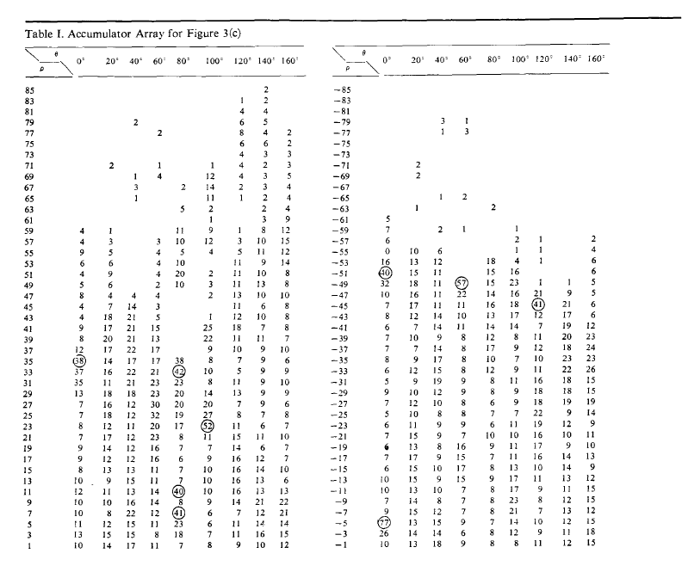
For given threshold, if the number of concurrent curves is larger than it, we can say that we find a line in the image space.
The larger threshold we use, the fewer lines we will find.

Slide 10
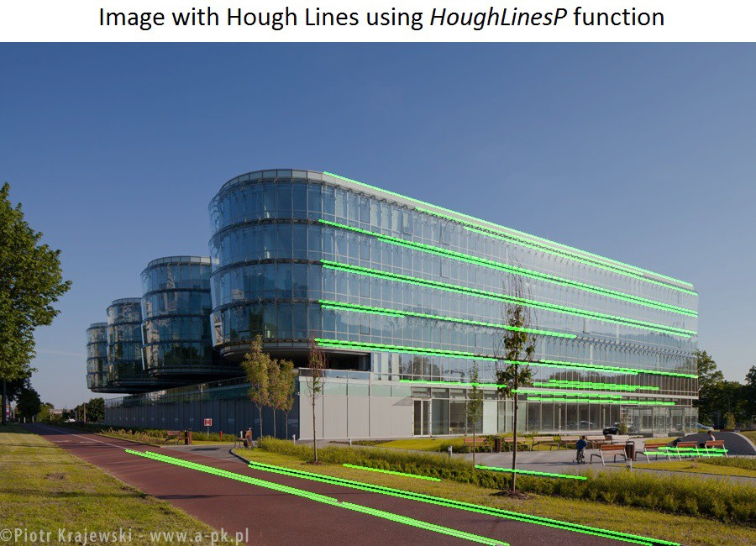
Application

Slide 11

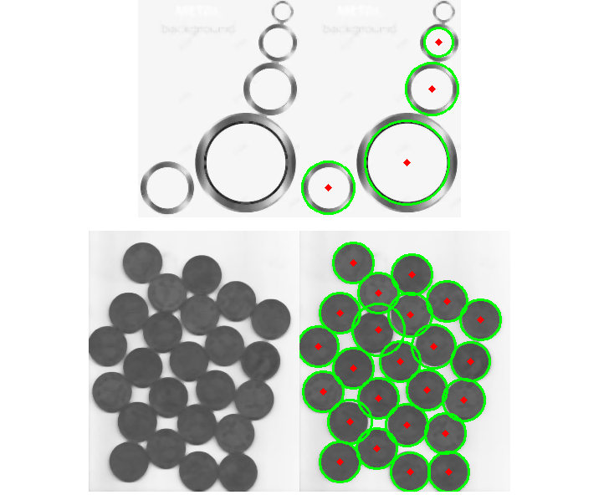
curves
For curves such as circle, the fundamentals is similar, and you just need to change the number of parameters.

Slide 12
References
Richard O. Duda and Peter E. Hart. 1972. Use of the Hough transformation to detect lines and curves in pictures. 15, 1 (Jan. 1972), 11–15.

Slide 13

End
Thank you for your listening

