Slide 1



Milestone 2
MPI VS CUDA
A Comparative Analysis
Optimizing Parallel Computing
Zhenyu Wang
47140170
COSC7502
Let's Start!

Slide 2


Milestone 2
Agenda
MPI+OpenMP
CUDA
Results
COSC7502
Page 02

Slide 3
Milestone 2
MPI & OpenMP
MPI: "Message Passing Interface (MPI) is a standardized and portable message-passing system designed to allow processes to communicate in a parallel computing environment."
OpenMP: "OpenMP (Open Multi-Processing) is an API that supports multi-platform shared memory multiprocessing programming in C, C++, and Fortran."
Combination: "By combining MPI and OpenMP, we can exploit parallelism both across multiple nodes (with MPI) and within a single node (with OpenMP)."
COSC7502
Page 03

Slide 4


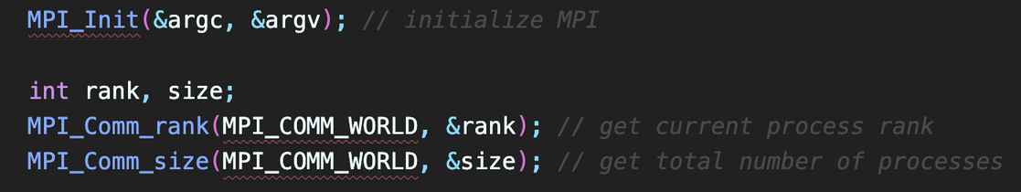
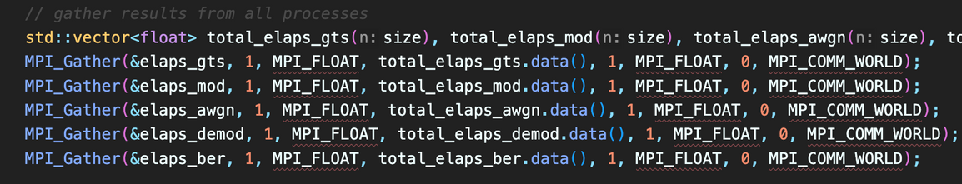
Milestone 2
MPI+OpenMP
Initialization: "Initialization of the MPI environment with MPI_Init."
Data Distribution: "Distribute data chunks to different processes using MPI_Scatter or MPI_Send/MPI_Recv."
Processing: "Each MPI process computes its chunk of data. If needed, further parallelization within a node using OpenMP."
Gathering Results: "Collect results from all processes using MPI_Gather."
COSC7502
Page 04

Slide 5
Milestone 2
MPI Deep Dive
MPI is inherently distributed. It enables processes to run concurrently on separate memory spaces across different nodes.
1
Nature of MPI
MPI relies on explicit communication mechanisms, such as sending and receiving messages, to coordinate and exchange data between processes.
2
Communication
COSC7502
Page 05

Slide 6
Milestone 2
MPI Deep Dive
In MPI, the workload can be distributed across processes, but it's crucial to balance the load to avoid performance bottlenecks.
3
Load Balancing
Processes might need to synchronize, especially in iterative algorithms where each iteration depends on the results of the previous one.
4
Synchronization
COSC7502
Page 06

Slide 7
Milestone 2
CUDA
Definition: "CUDA (Compute Unified Device Architecture) is a parallel computing platform and application programming interface (API) model created by NVIDIA."
GPU Acceleration: "It allows developers to use CUDA-enabled graphics processing units (GPUs) for general-purpose processing (an approach known as GPGPU, General-Purpose computing on Graphics Processing Units)."
Benefits: "Utilizes the massive parallel computing power of NVIDIA GPUs, leading to dramatic increases in computing performance."
COSC7502
Page 07

Slide 8
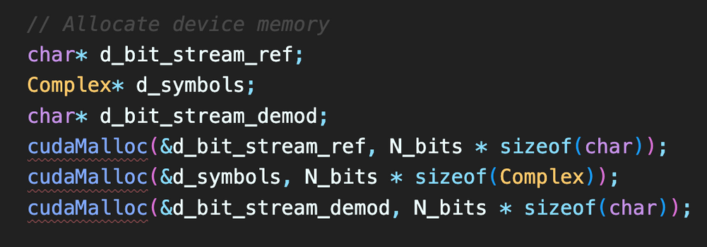
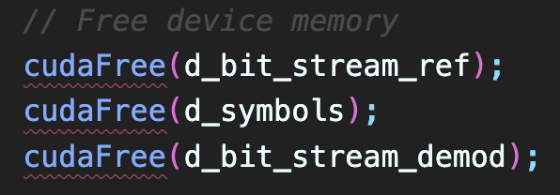
Milestone 2
CUDA
Memory Allocation: "Allocate memory on the GPU using cudaMalloc."
Data Transfer: "Transfer data between host and device using cudaMemcpy."
Kernel Execution: "Define and launch CUDA kernels to perform parallel computation on the GPU."
Memory Cleanup: "Free the allocated GPU memory using cudaFree."
COSC7502
Page 08

Slide 9
Milestone 2
CUDA Deep Dive
CUDA provides a hierarchical structure of parallelism, from threads to blocks to grids. This allows fine-grained parallel computations.
1
Nature of CUDA
CUDA has a unique memory hierarchy, including global memory, shared memory, and local memory. Effective use of these memory types can drastically improve performance.
2
Memory Hierarchy
COSC7502
Page 09

Slide 10
Milestone 2
CUDA Deep Dive
CUDA functions, known as 'kernels', run on the GPU and are executed by multiple threads in parallel.
3
Kernels
Suited for data-parallel tasks where the same operation is performed on different data elements.
4
Advantages
COSC7502
Page 10

Slide 11
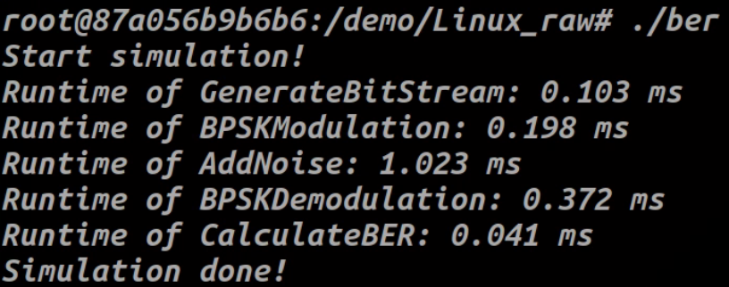
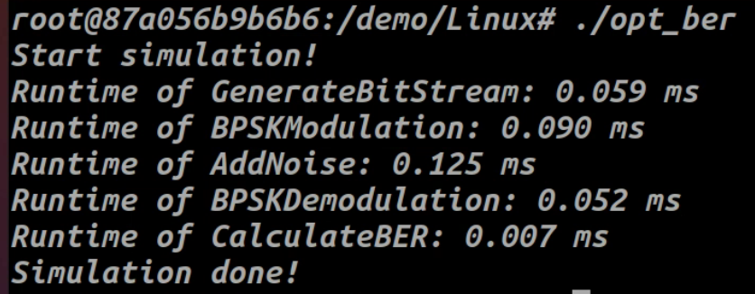
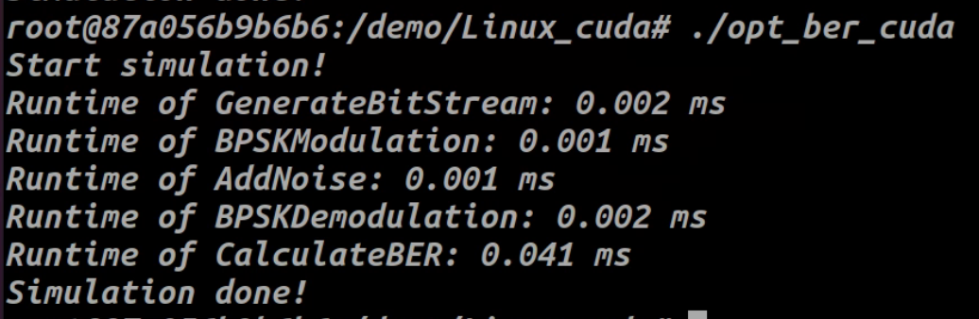
Milestone 2
Result*
Original Method
MPI+OpenMPI
CUDA
Runtime of GenerateBitStream: 0.108 ms
Runtime of BPSKModulation: 0.205 ms
Runtime of AddNoise: 1.108ms
Runtime of BPSKDemodulation: 0.379 ms Runtime of CalculateBER: 0.042 ms
Runtime of GenerateBitStream: 0.073 ms
Runtime of BPSKModulation: 0.061 ms
Runtime of AddNoise: 0.0314 ms
Runtime of BPSKDemodulation: 0.108 ms Runtime of CalculateBER: 0.011 ms
Runtime of GenerateBitStream: 0.002 ms
Runtime of BPSKModulation: 0.001 ms
Runtime of AddNoise: 0.001 ms
Runtime of BPSKDemodulation: 0.002 ms Runtime of CalculateBER: 0.041 ms
*The test results are all based on an Intel Core i7-12700H processor and an NVIDIA RTX3070Ti graphics card.
COSC7502
Page 11

Slide 12
Milestone 2
*The test results are all based on an Intel Core i7-12700H processor and an NVIDIA RTX3070Ti graphics card.
COSC7502
Page 12

Slide 13

Milestone 2
THANK YOU
Zhenyu Wang
s4714017@student.uq.edu.au
COSC7502

