Slide 1
Lab 1: GPS
Xupeng Zhu
NUID: 001814074

Slide 2
Communication structure
serial port
gps_driver
system arguments
Lcm;
struct: exlcm.gps
lcm_read.m
lcm log
log file

Slide 3
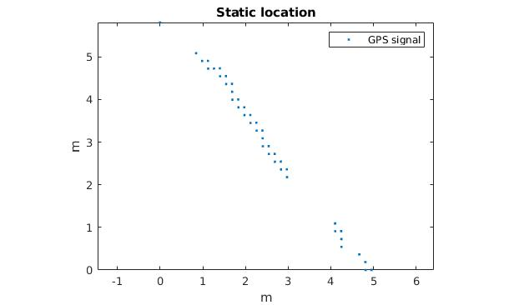
At a static point
Firstly, the GPS was placed at a static point. GPS location data was collected for around 7 mins.
For the distribution of the GPS location, its shape is resemble to Gaussian distribution with high correlation between utm_x and utm_y.
The location error appears to have a bound, i.e., within ±3m.

Slide 4
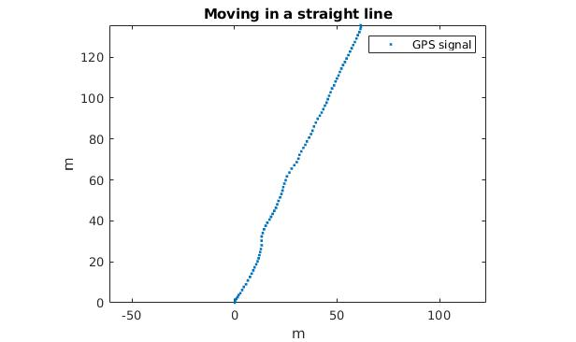
On a straight line
Then the GPS was moved along a straight line for about 141m.
The trajectory of the GPS location is close to a straight line. The error is about ±1m, which halved the static one. The error is continues rather than jump.
The reason of the GPS signal is more accurate in moving than in static may could be the multi-path effect was dramatically change during moving and be filtered so in the end it is more stable and accurate.

