Slide 1
LAB2: Real Time Kinematic GPS
Xupeng Zhu
001814074

Slide 2
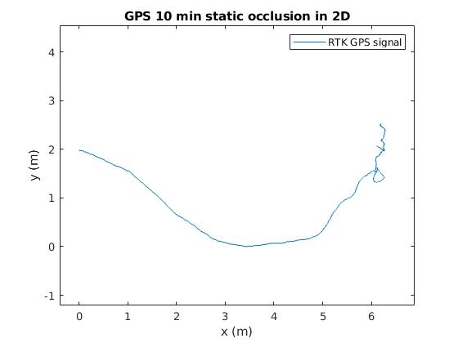
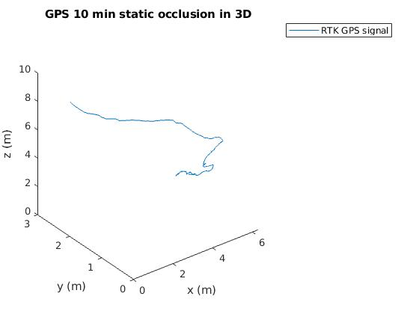
When there is occlusion, RTK GPS works poor. This problem may due to the multi-thread signal has instable carrier cycles.

Slide 3
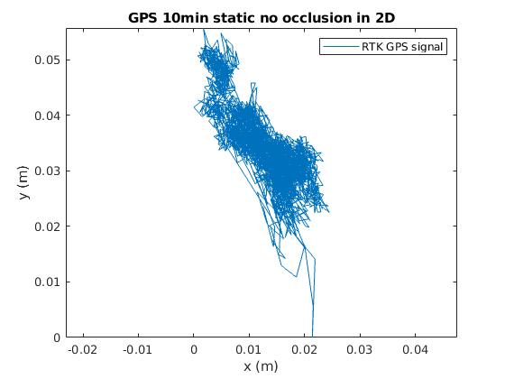
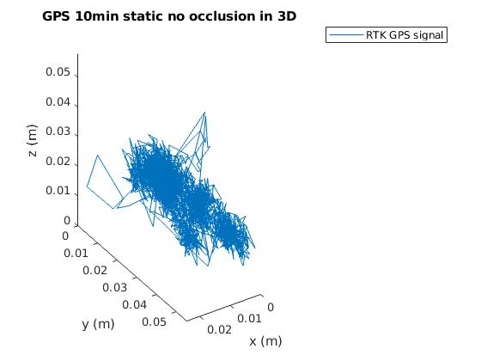
RTK GPS signal reached higher accuracy when there was no occlusion. The two GPSs communicate in real time on carrier circle to generate centimeter level accuracy.

Slide 4
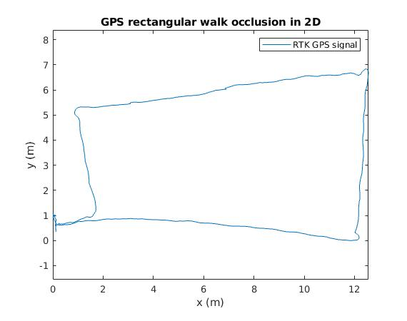
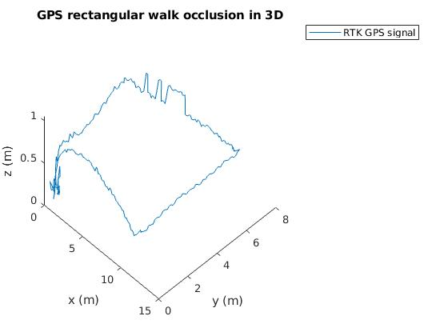
If GPSs are moving, the multi-thread will change according to the surrounding occlusion. So the accuracy will change according to the occlusion.

Slide 5
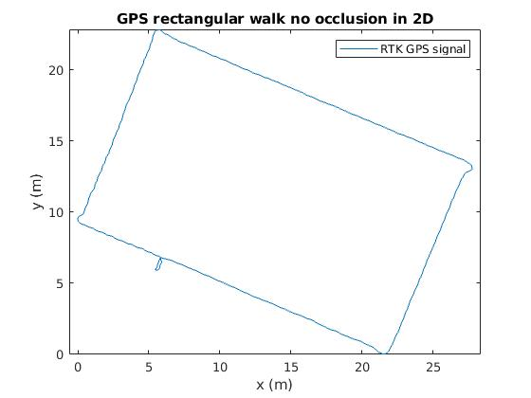
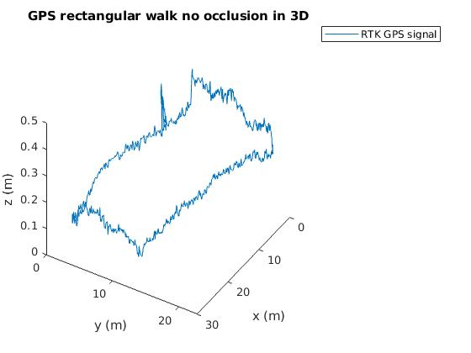
In the nearly idea environment (in a open basketball field), RTK GPS located in high accuracy that it can even capture the movement that we pick up the rover GPS (near (5, 6)) and the hight change during moving the rover GPS (small picks in Z axis).

