Slide 1
LAB3: IMU
Xupeng Zhu
001814074

Slide 2
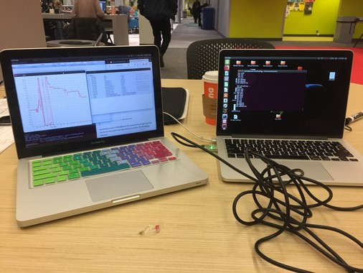
3. Run individual device drivers on separate machines

Slide 3
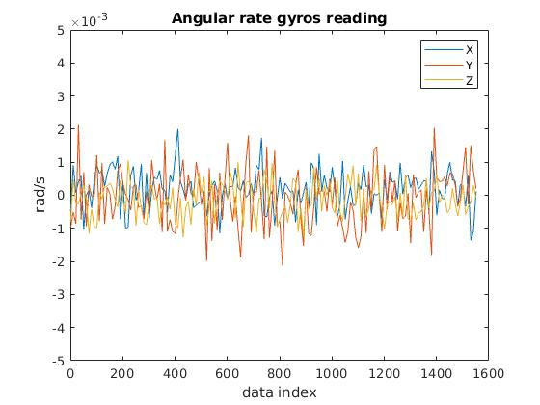
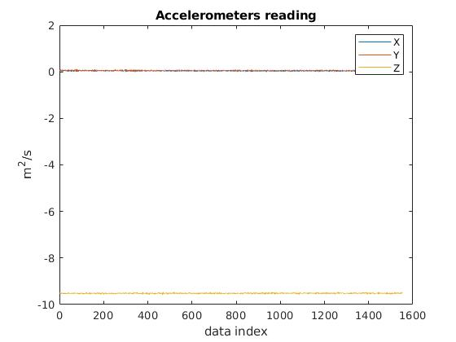
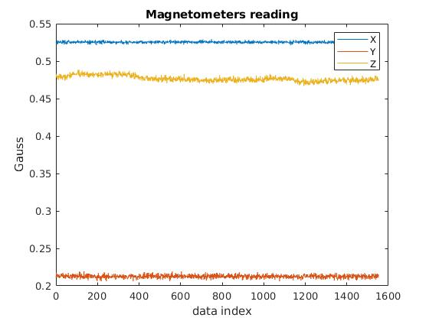
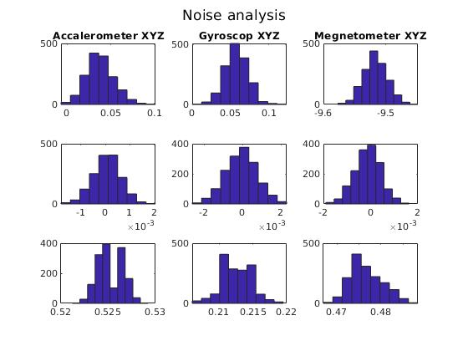
4. Collect data with IMU and GPS puck
The noise in static state of accelerometer, gyroscope, and magnetometer are similar to gauss distribution.

Slide 4
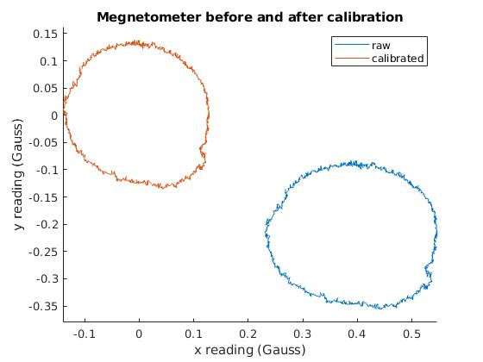
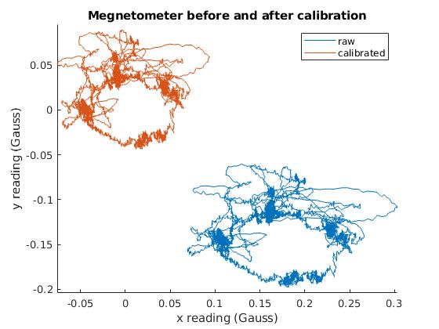
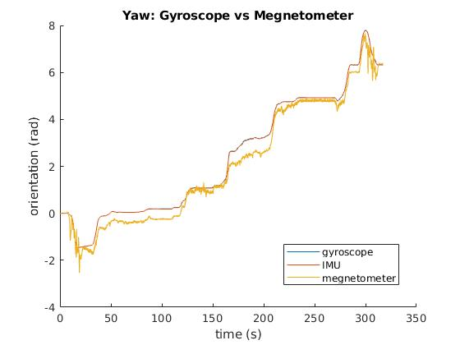
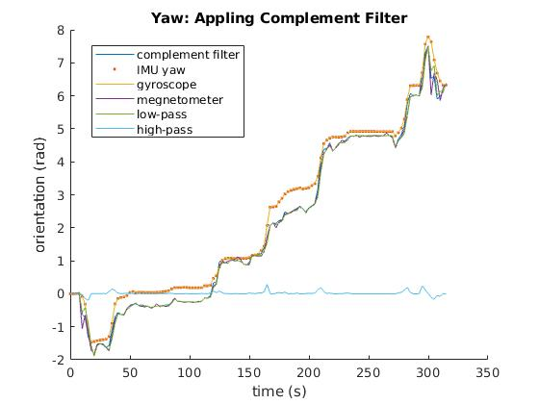
5. Estimate the heading (yaw)
The left figure shows magnetometer calibration for the 360 turn. The algorithm calibrated the readings by offset (hard iron) and ellipsoid distortion (soft iron). For the course, there are too many noise, the algorithm only calibrated hard iron, and we use the data in 360 turn to calibrate soft iron.
Integration of yaw rate sensor has similar plot as magnetometer readings, except there are some drift.
Applying complementary filter, both the yaw acceleration is captured and non-drift is achieved.

Slide 5
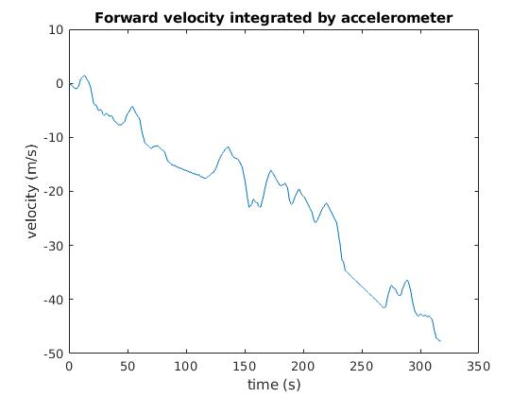
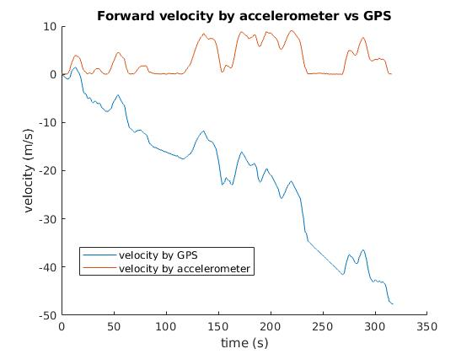
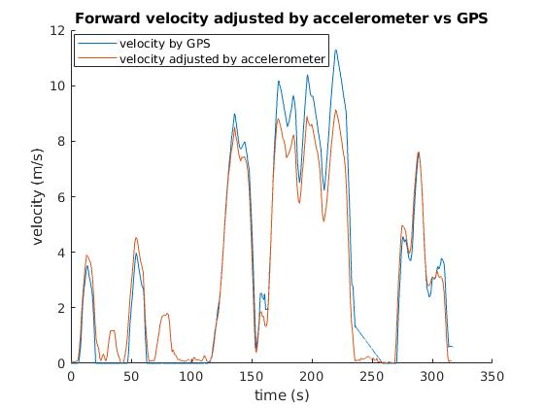
6. Estimate the forward velocity
The forward velocity is estimated by integration of acceleration-X.
In the left figure, the velocity obtained by accelerometer has the identical peaks and spikes as that of GPS. However, the accelerometer has a constant error, which lead to the drift in the integration.
The drift induced by accelerometer is compensated by adding a linear term, i.e., a*t. Were a is a constant that makes the area under GPS velocity the same as that of accelerometer velocity after compensation. Moreover, the negative velocity is set to zero, since the car do not drive backward during the course.

Slide 6
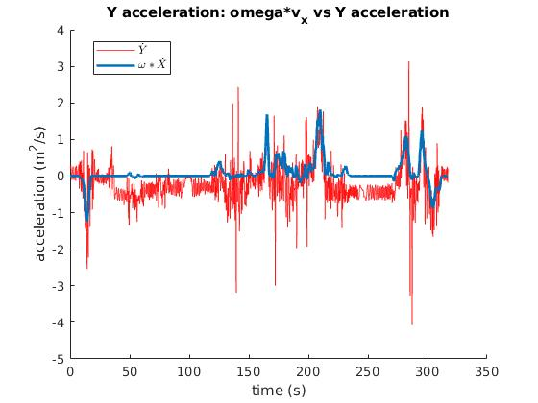
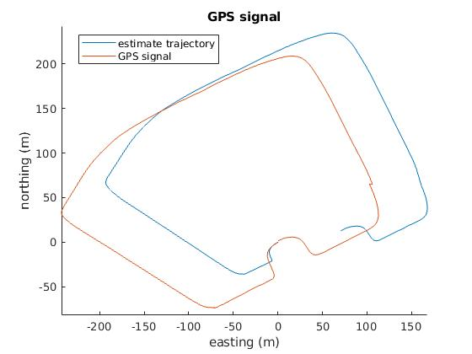
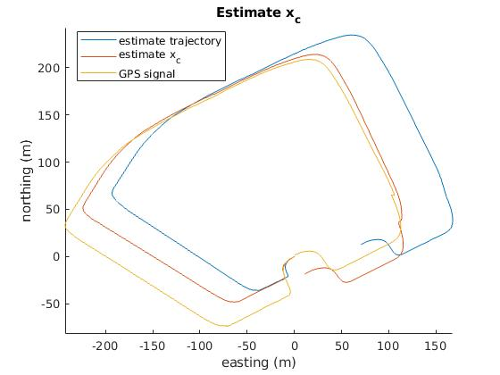
7. Integrate IMU data to obtain displacement and compare with GPS.
By computing ωX, it has some spikes similar to y obs. In general, ωX reflects the changing of y_obs. However, y_obs is more and should be more sensitive, and it contains more noise. At the same time the ωX is more stable.
The trajectory integrated by accelerometer has the identical shape of that of GPS. Nevertheless, there are some drift due to round error of the integration of accelerometer, as well as the x_c is ignored. Here a scale factor 0.85 for x,y is used.
By adding x_c term as 0.2m, the trajactory with consider of x_c is closer to the GPS ones. So x_c is estimated as 0.2m.

