Slide 1
LAB4: Camera Calibration and Mosaingsing
Xupeng Zhu
001814074

Slide 2
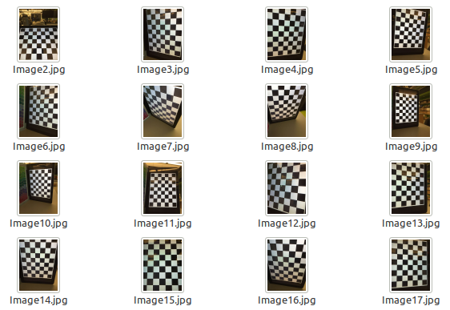
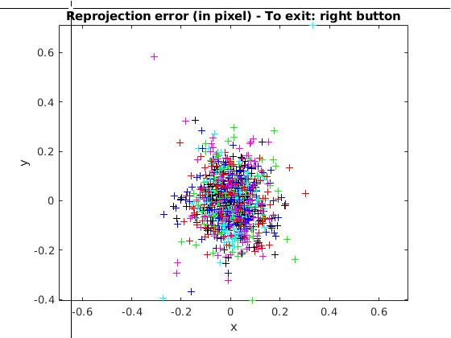
1. Camera Calibration. Take a look at the Caltech Camera Calibration toolbox
dx = dy = 0.0247m
image size = 640x480
image number = 20
Pixel error (mean projection error):
err = [0.11776 0.08828] (all active images)
The plots of projection error shows the error near to Gaussian distribution.

Slide 3
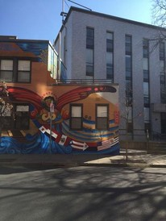
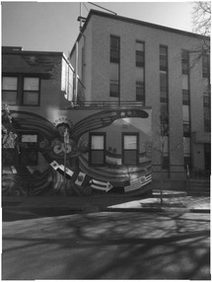
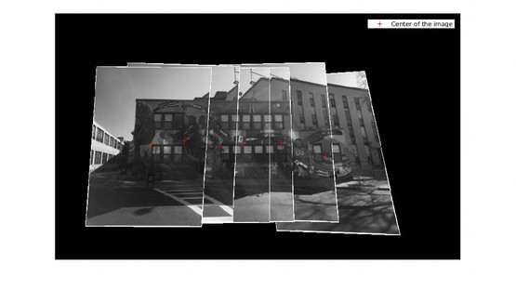
3. Compensate these images.
After calibration, the image is undistorted so there are some white edges in the edge of the image. Notice that the edges of buildings become straight line.
Before calibration
After calibration
6. Estimate the position
centers =
6×3 single matrix
0 0 1.0000
-134.9178 -40.9306 1.0000
-255.9880 -35.6671 1.0000
-323.2529 -31.4321 1.0000
-434.6336 -47.1572 1.0000
-535.3657 -36.5126 1.0000
The positions of the camera are estimated by transform matrix.

Slide 4
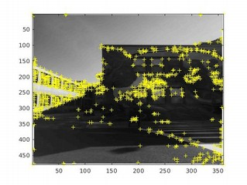
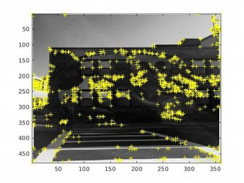
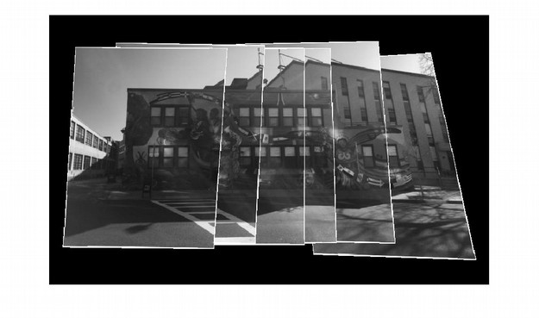
7. Finally blend the images into a composite mosaic
Harris feature detector is used during panoramic mosaic feature macing.
The calibrated images are mosaicked The object, i.e., the wall is concatenated smoothly but the front view and background are severely distorted.

Slide 5
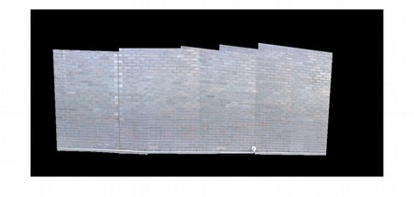
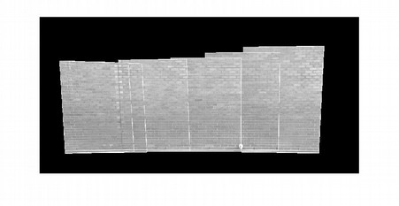
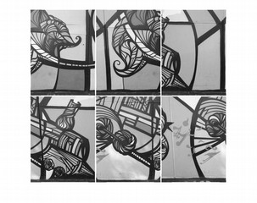
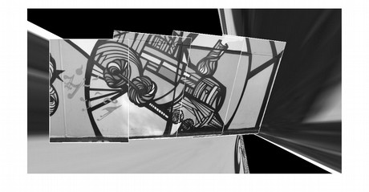
8. Mosaicing in cinder block wall
Mosaicing with raw images
Mosaicing with calibrated images
These images are mosaicked persuasively but not perfectly. For the raw images there are some distortion. For both mosaicing, due to a luck of sufficient features, some of the images are not mach.
9. Mosaicing in graffiti art with 15% overlap
Raw images
Mosaicing
Again, mosaicing failed due to a luck of features. These images have only 15% overlap, similar features are few and tends to mis-estimating the transform matrix.

