Slide 1
Investigating Trends in Neglected Tropical Disease (NTD) Clinical Studies
Group 16 - Lancaster University
WHO ICTRP Data 1999-2023

Slide 2
Project Overview
Source: WHO ICTRP
Period: 1999-2023 (25 years)
Trials: 311 valid trials
Countries: 62
Diseases: Chagas, Schistosomiasis, Endemic worms, Visceral leishmaniasis

Slide 3
Research Questions
RQ 2.2.1: What factors affect results publication?
RQ 2.2.2: Can network analysis reveal country partnerships?
RQ 2.2.3: What proportion funded by pharma companies?
RQ 2.2.4: Are children and pregnant women included?
RQ 2.2.5: Which drugs studied for Chagas disease?

Slide 4
RQ 2.2.1: Publication Factors
FINDING: Severe Publication Gap
Publication rate: 4.2% (13/311)
Unpublished: 95.8% (298/311)
Method: Logistic Regression
Features: phase, study type, sponsor, income level
Implication: Severe publication bias

Slide 5
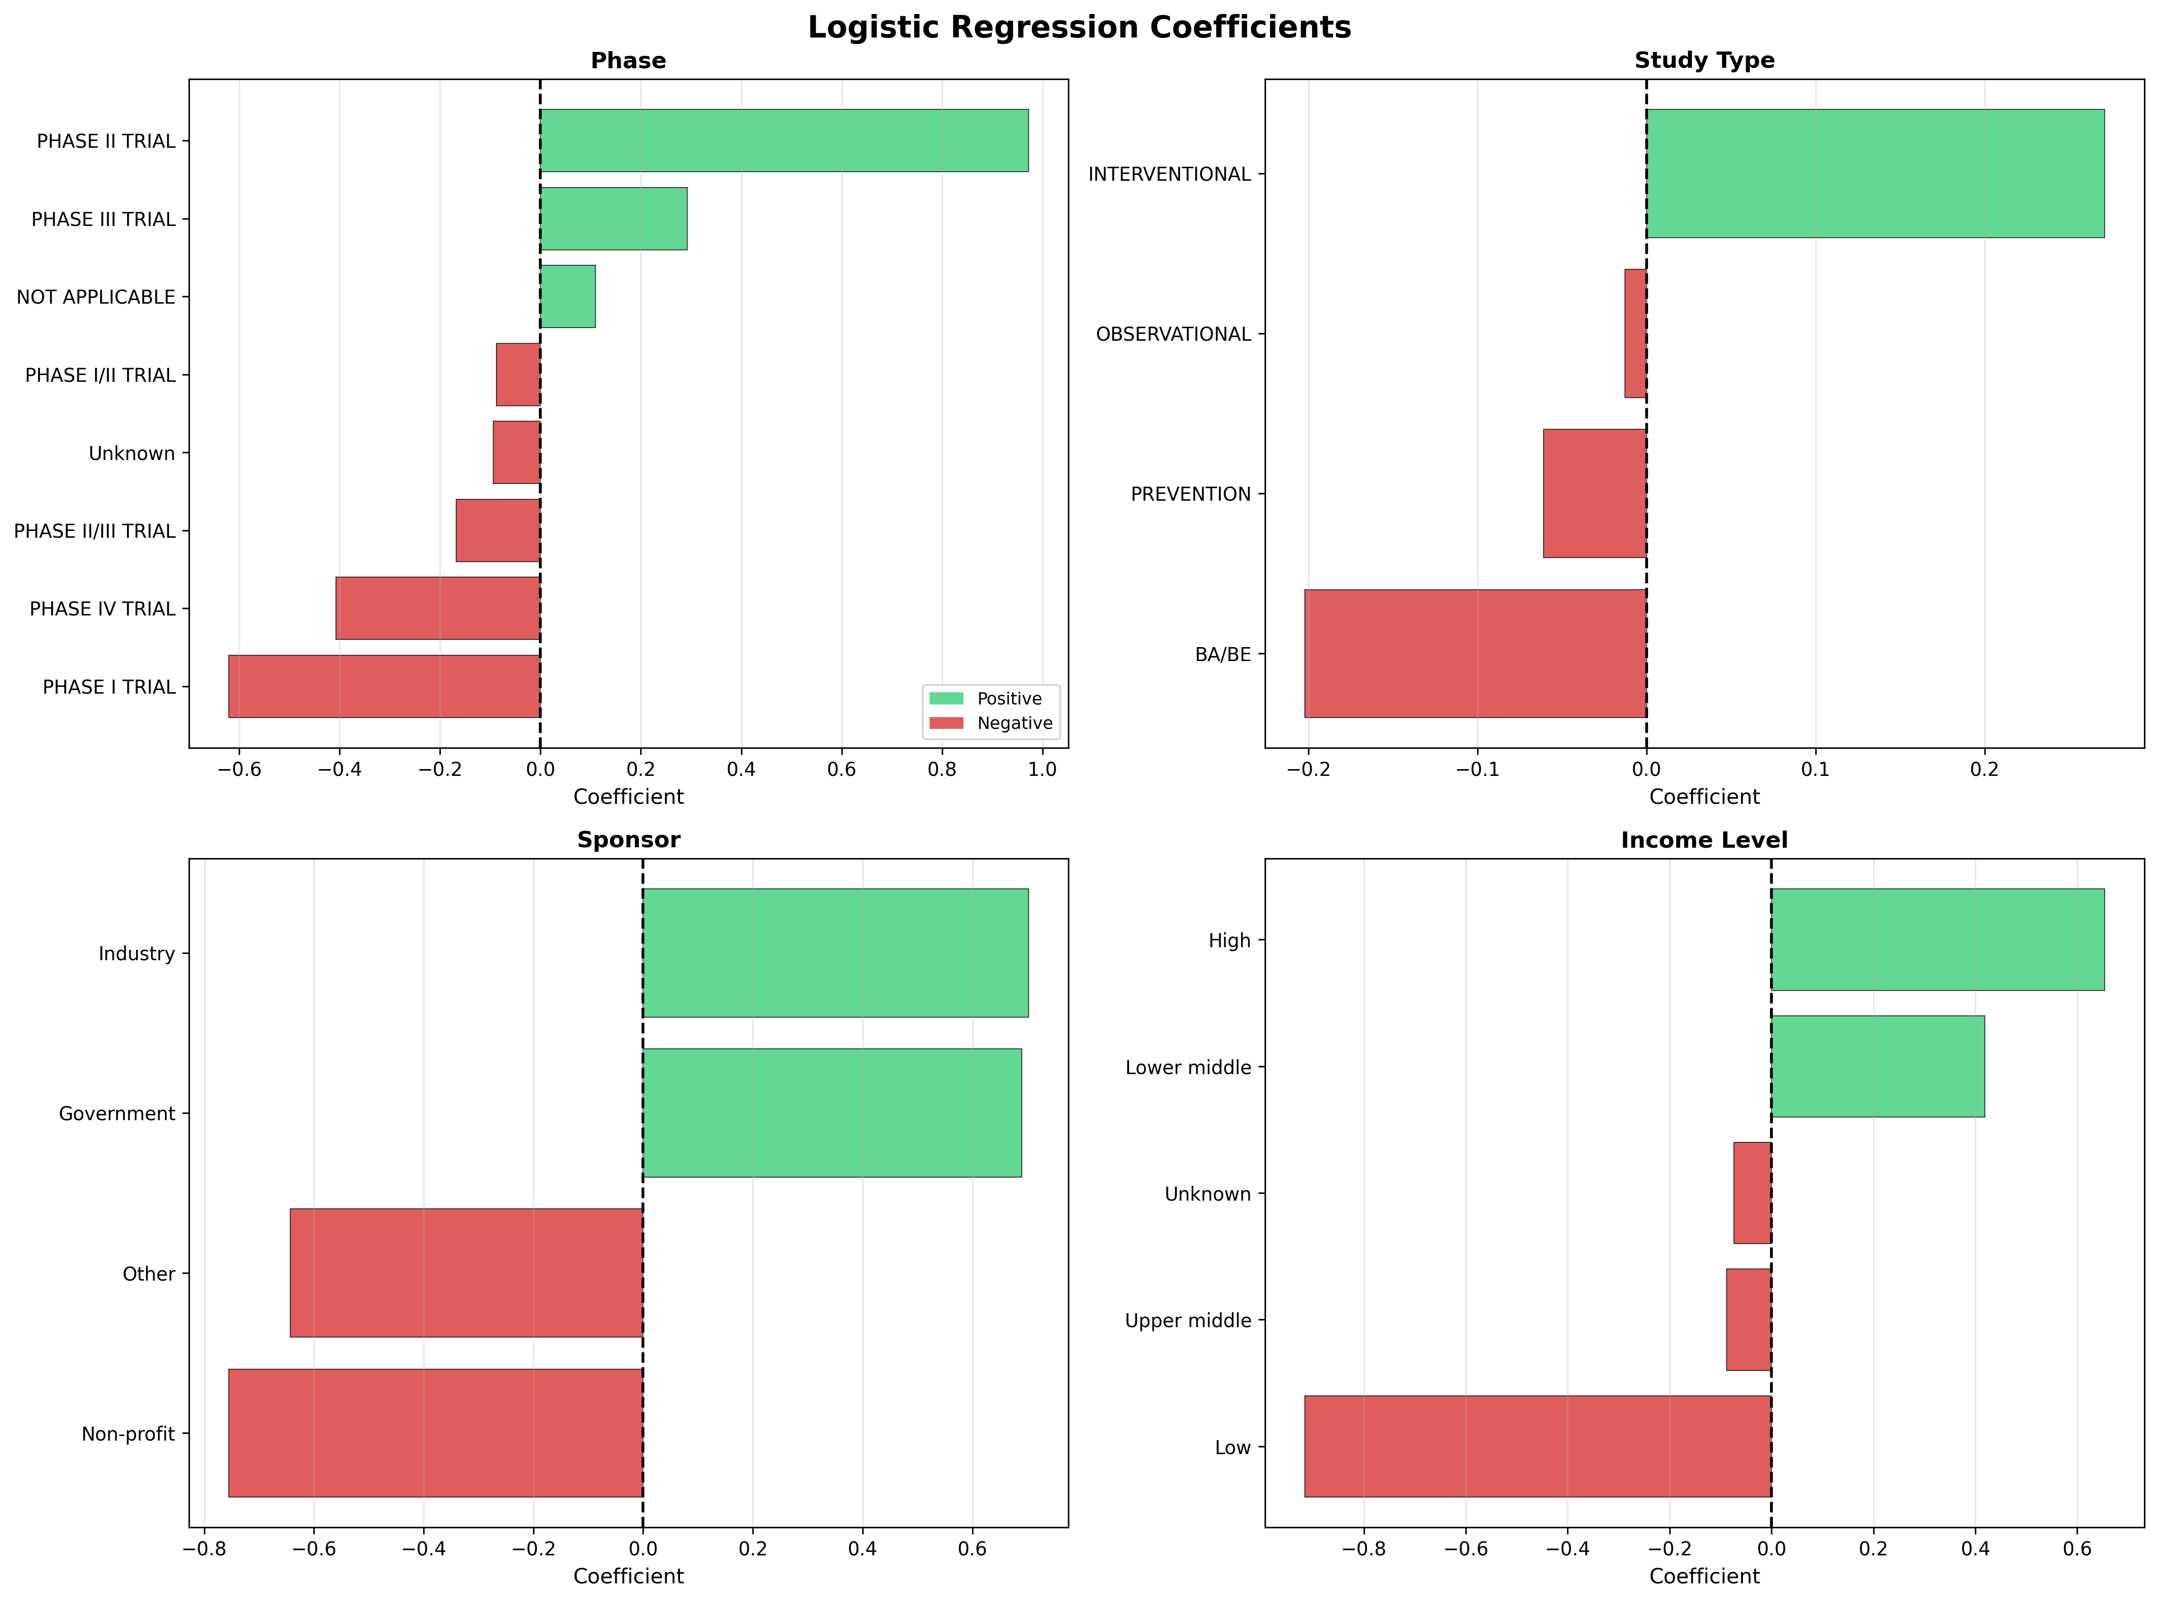
RQ 2.2.1: Publication Predictors
Factors increasing (+) and decreasing (-) publication likelihood

Slide 6
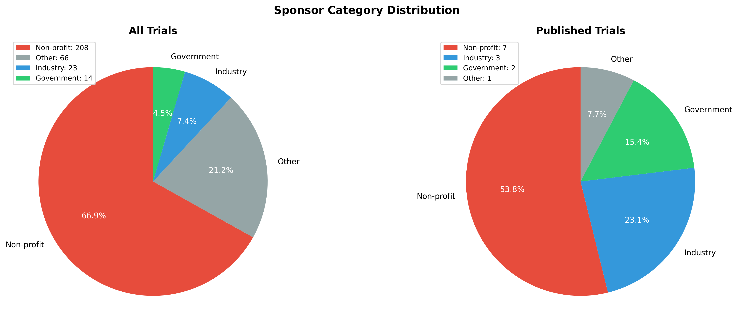
RQ 2.2.3: Pharmaceutical Funding
Non-profit: 66.9% | Industry: 7.4% | Government: 4.5%

Slide 7
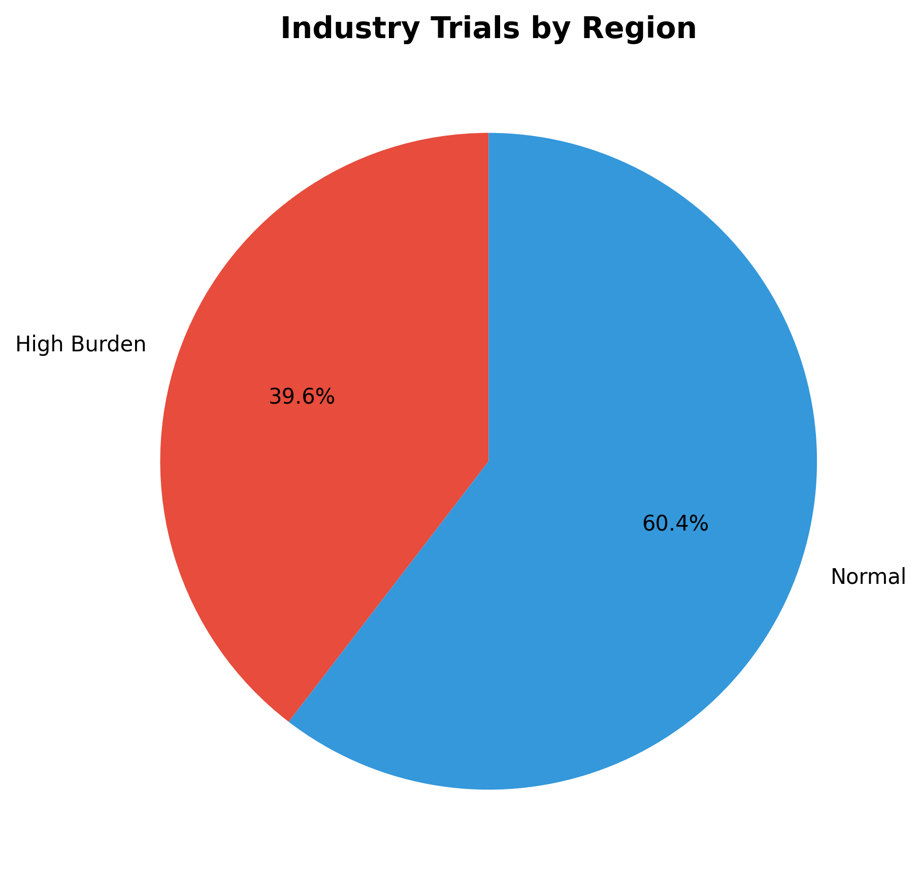
RQ 2.2.3: Industry vs Disease Burden
60% of industry trials NOT in high-burden regions

Slide 8
RQ 2.2.2: Country Collaborations
FINDING: Strong International Partnerships
Multi-country trials: 43
Countries in network: 43
Collaborative connections: 163
Top Hub Countries:
1. Argentina (22 partners, Centrality: 0.294)
2. Cambodia (18 partners, Centrality: 0.275)
3. Brazil (18 partners, Centrality: 0.159)

Slide 9
RQ 2.2.4: Special Populations
FINDING: Limited Inclusion
Children:
• No explicit tracking field
• Estimated ~50% may include children
Pregnant Women:
• Explicitly included: 12 trials (3.8%)
• Excluded/unclear: 96.2%
Implication: Vulnerable populations underrepresented

Slide 10
RQ 2.2.5: Drug Trends (Chagas)
FINDING: Benznidazole Dominates
Total Chagas trials: 88
Method: Regex extraction
Top 5 Drugs:
1. Benznidazole - 21 trials
2. Placebo - 10 trials
3. E1224 - 6 trials
4. Nifurtimox - 5 trials
Implication: Limited drug diversity

Slide 11
How Results Address Research Goals
Goal: Clarify evolution of NTD trial activities
✓ Temporal Trends: 25-year coverage
✓ Geographic Distribution: 62 countries analyzed
✓ Funding Structure: Non-profit 67%, Pharma 7%
✓ Publication Patterns: 4.2% gap identified
✓ Collaboration: Network analysis reveals hubs

Slide 12
Key Discoveries
3 Critical Findings:
1. PUBLICATION CRISIS
→ 95.8% unpublished
2. FUNDING GAP
→ Pharma 7.4%, Non-profits 67%
3. REPRESENTATION GAP
→ Pregnant women 3.8%, Children unclear

Slide 13
Data Limitations
Challenges:
• Severe publication bias (only 13 published)
• Data completeness (4 outliers, missing values)
• Classification accuracy (keyword-based)
• Temporal imbalance (varies by year)

Slide 14
Methodological Limitations
Analytical Challenges:
1. Logistic Regression:
• Small sample (n=13)
• Class imbalance (4% vs 96%)
2. Network Analysis:
• Country-level only
3. Drug Extraction:
• Regex-based, may miss variations
Mitigation: Stratified sampling, transparent docs

Slide 15
Recommendations
Data Collection:
• Standardize special population fields
• Mandate result publication
Methodological:
• Handle class imbalance (SMOTE)
• Try ensemble methods
Policy:
• Mandate publication (address 96% gap)
• Incentivize pharma investment
• Target high-burden regions

Slide 16
Strengths of Our Analysis
✓ Comprehensive Cleaning
Robust outlier detection, automated classification
✓ Multi-Method Approach
Statistics + ML + Network + Text Mining
✓ Reproducible Pipeline
5 modular scripts, complete documentation
✓ Transparent & Practical
All limitations acknowledged, actionable insights

Slide 17
Key Takeaways
NTD research needs structural reform:
• Better publication incentives
• Increased pharma engagement
• Improved data standards
• Inclusive trial design
Our Contribution:
• Evidence for policy makers
• Guidance for funders
• Roadmap for researchers
311 trials → 5 questions → 3 critical gaps

Slide 18
Thank You
Questions?
Group 16 - Lancaster University
Peizhe Jiang • Congyao Ren • Zixu Wang • Alaghwani Balsam

