Slide 1
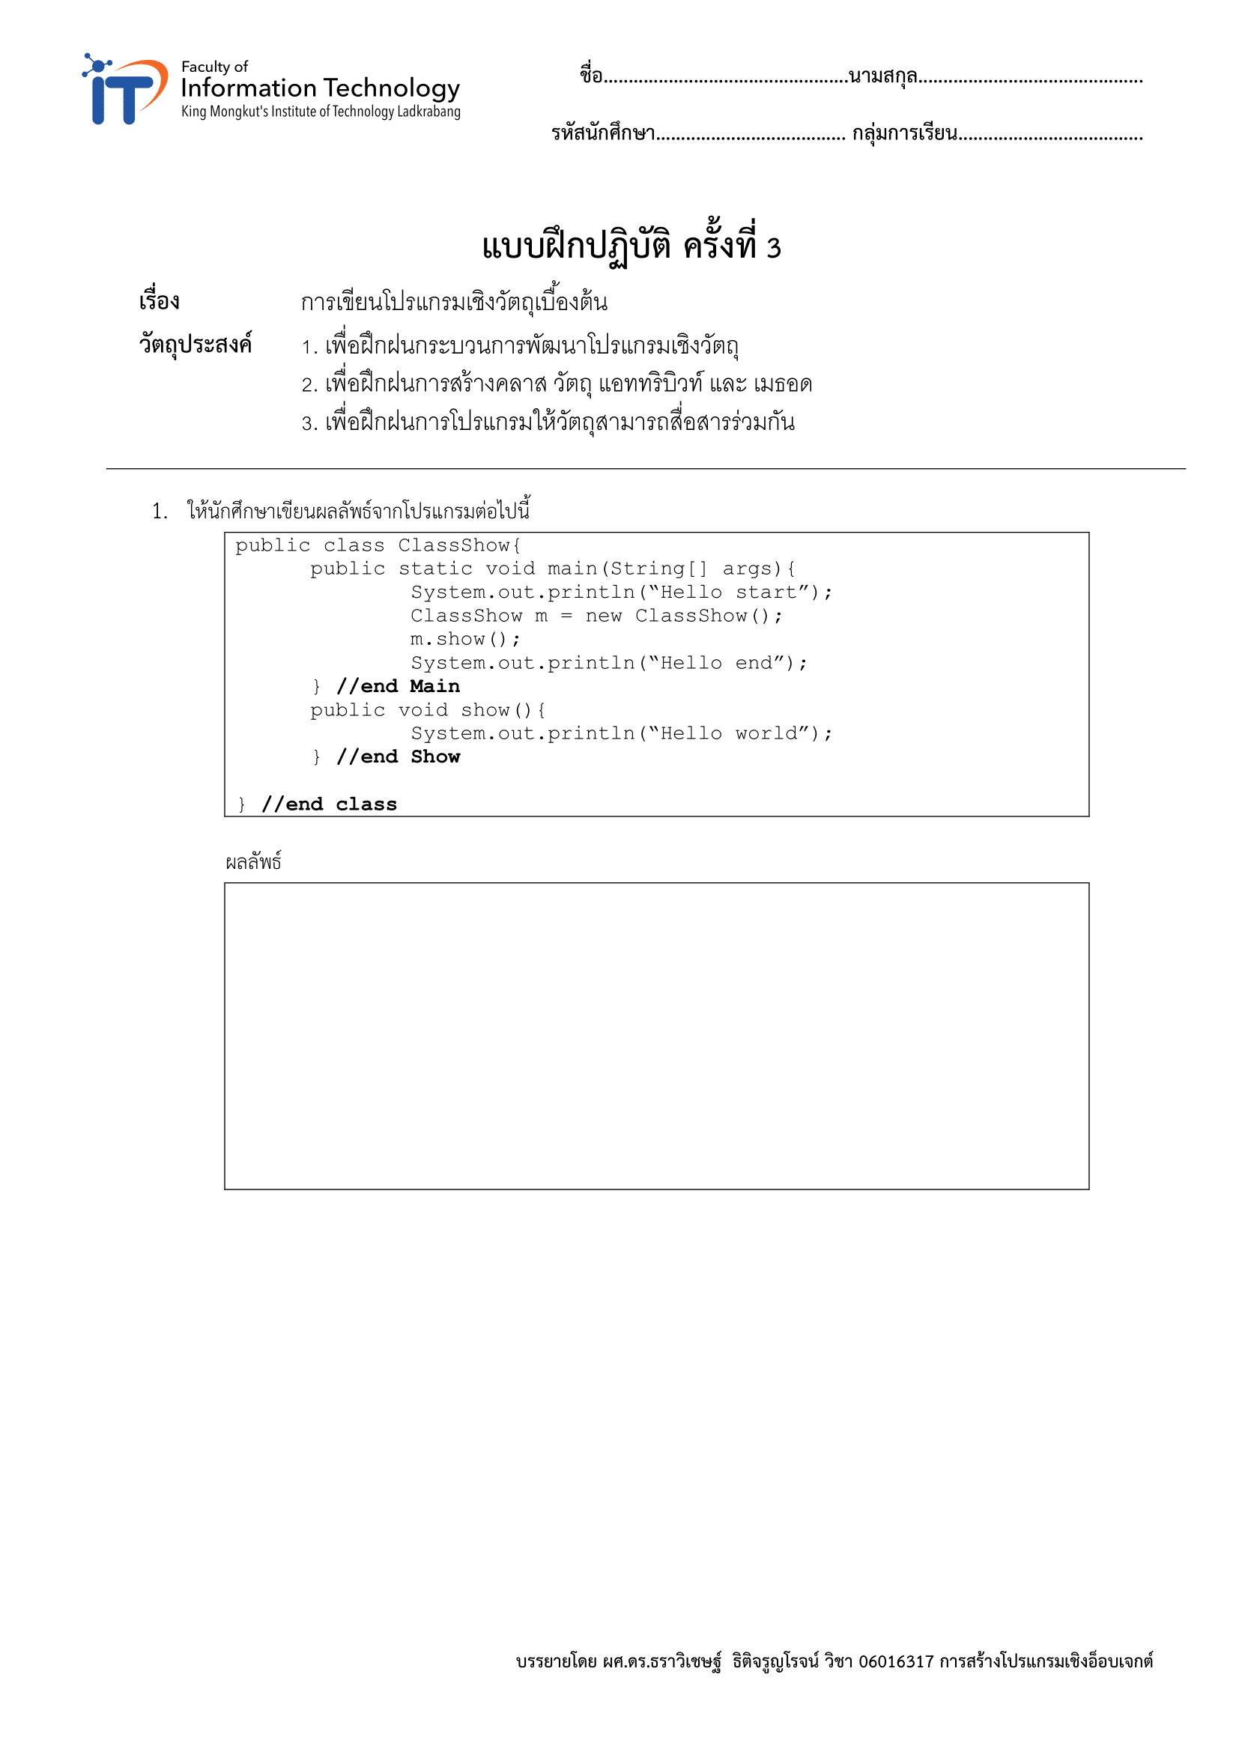
ปัณณทัต
สมอโพรง
64070182
1
Hello start
Hello world
Hello end

Slide 2
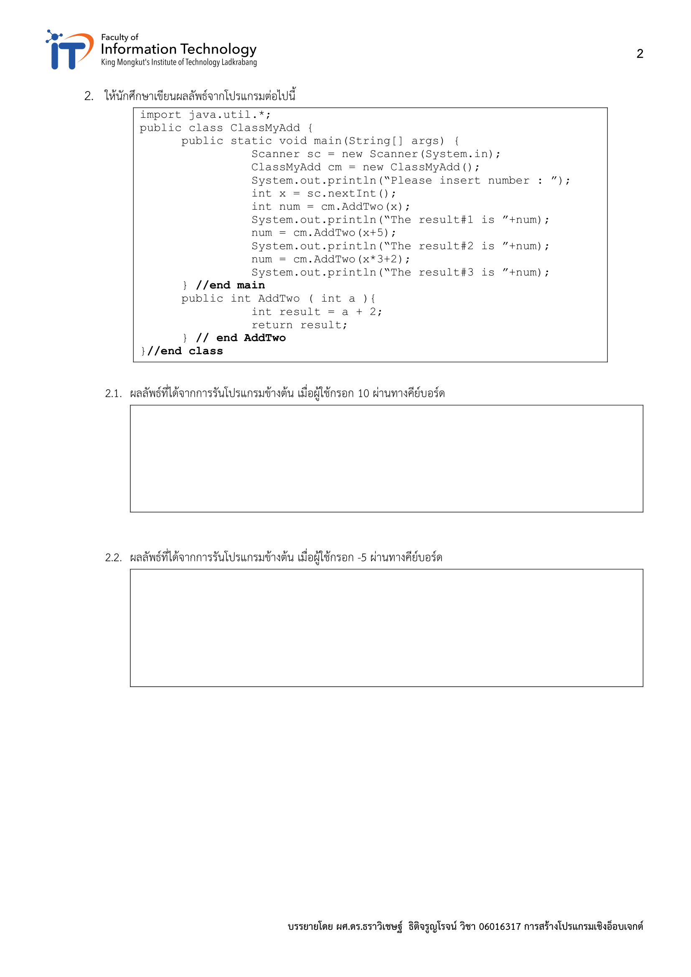
The result#1 is 12
The result#2 is 17
The result#3 is 34
The result#1 is -3
The result#2 is 2
The result#3 is -11

Slide 3
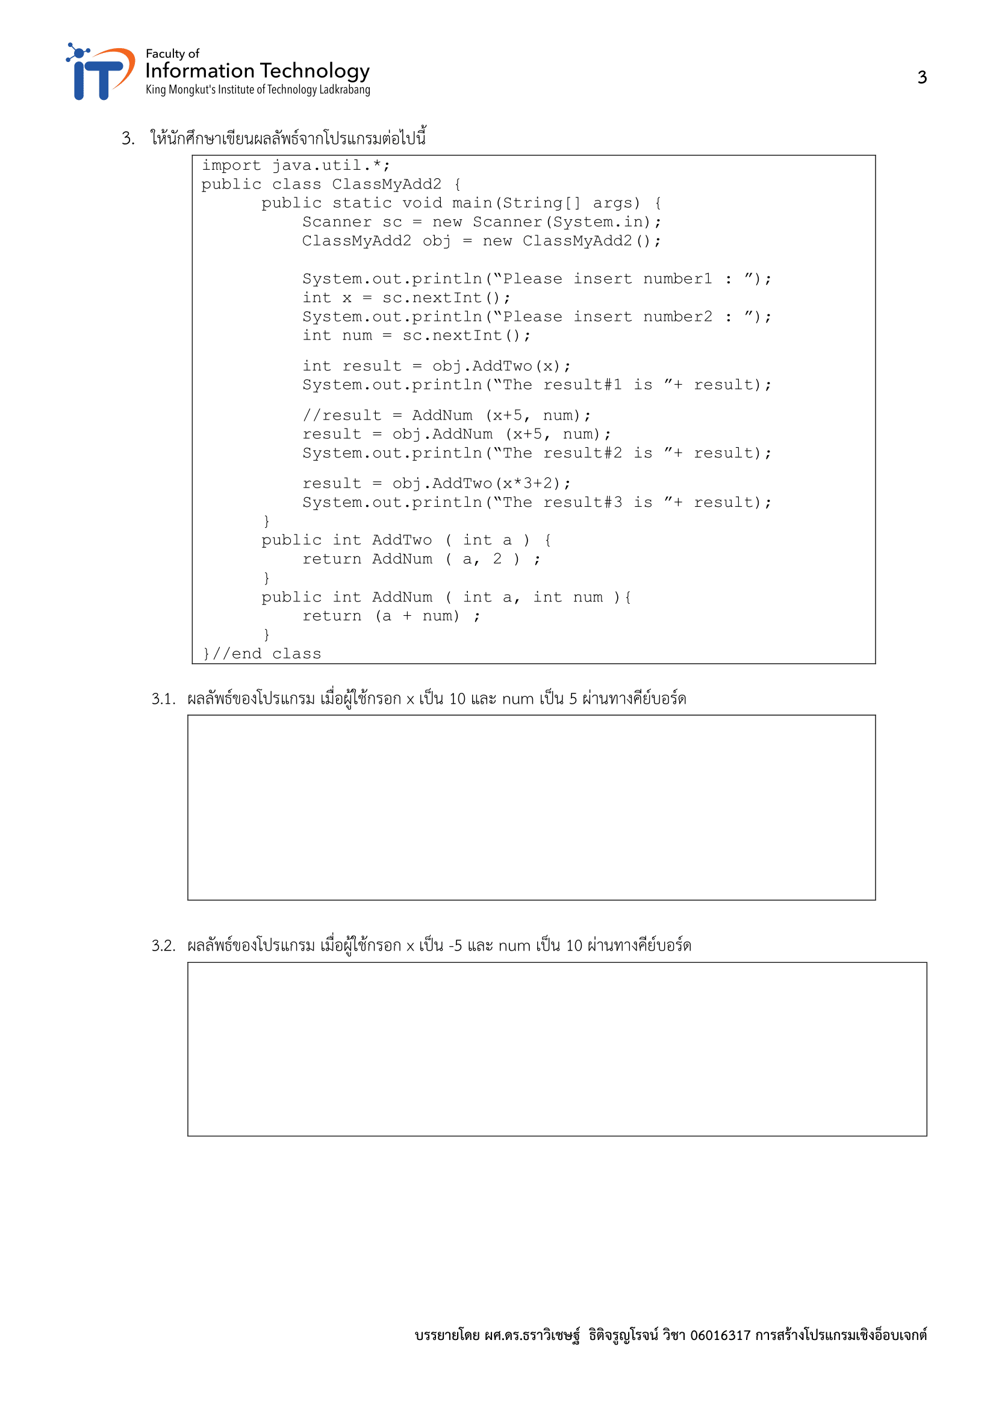
The result#1 is 12
The result#2 is 20
The result#3 is 34
The result#1 is -3
The result#2 is 10
The result#3 is -11

Slide 4
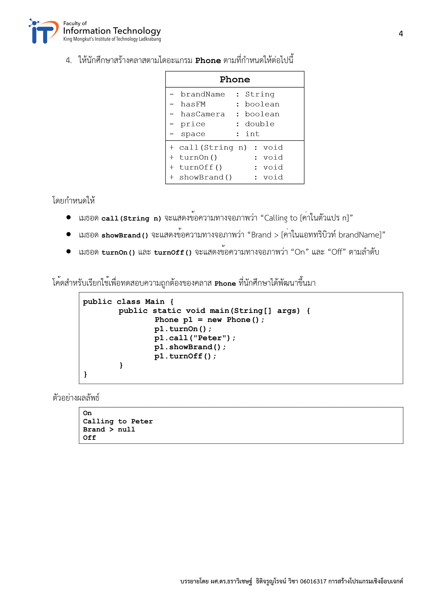

Slide 5
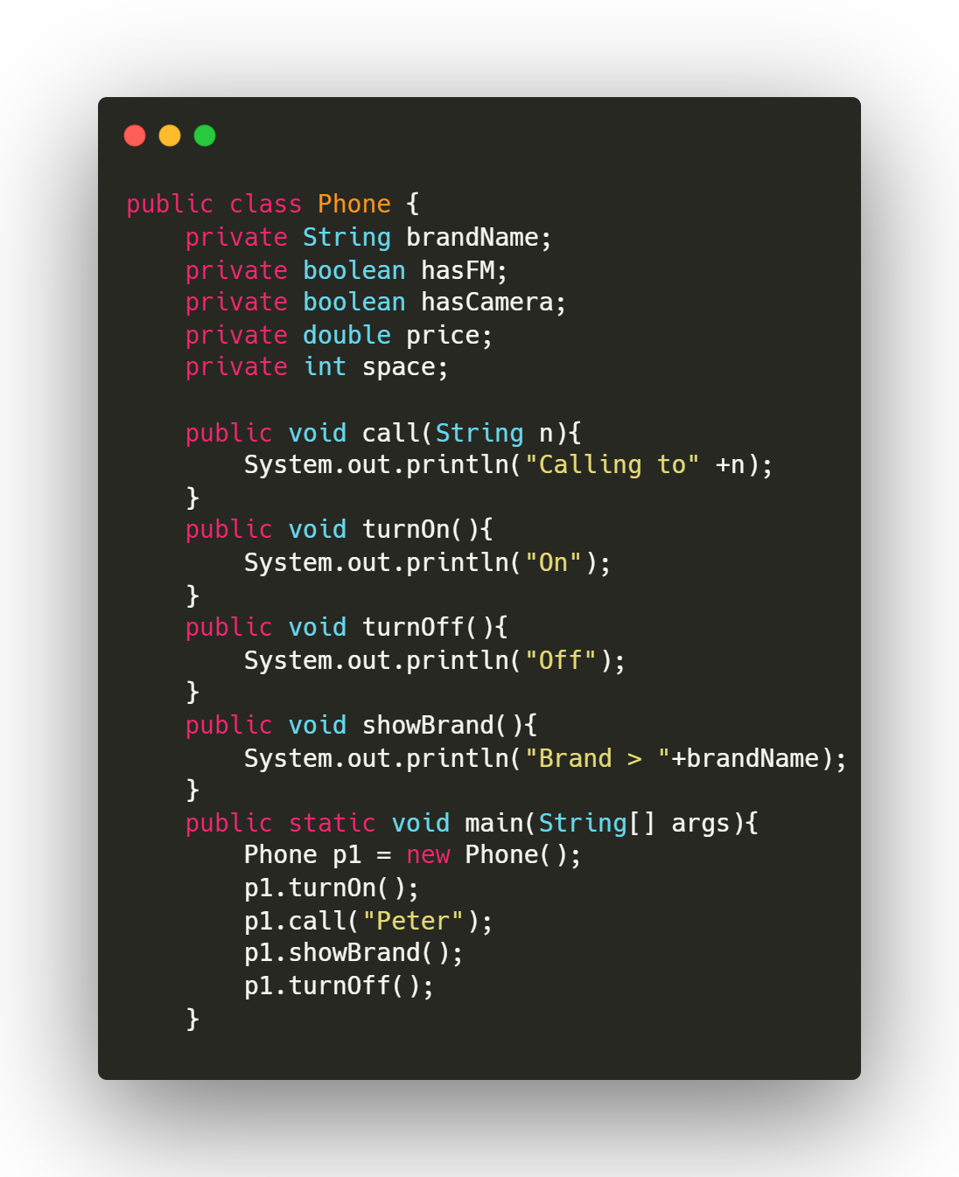

Slide 6
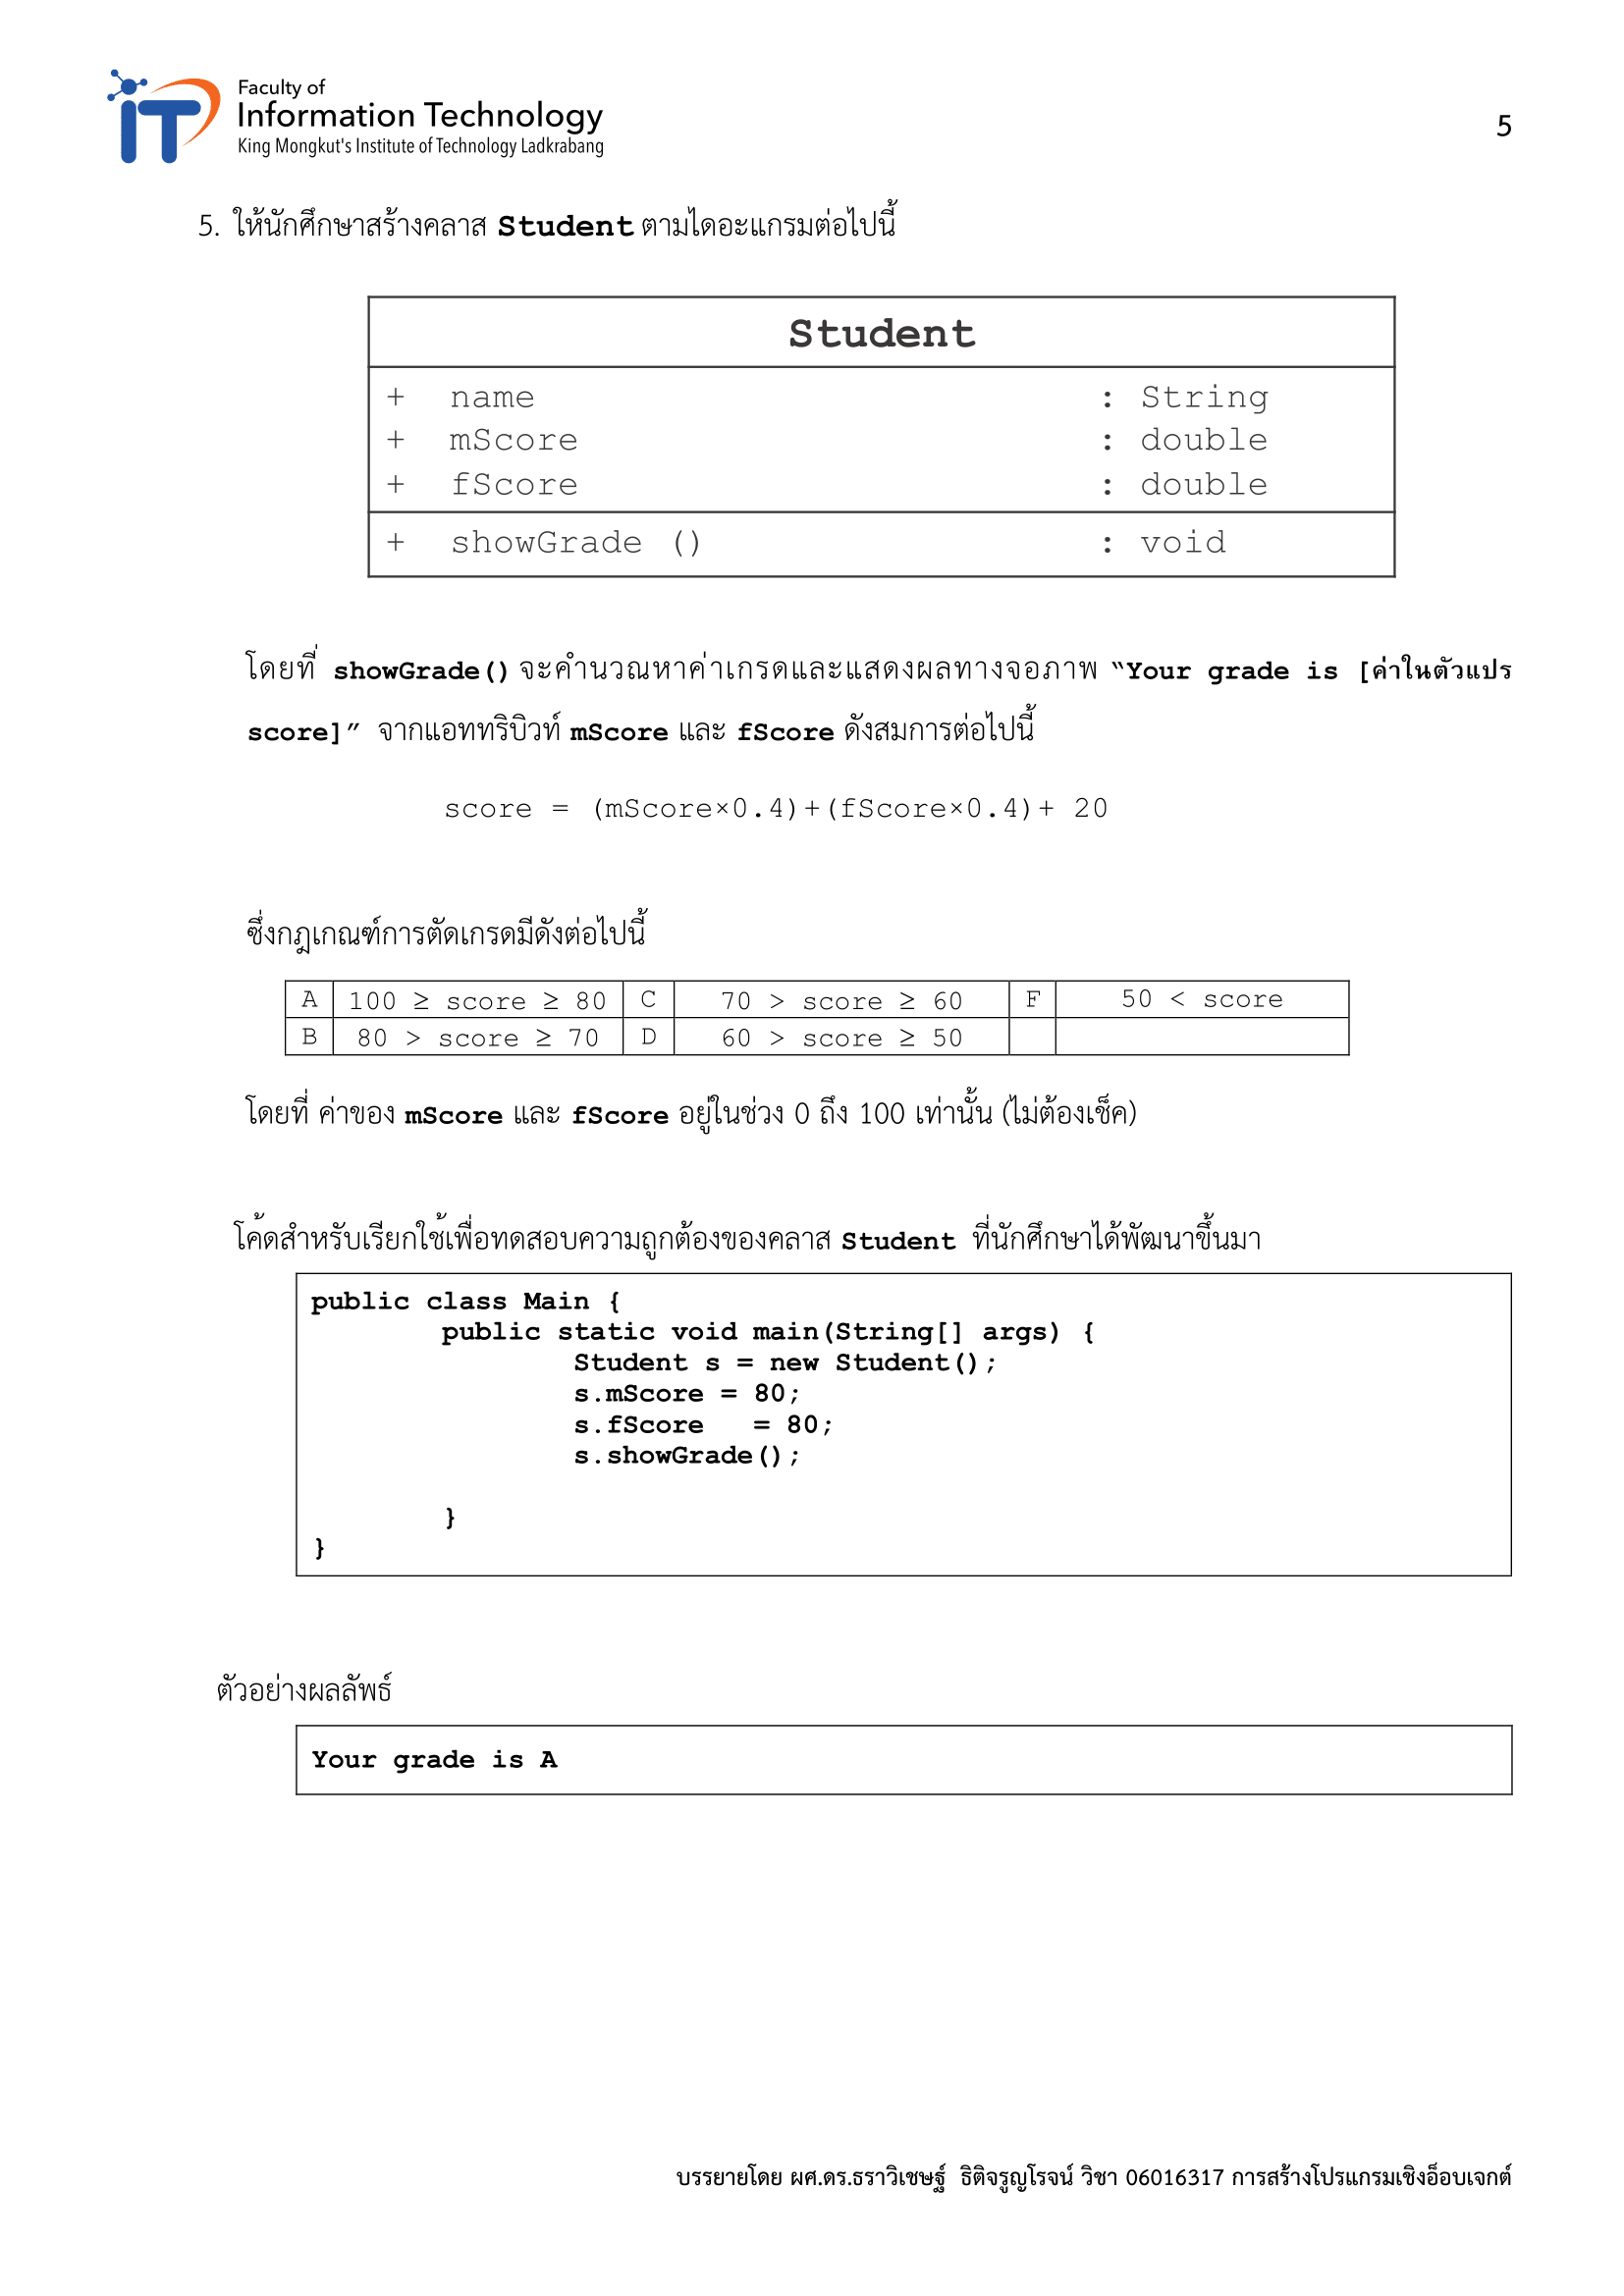

Slide 7
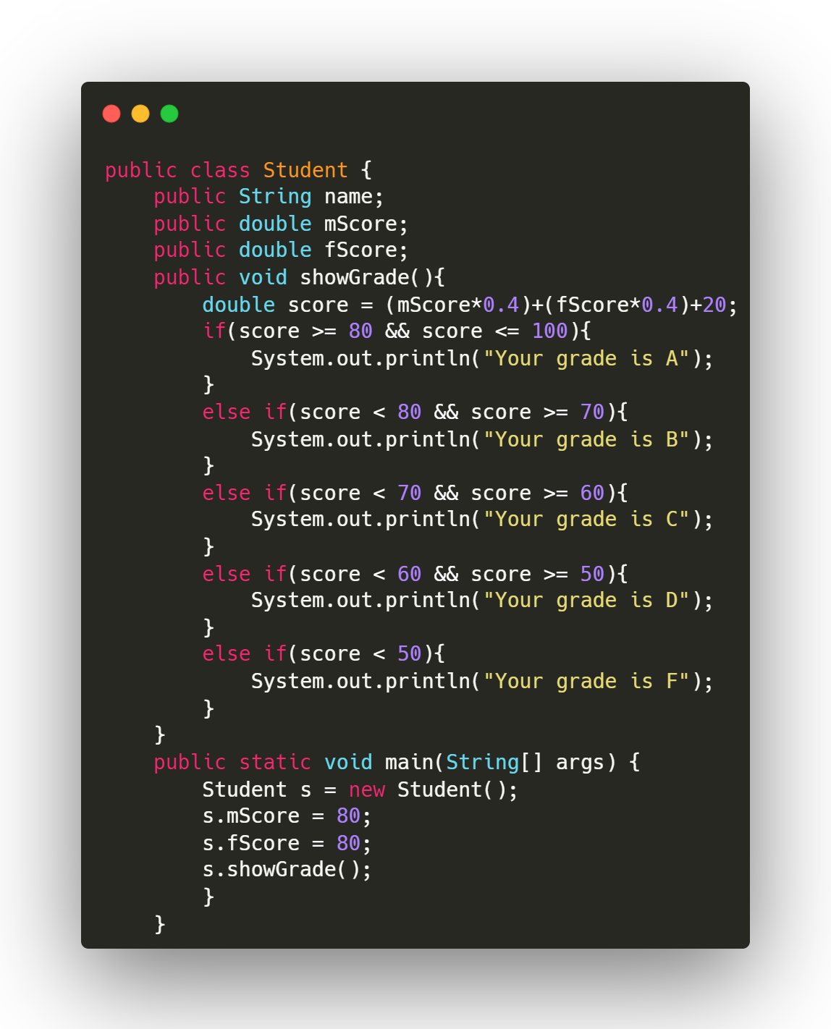

Slide 8
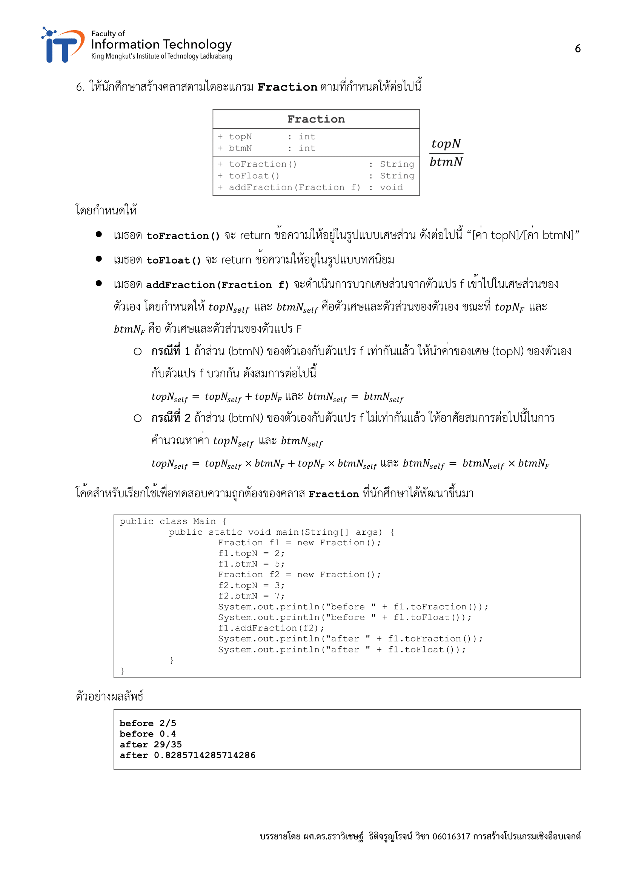

Slide 9
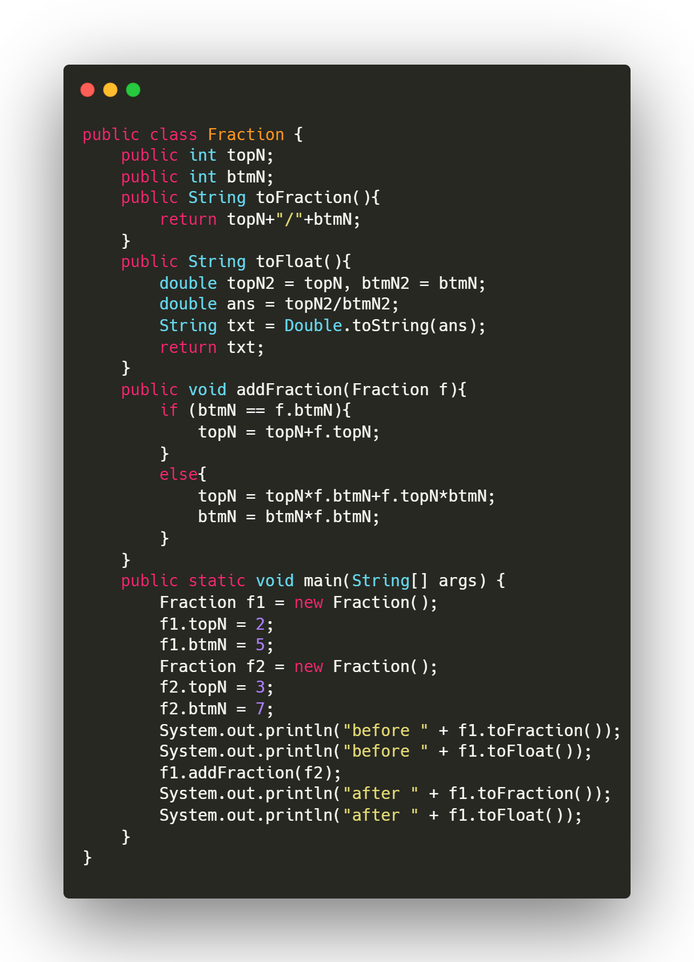

Slide 10
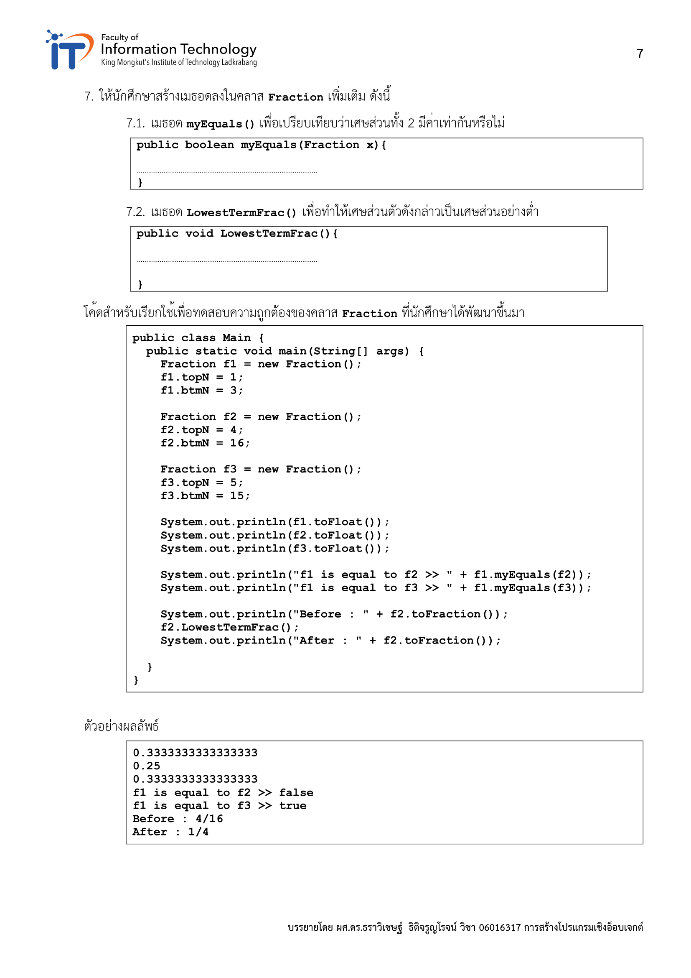
return (topN == x.topN/x.topN && btmN == x.btmN/x.topN);
if (btmN % topN == 0){
btmN /= topN;
topN /= topN;
}

Slide 11
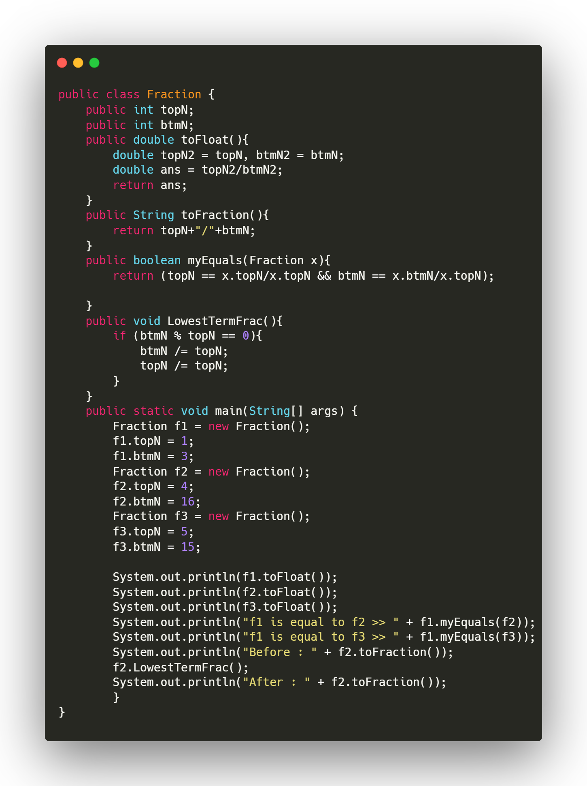

Slide 12
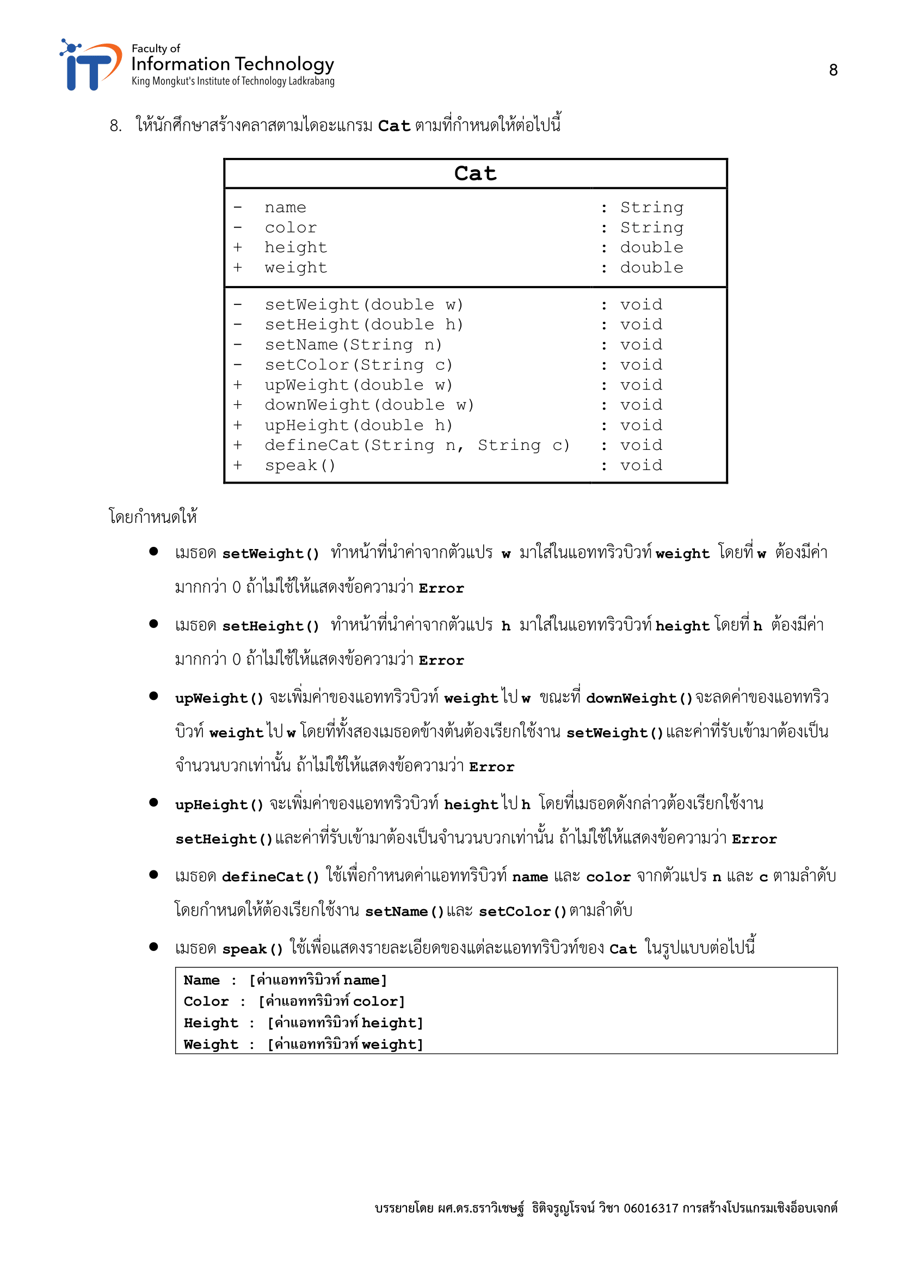

Slide 13
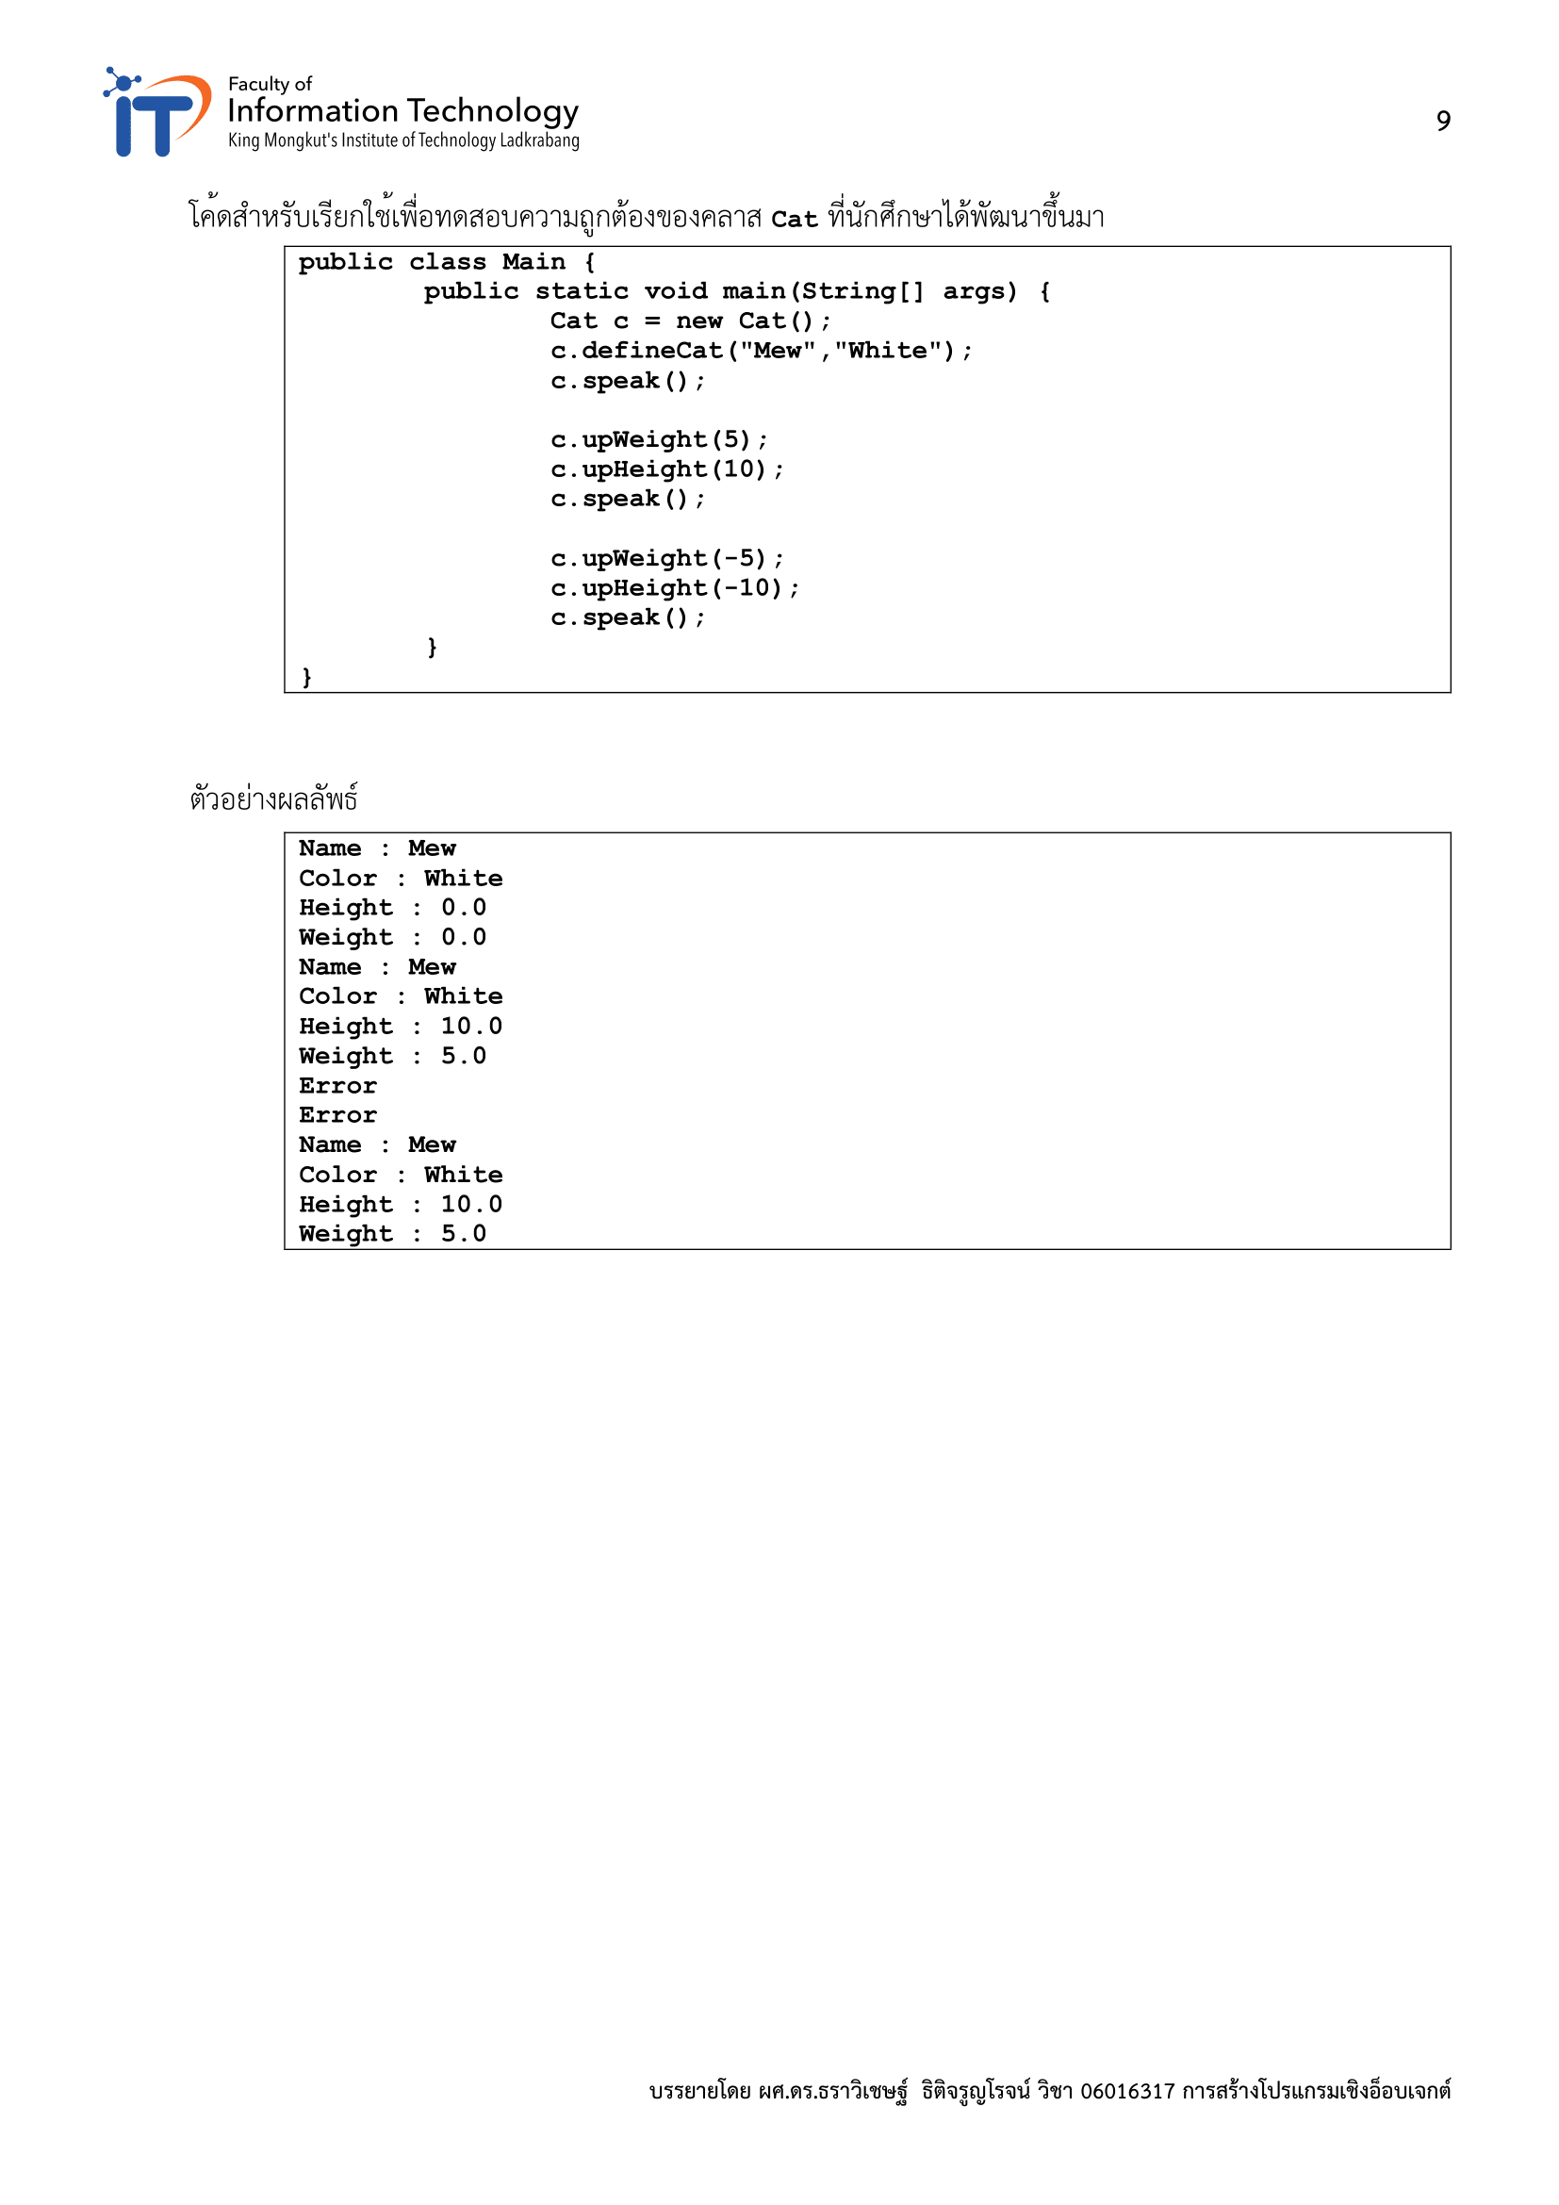

Slide 14
