Slide 1
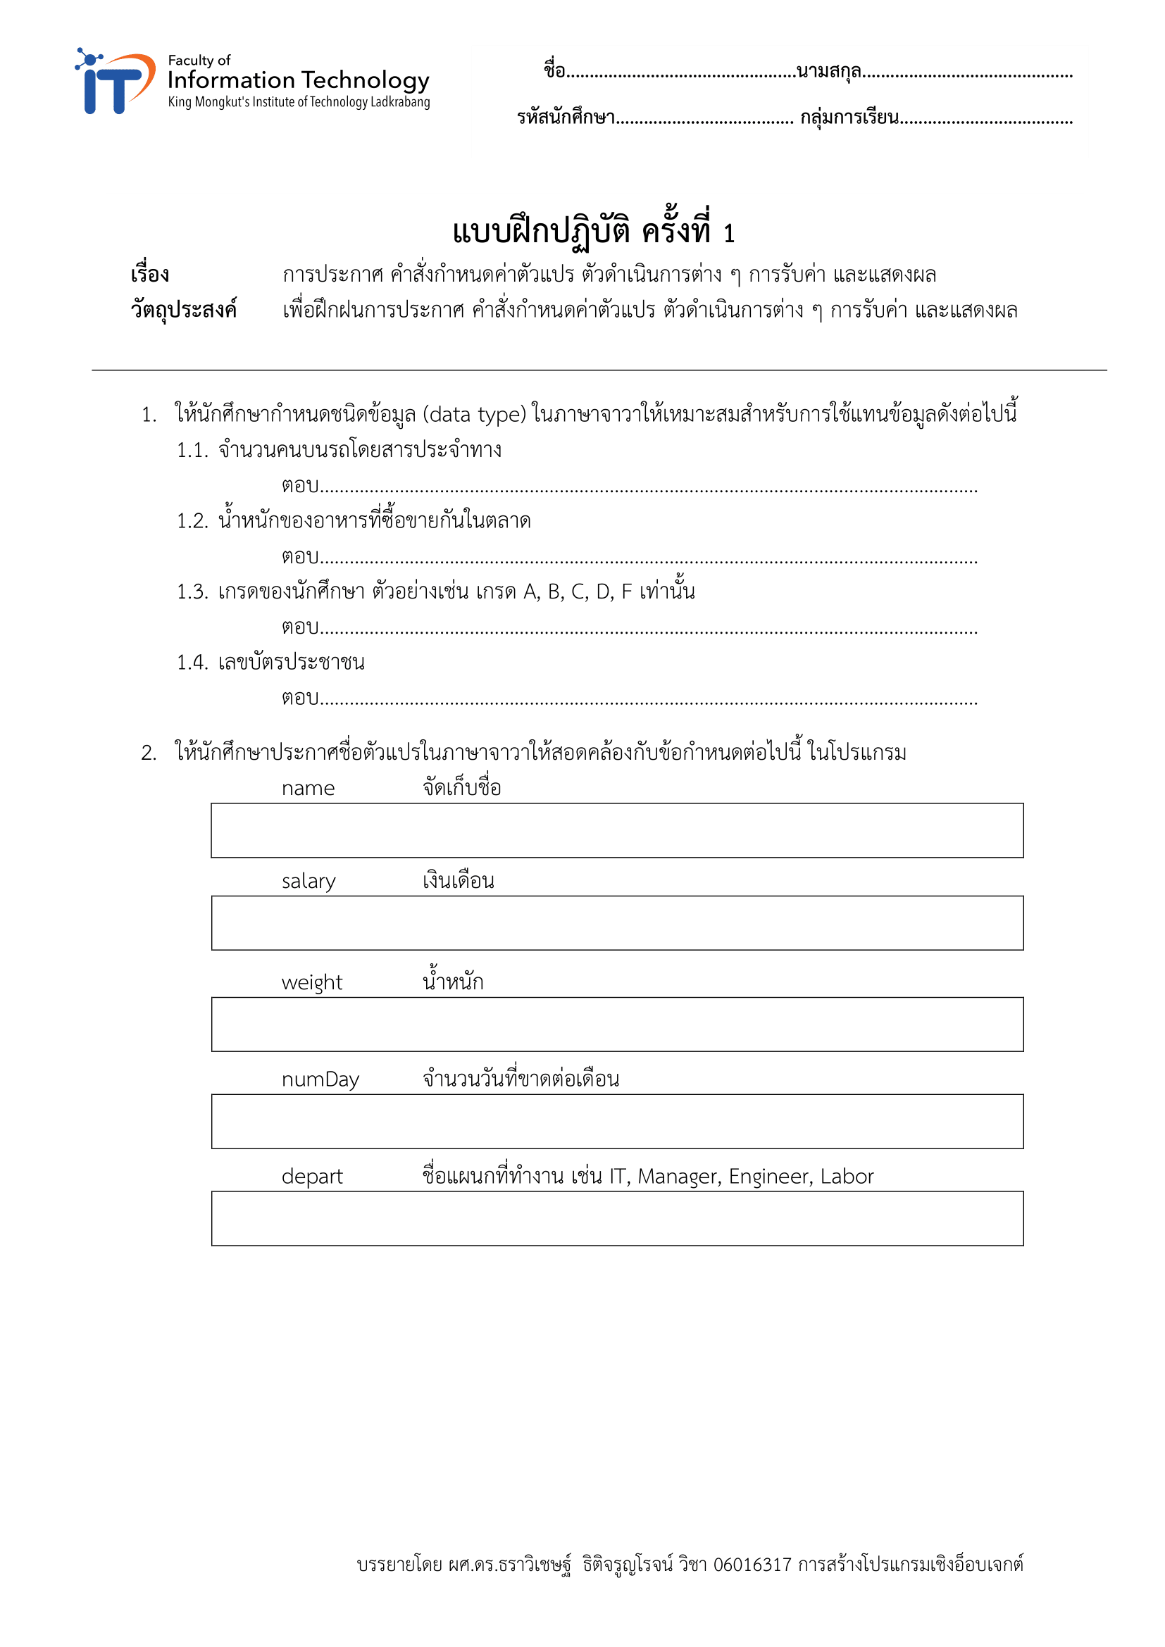
ปัณณทัต
สมอโพรง
64070182
1
int
double
str
str
str name
int salary
double weight
byte numDay
str depart

Slide 2
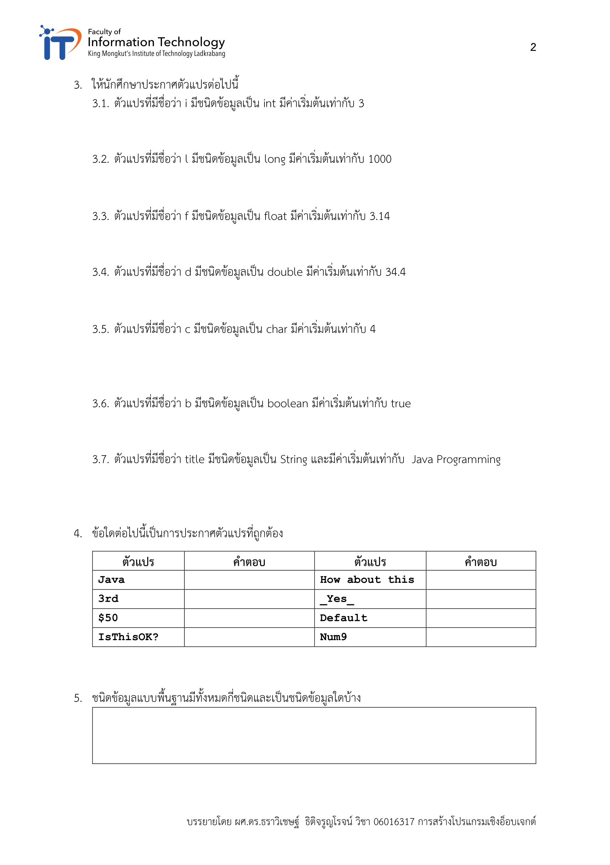
int i = 3
long l = 1000
float f = 3.14
double d = 34.4
char c = ‘4’
bool b = True
Str title = “Java Programming”
4 ชนิด
int, double, char, boolean

Slide 3
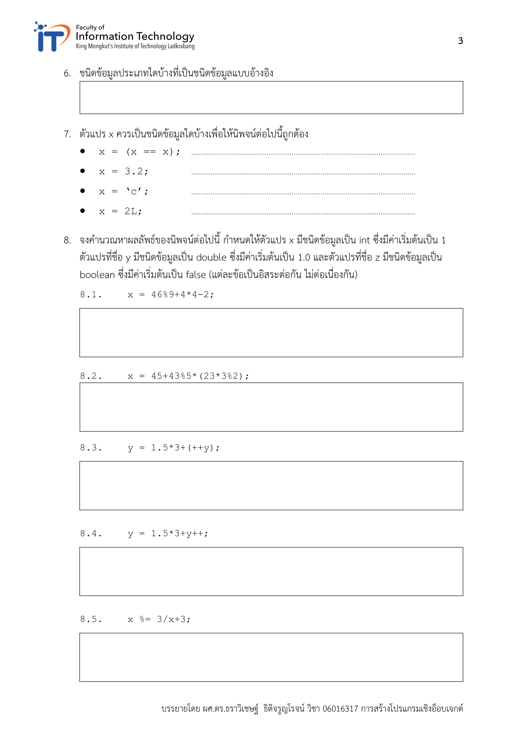
String, Object, Array
boolean
float
char
long
15
48
6.5
5.5
1

Slide 4
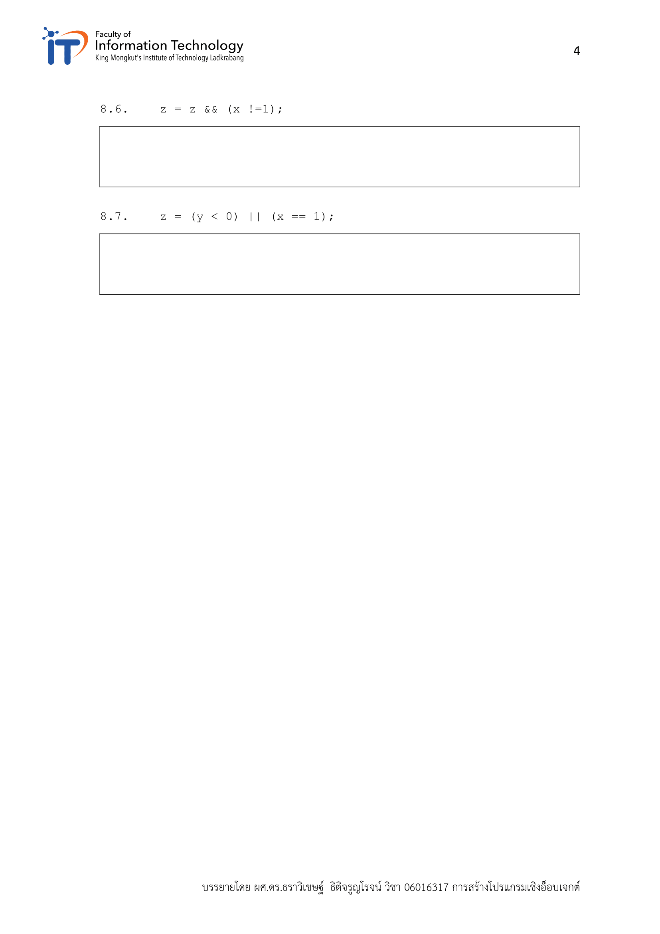
false
True

Slide 5
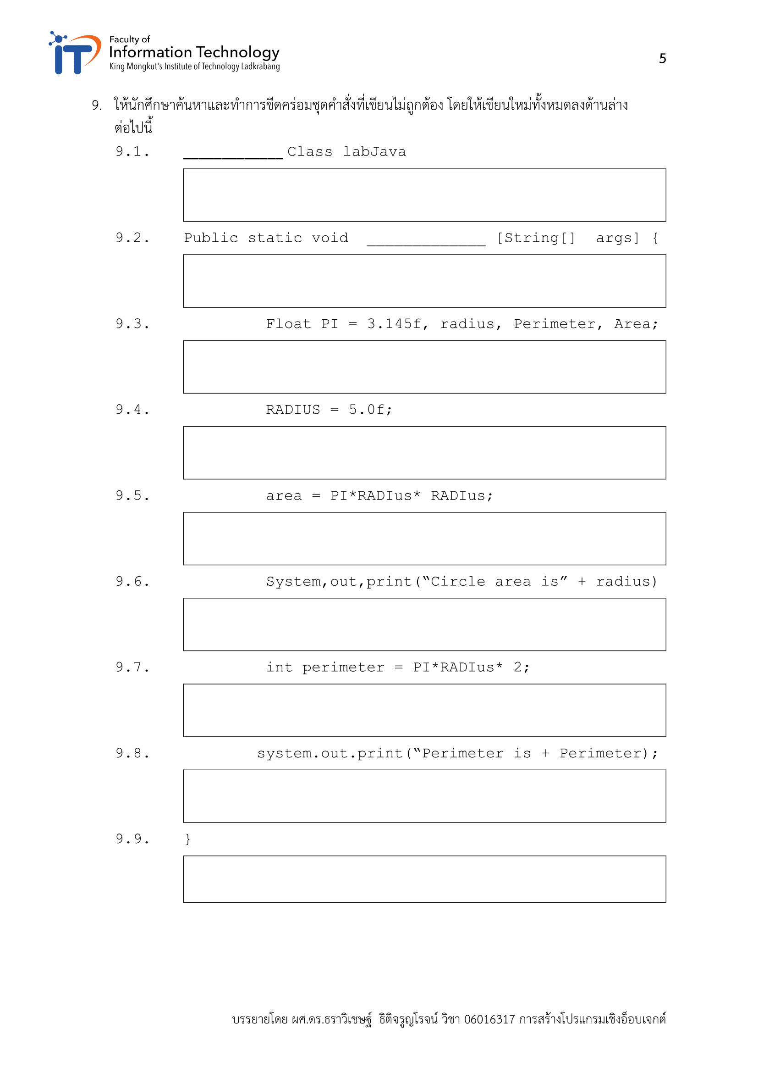
public class labJava
public static void main [String[] args] {

Slide 6
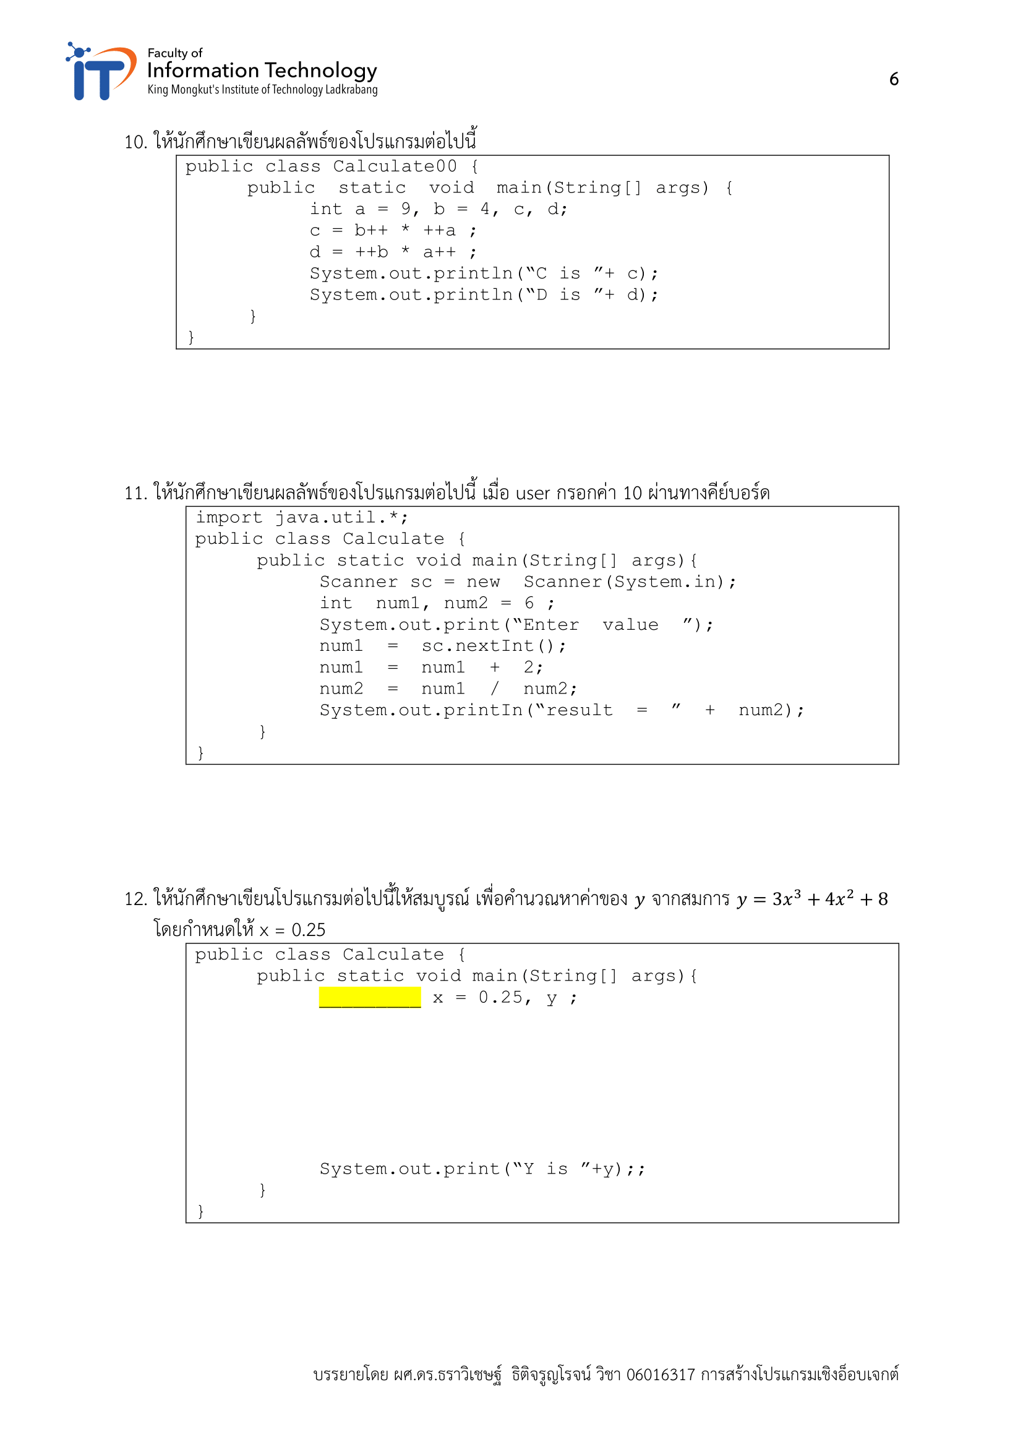
C is 40
D is 60
result = 2

Slide 7
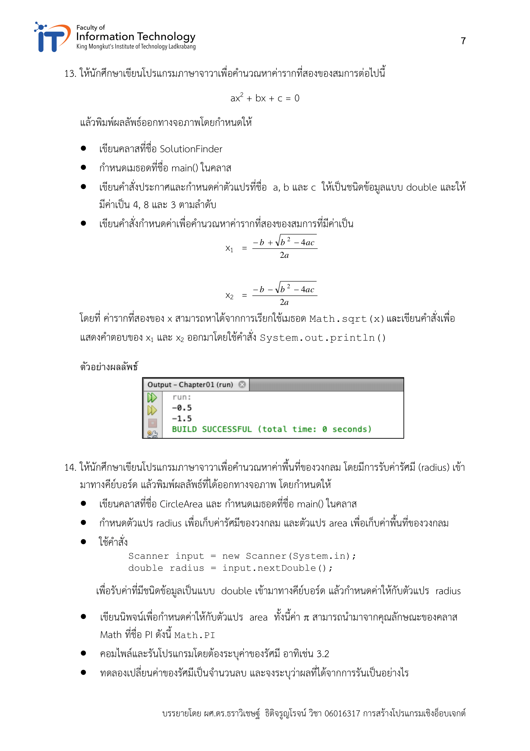

Slide 8
