Slide 1
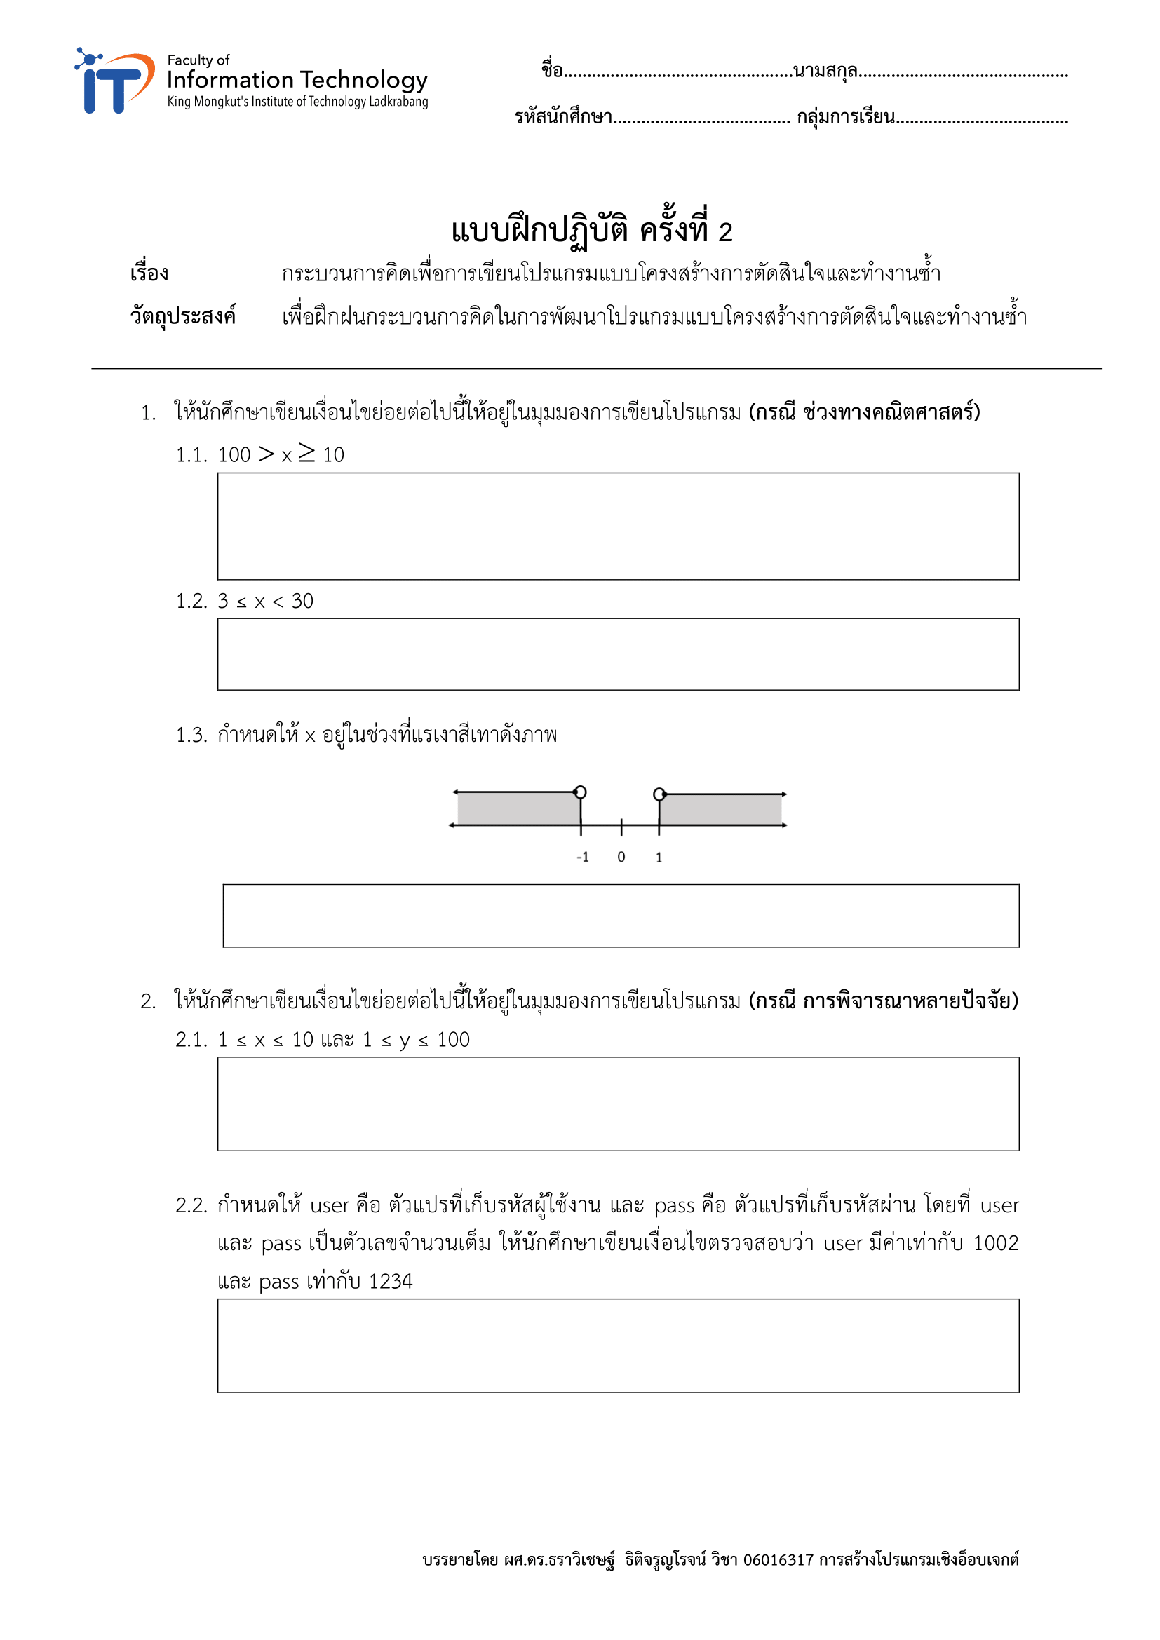
ปัณณทัต
สมอโพรง
64070182
1
if (x >= 10 && x < 100){}
if (x >= 3 && x < 30){}
if (x >= -1 && x <= 1){}
If (x >= 1 && x <= 10 && y >= 1 && y <= 100){}
if (user == 1002 && pass == 1234){}

Slide 2
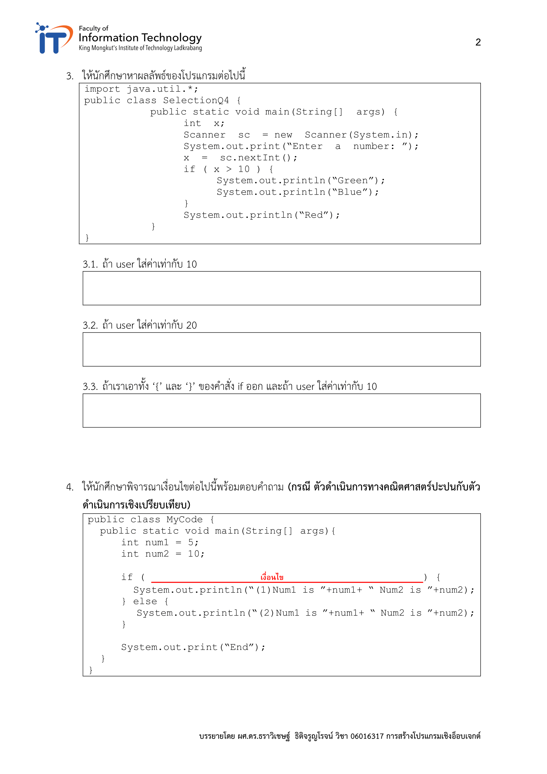
Red
Green
Blue
Red
Blue
Red

Slide 3
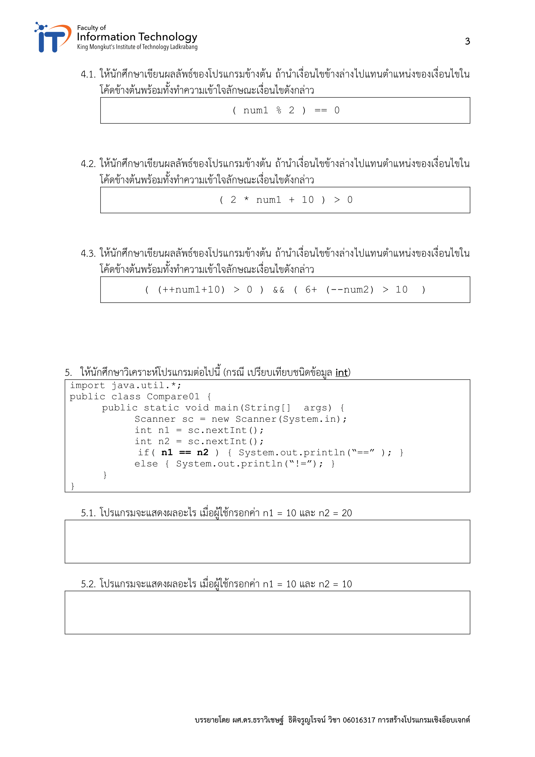
(2)Num1 is 5 Num2 is 10
(1)Num1 is 5 Num2 is 10
(1)Num1 is 6 Num2 is 9
!=
==

Slide 4
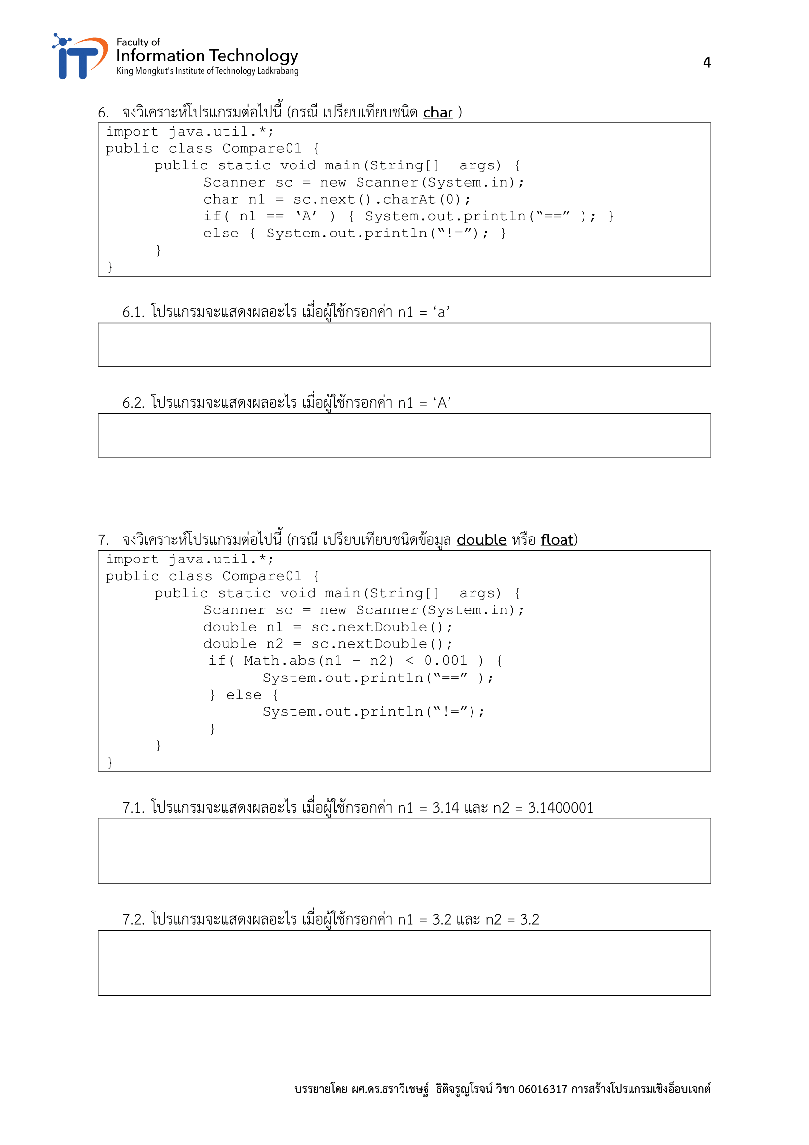
!=
==
==
==

Slide 5
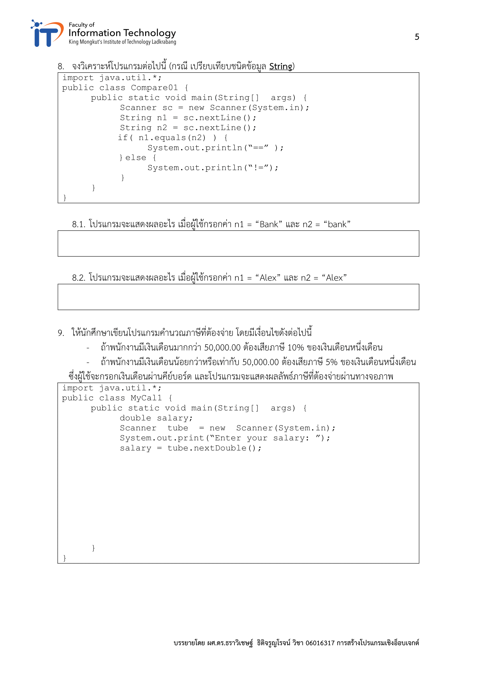
!=
==
if (salary > 50000){
System.out.println(salary * 0.9);
}
else if (salary <= 50000){
System.out.println(salary * 0.95);
}

Slide 6
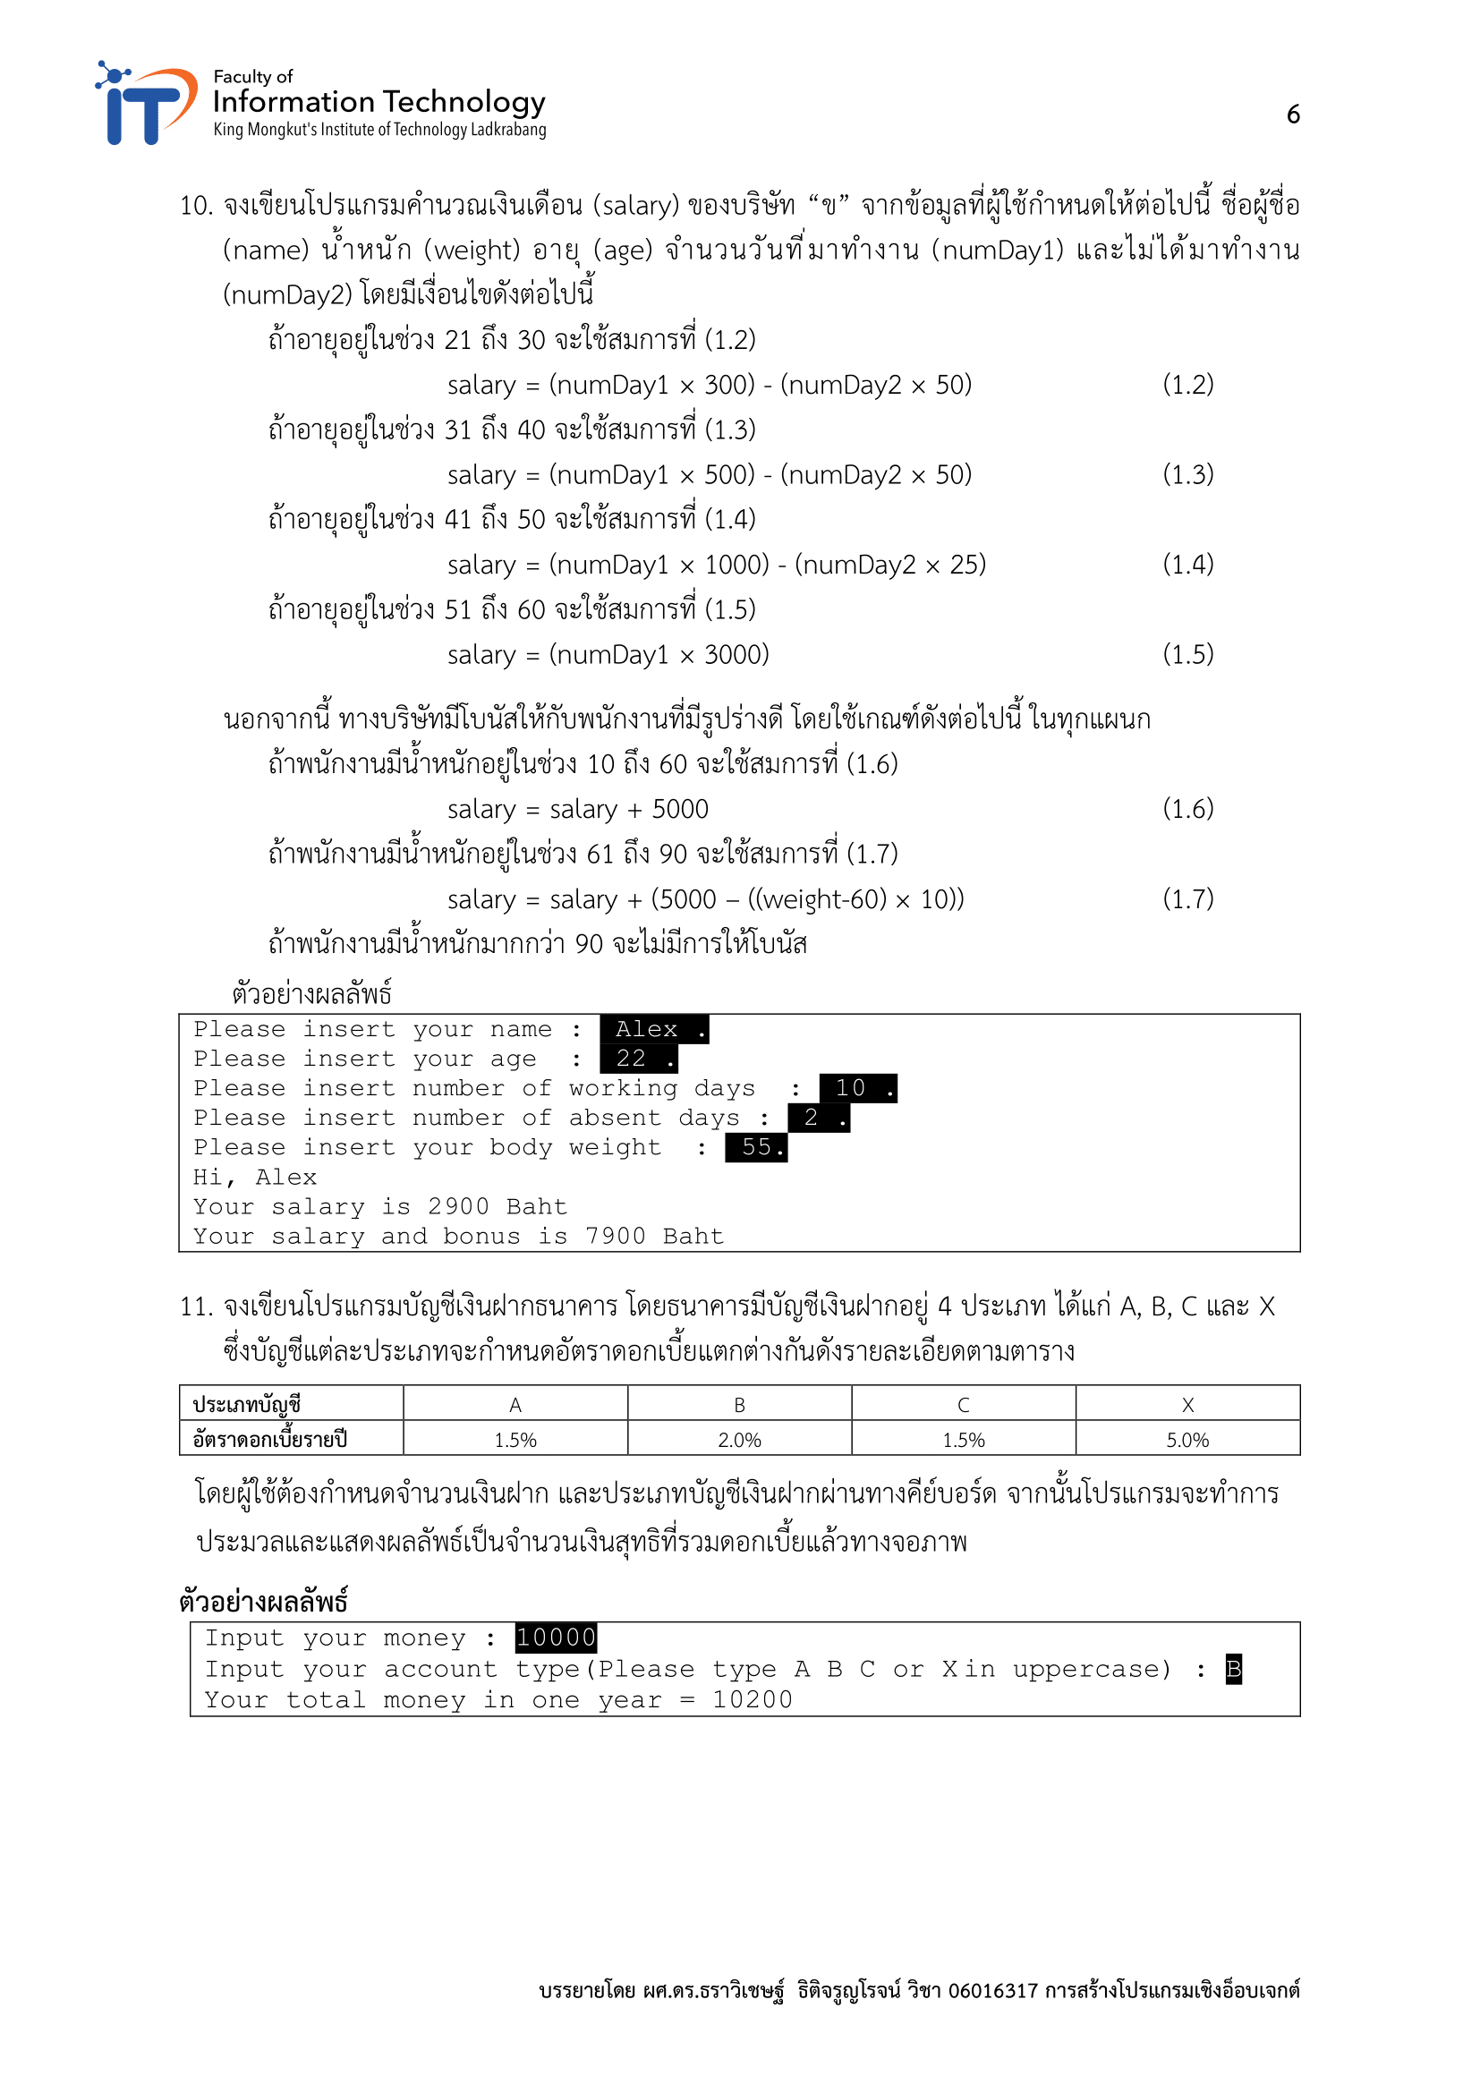
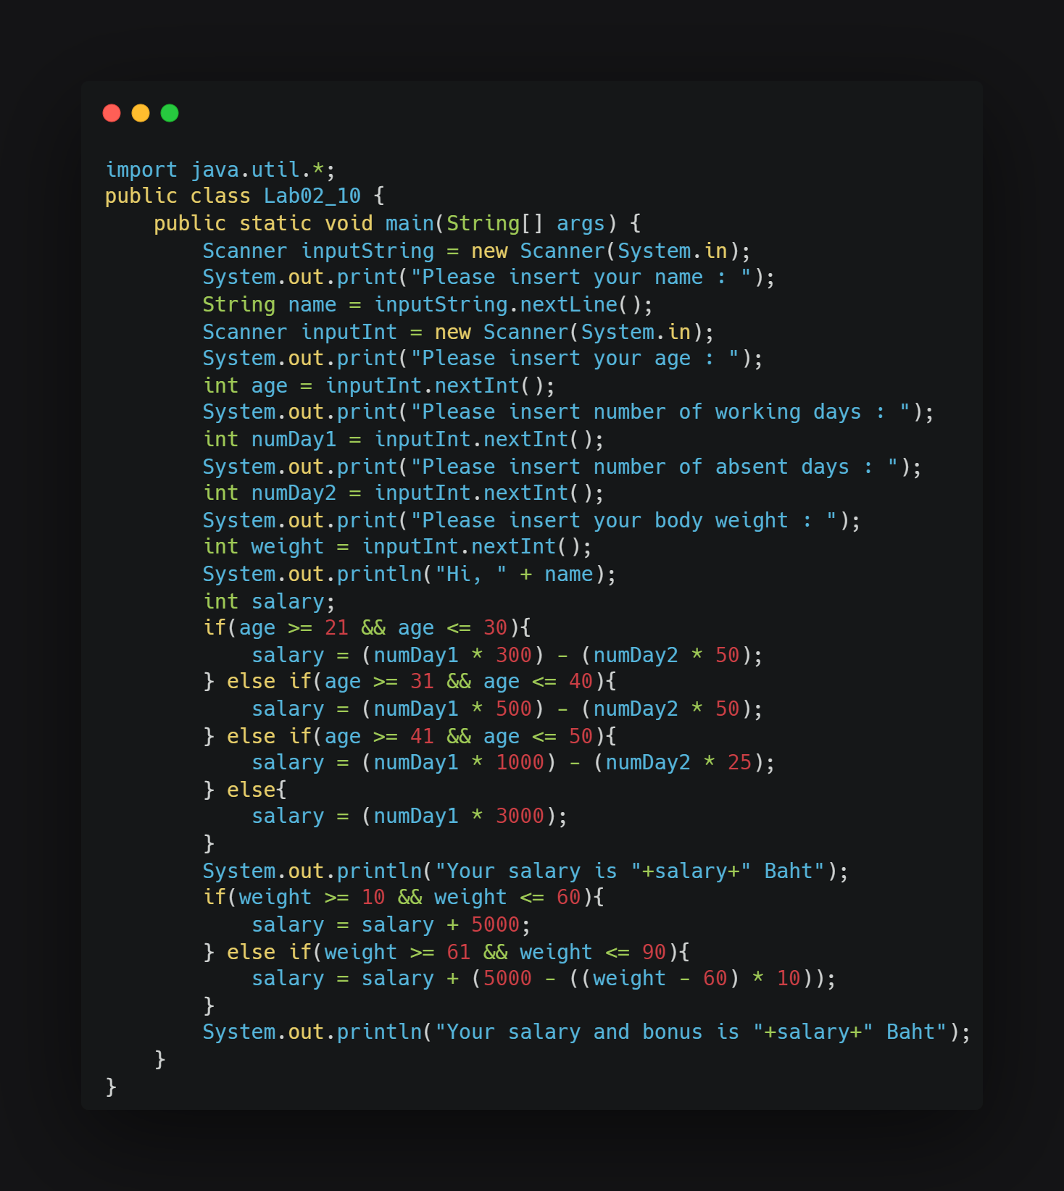

Slide 7
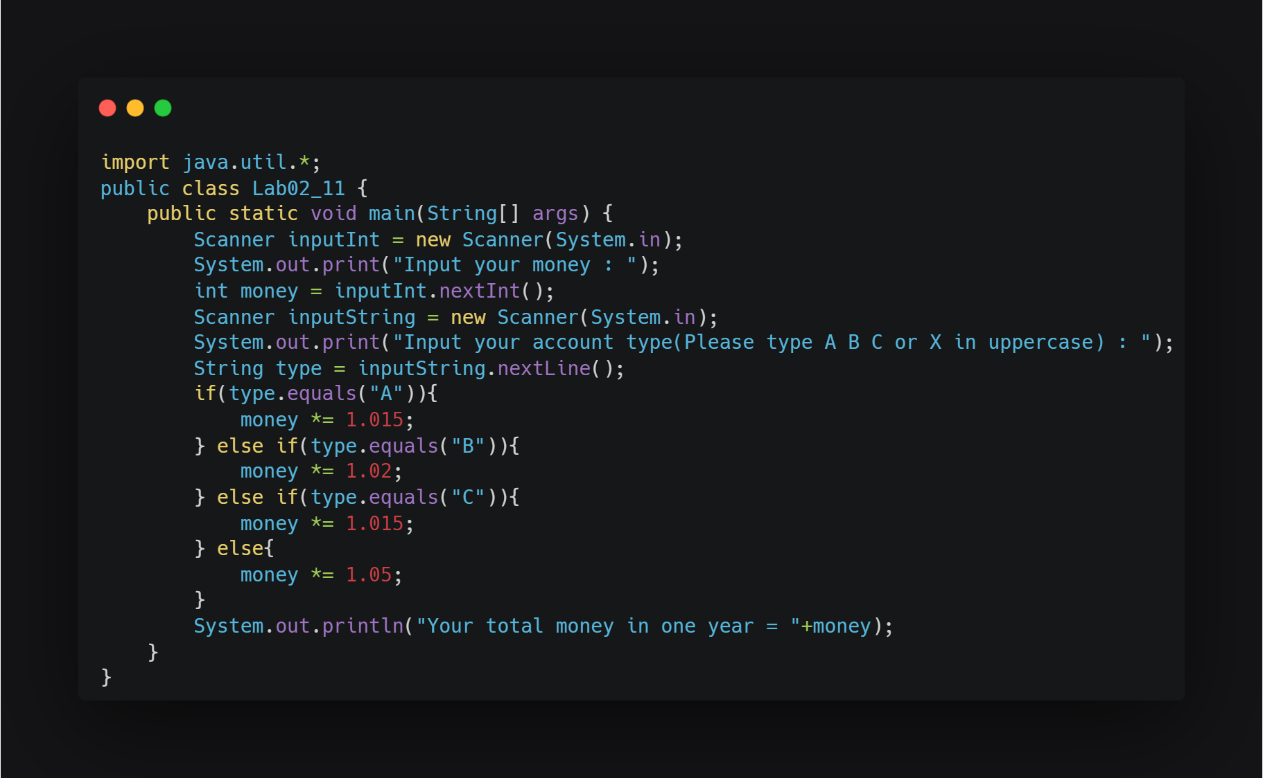

Slide 8
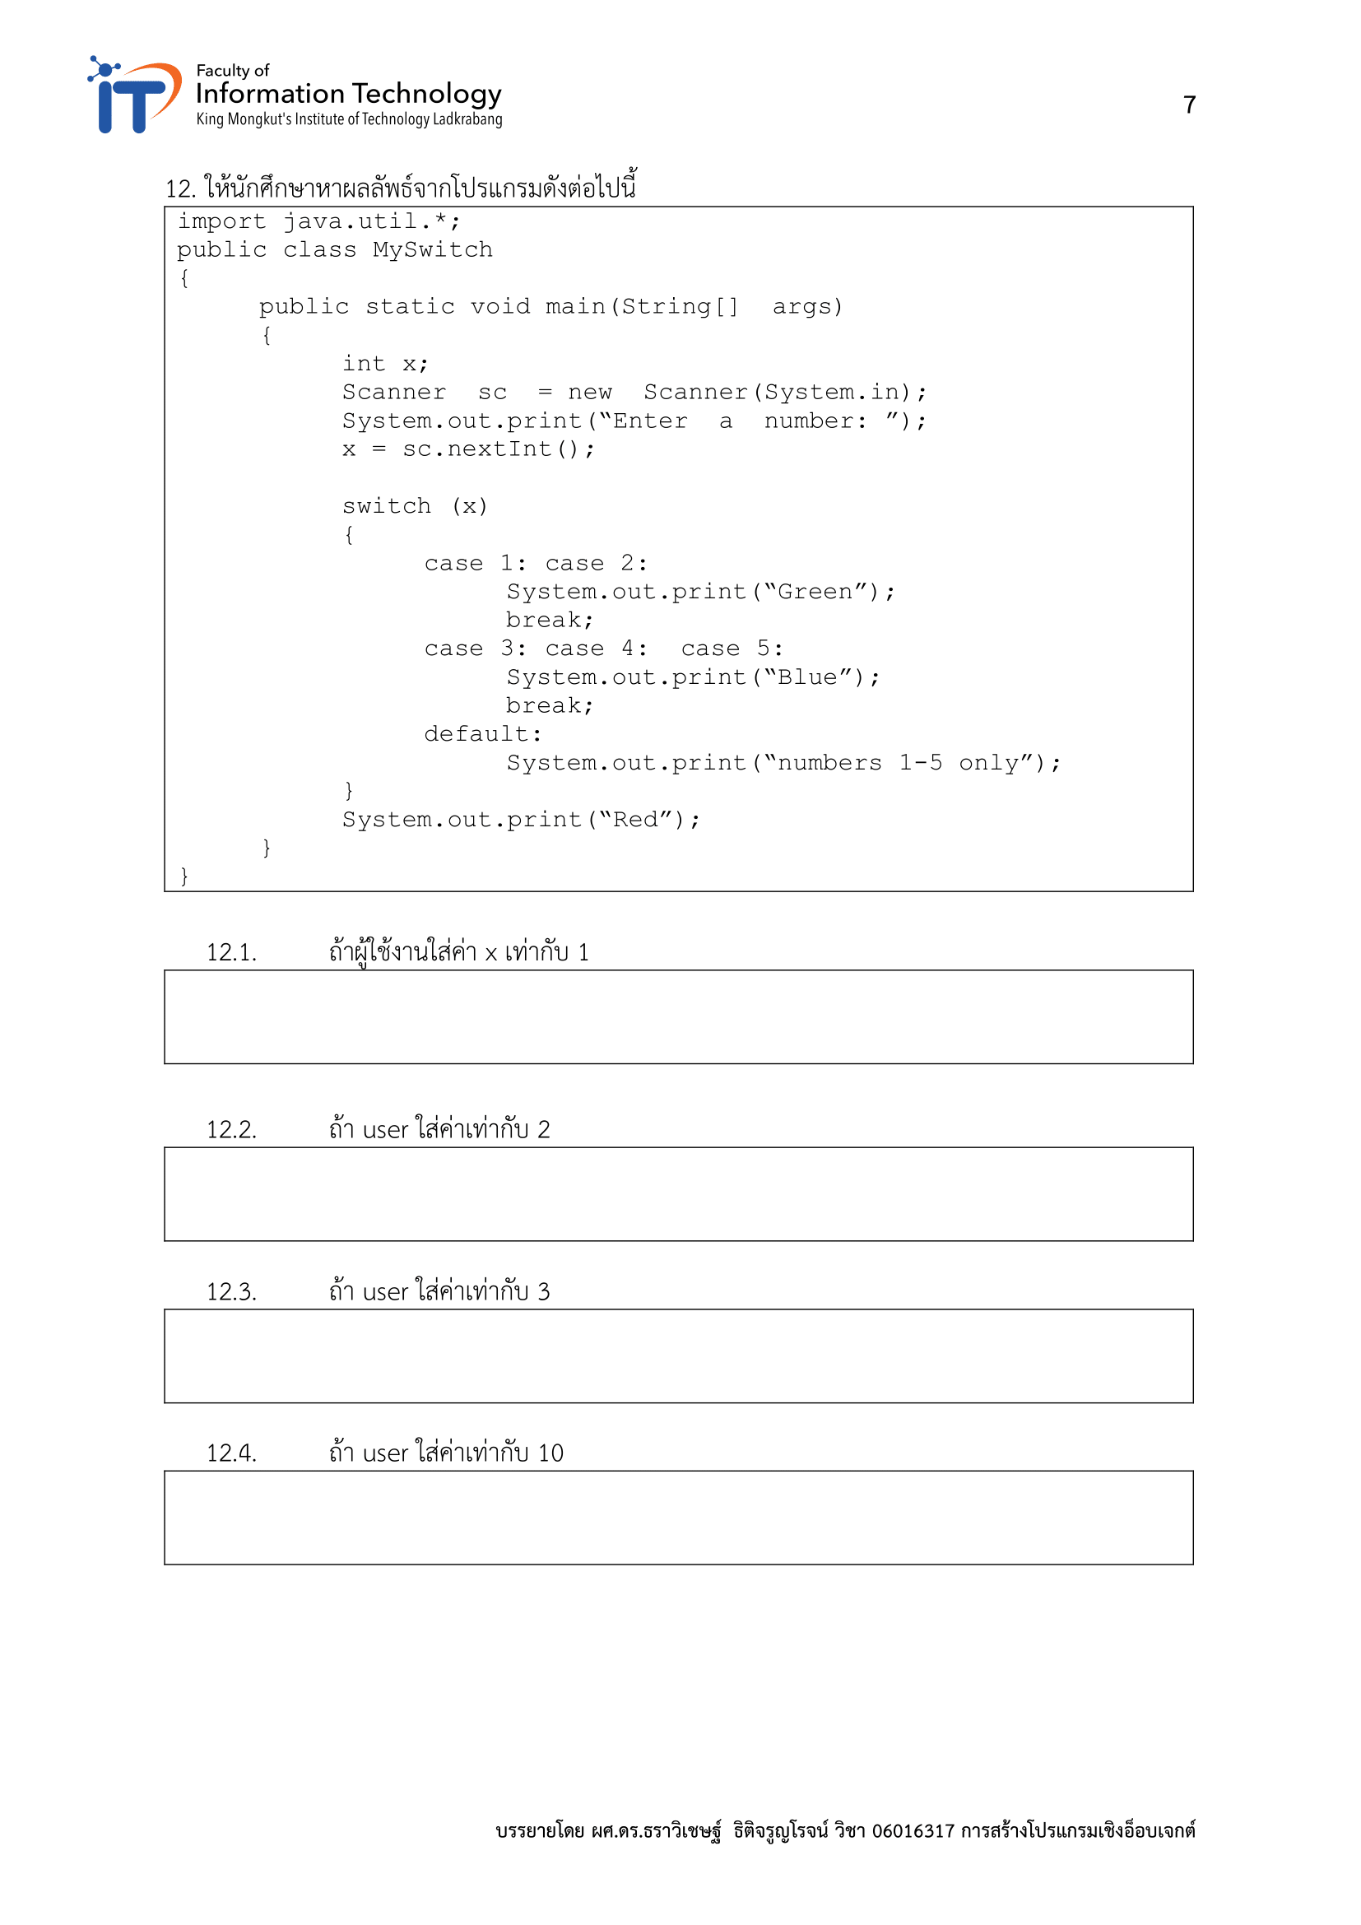
GreenRed
GreenRed
BlueRed
numbers 1-5 onlyRed

Slide 9
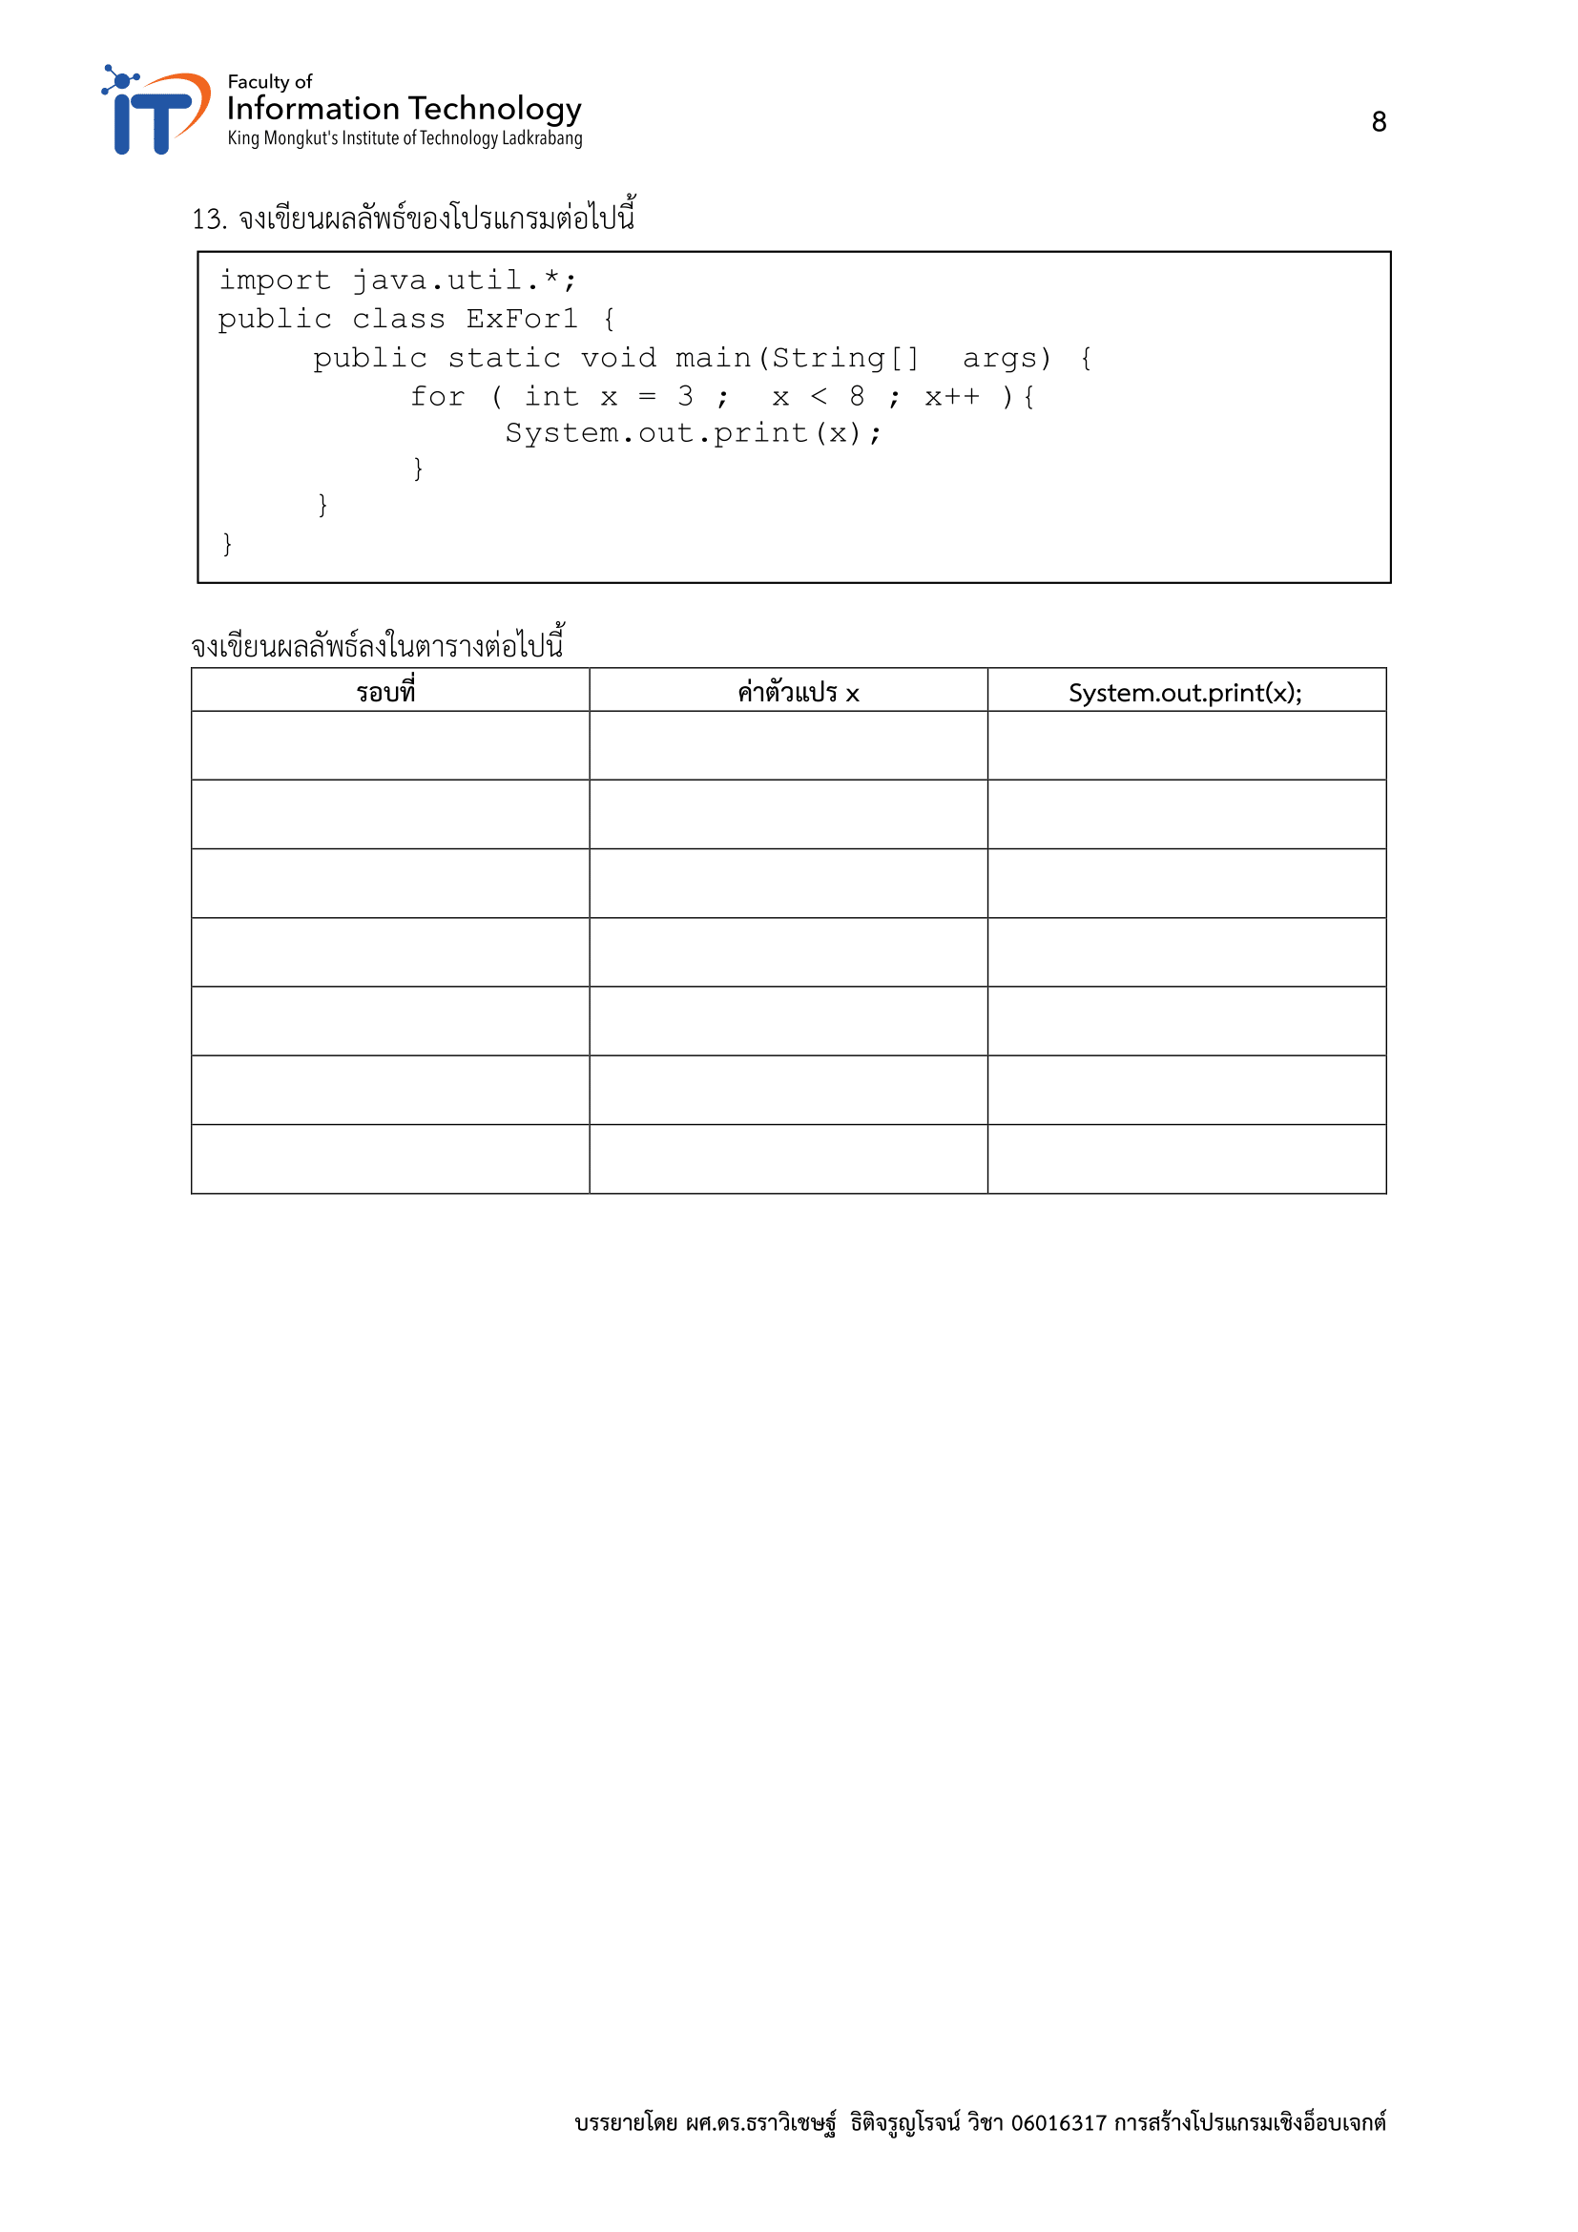
1 | 3 | 3
2 | 4 | 4
3 | 5 | 5
4 | 6 | 6
5 | 7 | 7
6 | - | -
7 | - | -

Slide 10
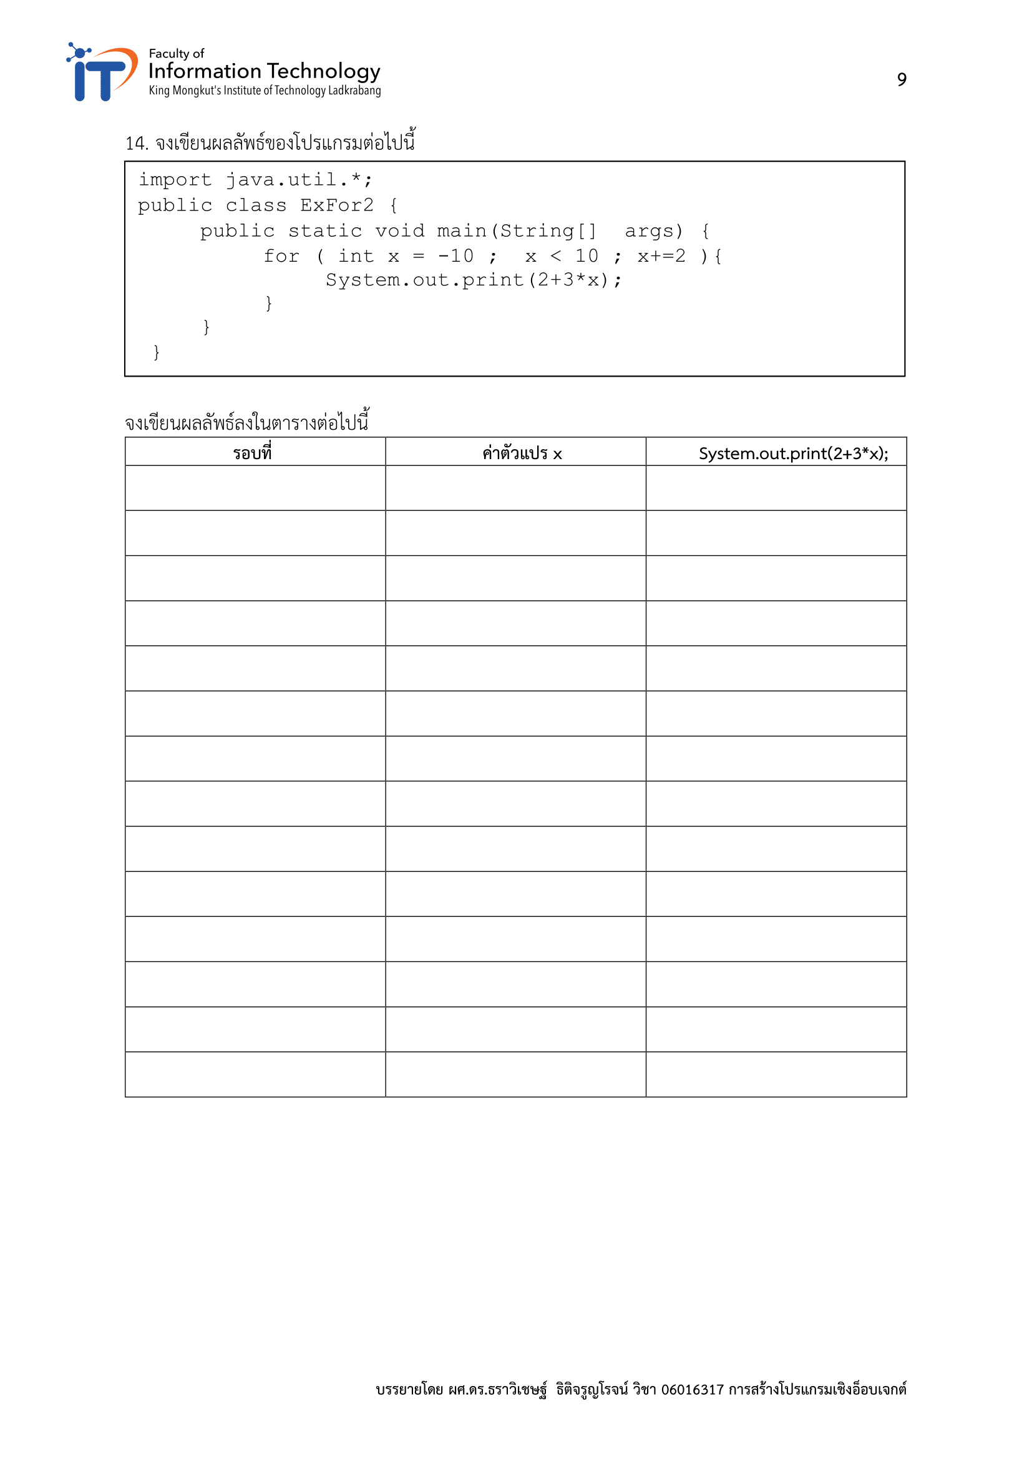
1 | -10 | -28
2 | -8 | -22
3 | -6 | 16
4 | -4 | -10
5 | -2 | -4
6 | 0 | 2
7 | 2 | 8
8 | 4 | 14
9 | 6 | 20
10 | 8 | 26
11 | 10 | 32
12 | 12 | 38
13 | 14 | 44
14 | 16 | 50

Slide 11
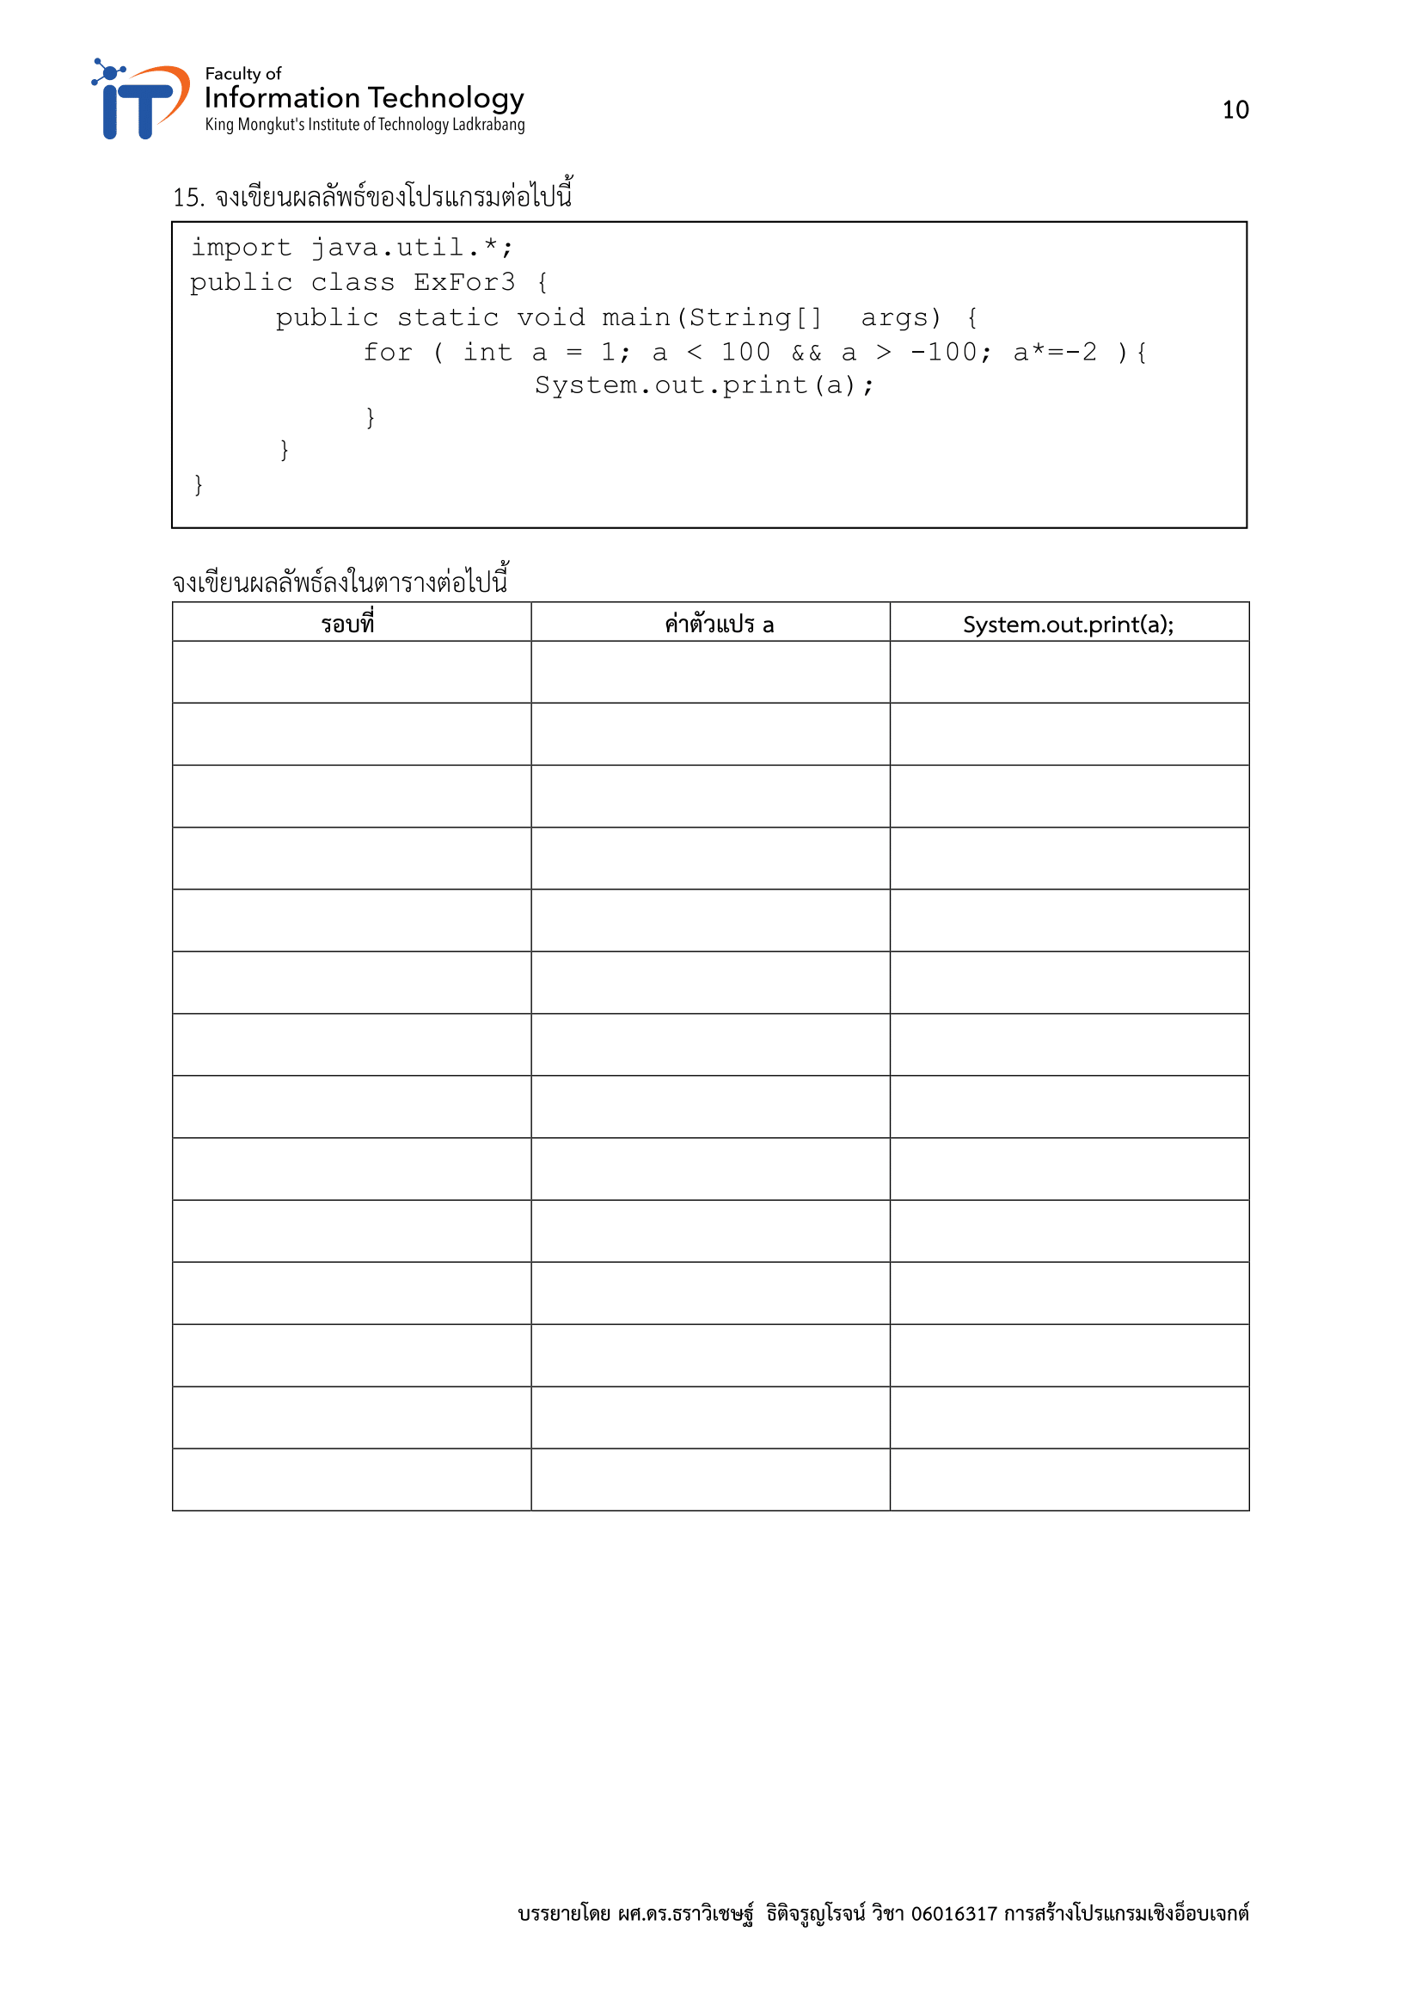
1 | 1 | 1
2 | -2 | -2
3 | 4 | 4
4 | -8 | -8
5 | 16 | 16
6 | -32 | -32
7 | 64 | 64
8
9
10
11
12
13
14

Slide 12
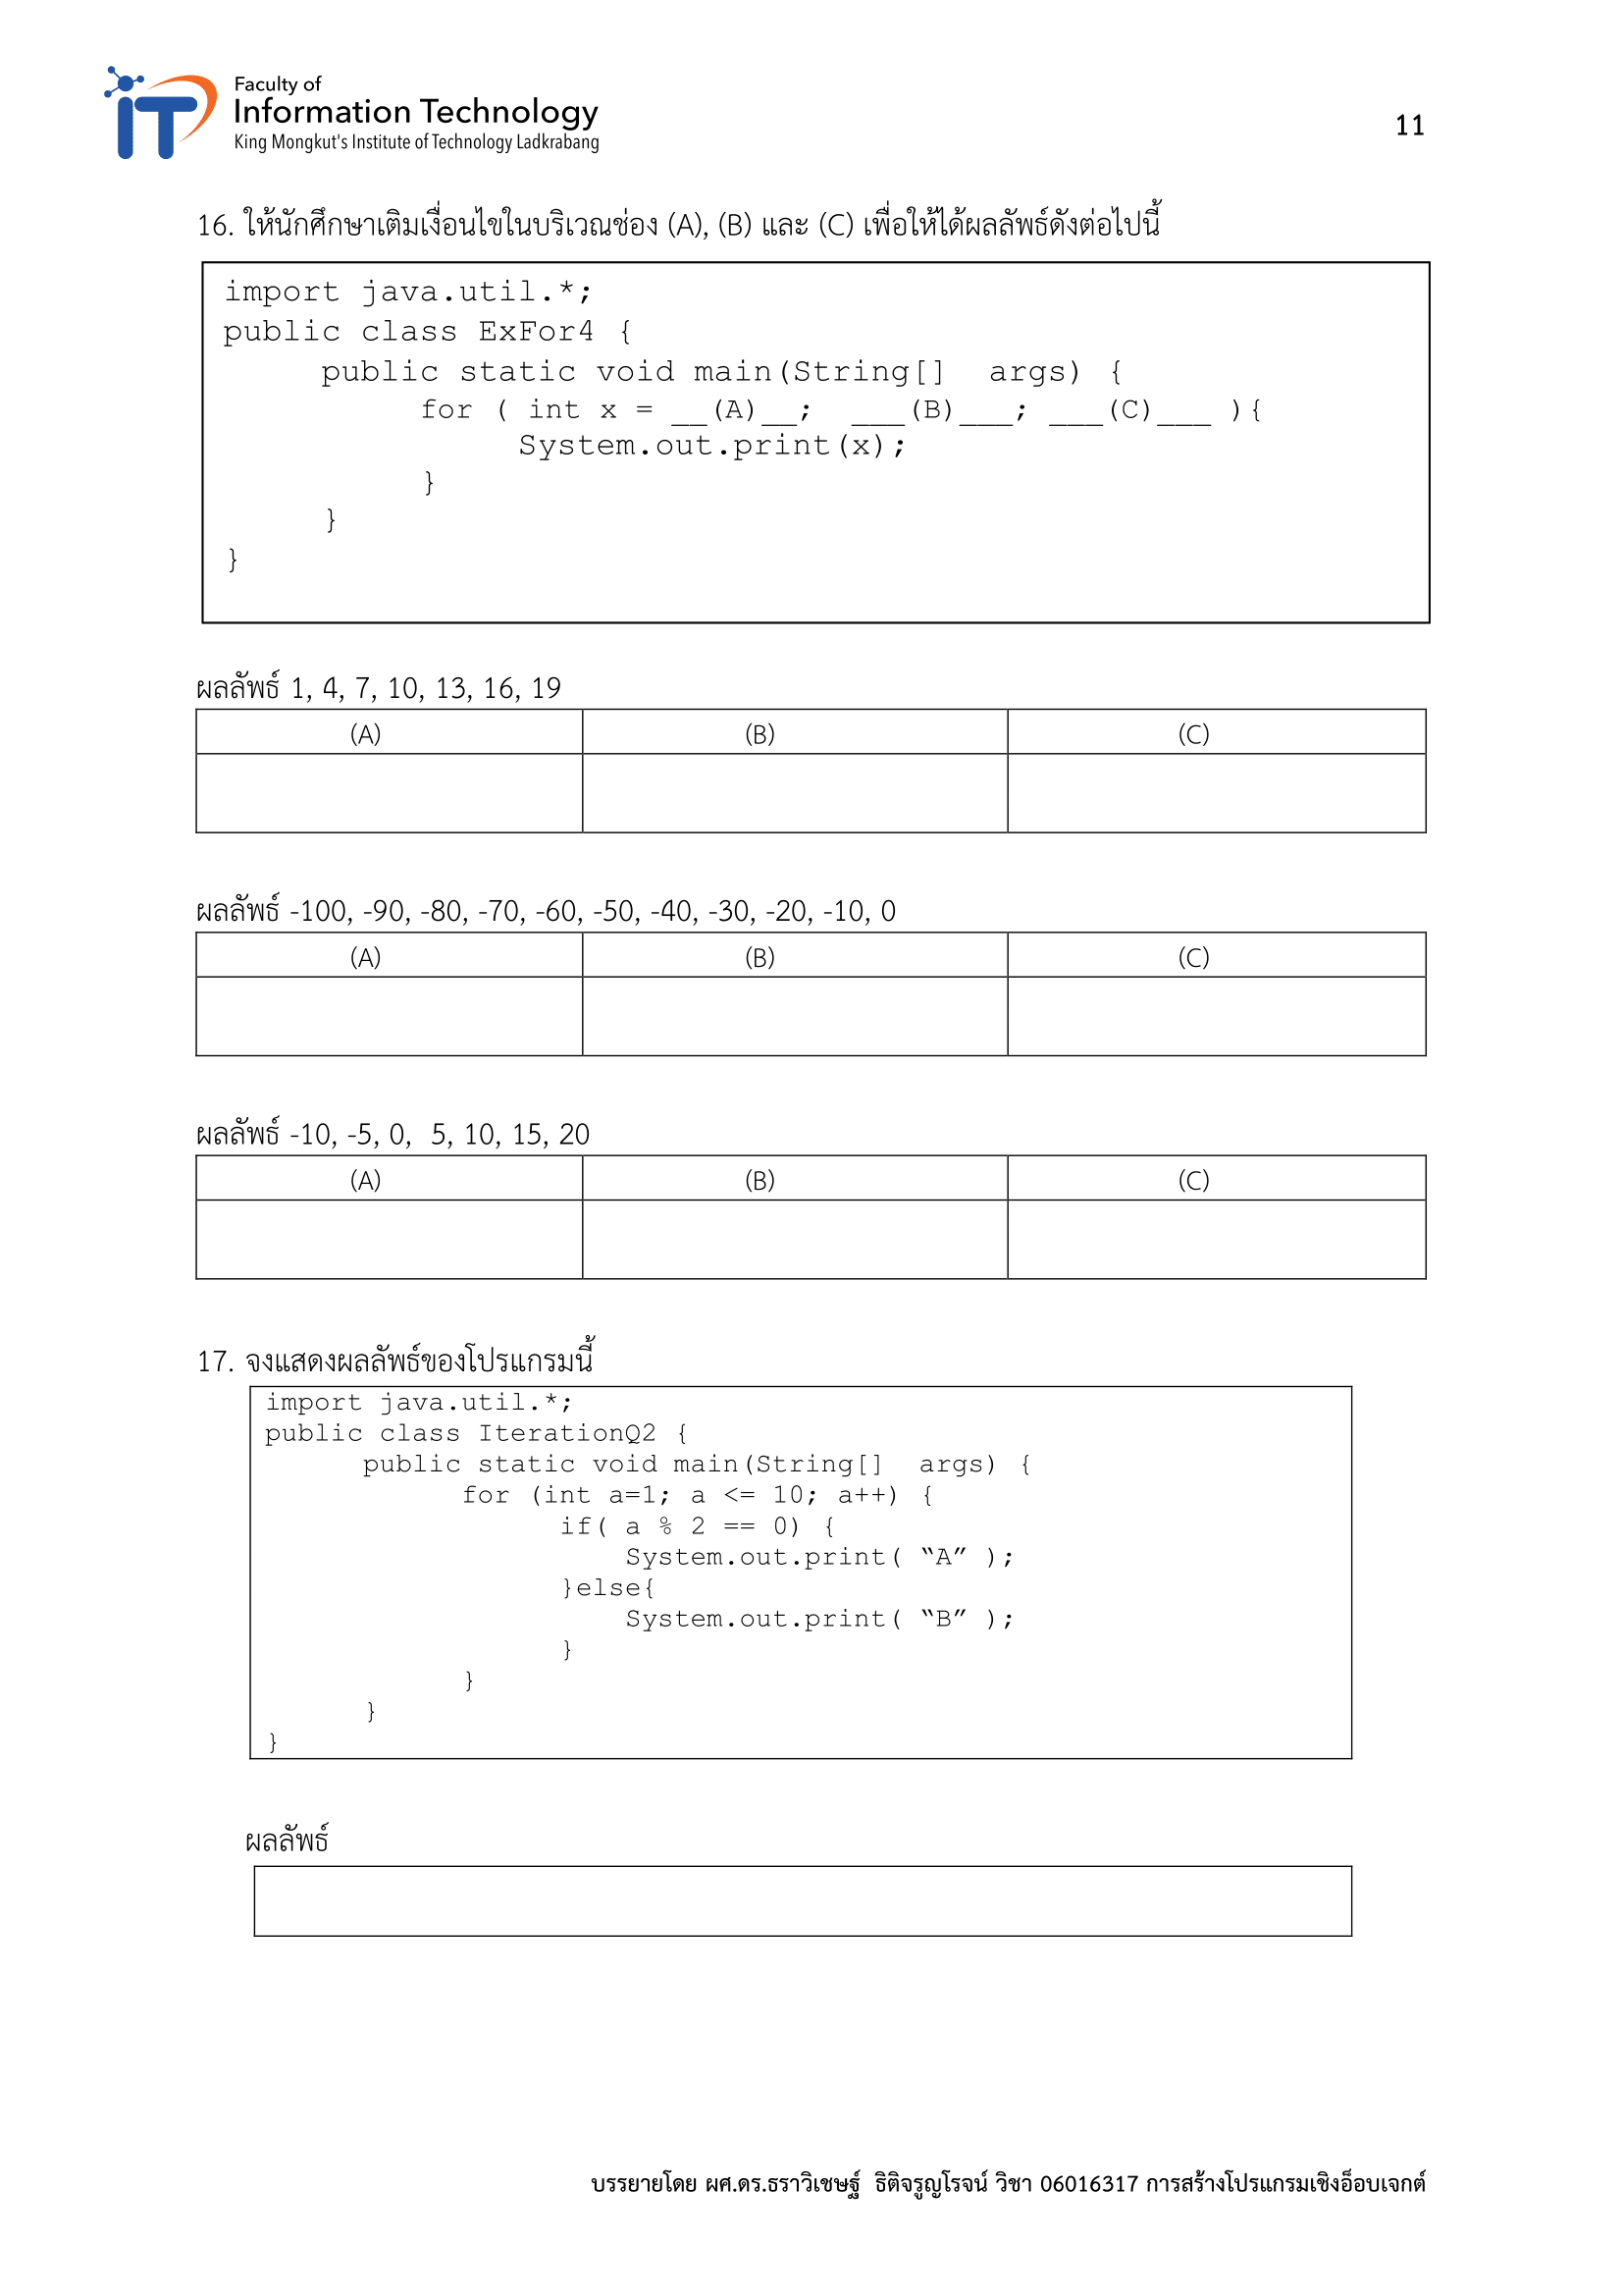
1
x < 20
x += 3
-100
x == 0
x += 10
-10
x == 20
x += 5
BABABABABA

Slide 13
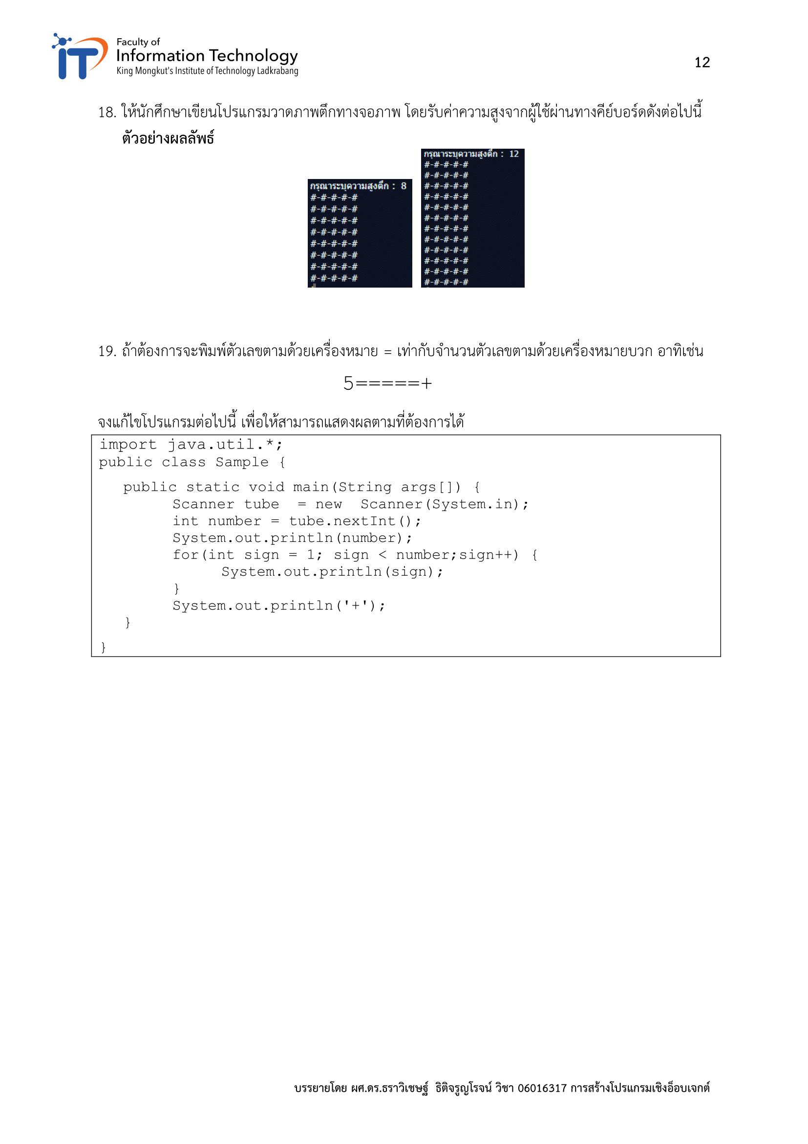
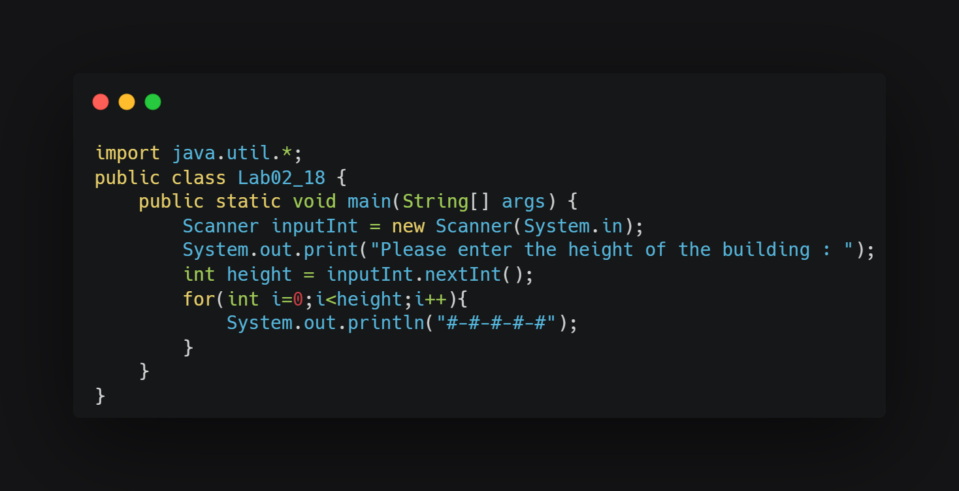

Slide 14
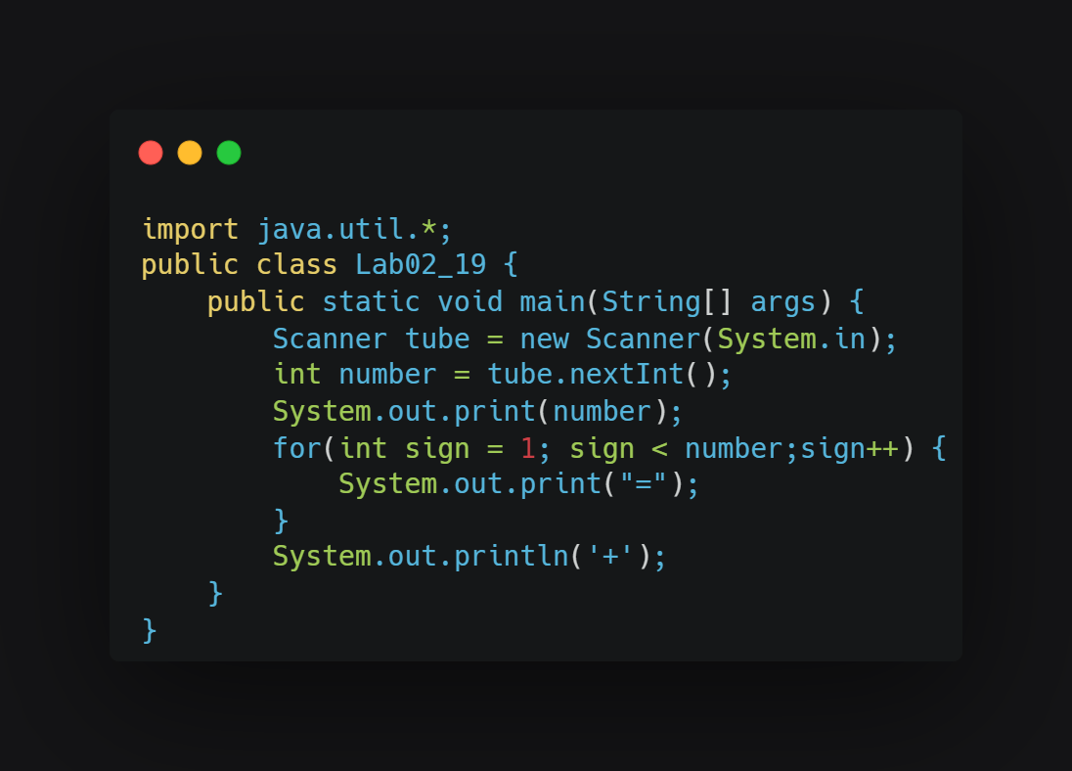

Slide 15
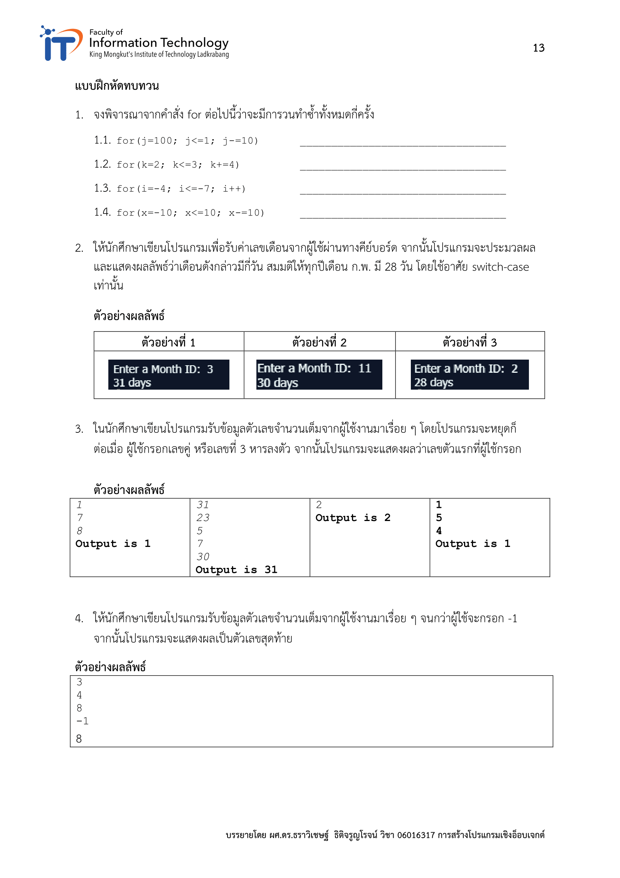

Slide 16
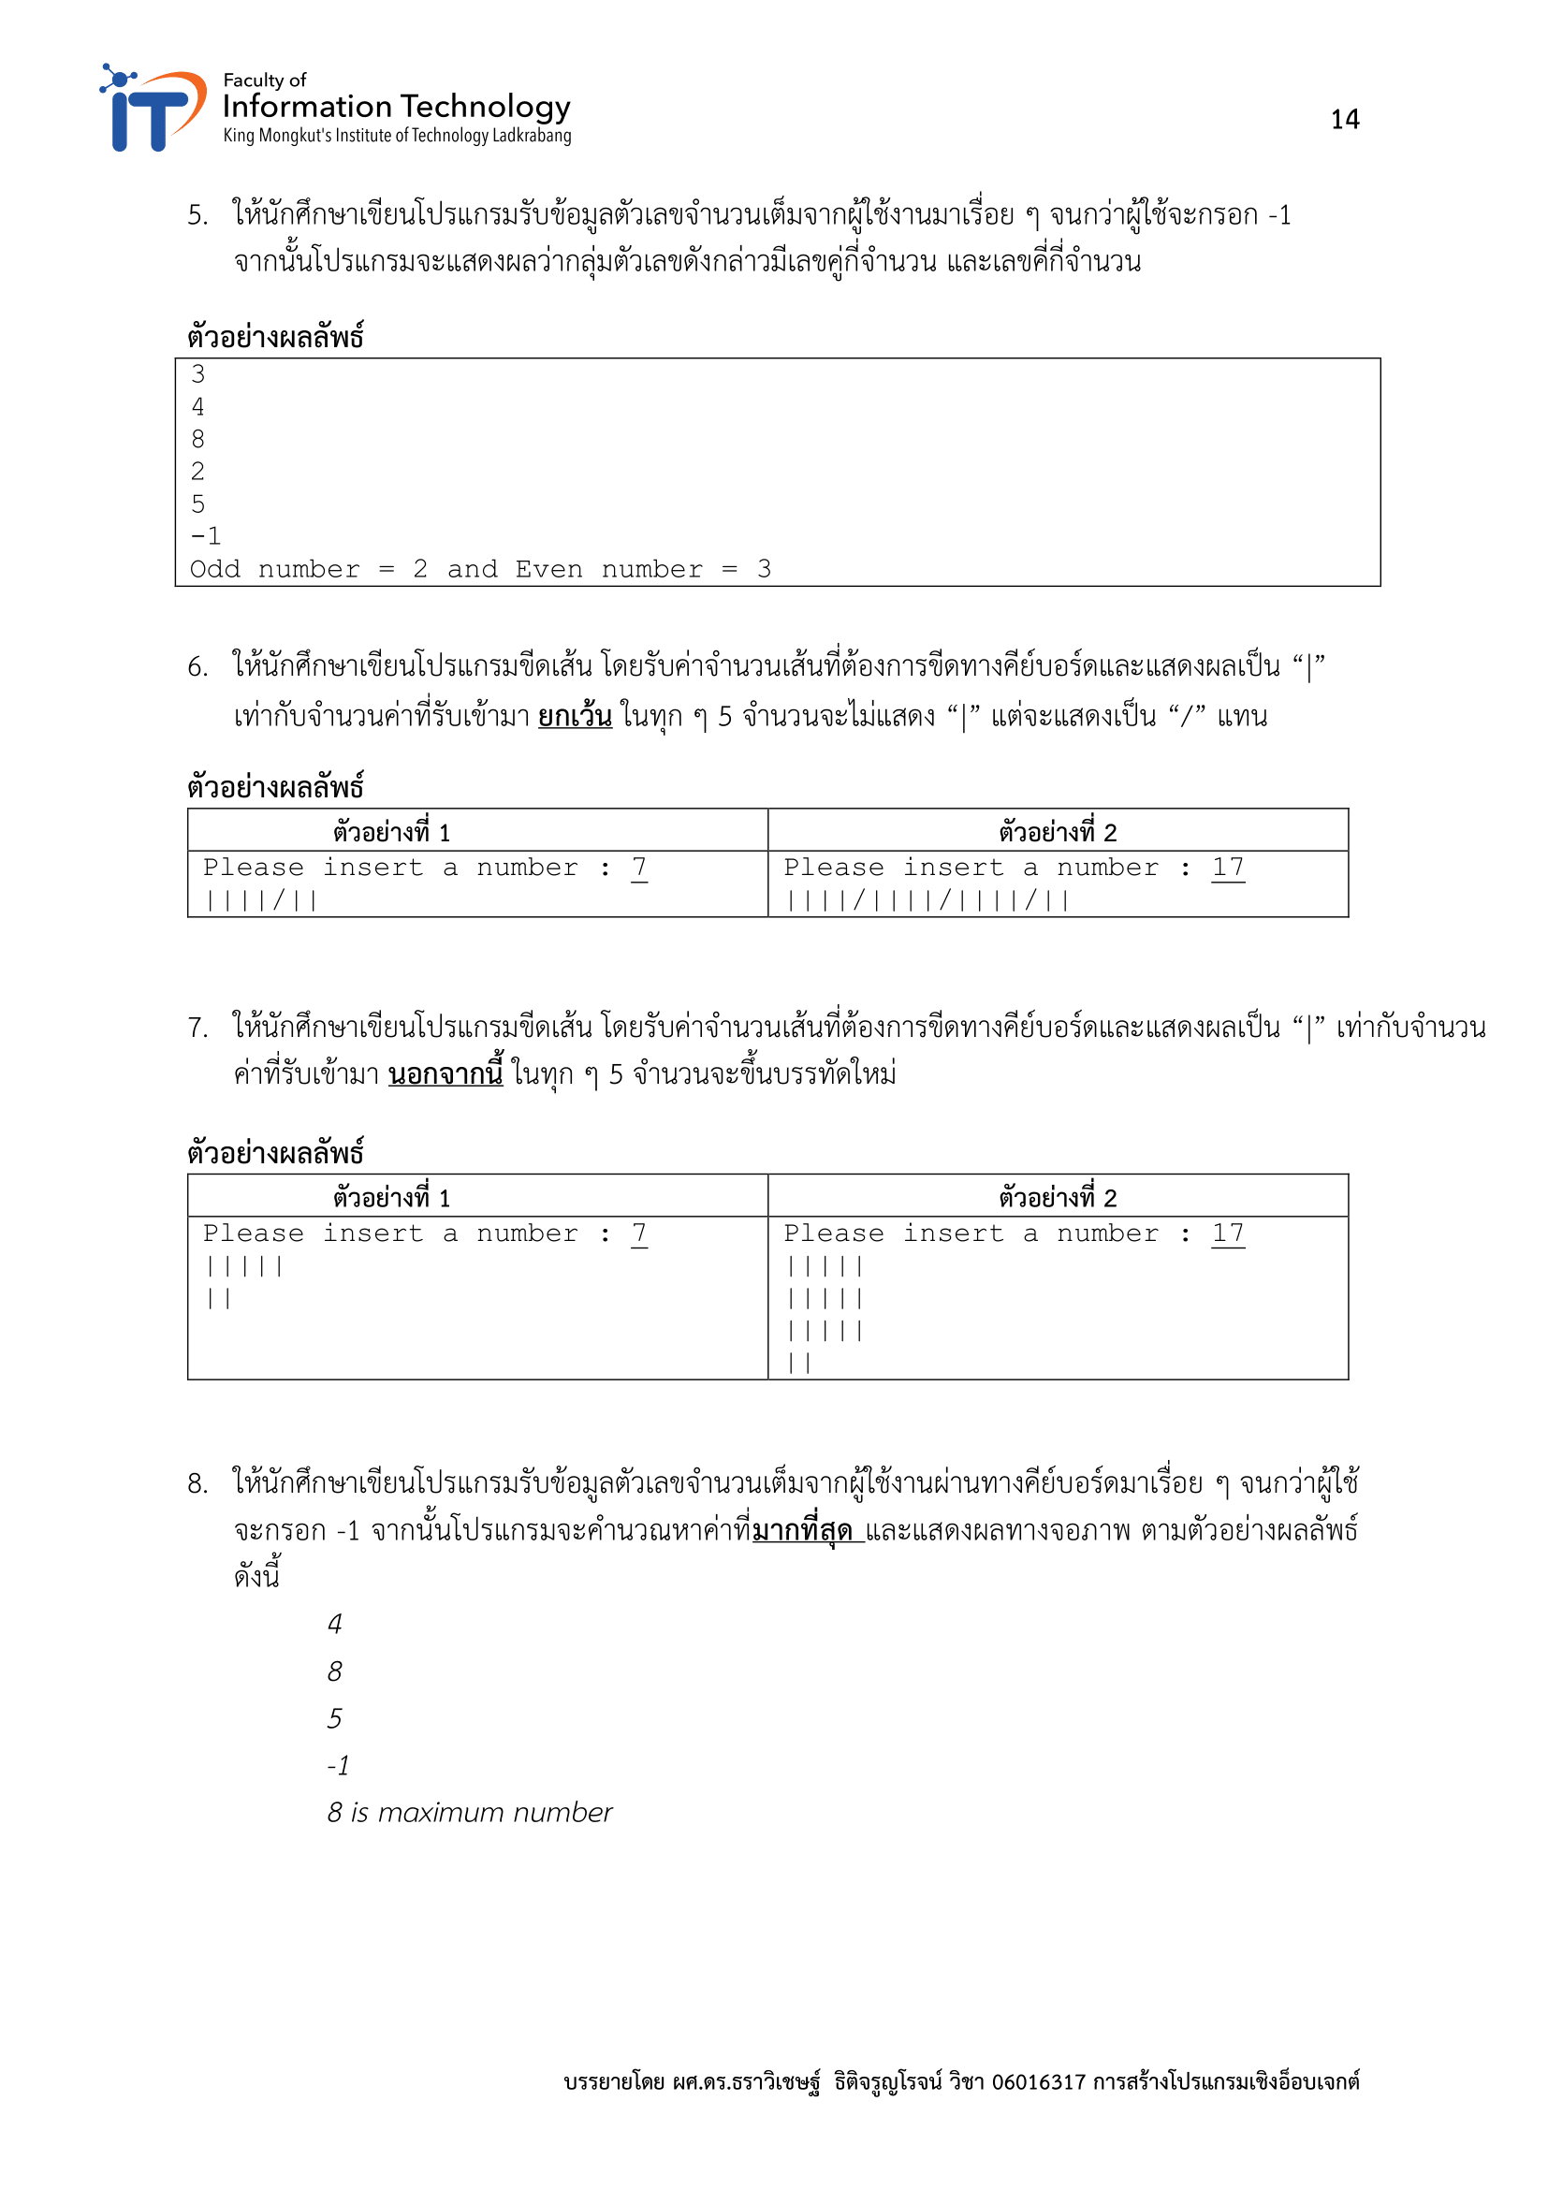

Slide 17
