Slide 1
Editing Bayesian Neural Network
Jiarao Liu, Yuan Zhang, Jiangjie Bian

Slide 2
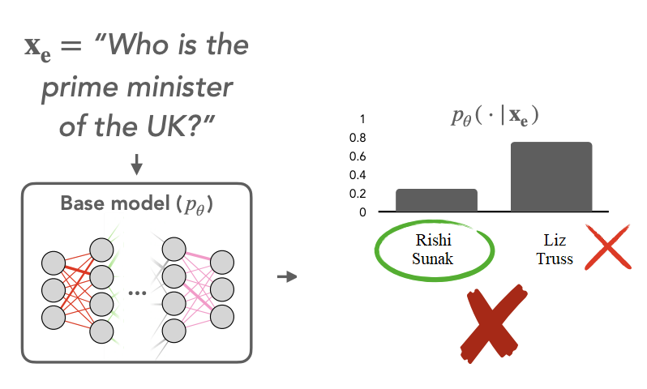
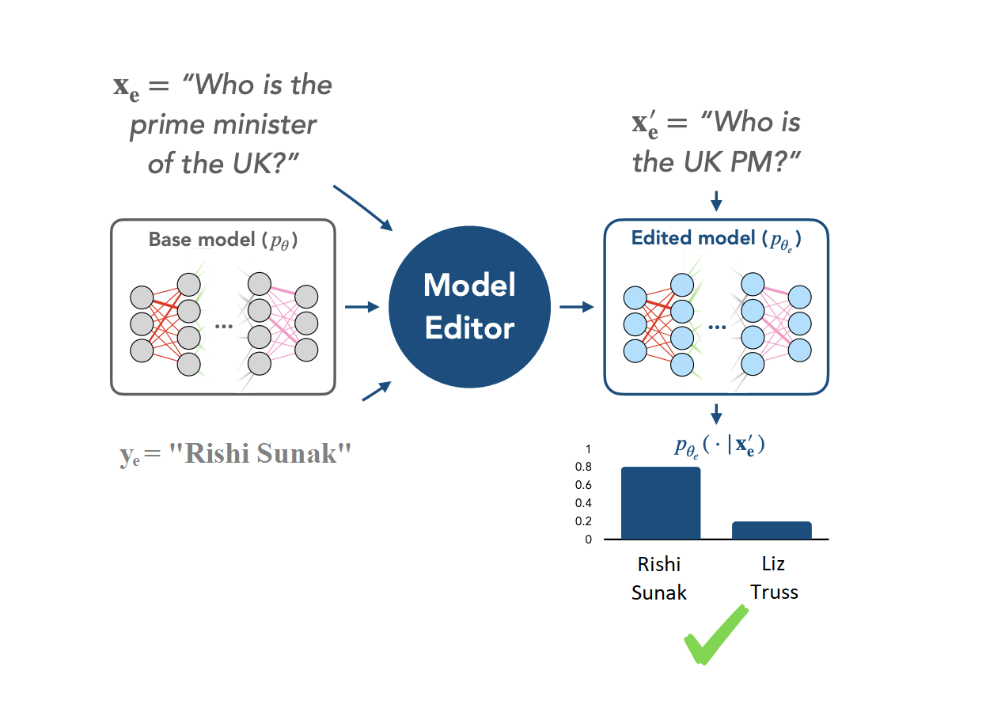
Problem
The real-world situation would change, so does the training dataset.
How to update the neural network without re-training.
Problem Formulation:
We have a trained Bayesian Neural Network posterior P(θ | D) trained by dataset D.
D = D_{remaining} ∪ D_{error}
D_{error} : The error Dataset to be updated
D_{new} : The dataset to replace D_{error}
Now we would like to find the updated BNN:
P( θ | D_{remaining} , D_{new} ) ,
which is equivalent to re-train the entire it with the dataset P(θ | D*), where D* = D_{remaining} ∪ D_{new}
Note: Liz Truss is former PM of UK.

Slide 3

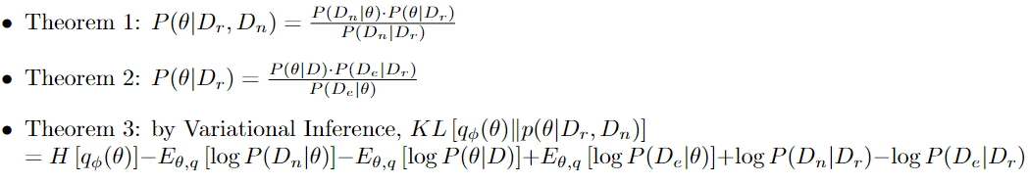
Approaches
We want to approximate the posterior P(θ | D_{remaining} , D_{new} )
We first define q_{𝜙}(θ) parameterized by 𝜙
Then, we want to minimize the KL divergence

Slide 4
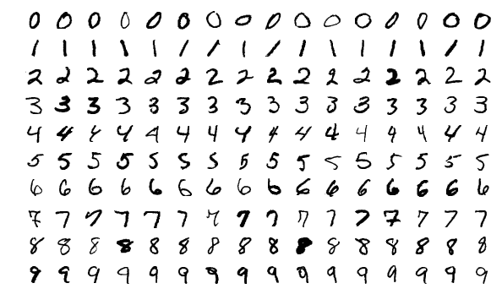
Experiments
Given a BNN P(θ | D) trained by MNIST Dataset
Find labels wrong (e.g. 7 labeled as 1)
Correct BNN with approach we mentioned before
Test the performance of the updated BNN
References
[1] Eric Mitchell, Charles Lin, Antoine Bosselut, Christopher D. Manning, and Chelsea Finn. Memory-based model editing at scale, 2022.
[2] Eric Mitchell, Charles Lin, Antoine Bosselut, Chelsea Finn, Christopher D. Manning FAST MODEL EDITING AT SCALE, 2022.
[3] Anton Sinitsin, Vsevolod Plokhotnyuk, Dmitriy Pyrkin, Sergei Popov, Artem Babenko1, EDITABLE NEURAL NETWORKS, 2020.

