Slide 1
Multisource Heterogeneous Specific Emitter
Identification Using Attention Mechanism-Based
RFF Fusion Method
汇报人：冯继元

Slide 2
01
提出背景
目录
02
创新点
03
算法过程
CONTENTS
04
实验结果

Slide 3
01
提出背景

Slide 4
提出背景
网络安全需求：随着新工业革命的兴起，如工业物联网（IIoT）、车联网（V2X）等新技术涌现，同时也带来了非法设备入侵、数据泄露、黑客攻击等安全问题。特定辐射源识别（SEI）技术作为一种简单有效的入侵防范技术，在确保网络安全方面具有重要作用。
现有研究不足：现有的SEI研究主要集中在单一接收器的射频（RF）信号上，但在实际场景中，如IIoT、车联网和智能传感系统等，RF信号通常来自不同类型的传感器，且处于不同位置。传统的SEI方法只能输入和识别单一接收器的数据，不适合多源异构场景，会浪费大量的多源异构数据，导致性能不佳。
KEYWORD
KEYWORD
KEYWORD
Click here to enter your text.Click here to enter your text.Click here to enter your text.Click here to enter your text.Click here to enter your text.Click here to enter your text.Click here to enter your text.Click here to enter your text.Click here to enter your text.Click here to enter your text.Click here to enter your text.Click here to enter your text.Click here to enter your text.Click here to enter your text.Click here to enter your text.Click here to enter your text.
针对上述问题，提出一种多源异构特定辐射源识别（MH-SEI）方法，以解决现实世界中工业物联网（IIoT）等场景下多源异构射频信号的特定辐射源识别问题，充分利用不同位置和类型的传感器收集的数据，实现对无线设备的准确认证，确保网络安全。

Slide 5
02
创新点

Slide 6
创新点
提出MH-SEI方法：
为了充分利用现实场景中不同位置和类型的传感器，首次提出了多源异构特定辐射源识别方法，基于真实世界的多源异构射频信号，探索更适合实际场景的解决方案。
2.设计MHAFFN网络：
提出了一种多源异构注意力指纹融合网络（MHAFFN），由多通道RFF特征提取模块、基于注意力机制的RFF融合模块和自动分类器组成，用于实现MH-SEI技术。
3.构建实验环境验证：
构建了一个由一个发射器和三个不同接收器组成的多源异构实验环境，通过真实世界的信号数据验证了所提出的MH-SEI方法的有效性和优越性。
KEYWORD
KEYWORD
KEYWORD
Click here to enter your text.Click here to enter your text.Click here to enter your text.Click here to enter your text.Click here to enter your text.Click here to enter your text.Click here to enter your text.Click here to enter your text.Click here to enter your text.Click here to enter your text.Click here to enter your text.Click here to enter your text.Click here to enter your text.Click here to enter your text.Click here to enter your text.Click here to enter your text.

Slide 7
03
算法过程

Slide 8
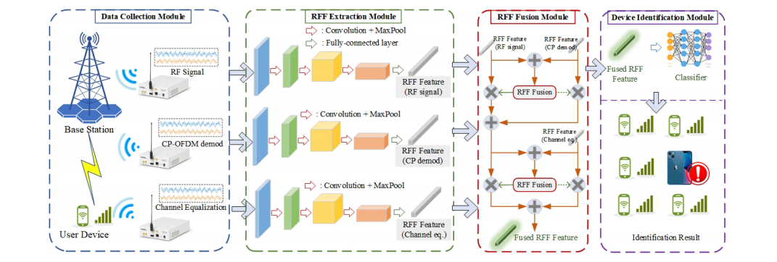
系统模型
KEYWORD
KEYWORD
KEYWORD
Click here to enter your text.Click here to enter your text.Click here to enter your text.Click here to enter your text.Click here to enter your text.Click here to enter your text.Click here to enter your text.Click here to enter your text.Click here to enter your text.Click here to enter your text.Click here to enter your text.Click here to enter your text.Click here to enter your text.Click here to enter your text.Click here to enter your text.Click here to enter your text.
Click here to enter your text.Click here to enter your text.Click here to enter your text.Click here to enter your text.Click here to enter your text.Click here to enter your text.Click here to enter your text.Click here to enter your text.Click here to enter your text.Click here to enter your text.Click here to enter your text.Click here to enter your text.Click here to enter your text.Click here to enter your text.Click here to enter your text.Click here to enter your text.
系统模型由数据收集模块，RFF提取模块，RFF融合模块，自动分类器模块四个模块组成。

Slide 9
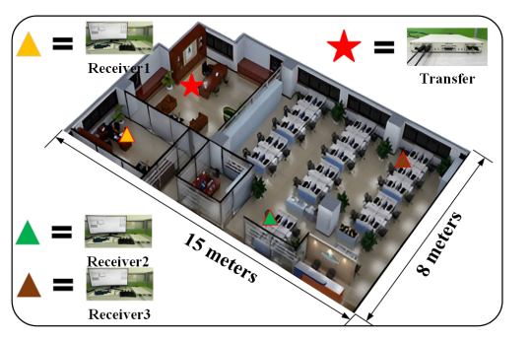
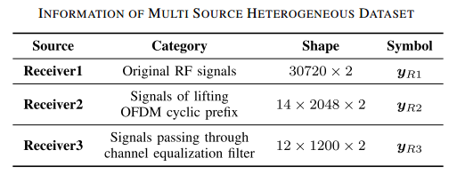
数据采集模块
KEYWORD
KEYWORD
KEYWORD
Click here to enter your text.Click here to enter your text.Click here to enter your text.Click here to enter your text.Click here to enter your text.Click here to enter your text.Click here to enter your text.Click here to enter your text.Click here to enter your text.Click here to enter your text.Click here to enter your text.Click here to enter your text.Click here to enter your text.Click here to enter your text.Click here to enter your text.Click here to enter your text.
Click here to enter your text.Click here to enter your text.Click here to enter your text.Click here to enter your text.Click here to enter your text.Click here to enter your text.Click here to enter your text.Click here to enter your text.Click here to enter your text.Click here to enter your text.Click here to enter your text.Click here to enter your text.Click here to enter your text.Click here to enter your text.Click here to enter your text.Click here to enter your text.
使用USRP设备，包括一个发射器和三个不同位置及接收模式的接收器，在实验室环境中按照LTE标准收集多源异构射频信号，为后续模块提供多源异构的信号数据。

Slide 10
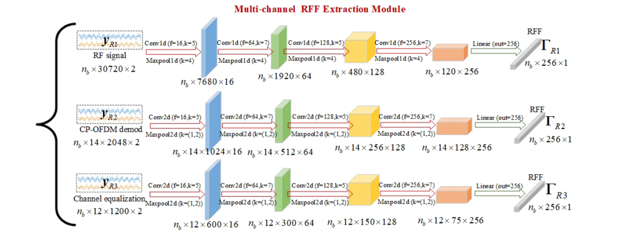
RFF提取模块
KEYWORD
KEYWORD
KEYWORD
Click here to enter your text.Click here to enter your text.Click here to enter your text.Click here to enter your text.Click here to enter your text.Click here to enter your text.Click here to enter your text.Click here to enter your text.Click here to enter your text.Click here to enter your text.Click here to enter your text.Click here to enter your text.Click here to enter your text.Click here to enter your text.Click here to enter your text.Click here to enter your text.
Click here to enter your text.Click here to enter your text.Click here to enter your text.Click here to enter your text.Click here to enter your text.Click here to enter your text.Click here to enter your text.Click here to enter your text.Click here to enter your text.Click here to enter your text.Click here to enter your text.Click here to enter your text.Click here to enter your text.Click here to enter your text.Click here to enter your text.Click here to enter your text.
多分支并行结构，利用多分支多尺度CNN，针对不同接收信号提取特征，包括卷积层、最大池化层和全连接层，从不同接收器的I/Q信号中提取射频指纹（RFF）。

Slide 11
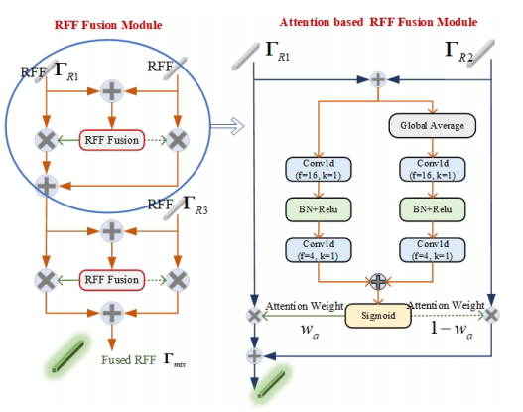
RFF融合模块
KEYWORD
KEYWORD
KEYWORD
Click here to enter your text.Click here to enter your text.Click here to enter your text.Click here to enter your text.Click here to enter your text.Click here to enter your text.Click here to enter your text.Click here to enter your text.Click here to enter your text.Click here to enter your text.Click here to enter your text.Click here to enter your text.Click here to enter your text.Click here to enter your text.Click here to enter your text.Click here to enter your text.
基于注意力机制，以模块化方式成对融合多个RFF，通过计算注意力权重来分配不同RFF的重要性。突出重要特征，为自动分类器提供更有效的特征表示。

Slide 12
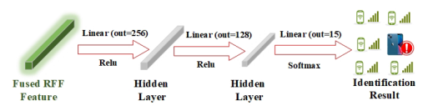
自动分类器模块
KEYWORD
KEYWORD
KEYWORD
Click here to enter your text.Click here to enter your text.Click here to enter your text.Click here to enter your text.Click here to enter your text.Click here to enter your text.Click here to enter your text.Click here to enter your text.Click here to enter your text.Click here to enter your text.Click here to enter your text.Click here to enter your text.Click here to enter your text.Click here to enter your text.Click here to enter your text.Click here to enter your text.
该模块三个全连接层，前两层用ReLU激活函数，最后一层用Softmax激活函数。以融合后的RFF为输入，对设备进行分类识别，输出识别结果。

Slide 13
04
实验结果

Slide 14
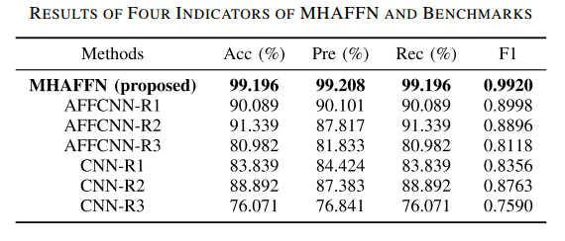
实验结果
可行性验证
在准确度（Acc）、精密度（Pre）、召回率（Rec）和F1分数上都有，可以采用MHAFFN方法来解决MH-SEI的问题方面具有可行性和显著的性能优势。
产生优势的原因：
这些传统的SEI方法只能输入和识别单个接收器的数据，因此只能利用多源异构数据的一小部分，而无法避免的导致性能不佳。

Slide 15
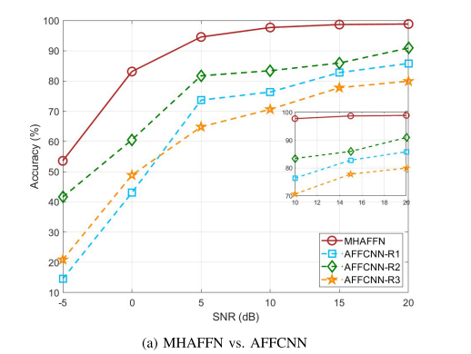
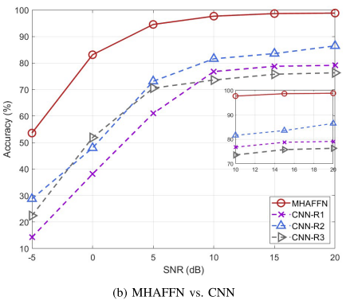
实验结果
鲁棒性验证
通过引入加性高斯白噪声（AWGN）模拟不完美环境下的SEI任务，在不同的信噪比下测试模型的鲁棒性。结果表明，MHAFFN在任何信噪比环境下都能保持较高的识别准确率，比两个基准算法高约10% - 15%。

Slide 16
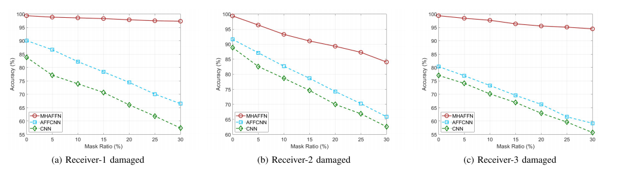
实验结果
容错机制验证
使用随机AWGN信号覆盖接收器数据的一定比例来模拟传感器损坏的场景，可以出即使在一个接收器出现故障的情况下，MHAFFN也能保持稳定的识别性能，因此可以得出MHAFFN相较于传统的SEI方法拥有更好的容错机制。

Slide 17
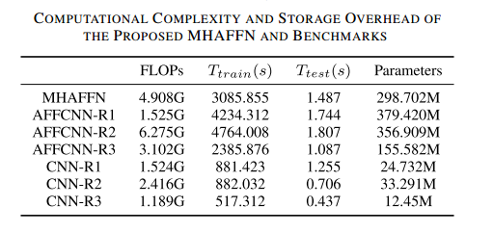
实验结果
复杂性分析
MHAFFN相比于其他算法是一种更为复杂的算法，但是也展现了拥有更好的识别性能和鲁棒性，更重要的是该方法能更好的利用多源异构数据。

Slide 18
谢谢！
请老师批评指正！

